Slide 1
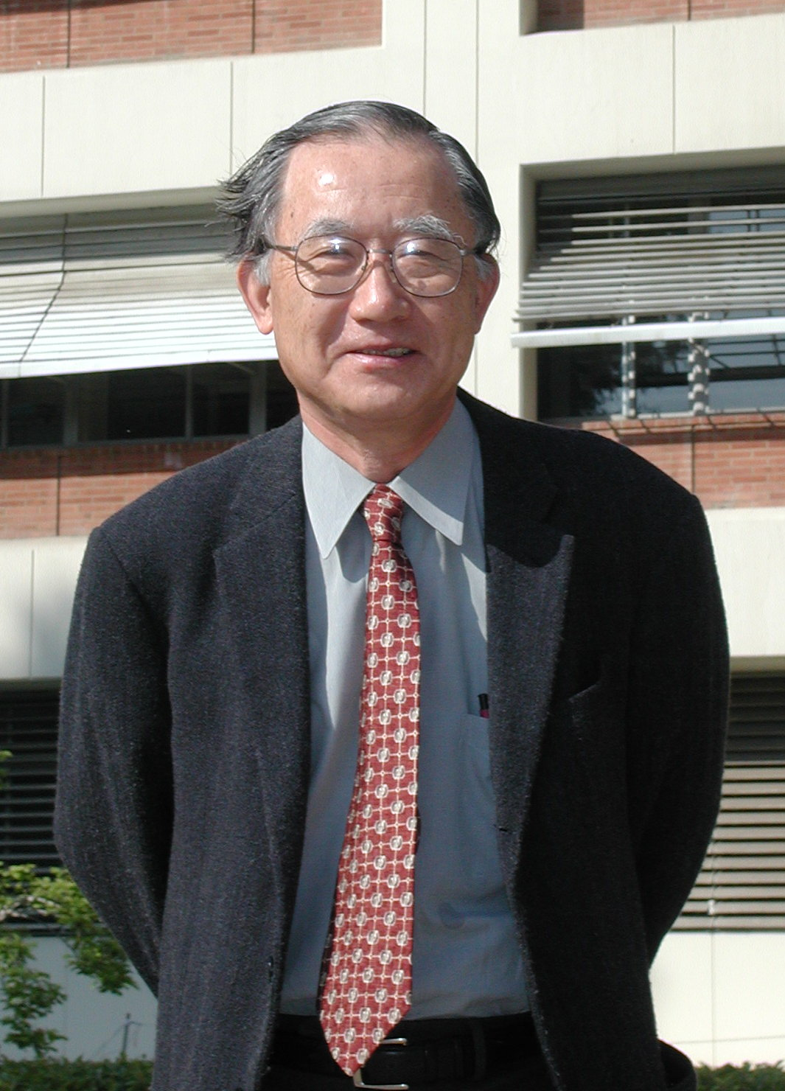
A Further Look at Q₁ and Q₂ from TOGA COARE*
Richard H. Johnson
Paul E. Ciesielski
Colorado State University
Thomas M. Rickenbach
East Carolina University
* Dedicated to Michio Yanai (AMS Monograph)

Slide 2
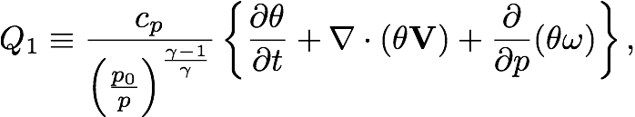


Yanai, M., 1961: A detailed analysis of typhoon formation. J. Meteor. Soc. Japan, 39, 187-214.
Q₁ = “heat source from individual change in potential temperature”
Q₂ = “heat source estimated from the moisture budget”

Slide 3
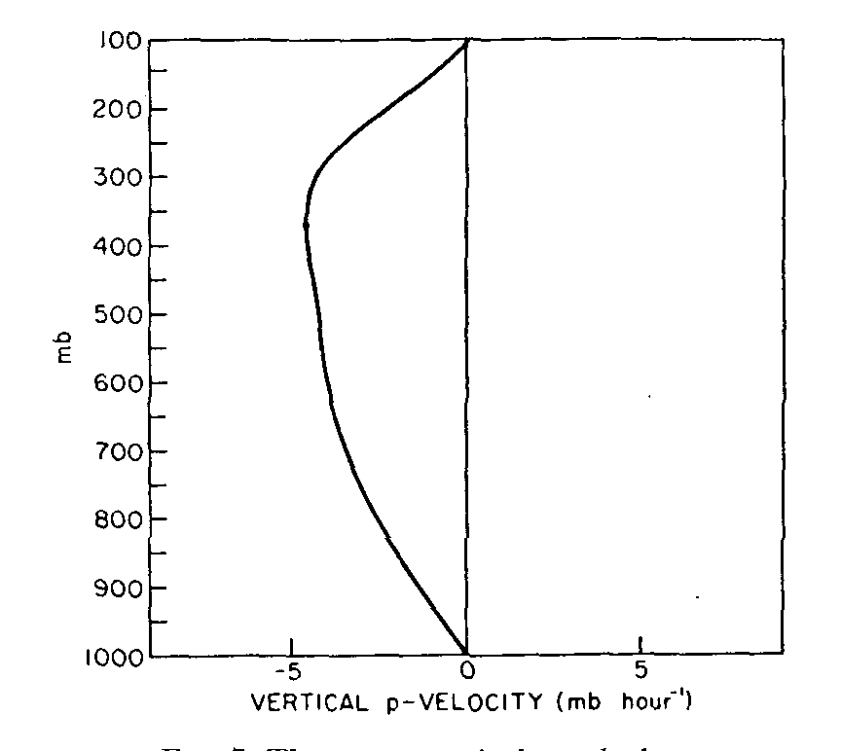
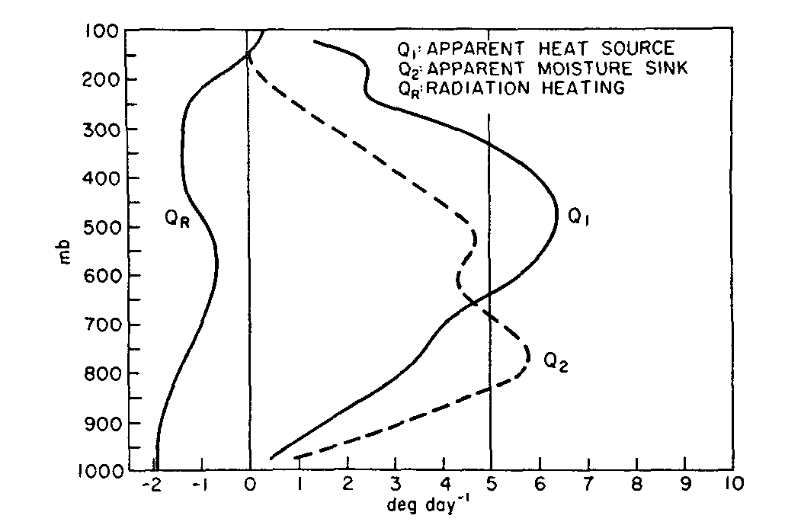
Marshall Islands mean vertical motion, Q₁ , Q₂ , and Q_{R}
(1956 data)
_
ω
0°C
Yanai et al. (1973)
Double-peak structure in Q₂; inflection in Q₁ profile

Slide 4
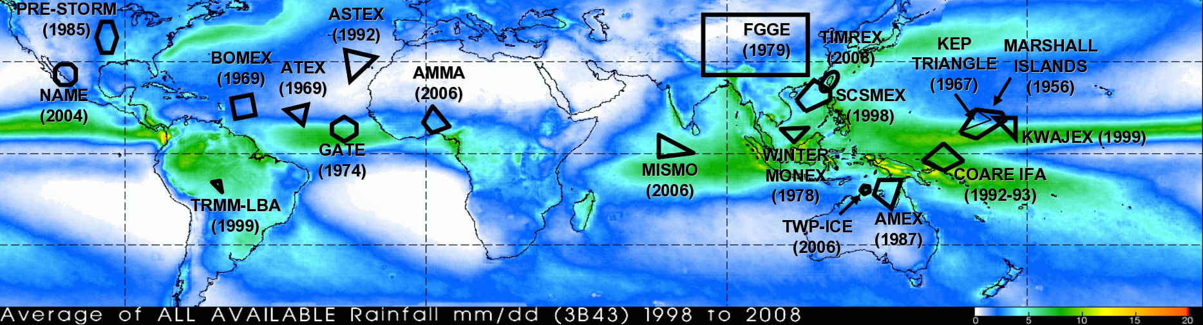
50+ Years of Field Campaigns
TRMM 3B43 Rainfall, 1998-2008
(1958)
DYNAMO (2011)
Many of these field campaigns have yielded Q₁ and Q₂ profiles similar to those obtained by Yanai et al. (1973)

Slide 5
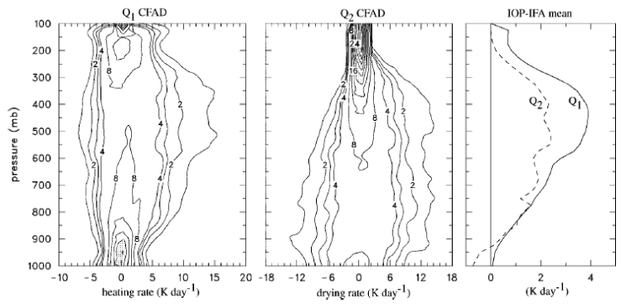
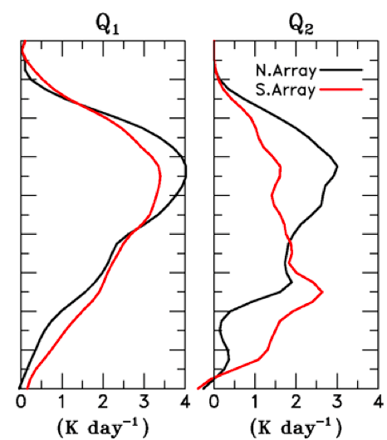

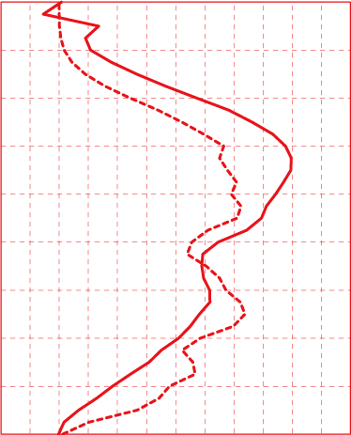
Common features:
Minimum in Q₂ near 600 hPa
Inflection in Q₁ near 650-700 hPa
DYNAMO
TOGA COARE
0°C
0°C
MISMO (Katsumata et al. 2011)
Yanai et al. (1973)

Slide 6
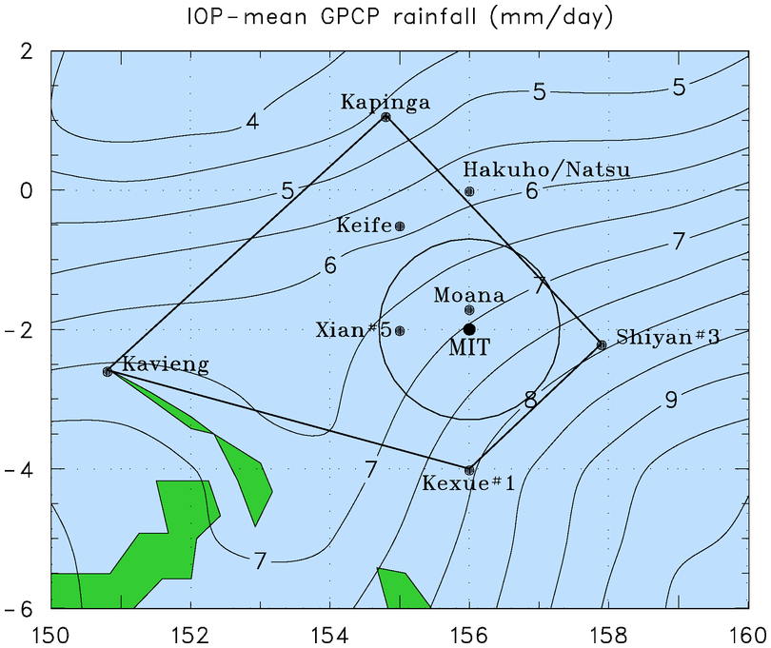
MIT C-Band Radar on R/V Vickers
Convective/stratiform partitioning of 10-min radar volumes based on modification of Steiner et al. (1995) [Rickenbach and Rutledge 1998]
1° X 1° gridded analysis fields averaged over radar domain (circle); 6-h intervals
Radar

Slide 7
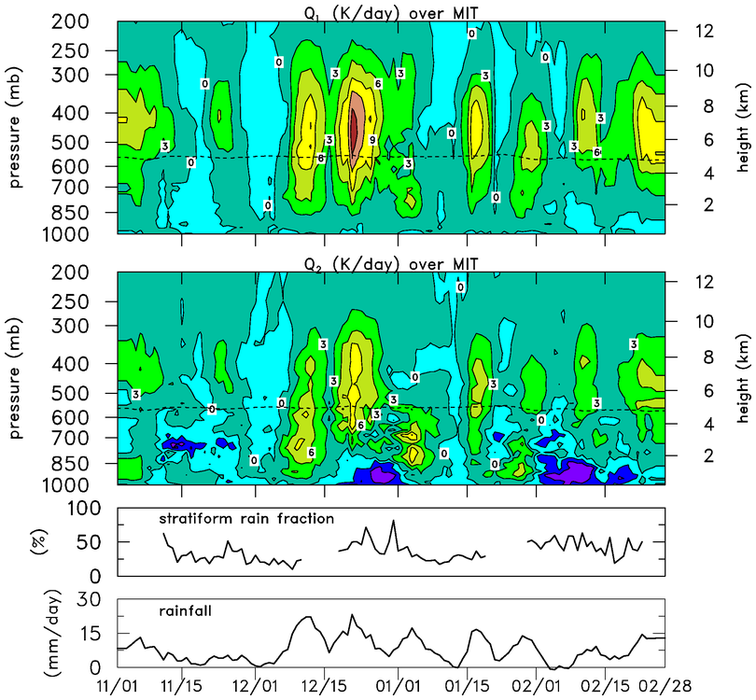
Stratiform rain fraction increases through active phase of MJO

Slide 8
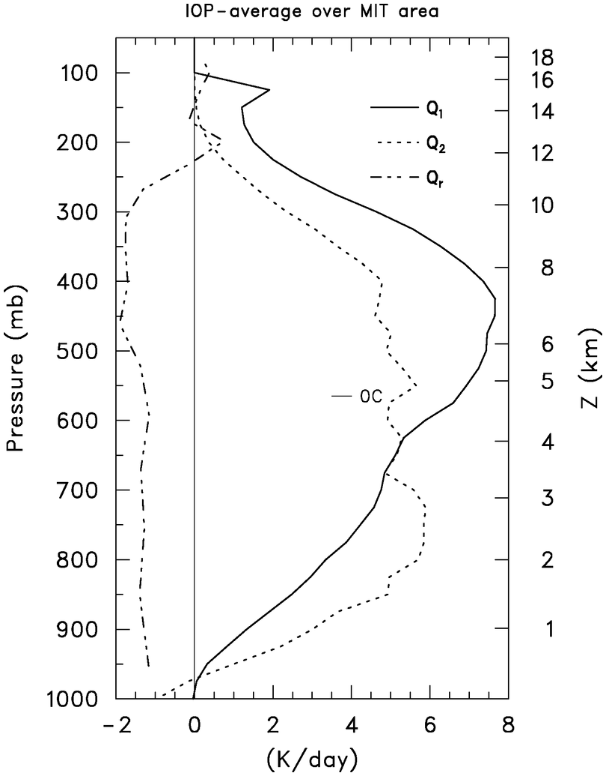
TOGA COARE
Q₁ and Q₂ profiles for periods when rainfall rate over radar domain exceeded 3.5 mm day⁻¹
Resemble Yanai et al. (1973) profiles
Radiative heating rate profile based on L’Ecuyer and Stephens (2003)
P₀ > 3.5 mm day⁻¹
Q₁
Q_{R}
Q₂

Slide 9
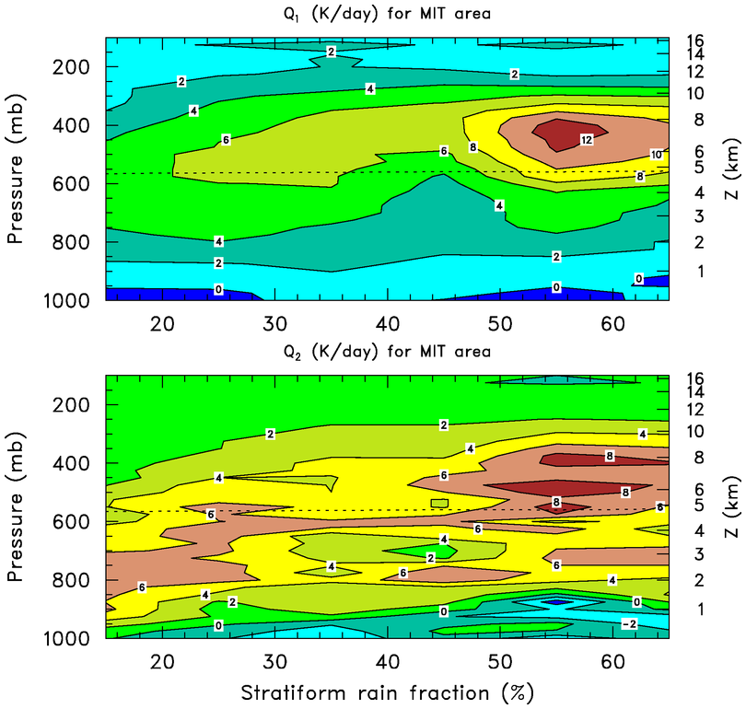
Q₁ and Q₂ as a Function of Stratiform Rain Fraction
Upward shift in heating and drying peaks as stratiform rain fraction increases
Moistening due to rainfall evaporation for large stratiform rain fraction

Slide 10
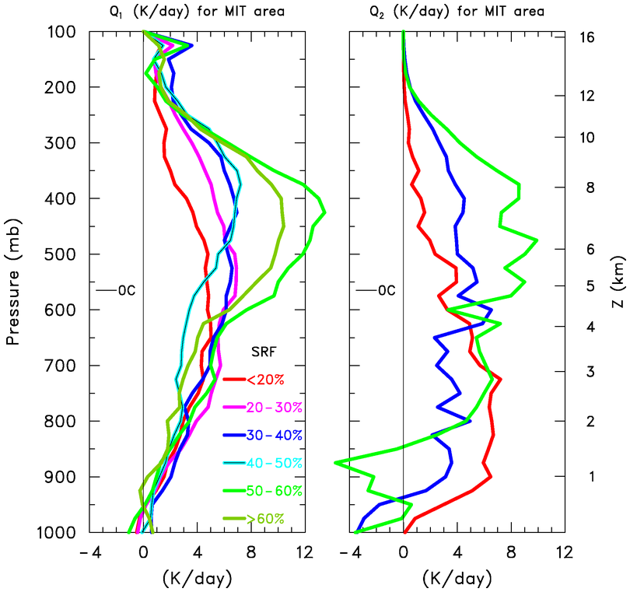
Q₁ and Q₂ profiles as a Function of Stratiform Rain Fraction
Inflection in Q₁ shows up as stratiform rain fraction (SRF) increases ➔ effects of melting
Q₂ peak shifts upward as SRF increases ➔ double peak due to separate contributions of convective and stratiform rain
Q₁
Q₂
(~20-50 cases in each group)

Slide 11
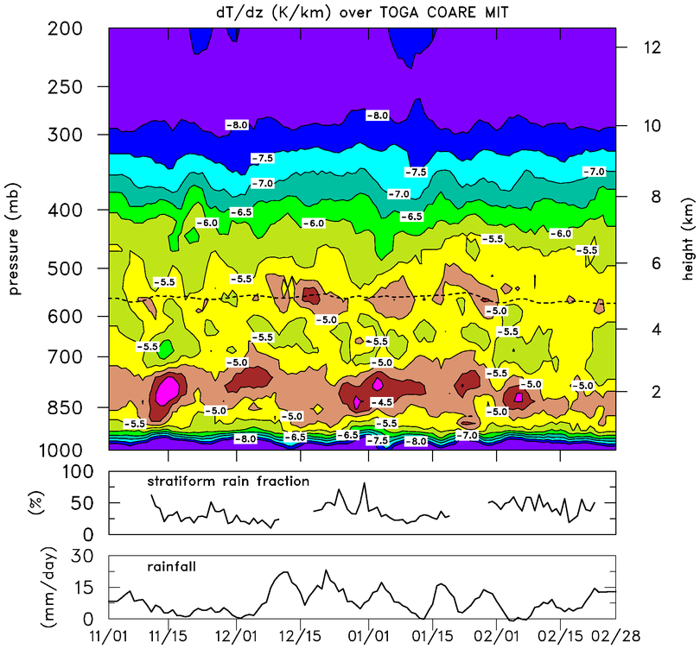
dT/dz, Stratiform Rain Fraction, and Rainfall
Melting stable layer most prominent during periods of rainfall
Trade stable layer most prominent during periods of light rainfall

Slide 12
Static Stability as a Function of Stratiform Rain Fraction
0°C
Melting stable layer strengthens with increasing SRF
Trade stable layer weakens, descends with increasing SRF

Slide 13
Microphysical Effects Enhancing Stable Layer near 0°C
Cooling due to melting below 0°C
Heating due to freezing/deposition above 0°C

Slide 14
Melting Stable Layer Impact on Q₁ as Measured by Soundings
Significant stratiform rain fraction in tropics (Schumacher and Houze 2003) and widespread nature of such systems leaves subtle imprint on temperature profile near the melting level, producing inflection in ∂s/∂p

Slide 15
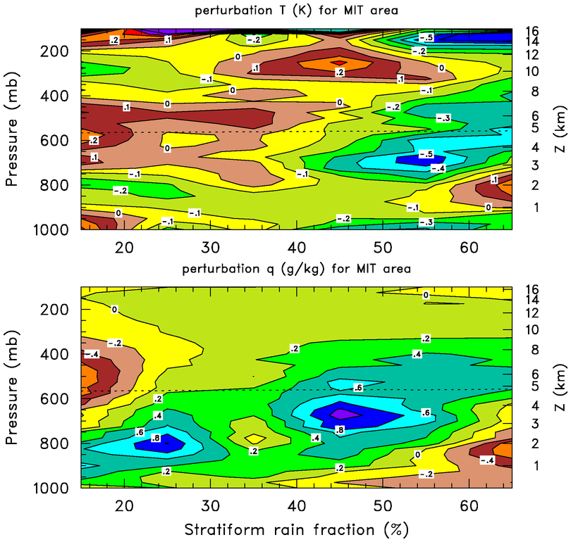
Temperature, Specific Humidity Perturbations
Cooling by melting, evaporation increases as SRF increases
Positive moisture anomaly shifts upward as SRF increases
Low-level warming, drying for large SRF reflects “onion” soundings (Zipser 1977)
T’
q’

Slide 16
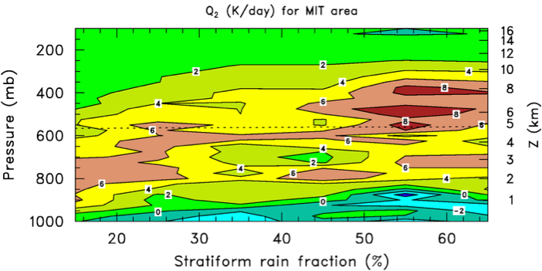
Omega, dq/dp, ω dq/dp, and Q₂
ω ∂q/∂p dominant term in Q₂
ω
Mean SRF is 36%, so mean Q₂ profile is roughly an average of profiles above and below
Hence the double-peak structure in Q₂ is from separate contributions of convective and stratiform rain
∂q/∂p
Q₂
ω ∂q/∂p

Slide 17
Summary
MIT C-Band radar data from TOGA COARE used to determine stratiform rain fraction over radar domain
Sounding budget results over radar domain stratified according to stratiform rain fraction
Results demonstrate that inflection in Q₁ profile is due to effects of melting
Results confirm that double-peak Q₂ structure is due to separate contributions of convective and stratiform rain
Both features highlight important contribution of stratiform precipitation to total tropical rainfall

Slide 18
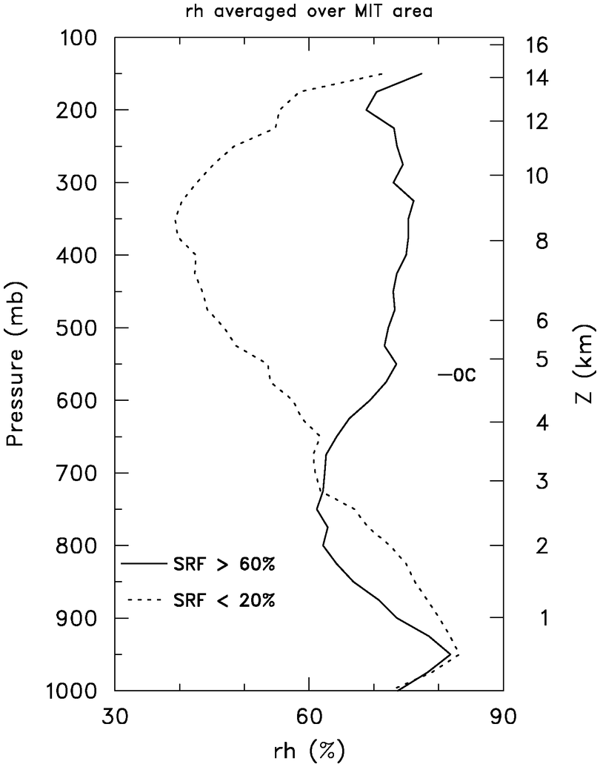
RH profiles for Small & Large SRF
Largest RH differences in upper troposphere
Drier conditions at low levels for large SRF reflects effects of drying in mesoscale downdrafts à la Zipser (1969, 1977)

