Slide 1
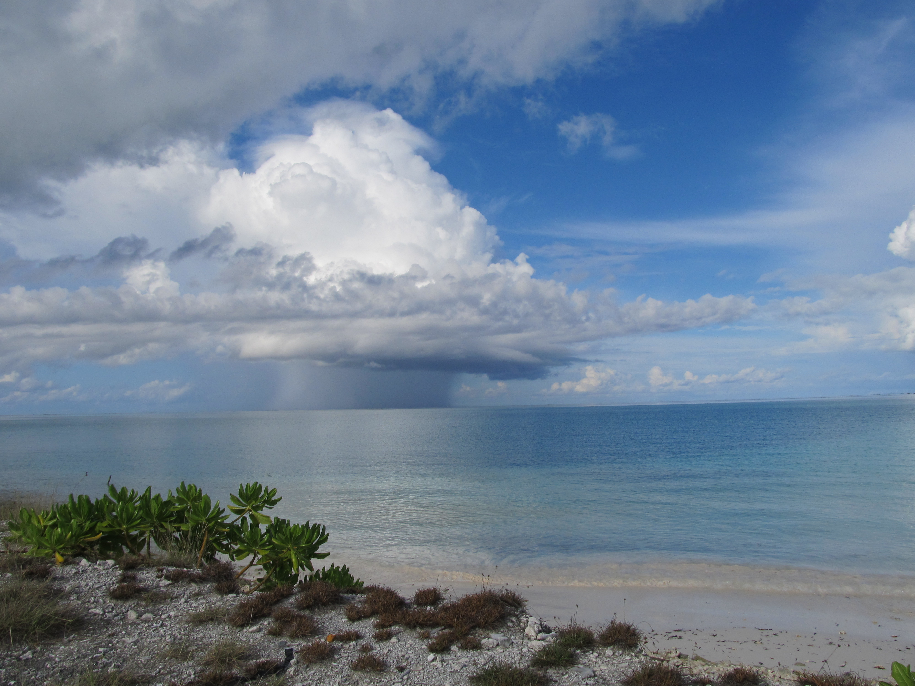
Multiscale Variability of the Atmospheric Boundary Layer during DYNAMO
Richard H. Johnson
Paul E. Ciesielski
Colorado State University
The Madden-Julian Oscillation: Observations, Theoretical Understanding, Modeling, and Prediction; AGU Fall Meeting, New Orleans, 11-15 December 2017
Kaustav Chakravarty

Slide 2
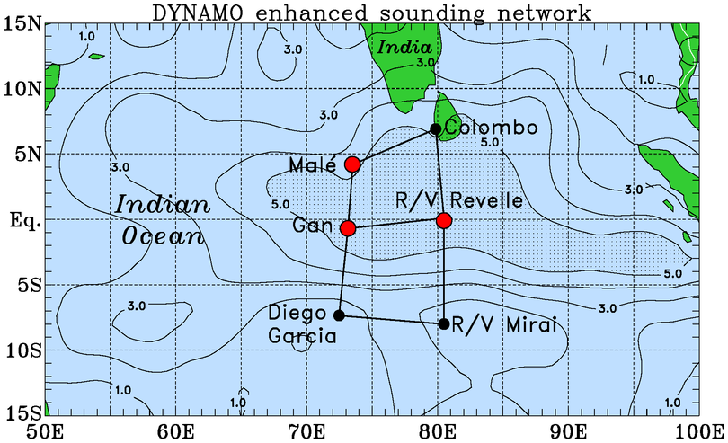
DYNAMO/CINDY/AMIE Sounding Domain
Boundary layer properties investigated at 3 sites
Amplitude of MJO signal (20-day low-pass filtered 450-hPa $−ω;$hPa h⁻¹)
(Johnson and Ciesielski 2017, JAS)

Slide 3
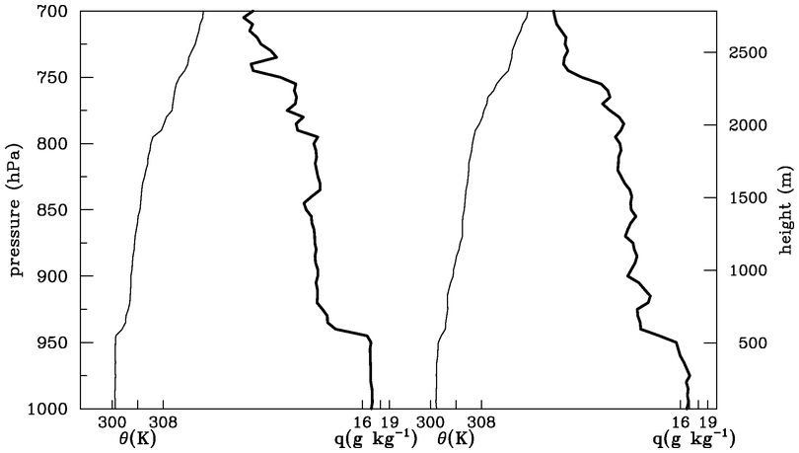
4 October Soundings at R/V Revelle
14 L
Procedure for determining mixed layers: soundings
Each sounding evaluated subjectively (5-hPa resolution)
Mixed layers: θ and q have approximately well-mixed structure over same depth, capped by distinct increase in stability, drying above; entrainment zone evident in majority of cases
Results backed up by recently developed objective procedure
08 L
q
θ
q
θ
hPa
m
θ
q
θ
q
ENTRAINMENT ZONE
07 L
13 L

Slide 4
4 October Soundings at R/V Revelle
07 L
13 L
Cumulus cloud bases are at the top of the entrainment zone, so arguably it is important to accurately predict mixed layer properties in order to properly represent cumulus cloud populations
“trade-like” stable layer
q
θ
q
θ
07 L
13 L
Shallow cumulus layers frequently observed

Slide 5
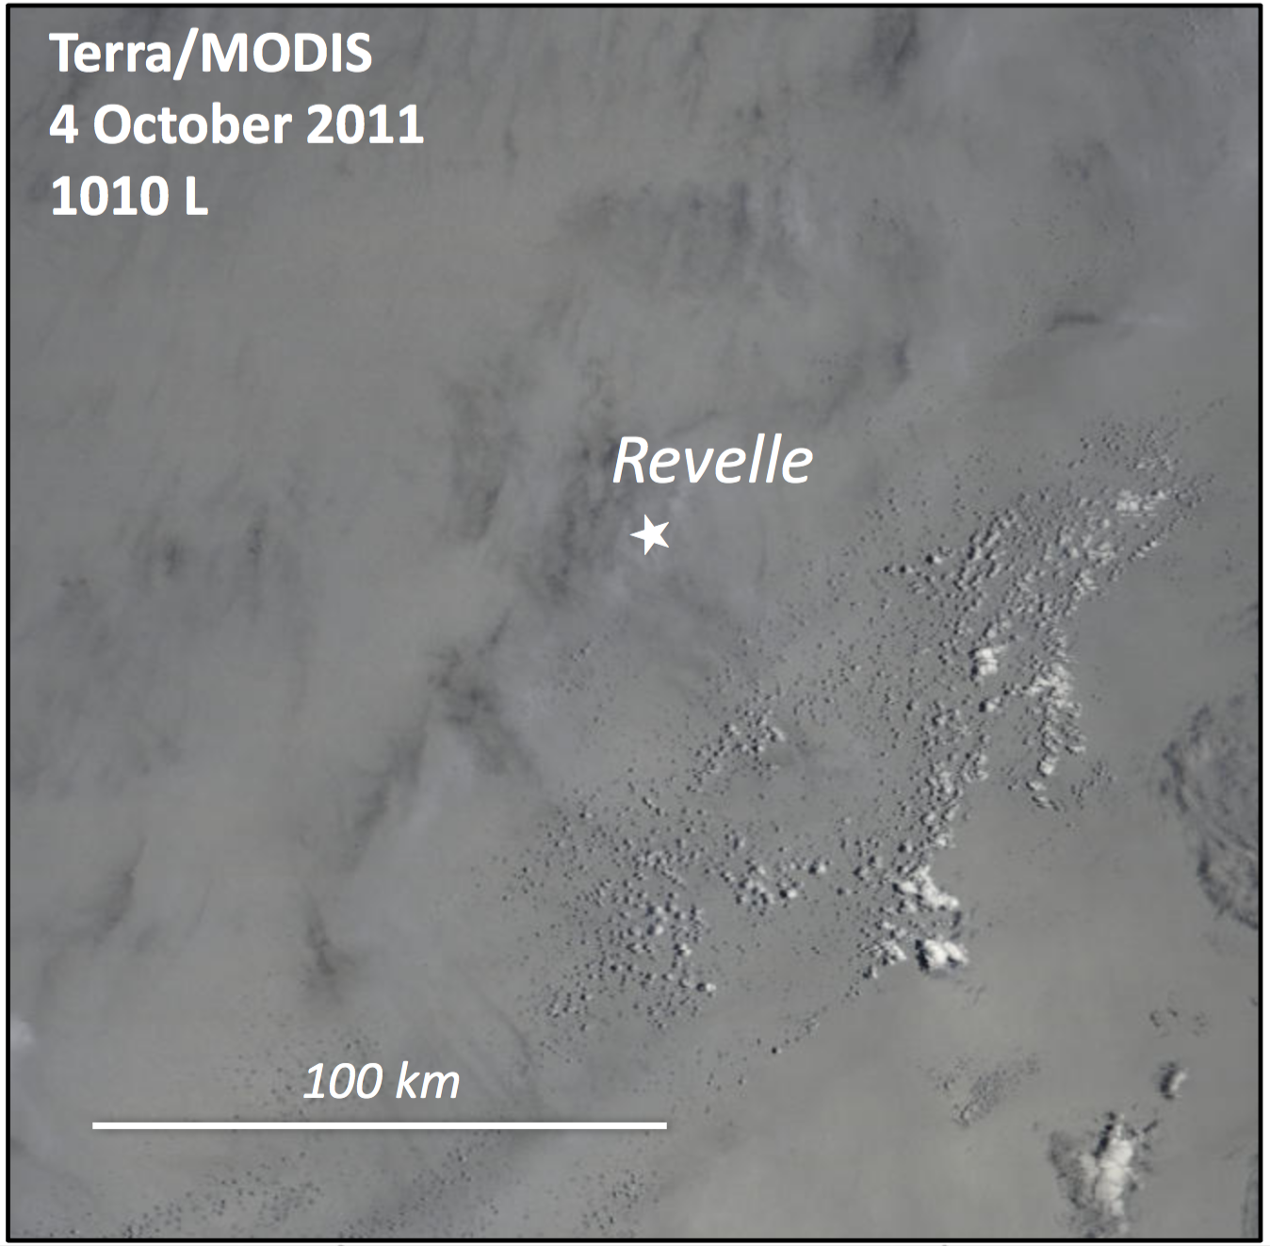
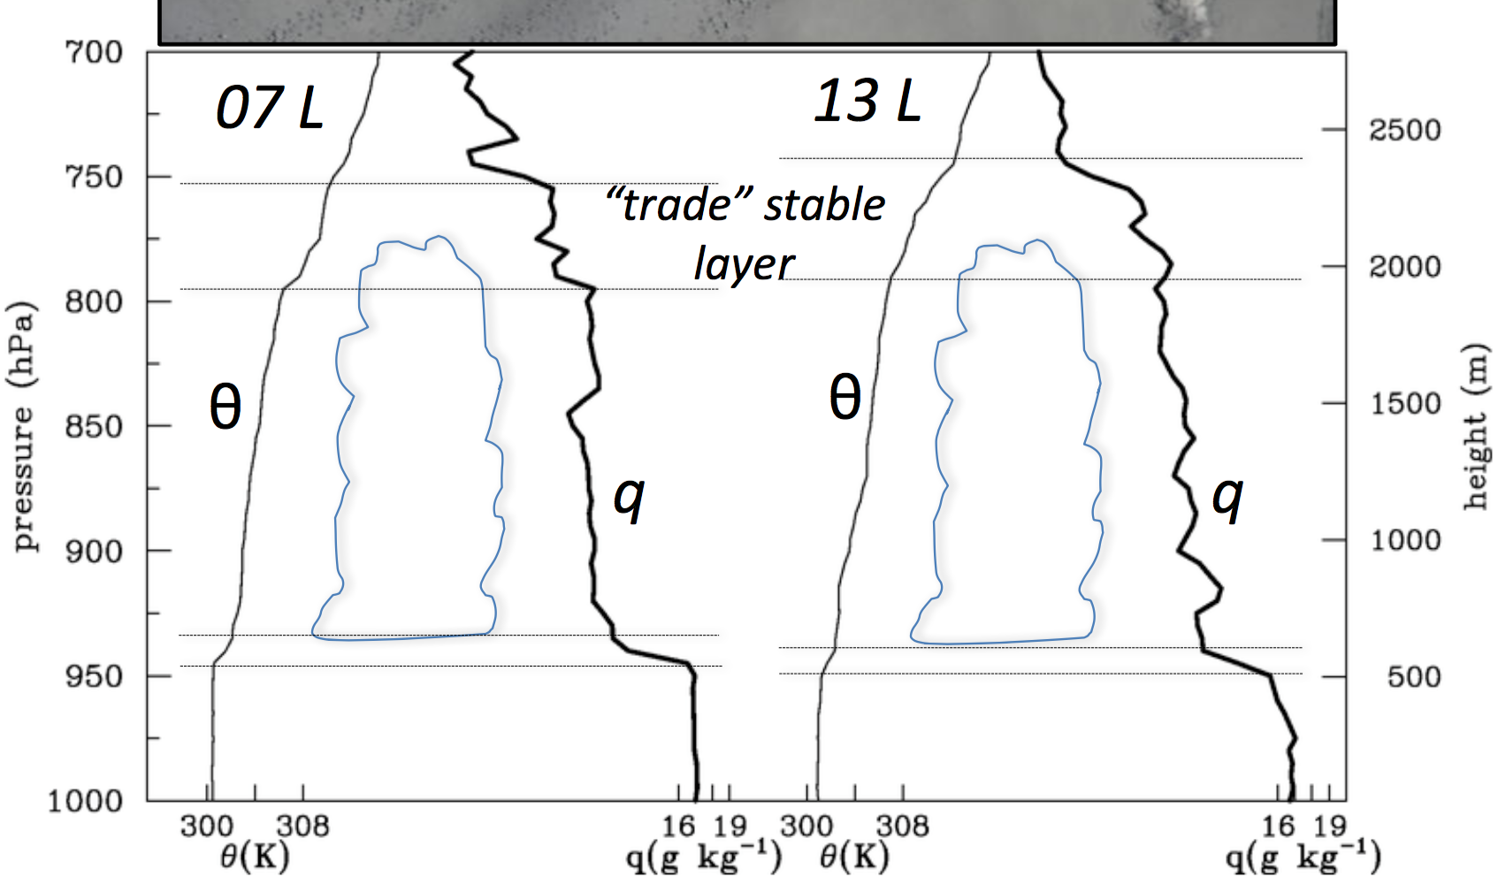
Terra/MODIS visible image (250 m)
Revelle Soundings
4 October 2011
Many soundings show indication of “trade-like” stable layer near 2 km or 800 hPa, especially during buildup phase of MJO
Terra/MODIS Visible Image (250 m)

Slide 6
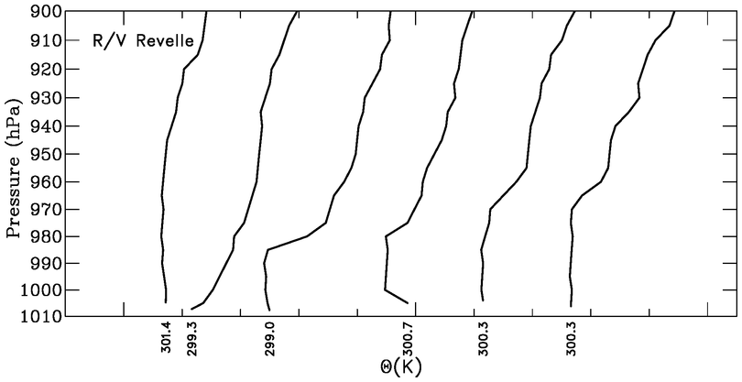
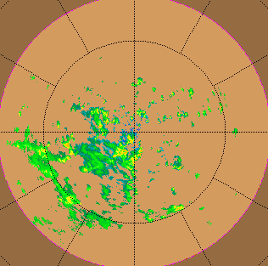
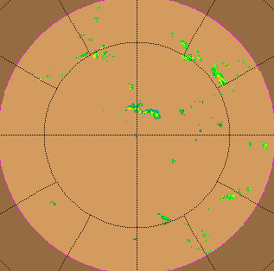
Recovering Boundary Layer Wake at R/V Revelle
22 November 2011
θ
04 LT
07 10 13 16 19
9-12 h
TOGA radar on Revelle
Comparable to wake recovery periods found in TOGA COARE (Young, Perugini, Fairall 1995)
0729 LT 22 Nov
1859 LT 22 Nov

Slide 7
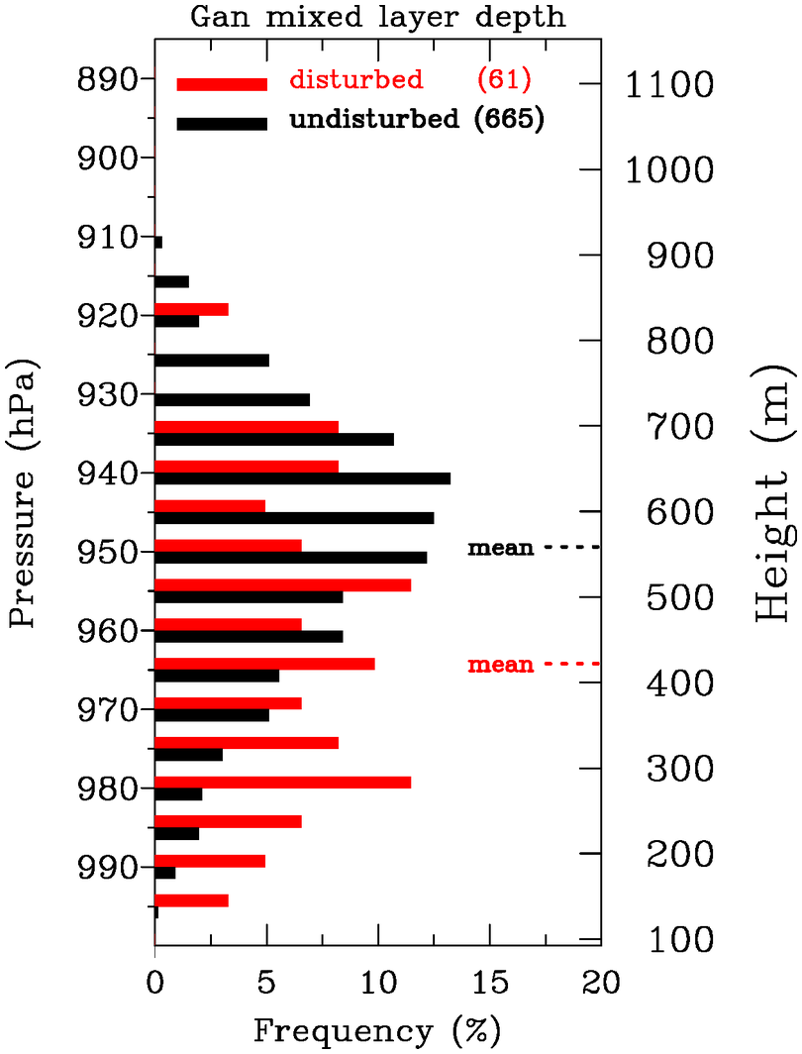
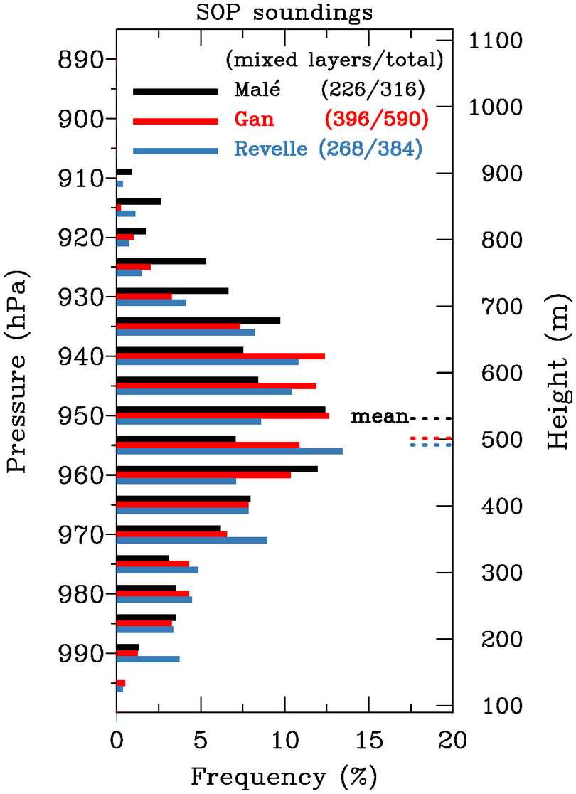
Mean Mixed Layer Statistics
Mean z_{i} ML
503 | 69
535 | 72
491 | 64
(m) frequency (%)
Gan
Mal$\acute{e}$
Revelle
Undist. Trades ~600
(1 Oct–15 Dec)
COARE* 512 72
GATE** 424 79
* Johnson et al. (2001)
** Fitzjarrald and Garstang (1981)

Slide 8
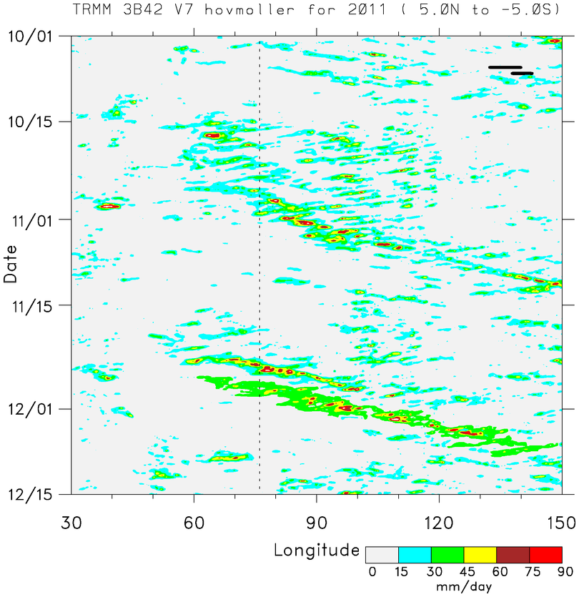
■ Two prominent MJO events: October and November
MJO 1
■ MJO envelopes consists of westward- and eastward-moving disturbances
Time
EAST AFRICA
MJO 2
DYNAMO ARRAY
SUMATRA
BORNEO

Slide 9
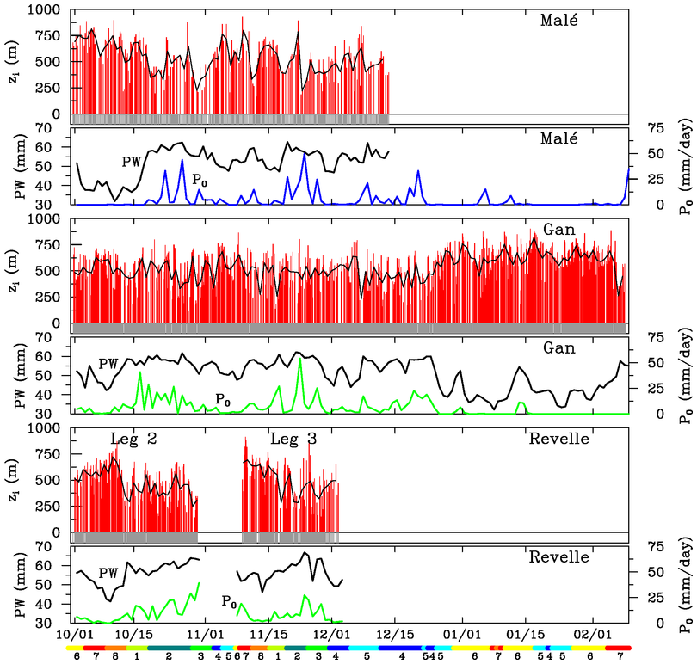
Mixed Layers at Mal$\acute{e}$, Gan, and Revelle
Shallower MLs during rainy periods, less so at Gan
Oct/Nov MJO modulation of ML depth greatest at Mal$\acute{e}$ and Revelle
Greatest ML depths at Gan during dry, suppressed period in Jan and Feb
MJO1
MJO2

Slide 10
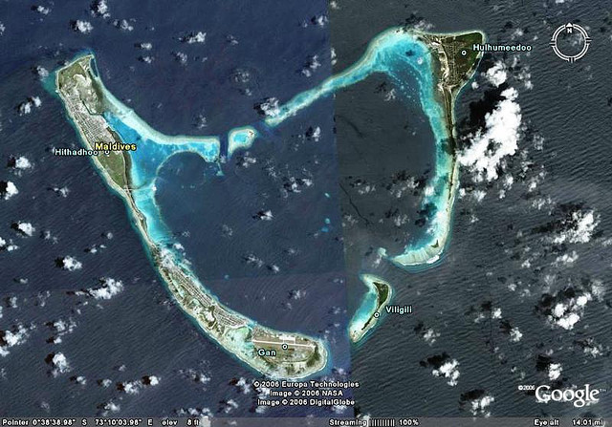
Why is MJO modulation of ML depth less at Gan Island?
Addu Atoll
Diurnal heating/cooling of atoll makes lower portion of Gan soundings less representative of open ocean
Mal$\acute{e}$ & especially Revelle more representative of open ocean
Gan sounding site
Mal$\acute{e}$ is much smaller
10 km
l
l

Slide 11
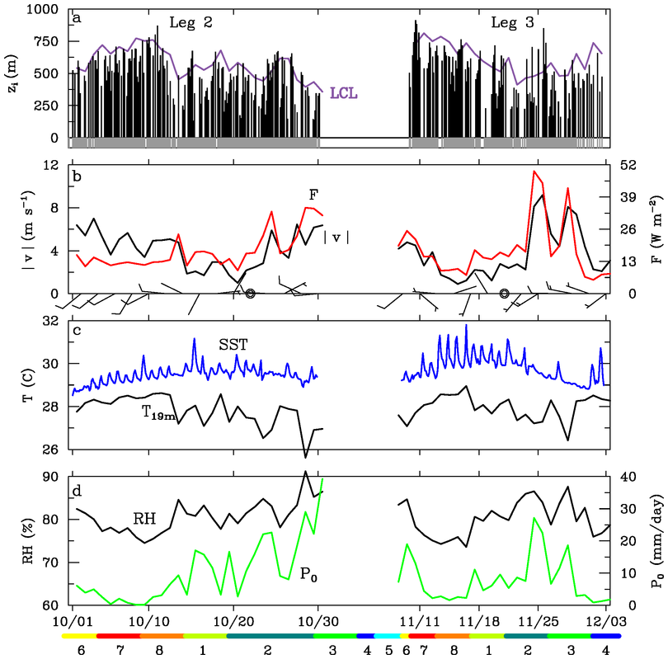
R/V Revelle
ML depths, LCL
?
ML deepens during SST warming phases
Buoyancy flux F nearly constant during early Oct: weakening L-S subsidence promoted ML growth
ML grows above LCL, promoting cloud growth
SST diurnal cycle during ocean warming phases
Surface buoyancy flux, wind speed
data courtesy Edson, Fairall, de Szoeke

Slide 12
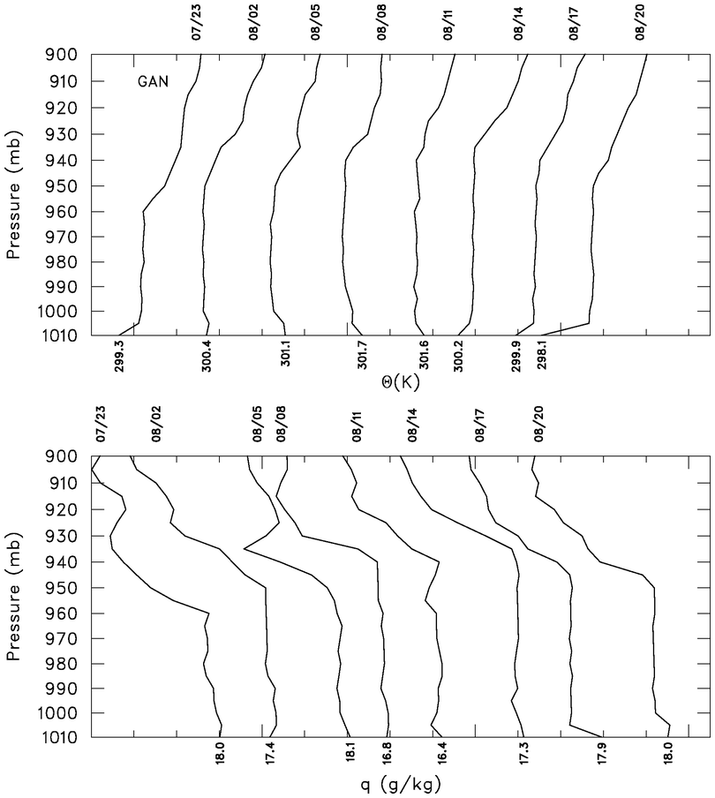
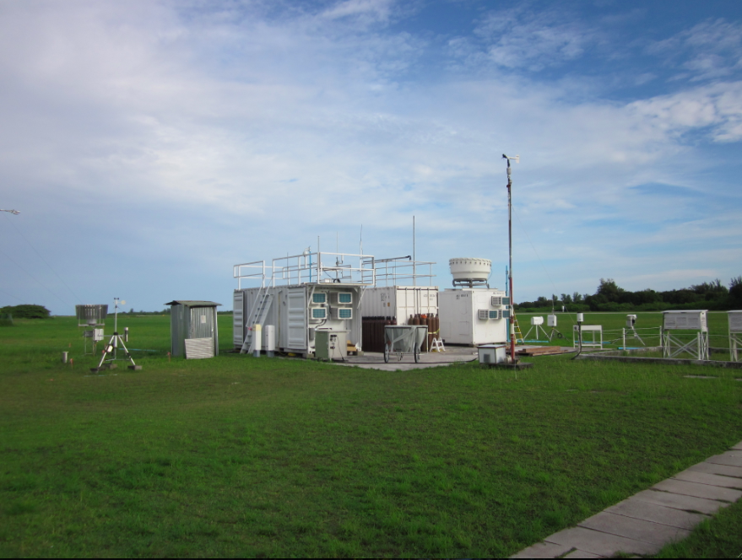
Diurnal cycle of mixed layer at Gan Island
- 8 October -
04 L
07
10
13
16
19
23
01
θ
250 m diurnal variation
Large diurnal cycle during suppressed periods
q
Gan ARM Sounding Site
However, Gan soundings influenced by atoll heating/cooling

Slide 13
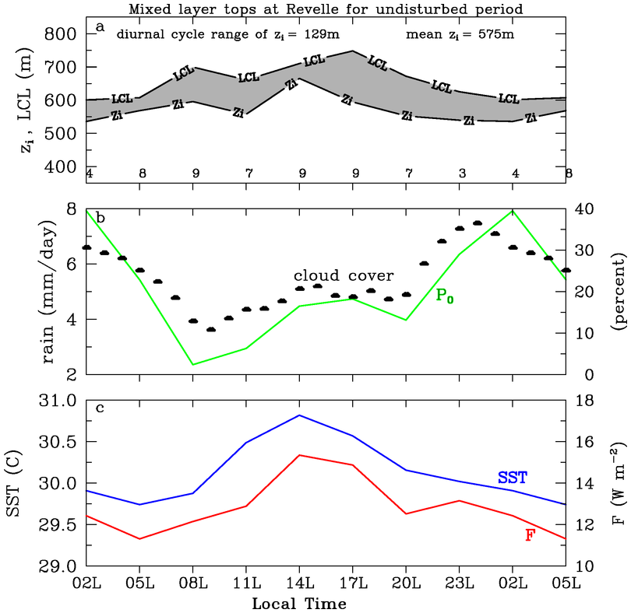
Mixed layer at Revelle more representative of open ocean
Diurnal Cycle at Revelle, 11-21 November
Afternoon SST peak leads to increased F, reduction in z_{LCL} – z_{i} , more BL thermals can reach condensation levels, afternoon cloud cover and rainfall maximum
Nocturnal rainfall peak still present, typical of open ocean
Explains semi-diurnal rainfall maxima

Slide 14
SUMMARY
Atmospheric mixed layers observed for ~70% of soundings; mean depth ~475-525 m; findings similar to TOGA COARE, GATE
Mixed layers modulated on multiple time scales
MLs deepen during MJO suppressed phase
Modulation of ML by MJO less distinct at Gan: possible explanation – atoll heating/cooling effects
Afternoon ML peak on suppressed days at Revelle associated with SST diurnal warm layer; concurrent afternoon peaks in rainfall/echo area coverage
Increase in cloudiness/rain on MJO-to-diurnal time scales a result of ML growth, allowing more BL thermals to reach condensation levels
Risky to generalize atoll/island BL properties to open ocean

Slide 15
Extra slides

Slide 16
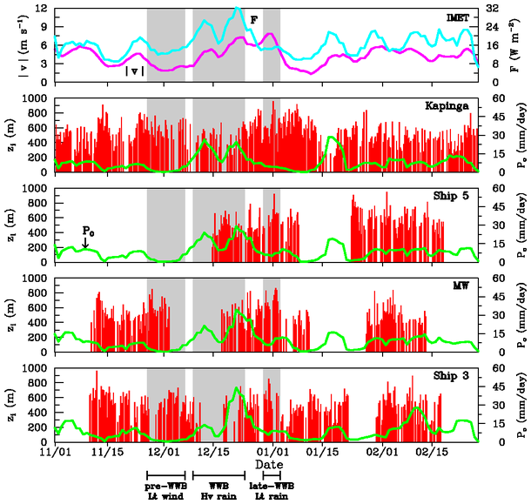
TOGA COARE
Mixed layer deepest during light-rain periods, shallowest during rain periods
ML depth varies on MJO time scale
(Johnson et al. 2001)

