Slide 1
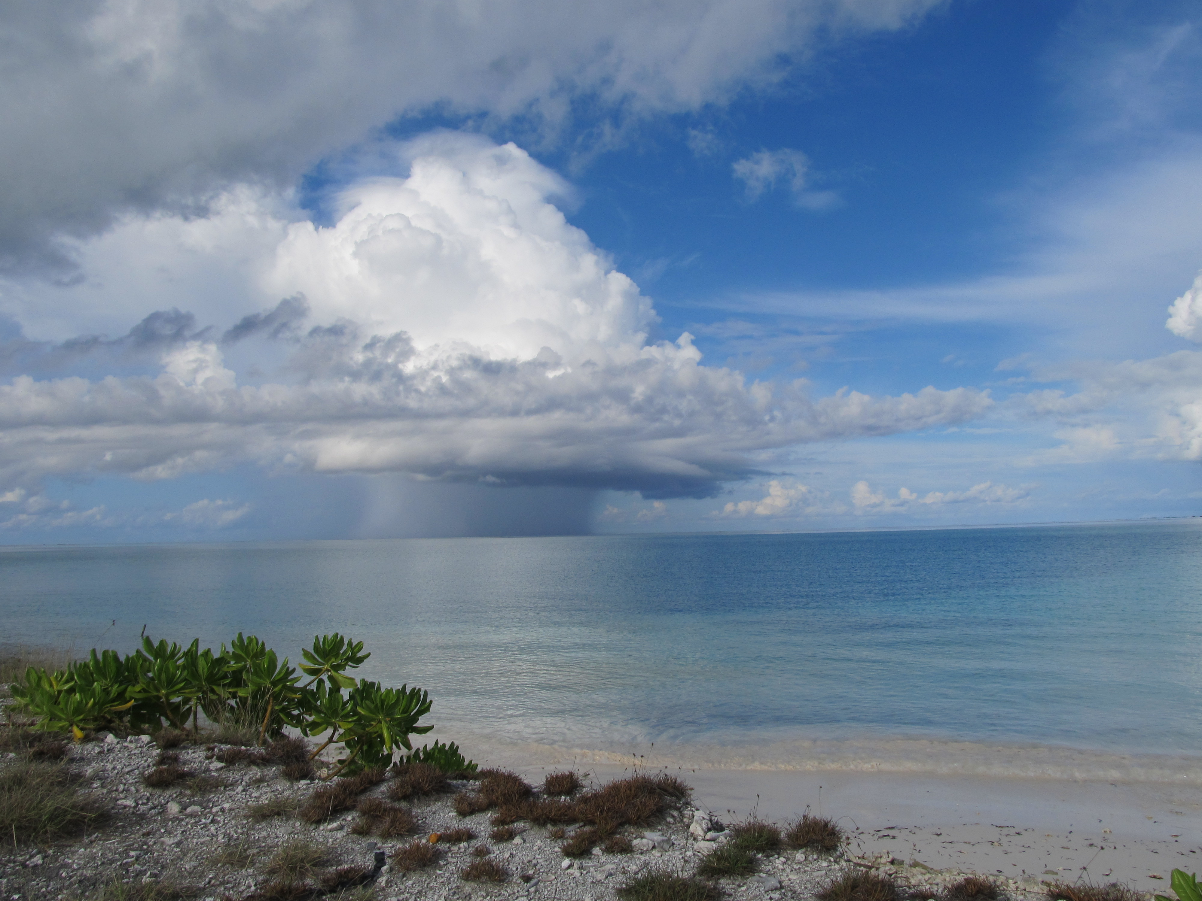
Diurnal Cycle of the Atmospheric Mixed Layer during DYNAMO/CINDY/AMIE
Richard H. Johnson
Paul E. Ciesielski
Colorado State University
J. L. Davison
University of Louisville
Acknowledgments: NSF Grant AGS-1360237 and DOE Grant DE-SC0008582
Third Symposium on Prediction of the Madden-Julian Oscillation: Processes, Prediction and Impact; AMS Annual Meeting, Phoenix, 5 January 2015
Kaustav Chakravarty

Slide 2
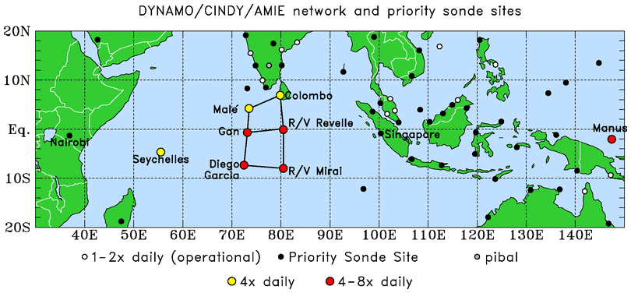
BORNEO
SUMATRA
Two sounding quadrilaterals
This study: 3-hourly soundings from Gan (Addu Atoll) and R/V Revelle

Slide 3
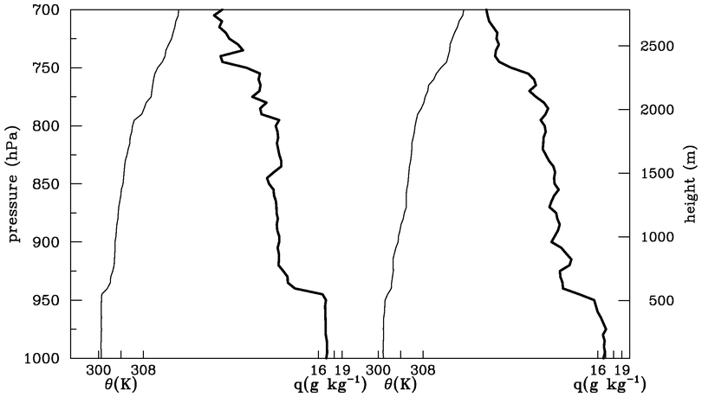
4 October Soundings at R/V Revelle
14 L
Procedure for determining mixed layers: soundings
Each sounding evaluated subjectively (5-hPa resolution)
Mixed layers: θ and q have approximately well-mixed structure over same depth, capped by distinct increase in stability, drying above; entrainment zone evident in majority of cases
08 L
q
θ
q
θ
hPa
m
ENTRAINMENT ZONE
08 L
14 L

Slide 4
4 October Soundings at R/V Revelle
08 L
14 L
Cumulus cloud bases are at the top of the entrainment zone, so arguably it is important to accurately predict mixed layer properties in order to properly represent cumulus cloud populations
“trade-like” stable layer
q
θ
q
θ
08 L
14 L

Slide 5
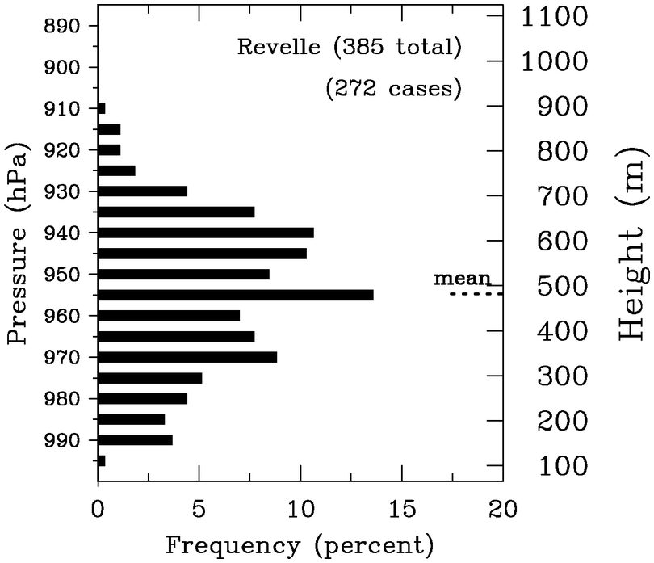
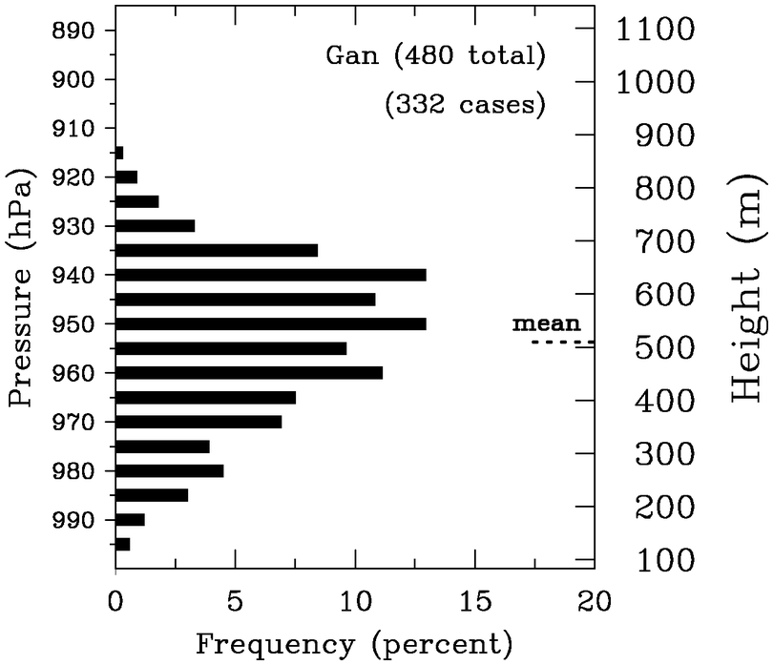
Mean Mixed Layer Statistics
REVELLE
Mean z_{i} ML frequency
(m) (%)
Revelle (Oct-Nov)
Gan (Oct-Nov)
Gan (Oct-Jan 15)
Undist. Trades: ~600 m
473 | 71
505 | 69
518 | 70
512 | 72
424 | 79
(OCT-NOV)
COARE*
GAN
GATE**
* Johnson et al. (2001)
** Fitzjarrald and Garstang (1981)

Slide 6
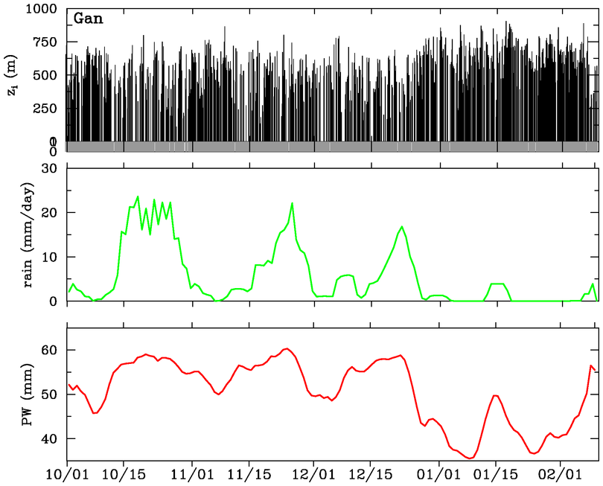
Mixed-Layer Depths at Gan Island (1 October – 8 Feburary)
MIXED-LAYER DEPTHS
mean
DRY PERIOD
Reduced ML depths during rainy periods
Deep ML’s during January dry period
0
MJO1
MJO2
MJO3
TRMM RAINFALL
PRECIPITABLE WATER

Slide 7
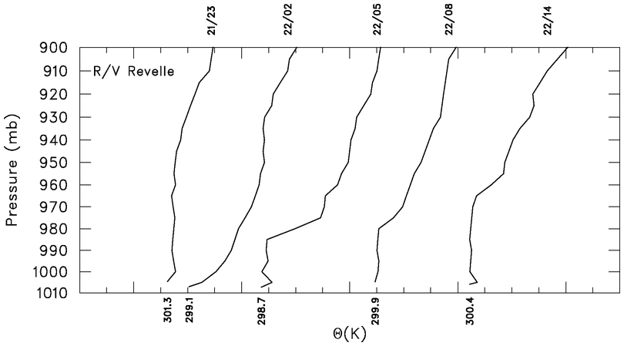
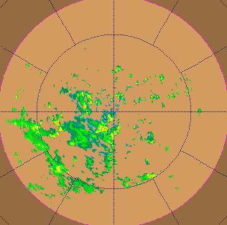
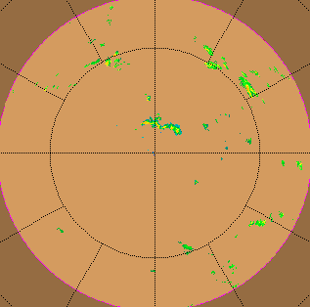
Recovering Boundary Layer Wake at R/V Revelle
22 November 2011
θ
04 L 07 10 13 19
~ 12 h
Comparable to wake recovery periods found in TOGA COARE (Young, Perugini, Fairall 1995)
0229 UTC 22 Nov
1359 UTC 22 Nov

Slide 8
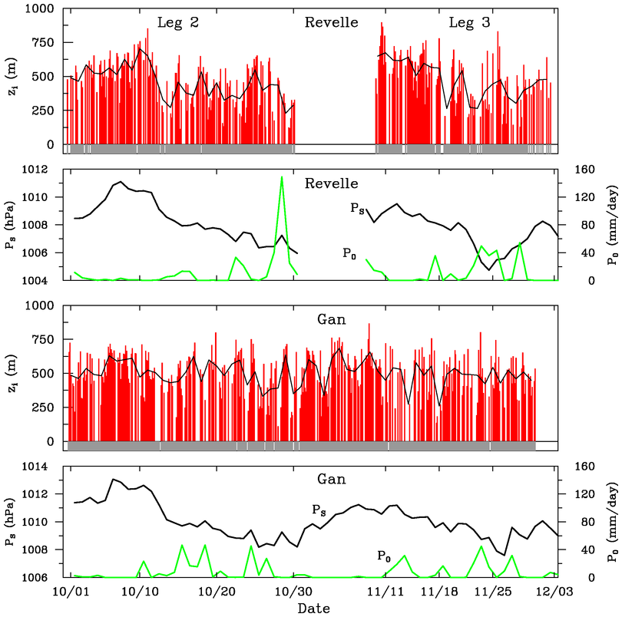
Revelle
Mixed layers at Revelle and Gan Island
Shallow ML’s during rainy periods
Mixed layer modulation by MJO: less prominent at Gan than Revelle
Cause: more frequent rain episodes, atoll effects?
SFC PRESSURE
RAIN
Gan
SFC PRESSURE
RAIN

Slide 9
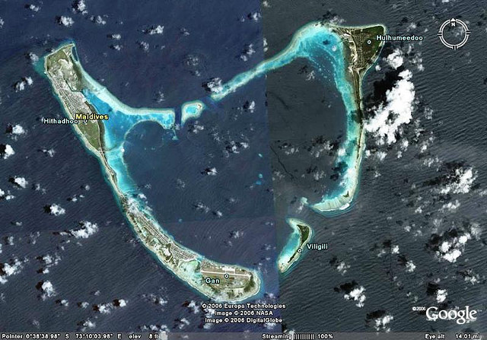
Addu Atoll
Gan sounding site
l
10 km
l

Slide 10
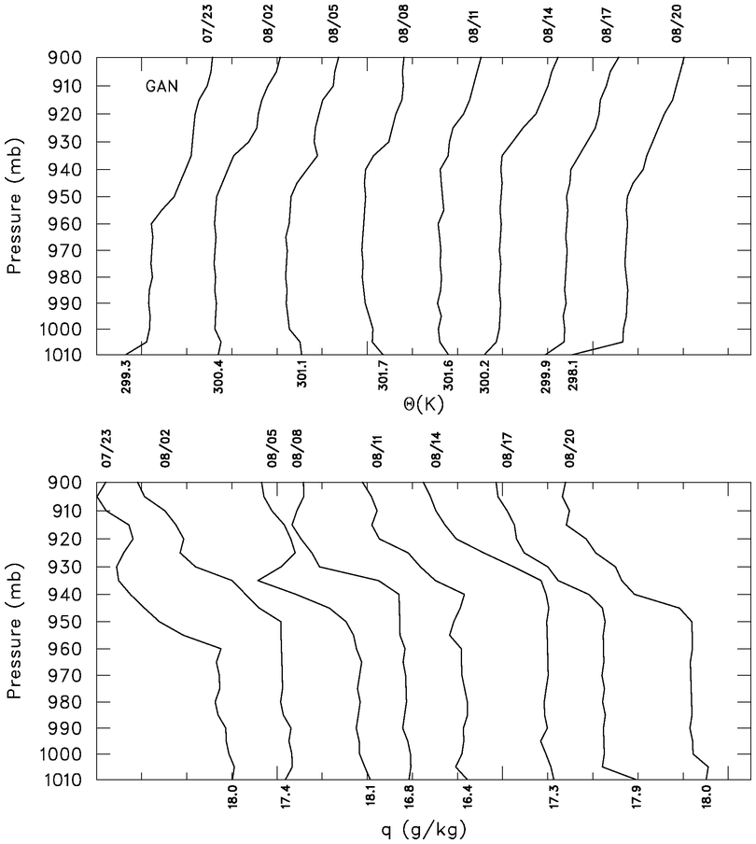
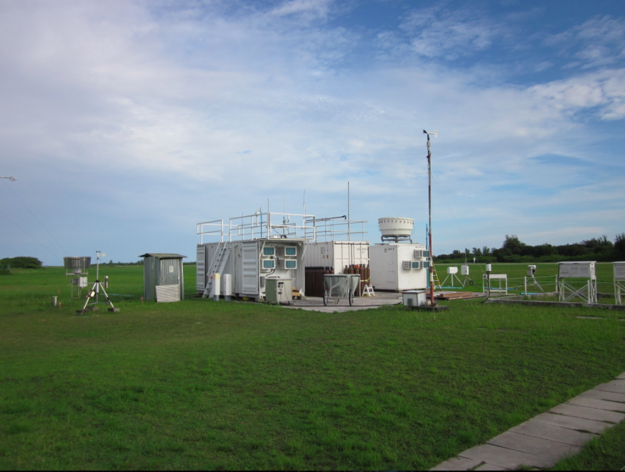
Diurnal cycle of mixed layer at Gan Island
- 8 October -
04 L
07
10
13
16
19
23
01
θ
250 m diurnal variation
Large diurnal cycle during suppressed periods
q
Gan ARM Sounding Site

Slide 11
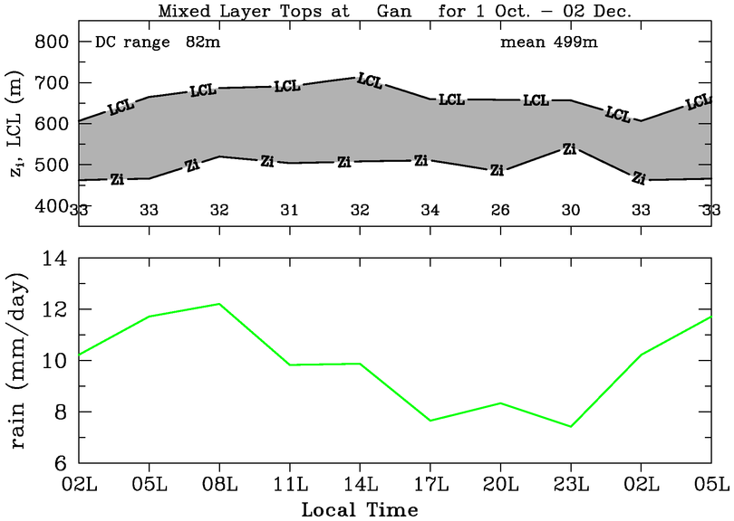
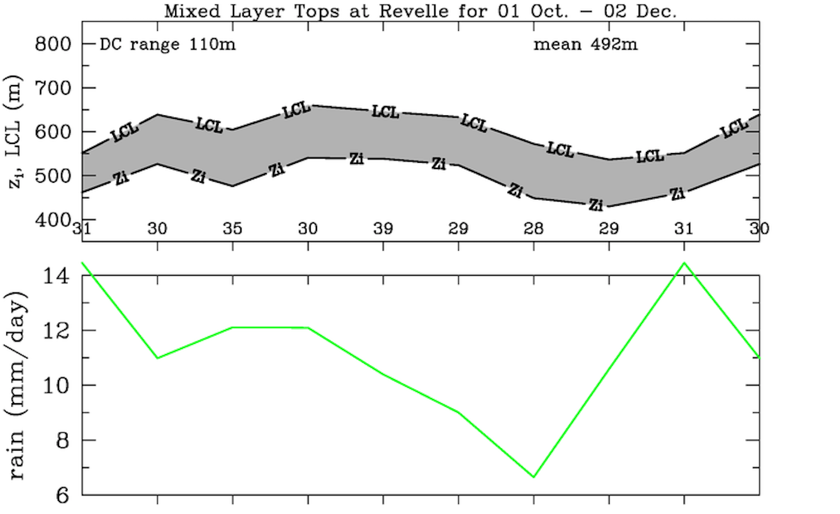
Mixed layer diurnal cycle (two-month means)
Gan Island
LCL
Mixed-layer top
Early morning rainfall maximum, typical of open ocean
Weak ML diurnal cycle
Revelle: nocturnal rainfall peak, minor afternoon ML peak
z_{LCL} – z_{i} greater at Gan (slightly drier conditions over land)
TRMM RAINFALL
NOON
Revelle
LCL
Mixed-layer top
TRMM RAINFALL
NOON

Slide 12
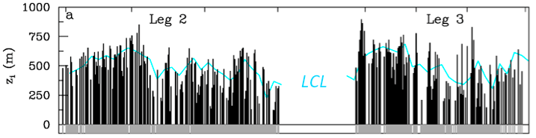
Revelle Atmospheric Mixed Layer Depth, SST, Rainfall
R/V Revelle
ATMOSPHERIC MIXED LAYER DEPTH, LCL
?
SST-warming phases:
Deepest mixed layers
ML depth increases with time, extends above LCL; promotes cloud growth
Prominent SST diurnal cycle
SST-warming phases:
Deepest mixed layers
ML depth increases with time, extends above LCL; promotes cloud growth
SST-warming phases:
Deepest mixed layers
MJO1
MJO2
Notes:
Large diurnal cycle in SST before MJO heavy rainfall, particularly during Nov when sfc wind was weaker.

Slide 13
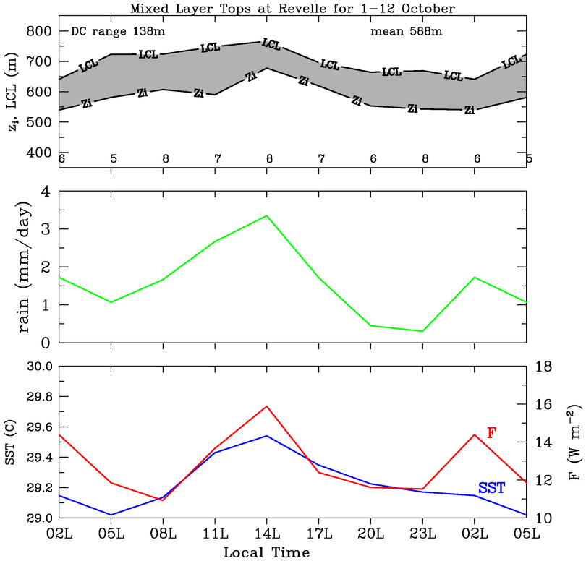
October suppressed period mixed layer diurnal cycle at Revelle
Afternoon SST peak leads to increased F, reduction in z_{LCL} – z_{i} , afternoon rainfall maximum
Weak nocturnal rainfall peak still present
TRMM RAINFALL
NOON
SURFACE BUOYANCY FLUX (F)
SST

Slide 14
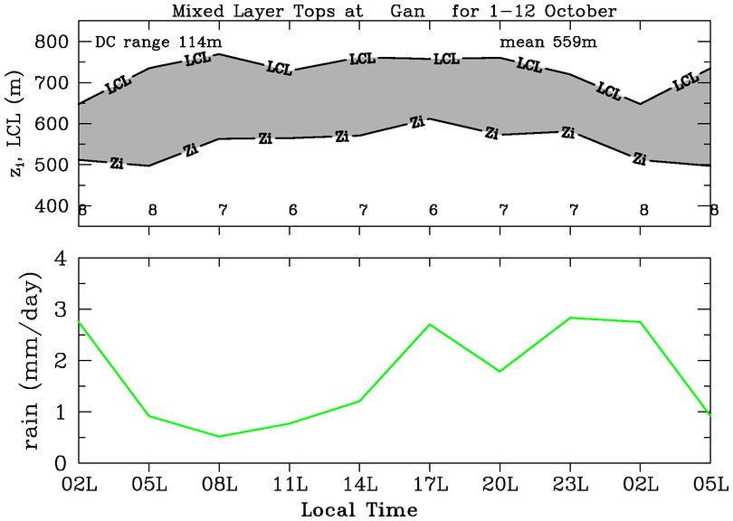
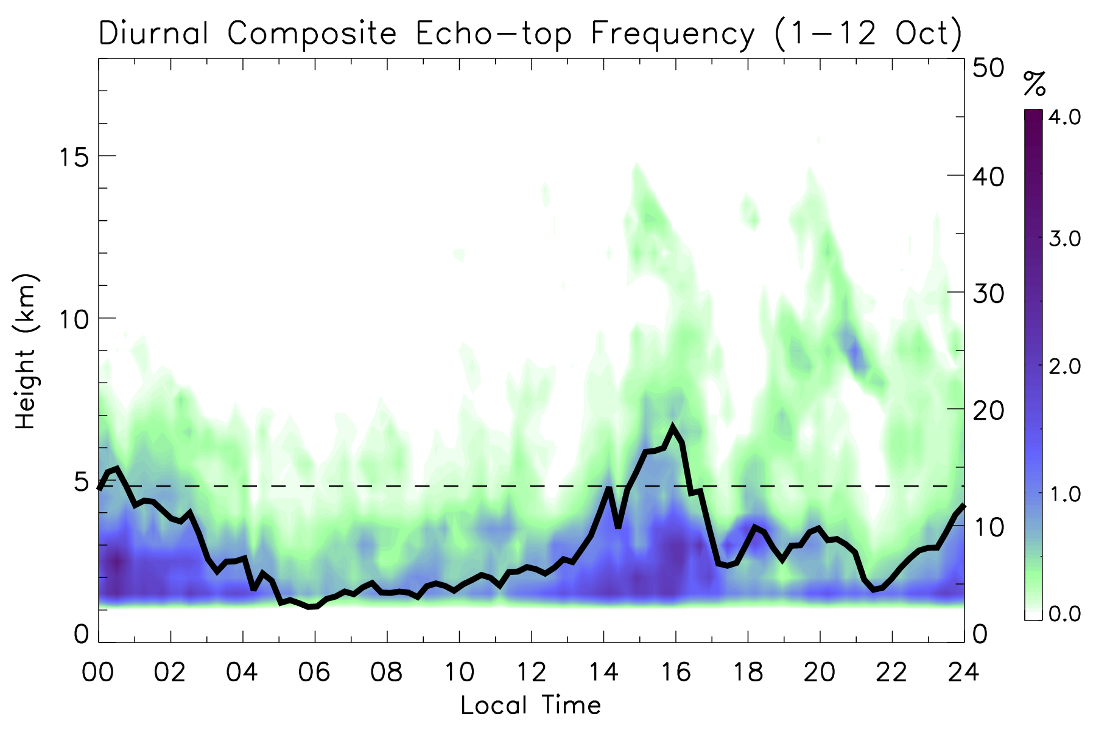
October suppressed period mixed layer diurnal cycle at Gan
Late afternoon peak in mixed layer depth and rainfall
Nocturnal rainfall peak still present
S-Pol echo statistics also support late afternoon peak in rainfall
At Gan, behavior associated with both SST & atoll heating
TRMM RAINFALL
NOON
(S-Pol NW quadrant RHI data)
Echo area coverage
NOON
(from Ruppert & Johnson 2015)

Slide 15
SUMMARY
Atmospheric mixed layers observed for ~70% of soundings; mean depth ~475-525 m; findings similar to TOGA COARE, GATE
Mixed layers modulated on multiple time scales
Deepest MLs during MJO suppressed phase
Modulation of ML by MJO less distinct at Gan: possible explanations – more frequent rainfall, persistent diurnal cycle
Afternoon ML peak on suppressed days associated with SST diurnal cycle/atoll heating; concurrent afternoon peaks in rainfall/echo area coverage
Risky to generalize Gan BL properties to open ocean

Slide 16
Extra slides

Slide 17
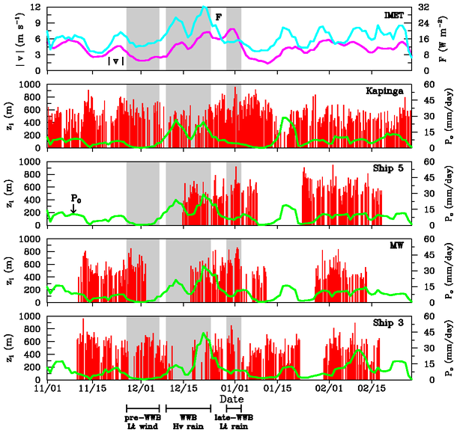
TOGA COARE
Mixed layer deepest during light-rain periods, shallowest during rain periods
ML depth varies on MJO time scale
(Johnson et al. 2001)

Slide 18
Mean Mixed Layer Height Statistics
REVELLE
Mean z_{i} ML frequency
White: Soundings
Red: Bragg Scat.
(m) (%)
Revelle (Oct-Nov)
Gan (Oct-Nov)
Gan (Oct-Jan 15)
Gan (Oct-Jan 15)
Undist. Trades: ~600 m
473 | 71
505 | 69
518 | 70
455
512 | 72
424 | 79
(OCT-NOV)
GAN
COARE*
GATE**
* Johnson et al. (2001)
** Fitzjarrald and Garstang (1981)

Slide 19
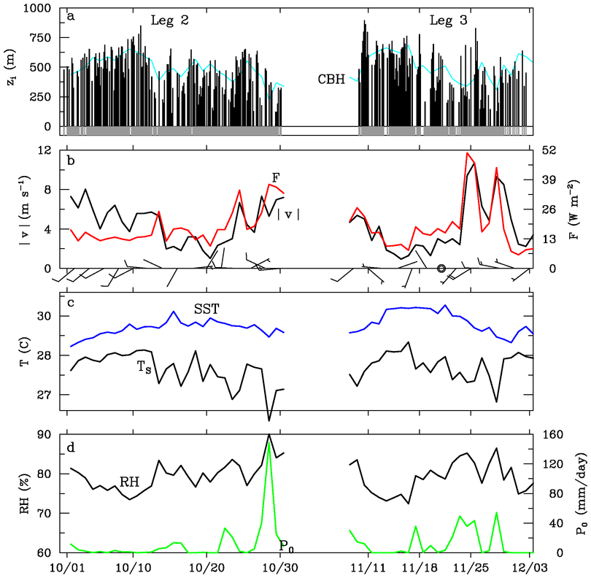
Mixed layer at R/V Revelle
LCL
ML modulated by MJO
Deepest ML during MJO build-up phases
Reduction in ML depth accompanies onset of rain
Large buoyancy fluxes during active MJO phases
WIND SPEED
BUOYANCY FLUX
(AIR TEMPERATURE)
data courtesy Edson, Fairall, de Szoeke
RAIN

Slide 20
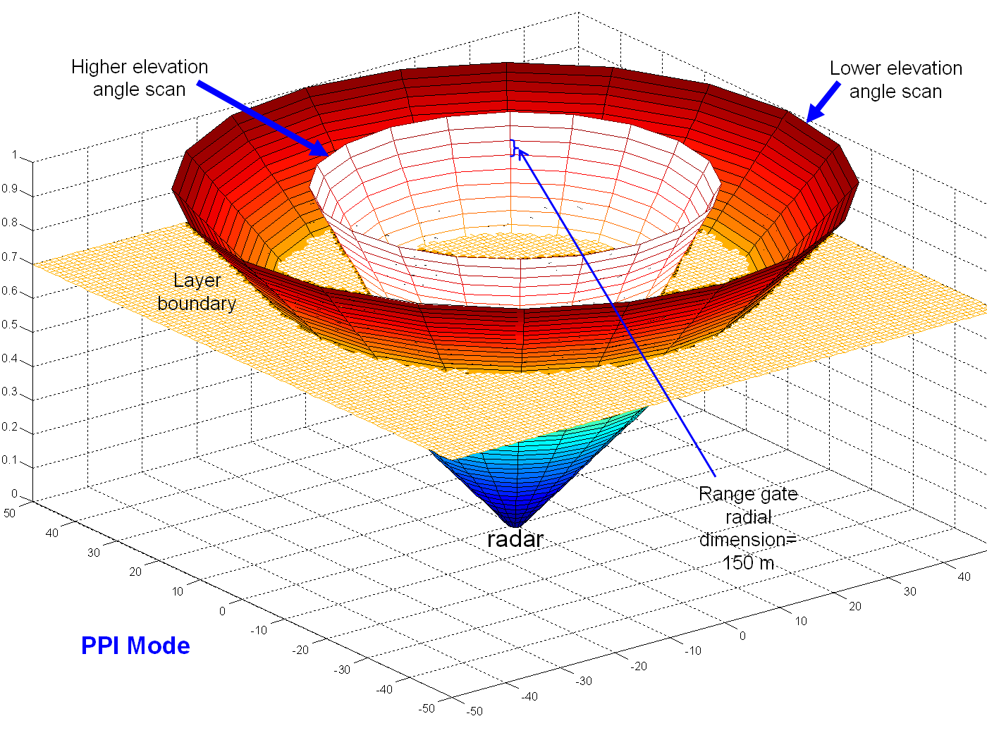
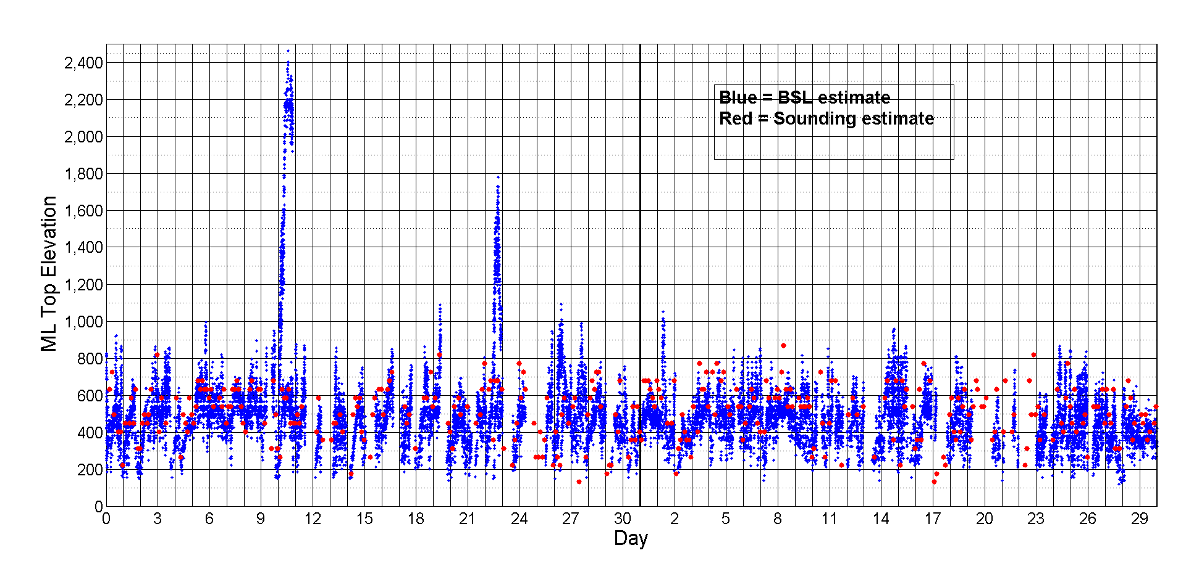
Comparison with Bragg scattering results from S-Pol radar
(Davison et al. 2013a,b)
OCTOBER
NOVEMBER

Slide 21
4 October Soundings at R/V Revelle
08 L
14 L
“trade-like” stable layer
q
θ
q
θ
08 L
14 L
Shallow cumulus layers frequently observed

Slide 22
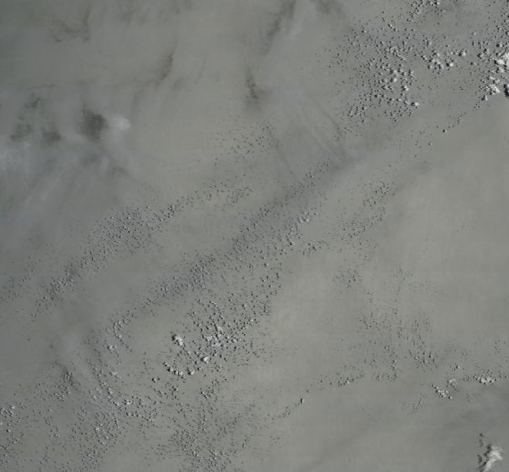
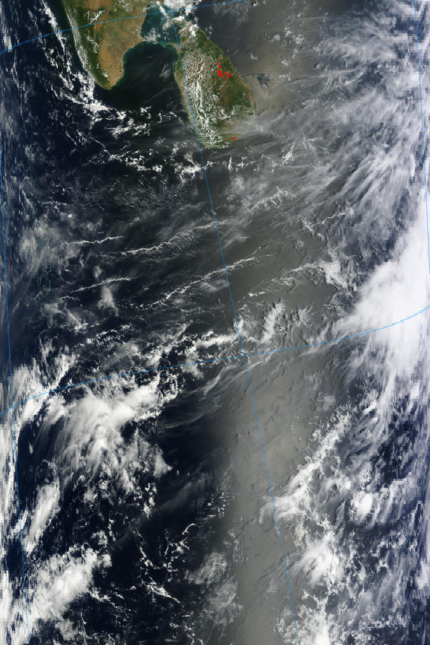

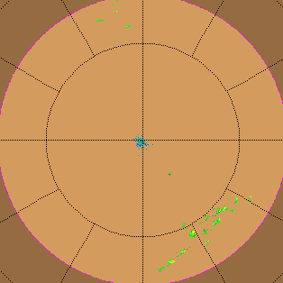
India
Terra/MODIS
2011/277
10/04/2011
05:10 UTC
250 m
Sri Lanka
4 October 0459 UTC
Revelle
★
TOGA RADAR

