Slide 1
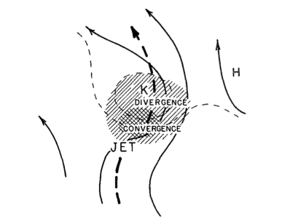
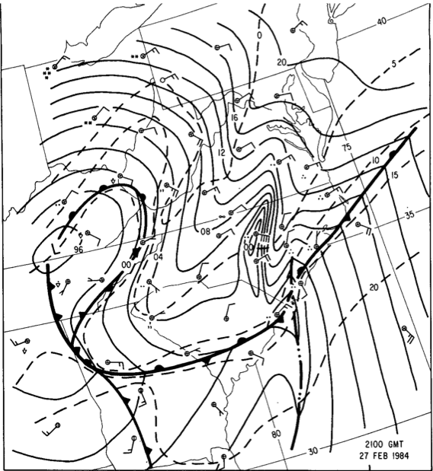
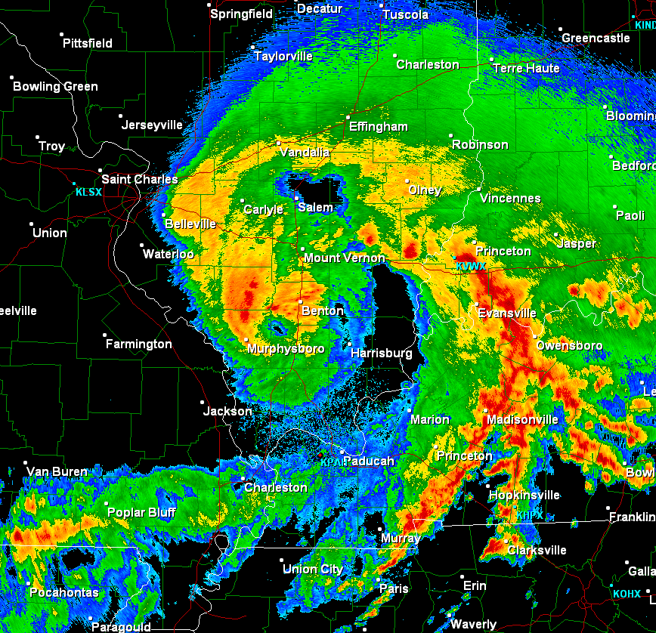
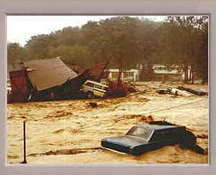
Mesoscale Convective Processes (Warm Season): A Tribute to Lance
Richard H. Johnson
Colorado State University
Bosart and Sanders (1981)
JOHNSTOWN FLOOD
Bosart and Seimon (1988)
Weisman, Evans, Bosart (2013)
Lance Bosart Symposium, 19-20 April 2013

Slide 2
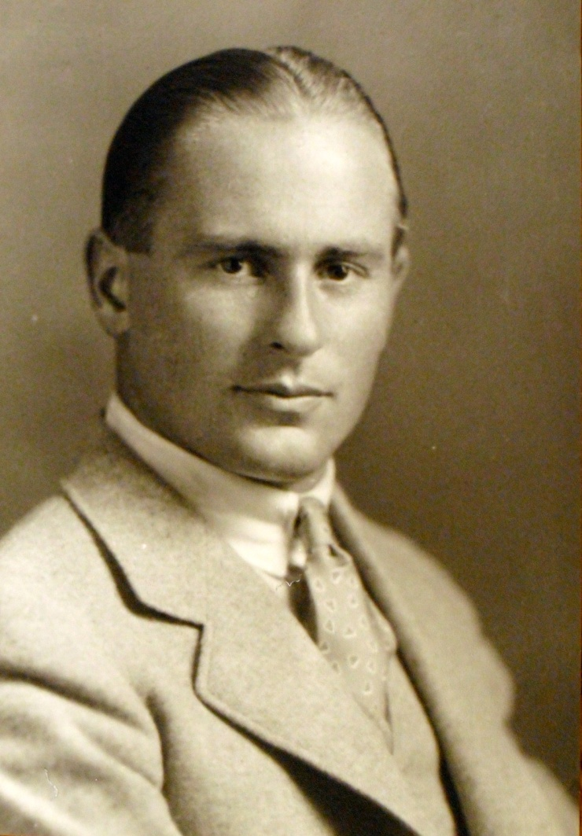
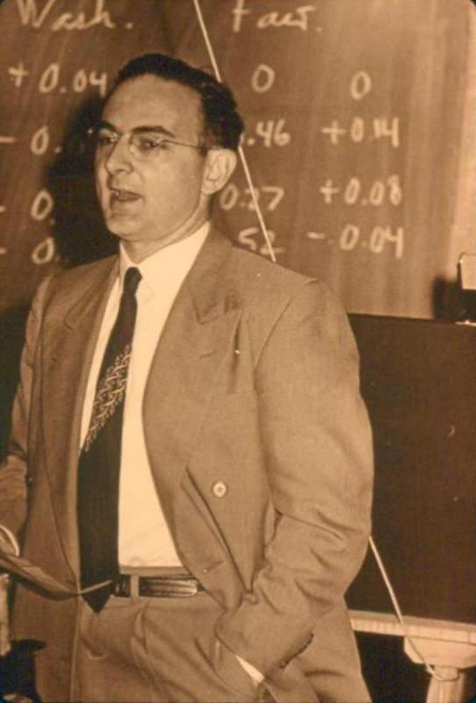
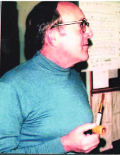
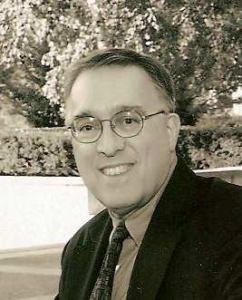
Abbreviated Family Trees
Willett (1929)
Reed, MIT (1949)
Sanders, MIT (1954)
Johnson, UW (1975)
Bosart, MIT (1969)
“Though synoptic meteorology was always my primary interest, I wrote my ScD thesis under Willett on the seemingly exotic subject " The Effect of Atmospheric Motions on Ozone Distribution and Variations," motivated largely by what I understood as an unwritten rule that mainline synoptic meteorology was not a suitable area for an MIT doctoral dissertation. The rule, if ever such existed, was broken a few years later by my early collaborator Fred Sanders.”
-- R. Reed, 2001

Slide 3
Reed and Sanders
Reed, MIT (1949)
Sanders, MIT (1954)
“Fred and I were kindred spirits who fed each other's discontent with what we regarded as the nearly blind acceptance by many meteorologists of the model of cyclone development advocated by the Norwegian School.”
-- R. Reed, 2001

Slide 4
Reed and Sanders & Fronts
Reed, MIT (1949)
Sanders, MIT (1954)

Slide 5
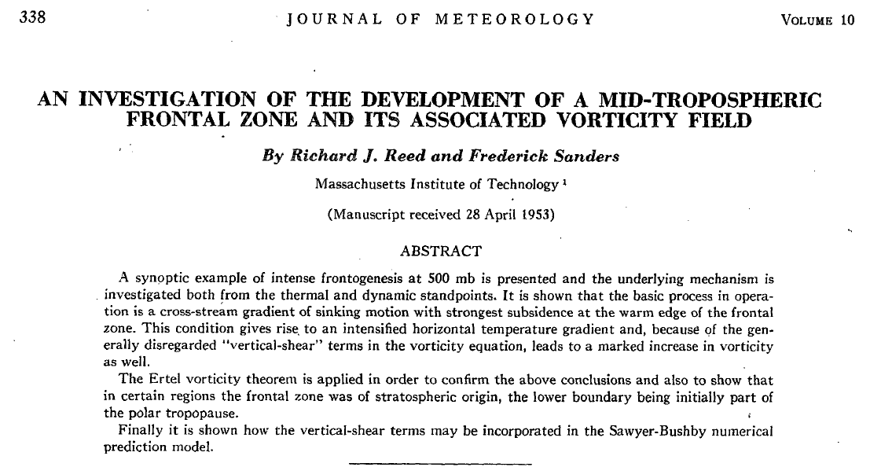
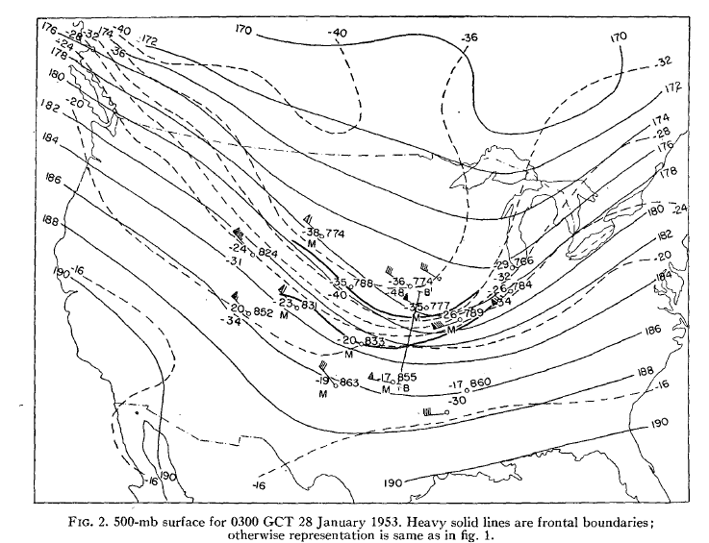
Reed and Sanders (1953)
Time from case study event to submission: 3 months
Time for review and publication: 6 months
No word processing, internet, MAP, twitter

Slide 6
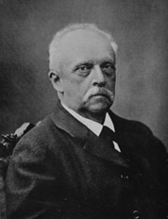
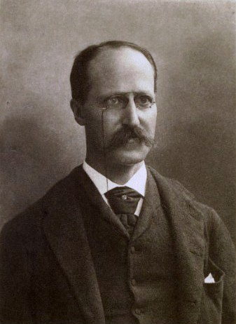
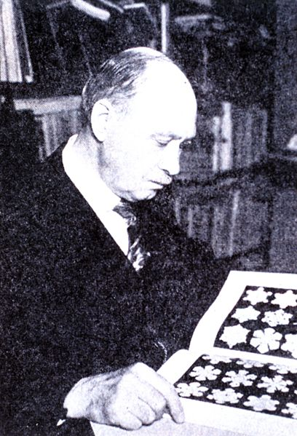
von Helmholtz (1843)
Rowland (1870)
Humphreys (1897)
Reed family tree, courtesy Bob Hart Poster, 2013 AMS Annual Meeting
Willett (1929)
Johnson (1975)
Reed (1949)
Sanders (1954)
Bosart (1969)

Slide 7
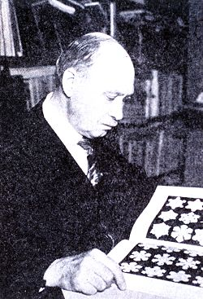
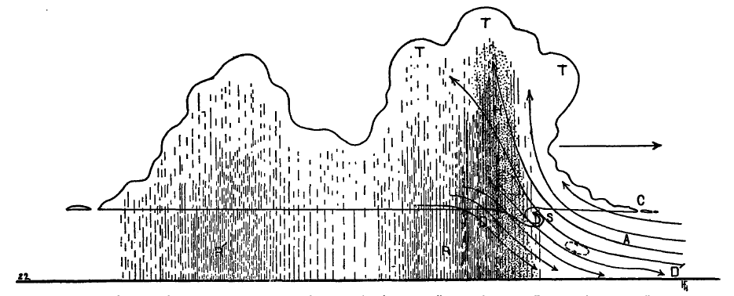
Early Observations of Squall Lines
Humphreys, W.J., 1914: The thunderstorm and its phenomena. Mon. Wea. Rev., 42, 348-380.
30 July 1913 Wash. DC “thunderstorm”; gusts to 70 mph; 2’’ rain; 6-mb pressure jump
William J. Humphreys 1862-1949
R’
R
~ 60 – 70 km
“…initial convection at R…secondary rain at R’. …the secondary rain is a thing of frequent occurrences” – foreshadowing later squall-line research

Slide 8
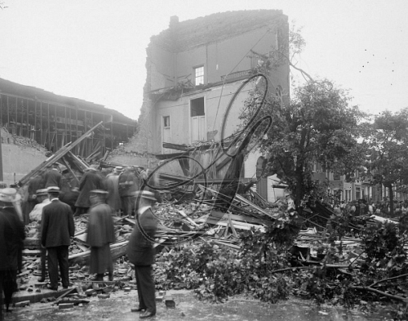
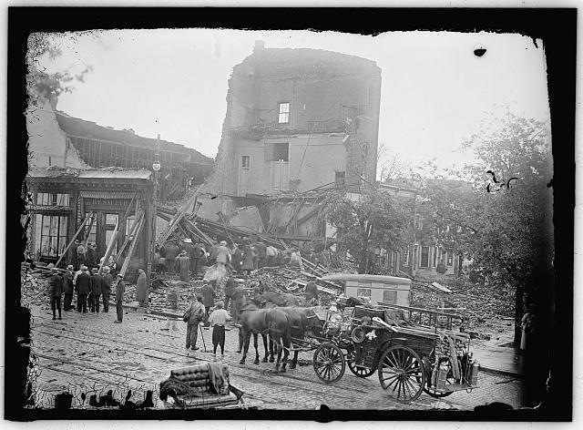
WASHINGTON D.C., 1913. Storm damage at 7th Street and L Street NW in Washington D.C.
Photograph, 30 July 1913

Slide 10
Lance’s Endless Pursuit of Mesoscale Convective Processes
Mesoscale aspects of tropical cyclones
Extreme rainfall events
Diurnal cycle of rainfall
Mesoscale convective systems
Derechos
MCVs
Dryline convection
Tornadic thunderstorms
Monsoon (SW U.S.) precipitation systems
High-amplitude internal gravity waves, coupling with convection

Slide 11
Lance’s Endless Pursuit of Mesoscale Convective Processes
Mesoscale aspects of tropical cyclones
Extreme rainfall events
Diurnal cycle of rainfall
Mesoscale convective systems
Derechos
MCVs
Dryline convection
Tornadic thunderstorms
Monsoon (SW U.S.) precipitation systems
High-amplitude internal gravity waves, coupling with convection

Slide 12
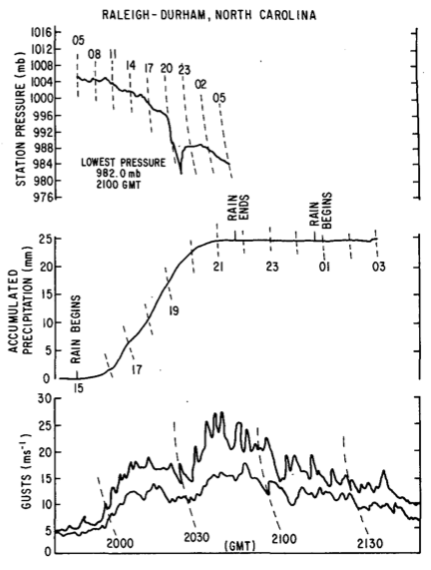
RALEIGH-DURHAM, NC
Bosart and Seimon (1988, MWR)
“A Case Study of an Unusually Intense Atmospheric Gravity Wave”
14 mb fall in 40 min
Occurs as rain ceases
Easterly wind gusts > 25 m s⁻¹

Slide 13
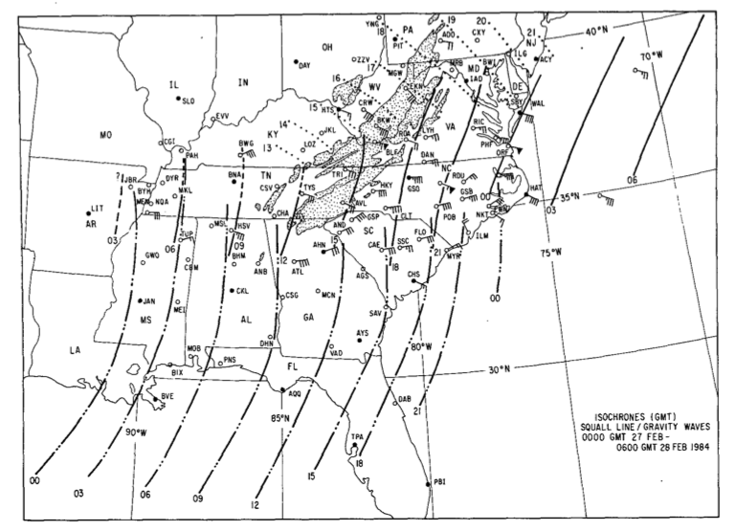
Gravity wave isochrones
Strong easterly gusts
Squall line isochrones
…gravity waves first detected in wake depression to rear of squall line…

Slide 14
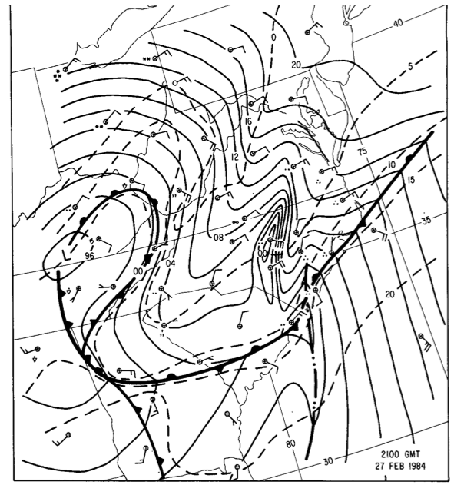
Surface pressure analysis
2100 UTC
27 February 1984
Strong cross-isobar easterly flow in wake low

Slide 15
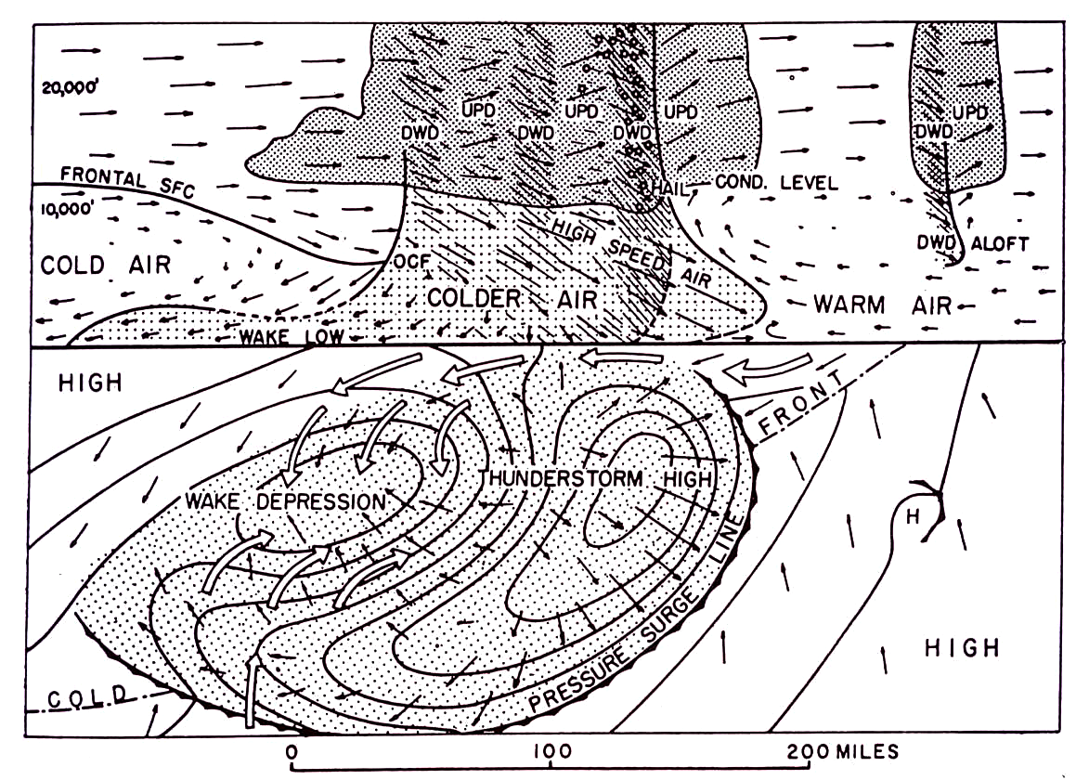
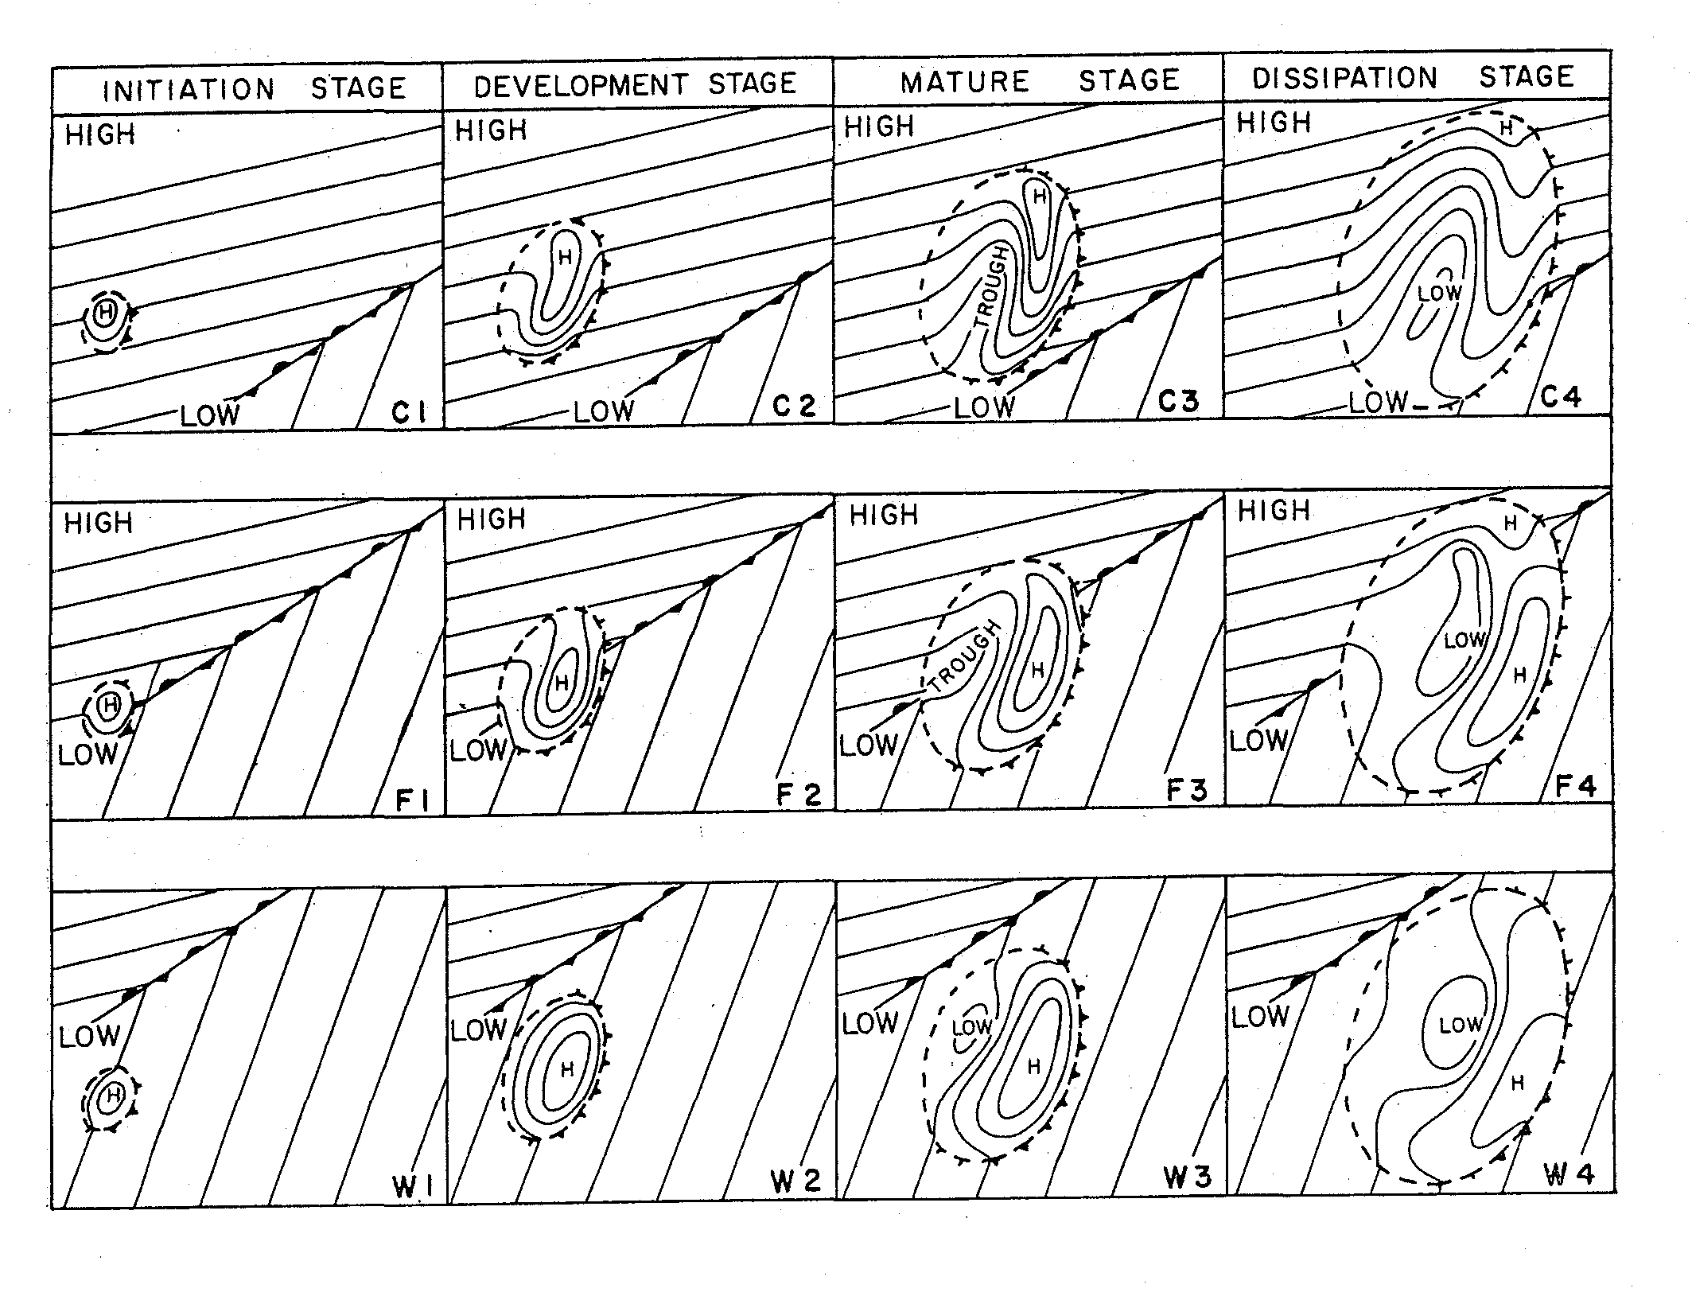
Fujita (1955)
Similar isobar pattern
Fujita (1963)
In cold air
Along front
In warm sector

Slide 16
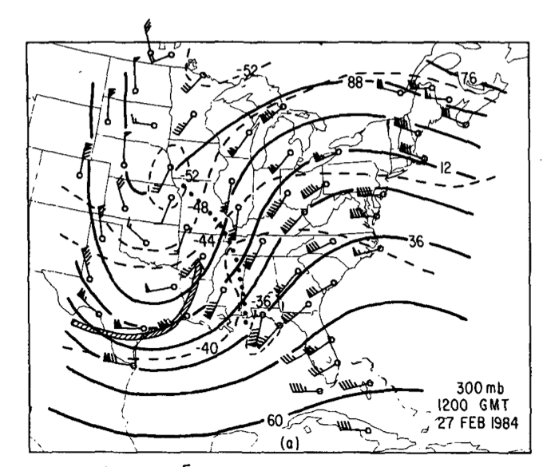
Summary of 27 February 1984 Event
Initiated by geostrophic adjustment in strong upper-level trough/ridge system
Gravity wave organized and intensified within wake low to rear of squall line
Environment supported wave ducting

Slide 17
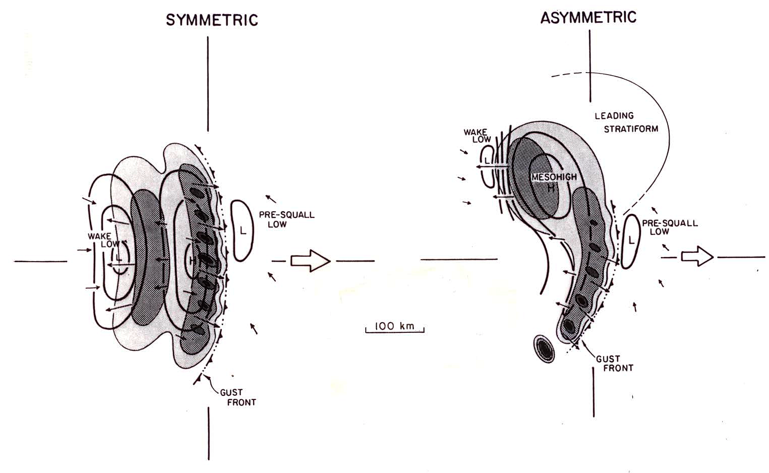
Wake low linked to stratiform region
Observed to follow northward shift of stratiform region as convective systems evolve from “symmetric” to “asymmetric”
(Loehrer and Johnson 1995;
based on 1985 OK PRE-STORM data)
[Symmetric/asymmetric structures adapted from Houze et al. 1990]

Slide 18
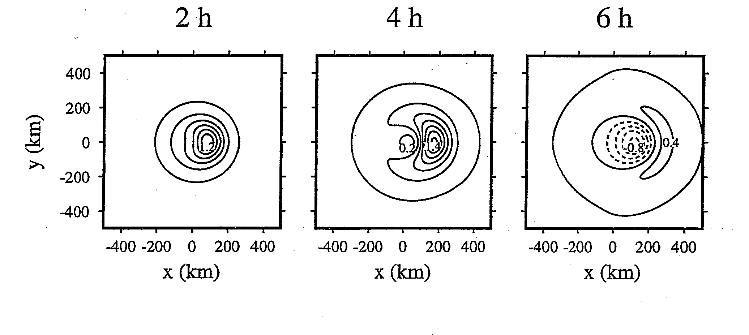
Linear Dynamics of Squall Line Mesohighs/Wake Lows
(Haertel and Johnson 2000)
Analytical solution: A moving cool source 4 km deep (representing stratiform precipitation region) generates a gravity wave moving at ~13 m s⁻¹ with an associated surface mesohigh/wake low couplet. Intensity of pressure couplet increases rapidly as speed of cold pool approaches speed of gravity wave.
Numerical solution: (150-km diameter cooling, speed = 10 m s⁻¹, lasting 4 h)
Contour interval: 0.2 hPa
L
H
(Fujita 1963)

Slide 19
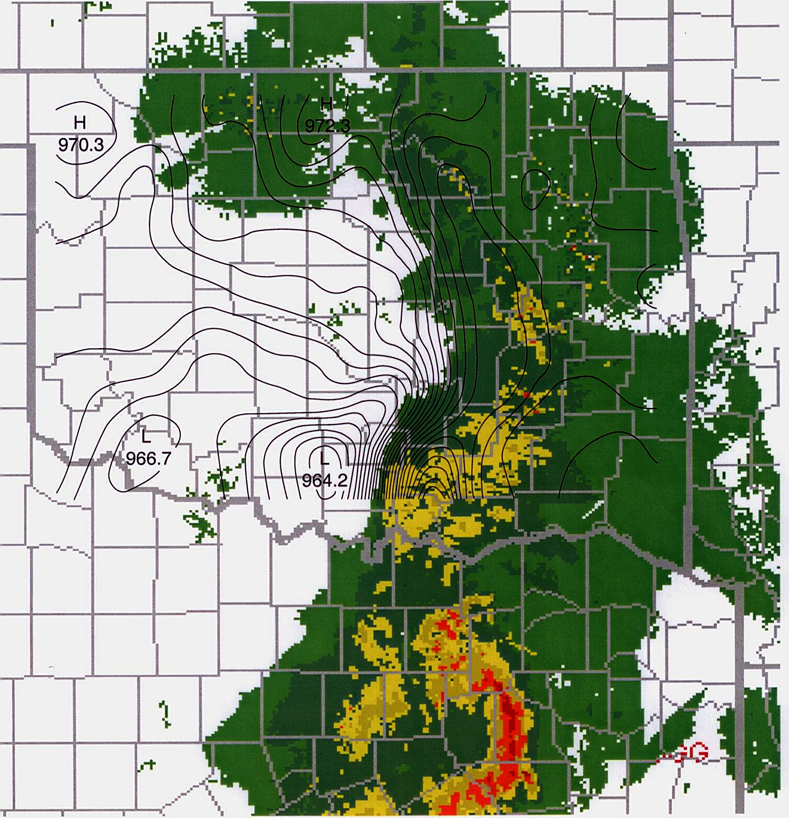
What about high-amplitude events?
Dallas-Fort Worth “Mayfest” Hailstorm/Bow Echo, Intense Wake Low
6 May 1995
WAKE LOW
H
~13 hPa
Texas’s worst hailstorm; 20 deaths; > $1B damage
00 UTC
6 May 1995
BOW ECHO
★
DALLAS
(Johnson 2001, BAMS)

Slide 20
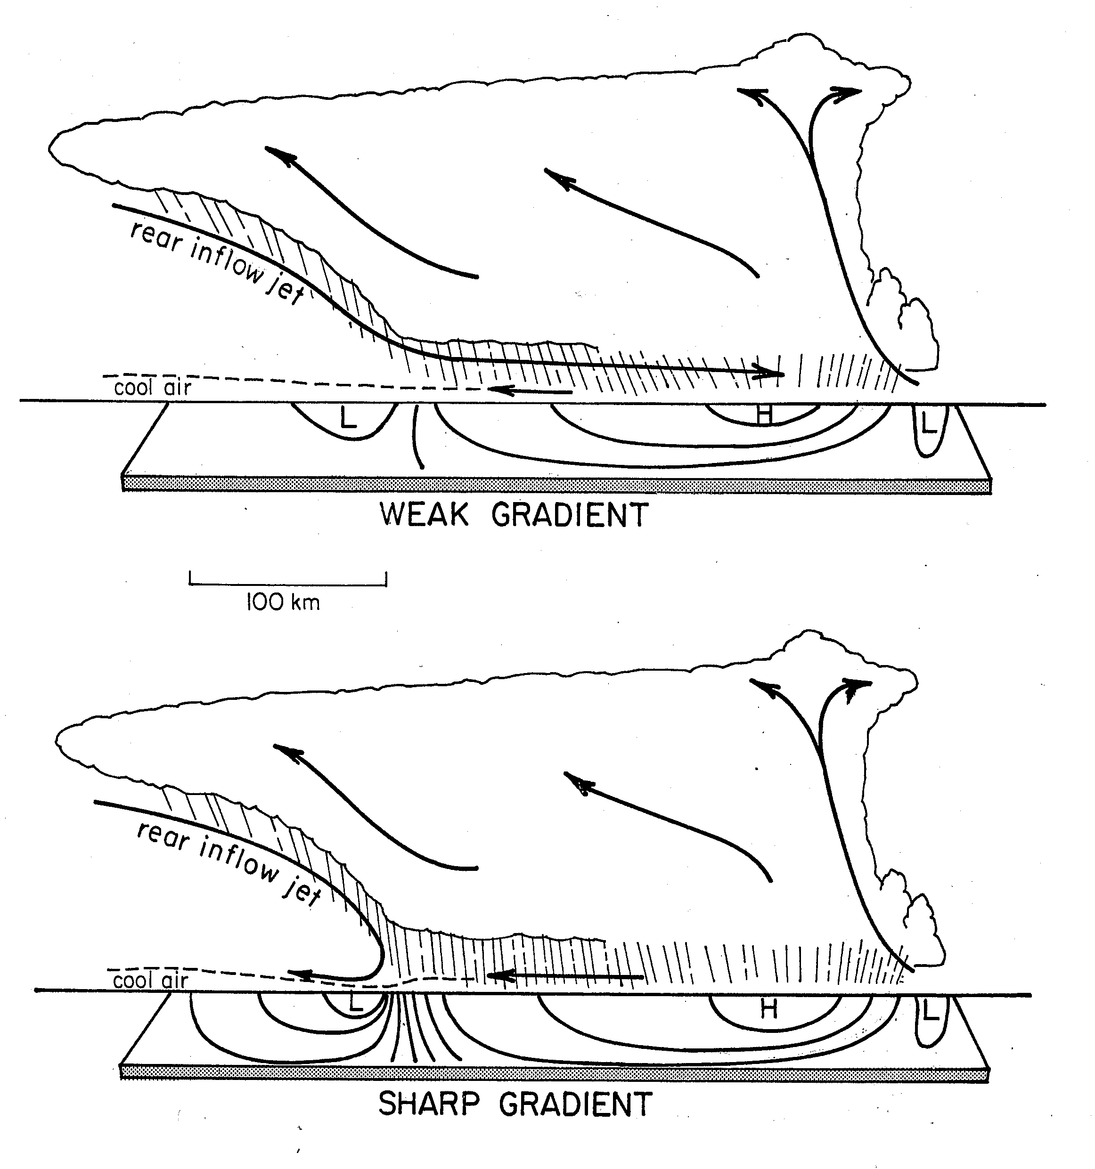
Weak and Sharp Wake-Low Pressure Gradients
Synthesis of 1985 PRE-STORM MCSs – weak pressure gradient exists where rear inflow passes through stratiform region toward convective line, sharp gradient where it is blocked
(Johnson 2001)

Slide 21
250 hPa
Unbalanced flow, jet streak propagating toward ridge axis (Uccellini and Koch 1987)
Squall line

Slide 22
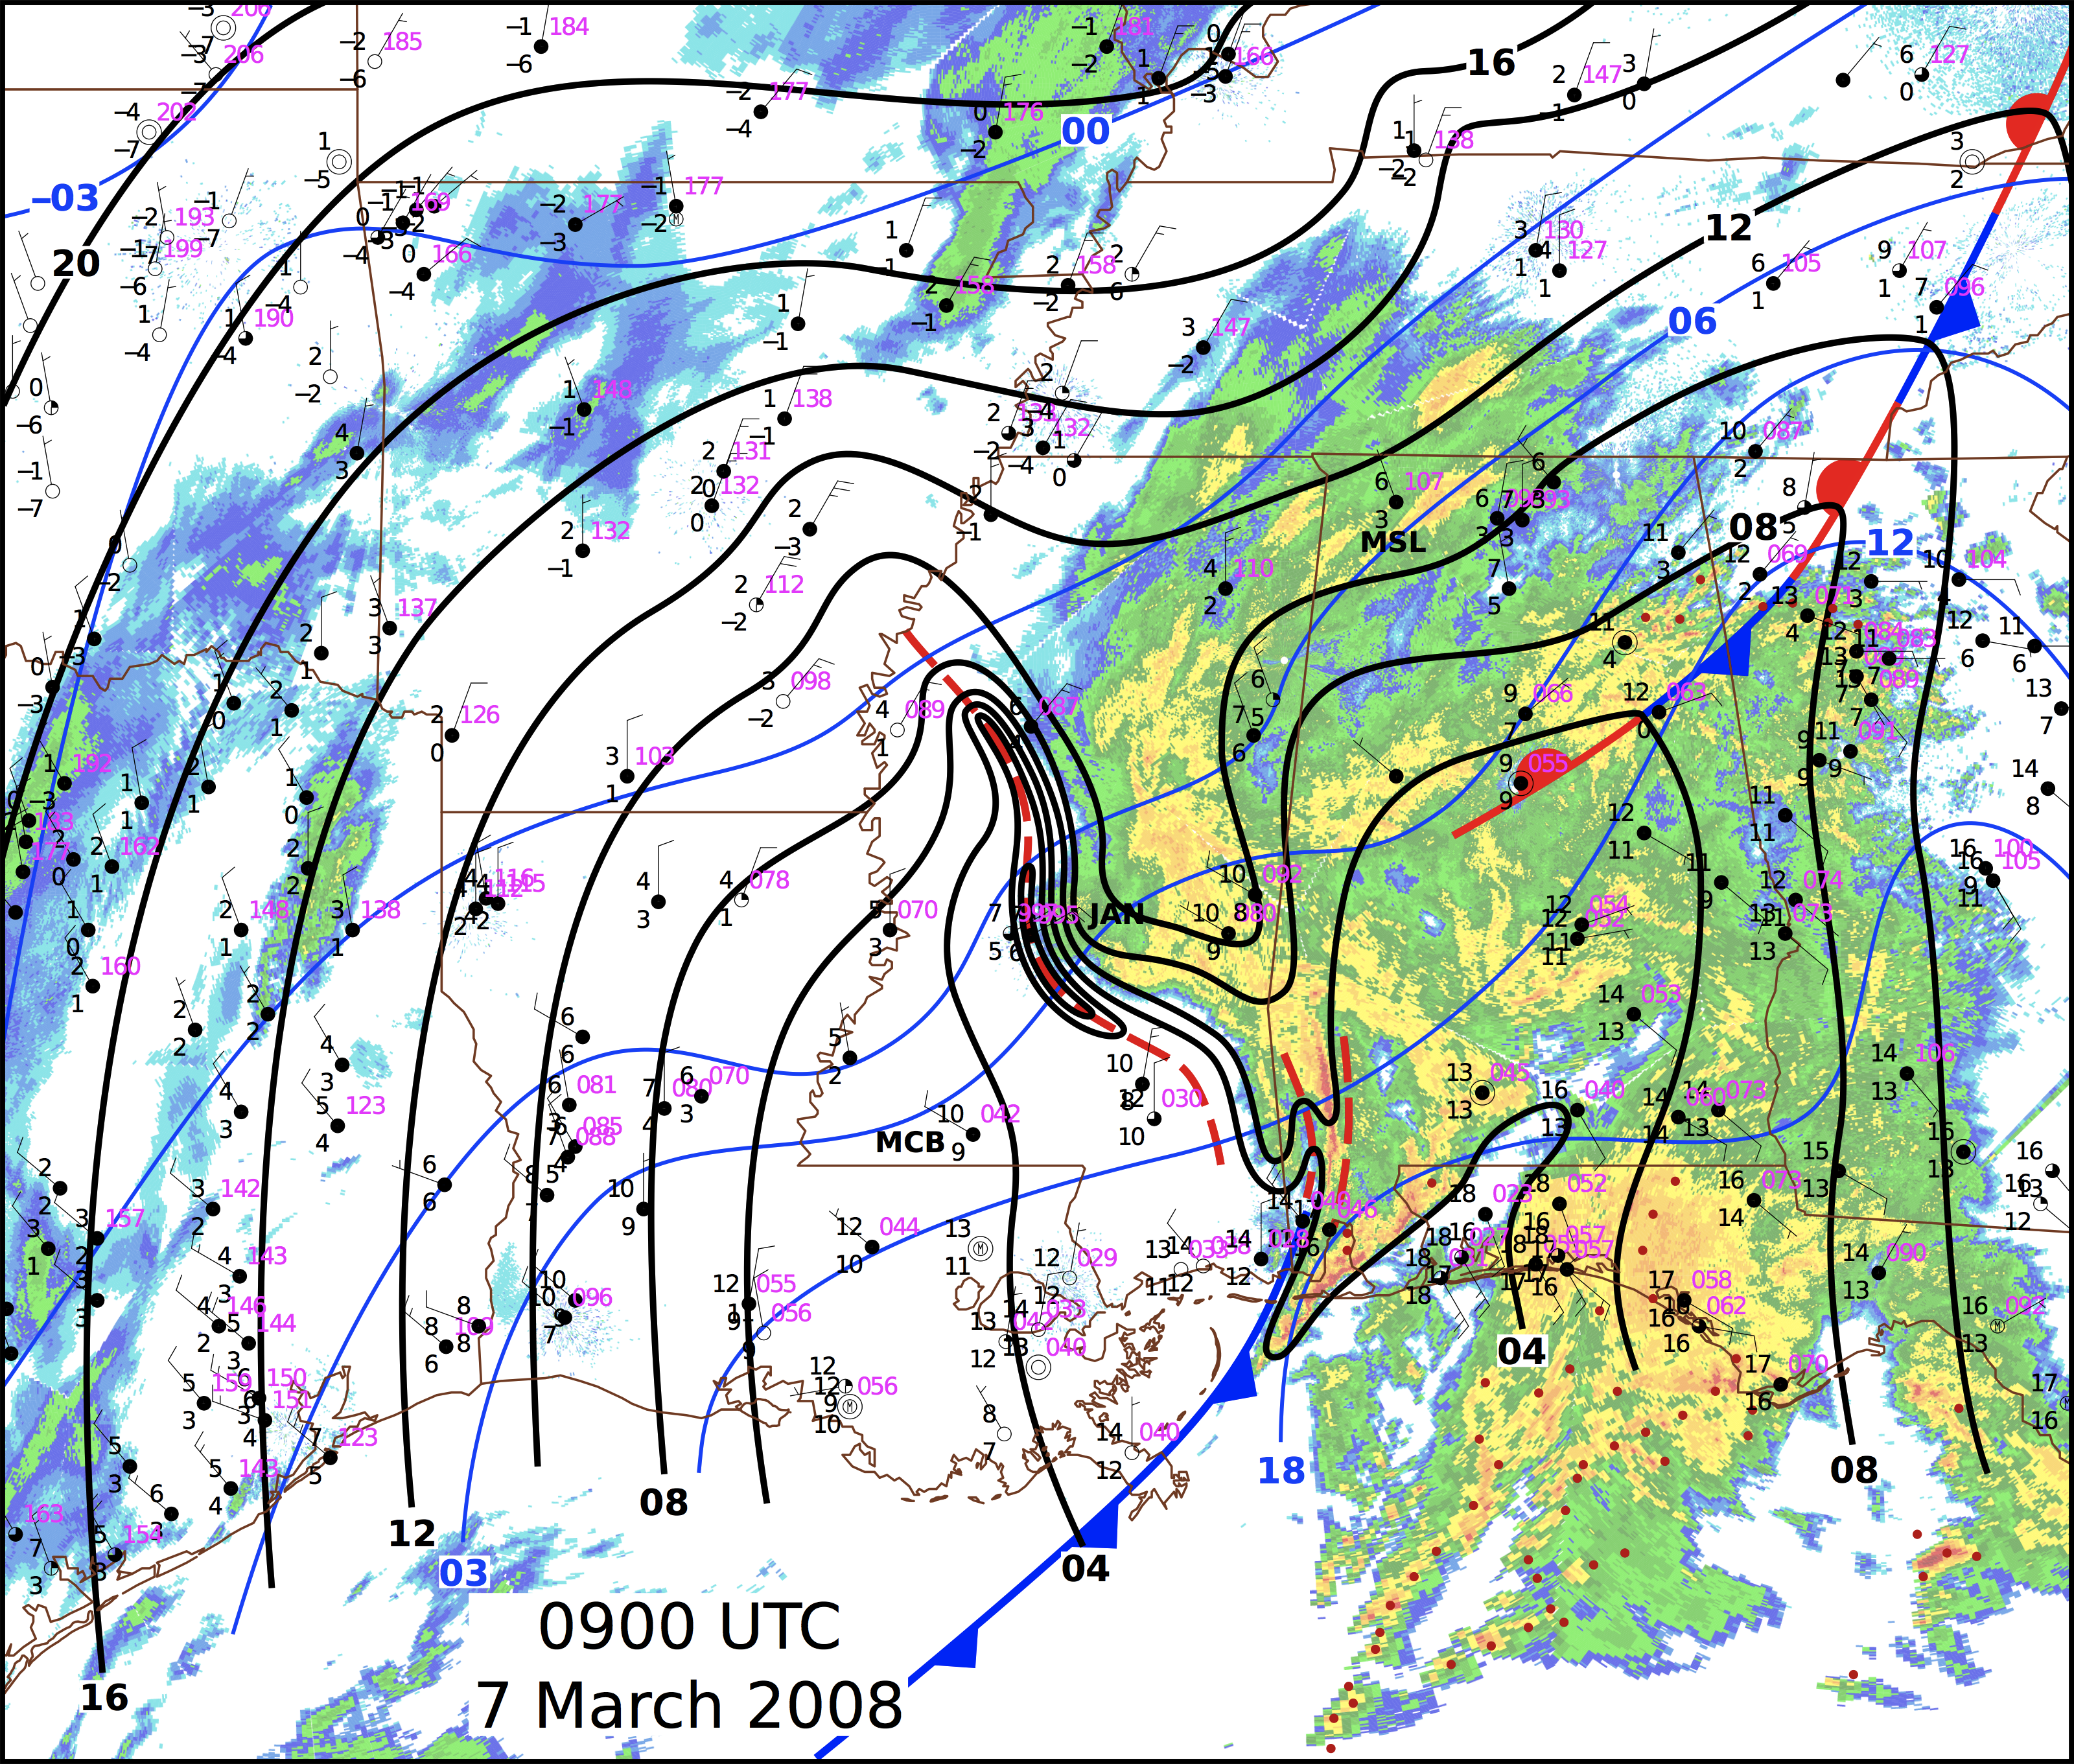
Family tree extended…Ruppert and Bosart (2013)

Slide 23
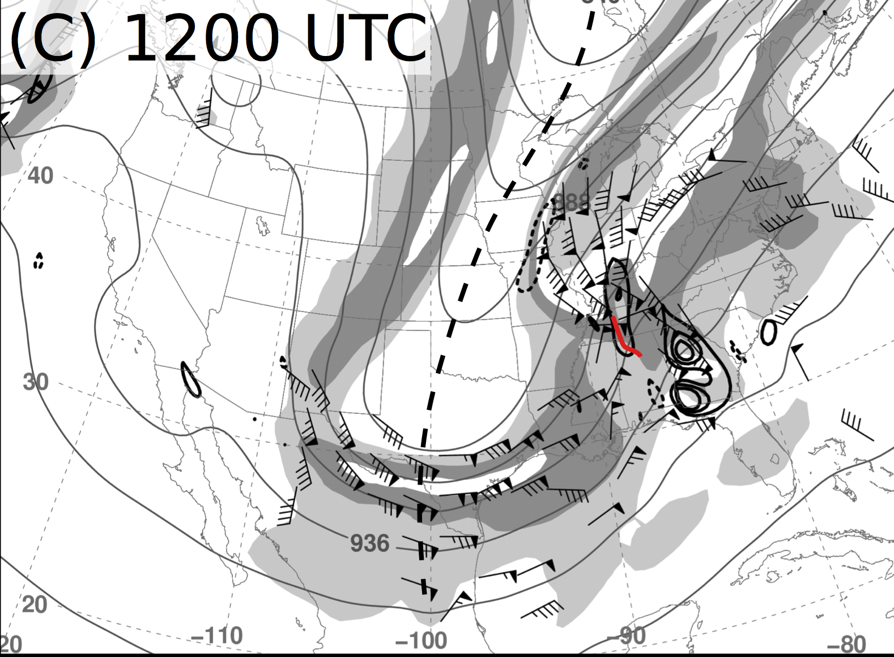
Ruppert and Bosart (2013)
300 hPa Ageostrophic Wind, Divergence
DIV

Slide 24
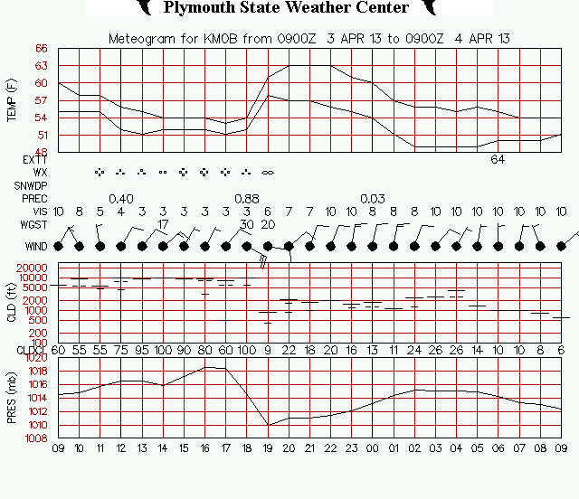
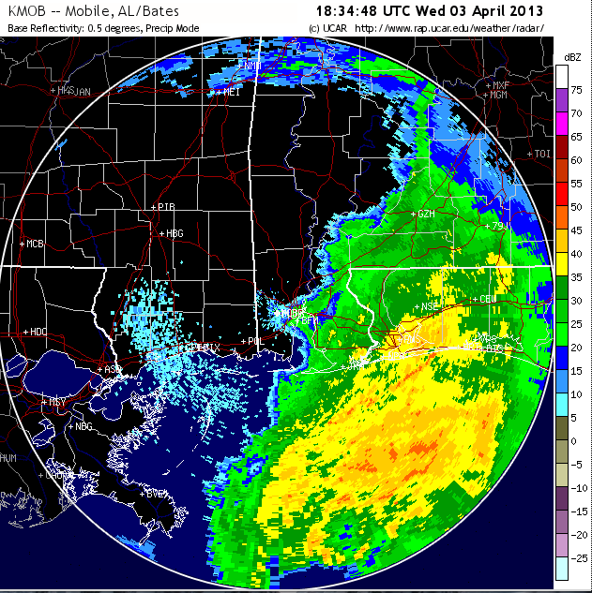
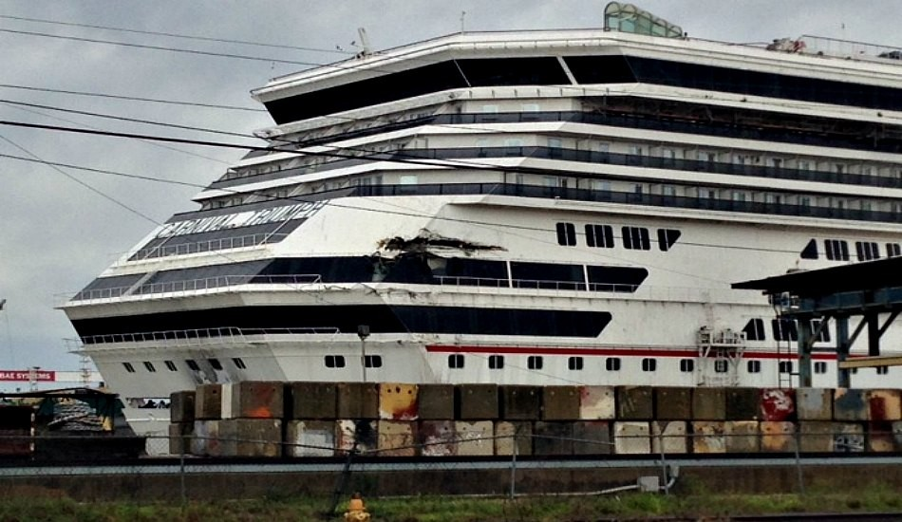
‘Wake low’ hits Mississippi, Alabama coasts; cruise ship breaks free (3 April 2013)
- Examiner.com
8 mb pressure fall, at end of rain
Carnival “Triumph”
Gusts to 71 mph at Bay St Louis

Slide 25
Wake low – 17 April 2013
KDBQ 171953Z 15024G30KT 8SM OVC004 05/05 A2995 RMK AO2 PK WND 08032/1913 LTG DSNT SW RAE15 PRESRR SLP149 P0002 T00500050
KDBQ 171907Z 07021G27KT 5SM -RA BR OVC004 04/04 A2994 RMK AO2 PK WND 06027/1906 LTG DSNT SE PRESFR P0002
KDBQ 171853Z 05011KT 5SM -RA BR OVC006 04/04 A3004 RMK AO2 LTG DSNT E-S TSE00B12E27 PRESFR SLP178 P0014 T00390039
★
DBQ

Slide 26
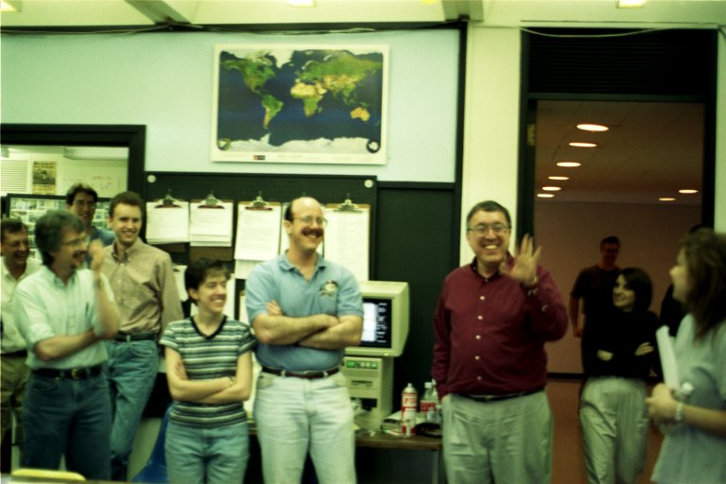
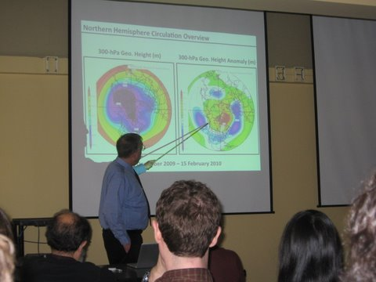
Probably no one (alive) has initiated and completed more studies of meteorological phenomena simply based on routinely observing the weather…

