Slide 1
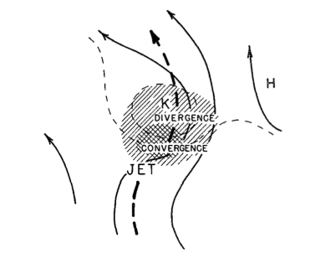
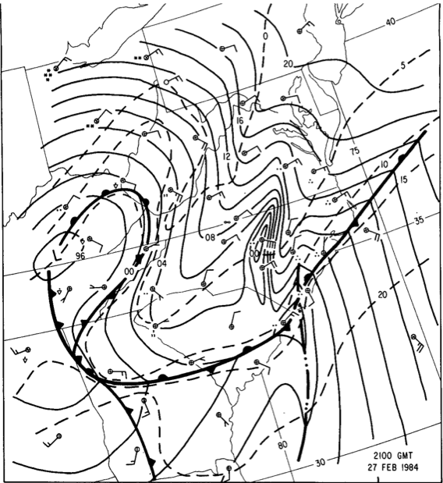
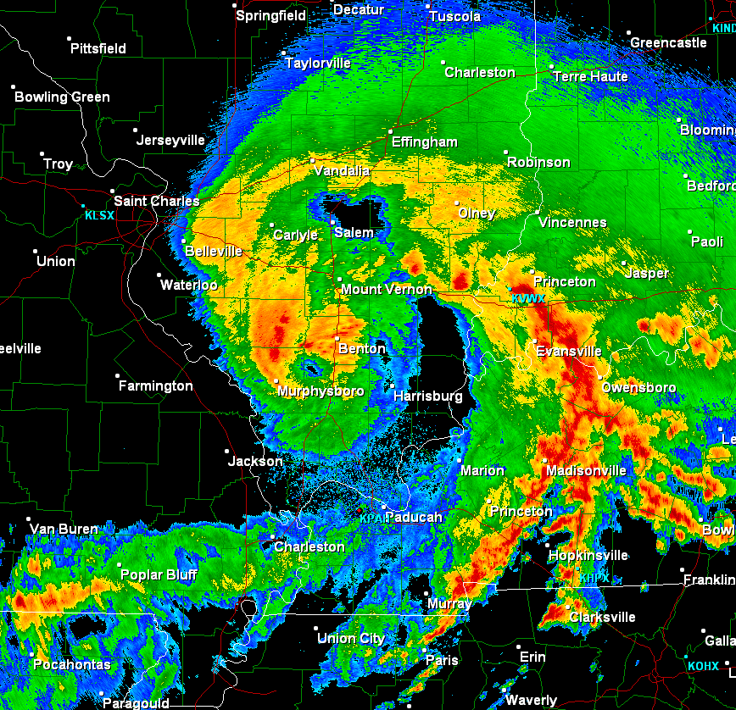
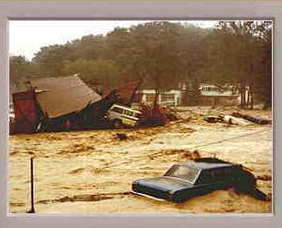
Warm Season Mesoscale Convective Processes: A Tribute to Lance Bosart
Richard H. Johnson
Colorado State University
Bosart and Sanders (1981)
JOHNSTOWN FLOOD
Bosart and Seimon (1988)
Weisman, Evans, Bosart (2013)
Lance Bosart Symposium, AMS Annual Meeting, Seattle, 25-26 January 2017

Slide 2
Lance’s Endless Pursuit of Mesoscale Convective Processes
Mesoscale aspects of tropical cyclones
Extreme rainfall events
Diurnal cycle of rainfall
Mesoscale convective systems
Derechos
MCVs
Dryline convection
Tornadic thunderstorms
Monsoon (SW U.S.) precipitation systems
High-amplitude internal gravity waves, coupling with convection

Slide 3
Lance’s Endless Pursuit of Mesoscale Convective Processes
Mesoscale aspects of tropical cyclones
Extreme rainfall events
Diurnal cycle of rainfall
Mesoscale convective systems
Derechos
MCVs
Dryline convection
Tornadic thunderstorms
Monsoon (SW U.S.) precipitation systems
High-amplitude internal gravity waves, coupling with convection

Slide 4
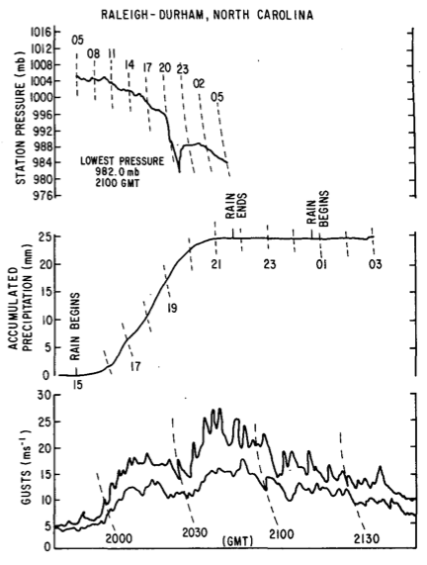
RALEIGH-DURHAM, NC
Bosart and Seimon (1988, MWR)
“A Case Study of an Unusually Intense Atmospheric Gravity Wave”
14 mb fall in 40 min
27-28 February 1984
Occurred as rain ceased
Easterly wind gusts > 25 m s⁻¹

Slide 5
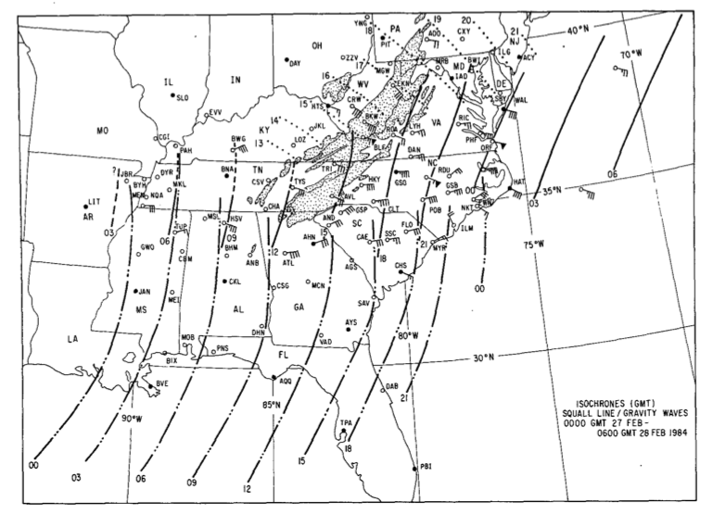
Gravity waves first detected in wake depression to rear of a squall line
Gravity wave isochrones
Strong easterly gusts
Squall line isochrones
Notes:
Stippling is terrain above 600 m

Slide 6
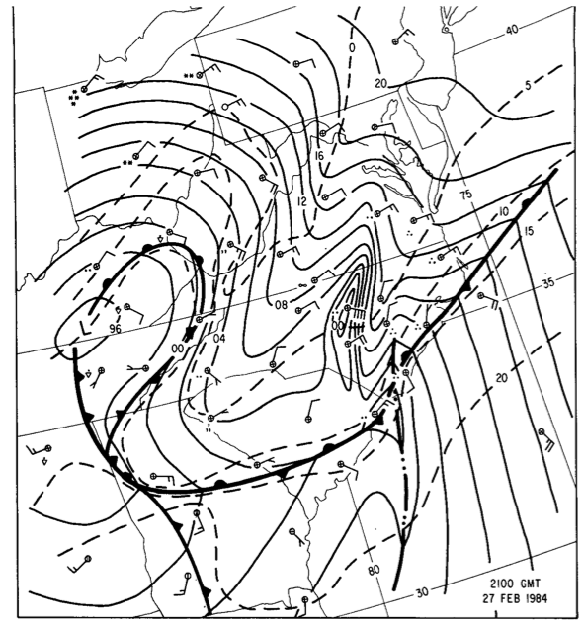
Surface pressure analysis
2100 UTC
27 February 1984
Strong cross-isobar easterly flow in wake low

Slide 7
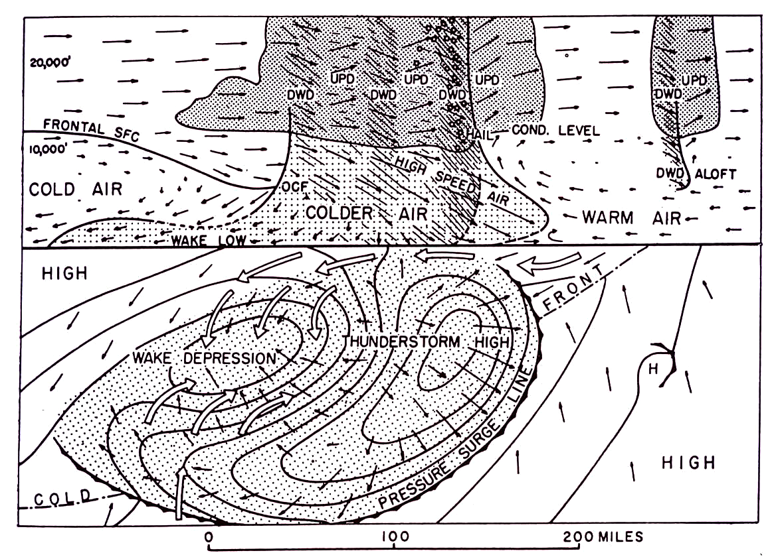
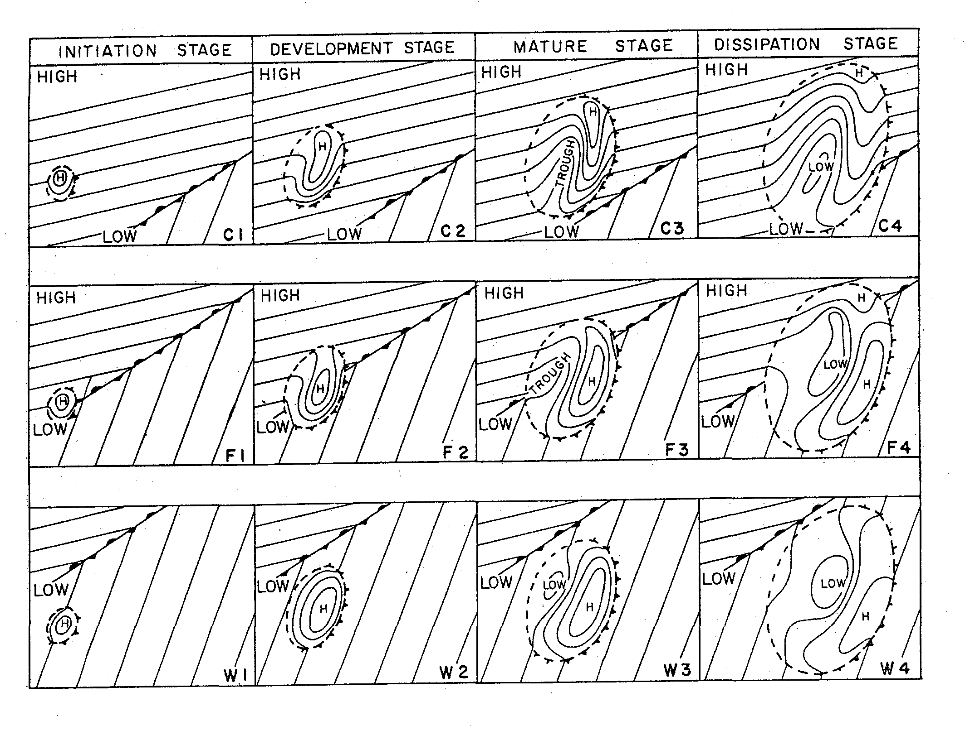
Fujita (1955)
Similar isobar pattern
Fujita (1963)
In cold air
Along front
In warm sector

Slide 8
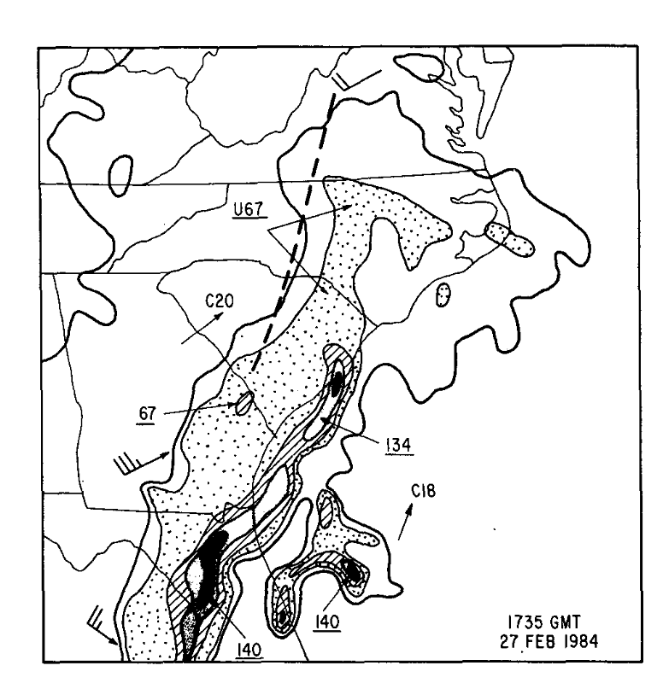
Gravity wave
Radar Reflectivity
1735 UTC

Slide 9
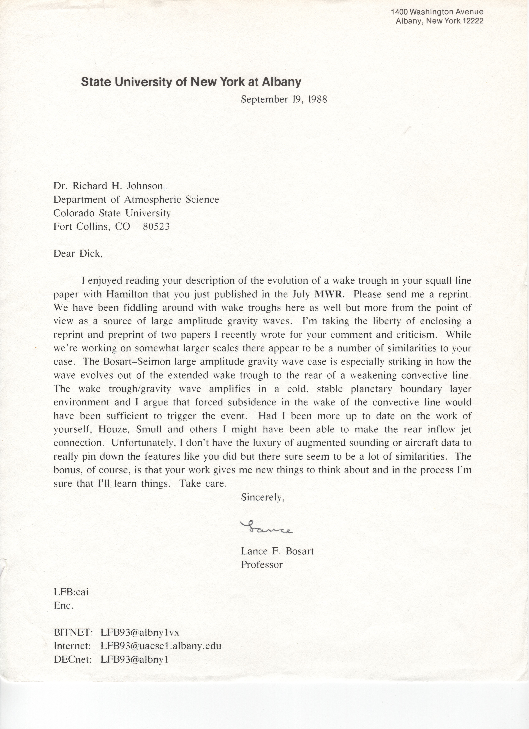

Slide 10
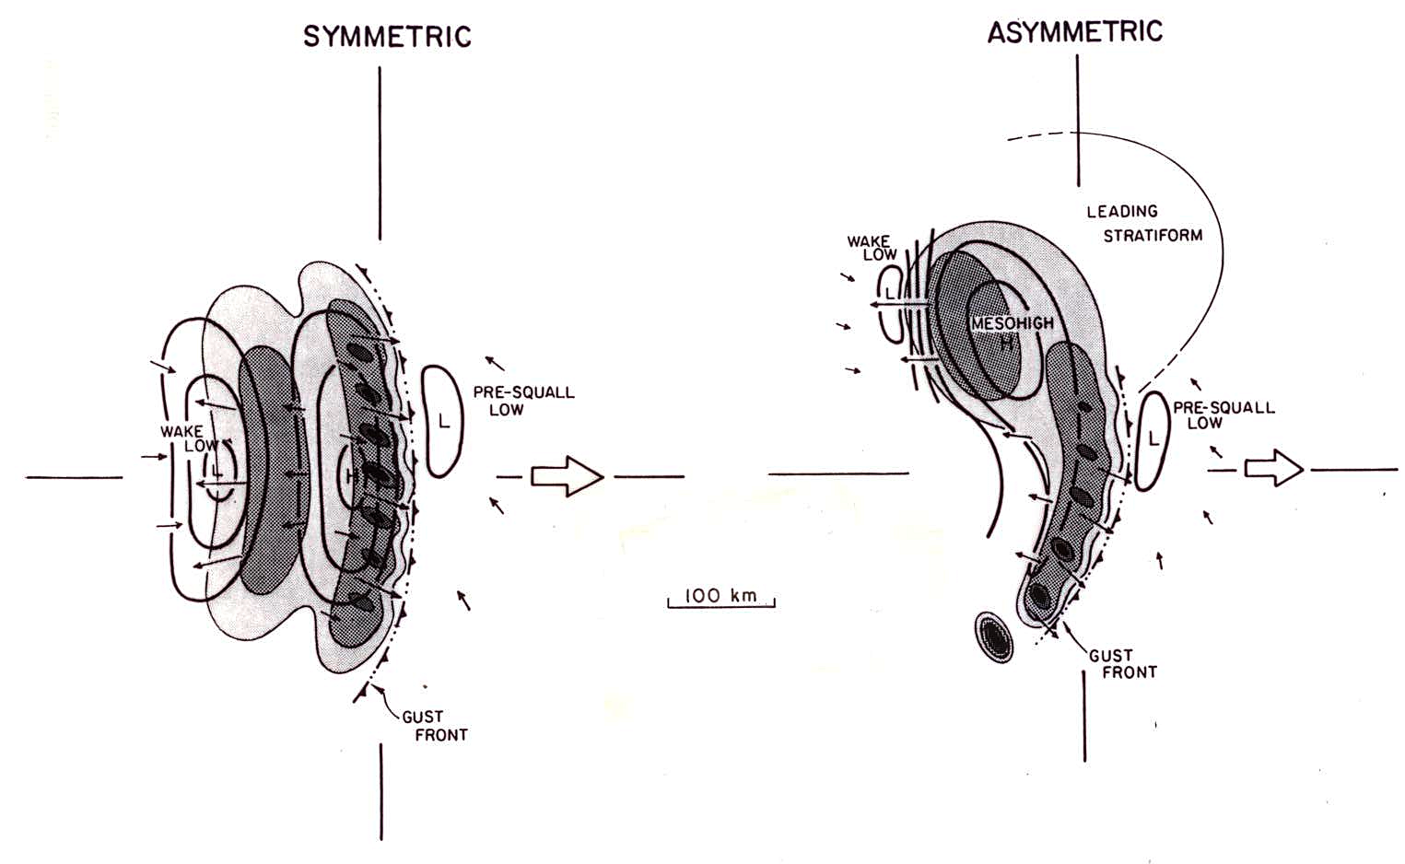
Wake low linked to stratiform region
Observed to follow northward shift of stratiform region as convective systems evolve from “symmetric” to “asymmetric”
(Loehrer and Johnson 1995;
based on 16 OK PRE-STORM MCSs)
[Symmetric/asymmetric structures adapted from Houze et al. 1990]

Slide 11
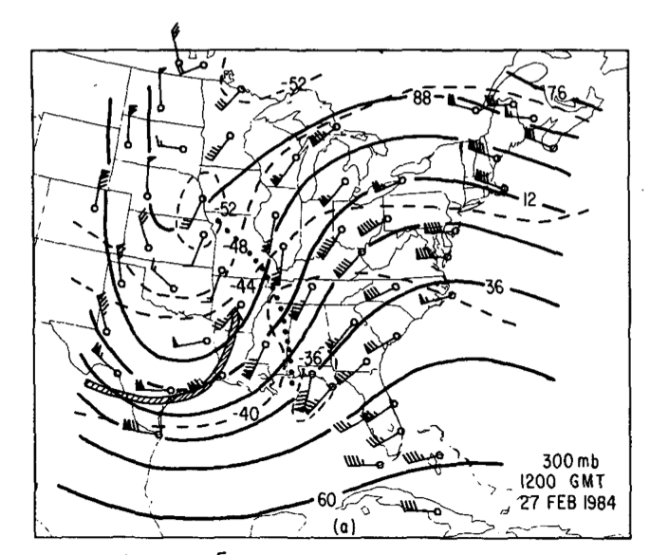
Summary of 27 February 1984 Event
Initiated by geostrophic adjustment in strong upper-level trough/ridge system (Uccelliini and Koch 1987)
Gravity wave organized and intensified within wake low to rear of squall line
Environment supported wave ducting

Slide 12
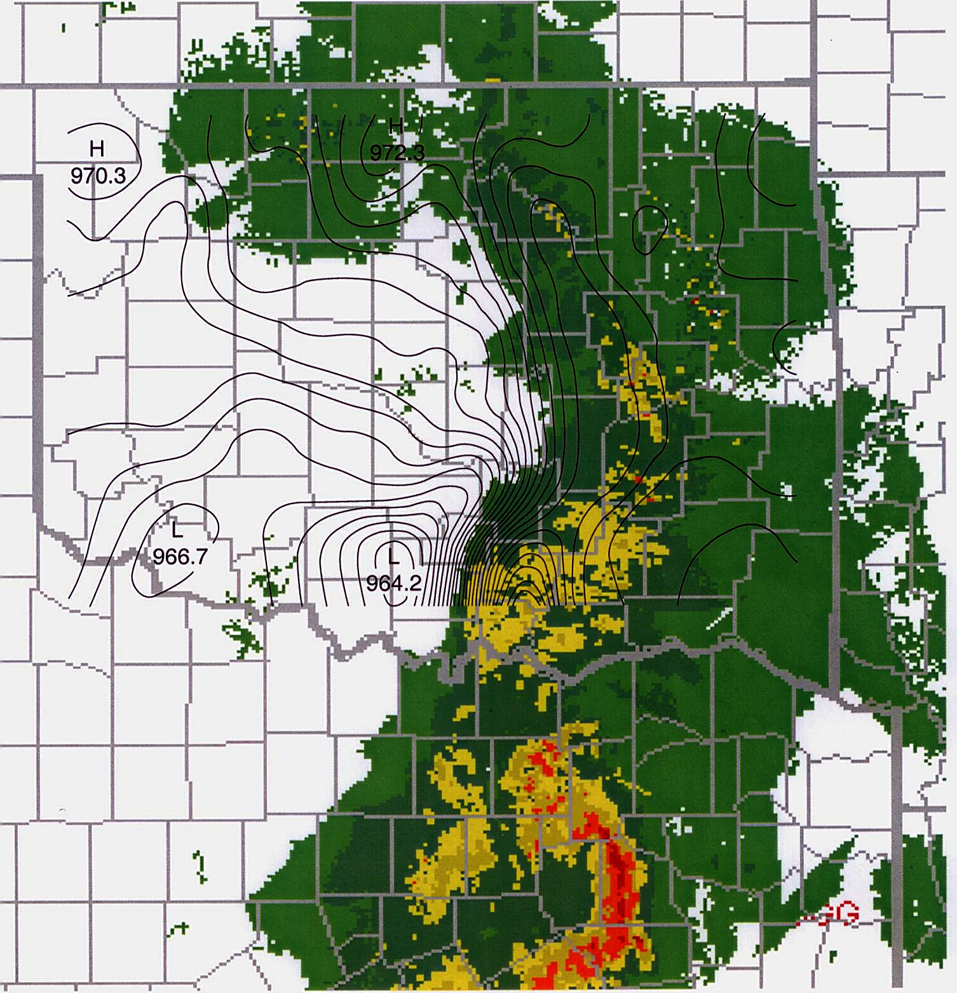
What about high-amplitude events?
Dallas-Fort Worth “Mayfest” Hailstorm/Bow Echo, Intense Wake Low
6 May 1995
WAKE LOW
H
~13 hPa
Texas’s worst hailstorm; 20 deaths; > $1B damage
00 UTC
6 May 1995
BOW ECHO
★
DALLAS
(Johnson 2001, BAMS)

Slide 13
250 hPa
Unbalanced flow, jet streak propagating toward ridge axis (Uccellini and Koch 1987)
Squall line

Slide 14
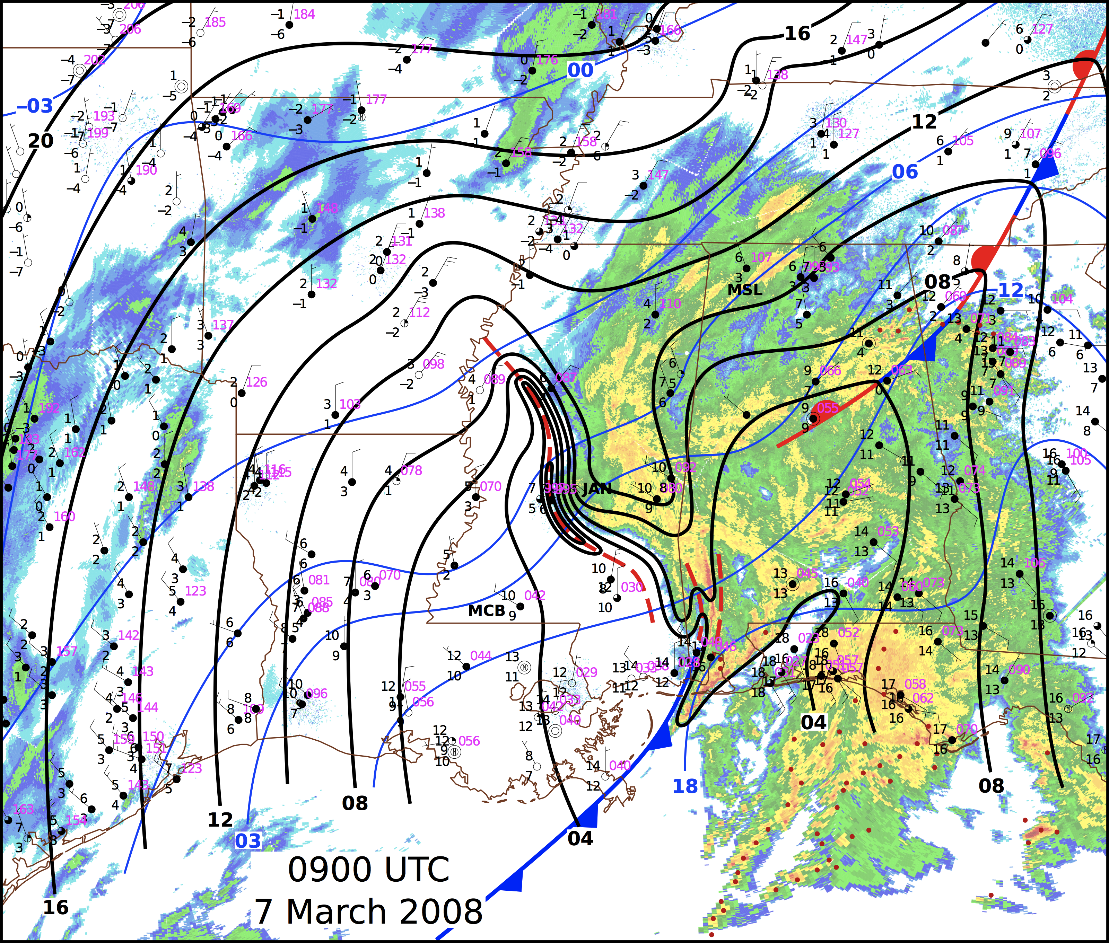
Ruppert and Bosart (2014)
Surface pressure falls > 10 hPa, including 6.7 hPa in 10 min!

Slide 15
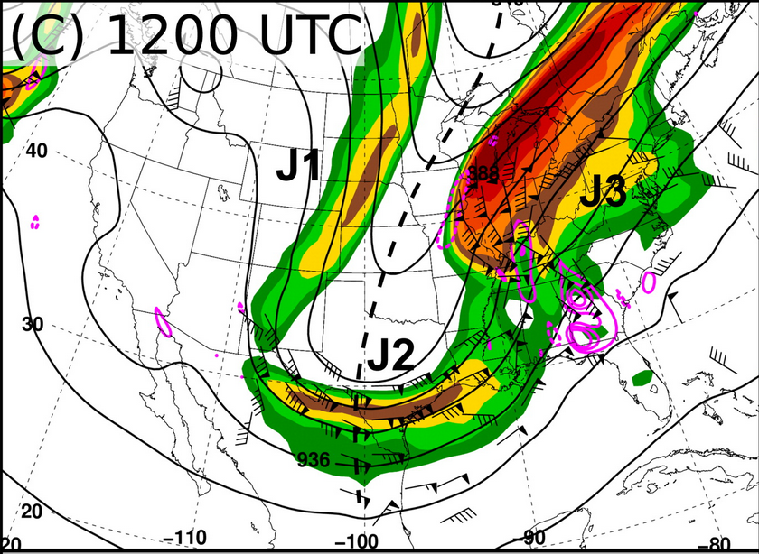
Ruppert and Bosart (2014)
300 hPa Ageostrophic Wind, Divergence
DIV

Slide 16
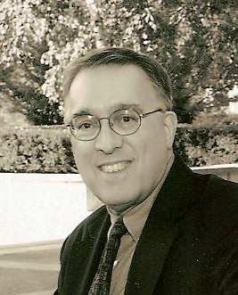
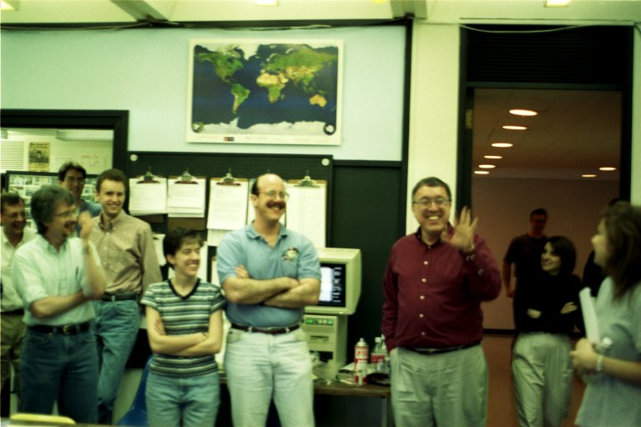
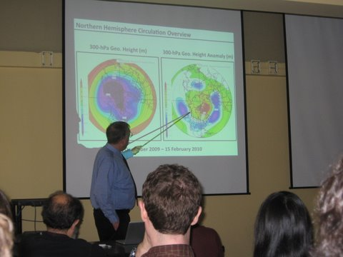
Probably no one in our field has initiated and completed more studies of meteorological phenomena simply based on routinely observing the weather

Slide 17
END

Slide 18
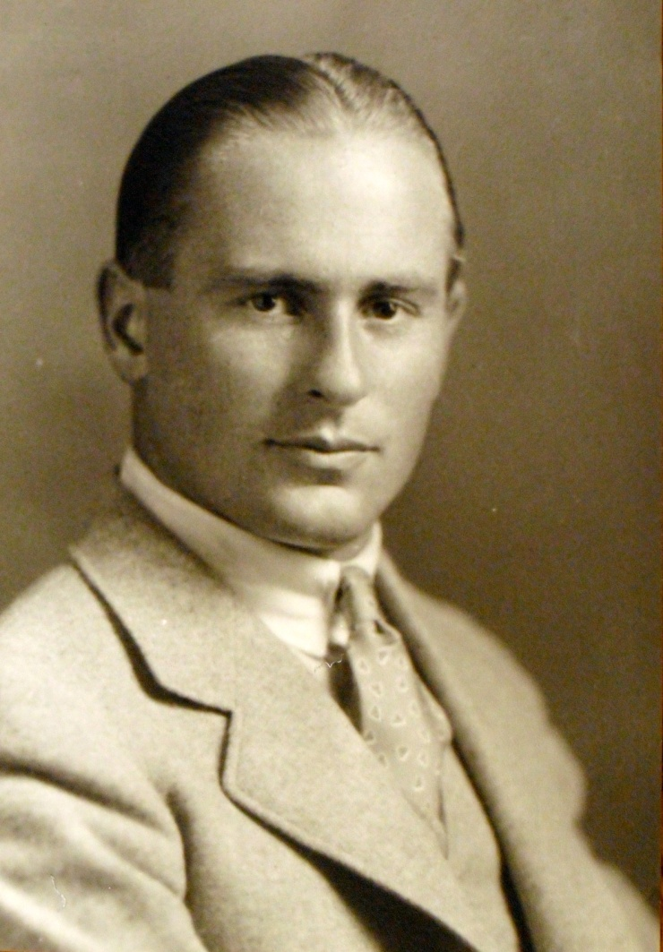
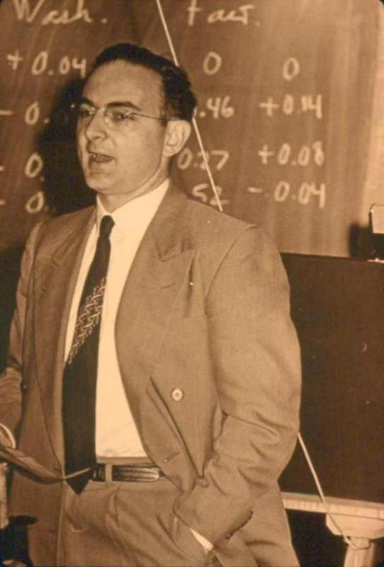
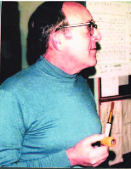
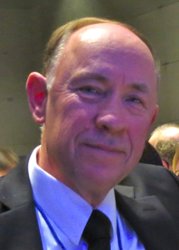
Abbreviated Family Trees
Willett (1929)
Reed, MIT (1949)
Sanders, MIT (1954)
Johnson, UW (1975)
Bosart, MIT (1969)
“Though synoptic meteorology was always my primary interest, I wrote my ScD thesis under Willett on the seemingly exotic subject " The Effect of Atmospheric Motions on Ozone Distribution and Variations," motivated largely by what I understood as an unwritten rule that mainline synoptic meteorology was not a suitable area for an MIT doctoral dissertation. The rule, if ever such existed, was broken a few years later by my early collaborator Fred Sanders.”
-- R. Reed, 2001

Slide 19
Reed and Sanders
Reed, MIT (1949)
Sanders, MIT (1954)
“Fred and I were kindred spirits who fed each other's discontent with what we regarded as the nearly blind acceptance by many meteorologists of the model of cyclone development advocated by the Norwegian School.”
-- R. Reed, 2001

Slide 20
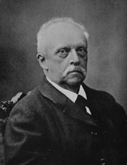
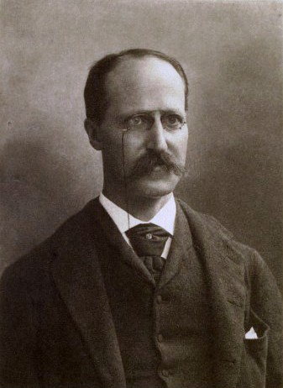
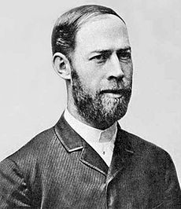
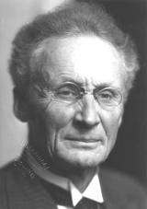
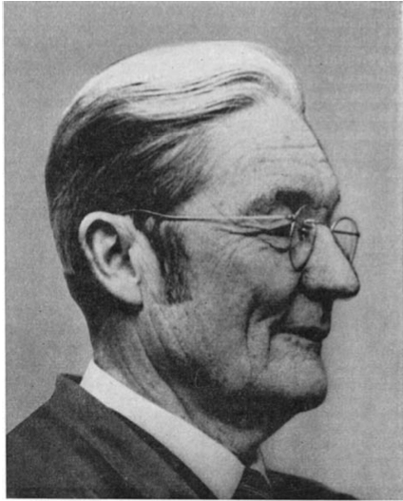
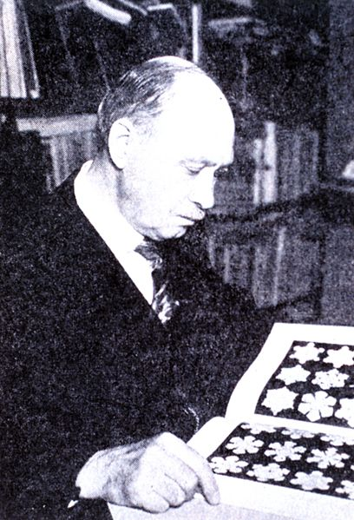
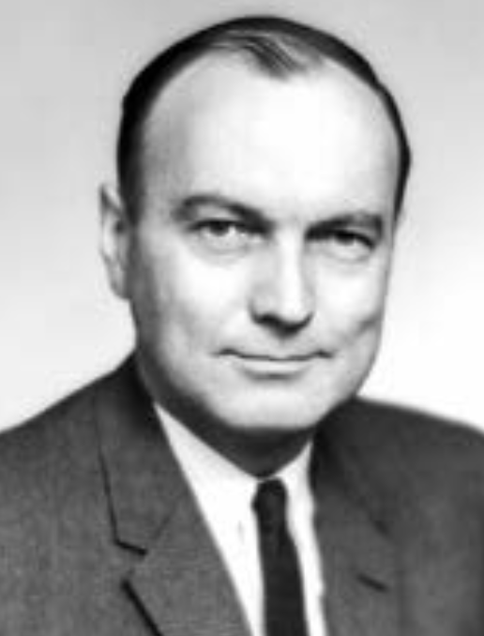
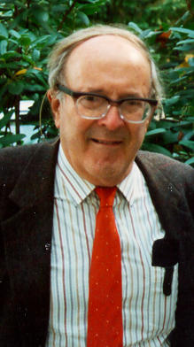
Von Helmholtz (1843)
Rowland (1870)
Hertz (1880)
Bjerknes (1892)
Bergeron (1916)
Humphreys (1897)
Willett (1929)
Pettersen (1933)
Family trees courtesy Bob Hart, FSU
Malone (1946)
Johnson (1975)
Reed (1949)
Sanders (1954)
Bosart (1969)

Slide 21
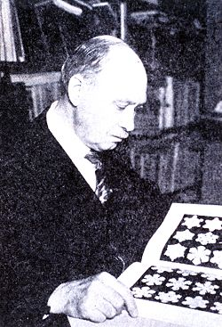
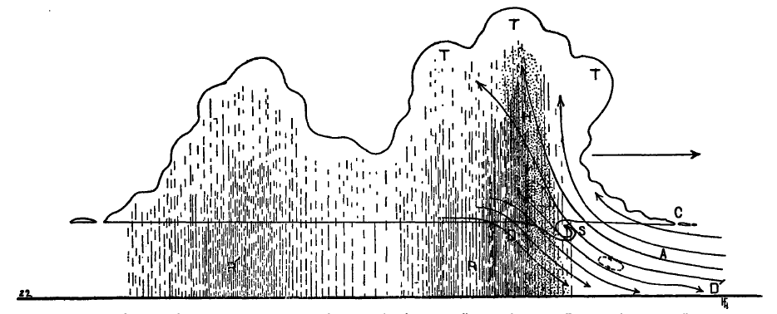
Early Observations of Squall Lines
Humphreys, W.J., 1914: The thunderstorm and its phenomena. Mon. Wea. Rev., 42, 348-380.
30 July 1913 Wash. DC “thunderstorm”; gusts to 70 mph; 2’’ rain; 6-mb pressure jump
William J. Humphreys 1862-1949
R’
R
~ 60 – 70 km
“…initial convection at R…secondary rain at R’. …the secondary rain is a thing of frequent occurrences” – foreshadowing later squall-line research (e.g., Fujita, Pedgley, Newton, Zipser, Houze)

Slide 22
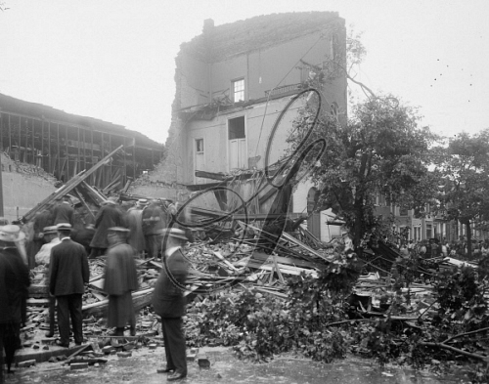
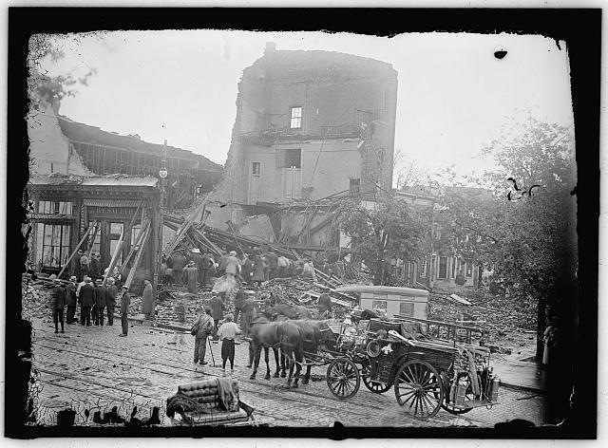
WASHINGTON D.C., 1913. Storm damage at 7th Street and L Street NW in Washington D.C.
Photograph, 30 July 1913

