Slide 1


New Insights on the MJO from DYNAMO*
Richard H. Johnson
Colorado State University
Contributors:
Students: Erin Dagg, Caitlin Fine, James Ruppert, Hungjui Yu
Research Staff: Paul Ciesielski, Rick Taft
Others: Steve Rutledge, Weixin Xu, Thomas Birner, Zhe Feng (PNNL)
Owen Shieh
*Dynamics of the MJO
Department of Atmospheric Science Colloquium, 15 November 2013

Slide 2
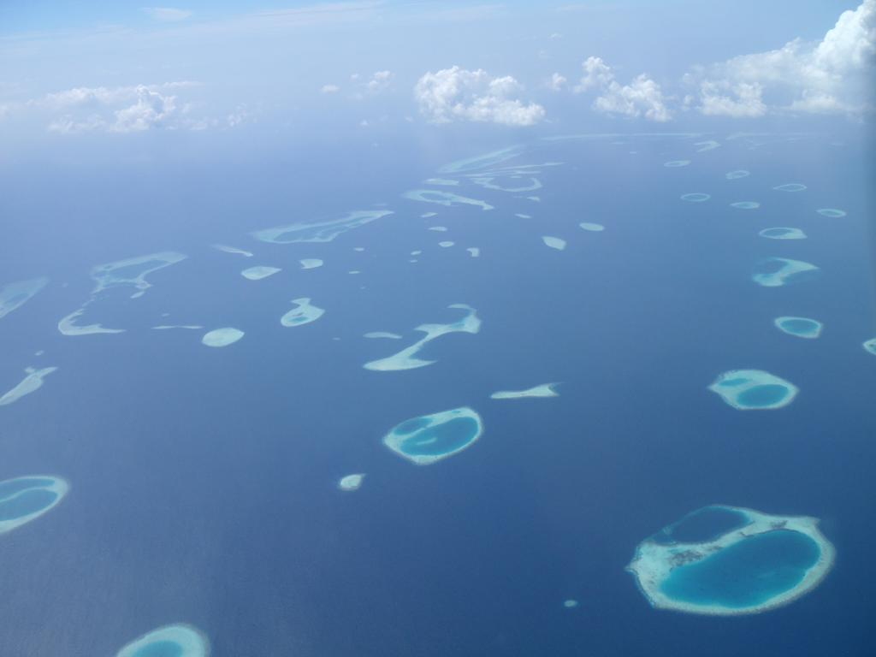
CSU Participants in 2011 DYNAMO Field Campaign
Students Research Staff Faculty
Gus Alaka | Bob Bowie | Dick Johnson
Adam Davis | Paul Ciesielski | Eric Maloney
Alex Gonzalez | Brenda Dolan | Steve Rutledge
Nick Guy | Tim Lang
Walter Hannah | Angela Rowe
Adele Igel
Matt Igel
Todd Jones
Rachel McCrary
Tiffany Meyer
Matt Paulus
Gavin Roy
James Ruppert
Adam Rydbeck
Stephanie Slade
Elizabeth Thompson

Slide 3
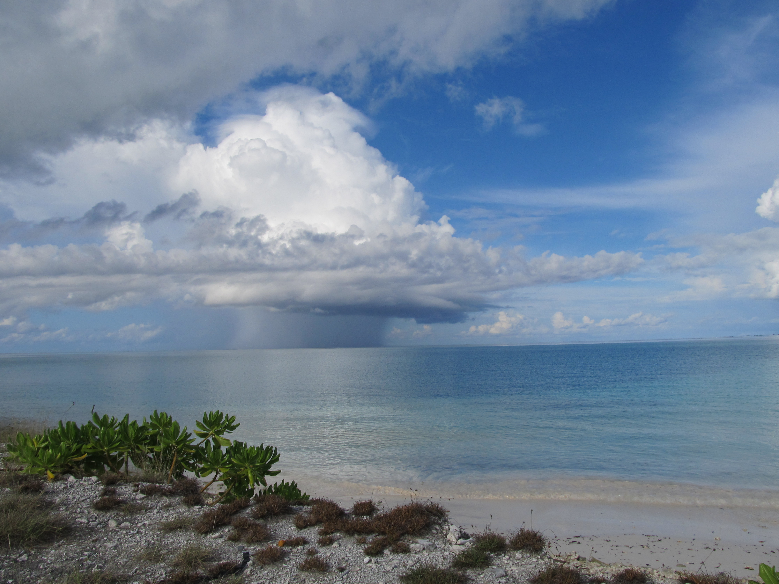
Outline of talk
What is the MJO and what are its global impacts?
Overview of October/November 2011 MJOs
Preliminary analyses of moistening processes during MJO initiation phase; role of diurnal cycle
Impacts of Sumatra on MJO convection, tropical cyclone genesis
Summary and Conclusions
Kaustav Chakravarty

Slide 4
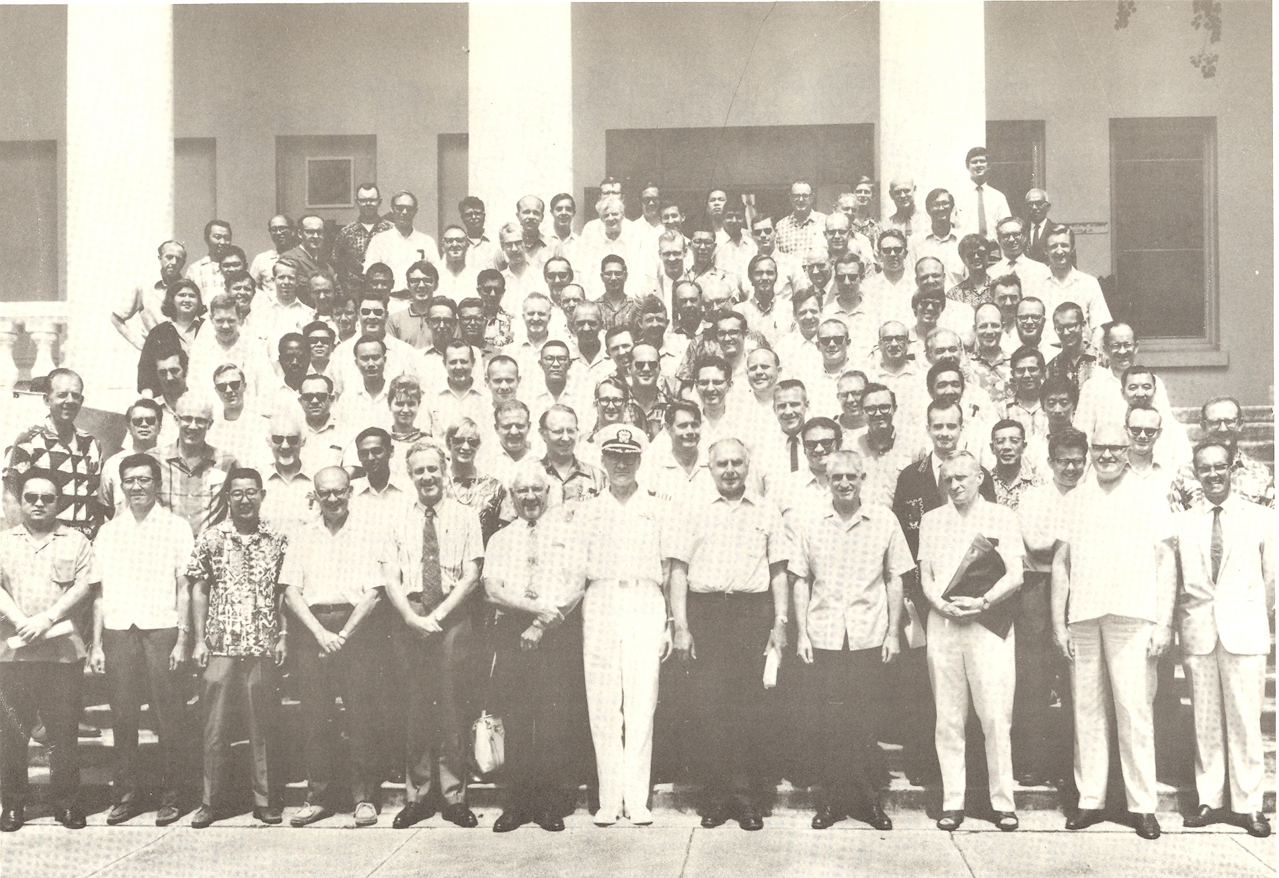
AMS/WMO Symposium on Tropical Meteorology, 1-6 June 1970, Honolulu
van Loon
Spengler
Dunn
Julian
Reed
Gray
Madden
La Seur
Zipser
Jim Sadler
Ruprecht
Holton
Hastenrath
J. Simpson
N. Frank
R. Simpson
Takio Murakami
Jenne
Krish
W. Sam Houston
V. Oliver
Colin Ramage
E. Bollay
P. Kutschenreuter

Slide 5
“Hot Topics” at 1970 Tropical Conference
Planning for “GATE” in Pacific (switched to Atlantic in 1970; Japan pulled out)
“Easterly wave” studies (Reed, Holton)
Results from Line Islands Experiment (1967), including analysis by Madden of 4-5 day tropical variations using Line Islands rawinsonde data
**
**A question raised by Gary Atkinson led to the analysis of a much longer record by Madden using Canton Is. data, and the eventual discovery of the MJO.
Notes:
At meeting in Brussels in 1970 it was decided that due to the availability of resources (ships, satellite), the preferred location for “GATE” – the western Pacific – had to be given up, with the third choice (the eastern Pacific was 2nd), the eastern Atlantic being selected.

Slide 6
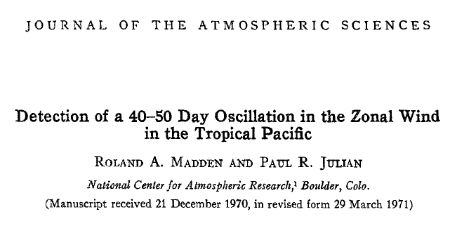
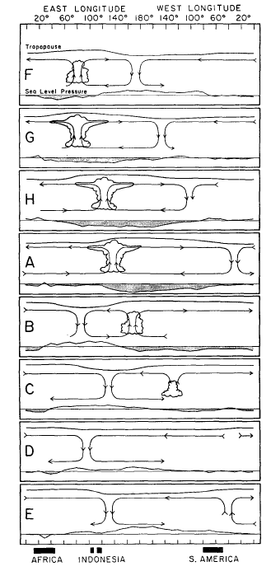
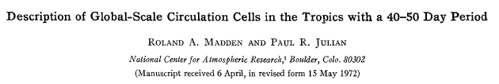
(Madden and Julian 1972)
“Madden-Julian Oscillation: MJO”
Published September 1972
Webster, P.J., 1987: The variable and interactive monsoon. Monsoons, J.S. Fein and P.L. Stephens, Eds. (“Madden-Julian 40-50 day wave”)
R. Swinbank, T.N. Palmer and M.K. Davey. 1988: Numerical Simulations of the Madden and Julian Oscillation. Journal of the Atmospheric Sciences: Vol. 45, No. 5, pp. 774–788.
(“MJ Oscillation”)
Ngar-Cheung Lau, Isaac M. Held and J. David Neelin. 1988: The Madden-Julian Oscillation in an Idealized General Circulation Model. Journal of the Atmospheric Sciences: Vol. 45, No. 24, pp. 3810–3832.
(“Madden-Julian Oscillation”)

Slide 7

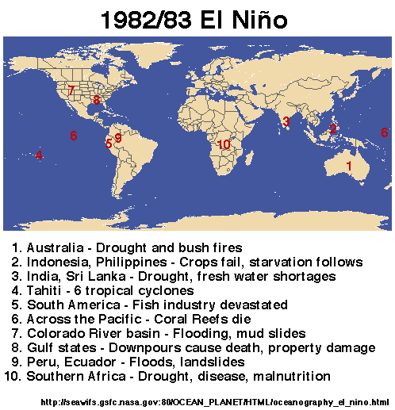
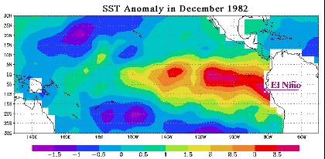
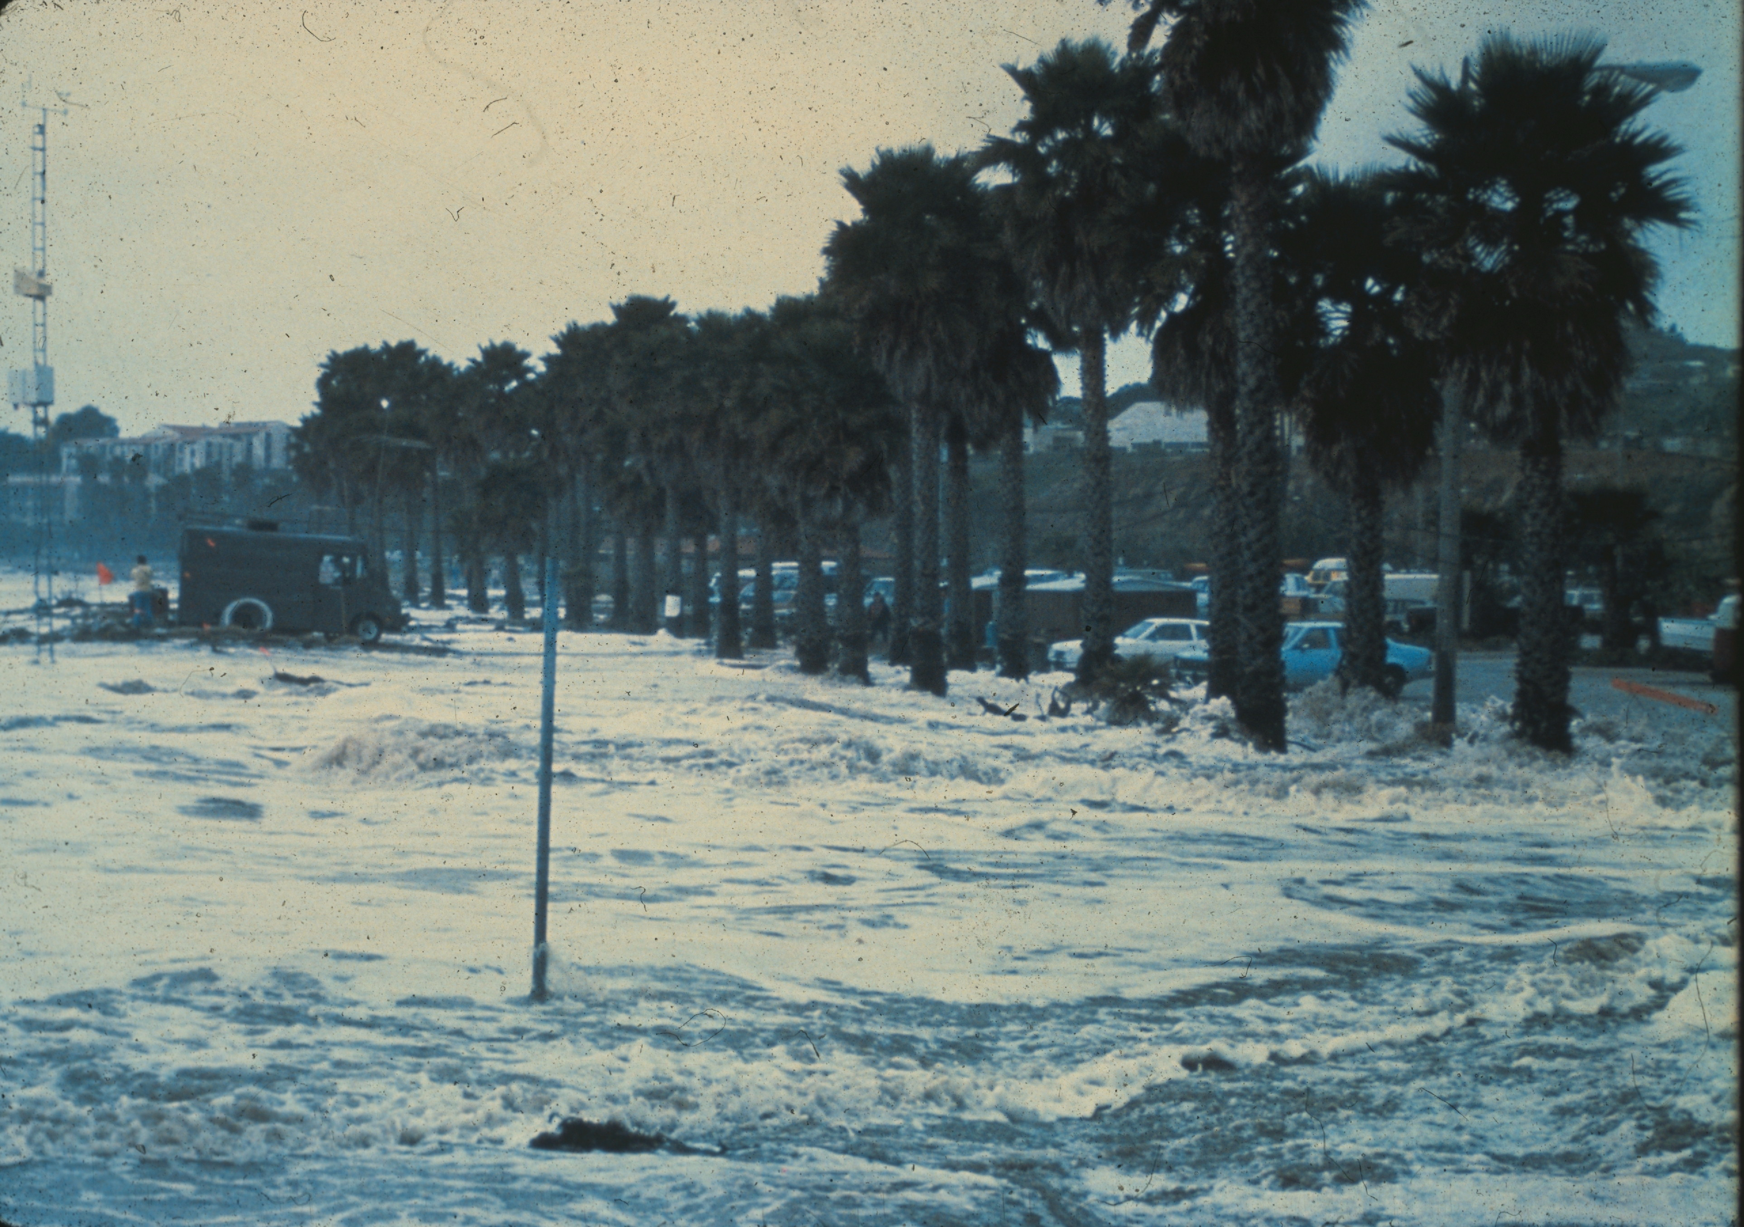
1982-83 El Niño
Cost: 2000 lives lost, ~$13B worldwide
Santa Barbara, CA

Slide 8
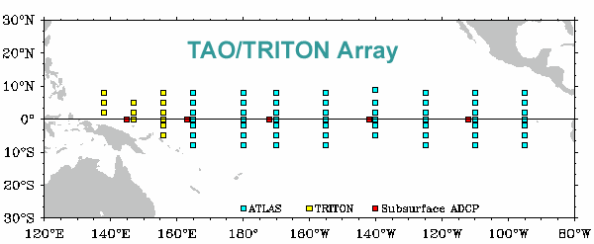
1982-83 El Niño motivated the establishment of TOGA TAO Array, starting in 1984
Shortly thereafter, the TOGA (1985-1994) pro-gram began → observations, predictability, and prediction of tropical ocean-atmosphere coupled system → prominent intraseasonal variability (westerly wind bursts, MJO events) observed

Slide 9
Madden and Julian (1971): 1587 citations
Madden and Julian (1972): 1344 citations

Slide 10
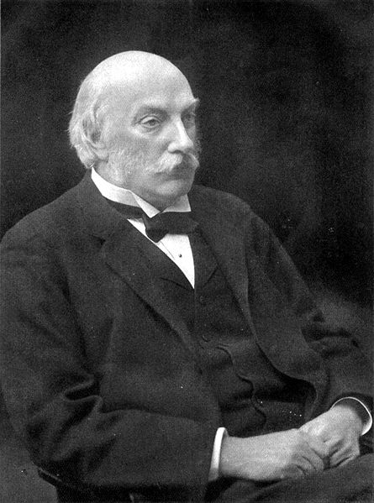
“Scientists must often experience a feeling not far removed from alarm, when we contemplate the flood of new knowledge which each year brings with it. ….new journals continually appear. Every year the additions to the common stock of knowledge become more bulky, and one is compelled to ask, Where is this to end?”
– Lord Rayleigh (1874)

Slide 11
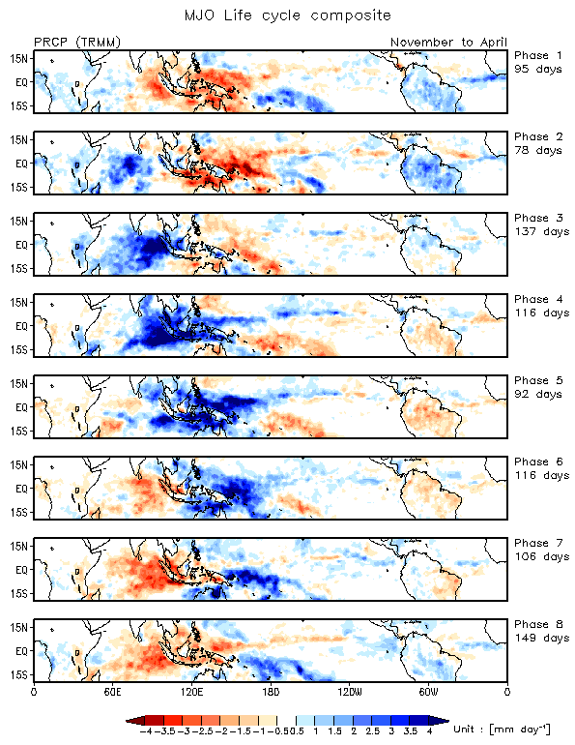
Precipitation
(courtesy Chidong Zhang)
Madden and
Julian (1972)

Slide 12
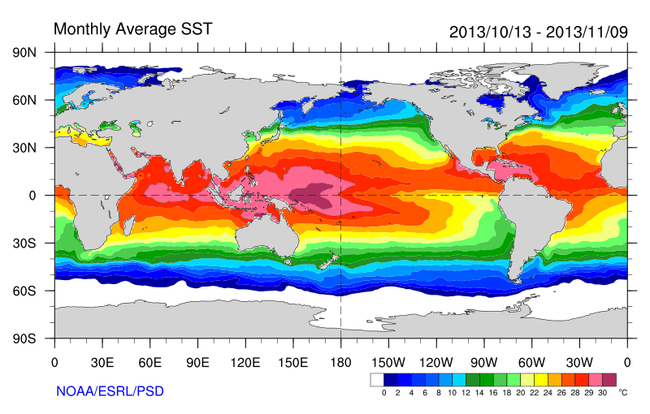

Slide 13
Tropical cyclones
Tornados
Extreme rainfall
Flood
Fires
Cold surges
Heat waves
Storm track
Westerly wind burst
Equatorial waves
Monsoons
drought
ITCZ
ENSO, NAO, AO, AAO
Indian Ocean Dipole
Indonesian Throughflow
Wyrtki Jet
Seychelle-Chagos Thermocline Ridge (SCTR)
Antarctic circumpolar circulation
Weather
MJO
Climate
(courtesy Chidong Zhang, 2013)
Ozone, CO, Aerosol, Ocean chlorophyll
Earth’s angular momentum, Length of the day
Electromagnetic field (Schumann resonance)

Slide 14
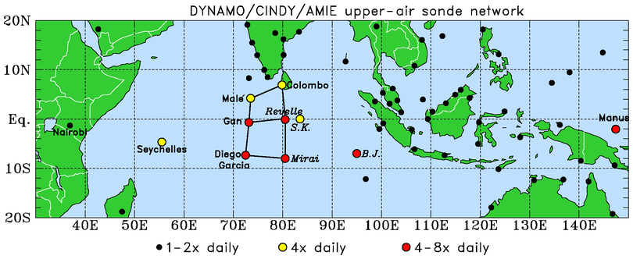

DYNAMO (Dynamics of the MJO); October 2011 – March 2012
.
N Array
S Array
Northern Array: October-early December, 4 & 8/day soundings
Southern Array: October-November, 8/day soundings
Gridded analysis 1 deg, 4/day, mix of high-res and GTS-res data, no model data
Moistening processes during the initiation stage of the MJO
Role of convective cloud populations in MJO initiation
Role of air-sea interaction in the Indian Ocean in MJO initiation

Slide 15
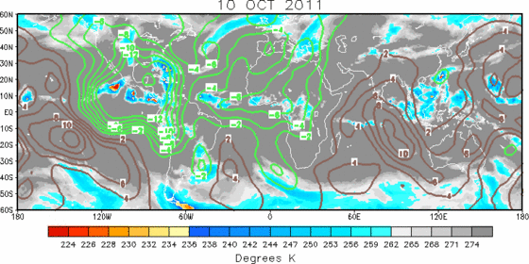
200 hPa Velocity Potential and IR Brightness Temperature

Slide 16
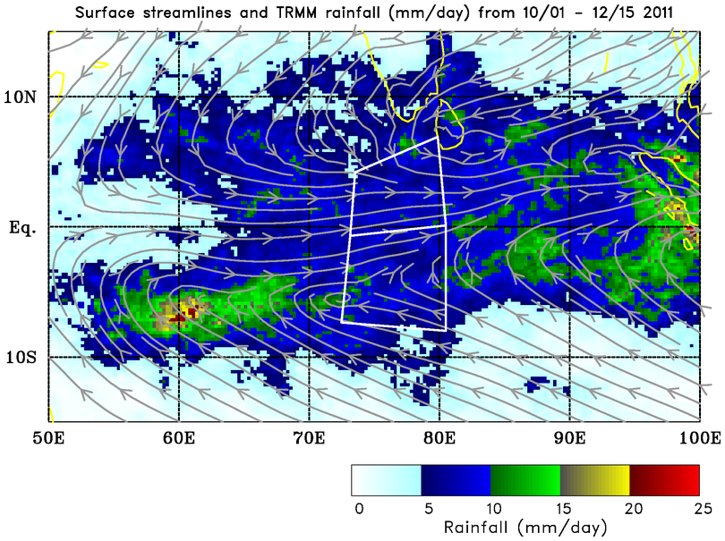
Double-ITCZ pattern; similar average rain rates over both arrays…
Mean: 7.8 mm day⁻¹
…but evolution of rainfall differs between the two…
Mean: 8.0 mm day⁻¹

Slide 17
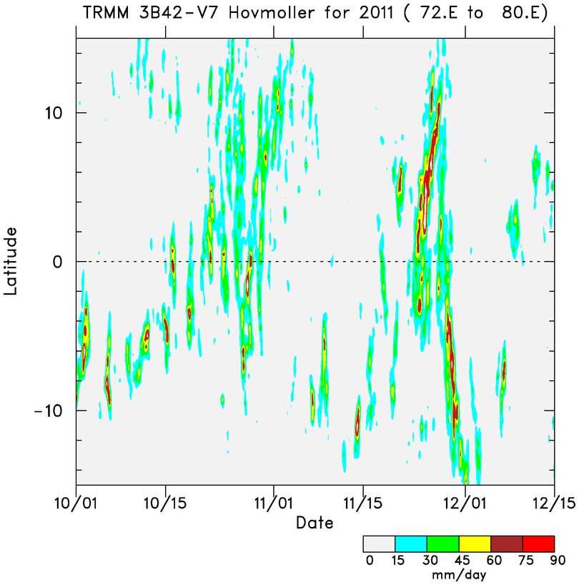
N
More prominent MJO signal
N ARRAY
MJO 1
MJO 2
S ARRAY
More persistent convection in southern array
“ITCZ” convection shifts to equator during MJO active phase
S
Time

Slide 18
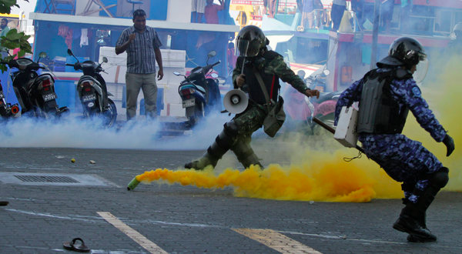
October/November MJO activity over Northern Array associated with seasonal cycle of precipitation
MJO 1
MJO 2
Maldives political crisis
MJO 3

Slide 19
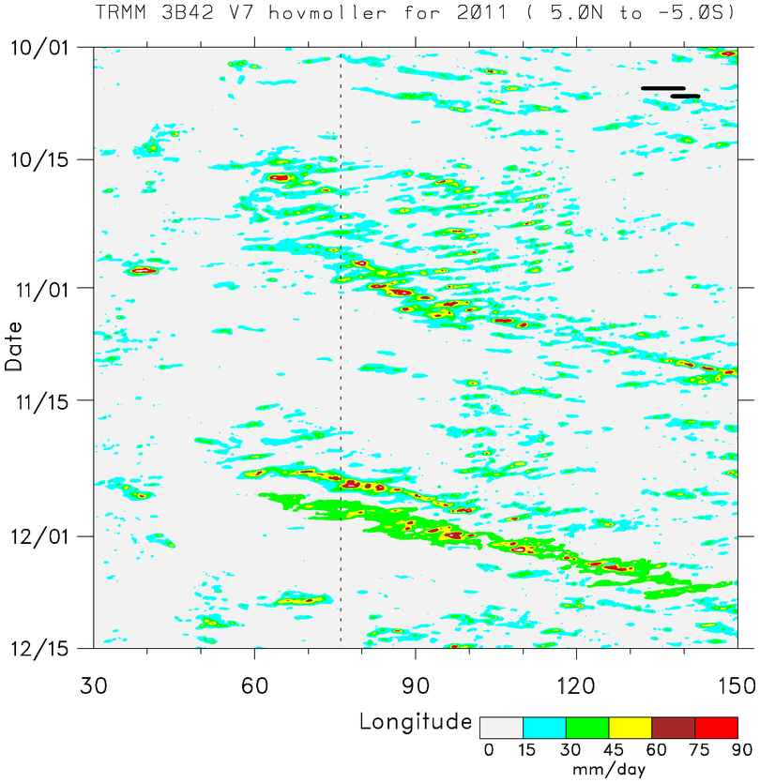
■ Two prominent MJO events: October and November
MJO 1
■ MJO envelopes consists of westward- and eastward-moving disturbances
Time
EAST AFRICA
MJO 2
DYNAMO ARRAY
SUMATRA
■ MJO2: two strong Kelvin waves, shorter precipitation duration
BORNEO

Slide 20
Northern Sounding Array
(NSA)
u
MJO1 preceded by low-level westerlies descent of easterlies; MJO2 by low-level easterlies; WWBs then follow
Low-to mid-level moisture build-up several weeks prior to active phases
Prominent UT/LS Kelvin/gravity wave signals
2-day disturbances with MJO1, 4-5 day period with MJO2
RH
T’
PRECIPITATION
MJO2
MJO1
(Johnson and Ciesielski 2013)

Slide 21
Northern Sounding Array
MJO2
Ascending patterns of low-level convergence/ upper-level divergence
Shallow-to-deep-to-stratiform evolution of precipitation inferred from vertical motion for both MJOs
Longer period of upward motion associated with MJO1 than MJO2
MJO1
DIV
CONV
(Johnson and Ciesielski 2013)

Slide 22
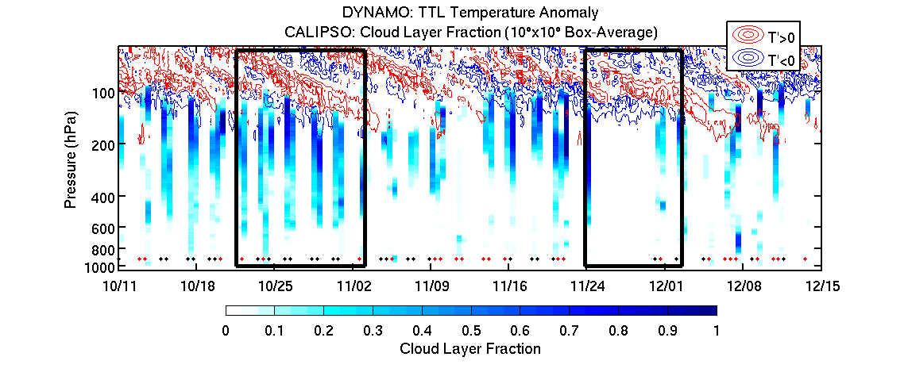
Erin Dagg

Slide 23
“Stepwise” Evolution of Clouds/Moisture During MJO Build-up Phase
W
E
1992-93 TOGA COARE: Kikuchi and Takayabu (2004)
2006 MISMO: Katsumata et al. (2009)
CALIPSO/CloudSat data: Virts and Wallace (2010); Del Genio et al. (2012)

Slide 24
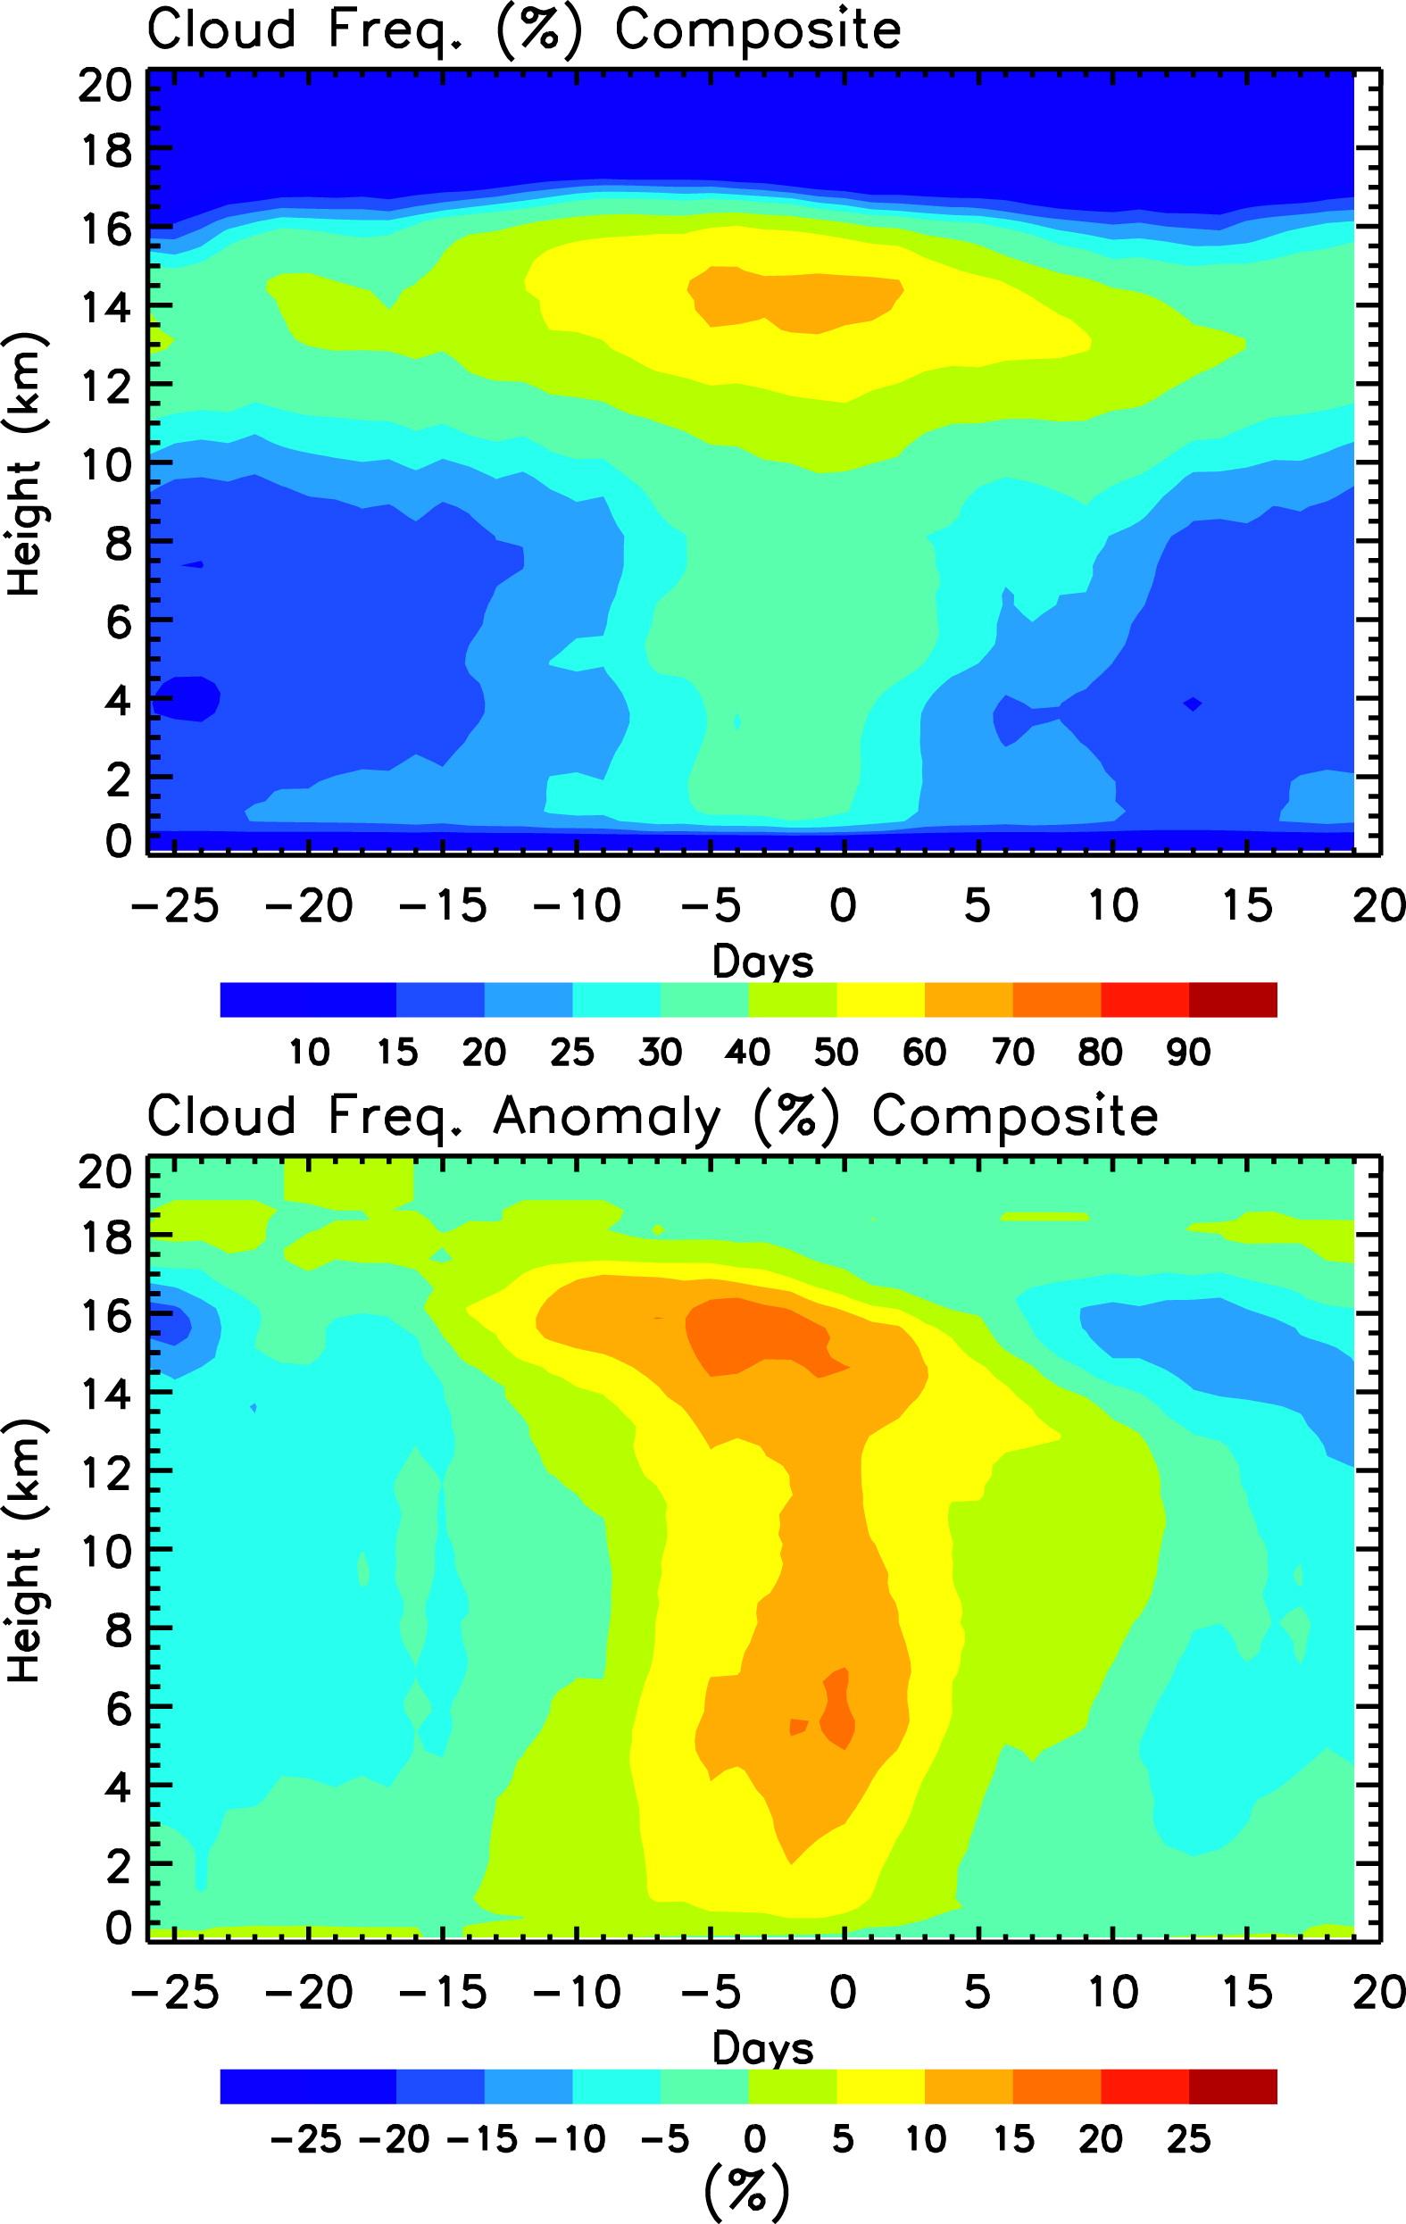
Del Genio et al.(2012)
CloudSat/CALIPSO ten MJO composite: found shallow-to-congestus-deep transition
Congestus

Slide 25
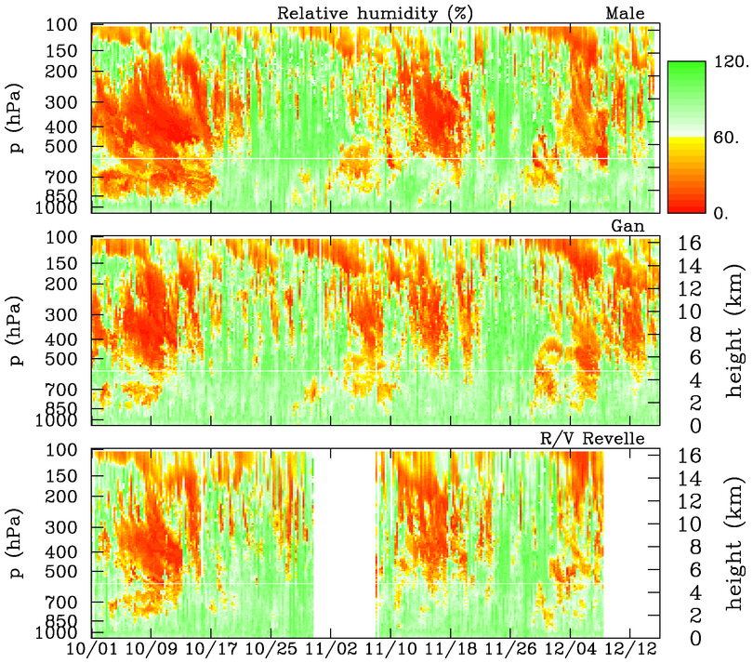
‘
Malé
deep
deep
DRY
0°C
mid
mid
mid
shallow
shallow
shallow
Gan
DRY
deep
deep
mid
mid
mid
shallow
shallow
shallow
Revelle
DRY
deep
deep
mid
mid
shallow
shallow

Slide 26
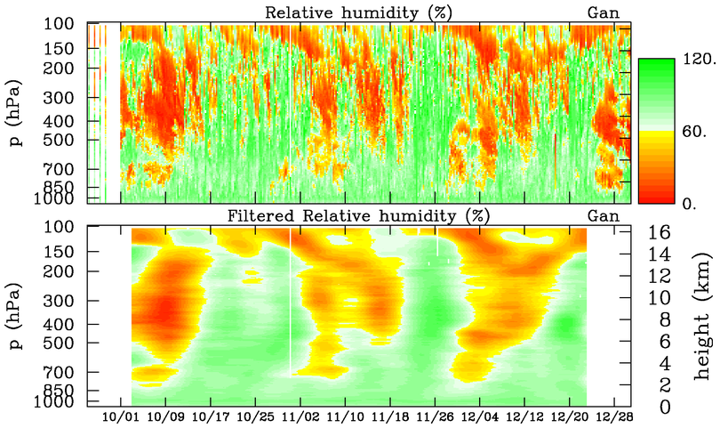
Unfiltered RH vs. 10-day Low-Pass Filtered RH
DRY
DRY
DRY
MOIST

Slide 27
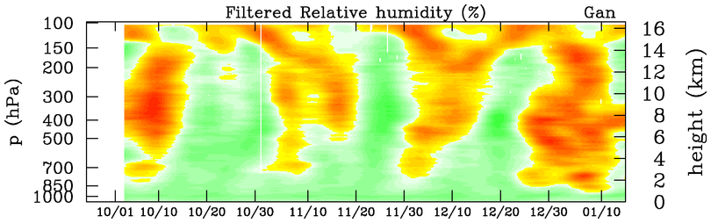
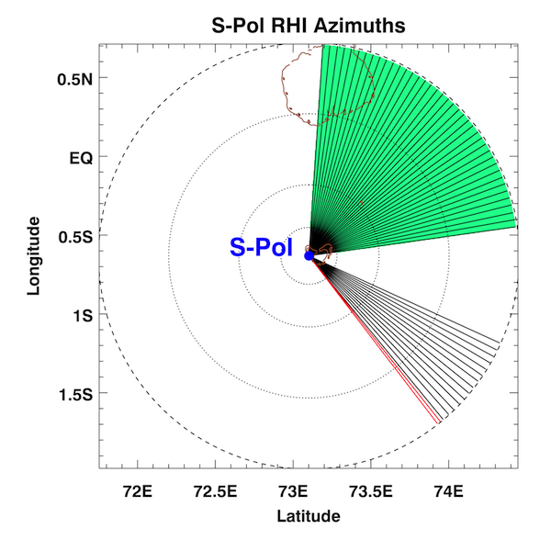
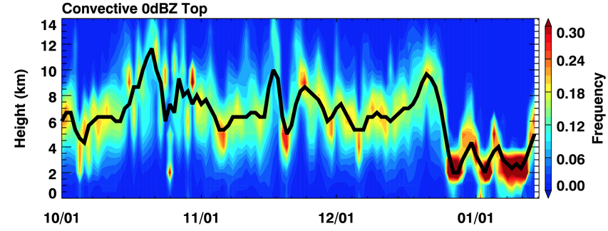
DRY
DRY
MOIST
S-PolKa RHI
Deep
Deep
Deep
Cg
Cg
Cg
Cu
Cu
0°C
Cu
Figure courtesy Zhe Feng (PNNL)

Slide 28
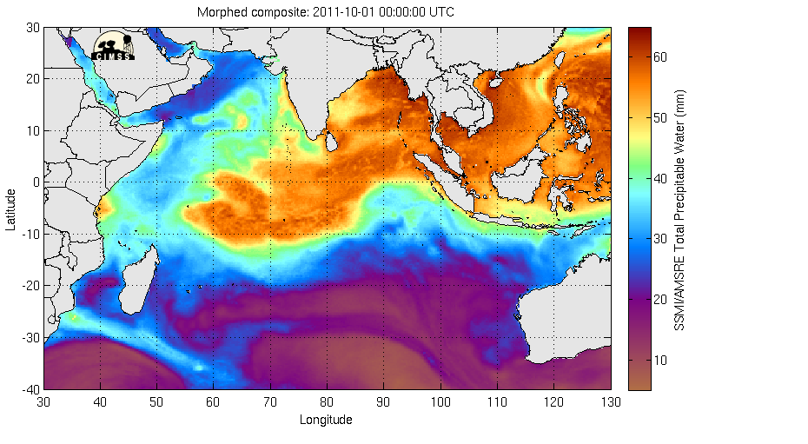
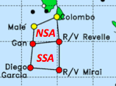
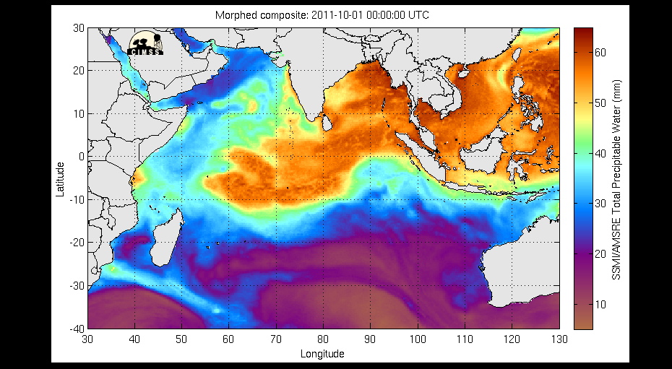
SSMI/AMSR-E Total Precipitable Water (mm) – October 1-15

Slide 29
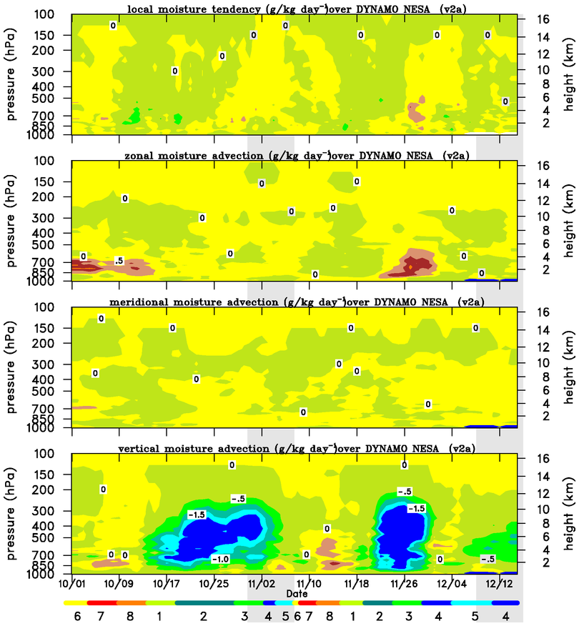




MJO1
MJO2
MOISTENING
DRYING
DRYING
DRYING
Drying from zonal advection and subsidence
MOISTENING
DRYING
Notes:
5-day running means

Slide 30
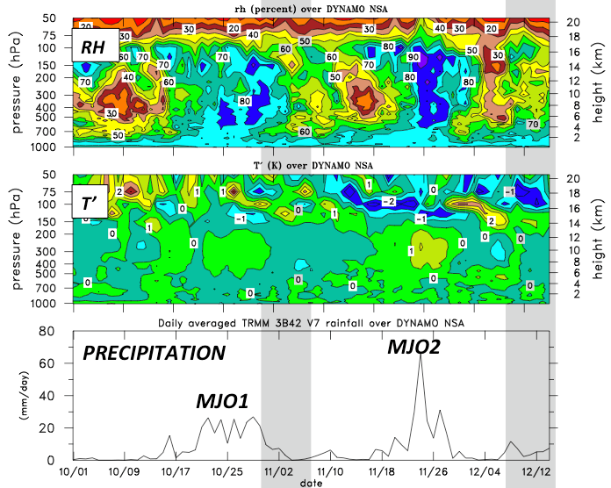
Nearly steady conditions

Slide 31
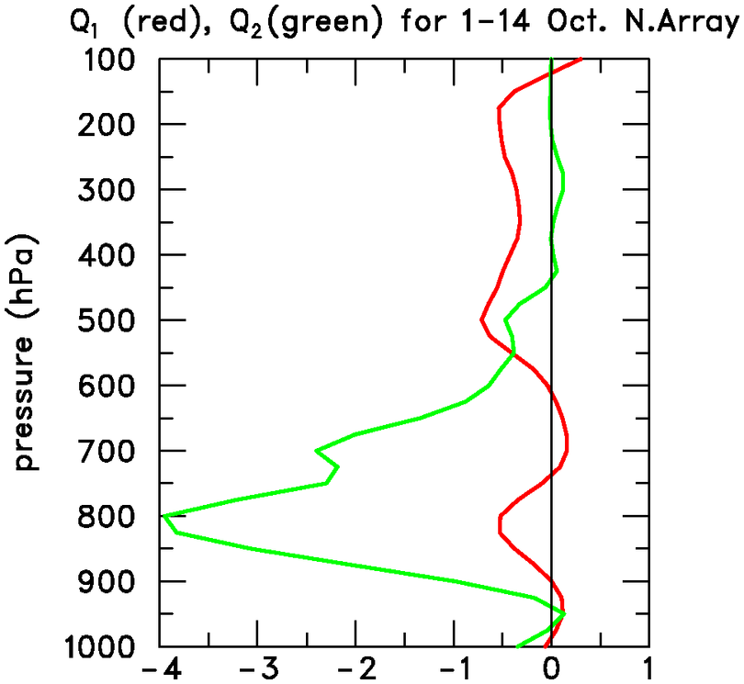
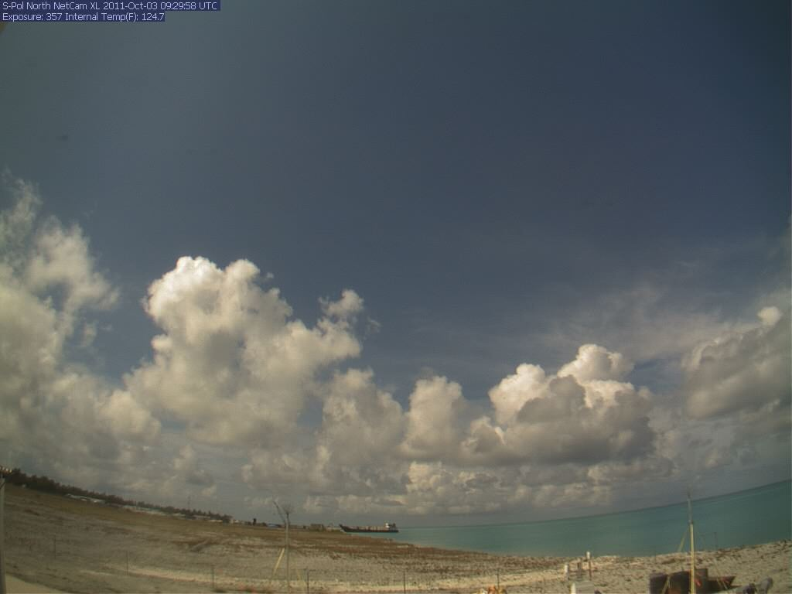
October 3, S-Polka
Moistening by shallow, nonprecipitating cumulus, offsetting drying by horizontal advection and subsidence; resembles trades
Q₂ (“apparent moisture sink”)
Q₁ (“apparent heat source”)
(K day⁻¹)

Slide 32
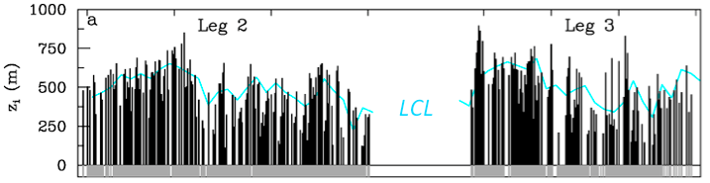
Atmospheric Mixed Layer Depth, SST, Rainfall
R/V Revelle
ATMOSPHERIC MIXED LAYER DEPTH, LCL
?
SST-warming phases:
Deepest mixed layers
ML depth increases with time, extends above LCL
Prominent SST diurnal cycle
MJO1
MJO2
Notes:
Large diurnal cycle in SST before MJO heavy rainfall, particularly during Nov when sfc wind was weaker.

Slide 33
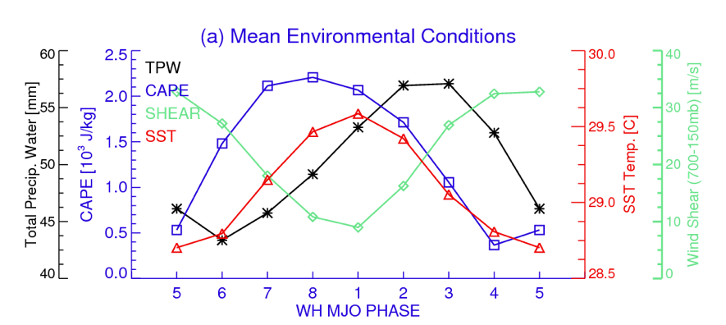
DYNAMO MJO Composite Results, R/V Revelle
(Xu and Rutledge 2013)
Results suggest of air-sea coupling a factor in the MJO

Slide 34
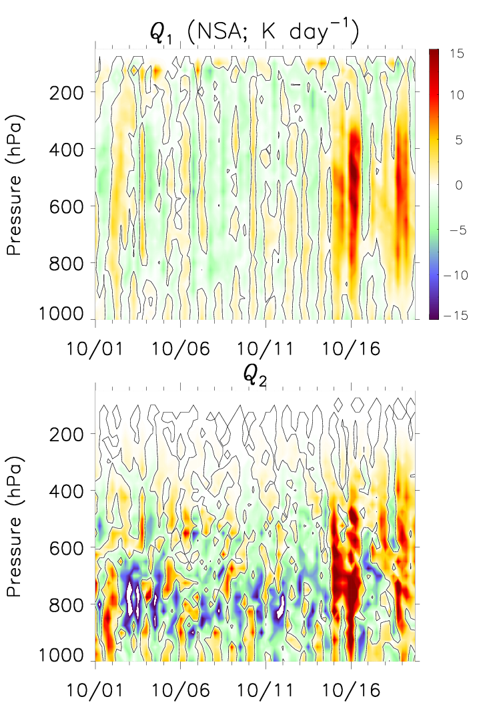
Q₁ and Q₂, Northern Sounding Array – First half of October
(James Ruppert)
Moistening diurnally modulated, peaking in afternoon Similar results found for November MJO
Notes:
Overall, Q1 is weak, and Q2 shows moistening maximizing around 800 hPa, consistent the mean profiles from earlier
Strong diurnal pulsation can be noted, however
Upward sloping depth of moistening indicates a deepening cloud field before deep conection
Next are images from 12 October

Slide 35
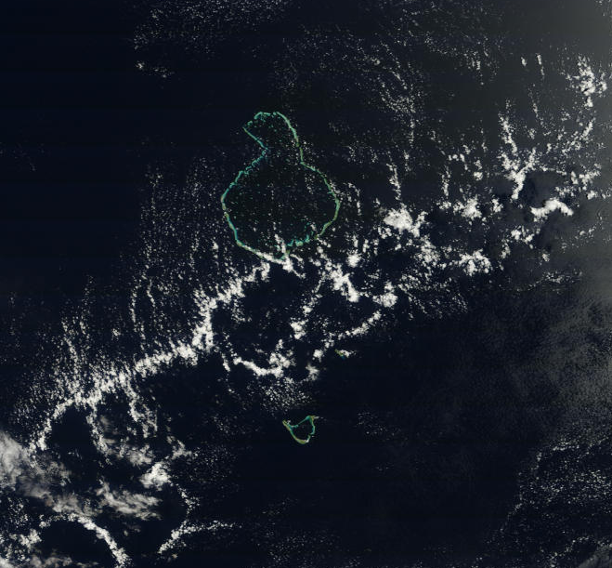
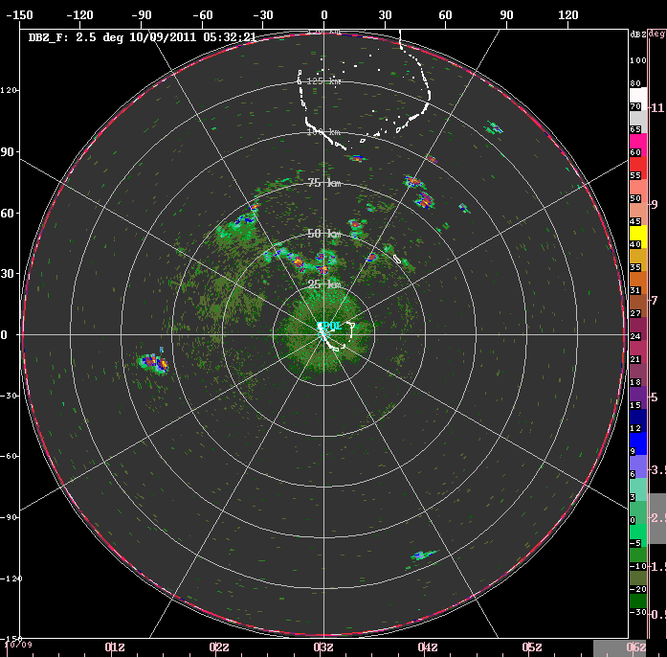
TERRA/MODIS
9 October 2011
1132 LT
50 km
OPEN CELLS
S-PolKa on Addu Atoll (Gan Island)

Slide 36
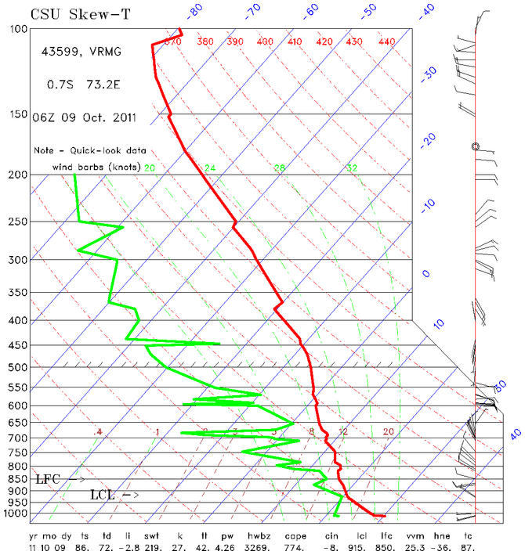
• Dry mid-troposphere inhibits deep convection
• Models have a difficult time re: convective sensitivity to midlevel moisture (Derbyshire et al. 2004; Del Genio et al. 2012)
GAN ISLAND
(11 L)
10 km

Slide 37
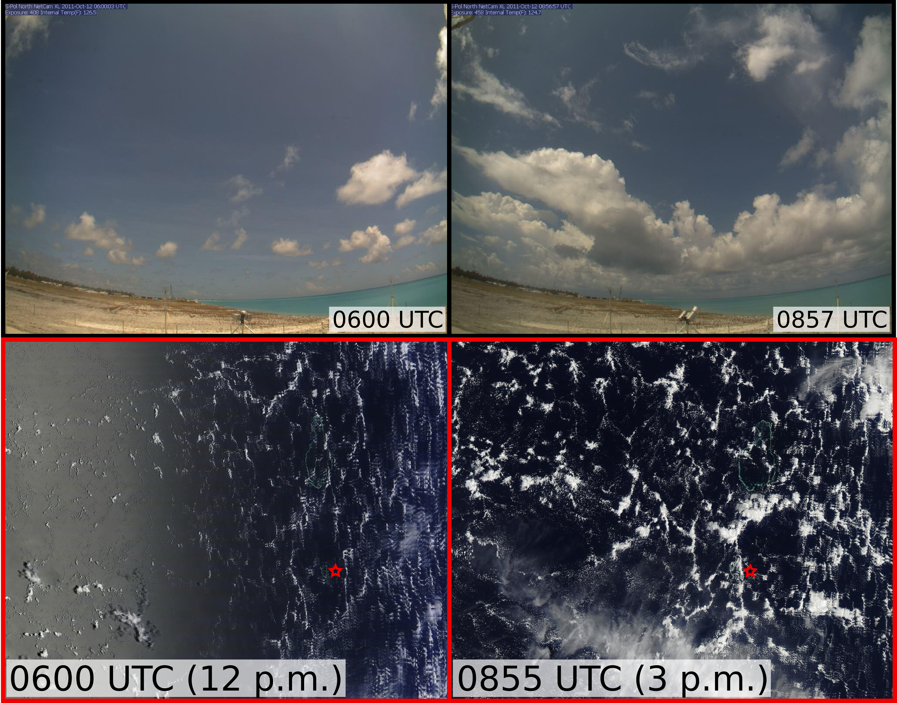
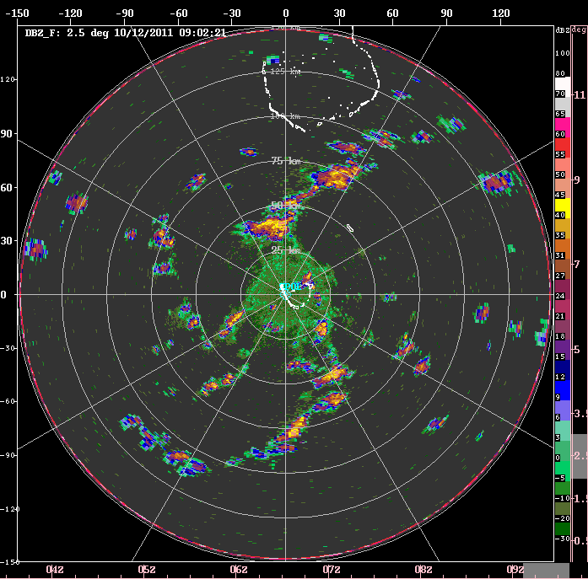
12 October 2011
Gan S-Pol Cam (north)
(James Ruppert)
MODIS/Terra
MODIS/Aqua
Gan Island
Notes:
Increased cloud depth and coverage by midafternoon
Most are non-raining, suggesting that the moisture remains in the troposphere
Rayleigh-Benard convection (open cells) is evident (during most days), consistent with the driving force of heating from below in light-wind conditions
(Radar) Convection is more vigorous along cell walls, suggesting the aid of low-level convergence by this organization

Slide 38
Open Cells
~ 30-50 km
Mesoscale circulations during suppressed periods lead to localized areas of enhanced boundary layer moistening, deeper cloud growth than would otherwise occur; assists in MJO moisture preconditioning?
Diurnal cycle important

Slide 39
MOISTENING
DRYING
Mid-October moistening: drying from horizontal advection ends, zonal moistening at midlevels, meridional moistening at most levels, vertical transport increases
DRYING
DRYING
MOISTENING
DRYING
Notes:
5-day running means

Slide 40
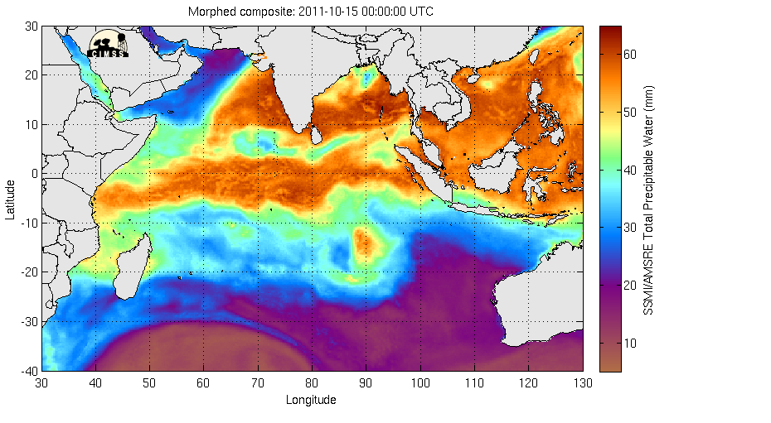
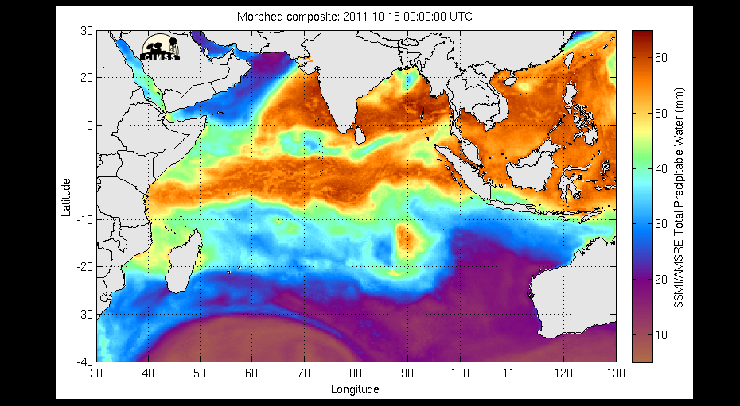
SSMI/AMSR-E Total Precipitable Water (mm) – October 15-31

Slide 41
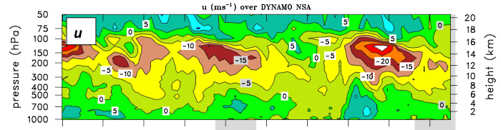
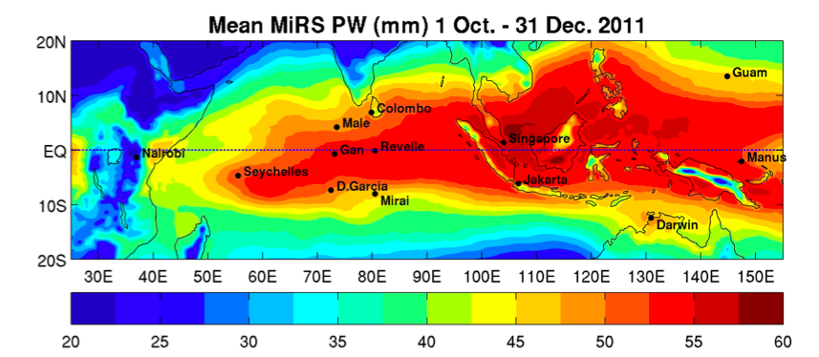
Findings support idea of important role of horizontal moisture advection by easterlies in developing phase of MJO (Maloney 2009)
Zonal advection, meridional advection, and convective moistening all appear to play moistening roles over NSA for October MJO; zonal advection and convective moistening for November MJO
Notes:
Microwave-integrated Retrieval System

Slide 42
Dynamics of the MJO (DYNAMO): 1 October 2011 – 31 March 2012
.
BORNEO
SUMATRA

Slide 43
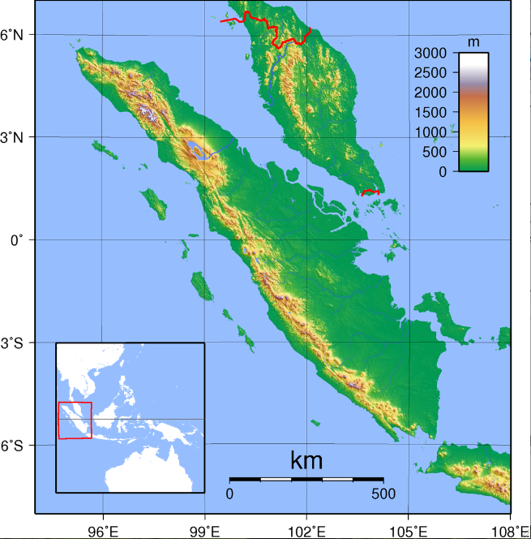
Max elevation = 3.8 km
Malaysia
Sumatra

Slide 44
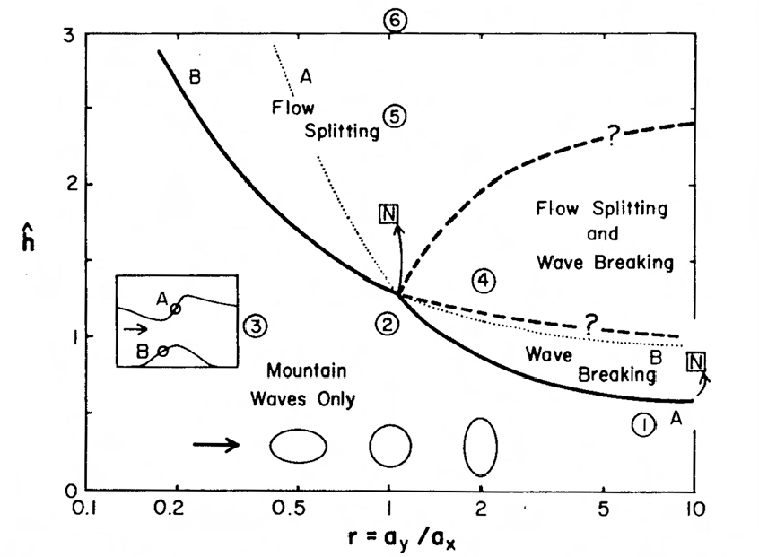

Smith (1989)
*

Slide 45
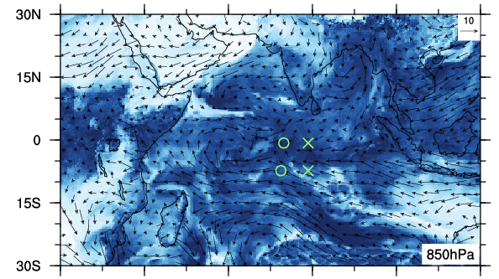

ECMWF 850 hPa Analysis, 18 October 1200 UTC
Wind (m s⁻¹), Relative Humidity (%)
“wake vortex”
×
○
Sumatra
RH (%)

Slide 46
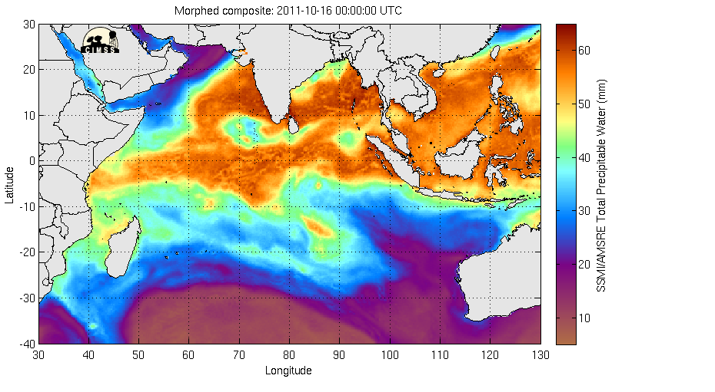
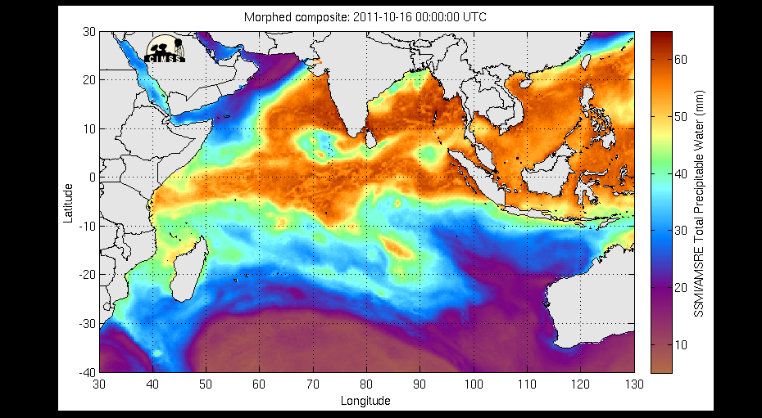
CIMMS TPW (16-20 October 2011)

Slide 48

700-hPa u, ζ
Positive vorticity maxima downstream of Sumatra with easterly flow
Vorticity anomalies progress westward at 4-5 m s⁻¹
Time
SUMATRA
ECMWF OA 0.25°

Slide 49


CIMMS TPW (20-24 November 2011)

Slide 50


METEOSAT Water Vapor (20-27 November 2011)
Tropical Storm 05A

Slide 51


Tropical Storm 05A
(26 Nov - 1 Dec 2011)
29 Nov
Sri Lanka: Storm and Floods – 27 Nov 2011
19 killed, 43 fishermen missing

Slide 52


CIMMS TPW (29 Nov – 6 Dec 2011)
Tropical Storm Alenga

Slide 53


Borneo
Sumatra
Severe Tropical Storm Alenga
(5-7 December 2011)
Australia

Slide 54
Flow fields for |u| > 5 m s⁻¹ between 3 and 7°N at 100°E

Slide 55


Slide 56


Slide 57


Slide 58
Summary
The MJO has global impacts
Two prominent MJOs sampled during DYNAMO
A number of similarities, but important differences between October & November MJOs
Moistening processes: zonal & meridional advec-tion, convective moistening; stepwise progression
Evidence of important coupling between ocean and atmosphere; prominent diurnal cycle of convection
Island of Sumatra impacts MJO convection; possible initiator of tropical cyclones in N & S Indian Ocean

