Slide 1


New Insights on the MJO from DYNAMO*
Richard H. Johnson
Colorado State University
Contributors:
Paul Ciesielski, James Ruppert, Erin Dagg, Thomas Birner, Caitlin Fine, Masaki Katsumata
*Dynamics of the MJO (Madden-Julian Oscillation)
Workshop on the Frontiers of Tropical Meteorology, The Chinese University of Hong Kong, 21 September 2017

Slide 2
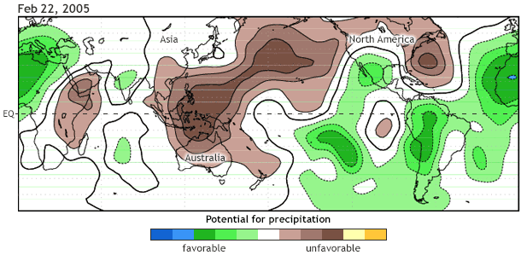
What is the Madden-Julian Oscillation (MJO)?
60°N
HKG
★
60°S
NOAA Climate.gov
MJO is dominant source of intra-seasonal variability in the tropics
MJO makes a global circuit every 30-60 days
MJO affects weather in the tropics and midlatitudes

Slide 3
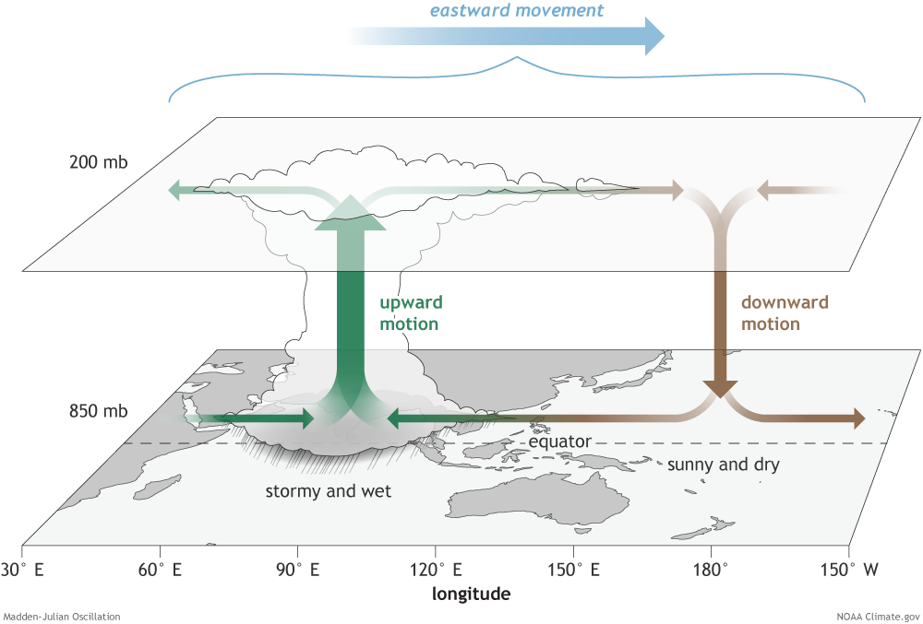
What is the structure of the MJO over the Eastern Hemisphere?
Convection amplifies over the Indian Ocean
…then moves east-ward at about 5 m s⁻¹

Slide 4
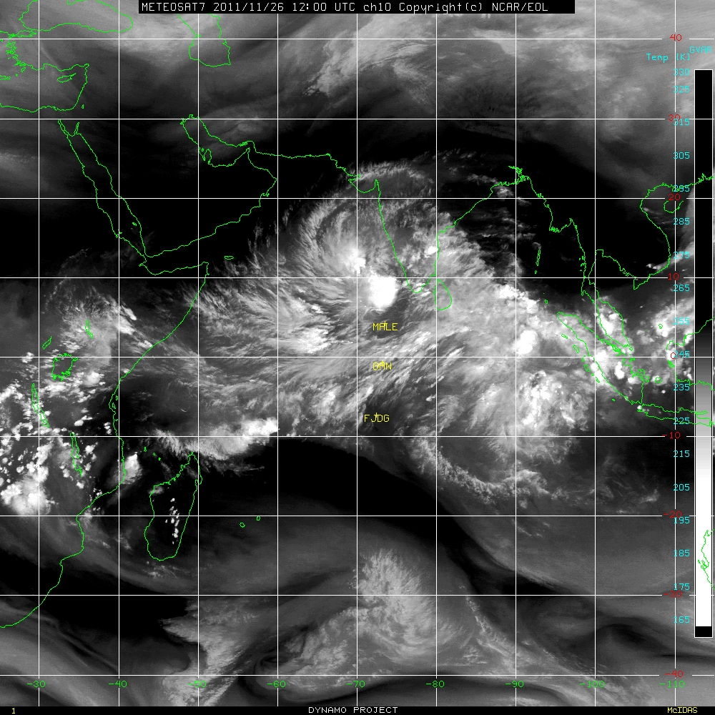
The MJO consists of many cloud systems
November 2011 MJO
26 Nov 2011, 1200 UTC

Slide 5
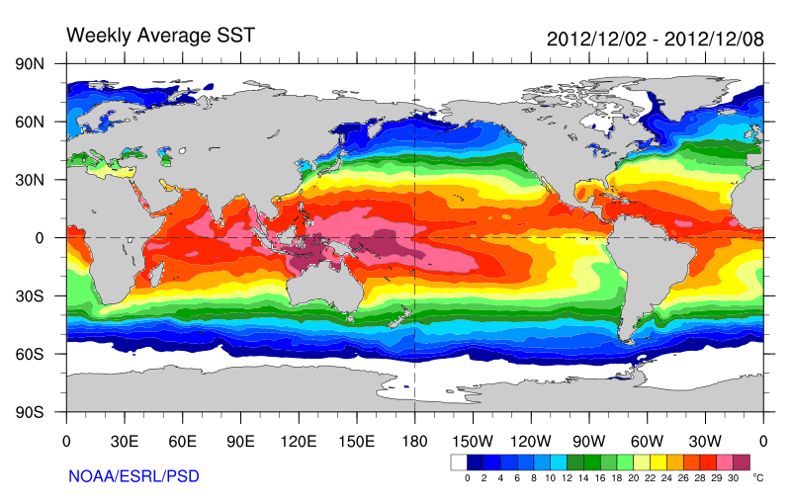
Deep convection in the MJO intensifies over the oceanic “Warm Pool”
Though a global phenomenon, why do convection and precipitation start to increase over the Indian Ocean?
“WARM POOL”

Slide 6
Tropical cyclones
Tornadoes
Extreme rainfall
Flood
Fires
Cold surges
Heat waves
Storm track
Westerly wind burst
Equatorial waves
Monsoons (active/break periods)
Drought
ITCZ
ENSO, NAO, AO, AAO
Indian Ocean Dipole
Indonesian Throughflow
Wyrtki Jet
Seychelle-Chagos Thermocline Ridge (SCTR)
Antarctic circumpolar circulation
Why do we care about the MJO?
Weather
MJO
Climate
(courtesy Chidong Zhang)
Ozone, CO, Aerosol, Ocean chlorophyll
Earth’s angular momentum, Length of the day
Electromagnetic field (Schumann resonance)

Slide 7
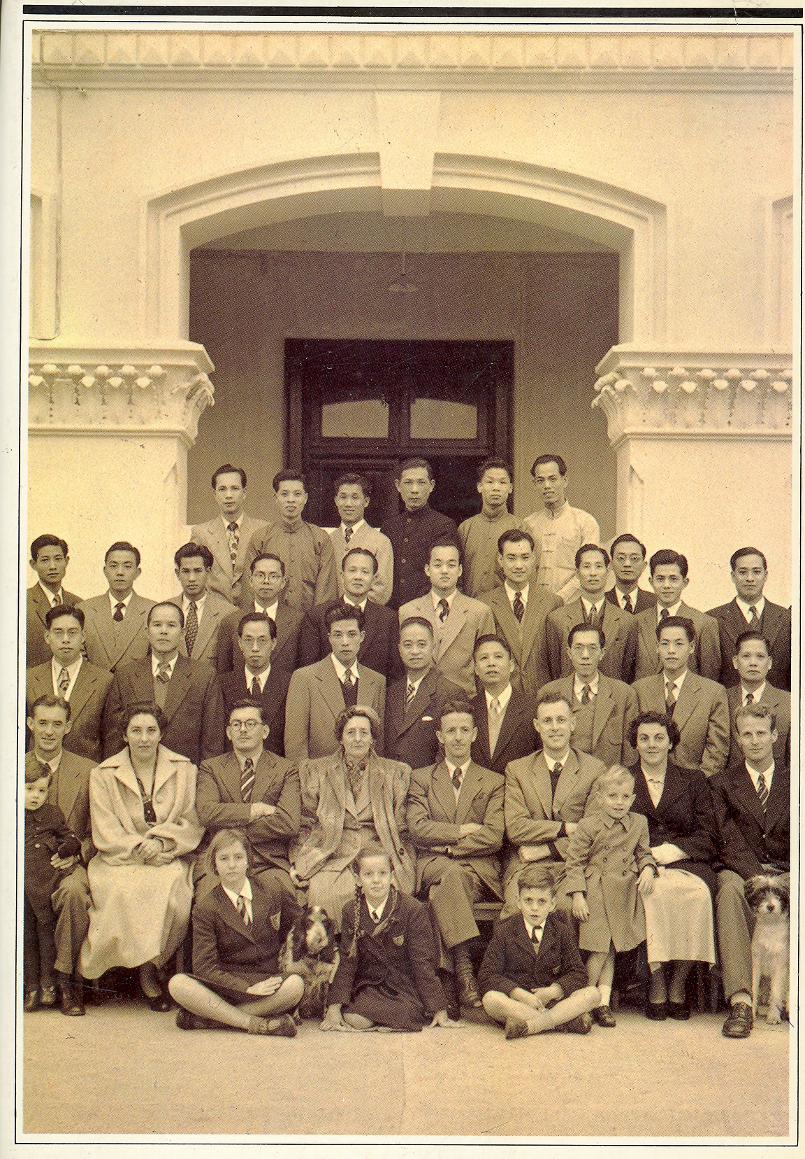
Pre-MJO History
Increasing aviation in the tropics, including Asia, placed growing demands in the 1950s on observations and tropical forecasting
Why is it called the Madden-Julian Oscillation?
Staff of the Hong Kong Observatory soon after World War II
A player in the history of the discovery of the MJO was Colin S. Ramage, Acting Director, Hong Kong Royal Observatory, 1955. Ramage later founded the Program in Meteorology at the University of Hawaii in 1956
(in From Time Ball to Atomic Clock by Anthony Dyson, 1983)

Slide 8
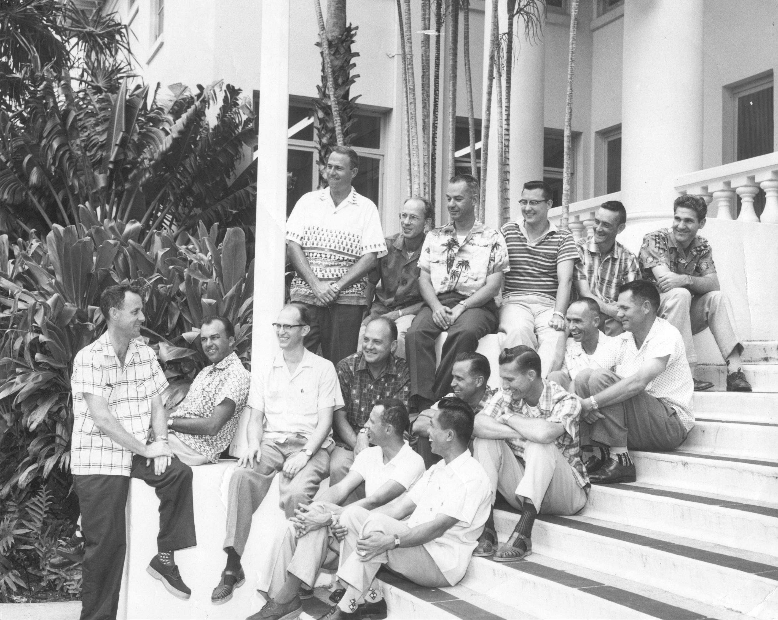
Program in Meteorology established at University of Hawaii in 1956
Late 1950s
Ramage
Notes:
Picture from late 50s showing Ramage (left), Sadler (2nd left)

Slide 9
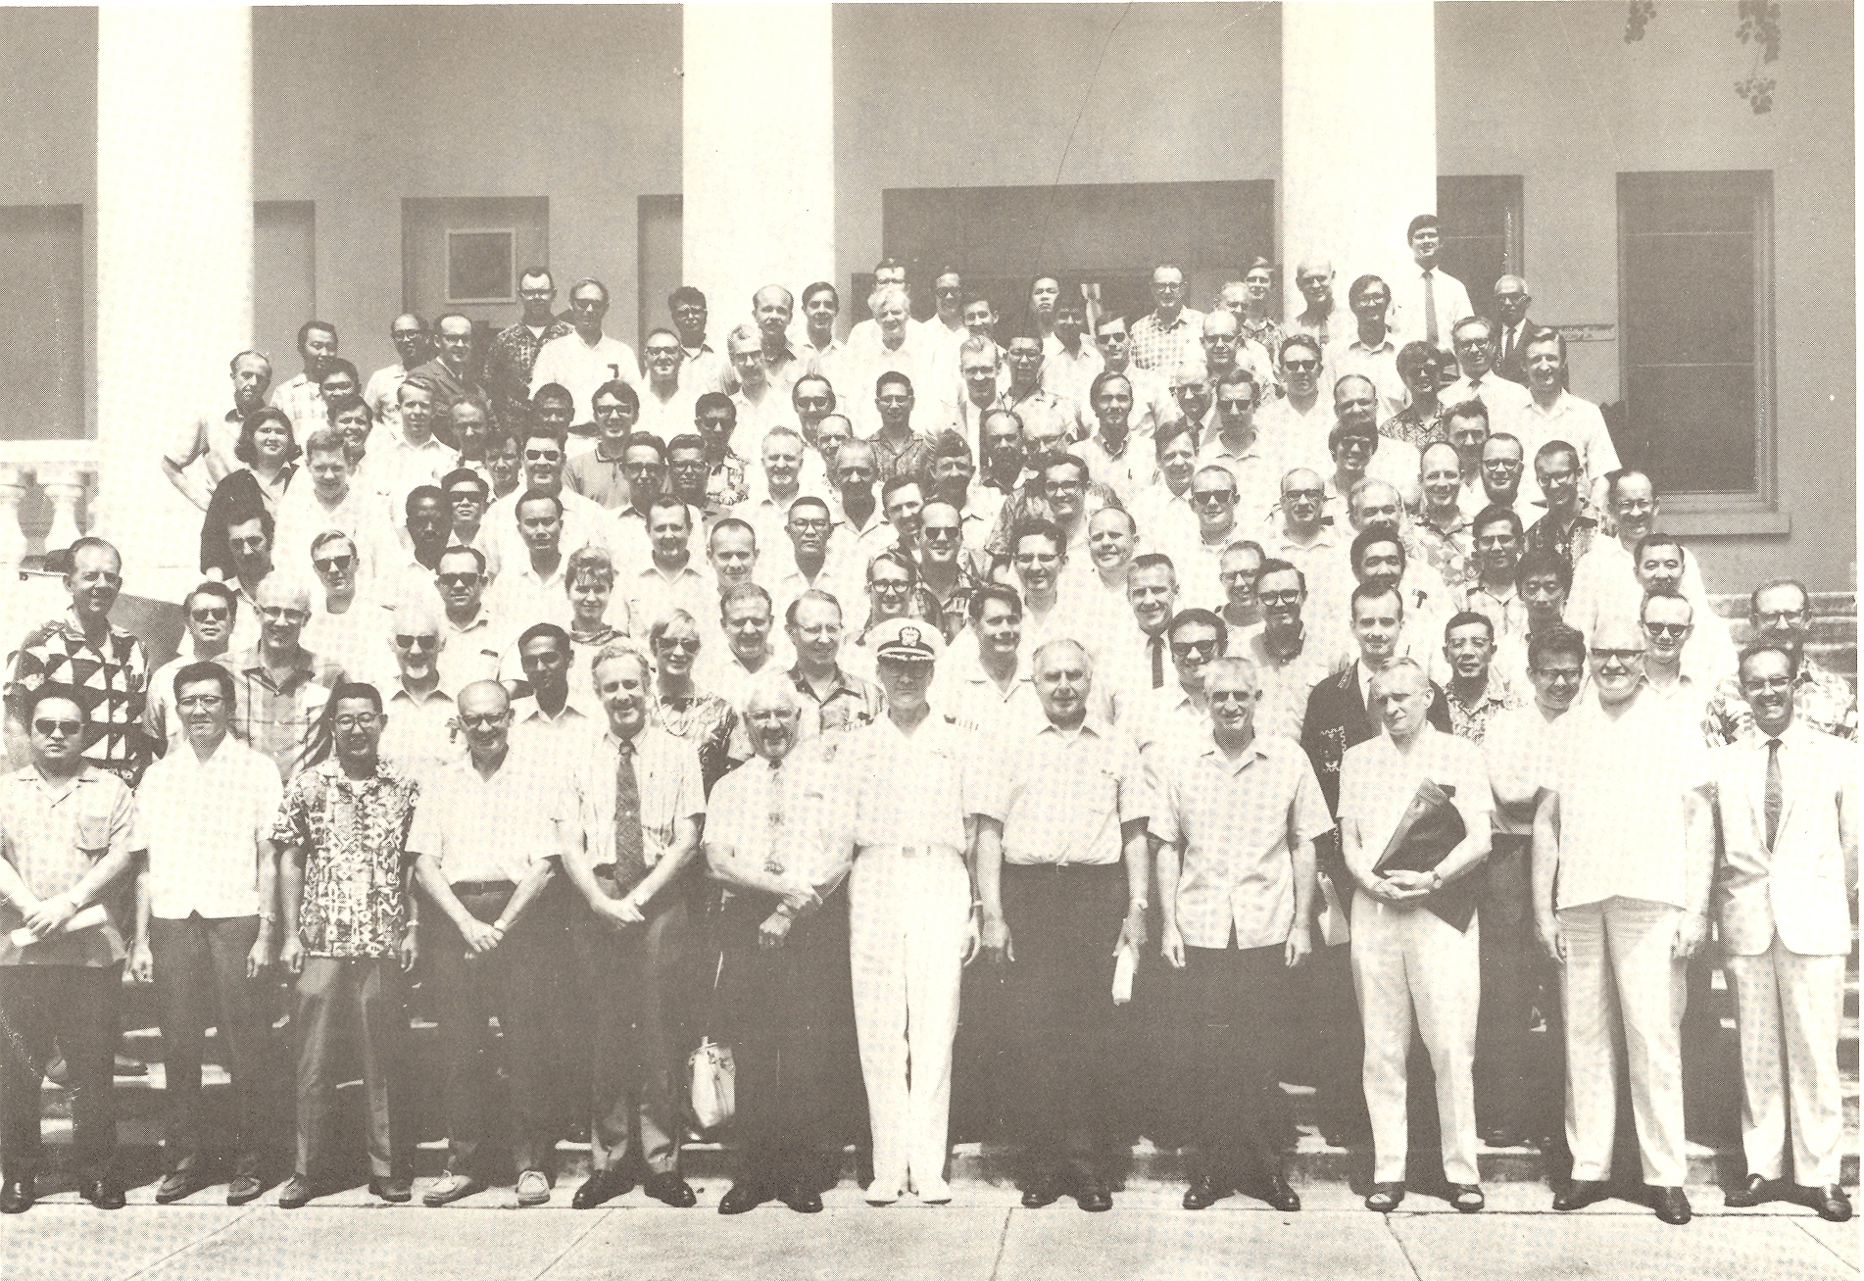
AMS/WMO Symposium on Tropical Meteorology, 1-6 June 1970, Honolulu
van Loon
Spengler
Dunn
Julian
Reed
Gray
Madden
La Seur
Zipser
Jim Sadler
Ruprecht
Holton
Hastenrath
J. Simpson
N. Frank
R. Simpson
Takio Murakami
Jenne
Krish
W. Sam Houston
V. Oliver
Colin Ramage
E. Bollay
P. Kutschenreuter

Slide 10
“Hot Topics” at 1970 Tropical Conference
Planning for “GATE” in Pacific (switched to Atlantic in 1970; Japan pulled out)
“Easterly wave” studies (Reed, Holton, Chang, Wallace, Yanai, Nitta)
GATE: GARP Atlantic Tropical Experiment
Notes:
At meeting in Brussels in 1970 it was decided that due to the availability of resources (ships, satellite), the preferred location for “GATE” – the western Pacific – had to be given up, with the third choice (the eastern Pacific was 2nd), the eastern Atlantic being selected.

Slide 11
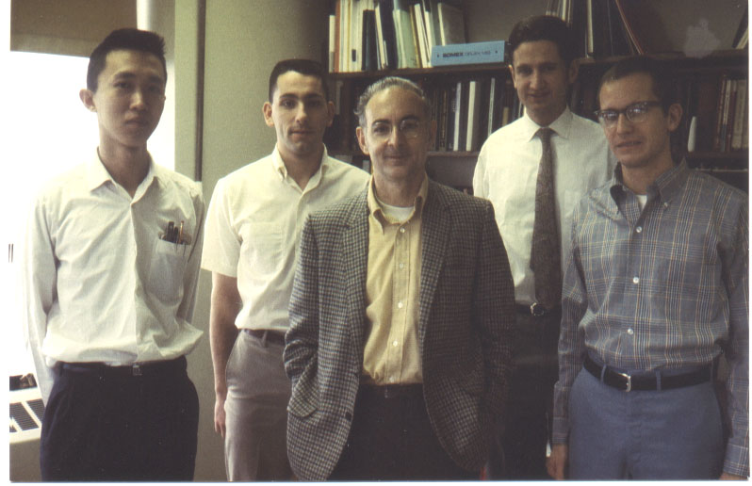
C.-P. Chang
V. Kousky
R. Reed
M. Wallace
J. Holton
1969 Photo by M. Yanai

Slide 12
“Hot Topics” at 1970 Tropical Conference
Planning for “GATE” in Pacific (switched to Atlantic in 1970; Japan pulled out)
“Easterly wave” studies (Reed, Holton, Chang, Wallace, Yanai, Nitta)
Results from Line Islands Experiment (1967), including analysis by Madden of 4-5 day tropical variations using Line Islands rawinsonde data
**
**A question raised by Gary Atkinson led to the analysis of a much longer record by Madden using Canton Is. data, and the eventual discovery of the MJO
Notes:
At meeting in Brussels in 1970 it was decided that due to the availability of resources (ships, satellite), the preferred location for “GATE” – the western Pacific – had to be given up, with the third choice (the eastern Pacific was 2nd), the eastern Atlantic being selected.

Slide 13
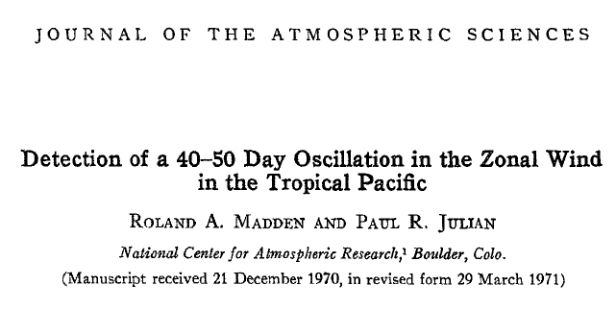
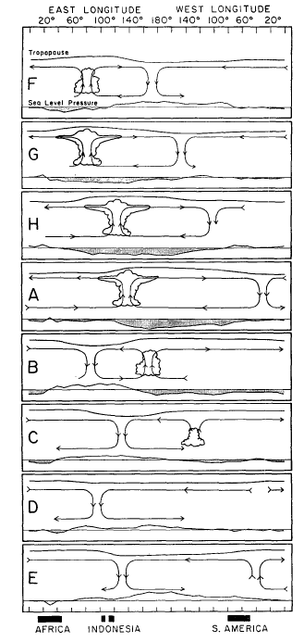
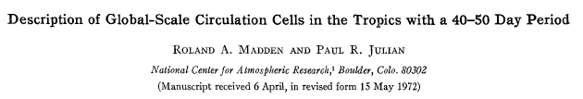
(Madden and Julian 1972)
“Madden-Julian Oscillation: MJO”
Webster, P.J., 1987: The variable and interactive monsoon. Monsoons, J.S. Fein and P.L. Stephens, Eds. (“Madden-Julian 40-50 day wave”)
R. Swinbank, T.N. Palmer and M.K. Davey. 1988: Numerical Simulations of the Madden and Julian Oscillation. Journal of the Atmospheric Sciences: Vol. 45, No. 5, pp. 774–788.
(“MJ Oscillation”)
Ngar-Cheung Lau, Isaac M. Held and J. David Neelin. 1988: The Madden-Julian Oscillation in an Idealized General Circulation Model. Journal of the Atmospheric Sciences: Vol. 45, No. 24, pp. 3810–3832.
(“Madden-Julian Oscillation”)

Slide 14
Why did it take so long for interest to grow in this phenomenon?

Slide 15

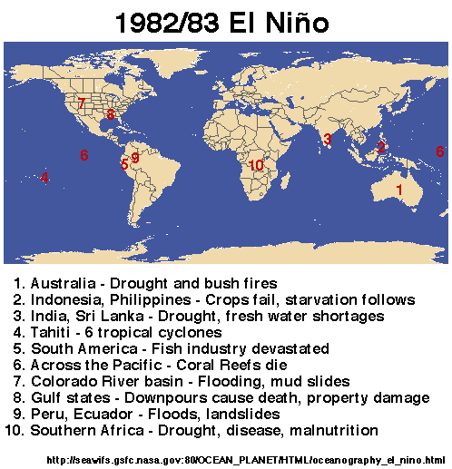
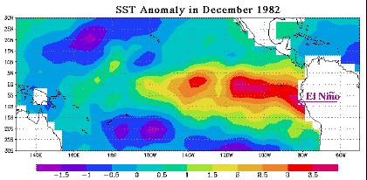
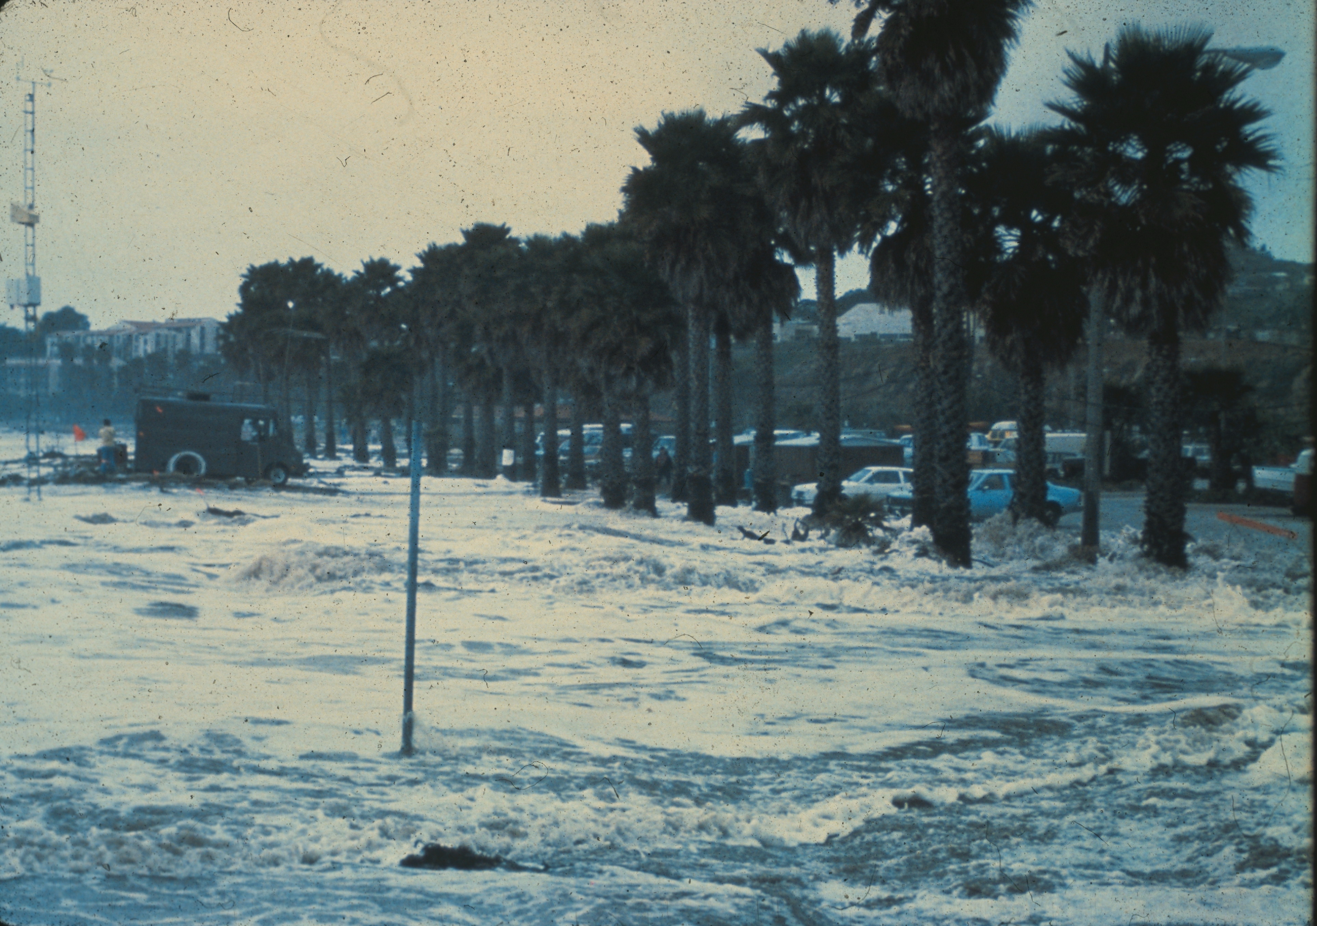
1982-83 El Niño
Cost: 2000 lives lost, ~$13B worldwide
Santa Barbara, CA

Slide 16
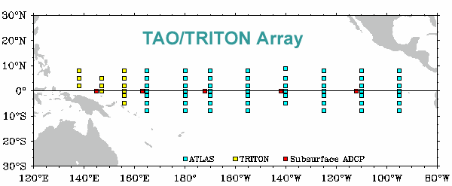
1982-83 El Niño motivated the establishment of TOGA TAO Array, starting in 1984
Shortly thereafter, the TOGA (1985-1994) pro-gram began → observations, predictability, and prediction of tropical ocean-atmosphere coupled system → prominent intraseasonal variability (westerly wind bursts, MJO events) observed

Slide 17
Madden and Julian (1971): 2641 citations
Madden and Julian (1972): 2232 citations
(all journals)
MJO is now a household name in atmospheric science
CONTINUED GROWTH

Slide 18
“Madden-Julian Oscillation: MJO”
(Madden and Julian 1971, 1972)
First detected in study of 1967 Line Islands data
Significance not recognized until mid-1980s following deployment of TOGA TAO array in 1984
“MJO” acronym not introduced until 1988
Global impacts: tropical cyclones, ENSO triggering, monsoons, midlatitude storm tracks, floods, tornadoes, heat waves, etc.
Models do not represent MJO well and there is still no generally accepted theory for the phenomenon
Maritime continent passage is additional complication

Slide 19
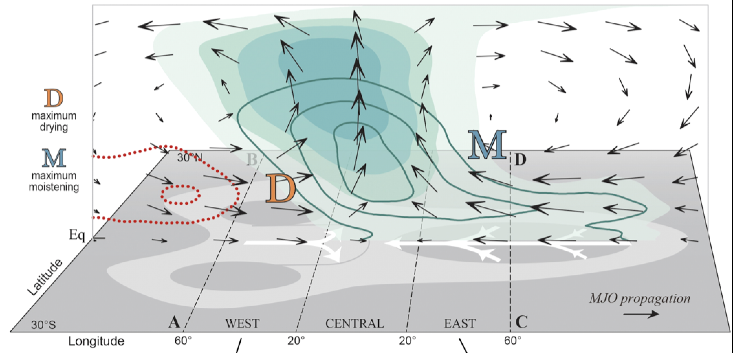
MJO Remains an Enigma
(Adames and Wallace 2015)
Theories:
WISHE (Wind-Induced Surface Heat Exchange)
Wave-CISK (Conditional Instability of the Second Kind)
Moisture mode or dispersive moisture wave
Multiscale interactions (convective to planetary scale)
Stratiform instability
Radiative-convective instability
Instability involving air-sea coupling

Slide 20
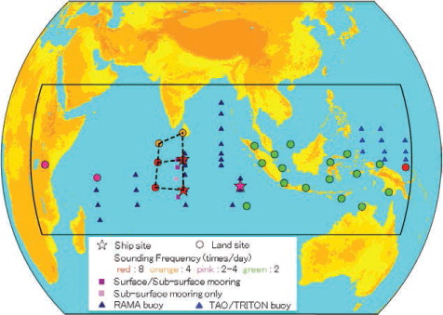

Dynamics of the MJO (DYNAMO)
(October 2011 – March 2012)
Joint field campaign with CINDY (Japan)
Scientific Objectives
Moistening processes during initiation stage of MJO over Indian Ocean
Role of convective cloud populations in MJO initiation
Role of air-sea interaction in the Indian Ocean in MJO initiation
Addu Atoll (Yoneyama et al. 2013)

Slide 21
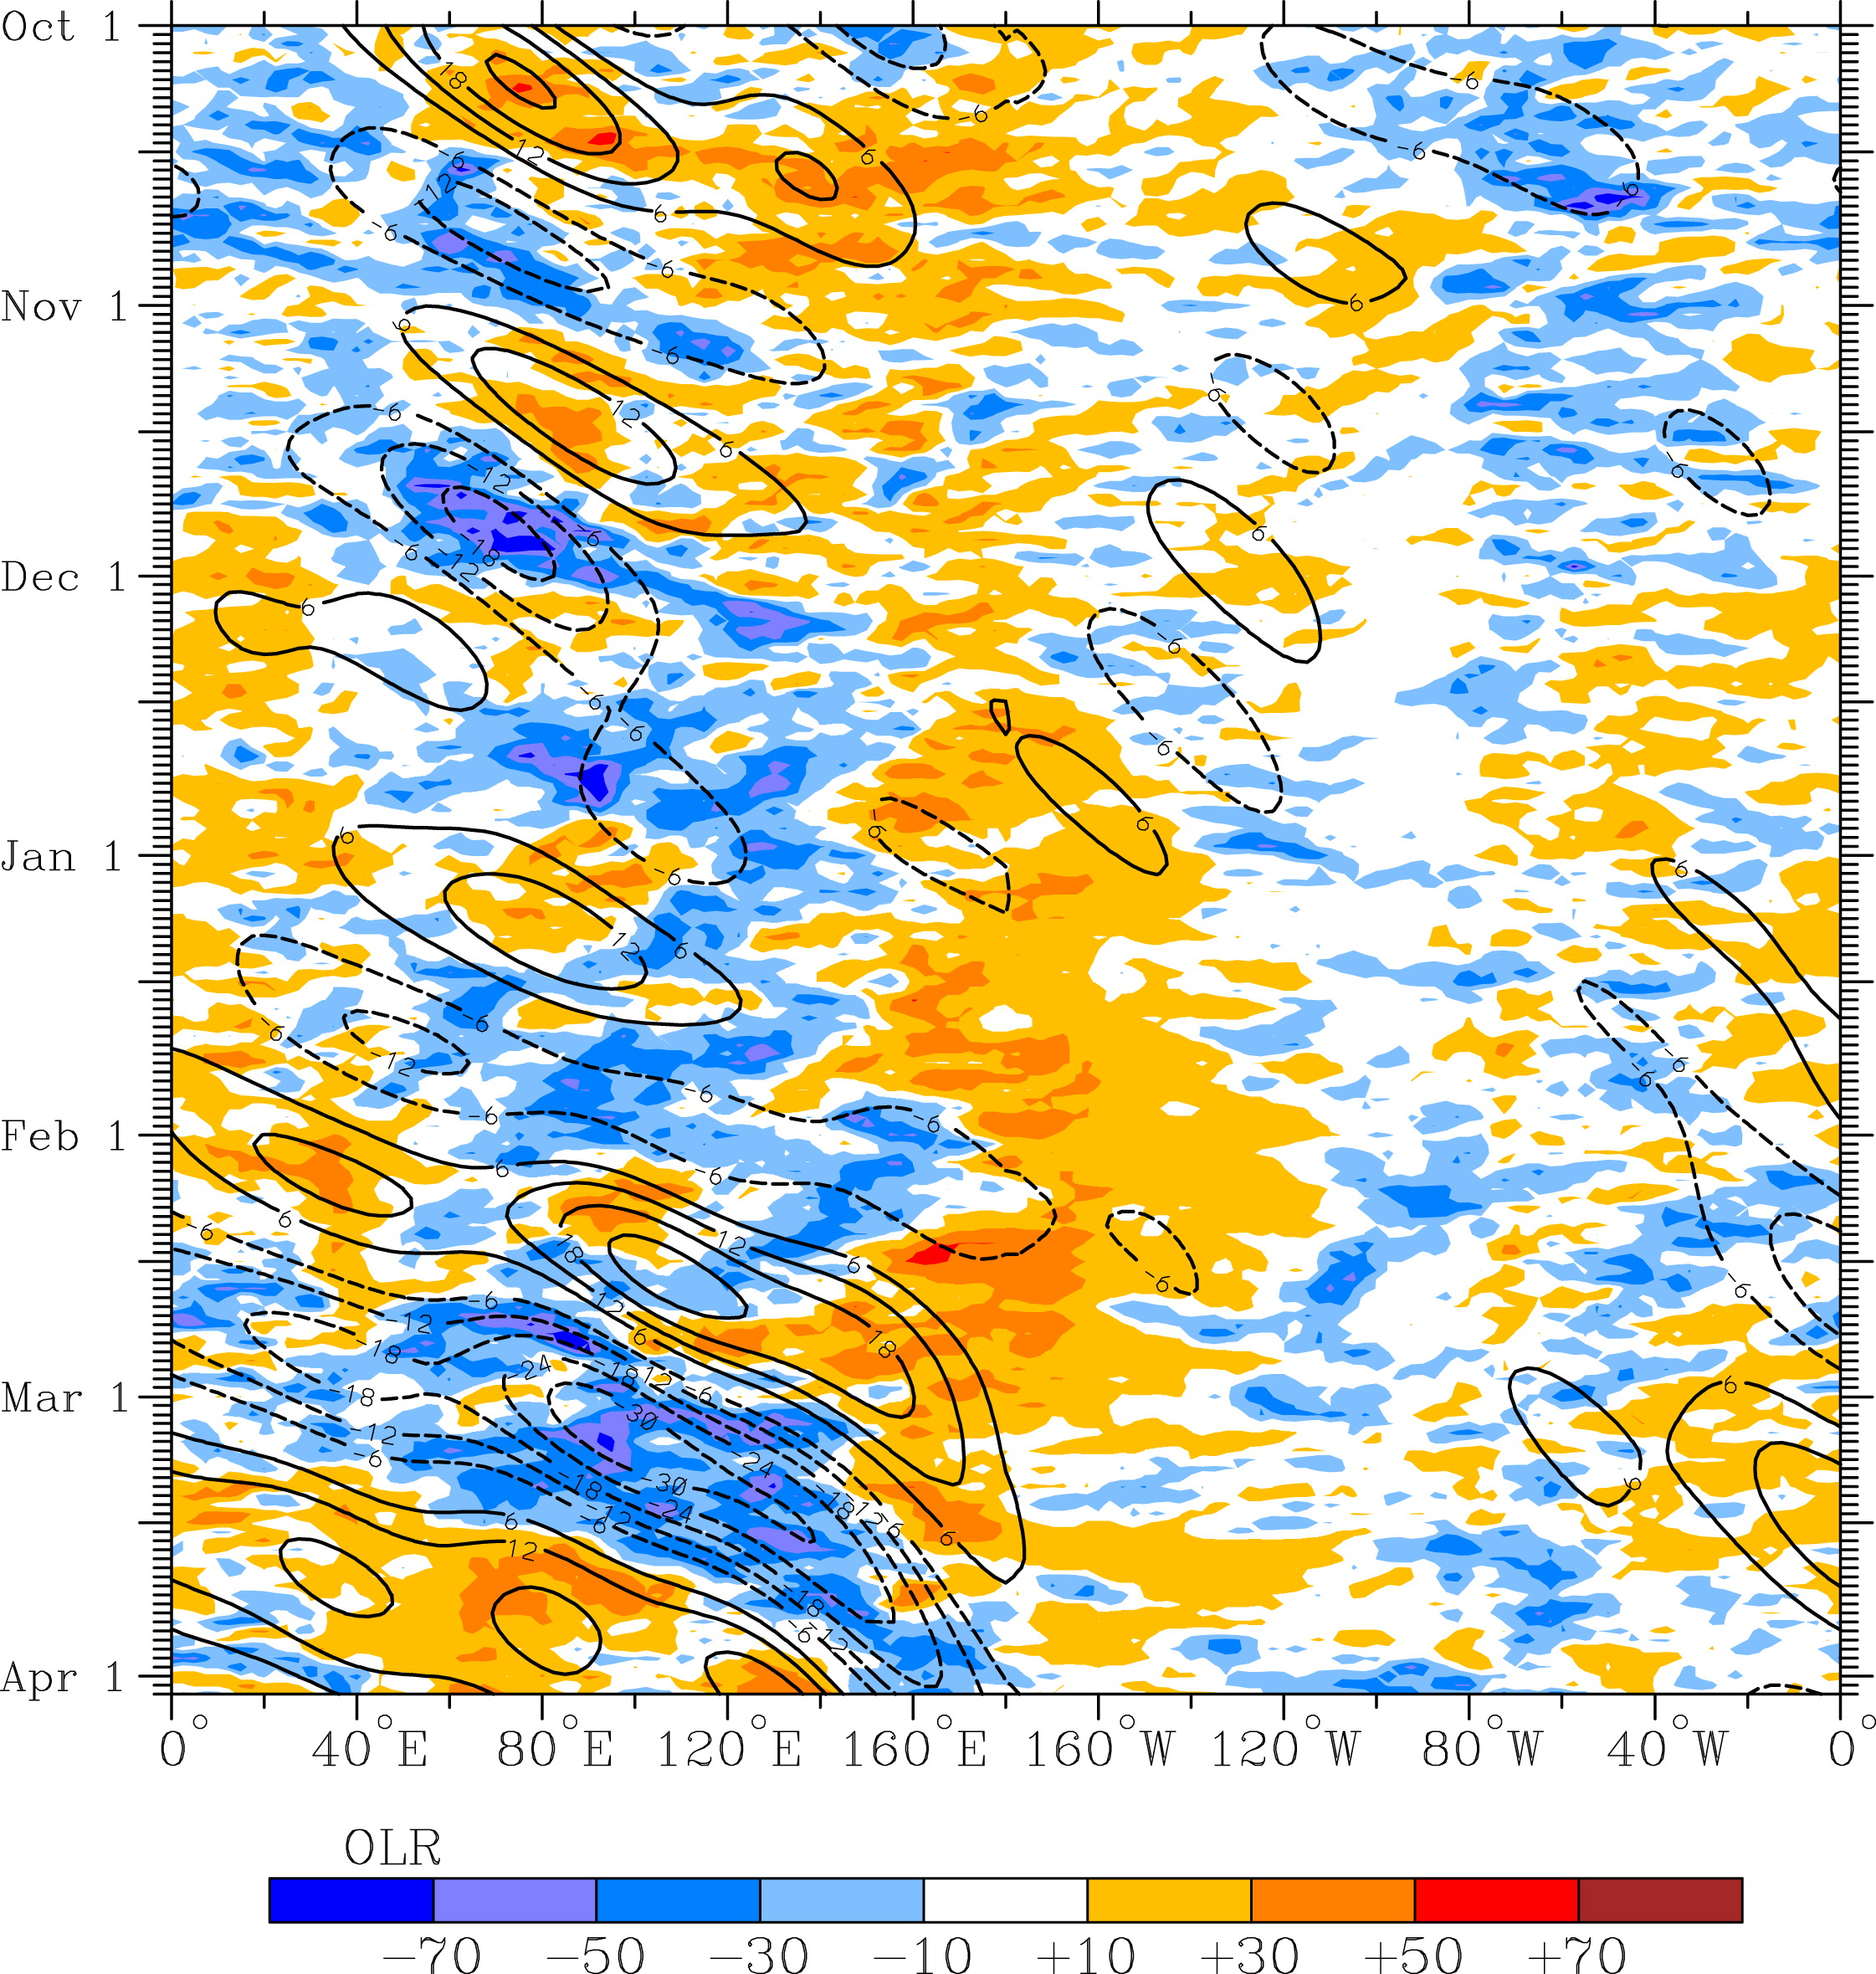
OLR anomalies and MJO-filtered OLR (10N to 10S) for DYNAMO period
OCTOBER MJO
NOVEMBER MJO
DYNAMO SOUNDING ARRAY
Time ➔
Kiladis et al. (2014)
East Asia

Slide 22
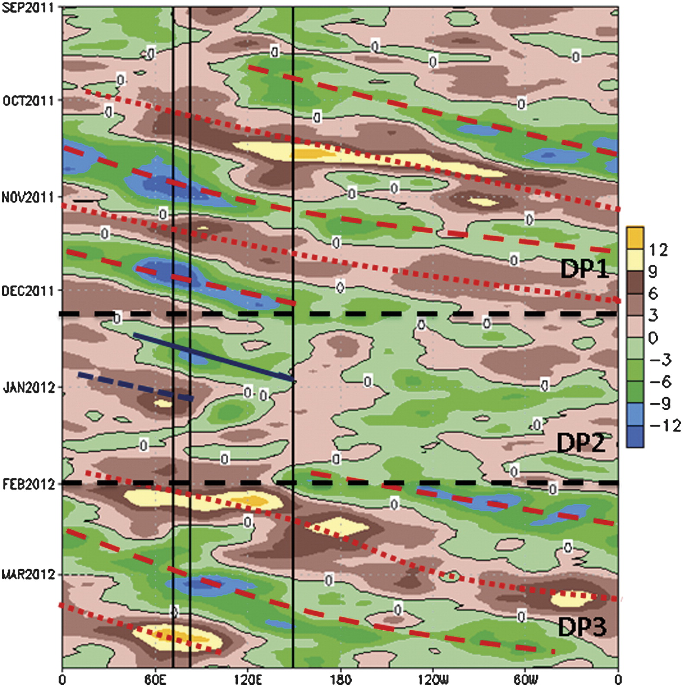
200-hPa Velocity Potential Anomalies
(10N-10S)
Gottschalck et al. (2013, MWR) and Powell and Houze (2015) link Oct and Nov events to global circuits in 200-hPa velocity potential anomalies
Time ➔
DIVERGENCE
DIVERGENCE
OCT MJO
Manus
NOV MJO
DYNAMO Arrays
(Gottschalck et al. 2013)

Slide 23
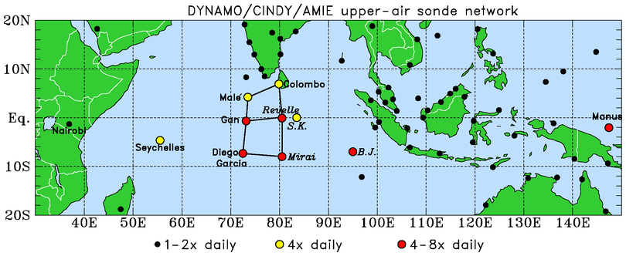
DYNAMO (Dynamics of the MJO); October 2011 – March 2012
.
N Array
(Addu Atoll)
S Array
Northern Array: October-early December, 4 & 8/day soundings (added < 6 mo. prior to field phase!)
Southern Array: October-November, 8/day soundings

Slide 24
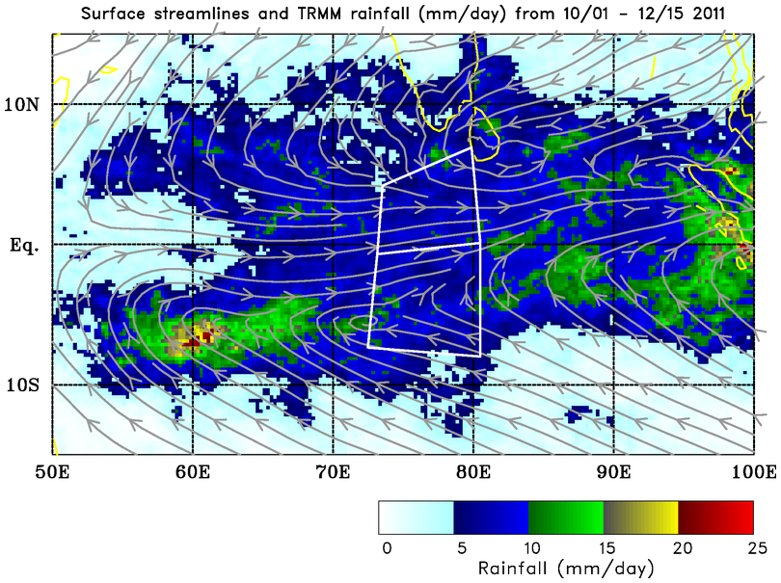
Double-ITCZ pattern; similar average rain rates over both arrays…
Mean: 7.8 mm day⁻¹
…but evolution of rainfall differs between the two…
Mean: 8.0 mm day⁻¹

Slide 25
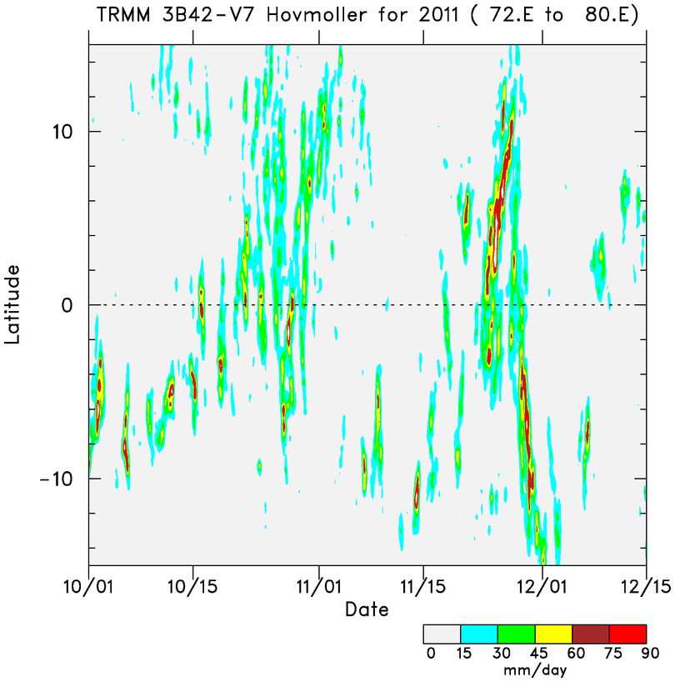
N
More prominent MJO signal
N ARRAY
S ARRAY
More persistent convection in southern array
“ITCZ” convection shifts to equator during MJO active phase
S
Time

Slide 26
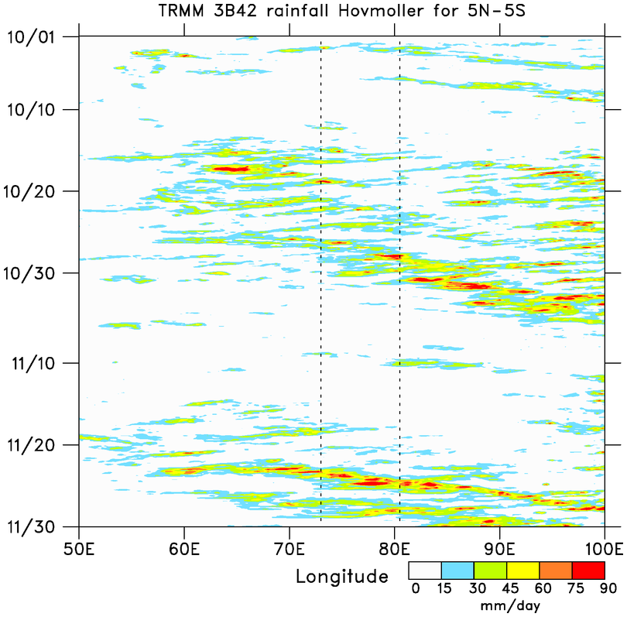
■ Two prominent MJO events: October and November
Sumatra diurnal cycle
2-day disturbances
WESTWARD
■ MJOs consist of westward- and eastward-moving disturbances
SUMATRA
Time
EASTWARD
■ Two-day disturbances over DYNAMO arrays during October MJO
WESTWARD
DYNAMO ARRAY
EASTWARD
Tip of Africa

Slide 27


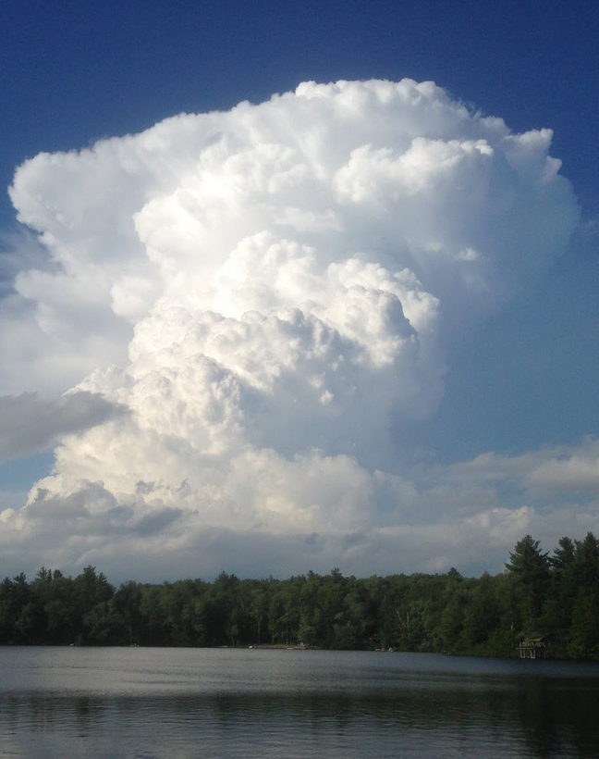
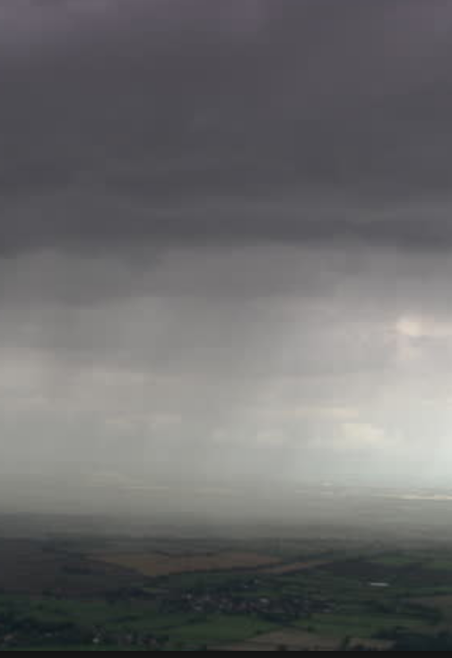
Cloud types
cumulus
congestus
cumulonimbus or deep convection
stratiform precipitation

Slide 28
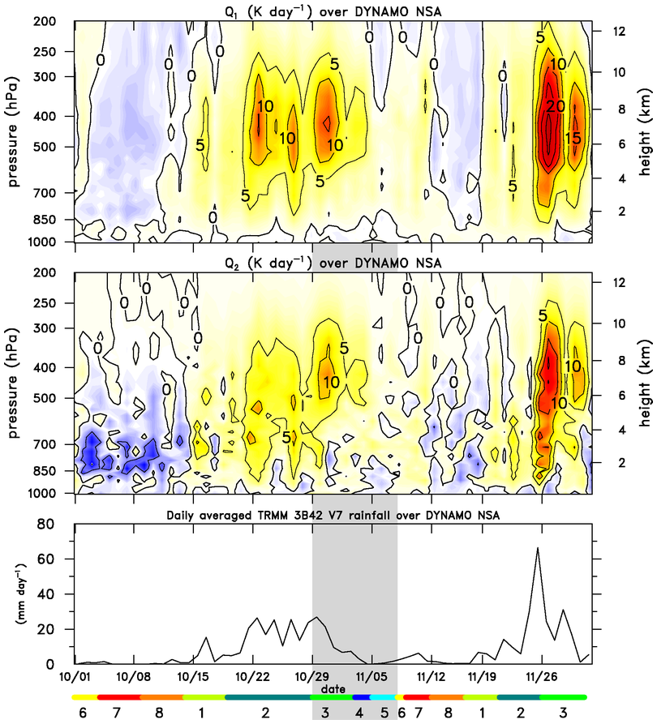
⬥ Inferences regarding “dominant” cloud populations:
  Cumulus
  Congestus
  Deep convection
  Stratiform
Heating
Drying
Johnson et al. 2015
Rainfall
RMM Index

Slide 29
⬥ Inferred cloud populations:
  Cumulus
  Congestus
  Deep convection
  Stratiform
⬥ Similar evolution for both MJOs, but shorter periods for each stage for MJO2
Cumulus
Congestus
Cumulus
Deep
Congestus
Stratiform
Deep
Stratiform
⬥ Possible stepwise evolution of convection? [Kikuchi and Takayabu (2004), Katsumata et al. (2009), Virts and Wallace (2010), Del Genio et al. (2012)]

Slide 30
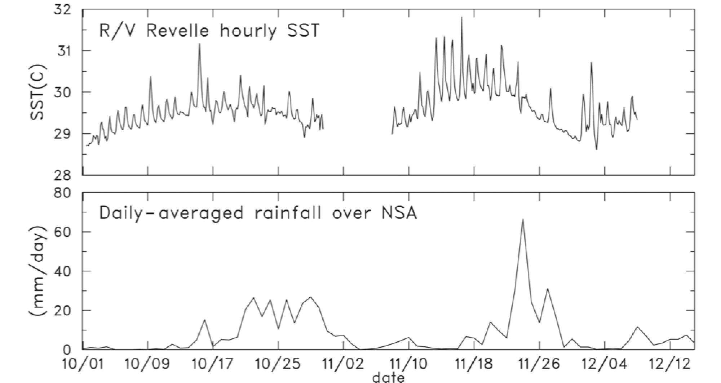
(Johnson and Ciesielski 2013)
Increasing SST, prominent diurnal cycle leading up to MJO active phases

Slide 31
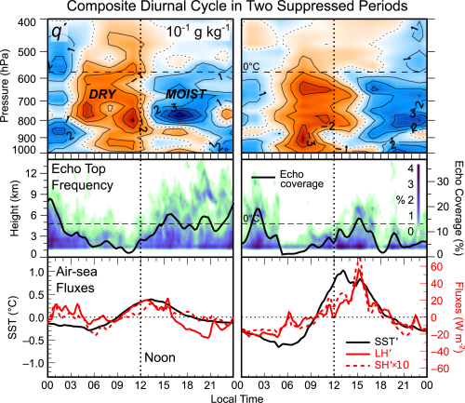
SST, surface fluxes peak in afternoon
Late afternoon (and nocturnal) peaks in radar echoes
Corresponding moistening of low to mid-troposphere
Diurnal cycle accelerates the moistening process (Ruppert 2016)
06-11 Oct
13-16 Nov
(Ruppert and Johnson 2016, JAMES)

Slide 32
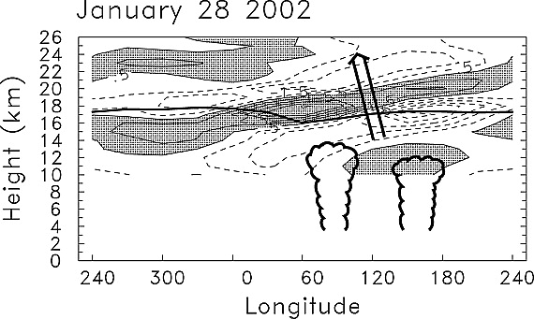
EFFECTS OF LARGE-SCALE ENVELOPES OF CONVECTION
location and altitude
of convection
deduced from OLR data
(Randel and Wu 2005)
(also Wheeler et al. 2000; Straub and Kiladis 2002)
Global-scale Kelvin wave forced by convection

Slide 33
Relative Humidity (NSA)
Moistening aloft prior to MJO active phase; increasing cirrus (CERES)
<MSE> peak
Decreasing <Q_{R}> prior to active phase
<Q_{R}> determined as a residual
BUDGETS (−0.59 K day⁻¹)
Sfc fluxes, LW trapping, bottom-heavy heating ➔ buildup of <MSE>
(−0.63 K day⁻¹)
(CERES)
(Johnson et al. 2015)

Slide 34
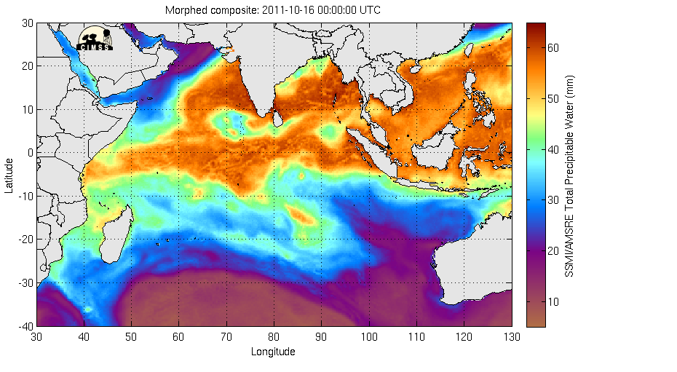
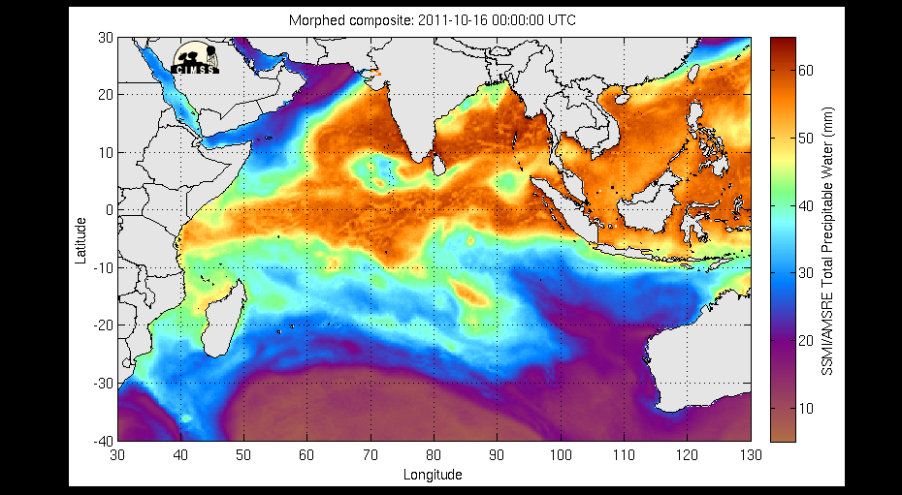
CIMMS TPW (16-20 October 2011)

Slide 35
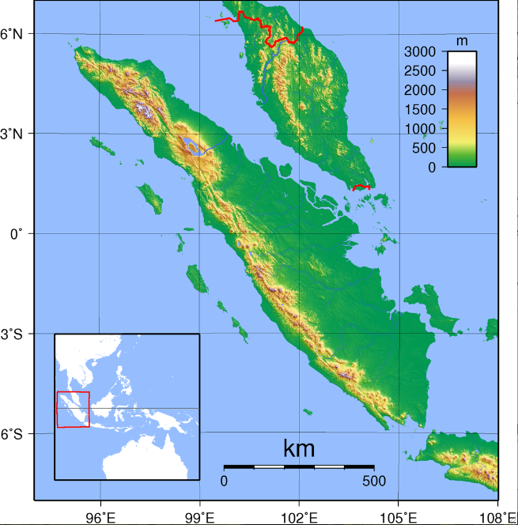
Max elevation = 3.8 km
Low-level flow
Malaysia
Sumatra extends from ~6N to 6S
Steep mountain chain on west side of island (>3 km), highest terrain on north end
Since Sumatra straddles the equator, wake vortices in easterly flow are cyclonic in both hemispheres
Equator
Sumatra

Slide 36
Max elevation = 3.8 km
Malaysia
Data for the study:
  YOTC ECMWF (May 2008 – Apr 2010)
  DYNAMO ECMWF OA (Oct 2011 – Mar 2012)
  Both datasets: 6-h time interval, 0.25 deg grid
Analysis Method:
  Objective feature tracking algorithm of Kevin Hodges (1995, 1999) applied to relative vorticity field
Sumatra

Slide 37
All shed cyclonic vortex tracks in study domain (10°N to 10°S)
Large concentration of tracks downstream of four regions
Initiation regions not involved in TC genesis
(Fine et al. 2016, MWR)

Slide 38
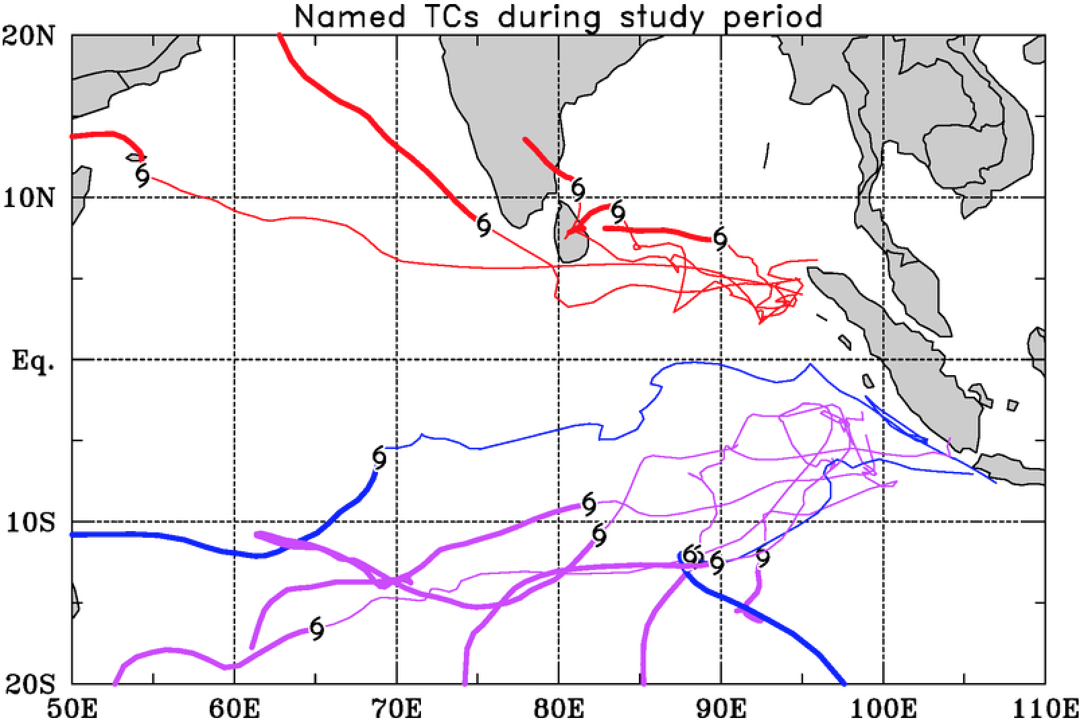
YOTC and DYNAMO Terrain-induced vortex & TC tracks
13 TC cases
Average pre-TC duration for YOTC and DYNAMO TCs (2.5 years of data) = 10.1 days

Slide 39
YOTC and DYNAMO Terrain-induced vortex & TC tracks
13 TC cases
25.5% of all IO TCs originated from terrain-induced vortices!

Slide 40

YOTC and DYNAMO Terrain-induced vortex & TC tracks
INDIA
= location
of first named tropical cyclone
INDIAN OCEAN
Easterly Flow
SUMATRA

Slide 41
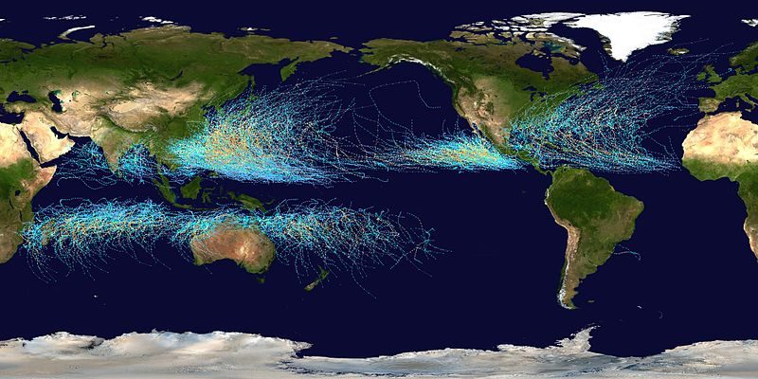
Tropical Cyclone Tracks 1985-2005
Sumatra is unique in the tropics

Slide 42
Summary
MJOs are dominant source of tropical intraseasonal variability; two prominent MJOs during DYNAMO
Oct and Nov MJOs linked, in part, to global circumnavigating Kelvin waves
SST increases in suppressed phase ➔ increasing cloud populations, cu to cg: diurnal cycle of SST/shallow cumulus ➔ accelerates moistening process ➔ air-sea coupling important to MJO
UT/LS Kelvin wave signal leads to cirrus increase, reduced <Q_{R}> prior to MJO active phase
Sumatra and surrounding terrain serve as low-level vortex generators ➔ TC formation over IO

Slide 44
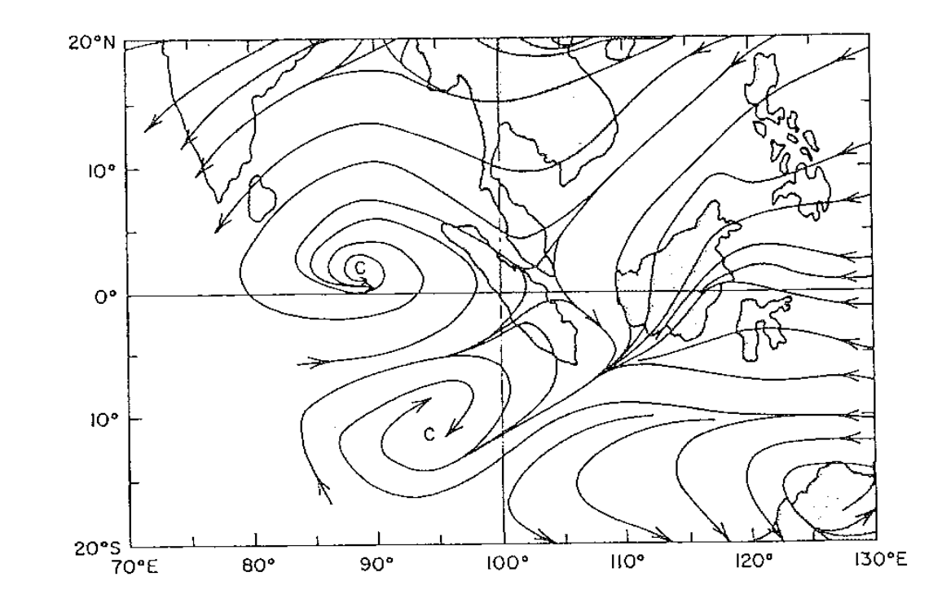
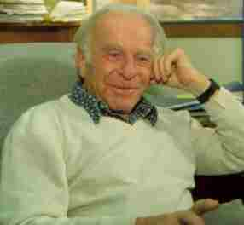
Historical Context
Tropical Cyclone Formation
Argued that easterly flow impinging on Sumatra would create counter-rotating wake vortices (Fr ~ 0.5)
Kuettner (1989, Wetter und Leben)
[Kuettner and Soules 1967]
Because Sumatra straddles the equator, both circulations are cyclonic
Each vortex has accompanying low pressure and has the potential to generate tropical cyclones over the Indian Ocean
EQ
Joachim Kuettner
Sumatra “double vortex”
850 hPa

Slide 45
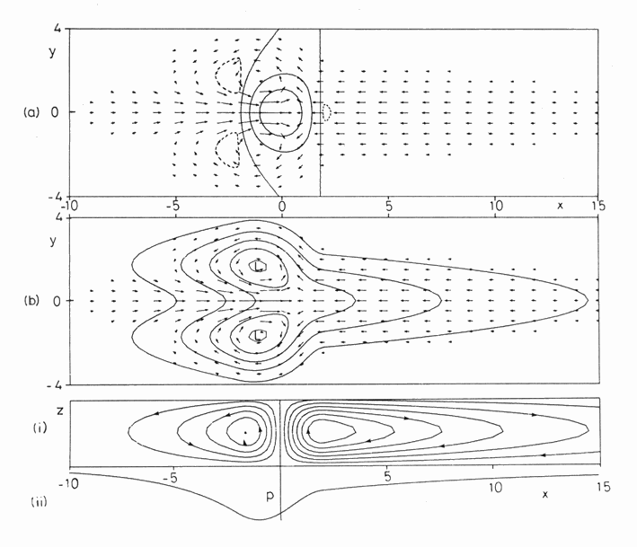
“Gill Model”
Heat Source
Rossby gyres
Westerly Wind Burst (WWB)
Can trigger Kelvin wave in western Pacific Ocean and El Niño onset
Kelvin wave
Gill, A., 1980: Some simple solutions for heat induced tropical circulation. Quart. J. Royal Meteorol. Soc., 106, 447-462.

Slide 46
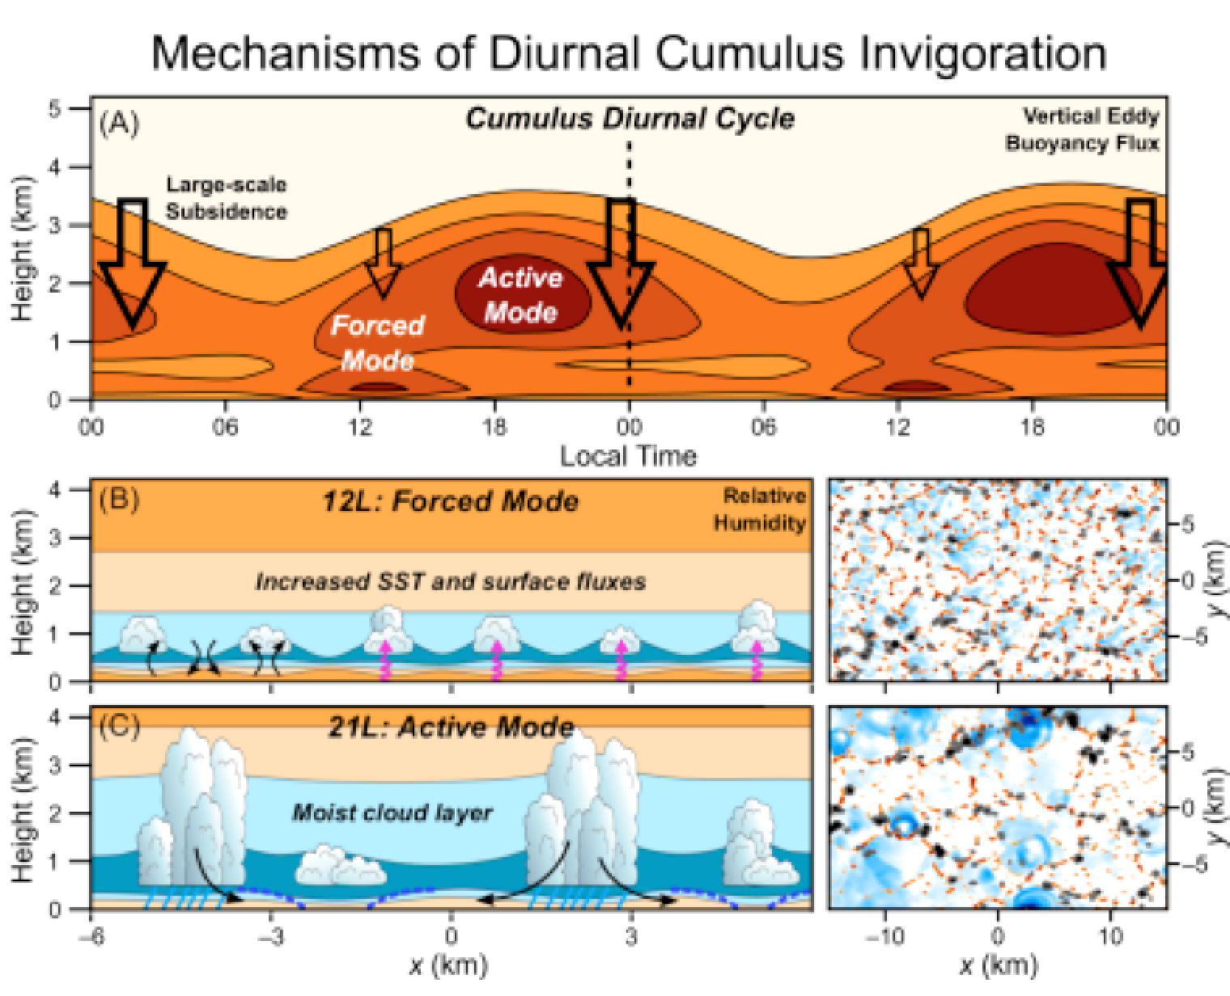
George Bryan’s CM1, 200-m grid, 100 X 50 km domain, SST diurnal cycle imposed; WTG approximation
“Forced BL” clouds associated with afternoon SST/surface flux peaks
Deeper, “active” clouds later afternoon/evening, aided by cold pools
Ruppert (2016) shows that MJO moistening phase is accelerated by diurnal cycle
(Ruppert and Johnson 2016, JAMES)
Notes:
Conceptualized forcing mechanisms of the cumulus diurnal cycle—both the “forced” and “active” modes—over the tropical warm pool. (a) Time‐height series of vertical eddy buoyancy flux (cf. Figure 13a; smoothed to emphasize robust features), with large‐scale subsidence indicated by the open arrows. (b and c, left) Schematized cloud scenes in the x‐z plane at (b) 12L and (c) 21L, including relative humidity (shaded; warmer colors indicate drier air), surface fluxes (magenta arrows), eddy circulation (black arrows), cold pools (blue‐dashed lines), and rainfall (light‐blue lines). (b and c, right) Corresponding maps in the x‐y plane of negative
at 25 m (blue), upward motion at 225 m (red), and cloud (gray‐black) (directly from model output; cf. Figure 6).
IF THIS IMAGE HAS BEEN PROVIDED BY OR IS OWNED BY A THIRD PARTY, AS INDICATED IN THE CAPTION LINE, THEN FURTHER PERMISSION MAY BE NEEDED BEFORE ANY FURTHER USE. PLEASE CONTACT WILEY'S PERMISSIONS DEPARTMENT ON PERMISSIONS@WILEY.COM OR USE THE RIGHTSLINK SERVICE BY CLICKING ON THE 'REQUEST PERMISSIONS' LINK ACCOMPANYING THIS ARTICLE. WILEY OR AUTHOR OWNED IMAGES MAY BE USED FOR NON-COMMERCIAL PURPOSES, SUBJECT TO PROPER CITATION OF THE ARTICLE, AUTHOR, AND PUBLISHER.

Slide 47
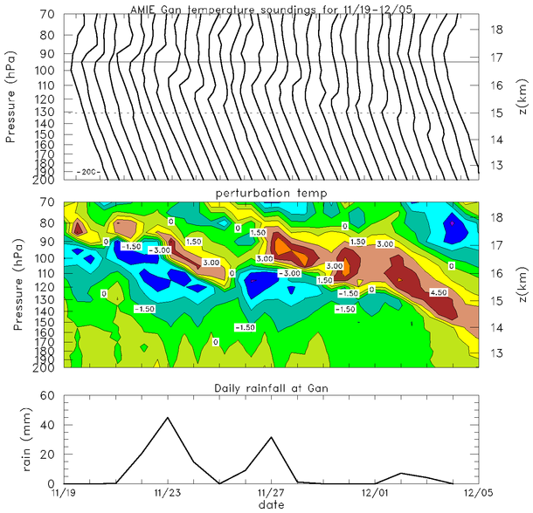
_
_
_
_
_
_
_
_
_
_
_
_
_
Tropopause Descent
_
_
_
_
_
_
_
_
_
_
_
_
_
_
_
_
_
_
_
_
_
_
_

Slide 48
EFFECTS OF LARGE-SCALE ENVELOPES OF CONVECTION
(Randel and Wu 2005)
WARM
COOL
location and altitude
of convection
deduced from OLR data
Global-scale Kelvin wave forced by convection

Slide 49
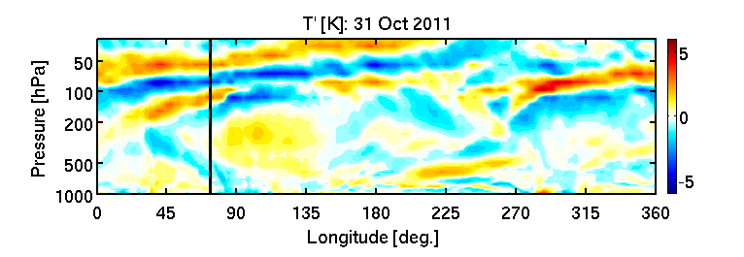
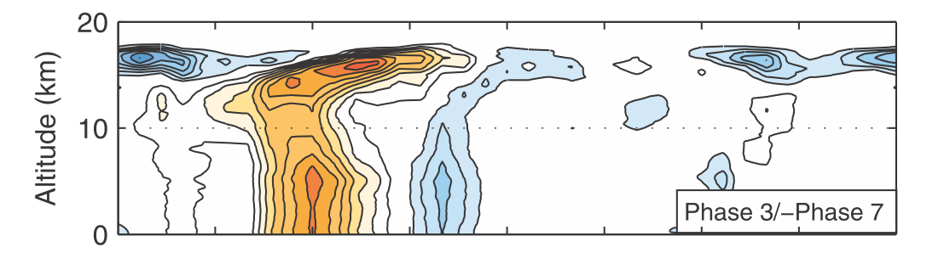
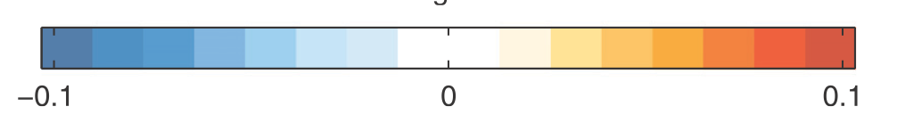
(Erin Dagg)
ERAi
cool
warm
MJO
(Virts and Wallace 2010)
CALIPSO cloud index

Slide 50
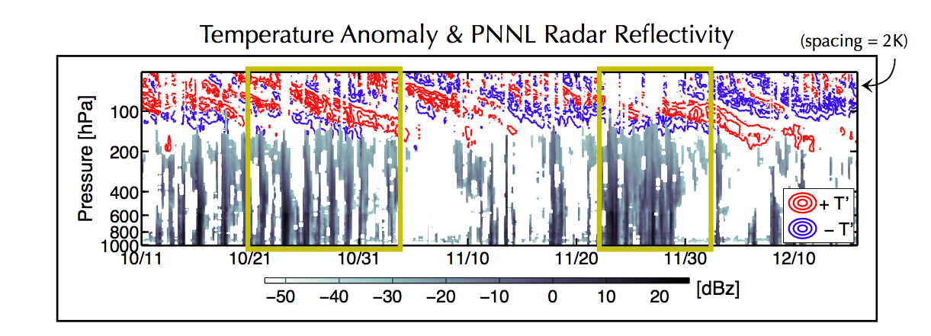
Gan Island
(Virts and Wallace 2010)
0
360
CALIPSO cloud index

Slide 51
Gan Island
(Virts and Wallace 2010)
0
360
CALIPSO cloud index

Slide 52
Cirrus before active phase
(Virts and Wallace 2010)
CALIPSO cloud index

Slide 53
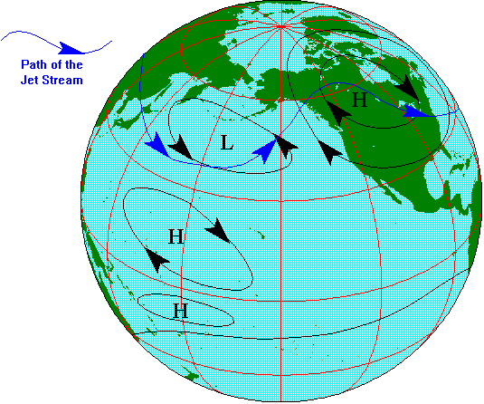
“PNA Pattern” – Rossby Wave Train
Hoskins and Karoly (1981); Horel and Wallace (1981); Webster (1981)

Slide 54
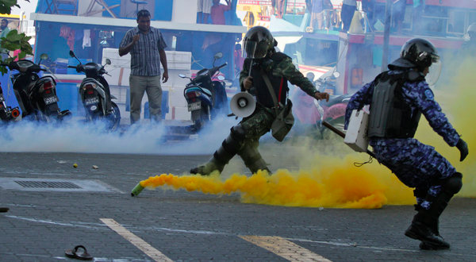
October/November MJO activity over Northern Array associated with seasonal cycle of precipitation
Maldives political crisis
December
MJO

Slide 55
Northern Sounding Array
(NSA)
u
Oct MJO preceded by low-level westerlies descent of easterlies; Nov MJO by low-level easterlies; WWBs then follow
Low-to mid-level moisture build-up several weeks prior to active phases
Prominent UT/LS Kelvin/gravity wave signals
2-day disturbances with MJO1, 4-5 day period with MJO2
RH
T’
PRECIPITATION
MJO2
MJO1
(Johnson and Ciesielski 2013)

Slide 56
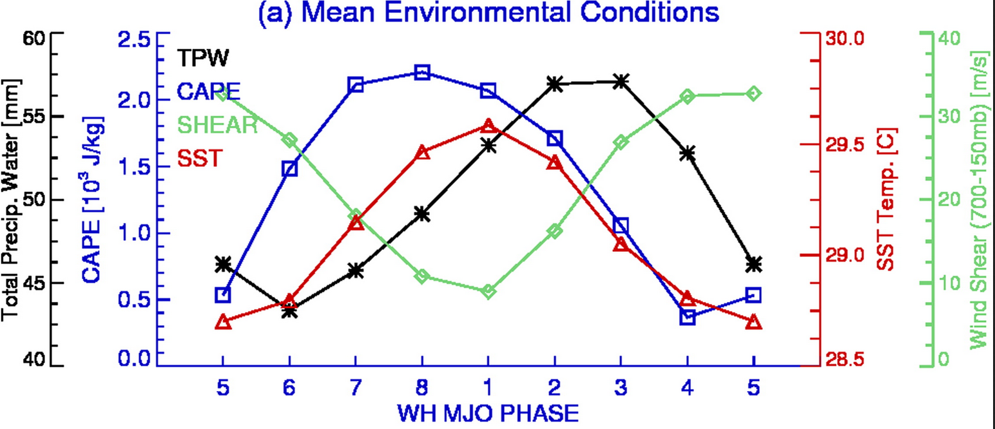
SST increase leads to build-up of CAPE
MJO Active Phase over IO
DYNAMO COMPOSITE
(Xu and Rutledge 2014)

Slide 57
(Johnson and Ciesielski 2013)
Prominent SST diurnal cycle leading up to MJO active phases

Slide 58
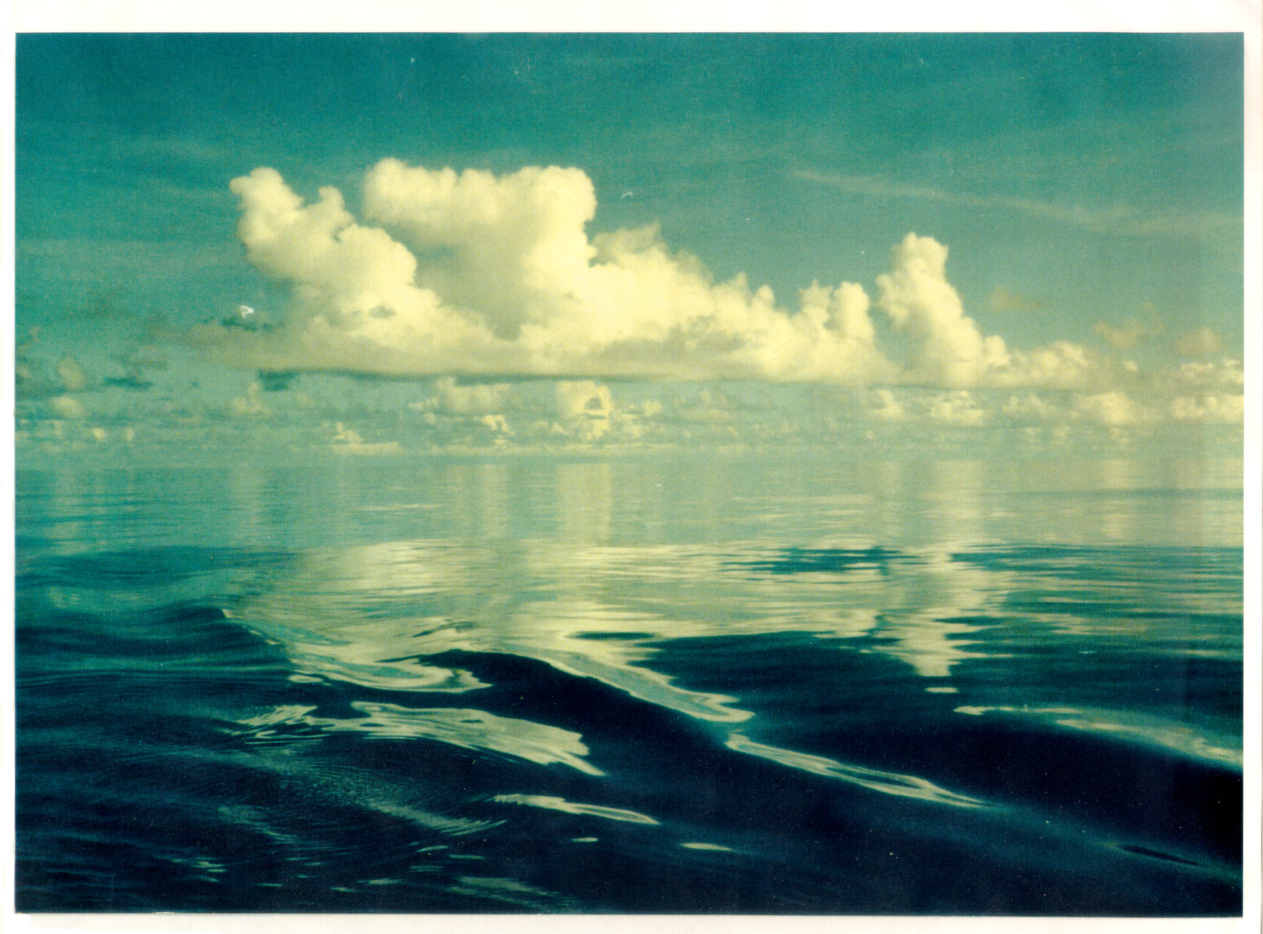
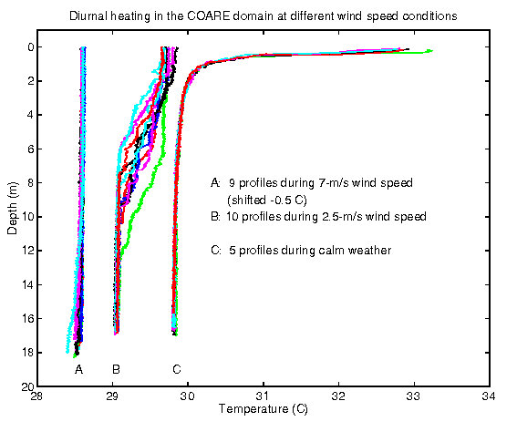
(Soloviev and Lukas 1997)
TOGA COARE, early December 1992
Xin Lin

Slide 59
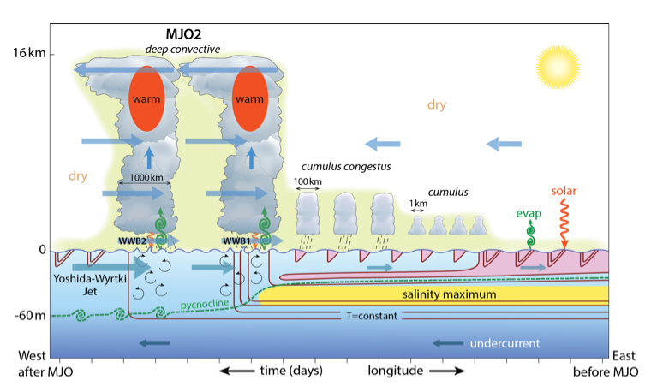
Moum et al. (2014, BAMS)

Slide 60
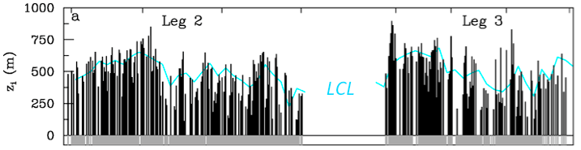
Revelle Atmospheric Mixed Layer Depth, SST, Rainfall
R/V Revelle
ATMOSPHERIC MIXED LAYER DEPTH, LCL
?
SST-warming phases:
Deepest mixed layers
ML depth increases with time, extends above LCL; promotes cloud growth
SST-warming phases:
Deepest mixed layers
ML depth increases with time, extends above LCL; promotes cloud growth
SST-warming phases:
Deepest mixed layers
Is there a role for the diurnal cycle in MJO initiation?
MJO1
MJO2
Notes:
Large diurnal cycle in SST before MJO heavy rainfall, particularly during Nov when sfc wind was weaker.

Slide 61

Tilted T, RH structure in upper troposphere
(CERES)

Slide 62
MJO Remains an Enigma
(Adames and Wallace 2015)
Theories:
WISHE (Wind-Induced Surface Heat Exchange)
Wave-CISK (Conditional Instability of the Second Kind)
Moisture mode or dispersive moisture wave
Multiscale interactions (convective to planetary scale)
Stratiform instability
Radiative-convective instability
Instability involving air-sea coupling

Slide 63

The MJO as a Dispersive, Convectively Coupled Moisture Wave: Theory and Observations
Eastward motion
Time ➔
Westward group velocity
Adames and Kim (2016, JAS)
20-100 day filtered OLR

