Slide 1
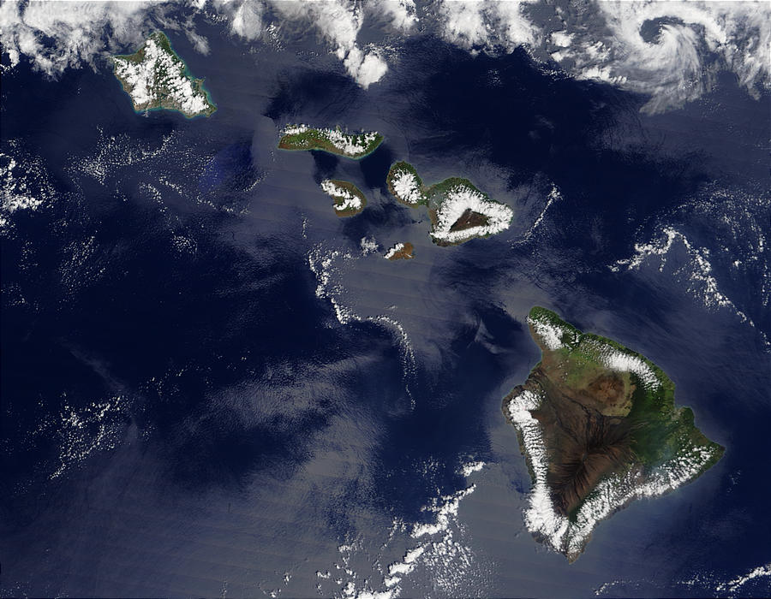
Fifty Years of Progress in Tropical Meteorology: A Personal View
Richard H. Johnson
on the occasion of
50th Anniversary Symposium
Department of Meteorology University of Hawai’i
11 September 2006

Slide 2
Fifty Years Ago: 1956
February 22
Elvis Presley enters music charts for first time with “Heartbreak Hotel”
March 15
“My Fair Lady” opens in New York City
April 14
Videotape first developed
June 29
Interstate Highway System created in U.S.
August 19
Beginnings of Department at U. Hawaii
October 8
Don Larsen throws first, and only perfect game in World Series
October 31
Suez Crisis
November 6
Eisenhower reelected
Notes:
Formation of UH department motivated by Air Force need for research on typhoons

Slide 3
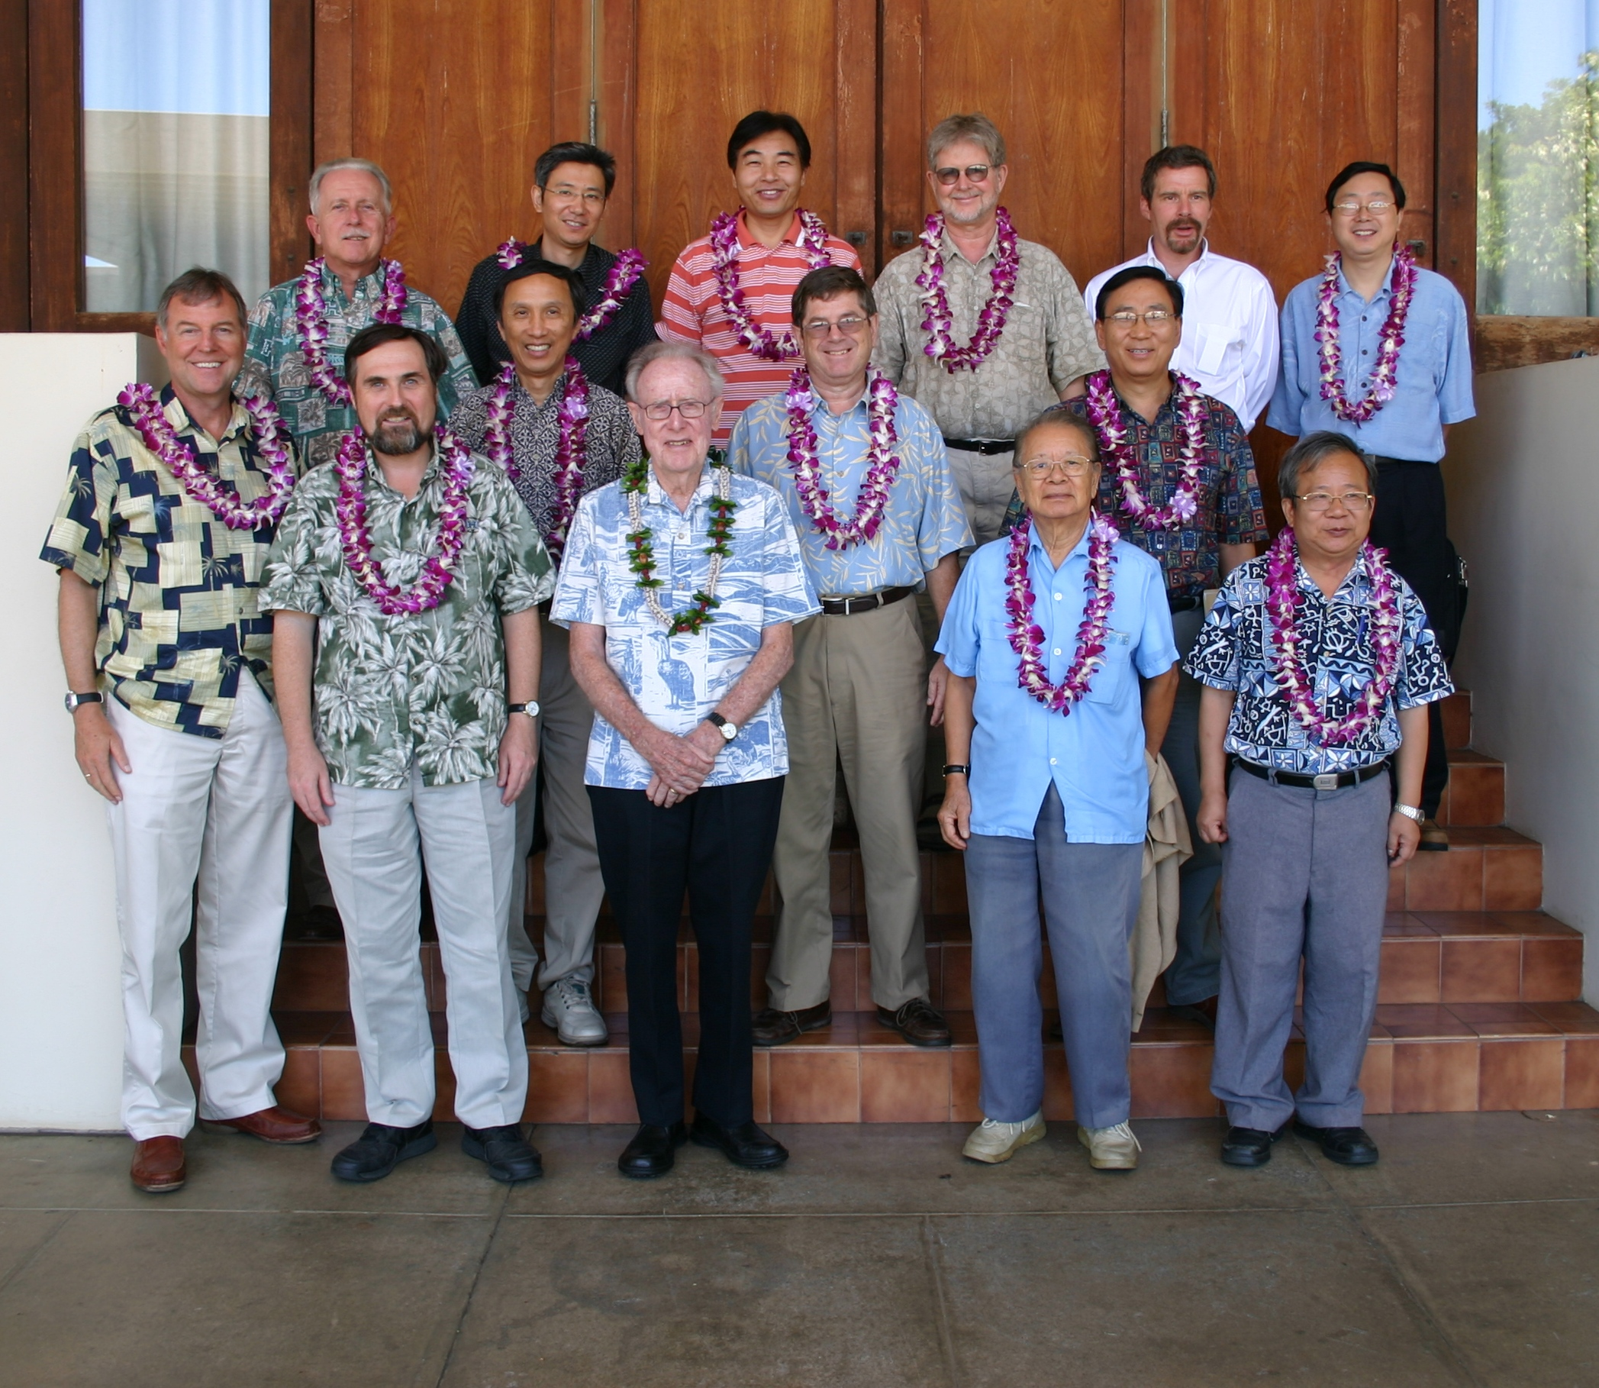
Department of Meteorology, University of Hawai’i 50th Anniversary Celebration
East-West Center, University of Hawaii, Manoa 11 September 2006

Slide 4

TROPICAL METEOROLOGY
“FORMATIVE YEARS”
“DISCOVERY YEARS”
“GATE/FGGE YEARS”
1950s
NSF
1960s
NWP
NHRP
WMO
QBO
1970s
UH MET
QBO
EQ WAVES
IGY
JTWC
CISK
FGGE
NASA
TUTT
MJO
GATE
ENSO
TROP MET
NCAR
MONEX
NOAA
GARP
CU PARAM
TIROS/ATS
“ENSO/MONSOON YEARS”
MONSOON MET
“BROAD ADVANCES”
“GLOBAL CHANGE”
1980s
TOGA
1990s
‘82-83 EL NIÑO
2000s
TAO ARRAY
CONV/DYN/HURR/MONSOON
PNA
WISHE
NCEP REANAL
CLIMATE VAR
TOGA COARE
EARTH SIMULATOR
MONSOONS
TRMM
KYOTO
PDO
KATRINA
A-TRAIN
QUIKSCAT

Slide 5
● FIFTY YEARS OF PROGRESS IN ATMOSPHERIC SCIENCES ●
EVENTS
TROPICS
DISCOVERIES
CLIMATE DYNAMICS
1950 WMO; NSF
– 1949, 1956 BREWER-DOBSON CIRCULATION –
50’s
1954 TROP MET (RIEHL)
1951 TRADE WIND STRUCTUE (RIEHL, YEH, MALKUS, LA SEUR)
1956 UH DEPT FORMED 1957-8 IGY; 1958 NASA 1959 JTWC GUAM
1950s NWP (PHILLIPS, CHARNEY, VON NEUMAN)
1958 HOT TOWERS (RIEHL, MALKUS)
– 1958 CO₂ RECORD BEGAN, MAUNA LOA (KEELING) –
UCAR, NCAR; TIROS-1
1961 QBO (REED, VERYARD)
1963 PREDICTABILITY LIMIT (LORENZ)
60’s
1964 CISK (CHARNEY, ELIASSEN)
1966 ATS-1
1966 EQ WAVES (MATSUNO) 1967 TUTT (SADLER)
1967 GARP
1967 GREENHOUSE THEORY (MANABE, WETHERALD)
1969 BOMEX
1969 ENSO (BJERKNES)
1970 NOAA
1971 MJO (MADDEN-JULIAN)
1970-74 O₃ DEPLETION CHEMISTRY (CRUTZEN, ROWLAND, MOLINA)
70’s
1971 MONSOON MET (RAMAGE)
1971-4 CU PARAMETERIZATION (ARAKAWA, OOYAMA, YANAI)
1974 GATE 1975 GOES-1
1977 CRAY-1A; CLIMATE SHIFT
1977- TROPICAL CONVECTION (HOUZE, ZIPSER, BETTS)
1978- NAO RENEWED STUDY (VAN LOON, ROGERS,…)
1979 WCRP; MONEX; FGGE
1982-3 EL NIÑO
1980s– MONSOONS (KRISHNAMURTI, WEBSTER, SHUKLA, MURAKAMI, YANAI…)
80’s
– 1981 PNA PATTERN (HOSKINS, KAROLY, HOREL, WALLACE) –
1985 TOGA; TAO ARRAY
– 1985 PV INVERTIBILITY (HOSKINS) –
1987 MONTREAL PROTOCOL 1988 IPCC; HEAT WAVE
1987 ENSO MODEL (CANE-ZEBIAK) ; WISHE (EMANUEL)
1985 OZONE HOLE; THC (BROECKER)
1992-3 TOGA COARE
1980s-present CONTINUED ADVANCES: TROP CONVECTION, TROP DYNAMICS, EQ WAVES, MONSOONS, STRAT-TROP EXCHANGE, DIURNAL CYCLE, STRATOCUMULUS, HURRICANES, …
90’s
1993 CEPEX
1996 NCEP REANALYSIS 1997 TRMM, KYOTO P.
1997 PDO (MANTUA ET AL.) 1998 AO (THOMPSON, WALLACE)
1999 JTWC HAWAII; QUIKSCAT
1999 EQ WAVES (WHEELER-KILADIS); INDIAN OCEAN DIPOLE
00’s
2002 EARTH SIMULATOR
2005 KATRINA 2000s NASA’s A-TRAIN
Notes:
Chronology of events, discoveries in tropical meteorology and climate over past 50 years

Slide 6
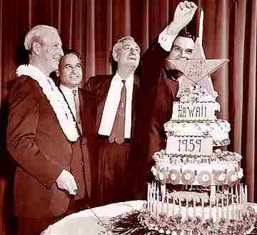
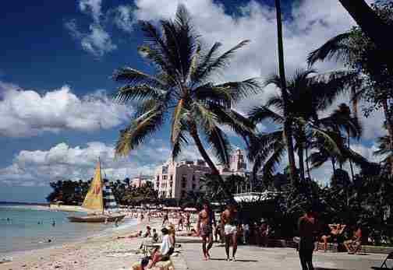
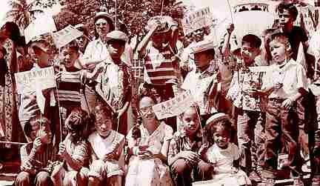
1950s
THE FORMATIVE YEARS
NWP, EARLY DEVELOPMENTS IN TROPICAL METEOROLOGY
Hawaiian Statehood 1959
(circa 1950)

Slide 7
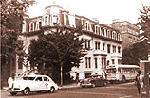
National Science Foundation History
The National Science Foundation's first location at 901 16th Street, NW, Washington, DC.
Established 1950
"Penicillin, the proximity fuze, the atom bomb, among a host of other scientific contributions to American victory in the Second World War, brought home to many citizens the value of scientific research. In the continuing crisis after the war, there were few who opposed the proposition that sustained Federal support of science and research was essential to the defense and welfare of the United States."
– Excerpt from The First Annual Report of the National Science Foundation, 1950-51

Slide 8

…31 countries…endorsed the transformation of IMO into a new inter-governmental World Meteorological Organization (WMO)… 23 March 1950
As weather, climate and water cycle knows no national boundaries, international cooperation at a global scale is essential…
WMO facilitates the free and unrestricted exchange of data and information, products and services in real- or near-real time…

Slide 9
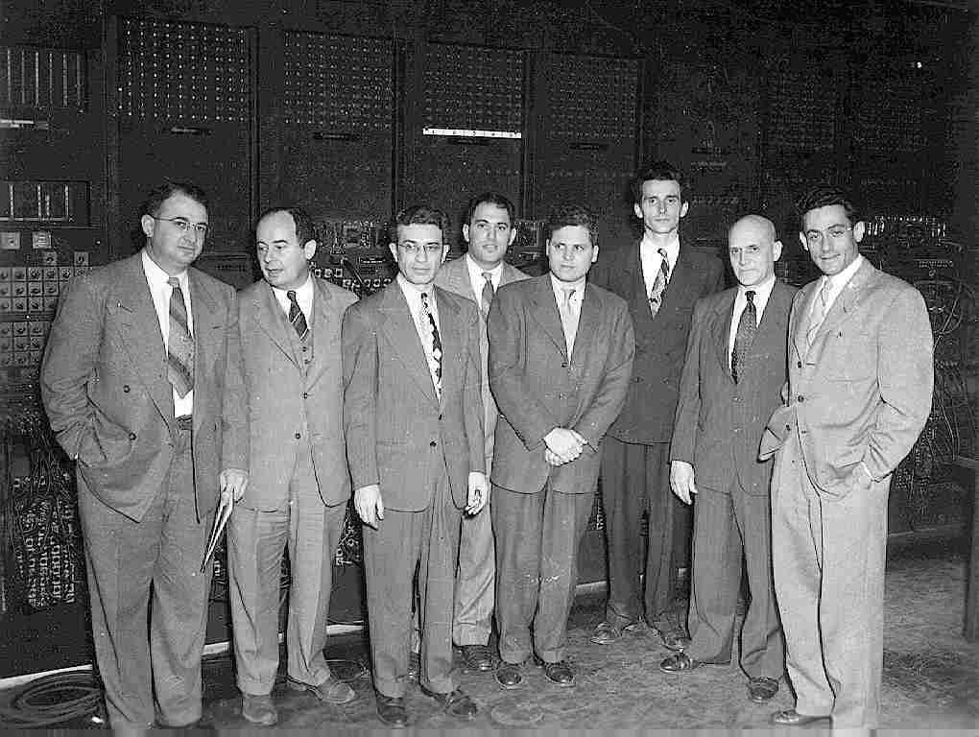
first weather forecast – ENIAC, 1950
Wexler
von Neumann
Namias
Fjortoft
Frankel
Reichelderfer
Freeman
Charney
In front of the Eniac, Aberdeen Proving Ground, April 4, 1950, on the occasion of the first numerical weather computations carried out with the aid of a high-speed computer.
Notes:
J. Von Neumann in 1946 led an effort at the Institute for Advanced Study at Princeton to build an electronic computer, and he recognized weather prediction as a prime candidate for its application. Charney and Eliassen, who were invited by von Neumann to Princeton in 1948, developed the nonlinear barotropic vorticity equation as the first application of numerical prediction, but progress on von Neumann’s computer was slow, so the Army was contacted in 1949 about using ENIAC. The first one-day, nonlinear prediction took place in April 1950…it took over 24 h, in part because of frequent ENIAC breakdowns.

Slide 10
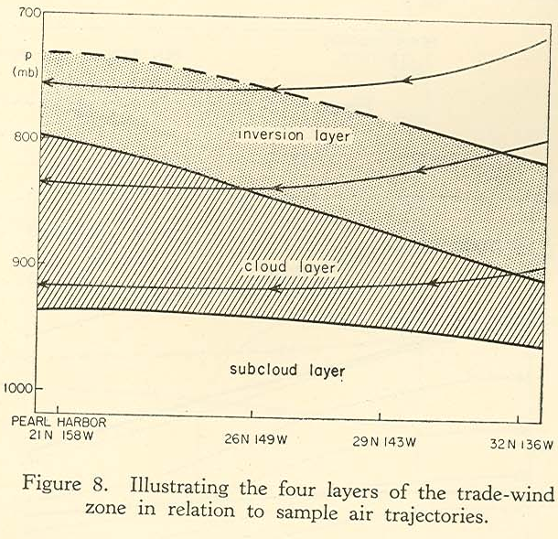
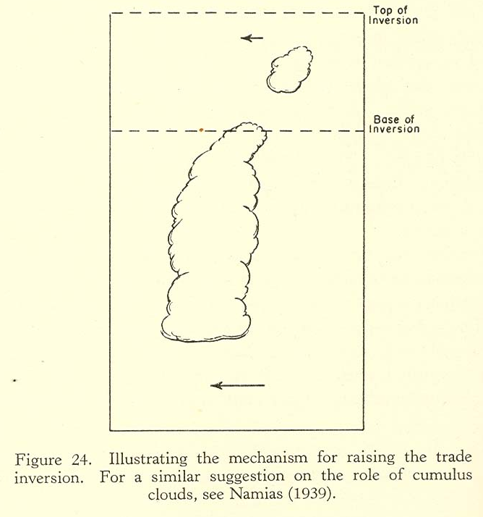
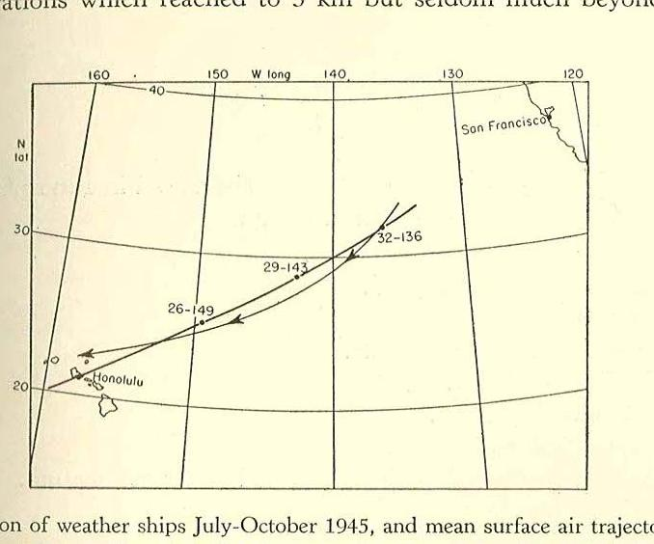
Riehl, H., Yeh T. C., Malkus J. S., and La Seur, N. E., 1951: “The Northeast Trade of the Pacific Ocean”. Quarterly Journal of the Royal Meteorological Society. 77, 598-626.
July-October 1945
3 weather ships Surface air trajectory
Rise of the inversion is accomplished through the pickup of latent heat by the trade in the course of its passage over the tropical ocean.
The bases of cumulus clouds are nearly uniform height, but the tops are very irregular.
The tops of the cumulus clouds break off and evaporate quickly
“…inversion ascends downstream, individual columns descend, shrink vertically and spread horizontally. Large masses of air, located above the inversion at 32N have become a part of the cloud layer when they reach Honolulu, HI”

Slide 11
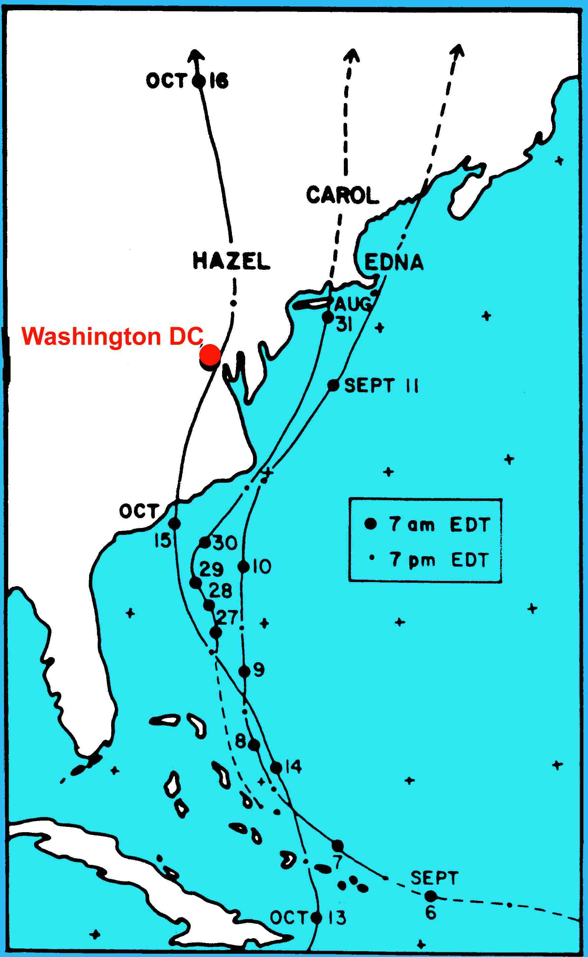
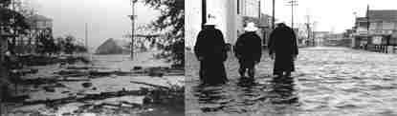
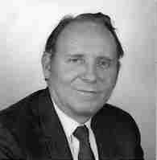
Hurricanes Carol, Edna, Hazel in 1954
Hazel 15 October 1954
Southport, NC
Wrightsville Beach, NC
Hazel went directly over Washington DC. In 1955 Congress authorized additional funding for the USWB to create the National Hurricane Research Project (NHRP).
Robert Simpson was appointed first Director of NHRP. (previously Chief Meteorologist, WBO, Hawaii, 1948-53)

Slide 12
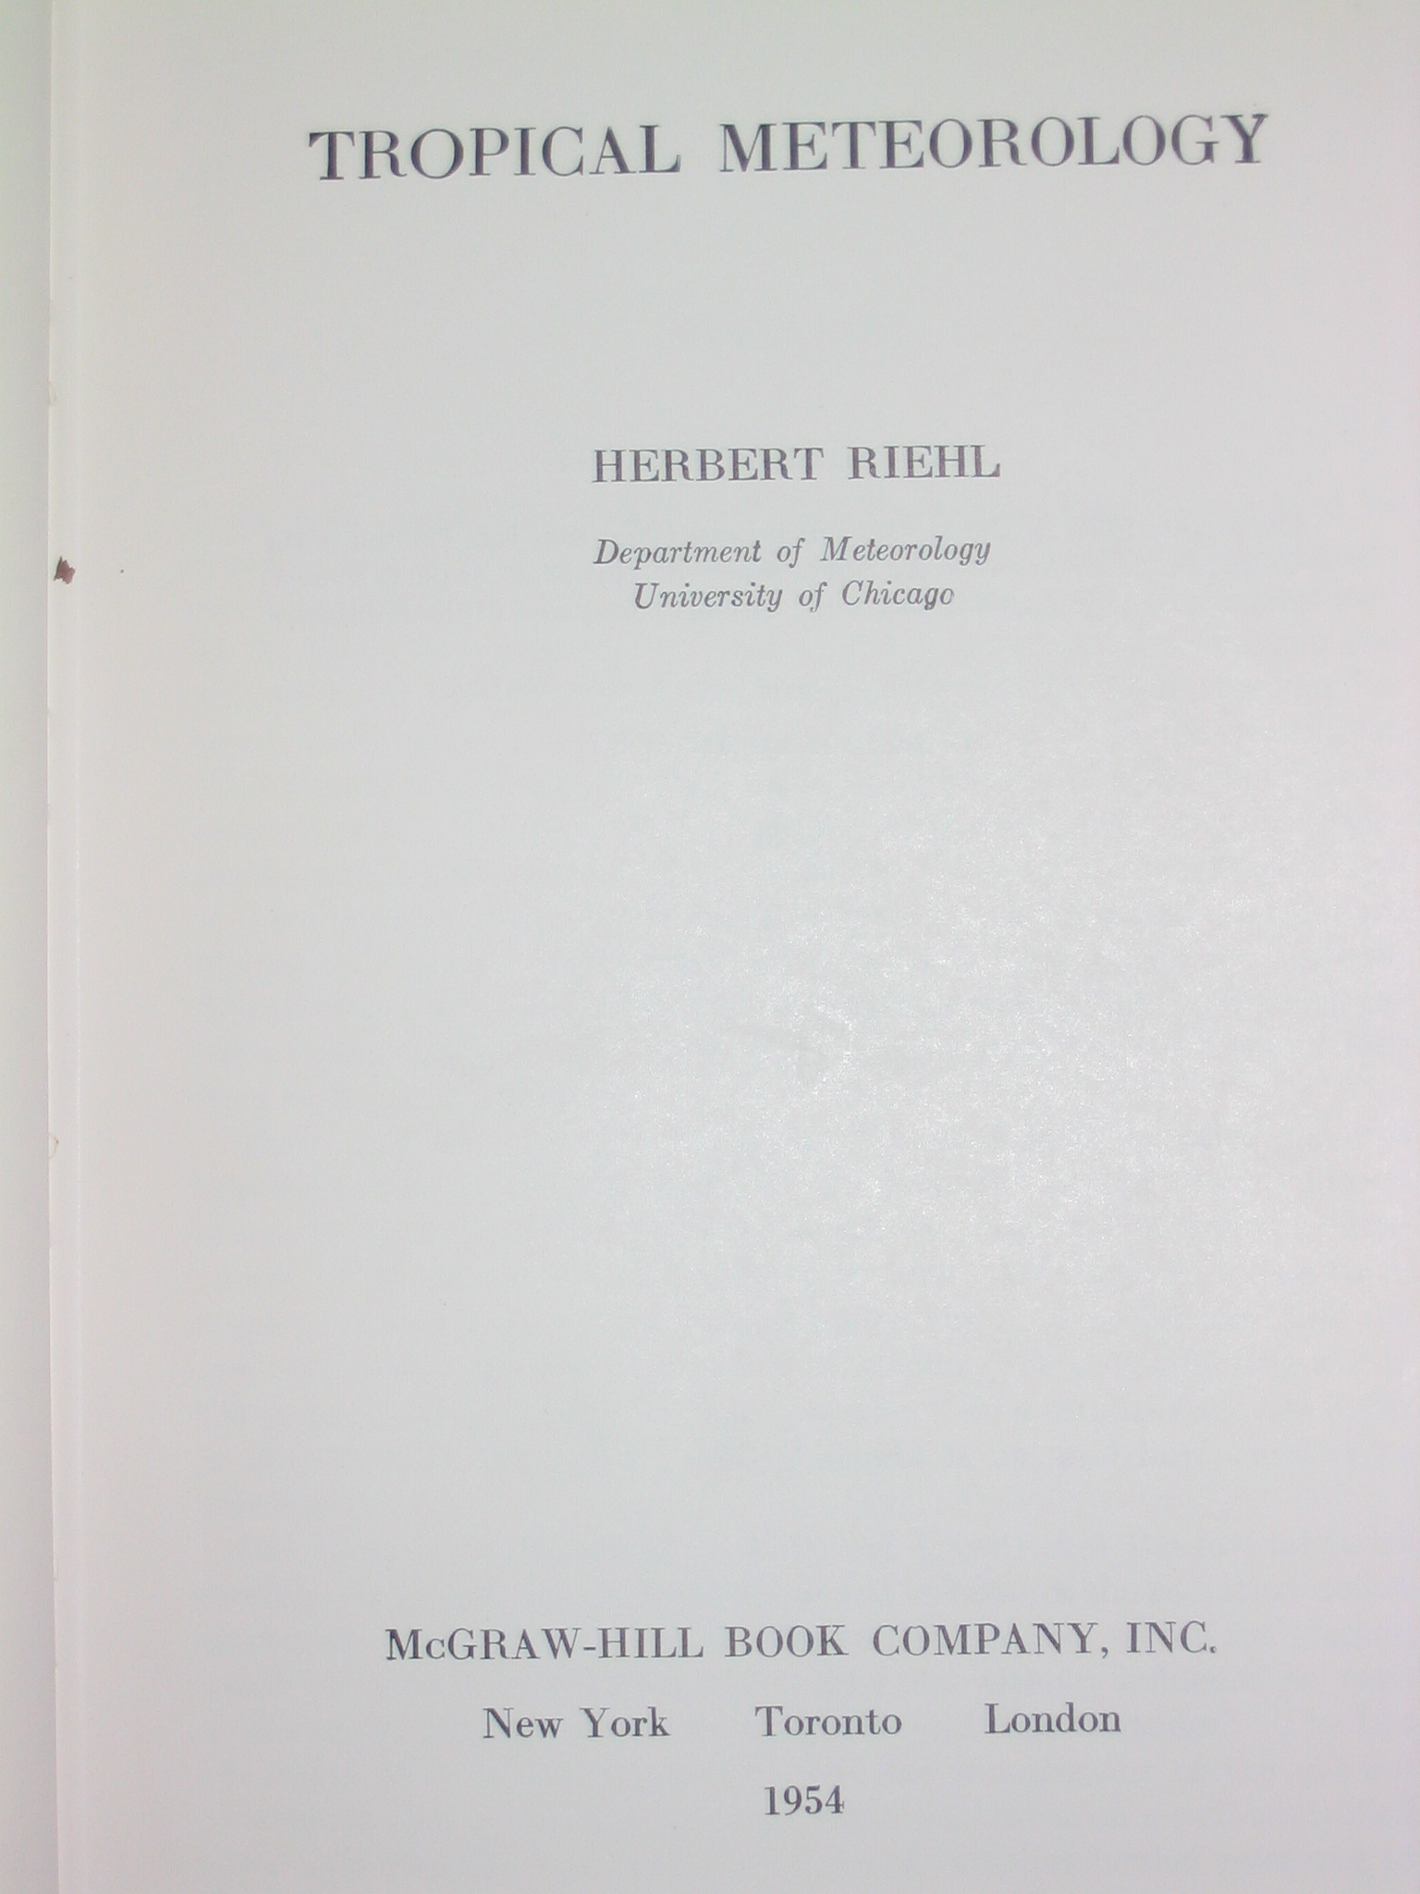
CHAPTERS
Tropical Meteorology (1954)
Herbert Riehl (age 38)
Winds and pressure
Temperature
Rainfall
Diurnal and local effects
Convection
The physics of tropical rain
Weather observations and analysis
Divergence and vorticity
Waves in the easterlies
Survey of low-latitude disturbances
Tropical storms
The general circulation
(book ultimately a result of WWII – formation of Institute of Tropical Meteorology in Puerto Rico, where Riehl arrived in 1943)

Slide 13
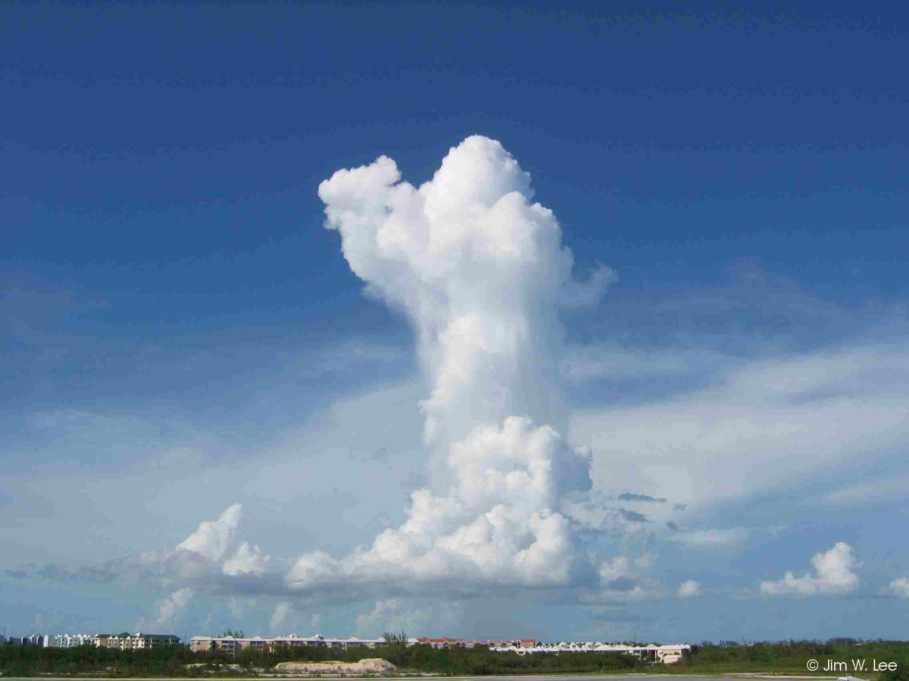
PREFACE
Tropical Meteorology (1954)
H. Riehl
“In July, 1943, the author first saw the tropics when he arrived in Puerto Rico at the Institute of Tropical Meteorology… On the first evening some of the staff walked along the beach and admired the beauty of the trade cumuli in the moonlight. Well schooled in the ice-crystal theory of formation of rain, they had no suspicions about
these clouds with tops near 8,000 feet where the temperature is higher than +10°C. Suddenly, however, the landscape ahead of them began to dim; then it disappeared; a roar approached as from rain hitting the roof tops. …cloud tops with temperatures below freezing were not needed for the production of heavy rain from trade-wind cumulus.”
“How is it with other theories in so far as they concern the tropics?”

Slide 14
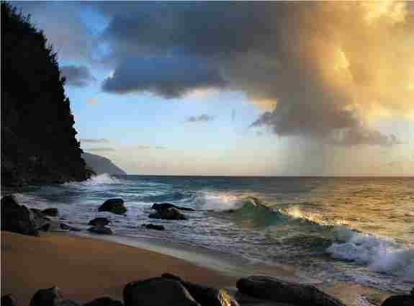
Warm-Rain Studies in Hawaii
Since the 1950s, Hawaii has served as a natural laboratory for studying warm rain in the Tropics.
Project Shower (1954)
Warm Rain Project (1965)
Joint Hawaii Warm Rain Project (1985)
Hawaiian Rainband Project (1990)
U. Hawaii PIs investigating warm-rain processes:
T. Takahashi (CPO Hilo), C.S. Ramage, T. Schroeder, R. Lavoie, A.H. Woodcock, Y.-L. Chen, C.M. Fullerton, R.C. Taylor, S.W. Lyons
Cloud modeling; riming electrification – T. Takahashi
Notes:
The earliest studies on warm rain were instigated (as pointed out by T. Schroeder) by prospects for weather modification, supported by a consortium of the Hawaiian Sugar Planters Association and the Hawaii Cattlemen’s Council. But then it was immediately learned that the warm-rain clouds in Hawaii were not amenable to artificial enhancement by silver iodide.

Slide 15
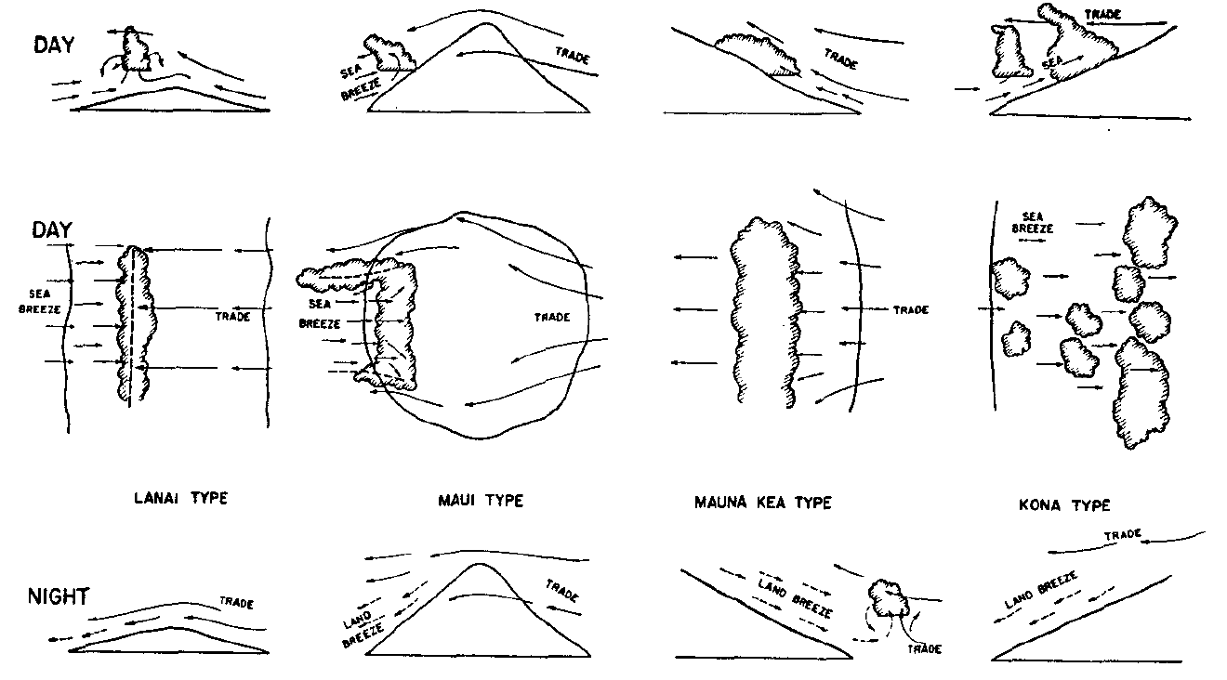
Leopold, L.B., 1949: The interaction of trade wind and sea breeze, Hawaii. J. Meteor. (Pineapple Research Institute and Experiment Station, Hawaiian Sugar Planters’ Association)
Hawaiian Island circulations discussed extensively in Riehl’s 1954 text.
Subsequent island circulation studies at U. Hawaii: Lavoie, Schroeder, Ramage, Y.-L. Chen, and others
Notes:
A naturalist, expert on rivers and son of Aldo Leopold, died on Feb. 23, 2006 at age 90.

Slide 16
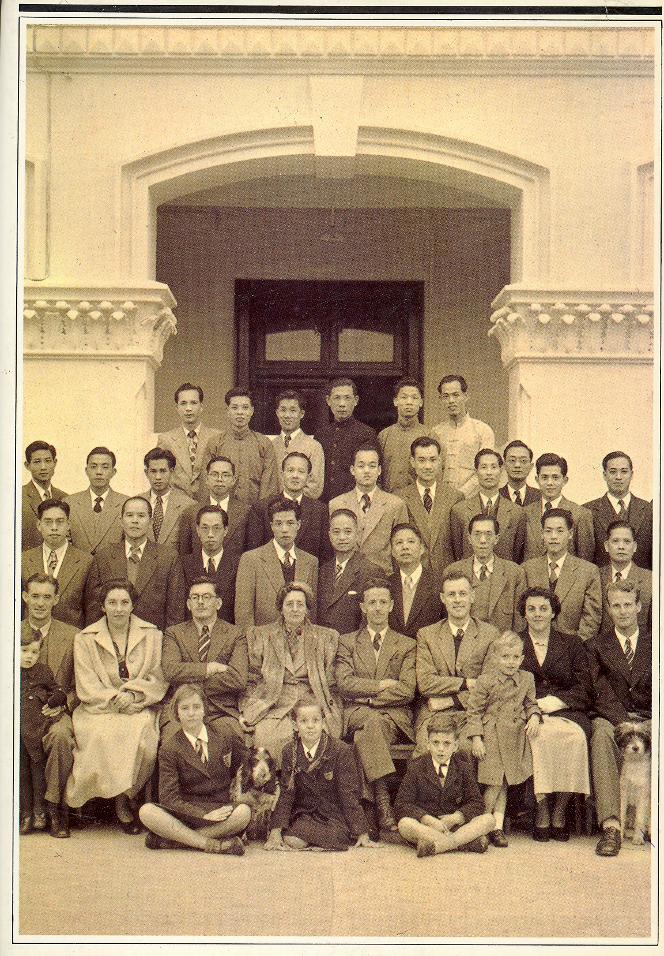
Post-WWII Aviation Boom
Increasing aviation in the tropics, including Asia, placed growing demands in the 1950s on observations and tropical forecasting.
Staff of the Hong Kong Royal Observatory soon after World War II
“Our forecast service [for aviation], separated from the Observatory itself, is designed and located to meet aviation needs; inevitably forecasts for the general public (including local typhoon warnings) and for shipping have suffered.”
– C.S. Ramage, Acting Director, Hong Kong Royal Observatory, 1955
(in From Time Ball to Atomic Clock by Anthony Dyson, 1983)

Slide 17
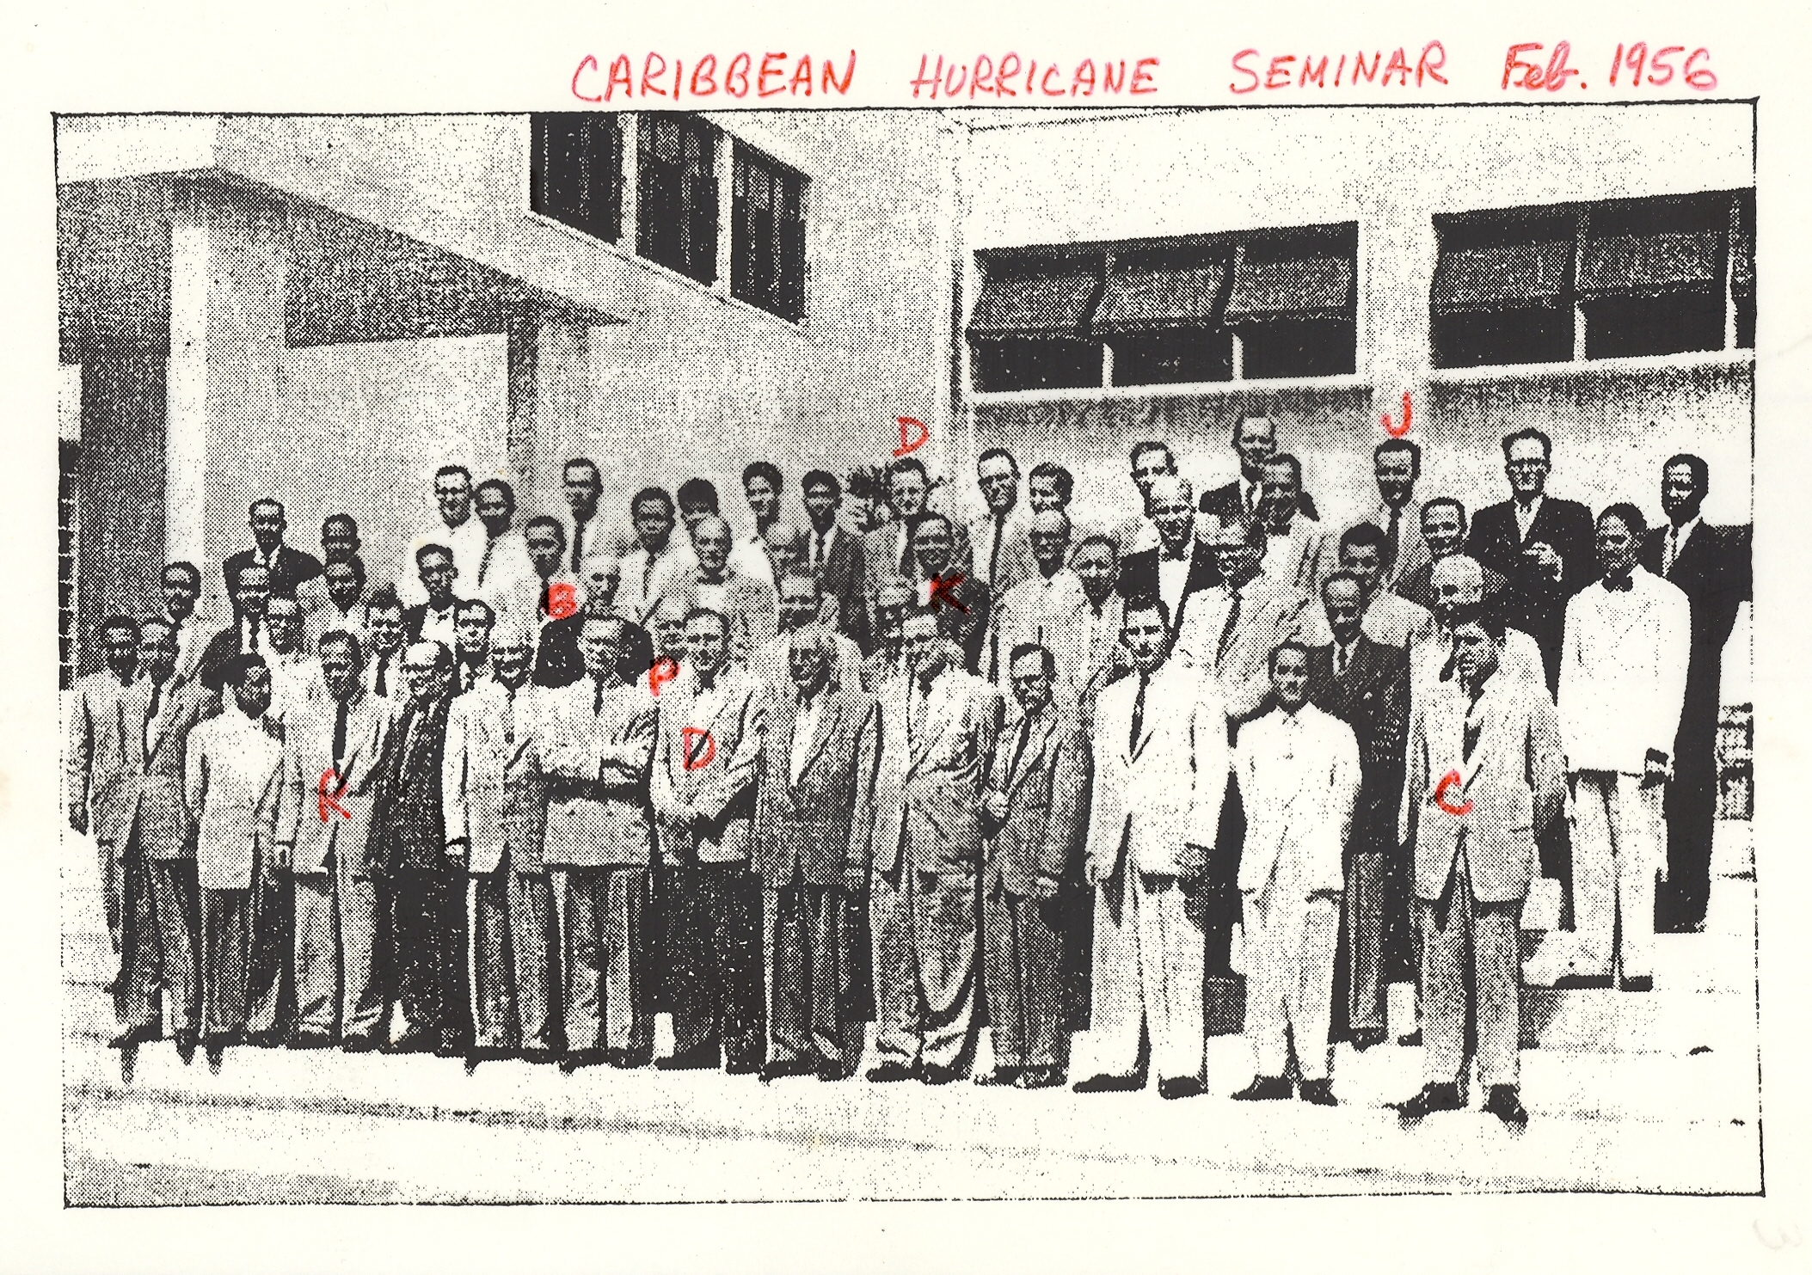

Slide 18

In 1956 the University established a Meteorology Program within the Department of Geosciences at the University of Hawaii with initial assistance from the US Air Force. Colin Ramage came from Hong Kong Royal Observatory to lead the program. A Department of Meteorology and Oceanography was established in 1960.

Slide 19
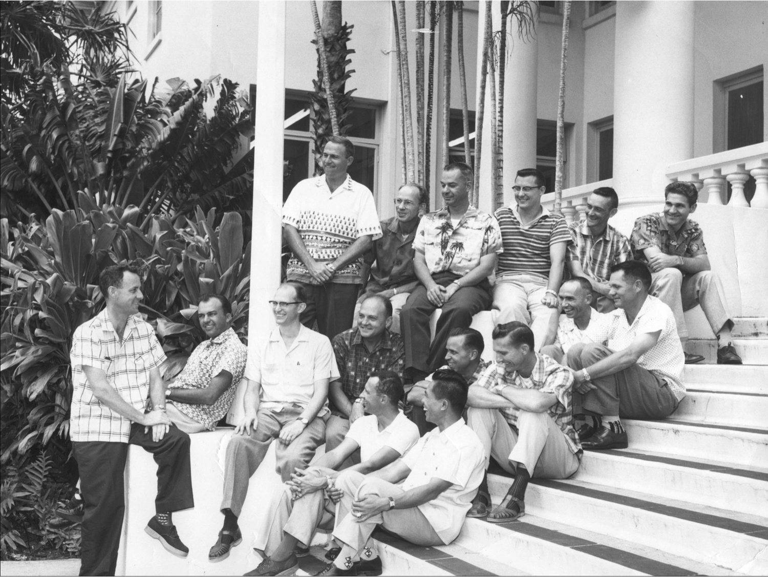
Circa 1959

Slide 20
Brewer (1949) – Dobson (1956) Circulation
(Brewer 1949)
drying
High 0₃
High 0₃

Slide 21
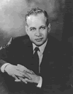
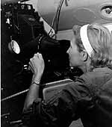
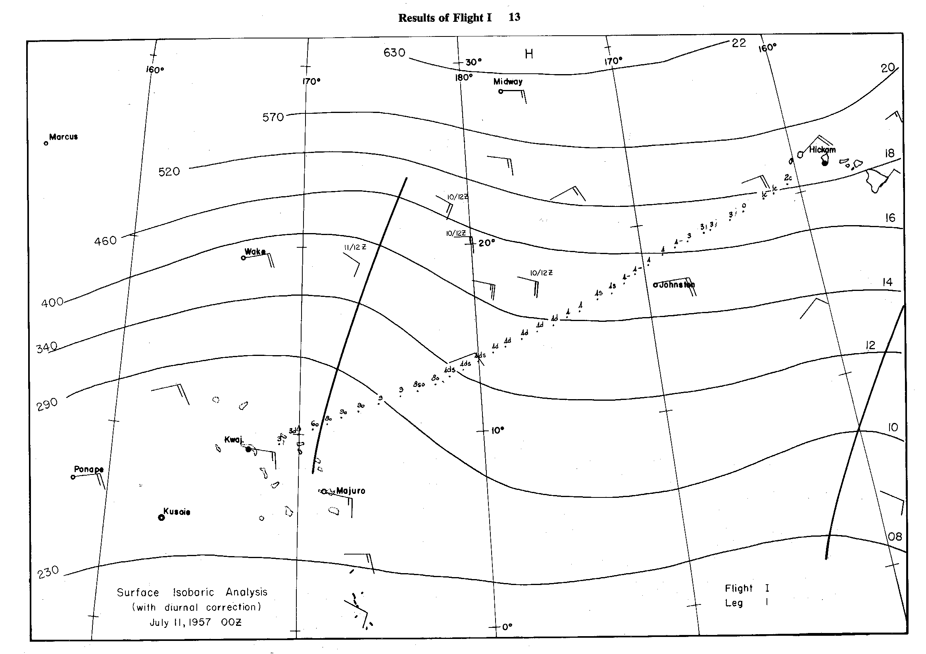
Tropical Pacific Flights
11 JULY 1957
HAWAII
KWAJALEIN
Malkus and Riehl (1964)

Slide 22
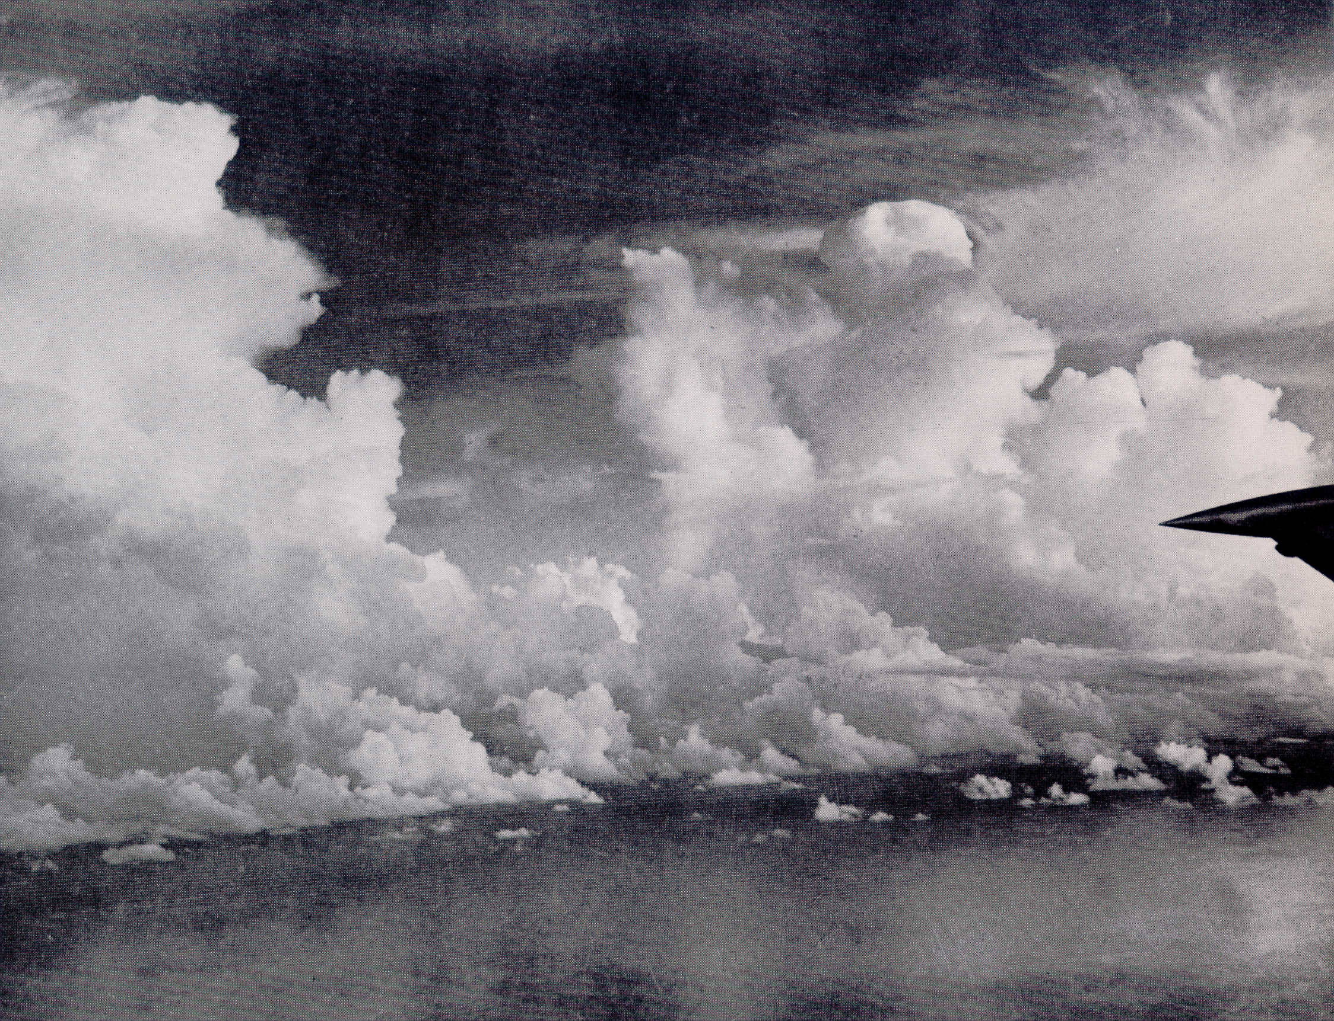
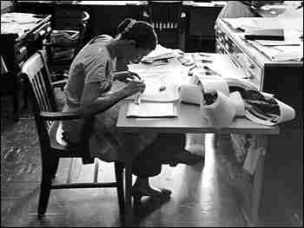
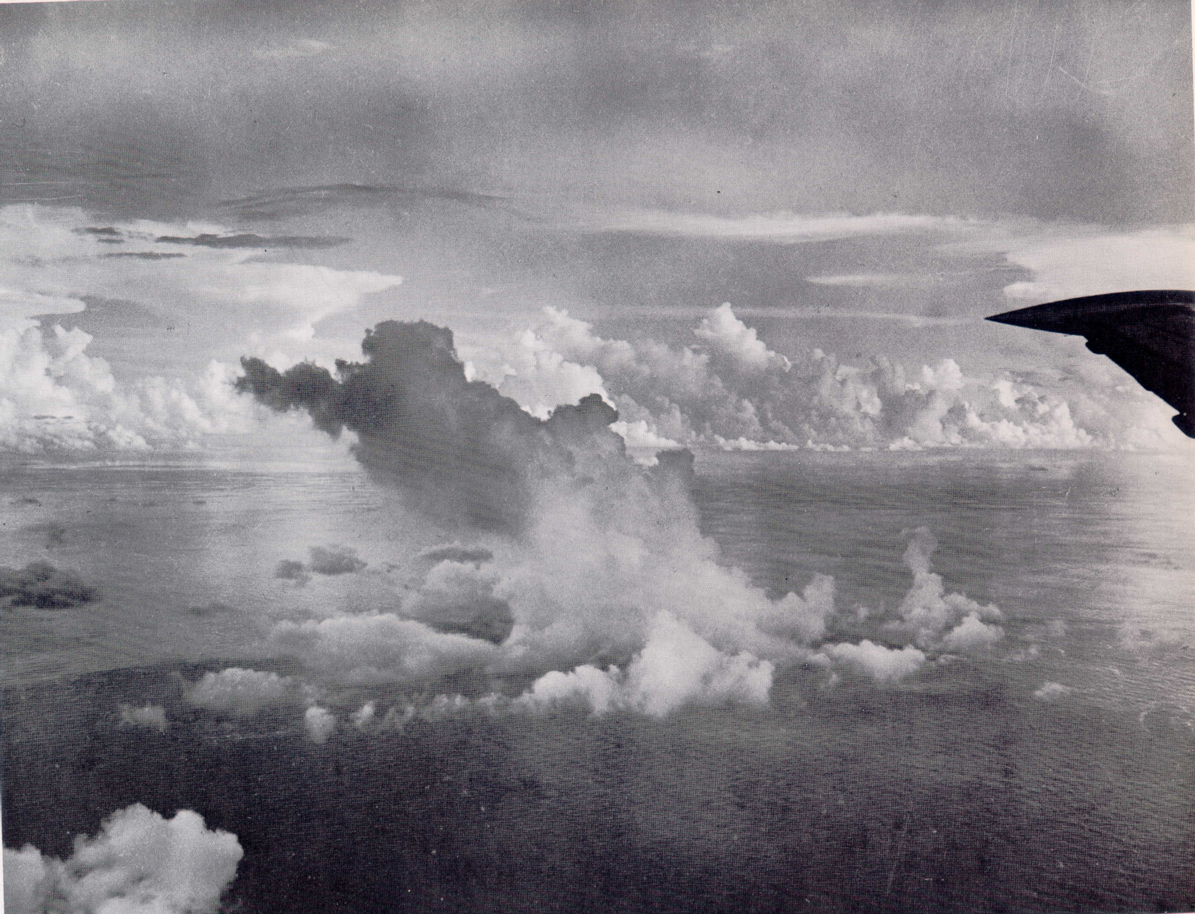
Photos from 1957 Pacific flights
Joanne Simpson at WHOI
“So I was interested in clouds for just themselves because they were fascinating,” explains Simpson. Rossby said that no one was very interested in them, so it was a good subject “for a little girl to study.”
– U. Chicago, late 1940s

Slide 23
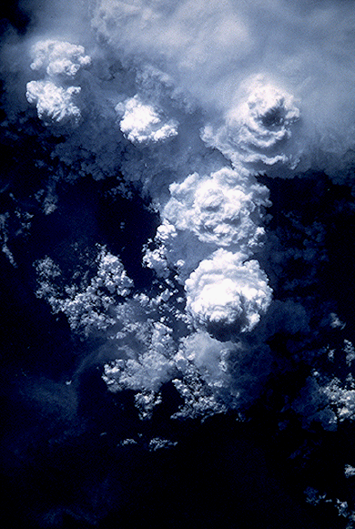
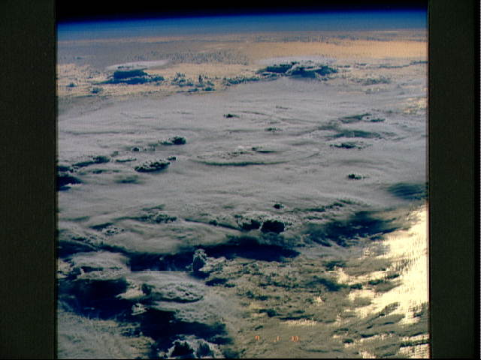
Riehl, H., and J. S. Malkus, 1958: On the heat balance in the equatorial trough zone. Geophysica, 6, 503-538.
Energy balance of equatorial trough zone requires undilute vertical transport through the θ_{e} or h minimum in the midtroposphere
About 2,000 “hot towers” needed to satisfy the global balance
Update: Zipser (2003) provides evidence that undilute ascent over tropical oceans is relatively rare: freezing is important source of additional buoyancy

Slide 24
During the 1950s, additional studies on tropical meteorology and monsoons were initiated:
Diurnal cycle of rainfall, island sea breezes, warm-rain processes in the tropics with Hawaii as a focus (Leopold, Ramage, Riehl, …)
Tibetan Plateau as a heat source for the monsoon, driving monsoonal circulations (Flohn, Yeh et al., Koteswaram, …)
Shifting of jet stream to north of Tibetan Plateau during onset of monsoon (Yin, Murakami, Suda, Dao,…)
Tropical cyclones (Colón, Dunn, Jordan, Syono, Hubert, Ramage, Yeh, Miller, Palmén, …)
Kona storms (Palmer, Riehl, Simpson, …, Businger)
Notes:
In 1951 Takio Murakami published a paper on the splitting of the jet stream over Japan during the Baiu season. Ramage (1959) investigated tropical cyclogenesis in the NW Pacific to downstream energy dispersion.

Slide 25
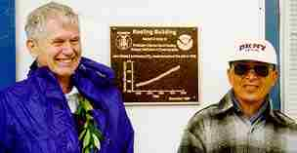
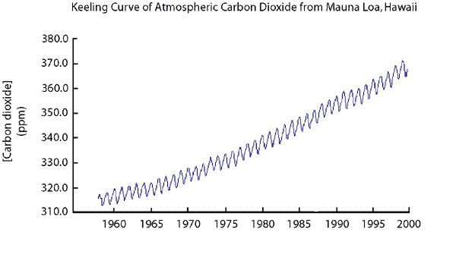
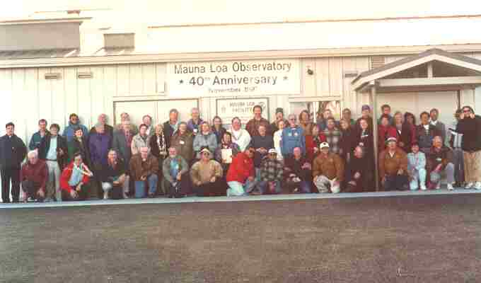
Keeling Curve (1958- )
Charles Keeling (left) at the dedication of the Keeling Building at the Mauna Loa Observatory, Hawaii (1997)
Following controversy about the suitability of the MLO location… Sadler, Ramage, and Hori (1982) demonstrated that, meteorologically, MLO is an excellent site for monitoring global trends in atmospheric CO₂
Notes:
Newell et al. (1978) argued that large-scale variations in the atmospheric circulation may mask real long-term changes in CO2 at MLO, but Sadler et al. (1982) disproved that assertion.

Slide 26

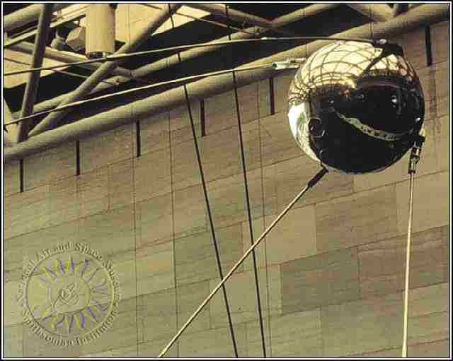

4 October 1957 Soviet Union launch of Sputnik 1
Formation of NASA 1 October 1958
"An Act to provide for research into the problems of flight within and outside the Earth's atmosphere, and for other purposes."
Eventually, studies of the Earth’s atmosphere began:
Radiation budget
Precipitation
Tropical cyclones
Clouds

Slide 27
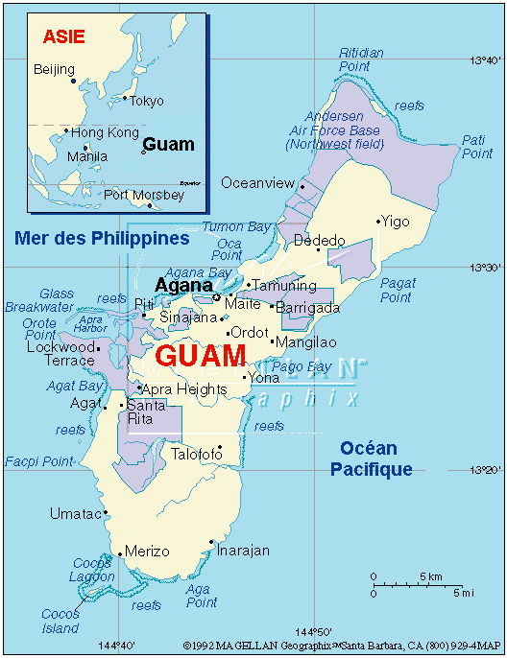
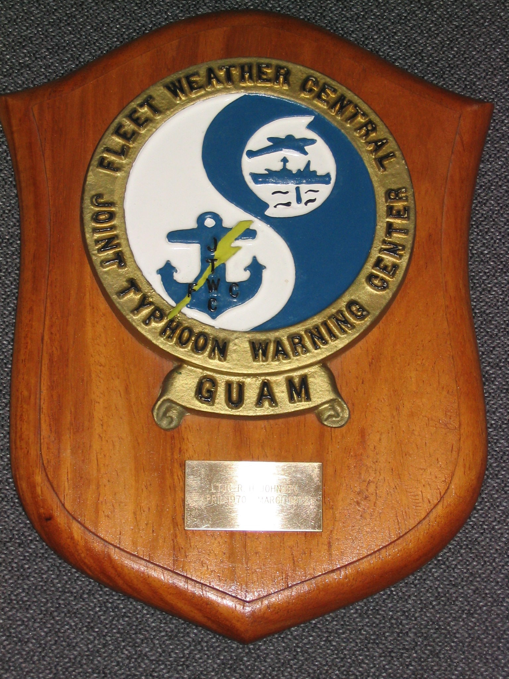
JTWC Guam 1959
In 1959, Admiral Harry Felt, combined the Navy and Air Force Centrals to establish the Joint Pacific Fleet Pacific Air Forces Typhoon Warning Center in Guam. Its joint charter was to provide tropical cyclone warnings to all U.S. Government agencies west of 180 degrees longitude.
LT JG R. H. JOHNSON 1970-72

Slide 28
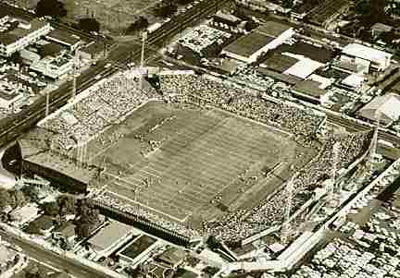
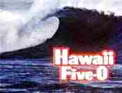
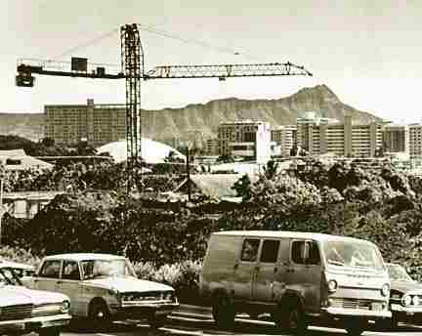

Honolulu Stadium 1963
1960s
THE DISCOVERY YEARS
TROPICAL METEOROLOGY, CLIMATE
Diamond Head 1968
1968

Slide 29
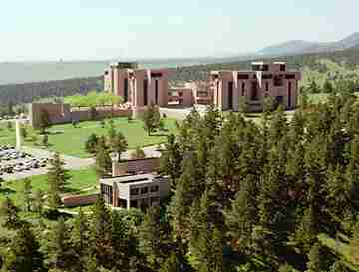
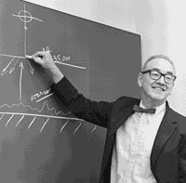
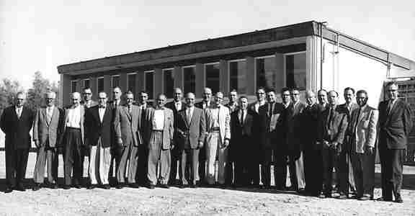
1960
Founding of UCAR/NCAR
First meeting of the original 14 university members of the University Corporation for Atmospheric Research on 2 April 1959 at the University of Arizona, Tucson.
Notes:
Outgrowth of 1956 NAS committee -- consisting of Rossby, von Neumann, Teller, Charney – commissioned at the urging of the USWB, which recommended an ambitious agenda to enhance meteorological research. First name was NIAR, National Institute for Atmospheric Research, but spelled backwards, it is RAIN. Rossby died in 1957. NAS report prepared in 1958.

Slide 30
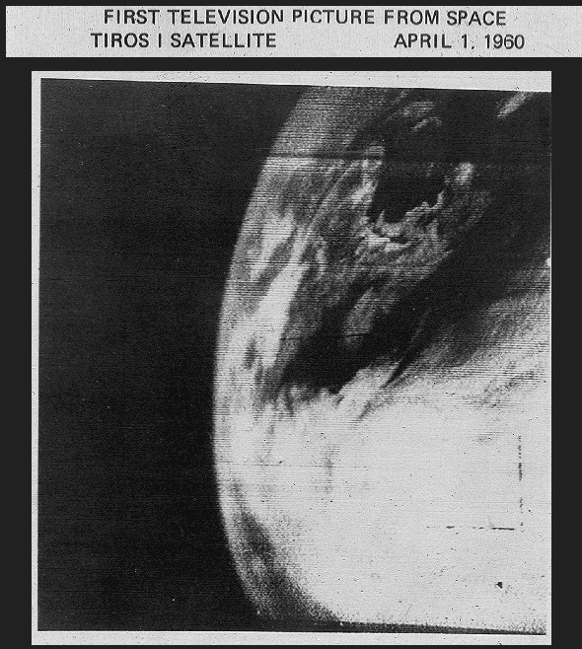
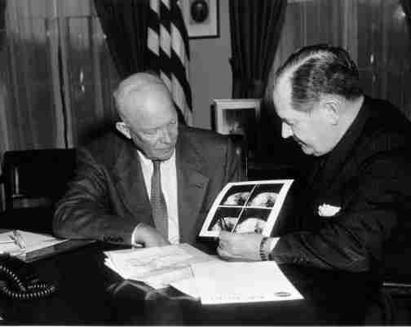
1960
TIROS 1
April 1960 Photos from TIROS 1
Sadler (1964) used TIROS to document tropical cyclones in the Eastern North Pacific and study the “killing effect” of vertical shear on TC intensity.
Notes:
There was controversy when the satellite era first began. “Some scornfully described the satellite as a solution in search of a problem” (Walter Orr Roberts 1960)

Slide 31
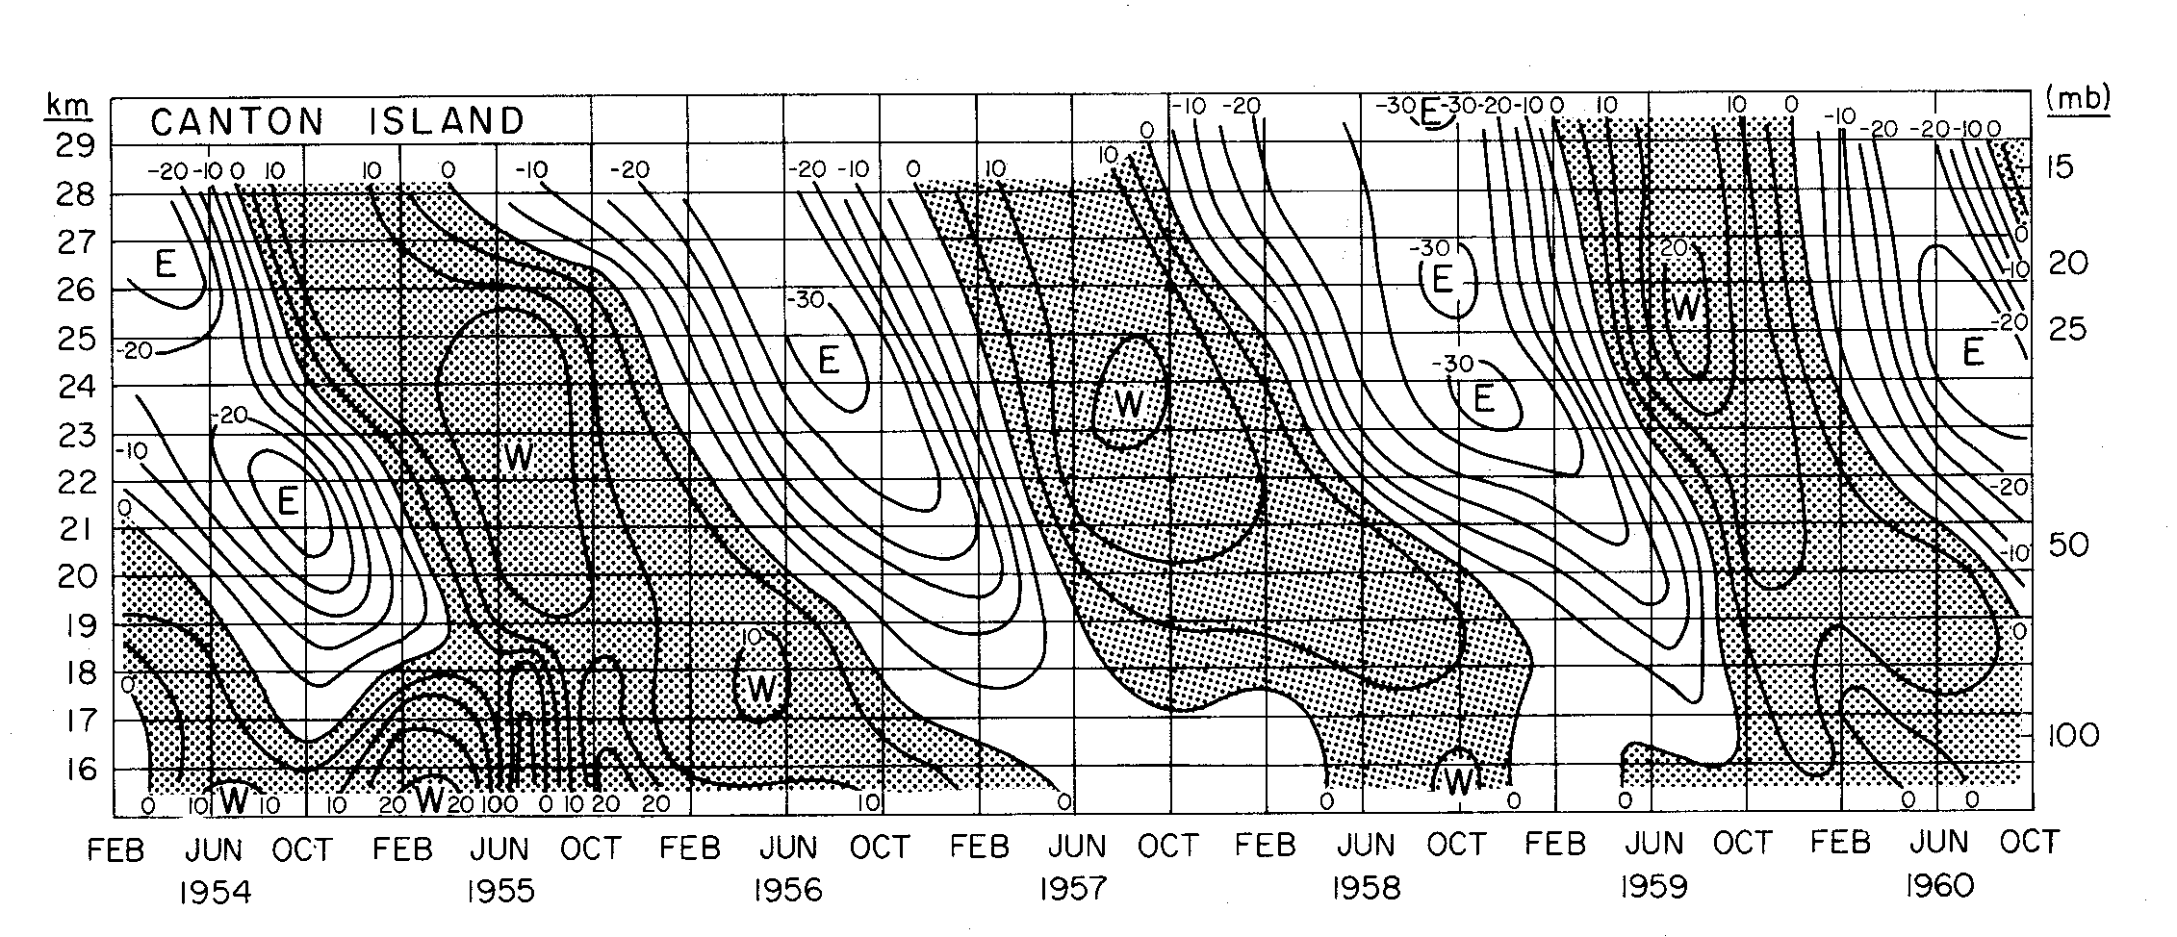
The Quasi-Biennial zonal wind Oscillation (QBO)
(Reed et al. 1961)
Reed, R.J., W.J.Campbell, L.A.Rasmussen and D.G.Rogers, 1961: Evidence of downward-propagating annual wind reversal in the equatorial stratosphere. Journal of Geophysical Research, 66, 813-818.**
Veryard, R.G. and R.A.Ebdon, 1961: Fluctuations in tropical stratospheric winds. The Meteorological Magazine, 90, 125-143.
** One reviewer recommended rejection of paper because findings conflicted with prevailing view on equatorial stratosphere (Reed 2003)

Slide 32
QBO: “Indeed, we are continually encountering new features whose existence we had not anticipated from years of familiarity with the governing laws. One of the more spectacular of these is the recently discovered 26-month or quasi-biennial oscillation...”
– Lorenz (1967)
Eliassen and Palm (1961) discovered that vertically propagating gravity waves can transfer momentum to the mean flow.
Booker and Bretherton (1967) and Hines and Reddy (1967) discovered that critical levels (where the Doppler-shifted phase speed goes to zero) would act as absorbers for vertically propagating gravity waves.
Lindzen and Holton (1968) used these results to develop a theory for the QBO. These results were also used to explain the trapped equatorial waves observed in the lower stratosphere by Yanai and Maruyama, and Wallace and Kousky.
A review of the QBO (Baldwin et al. 2001) summarizes advances in observations and modeling of QBO, including contributions on this problem by Kevin Hamilton.

Slide 33
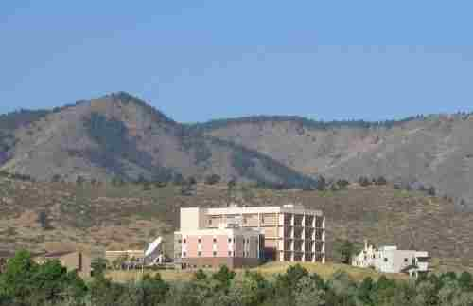
Department of Atmospheric Science, CSU (1962)
“An odd place for tropical meteorology studies”
Herbert Riehl 1915-1997

Slide 34
Formation of Ph.D.-Granting Departments of Meteorology/Atmospheric Science in the U.S.
1930s
Penn State, NYU, U. Washington, CalTech
4
WWII
1940s
UCLA, MIT, Chicago, Miami, Iowa, Iowa State, NPS, FSU, Missouri, Utah
10
1950s
Wisconsin-Madison, Michigan, Hawaii, Texas A&M, Arizona
5
1957 Sputnik/1958 NAS Study
1960s
Oklahoma, CSU, Wisconsin-Milwaukee, Maryland, SUNYA, Wyoming, Purdue, Illinois, Virginia, Oregon State, Princeton
11
1970s
Ohio State, Georgia Tech, Columbia
3
1980s
Nebraska, Texas
2
1990s
UC-Irvine
1

Slide 35
(May 1962)
Work by Estoque contributed importantly to subsequent sea breeze modeling studies

Slide 36
(1964)
CISK: A cooperative interaction between convection and the large-scale disturbance via lifting by Ekman pumping
[In a related mechanism – wave-CISK – the lifting was proposed to come from the wave field itself (Yamasaki 1969, Hayashi 1970; Lindzen 1974)]
Notes:
Ooyama (personal communication) told me that the original title did not have depression in it. He recognized that hurricane development was ultimately a highly nonlinear problem and talked to Charney about this. Charney’s concession was to add depression to the title. Charney’s interest in hurricanes was heightened when his car was struck by a falling tree during Hurricane Hazel in 1954 at Woods Hole.

Slide 37
Comments on CISK
Arakawa (2004)
“…[it is hard to see how CISK can lead to] intensification…because, if there are no sources, θ_{e} is simply redistributed by the motions, without creating a new maximum.”
“Missing from the CISK concept is the important role of surface fluxes in enhancing θ_{e} in the outer region of a hurricane where subsidence predominates (Ooyama 1969, 1982), and in the inner region as the cyclone intensifies (Emanuel 1989).”
These surface exchange processes associated with tropical cyclone development have come to be known as WISHE.

Slide 38
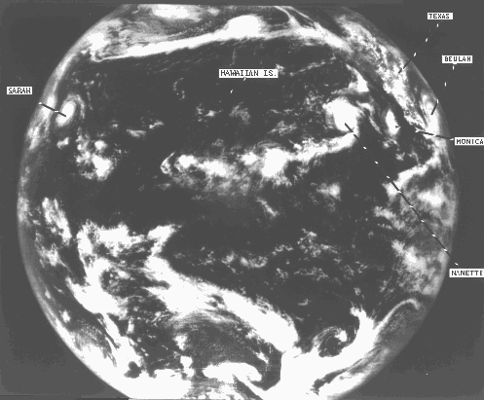
ATS 1 – First Geostationary Satellite (1966)

Slide 39
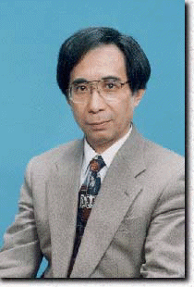
Matsuno, T., 1966: Quasi-geostrophic motions in the equatorial area. J. Meteor. Soc. Japan, 44, 25-43.
Velocity and pressure distributions in the horizontal plane for (a) Kelvin waves, and (b) Rossby-gravity waves
Formed the basis for subsequent studies of free and forced equatorial waves
Effects of vertical shear on equatorial Rossby and Kelvin waves: Wang and Xie (1996); Xie and Wang (1996)

Slide 40
Waves in the Easterlies: “Easterly Waves”
“The barotropic easterly wave, while commonplace in the Atlantic, is sufficiently rare in the Pacific that some Pacific analysts have convinced themselves that all so-called easterly waves are reflections of cold lows (Sadler 1966).” …Simpson et al. (1968)
Sadler, J. C., 1966: “The easterly wave – the biggest hoax in tropical meteorology.” Seminar at the National Center for Atmospheric Research, Boulder, CO, August 8-12.
Nitta and Yanai (1969) showed that the lower-tropospheric flow over Marshall Islands is barotropically unstable

Slide 41
TROPICAL UPPER-TROPOSPHERIC TROUGH (TUTT)
Sadler, J. C., 1967: The tropical upper tropospheric trough as a secondary source of typhoons and a primary source of trade-wind disturbances. Hawaii Institute of Geophysics, University of Hawaii, HIG-67-12 and AFCRL-67-0203. 44 pp.
doi: 10.1175/1520-0493(1976)104<1266:AROTTU>2.0.CO;2
Monthly Weather Review: Vol. 104, No. 10, pp. 1266–1278.
A Role of the Tropical Upper Tropospheric Trough in Early Season Typhoon Development
James C. Sadler
Department of Meteorology, University of Hawaii, Honolulu 96822 11 May 1976
(Manuscript received May 11, 1976, in final form July 29, 1976)

Slide 42
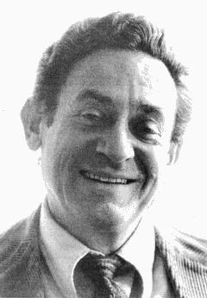


N. A. Phillips – Biography of Jule Charney
“Jule (around 1961) was struck with the fact that, although meteorology was presumably a global science, the lack of global observations prevented examination of this important aspect…
I recall that Jule pondered deeply on the commitment from him that a serious follow-through on this idea would entail. But having decided that it was a job that he should do, he pursued it with evangelical zeal…”
GLOBAL ATMOSPHERIC RESEARCH PROGRAM (1967-1982)

Slide 43
Series of Tropical Experiments (late 1960s – )
In August 1966, NCAR hosted a meeting of university scientists and agency representatives (NCAR, ESSA, NASA, NAS) to plan an integrated program of tropical experiments over the next 5-10 years. Chairs: Charney, Ramage, La Seur
Line Islands Experiment (1967-68)
BOMEX (1969)
ATEX (1969)
GATE (1974)

Slide 44
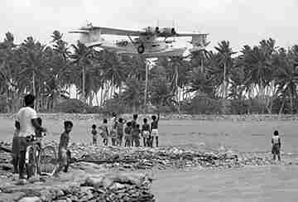
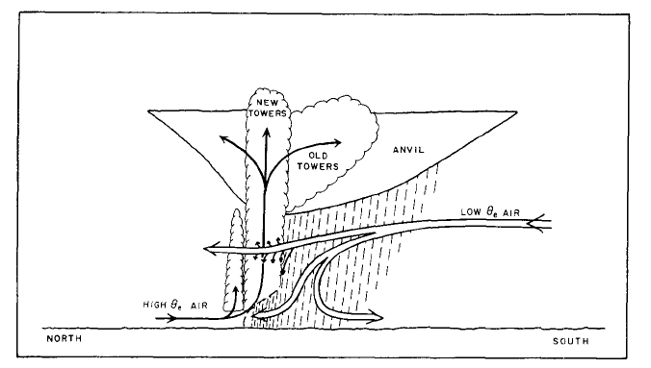
Line Islands Experiment Feb-Apr 1967
First detailed documentation of tropical squall lines (Zipser 1969)
UNSATURATED DOWNDRAFT

Slide 45
MWR (1968)
“Until 1965, middle latitude meteorologists ignored the Tropics, banishing them to the limbo of vague boundary conditions.”
“The outnumbered tropical meteorologists reciprocated by seldom looking beyond Cancer or Capricorn.”
“But now GARP is bringing the two groups together to plan and execute a series of tropical experiments designed to determine the nature and extent of interactions between low and high latitudes.”
“GATE” was originally planned for the western Pacific – Ramage argued it should include the maritime continent.

Slide 46
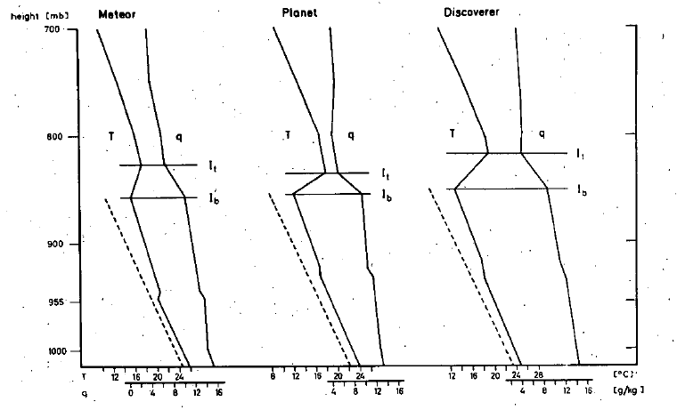
Barbados Oceanographic and Meteorological Experiment (BOMEX) Trade Wind Cumulus Experiment: 1969
Atlantic Trade Wind Experiment (ATEX) 1969
BOMEX ship array
Budget studies: Holland and Rasmussen (1973); Nitta and Esbensen (1974)
Augstein et al. (1973)

Slide 47




1969
(897 citations!)
“The maxima of the sea temperature in the eastern and central Pacific occur as a result of anomalous weakening of the trade winds of the Southern Hemisphere with inherent weakening of the equatorial upwelling. These anomalies are shown to be closely tied to the “Southern Oscillation” of Sir Gilbert Walker.”
Positive feedbacks maintain mean state, but it’s not clear how an oscillation would occur.
Bjerknes used upper-level wind data from Sadler (1959, Proc. 9th Pacific Science Congress, Bangkok) to support his arguments regarding Walker Circulation across Pacific
Bjerknes made extensive use of data gathered during the 1957 International Geophysical Year, which happened to be a time with a strong warm (El Nino) event.

Slide 48
Subsequent Pursuit of ENSO
Wyrtki (1975)
El Niño associated with preceding buildup of water in equatorial western Pacific by strong SE trades; then weakening winds allow warm water to flow eastward as an equatorial Kelvin wave.
Ramage/Hori (1981)
1972-73 El Niño strongly modulated by annual cycle; “El Niño prediction…difficult”
McCreary (1983)
Equatorial winds generate Rossby waves that reflect from western boundary to create an oscillation
Cane-Zebiak model (1985); delayed oscillator theories (Schopf and Suarez 1988; Battisti and Hirst 1989)
Jin (1997)
Recharge oscillator theory

Slide 49
Equatorial wave studies
Chang (1970)
Yanai and Maruyama (1966)
Wallace and Kousky (1968)
Wallace and Chang (1969)
Chang (1970)

Slide 50

C.-P. Chang
V. Kousky
R. Reed
M. Wallace
J. Holton
1969 Photo by M. Yanai

Slide 51


East-West Center 4 May 1971
1970s
GATE/FGGE YEARS
TROPICAL FIELD EXPERIMENTS
29 November 1975 Tsunami
Punalu`u, Hawai`i
Notes:
As part of the Viet Nam protest, there was a plan to defoliate the trees in the Japanese Garden at the East-West Center with agent orange, but it was never carried out.

Slide 52

Tropical Conference, 1-6 June 1970, Honolulu
van Loon
Adrian Gordon
Spengler
Dunn
Julian
Reed
Gray
Madden
Jim Sadler
La Seur
Ron Taylor
Zipser
Wan Cheng Chiu
Holton
Hastenrath
J. Simpson
Krish
N. Frank
R. Simpson
W. Sam Houston
Takio Murakami
V. Oliver
Colin Ramage
E. Bollay
P. Kutschenreuter

Slide 53
“Hot Topics” at 1970 Tropical Conference
Planning for “GATE” in Pacific (switched to Atlantic in 1970; Japan pulled out)
“Easterly wave” studies (Reed, Holton)
Results from Line Islands Experiment (1967), including analysis by Madden of 5-day tropical variations using Line Islands rawinsonde data**
**A question raised by Gary Atkinson led to further work by Madden using Canton Is. Data, and the eventual discovery of the MJO.
Notes:
At meeting in Brussels in 1970 it was decided that due to the availability of resources (ships, satellite), the preferred location for “GATE” – the western Pacific – had to be given up, with the third choice (the eastern Pacific was 2nd), the eastern Atlantic being selected.

Slide 54
“MJO”
Webster, P.J., 1987: The variable and interactive monsoon. Monsoons, J.S. Fein and P.L. Stephens, Eds. (“Madden-Julian 40-50 day wave”)
R. Swinbank, T.N. Palmer and M.K. Davey. 1988: Numerical Simulations of the Madden and Julian Oscillation. Journal of the Atmospheric Sciences: Vol. 45, No. 5, pp. 774–788.
(“MJ oscillation”)
Ngar-Cheung Lau, Isaac M. Held and J. David Neelin. 1988: The Madden-Julian Oscillation in an Idealized General Circulation Model. Journal of the Atmospheric Sciences: Vol. 45, No. 24, pp. 3810–3832.
(“Madden-Julian oscillation”)

Slide 55

Quote from 1970 Tropical Conference by Bill Gray:
“If little cumulus weren’t important, God wouldn’t have made so may of them”

Slide 56

– ESSA becomes NOAA –
BOMEX (1969) represented a major collaborative study on the interaction between the ocean and the atmosphere. “Perhaps it was no accident that BOMEX occurred at the same time that President Johnson assembled a group of scientists to study the problems the nation faced in managing and protecting the sea.”¹
¹ NOAA Ocean Explorer
Stratton Commission report: “Our Nation and the Sea”
Served as a blueprint for NOAA, founded on 3 October 1970

Slide 57

1971 – First text on Monsoon Meteorology

Slide 58


Tropical Dynamics Colloquium NCAR 1972
My recollections of: J. Sadler critique of Reed and Recker (1971)

Slide 59
Taylor’s Rainfall Atlas
Taylor, R.C., 1973: An Atlas of Pacific Islands Rainfall. Data Report 25, ONR Contract N00014-70-A-0016-0001, 7 pp.

Slide 60




Early 70s: Development of Ideas Related to the Problem of Cumulus Parameterization (Arakawa, Yanai, Ooyama, Gray)
Yanai, Esbensen, and Chu (1973)
Gray (1973)
Arakawa and Schubert (1974)
“Up moist – down dry”

Slide 61

1974 GARP Atlantic Tropical Experiment (GATE)
20 countries
40 research ships
12 research aircraft
> 1000 GATE papers
Sadler, J.C., 1975: The monsoon circulation and cloudiness over the GATE area. Mon. Wea. Rev., 103, 369-387.

Slide 62
The purpose of GATE was to understand the tropical atmosphere – in particular cumulus convection – and its role in the general circulation.
But…
Tropical eastern Atlantic is cooler than western Pacific warm pool – convection is different (e.g., lower level of peak heating)
The tropical eastern Atlantic is influenced by Africa; midlatitude teleconnections weaker than in Pacific
A new complication for parameterization arose: the frequent mesoscale organization of convection
Further complications, e.g., convective momentum transport, were clearly important and needed to be dealt with in the treatment of convection in models

Slide 63
Important Findings from GATE
Structure and properties of tropical mesoscale convective systems (Houze, Zipser, Betts)
Characteristics of Atlantic easterly waves (Reed, Burpee,Thompson, Y.-L. Chen)
Momentum transport by organized convection (LeMone, Barnes, Zipser, Stevens, Moncrieff)
Effects of environment on organization and propagation characteristics of squall lines (Barnes, LeMone, Zipser)

Slide 64

Mesoscale Organization
Line Islands, GATE, etc. – convection observed with distinct mesoscale organization
(Houze 1977)
…and found that such systems (squall lines)
were commonplace in the tropics
contained convective-scale and mesoscale downdrafts
enhanced the surface sensible and heat fluxes over large areas
contained stratiform “anvil” regions that contributed ~40% of the total precipitation
(Zipser 1977)

Slide 65
Barnes and Sieckman (1984)
Fast lines have drier midlevels and are oriented normal to strong low-level shear
Slow lines are approximately parallel to weaker low-level shear

Slide 66

Sadler’s Atlases
(Co-authors: Harris, Oda, Hori, Lander, …)
Sadler’s atlases, many produced in the 1970s, became a staple of many tropical meteorology research groups in the decades of the 70s and 80s.

Slide 67

1976-77 Climate Regime Shift
Warming in the eastern Pacific
Deeper Aleutian low
Impacts on ENSO (Wang 1995; Wang and An 2002)
Weakening global monsoons (Wang and Ding 2006)
L
Wu and Xie (2003)
Notes:
Wang (1995) found that changes in the circulation after the late 1970s led to anomalous equatorial westerlies and an enhancement of the trades in the SE Pacific, and a different character to the E. Pacific warming during El Ninos.

Slide 68


Winter MONEX (Dec 1978)
Joach Kuettner
WMONEX Planning Meeting 21-23 June 1977, NCAR
Invitees: C. Ramage, T. Murakami, H. Riehl, R. Simpson, P. Webster, R. Houze, C-P Chang, W. Washington, P. Crutzen, Krishnamurti, P. Julian, R. Johnson

Slide 69
WMONEX STUDIES
Sadler, J.C., 1979: Synoptic Scale Quick-Look for Winter MONEX – December 1978. UHMET 79-02.
Murakami, T., and A. Sumi, 1982: Southern Hemisphere monsoon circulation during the 1978-79 WMONEX Part I. J. Meteor. Soc. Japan.
Sumi, A., and T. Murakami, 1982: ….Part II
Chu, P.-S., and D. Sikdar, 1983: Characteristics of sea-level pressure and surface temperature variations during Winter MONEX. J. Meteor. Soc. Japan.
Chu, P.-S., and S.-U. Park, 1984: Regional circulation characteristics associated with a cold surge event over East Asia during Winter MONEX. Mon. Wea. Rev., 112, 955-965

Slide 70

WMONEX (DEC 1978)
(Houze et al. 1981)

Slide 71

Winter MONEX, Kuala Lumpur, December 1978

Slide 72

Winter MONEX, Kuala Lumpur, December 1978
Takio Murakami

Slide 73

Winter MONEX, Kuala Lumpur, December 1978
Arnold Hori
Louis Oda

Slide 74



Hurricane Iwa 23 November 1982
1980s
ENSO/MONSOON YEARS
POST-FGGE/MONEX STUDIES, ’82-83 EL NIÑO
Hit Kauai; $250M damage
Kilauea Eruption 3 April 1983

Slide 75

“Gill Model”
Heat Source
Rossby waves
Kelvin wave
Gill, A., 1980: Some simple solutions for heat induced tropical circulation. Quart. J. Royal Meteorol. Soc., 106, 447-462.

Slide 76

“PNA Pattern”
Hoskins and Karoly (1981); Horel and Wallace (1981); Webster (1981)

Slide 77



1982-83 El Niño
Cost: 2000 lives lost, ~$13B worldwide
Santa Barbara, CA

Slide 78

1982-83 El Niño motivated the establishment of TOGA TAO Array, starting in 1984
First supported under EPOCS; operation transferred to NDBC in 2005
Shortly thereafter, the TOGA (1985-1994) program began → observations, predictability, and prediction of tropical ocean-atmosphere coupled system

Slide 79


ENSO Impacts
NOAA/PMEL
Precipitation anomalies during El Niño
Impacts on East Asian climate via WNP anticyclone (Wang et al. 2000)

Slide 80
Results from Summer and Winter MONEX and FGGE led in the 1980s to a plethora of studies of the Asian Monsoon…and texts summarizing new results
Fein and Stephens (1987) Monsoons
Chang and Krishnamurti (1987) Monsoon Meteorology
Onset vortex
Somali jet, Arabian Sea cooling
Active-break mechanisms
Monsoon depressions
Cold surges
Role of Tibetan Plateau
Meiyu/Baiu fronts
T. Murakami chapters in both texts on Tibetan Plateau

Slide 81
Contributions on Monsoons by Takio Murakami
Murakami and Unninayar (1977) Strong jet stream over Japan linked to intensified local Hadley Circulation
Murakami and Sumi (1982) Southern Hemisphere monsoon circulation during the 1978-79 WMONEX
Murakami, Iwashima, and Nakazawa (1984) Study of heat, moisture, and vorticity budgets during FGGE-year SH summer monsoon
Murakami, Nakazawa, and He (1984); Murakami and Nakazawa (1985) Studies of the 40-50 day oscillation during the 1979 NH summer
Murakami, Chen, and Xie (1986) Used OLR data to study the relationship between seasonal cycles, low-frequency oscillations, and transient disturbances
Murakami (1987) Orography and monsoons. Monsoons (Fein/Stephens)
Murakami and Matsumoto (1994) Western North Pacific Monsoon

Slide 82



Tropical Field Experiments in the Mid-1980s
Australian Monsoon Experiment (AMEX; 1986-87): Improve understanding of physics and dynamics of tropical weather systems
Taiwan Area Mesoscale Experiment (TAMEX; 1987): Study circulations, MCSs, and orographic effects associated with the Mei-Yu front
(papers by Y.-L. Chen)
Equatorial Mesoscale Experiment (EMEX; 1987): Investigate mesoscale convective systems in the Australian summer monsoon flow
Stratospheric Tropospheric Exchange Project (STEP; 1987): Investigate stratospheric-tropospheric exchange and dehydration processes over N. Australia

Slide 83
Katrina
1988 Heat Wave
Causes: La Niña-related Pacific SST anomaly teleconnections (Trenberth and Branstator 1992); global warming (James Hansen)

Slide 84


Hurricane Iniki 11 September 1992
1990s
BROAD ADVANCES
CONVECTION, DYNAMICS, EQ. WAVES, HURRICANES, DIURNAL CYCLE, MONSOONS
Hit Kauai; $250M damage
Kilauea Eruption 3 April 1983
7 deaths; $1.8B damage
1992-93 TOGA COARE

Slide 85

1990 Hawaiian Rainband Project
Goal: To investigate the formation and dynamical/ microphysical structure of rainbands off the Big Island
Hawaii served as a test bed for ideas about flow blocking, island breezes, lee vortices and warm-rain processes
NCAR Group: Smolarkiewicz, Rasmussen, Carbone, Rotunno, Grubisic, Smith
U. Hawaii Studies: Schroeder, Chen, Takahashi, Ramage, and others

Slide 86


1992-93 Tropical Ocean Global Atmosphere Coupled Ocean-Atmosphere Response Experiment (TOGA COARE)
Project Leaders: Peter Webster and Roger Lukas
Objectives: Ocean-atmosphere coupling processes, organization of convection, oceanic response to forcing, and multiple-scale interactions
COARE contributed to fundamental advances in understanding air-sea coupling and exchanges; maintenance of the warm pool; organization of convection; the diurnal cycle in the sea and atmosphere; structure and dynamics of the MJO; convective momentum transport

Slide 87
MJO Research
Flurry of research in late-80s and 90s in recognition of MJO’s role in active-break periods of Asian Monsoon, and results emerging from TOGA COARE…and it continues today
Rui and Wang (1990); Wang and Rui (1990) – Studied structure and dynamics of “MJO”
Wang and Rui (1990) – Classified 122 Tropical Intraseasonal Convection Anomalies (TICAs), identifying eastward, northward, and westward-propagating systems
(Rui and Wang 1990)
Wang and Xie (1998) – Ocean mixed layer coupled with atmosphere may play an important role in sustaining the MJO

Slide 88
Coupling Between Convection and Its Environment
“Gregarious Tropical Convection” (Mapes 1993; Nicholls et al. 1991)
Dispersion of gravity waves from MCS heating; low-level ascent associated with “stratiform” component can lead to new convective growth near previous cells

Slide 89

What controls location of the ITCZ?
Going back to Charney (1971), there has been controversy over what controls the off-equatorial position of the ITCZ.
Ideas: Ekman pumping, moisture availability, critical latitude, wave-CISK, off-equatorial maximum response to heating, position determined by SST maximum or gradients, earth’s rotation rate, ocean-atmosphere coupling, location of continents, Andes, etc.
Xie and Philander (1994) argued that dynamic oceanic upwelling near the equator is a critical element of this mechanism, but that surface processes such as mixing and evaporation are also important.

Slide 90


Tropical Rainfall Measuring Mission (TRMM): 1997– present
TS Debby 25 Aug 2006

Slide 91


The Pacific Decadal Oscillation (PDO)
(Hare 1996; Mantua et al. 1997)
WARM PHASE
COOL PHASE
CLIMATE REGIME SHIFT

Slide 92



1997-98 El Niño
Lives lost: 21,000
Economic loss: >$30B
Santa Cruz, CA 8 FEB 1998

Slide 93



Drought over Maritime Continent in response to 1997-98 El Niño
Suppression of precipitation by aerosols

Slide 94




ANNULAR MODES
+
NAO
–
(Thompson and Wallace 1998)
(Marshall and Czaja)
NAO Index
(Hurrell)

Slide 95

Wheeler-Kiladis Diagram (1999)
Wavenumber-frequency power spectral peaks of "convectively-coupled equatorial waves"
Matthew Wheeler and George N. Kiladis. 1999: Convectively Coupled Equatorial Waves: Analysis of Clouds and Temperature in the Wavenumber–Frequency Domain. Journal of the Atmospheric Sciences: 56, 374–399.

Slide 96





QuikSCAT: 1999 -- present
W.T. Liu

Slide 97
QuikSCAT has yielded new insight on air-sea coupling
Tropical Instability Waves (TIWs)
(from Xie 2004)

Slide 98

SST and Wind Variations Induced by the Hawaiian Islands
(background fields removed)
m s⁻¹
(Xie et al. 2001)

Slide 99



2000s
GLOBAL CHANGE
Coral Bleaching Great Barrier Reef 2002

Slide 100

Tropical Biennial Oscillation (TBO)
– the tendency for a relatively strong Indian monsoon to be followed by a relatively weak one, and vice versa
Theories: Meehl (1997); Chang and Li (2000); Li et al. (2001)
(Chang and Li 2000)

Slide 101


Eastern Pacific Investigation of Climate (EPIC 2001)
Scientific objectives: ITCZ, east Pacific cold tongue, Pacific Hadley cell, ocean mixed layer, marine stratiform clouds
EPIC-related studies at Hawaii: S.-P. Xie, Y. Wang, R.J. Small, H. Xu, B. Wang

Slide 102


Coupling Processes in the Equatorial Atmosphere (CPEA)
Six-year program (2001-2007) sponsored by Japan to study coupling between lower and upper atmosphere associated with deep convection over the maritime continent

Slide 103


ENIAC – late 40s
Earth Simulator -- 2002
3.5 km aqua planet
NASDA, JAERI, JAMSTEC
(Satoh et al. 2006)

Slide 104


Indian Ocean Dipole (IOD)
Saji et al. (1999), Webster et al. (1999), Yamagata et al. (2002)
Li et al. (2003): The biennial tendency of the IOD is attributed to the monsoon-ocean feedback and the remote El Niño forcing that has a quasi-biennial component

Slide 105


Hurricane Katrina 2005
Deaths: >1000?
Economic Loss: $105B

Slide 106

NASA’s A-Train
Terra (1999)
Aqua (2002)
Aura (2004)
PARASOL (2004)
CloudSat (2006)
CALIPSO (2006)

Slide 107



28 June 2006
ORBIT
WESTERN PACIFIC
LARGE MCS
CIRRUS
30 km
1400 km
(courtesy Graeme Stephens)

Slide 108



B
MODIS 12 µm
(Channel 32)
23 Aug 2006
2100 UTC
Hurricane Ileana
A
A
B
20
CloudSat Radar Reflectivity (dBZ)
Eye
20
10
10
0
Height (km)
-10
-20
-30
0

Slide 109
Effects of Weather Events on the Course of History in Tropical Meteorology and Climate
India drought/famine in 1870s; failure of Indian monsoon in 1899 → monsoon research (H. Blanford); discovery of SO by Sir Gilbert Walker
Dust Bowl of 1930s → Bankhead-Jones Act of 1935; funding for C.-G. Rossby to study long-range prediction
Pacific Fleet typhoon losses 1944-45 → typhoon reconnaissance
Hurricane Hazel 1954 → formation of NHRP
1957-58 El Niño + IGY → understanding of ENSO
Global cooling, 1972-73 El Niño → NOAA’s Climate Analysis Center (1979)
1976-77 Climate Regime Shift → extended range forecasts at GFDL
1982-83 El Niño → TOGA and TAO Array
Antarctic ozone hole 1985 → Montreal Protocol
Western U.S. drought, early 2000s → national drought programs

Slide 110
Effects of Technological/Geopolitical Events on the Course of History in Tropical Meteorology and Climate
WWI → V. Bjerknes, Bergen: polar-front theory of cyclones
WWII → training programs at MIT, CalTech, UCLA, NYU, Chicago
WWII → Institute for Tropical Meteorology, Puerto Rico
WWII → new technologies (soundings, radar, aircraft)
WWII → formation of NSF, WMO
ENIAC, late 1940s → beginnings of NWP
Launch of Sputnik, 1957 → formation of NASA; curriculum reform in math, science, and engineering in the U.S.; new resources/met depts
TIROS, 1960 → study of hurricanes, tropical weather systems
Cold War + “impending ice age” , 1970s → National Climate Program Act (1976); NOAA National Climate Program Office
Earth Simulator 2002 → simulation of MJO, other tropical phenomena

Slide 111
Summary
WWII led to rapid build-up in workforce in meteorology; tropical meteorology studies began
In 1956, there were a handful of experts in tropical meteorology; today the field is large and growing rapidly, in part because prediction in midlatitudes is sensitive to the tropics
The University of Hawai’i at Manoa has, and continues to play a central role in progress in tropical and monsoon meteorology

