Slide 1
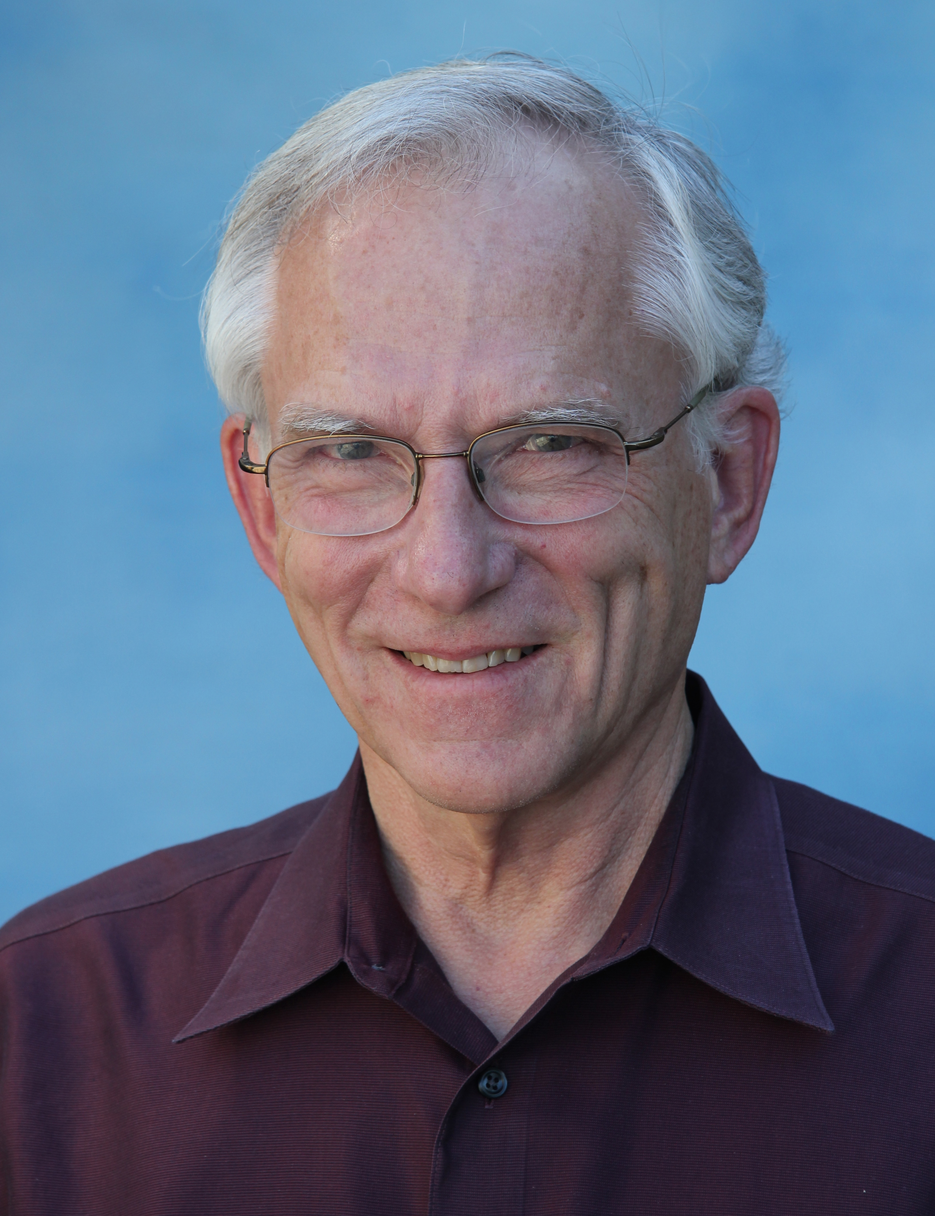
WMONEX to TOGA COARE
A Tribute to Bob Houze and His Lifelong Pursuit of Earth’s Precipitation Systems
Richard H. Johnson
Colorado State University
Robert A. Houze, Jr. Symposium, AMS Annual Meeting, Seattle, 24 January 2017

Slide 2
Bob Houze Field Campaign Time Line
MID-LATITUDES
PRE-STORM
CYCLES
GATE
EMEX
1970s
1980s
TROPICS
SMONEX
WMONEX
ATLANTIC HURRICANES
IMPROVE
COAST
MAP
COAST
TEPPS
2000s
AMMA
CaPE
RAINEX
1990s
TOGA COARE
JASMINE
KWAJEX
OLYMPEX
TRMM, CloudSat, GPM
HS3
DYNAMO
2010s
2020s?
GRIP

Slide 3
Bob Houze Field Campaign Time Line
MID-LATITUDES
PRE-STORM
CYCLES
…
GATE
|
EMEX
1970s
1980s
TROPICS
SMONEX
WMONEX
ATLANTIC HURRICANES
THIS TALK
IMPROVE
COAST
MAP
COAST
…
TEPPS
2000s
AMMA
CaPE
|
RAINEX
1990s
TOGA COARE
JASMINE
KWAJEX
OLYMPEX
TRMM, CloudSat, GPM
HS3
DYNAMO
2010s
2020s?
GRIP

Slide 4
Bob Houze Field Campaign Time Line
MID-LATITUDES
PRE-STORM
CYCLES
GATE
EMEX
1970s
1980s
TROPICS
SMONEX
WMONEX
ATLANTIC HURRICANES
IMPROVE
COAST
MAP
COAST
TEPPS
2000s
AMMA
CaPE
RAINEX
1990s
TOGA COARE
JASMINE
KWAJEX
OLYMPEX
TRMM, CloudSat, GPM
HS3
DYNAMO
2010s
2020s?
GRIP

Slide 5
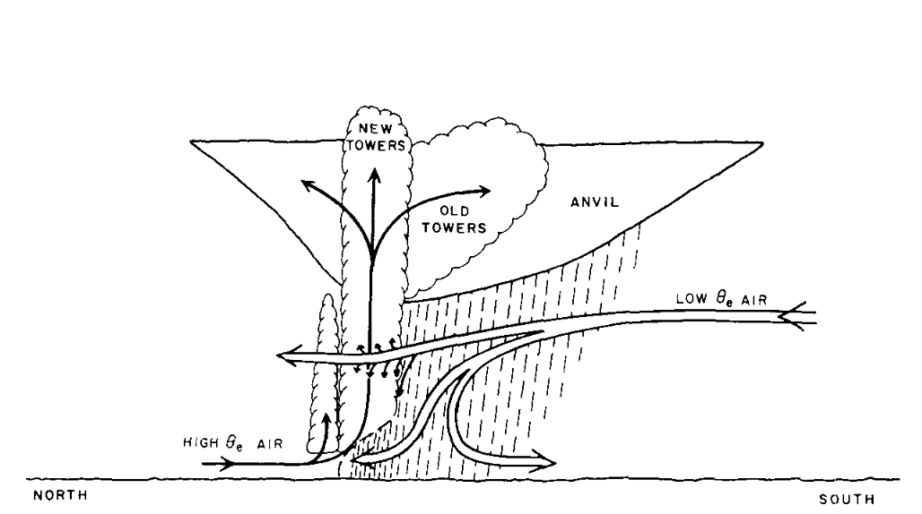
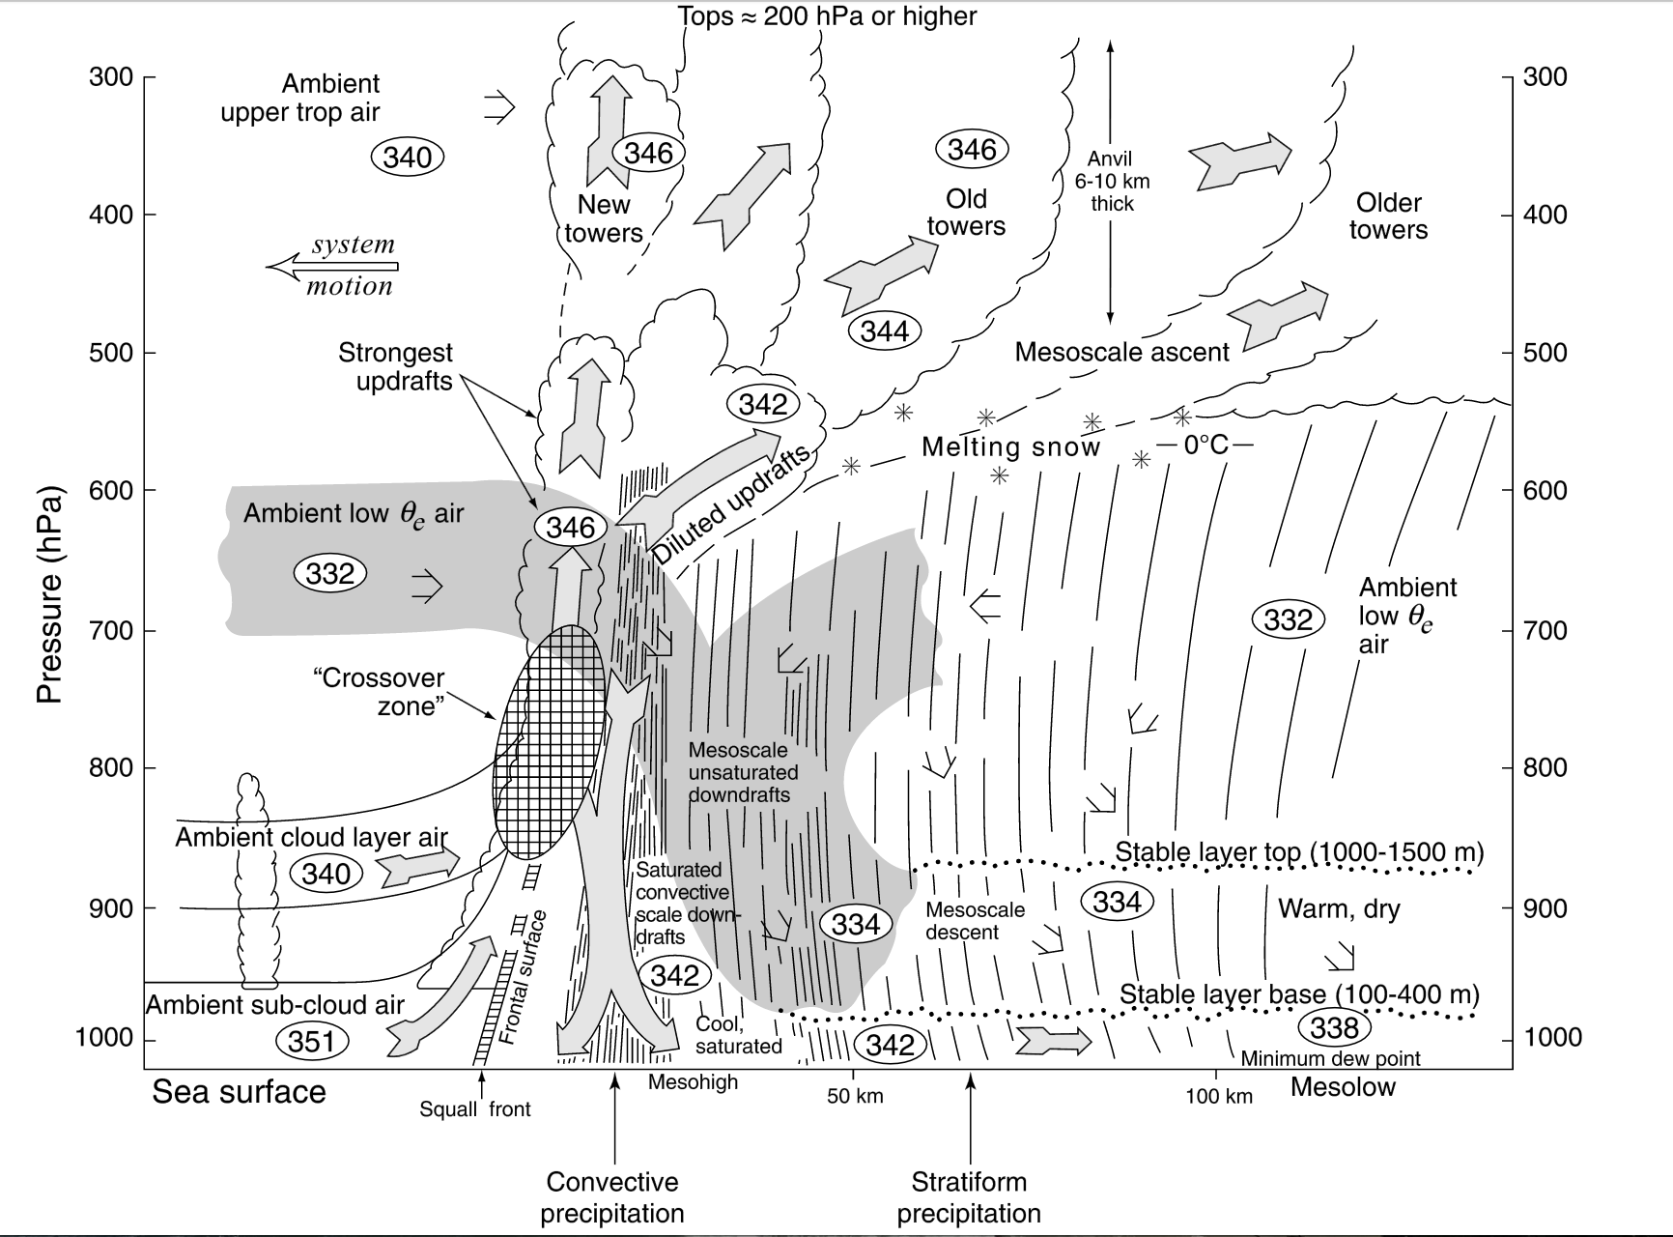
Leading up to MONEX: emerging recognition of prevalence of mesoscale organization of tropical convection…
LINE ISLANDS EXPERIMENT (1967)
BARBADOS (1968) & GATE (1974)
~ 600 km horizontal extent!
Zipser (1969)
Zipser (1977)
GATE
Houze (1977)
Notes:
Horizontal dimension of Line Islands MCS ~ 600 km. Zipser (1969) indicates system is similar to midlatitude squall lines (e.g., Newton 1963) and West Africa squall lines (Hamilton and Archbold 1945).

Slide 6
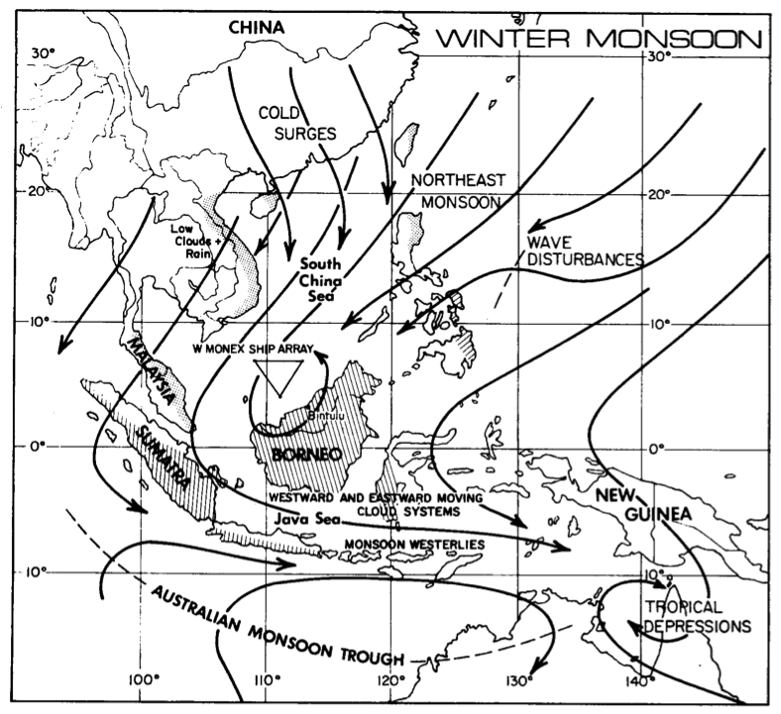
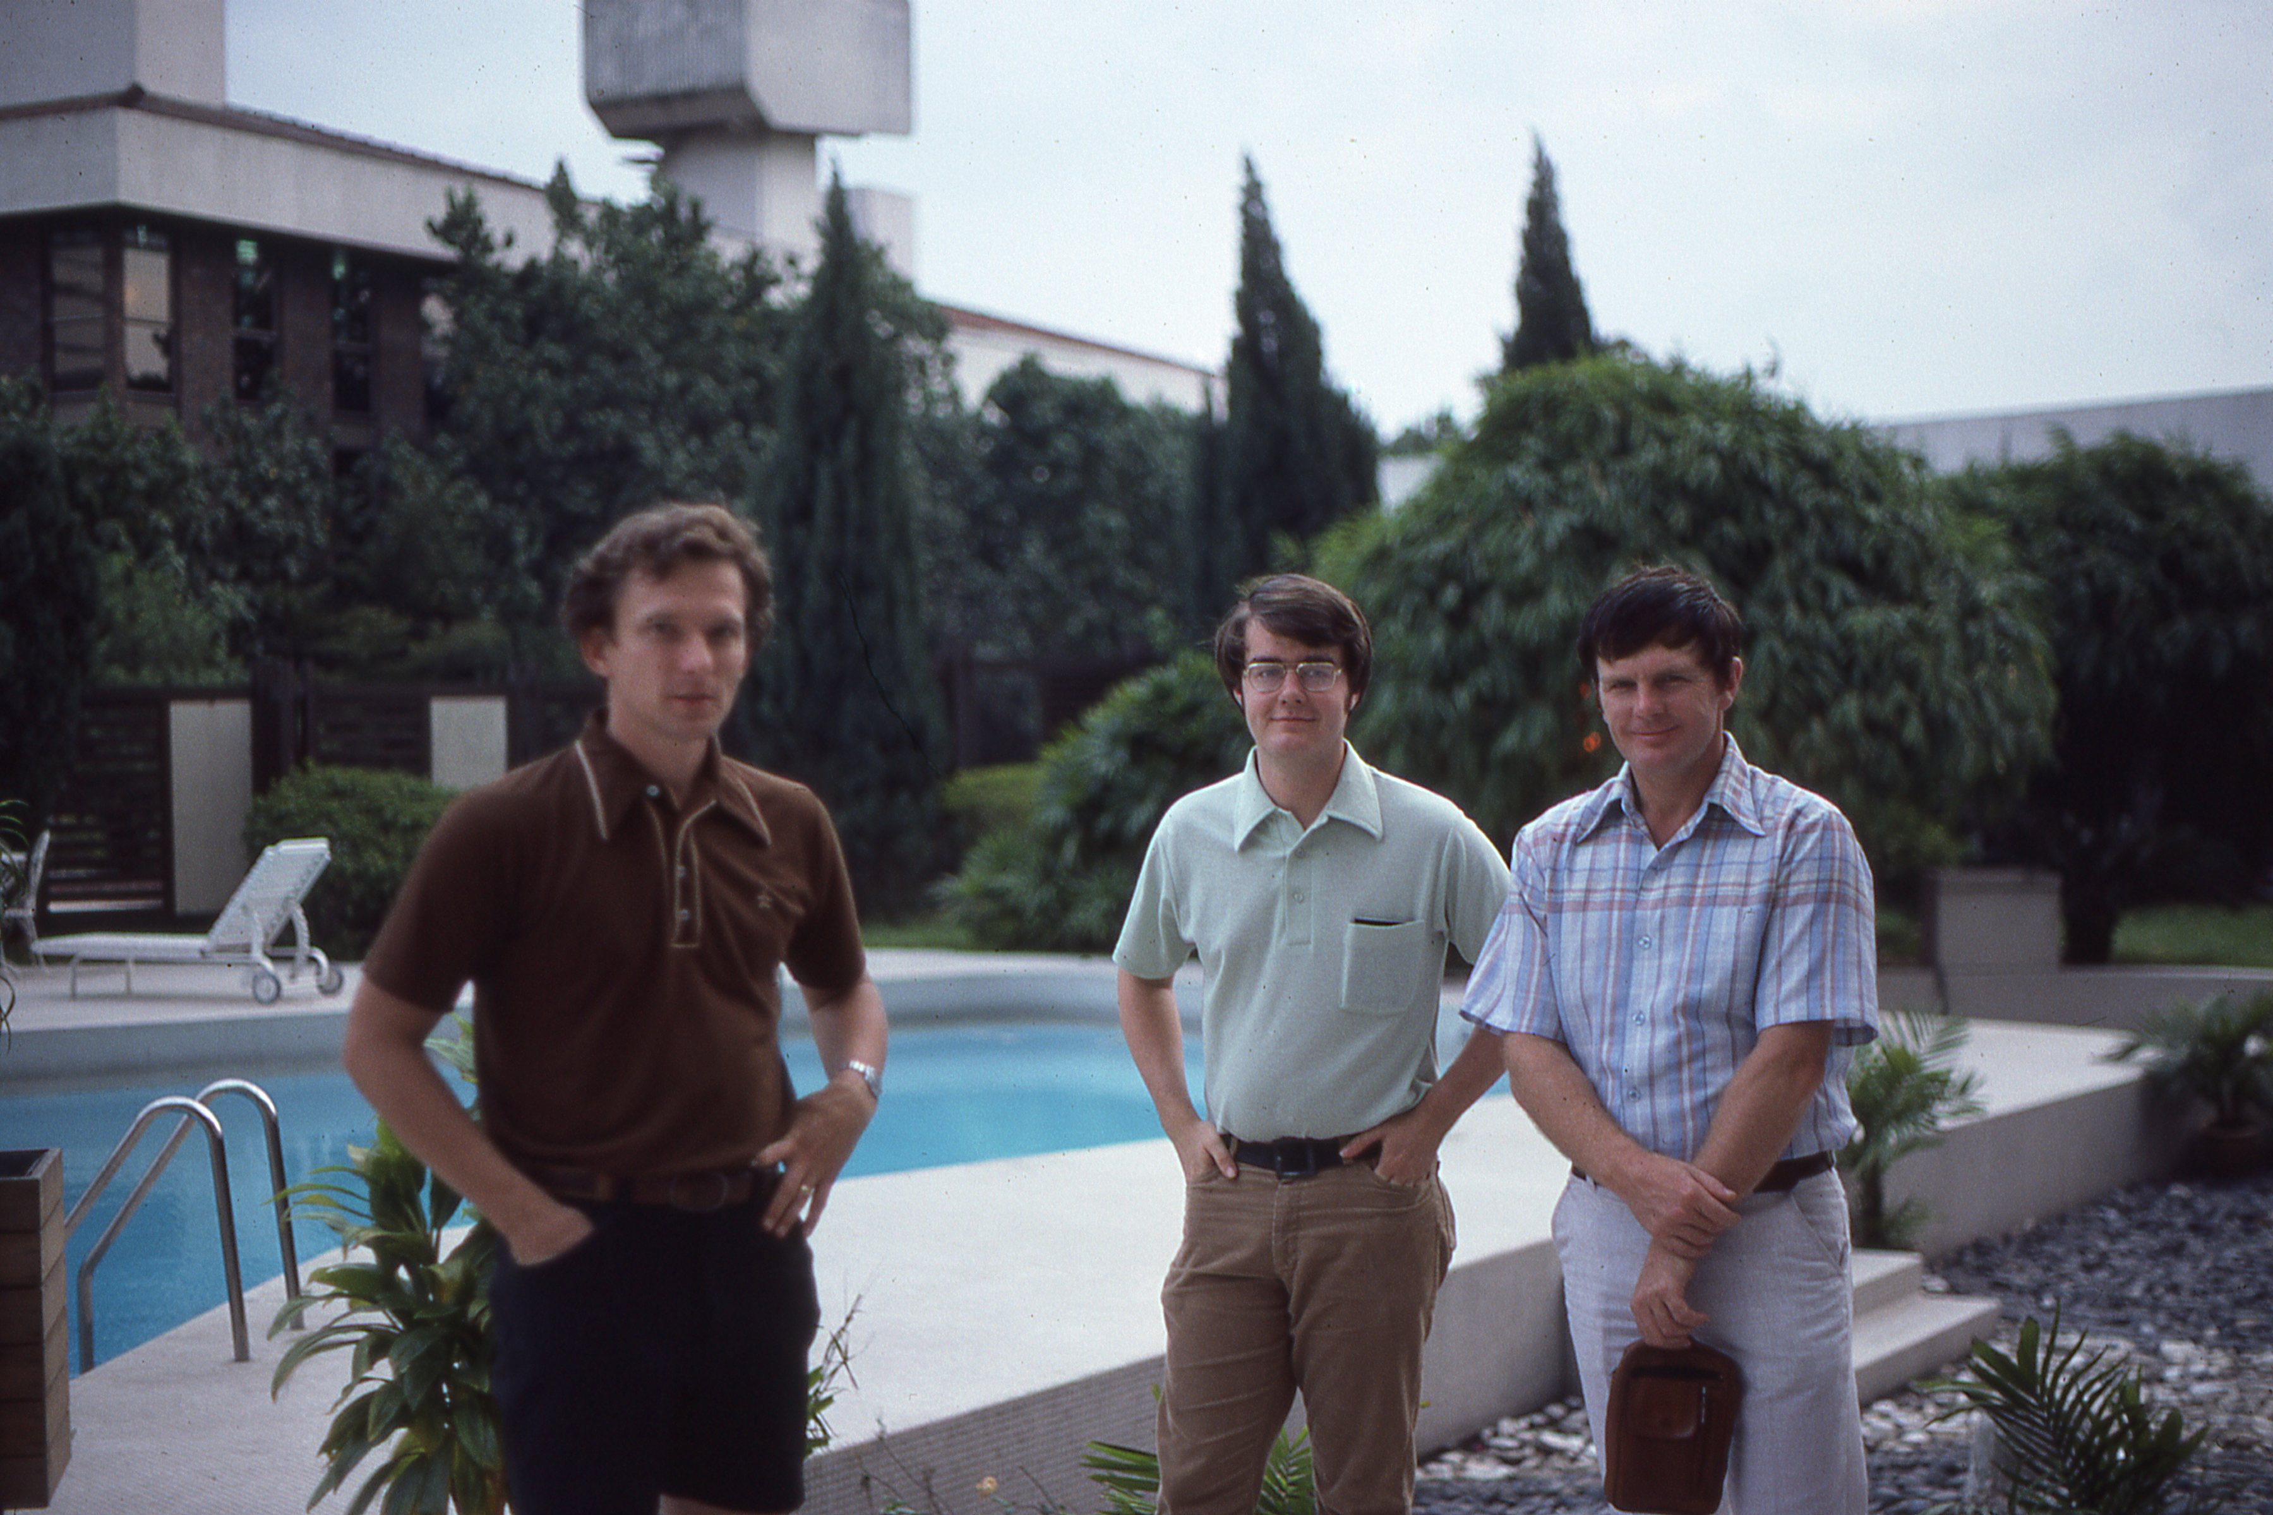
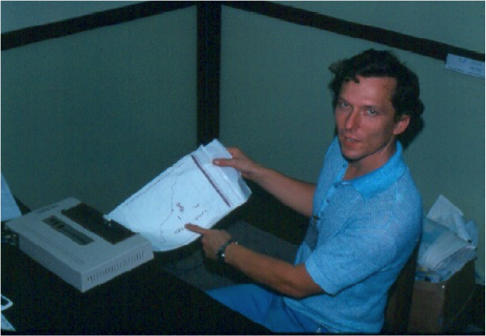
Winter MONEX
December 1978
Cold surges, Hadley/Walker circulations, interhemispheric exchanges, near-equatorial depressions, heat sources/sinks
Ops Center
Kuala Lumpur
MIT radar
Images from MIT radar at Bintulu
At Kuala Lumpur Operations Center
Notes:
Scientific objectives were mostly related to cold surges, interhemispheric exchanges, and near-equatorial depression in southern SCS. Nevertheless, a major finding had to do with near-equatorial convection and its diurnal cycle.

Slide 7
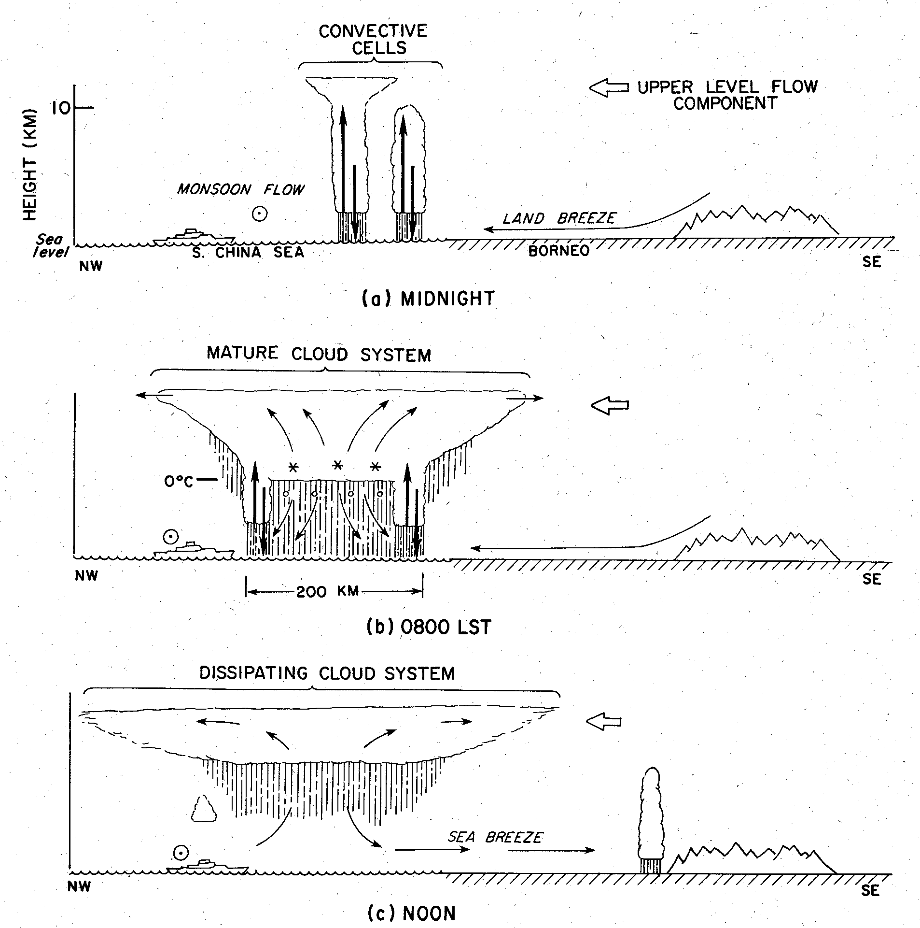
Houze, R. A., Jr., S. G. Geotis, F. D. Marks, Jr., and A. K. West, 1981: Winter monsoon convection in the vicinity of north Borneo. Part I: Structure and time variation of the clouds and precipitation. Mon. Wea. Rev., 109, 1595-1614.
And what came of these observations?
1400 L
*Bintulu
10 Dec 1978

Slide 8
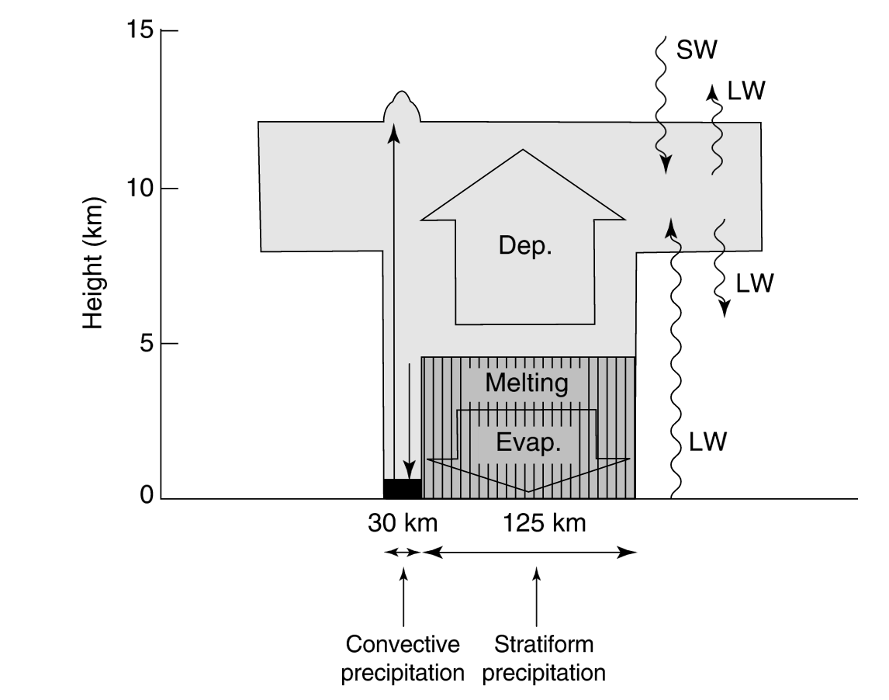
Then combining WMONEX and GATE findings…
Houze, R. A., Jr., 1982: Cloud clusters and large-scale vertical motions in the tropics. J. Meteor. Soc. Japan, 60, 396-410.
Physically based estimates of
Latent heating in convective and stratiform regions (condensation, evaporation, melting) – from GATE (Leary and Houze 1980)
Convergence of eddy heat flux – from GATE (LH 1980)
Radiative heating rates – based on WMONEX (Webster and Stephens 1980)
IDEALIZED TROPICAL CLOUD CLUSTER

Slide 9
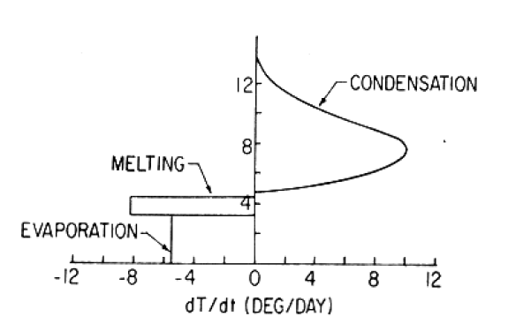
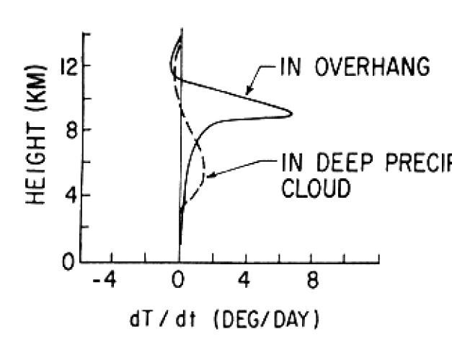
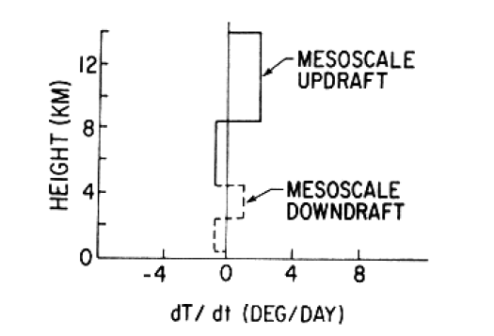
Contributions to Total Heating by Tropical Cloud Cluster
Conv. LH
Strat. LH
CONVECTIVE LATENT HEATING
STRATIFORM LATENT HEATING
CONVECTIVE EDDY TRANSPORTS
STRATIFORM EDDY TRANSPORTS
Conv. Eddy
Rad.
Strat. Eddy
RADIATIVE HEATING

Slide 10
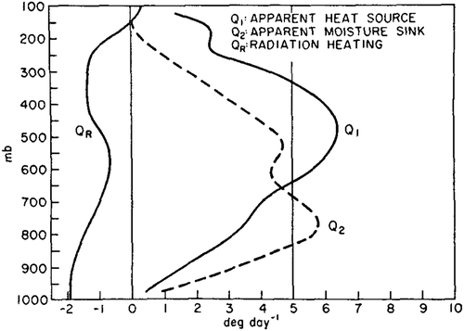
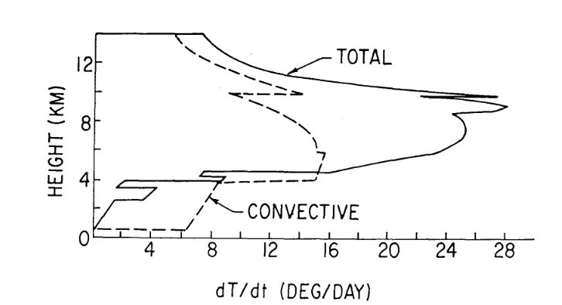
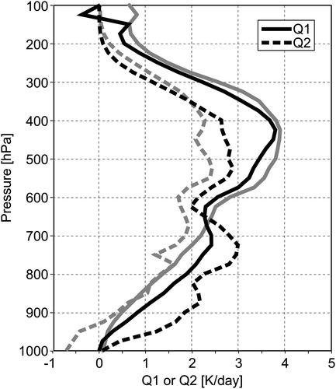
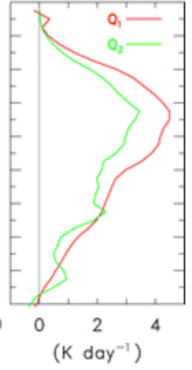
(Yanai et al. 1973)
Total Heating
Heating of Large-Scale Area by Mature Cloud Cluster
Q₁
DYNAMO
“Top-heavy” heating (Mapes 2000) due to combined effects of convective and stratiform regions
TOGA COARE
Q₁
MISMO
(Katsumata et al. 2011)
(Johnson et al. 2015)
Notes:
“Top-heavy” coined by Mapes (2000). Subtle indentation in Q1 profile below melting level is indication of great prevalence of stratiform precipitation systems in tropics.

Slide 11
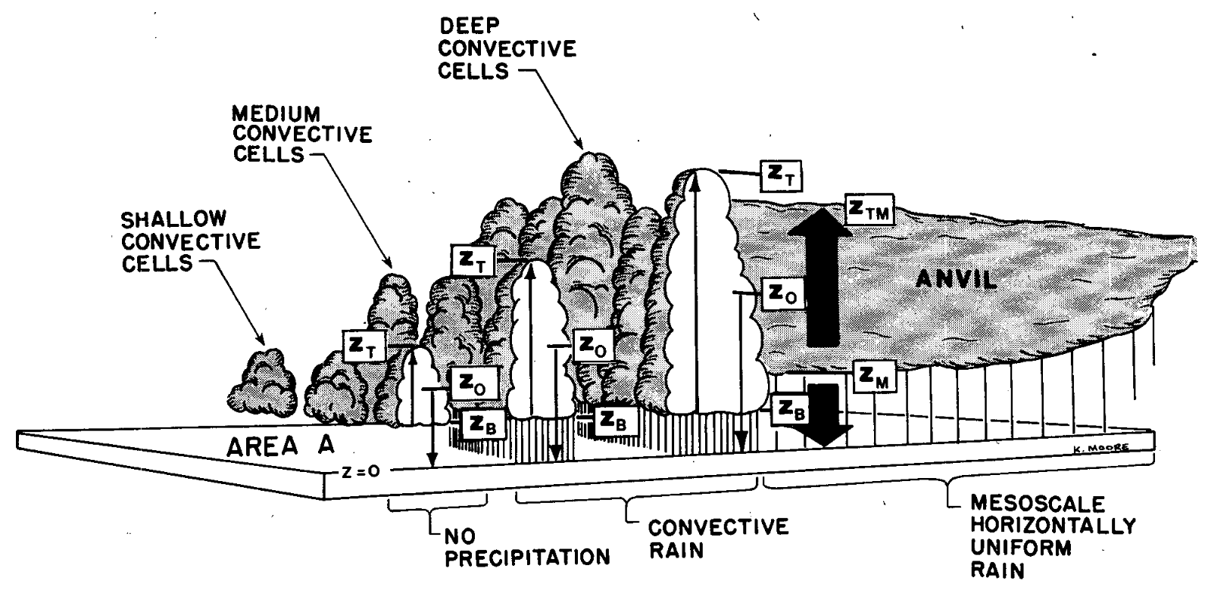
And radar data were then used to diagnose mass and heat fluxes by convective clouds in GATE…
Houze, R. A., Jr., C.-P. Cheng, C. A. Leary, and J. F. Gamache, 1980: Diagnosis of cloud mass and heat fluxes from radar and synoptic data. J. Atmos. Sci., 37, 754-773.

Slide 12
Bob Houze Field Campaign Time Line
MID-LATITUDES
PRE-STORM
CYCLES
.
GATE
EMEX
1970s
1980s
TROPICS
SMONEX
WMONEX
ATLANTIC HURRICANES
IMPROVE
COAST
MAP
COAST
TEPPS
2000s
AMMA
CaPE
RAINEX
1990s
TOGA COARE
JASMINE
TOGA COARE
KWAJEX
OLYMPEX
TRMM, CloudSat, GPM
HS3
2010s
2020s?
DYNAMO
GRIP

Slide 13
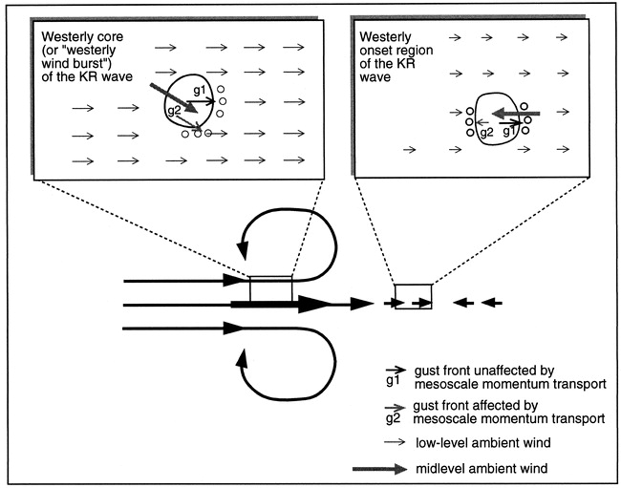
Momentum Transports in Large MCSs in TOGA COARE
Easterly momentum transported downward
Downward transport of westerly momentum
(Houze et al. 2000)
Notes:
Data: aircraft and shipboard Doppler radar data. Circulation features based on Gill’s Kelvin-Rossby wave model. MJO wasn’t coined until 1988 (Swinbank et al. 1988; Lau et al. 1988), and also as Madden-Julian 40-50 day wave by Webster (1987).

Slide 14
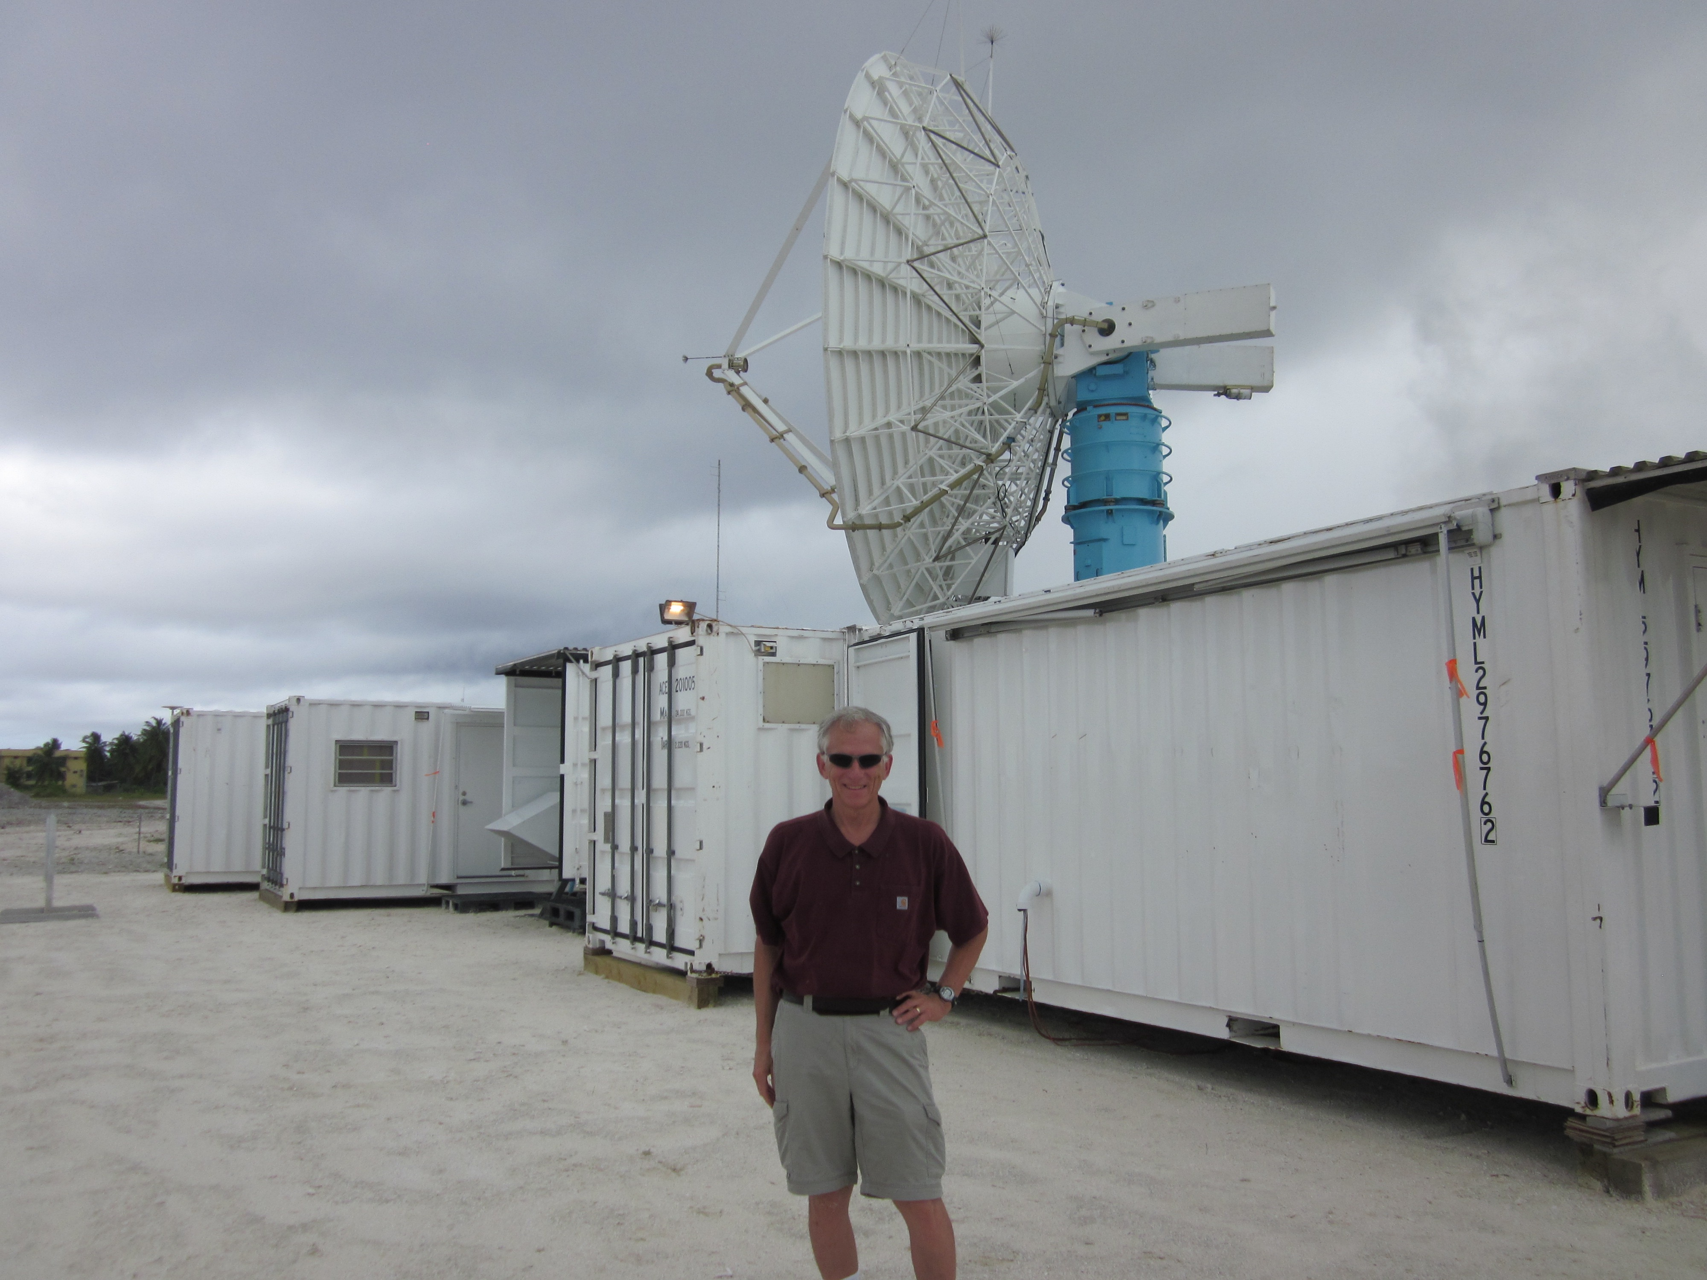
Probably no one in our field has more adeptly, comprehensibly, and accurately synthesized findings from field campaigns than Bob Houze
Thanks, Bob!
Photo by R. Johnson
Addu Atoll, 2011

Slide 15
END

Slide 16
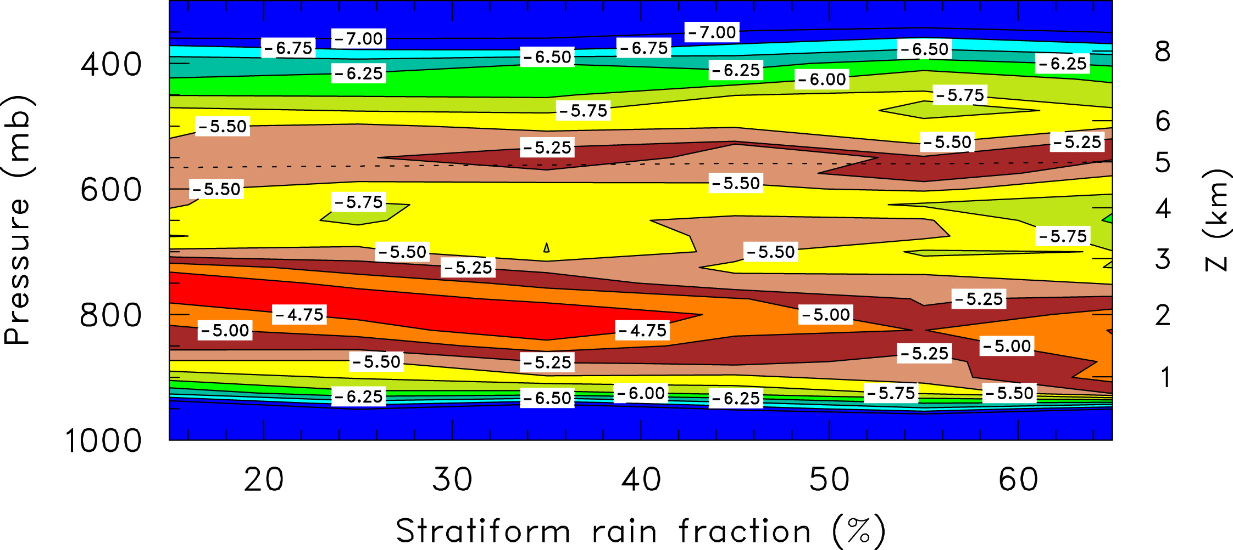
Static stability dT/dz (K km⁻¹) as a function of stratiform rain fraction over MIT radar coverage area during TOGA COARE
(Johnson, Ciesielski, and Rickenbach 2016; Yanai AMS Monograph)

Slide 17
Bob Houze Field Campaign Time Line
MID-LATITUDES
PRE-STORM
CYCLES
.
GATE
EMEX
1970s
1980s
TROPICS
SMONEX
WMONEX
ATLANTIC HURRICANES
IMPROVE
COAST
MAP
COAST
TEPPS
2000s
AMMA
CaPE
RAINEX
1990s
TOGA COARE
JASMINE
KWAJEX
OLYMPEX
TRMM, CloudSat, GPM
HS3
DYNAMO
2010s
2020s?
GRIP
Notes:
The Convection and Precipitation/Electrification Experiment (CaPE) was conducted in the central Florida region during the period 8 July through 18 August, 1991.

Slide 18
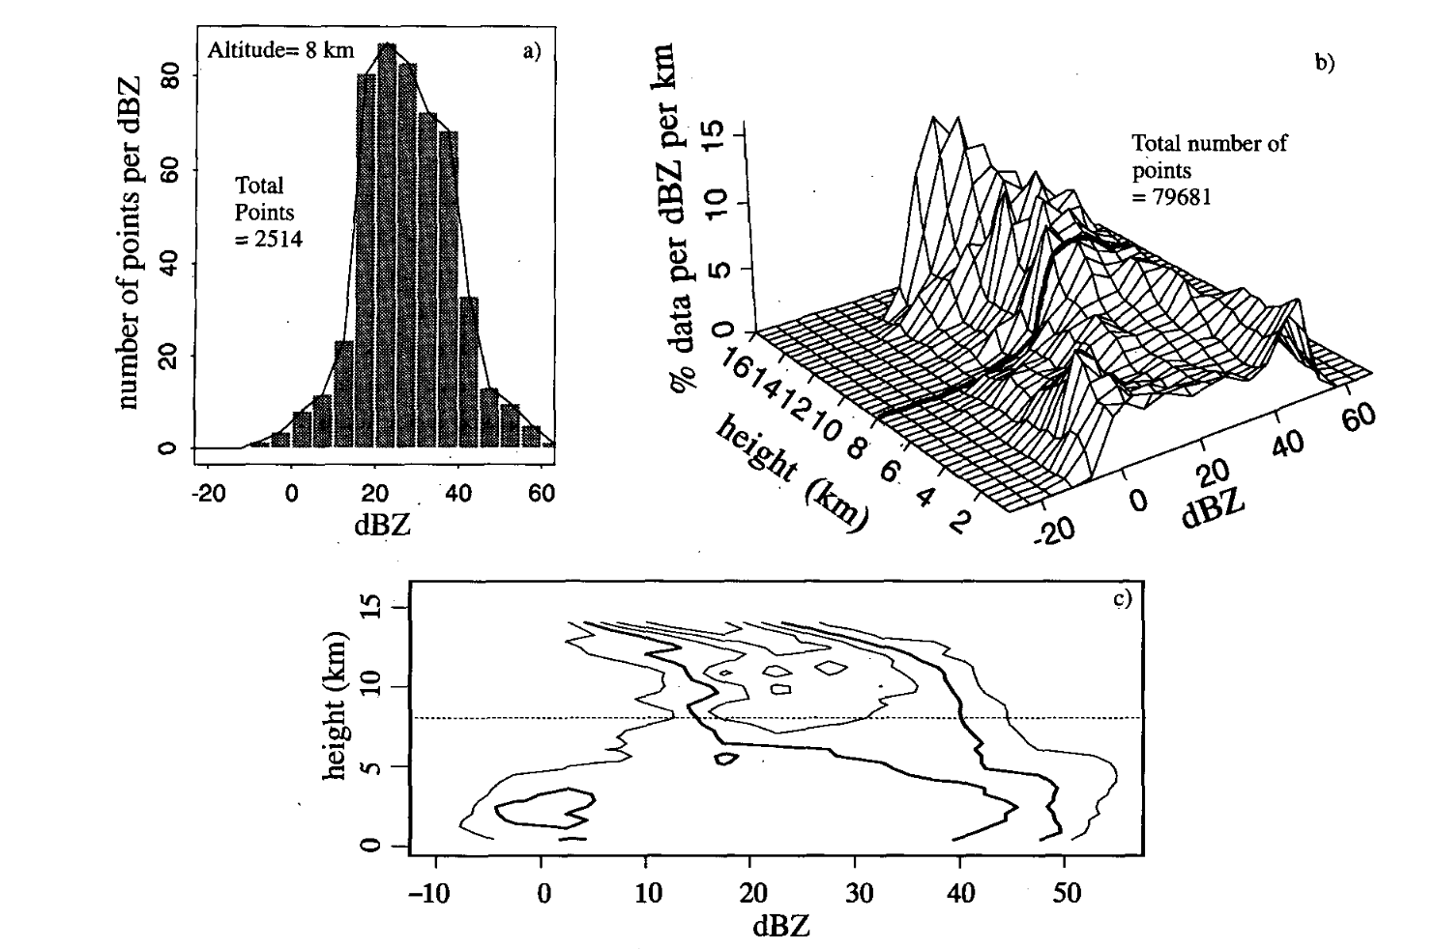
Yuter, S. E., and R. A. Houze, Jr., 1995: Three-dimensional kinematic and microphysical evolution of Florida cumulonimbus. Part II: Frequency distribution of vertical velocity, reflectivity, and differential reflectivity. Mon. Wea. Rev., 123, 1941-1963.
“CFAD” used since 1995 in 161 AMS publications alone!
“CFAD”
Contour by Frequency Altitude Diagram

Slide 19
Bob Houze Field Campaign Time Line
MID-LATITUDES
PRE-STORM
CYCLES
.
GATE
EMEX
1970s
1980s
TROPICS
SMONEX
WMONEX
ATLANTIC HURRICANES
IMPROVE
COAST
MAP
COAST
TEPPS
2000s
AMMA
CaPE
RAINEX
1990s
TOGA COARE
JASMINE
KWAJEX
OLYMPEX
TRMM, CloudSat, GPM
Cloud Dynamics (1993)!
DYNAMO
2010s
2020s?
HS3
GRIP

