Slide 1
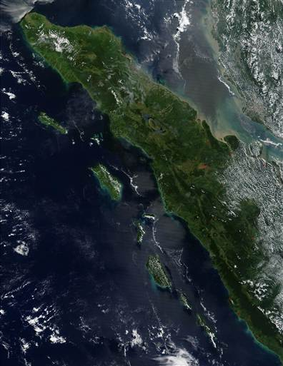
Downstream Effects of Sumatra on Weather and Tropical Cyclogenesis over the Indian Ocean
Richard H. Johnson
Colorado State University
Sumatra
WMO 3rd Monsoon Heavy Rainfall Workshop, New Delhi, India, 22-24 September 2015

Slide 2
Outline
Effects of Sumatra on weather over Indian Ocean during 2011 DYNAMO
Wake vortex generation by Sumatra
Relationship to tropical cyclone genesis over the Indian Ocean during 2011 DYNAMO and 2008-10 YOTC

Slide 3
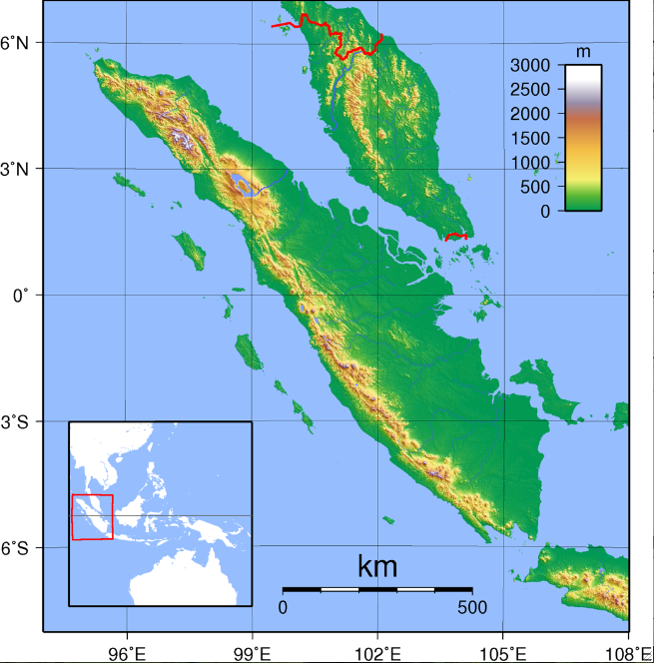
Max elevation = 3.8 km
Malaysia
Island extends from ~6N to 6S
Steep mountain chain on west side of island (>3 km)
Highest terrain on north end
Sumatra

Slide 4
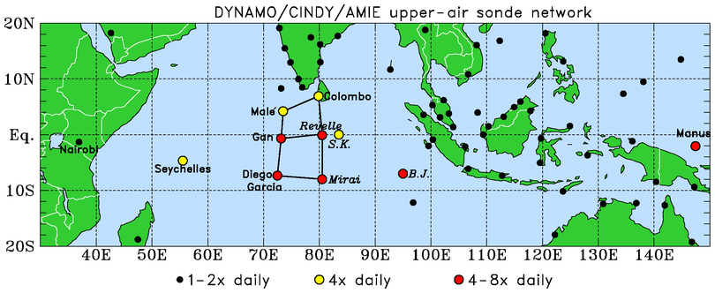
Dynamics of the MJO (DYNAMO): 1 October 2011 – 31 March 2012
.
BORNEO
SUMATRA
Moistening processes during the initiation stage of the MJO
Role of convective cloud populations in MJO initiation
Role of air-sea interaction in the Indian Ocean in MJO initiation

Slide 5
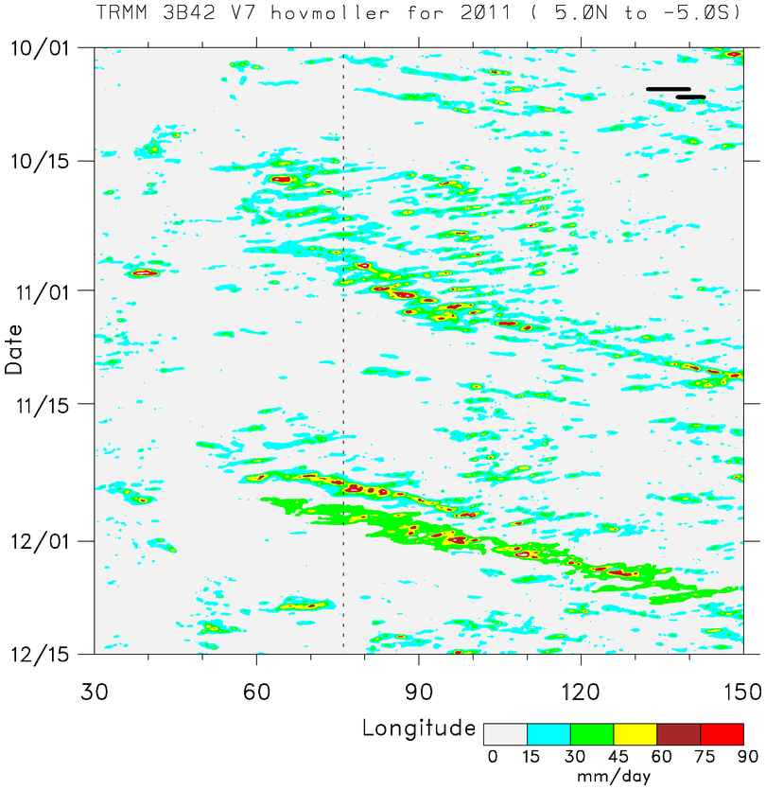
■ Two prominent MJO events during DYNAMO: October and November
■ MJO envelopes consists of westward- and eastward-moving disturbances
Time
EAST AFRICA
DYNAMO ARRAY
SUMATRA
BORNEO
■ Diurnal cycle over Borneo and Sumatra

Slide 6
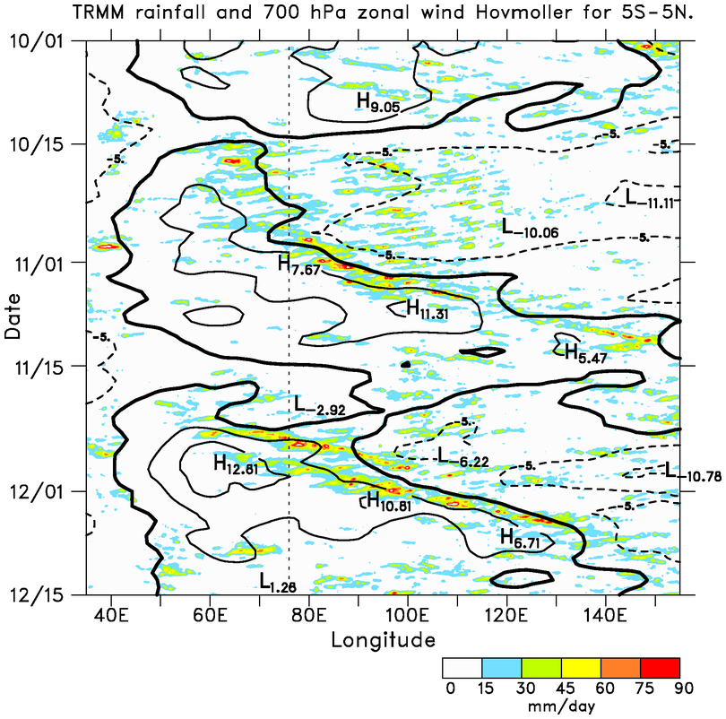
Rain, u₇₀₀
(5°N-5°S)
BORNEO
Diurnal cycle initiates near Borneo & Sumatra
Direction of diurnal propagation switches with wind direction: ave. speed ~14 m/s
Rapid shift to westerlies with Kelvin wave passage
SUMATRA
DYNAMO ARRAY
ECMWF OA (6 h, 0.25 deg)

Slide 7
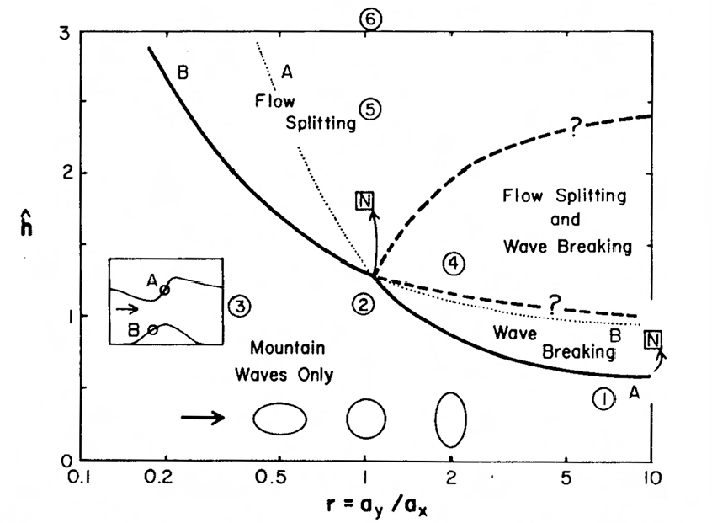
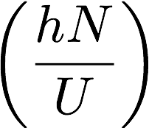
Wake vortices expected to the lee of N and S ends of Sumatra
Smith (1989)
Non-dimensional mountain height
*
(length/width ratio)

Slide 8
Flow fields for |u| > 5 m s⁻¹ between 3 and 7°N at 100°E

Slide 9
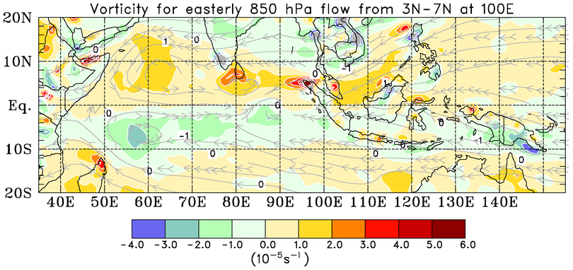
Positive vorticity anomalies to the lee of topographic features for easterly flow
Means for Oct-Nov-Dec of DYNAMO

Slide 10
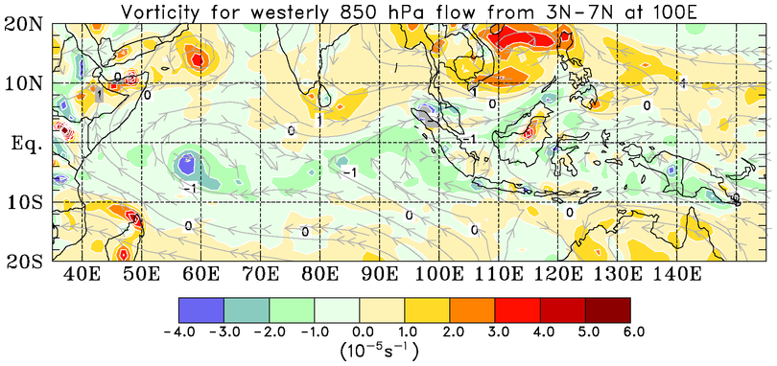
Negative vorticity anomalies to the lee of topographic features for westerly flow
Means for Oct-Nov-Dec of DYNAMO

Slide 11
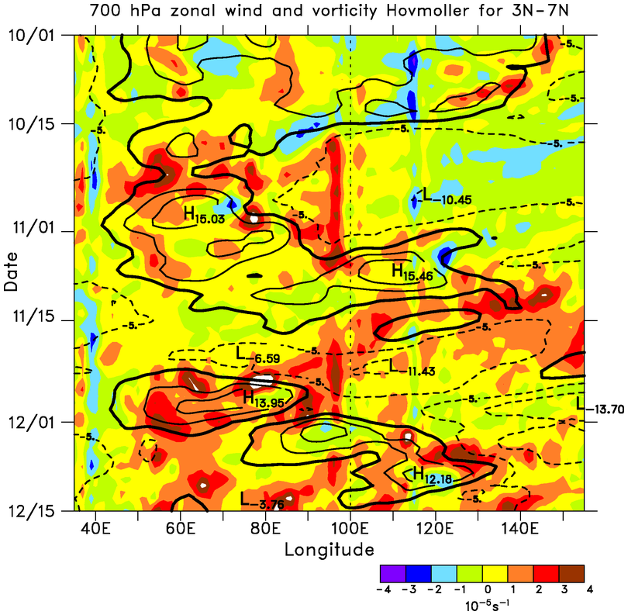
700-hPa u, ζ
Positive vorticity maxima just downstream of Sumatra with easterly flow
Vorticity anomalies progress westward at 4-5 m s⁻¹
Time
SUMATRA
ECMWF OA 0.25°

Slide 12
700-hPa u, ζ
Positive vorticity maxima downstream of Sumatra with easterly flow
Vorticity anomalies progress westward at 4-5 m s⁻¹
Time
SUMATRA
ECMWF OA 0.25°

Slide 13
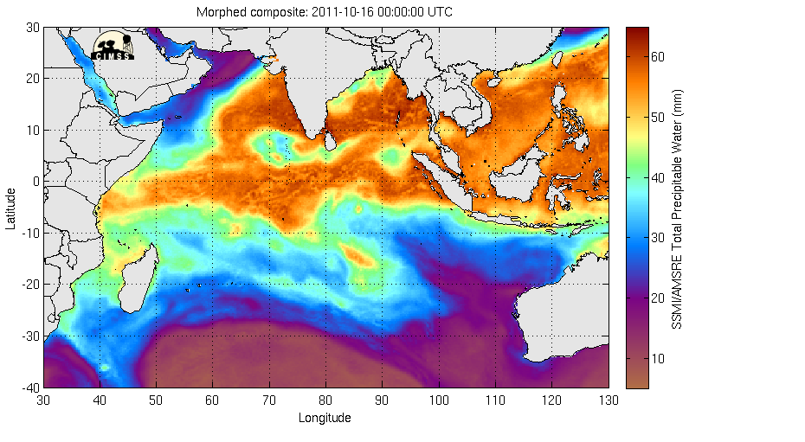
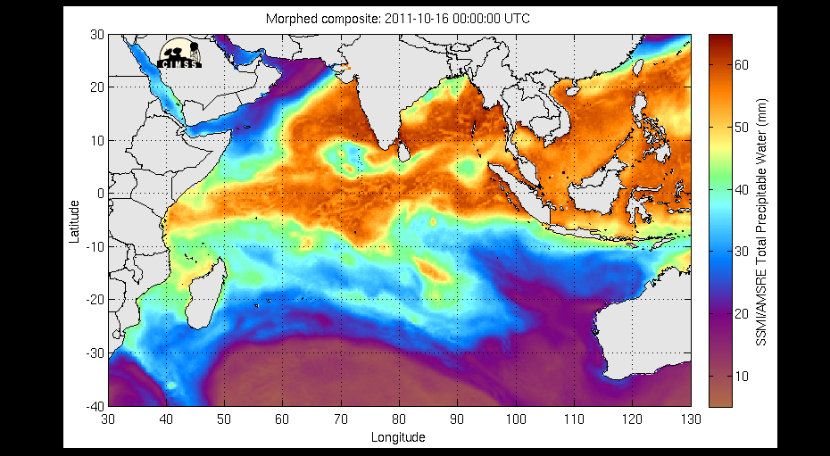
CIMMS TPW (16-20 October 2011)

Slide 14
700-hPa u, ζ
Positive vorticity maxima downstream of Sumatra with easterly flow
Vorticity anomalies progress westward at 4-5 m s⁻¹
Time
SUMATRA
ECMWF OA 0.25°

Slide 15
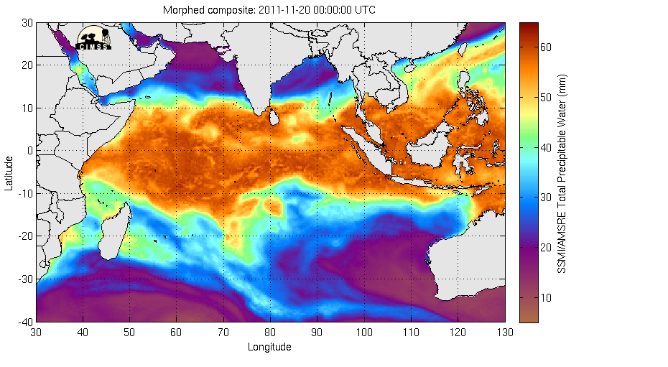
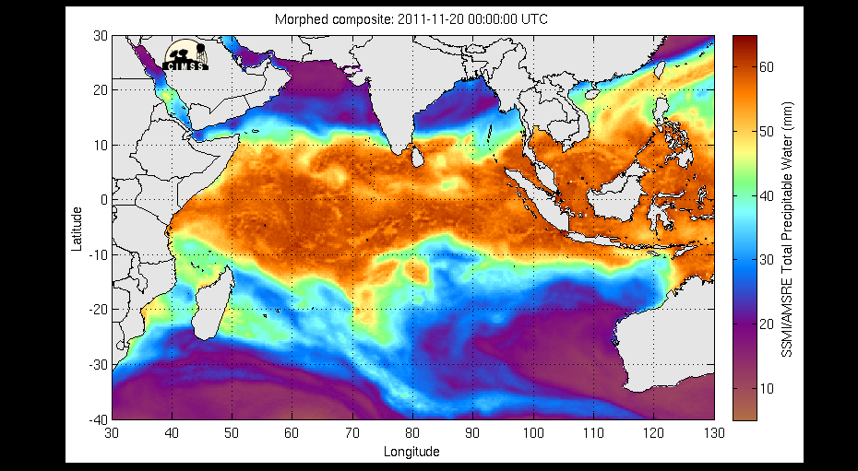
CIMMS TPW (20-24 November 2011)

Slide 16
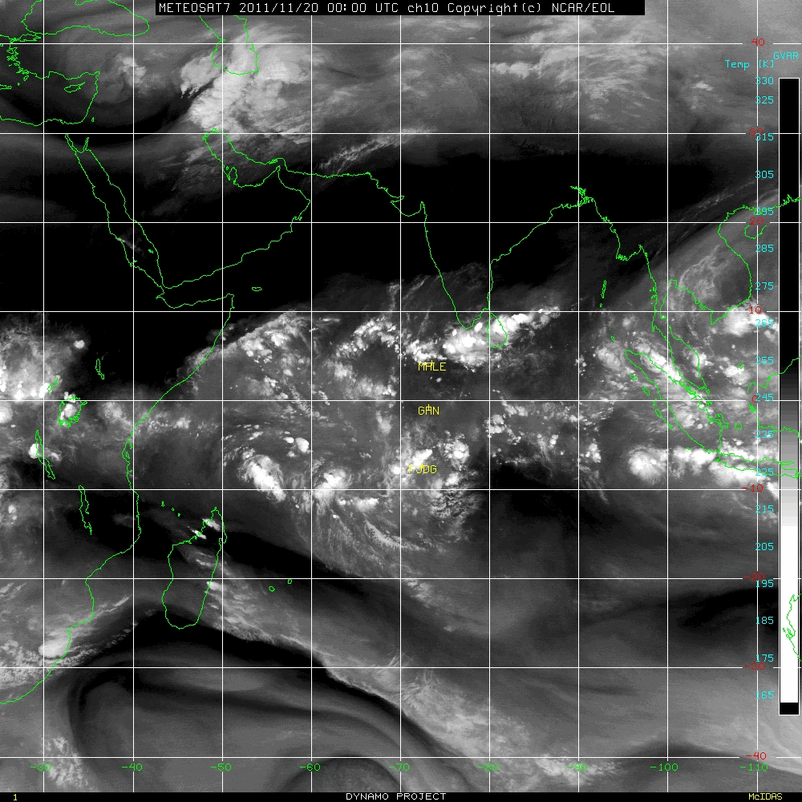

METEOSAT Water Vapor (20-27 November 2011)
Tropical Storm 05A

Slide 17
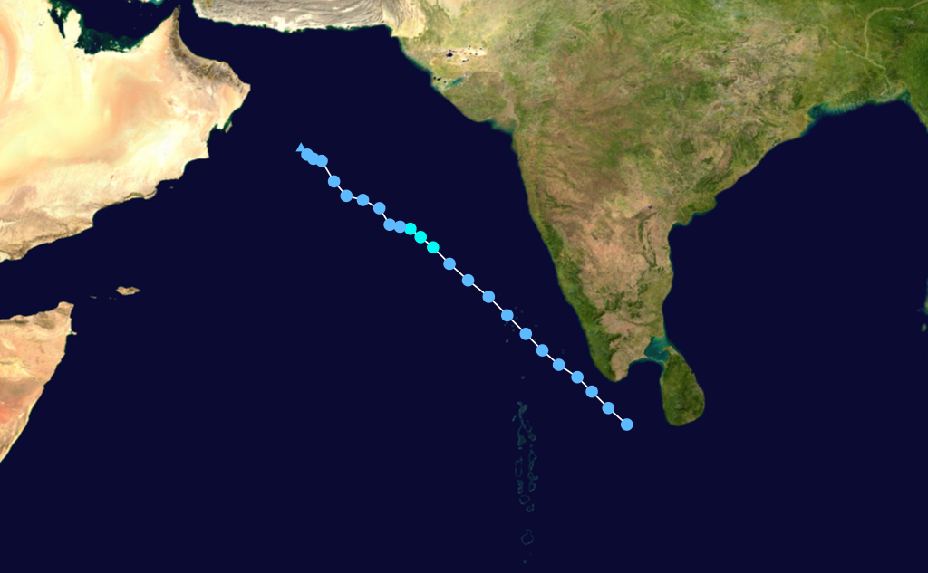
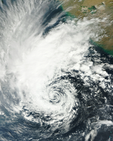
Tropical Storm 05A
(26 Nov - 1 Dec 2011)
29 Nov
Sri Lanka: Storm and Floods – 27 Nov 2011
19 killed, 43 fishermen missing

Slide 18
Development of TC05A* (19 -24 Nov 2011)
(Streamlines and geopotential height anomalies)
Pre-TC wake vortex tracked 5 days prior to naming of storm
TC05A named
*IMD ARB 04

Slide 19
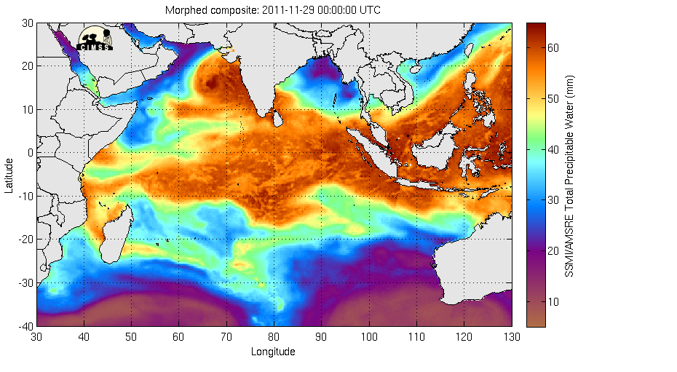
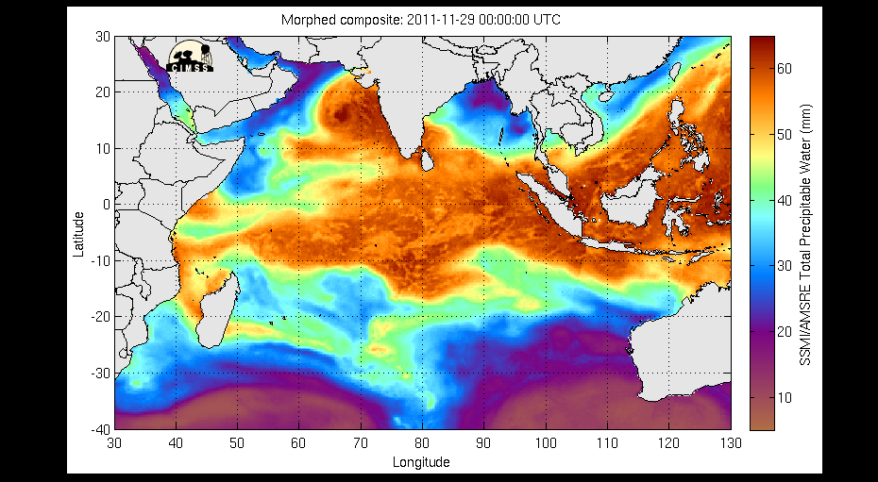
CIMMS TPW (29 Nov – 6 Dec 2011)
Tropical Storm Alenga

Slide 20
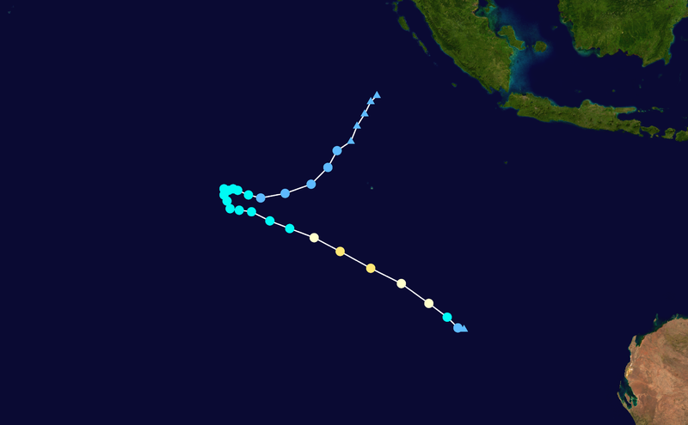
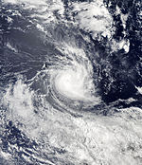
Borneo
Sumatra
Severe Tropical Storm Alenga
(5-7 December 2011)
Australia

Slide 21
DYNAMO Period Tropical Cyclones Traced to Lee Vortices

Slide 22
Named storms in 2008, 2009, and 2011 traced back to wake vortices
Dashed track segments refer to pre-TC circulations
Thick lines denote TCs in Oct-Nov-Dec; thin lines for other months
Some circulations tracked great distances before naming of storms
Lee vortex track

Slide 23
Development of TC07B* (29 Nov – 4 Dec 2008)
(Streamlines and geopotential height anomalies)
Pre-TC wake vortex tracked 5 days prior to naming of storm
TC07B named
*IMD BOB 08

Slide 24
Development of TCs Cleo, Ward*, David (2-7 Dec 2009)
(Streamlines and geopotential height anomalies)
Pre-Ward tracked 8 days
Pre-Cleo tracked 5 days prior
Pre-David tracked 7 days prior
Ward named on 10 Dec
David named on 13 Dec
Cleo named
*IMD BOB 05

Slide 25
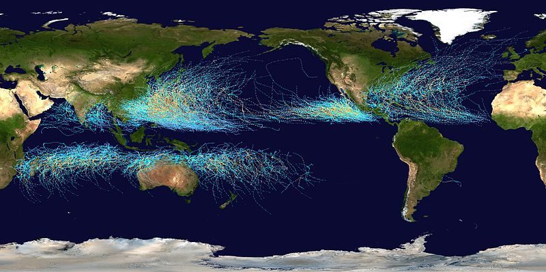
Tropical Cyclone Tracks 1985-2005
Sumatra is unique in the tropics

Slide 26
Summary
Diurnal cycle of precipitation associated with Sumatra/Borneo: systems propagate in direction of, and faster than mean zonal flow over eastern IO
During easterly flow, wake vortices often appear downstream of Sumatra; circulations cyclonic in both hemispheres
Wake vortices: initial disturbances for some TCs (first proposed by Kuettner 1989)
Ten TCs in DYNAMO and YOTC traced back to Sumatra wake vortices (6 in NH, 4 in SH)

Slide 27
Extra

Slide 28
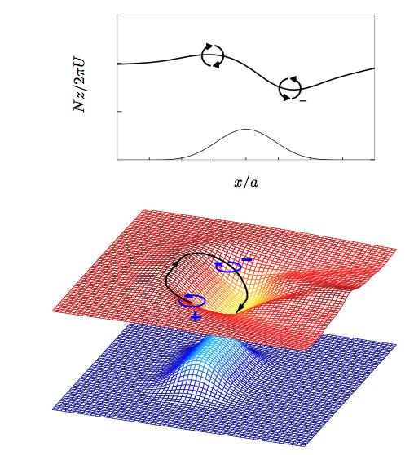
ĥ = 0.5
r = 2.4
(Epifanio 2006)

Slide 29
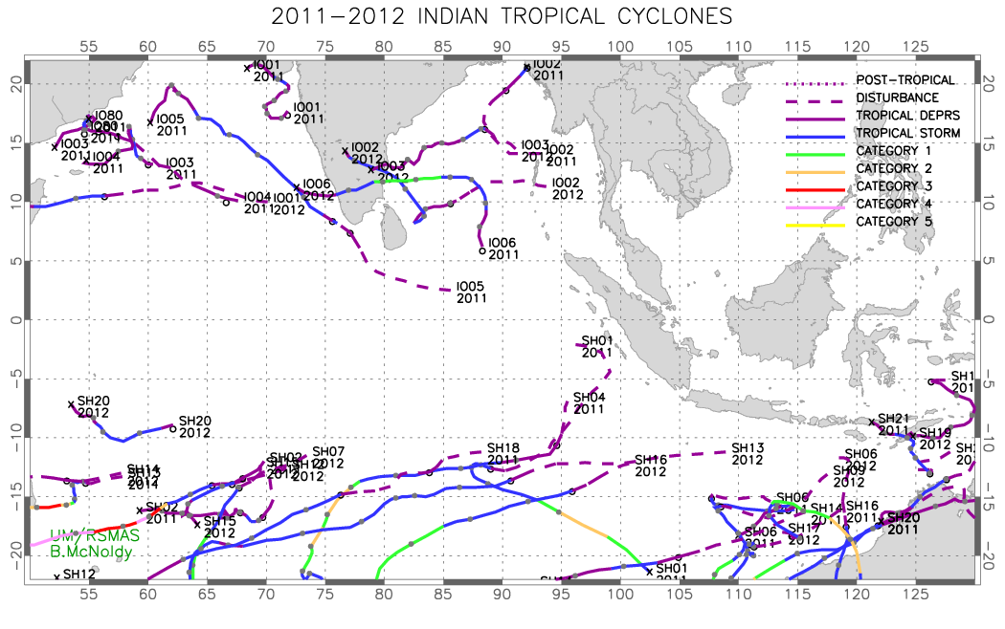

Slide 30

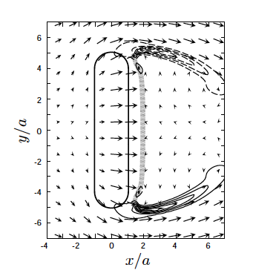
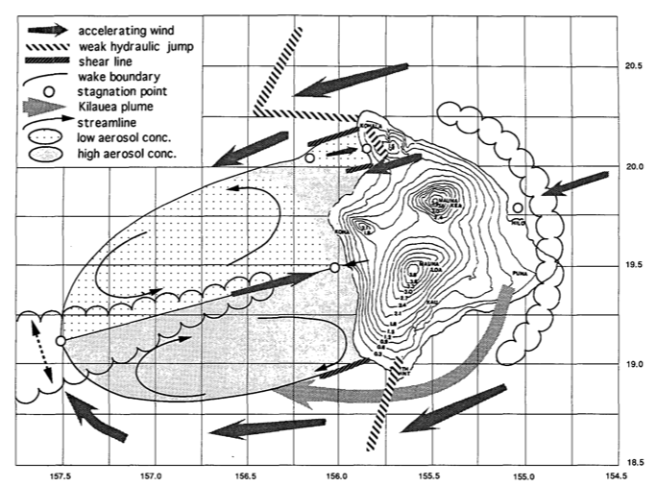
Smith (1989)
*
Epifanio and Durran (2002)
ĥ=1.8
r=5
Smith and Grubisic (1993)

