Slide 1
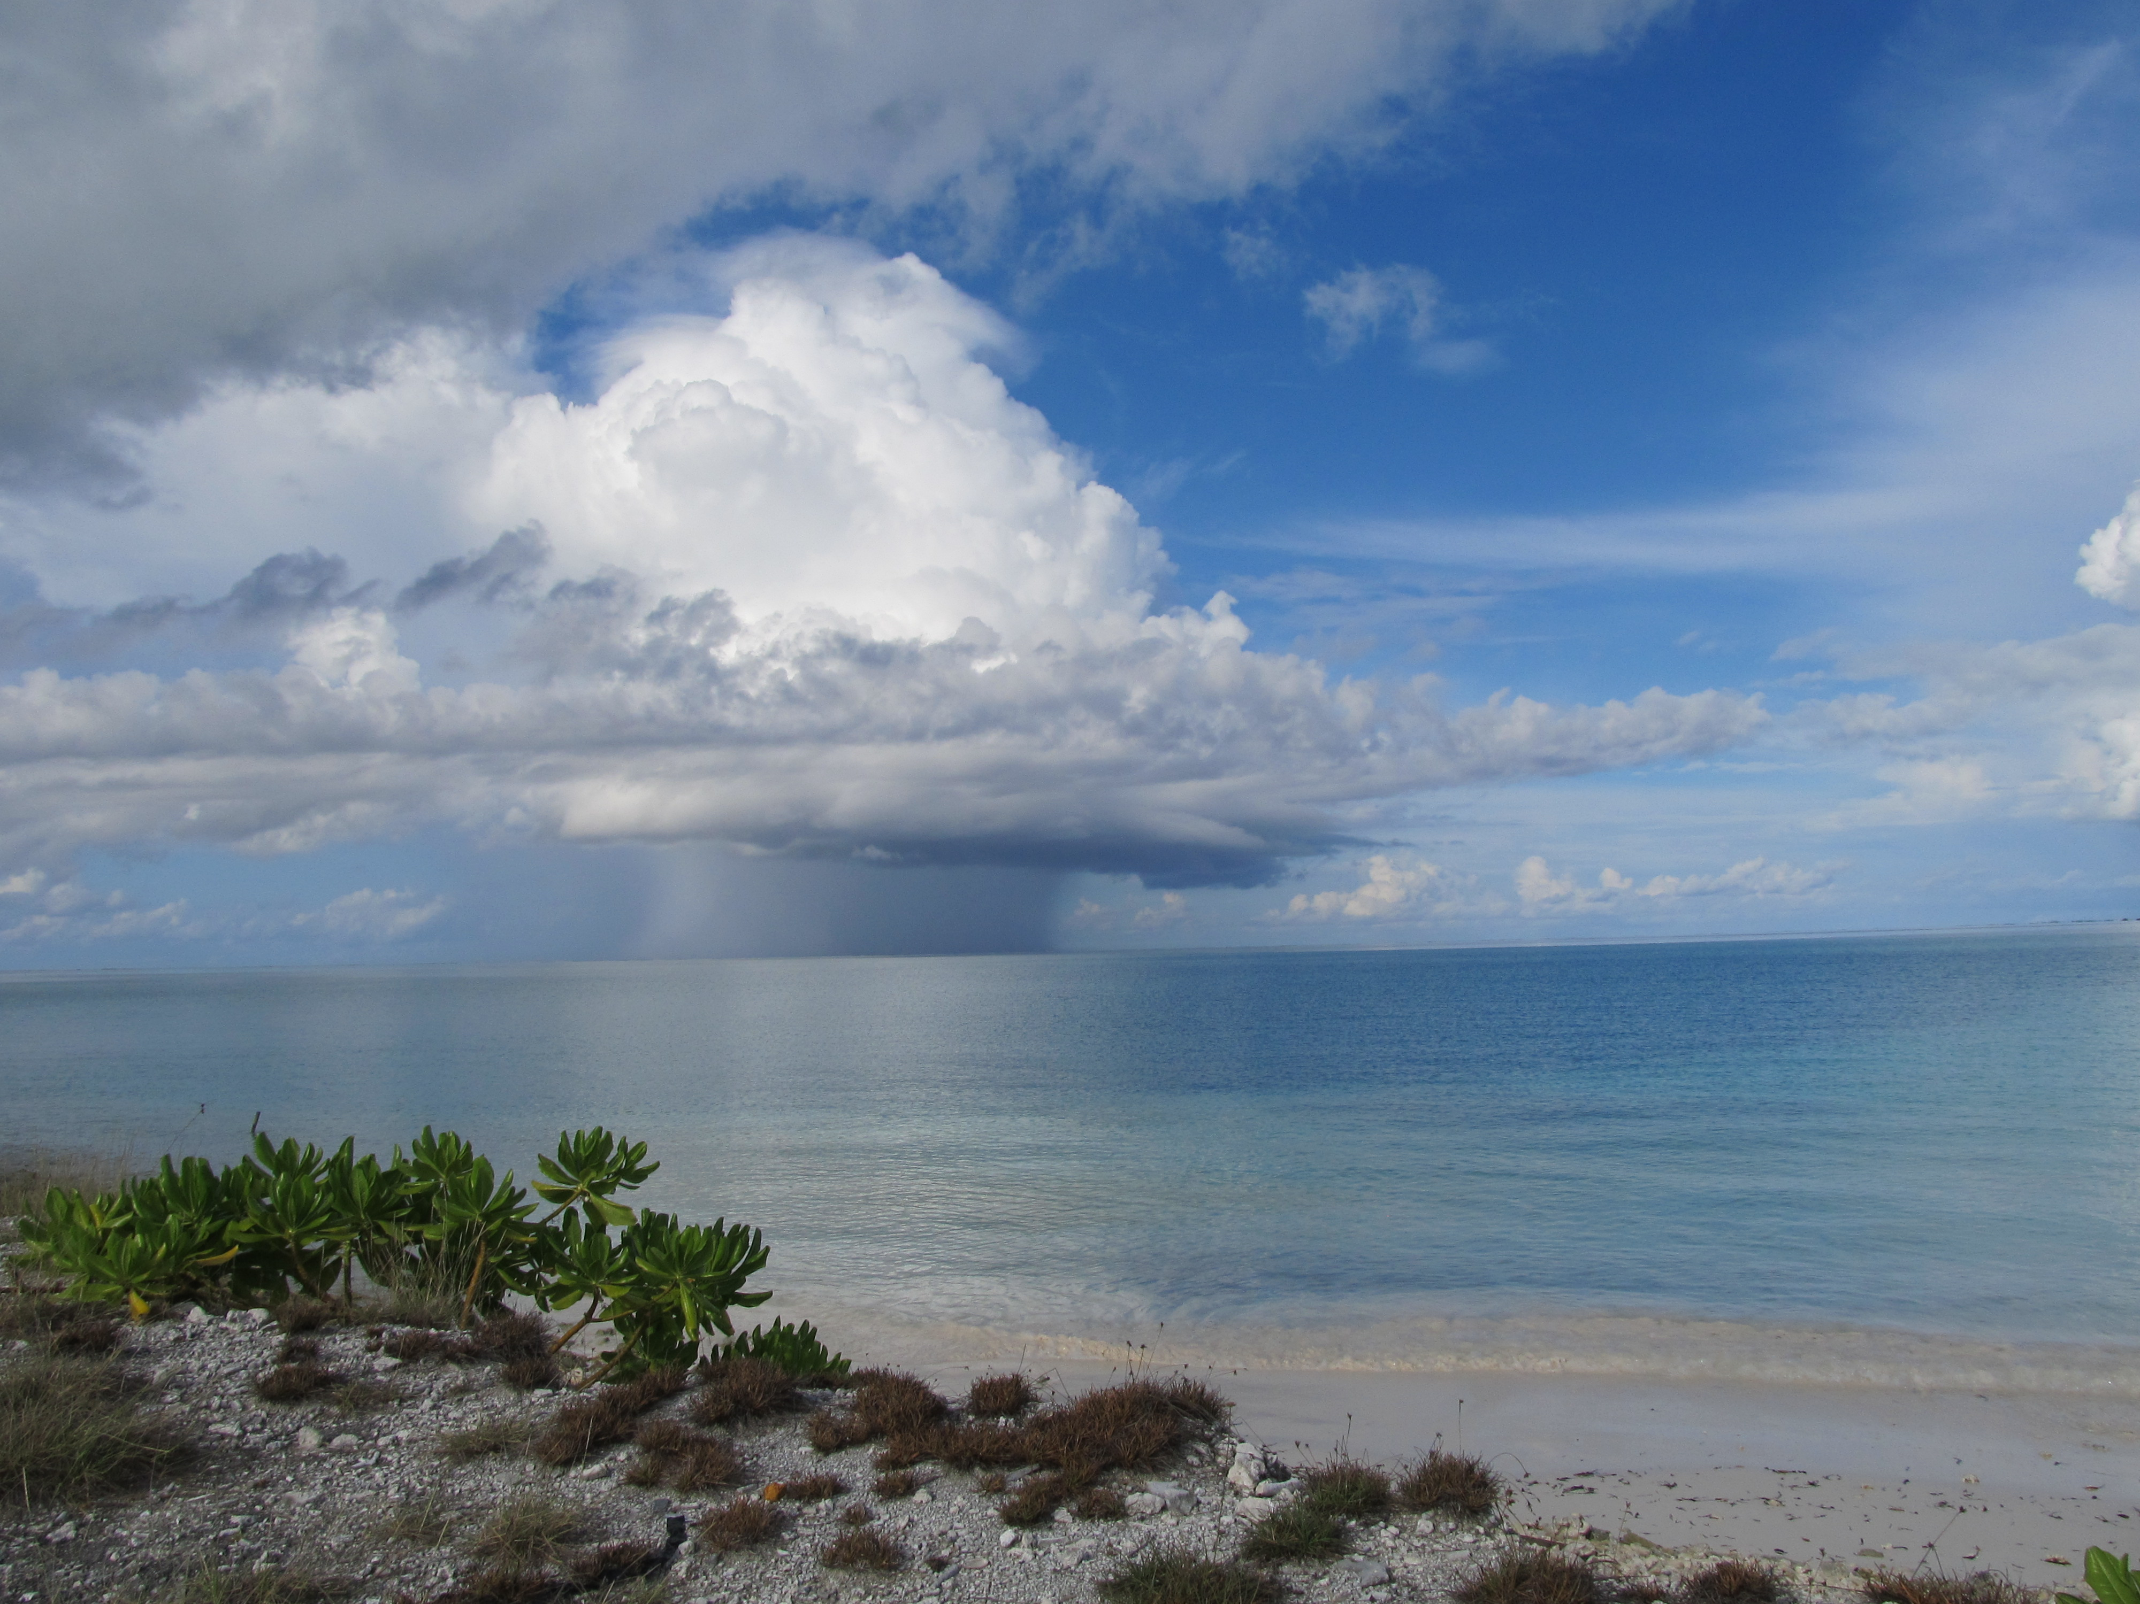
Role of Diurnally Driven Cumulus Moistening in the Initiation of the Madden-Julian Oscillation
Richard H. Johnson
Paul E. Ciesielski
Colorado State University
James H. Ruppert, Jr.
Penn State University
Oregon State University 28 January 2020
Addu Atoll: Kaustav Chakravarty

Slide 2
OUTLINE
The Madden-Julian Oscillation
  (a bit of history)
DYNAMO/CINDY Field Campaign
Diurnal cycle of the atmospheric boundary layer and shallow cumulus clouds
Role of diurnal cycle in cloud-layer moistening in the onset of the MJO

Slide 3
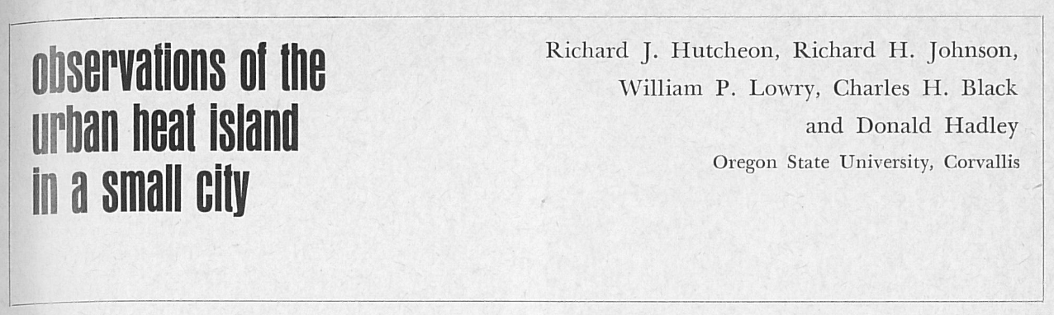
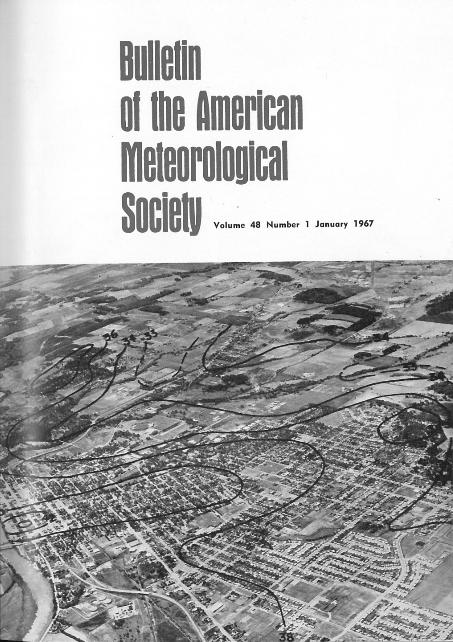
Bulletin of the American Meteorological Society
January 1967
Cover page

Slide 4
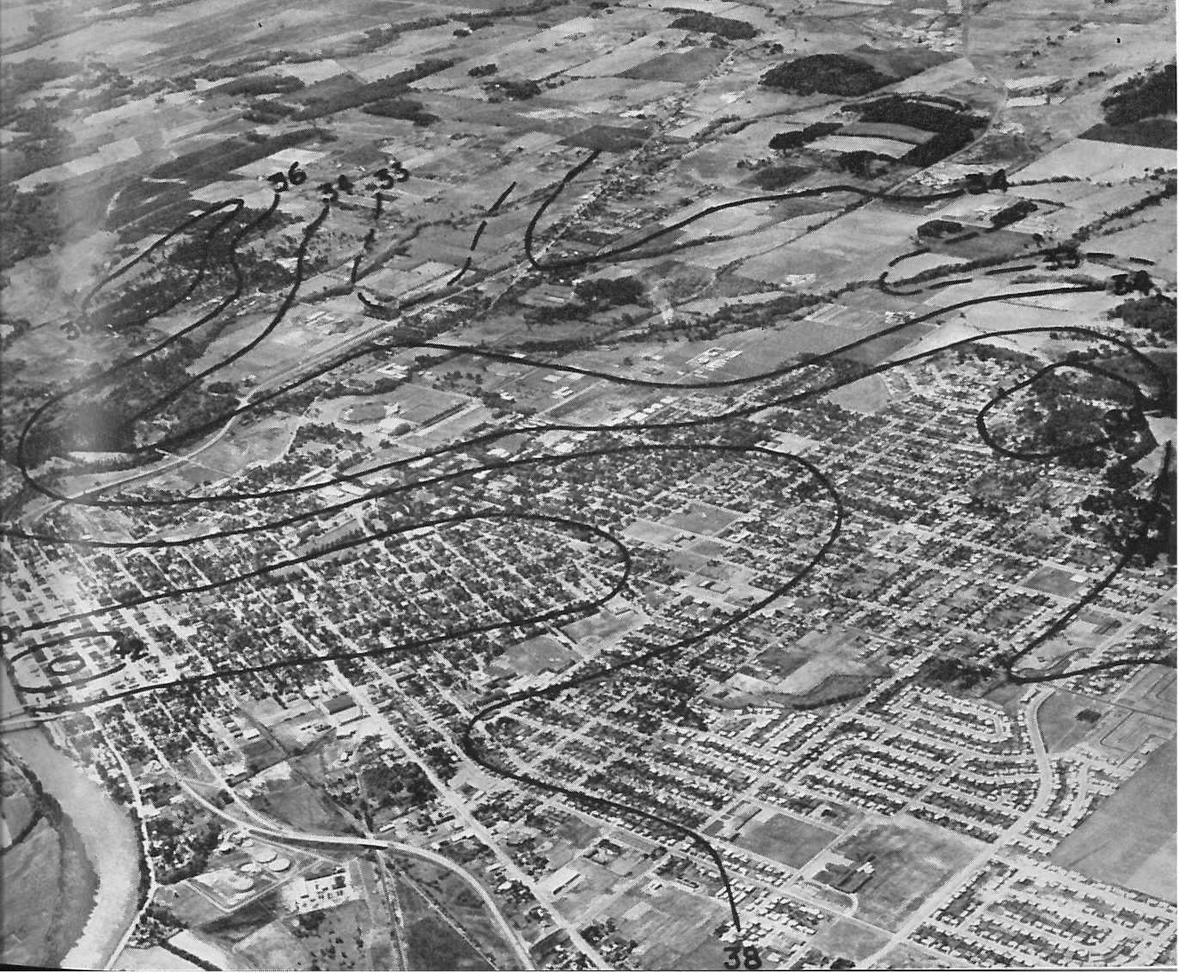
Observations of the Urban Heat Island in a Small City
31 January 1966
2200 PST
34
Hutcheon, Johnson, Lowry, Black, and Hadley (1967, BAMS)
33
34
33
34
38
36
36
38
34
38
40
42
Population: ~21,000

Slide 5
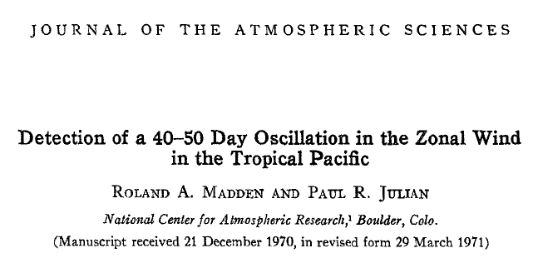
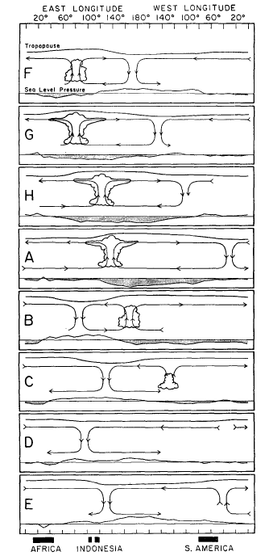
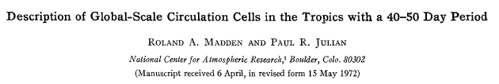
“Madden-Julian Oscillation: MJO”
Webster, P.J., 1987: The variable and interactive monsoon. Monsoons, J.S. Fein and P.L. Stephens, Eds. (“Madden-Julian 40-50 day wave”)
R. Swinbank, T.N. Palmer and M.K. Davey. 1988: Numerical Simulations of the Madden and Julian Oscillation. Journal of the Atmospheric Sciences: Vol. 45, No. 5, pp. 774–788.
(“MJ Oscillation”)
Ngar-Cheung Lau, Isaac M. Held and J. David Neelin. 1988: The Madden-Julian Oscillation in an Idealized General Circulation Model. Journal of the Atmospheric Sciences: Vol. 45, No. 24, pp. 3810–3832.
(“Madden-Julian Oscillation”)

Slide 6

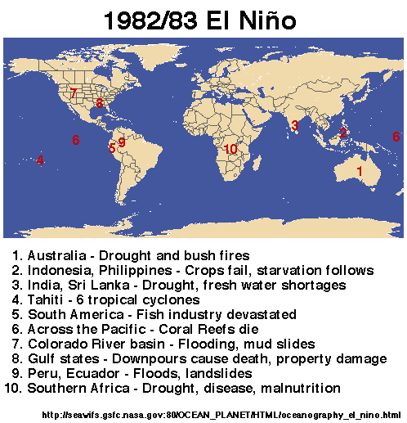
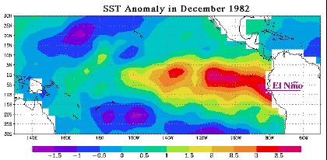
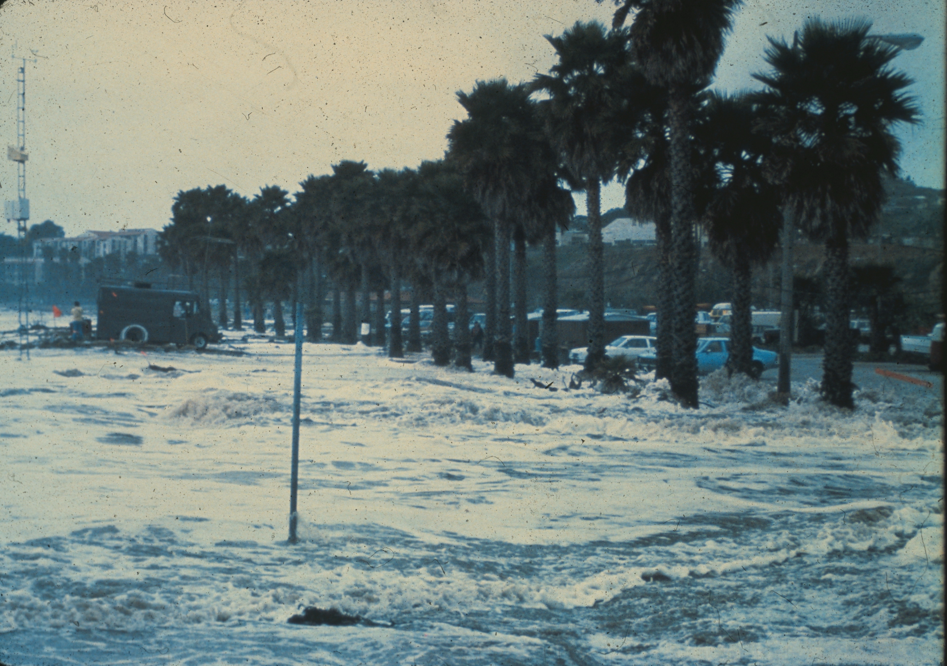
1982-83 El Niño
Cost: 2000 lives lost, ~$13B worldwide
Santa Barbara, CA

Slide 7
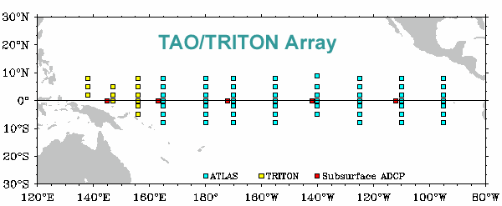
1982-83 El Niño motivated the establishment of TOGA TAO Array, starting in 1984
Shortly thereafter, the TOGA (1985-1994) pro-gram began → observations, predictability, and prediction of tropical ocean-atmosphere coupled system → prominent intraseasonal variability (WWB and MJO events) observed

Slide 8
Madden and Julian (1971): 3173 citations
Madden and Julian (1972): 2710 citations
(all journals)
CONTINUED GROWTH

Slide 9
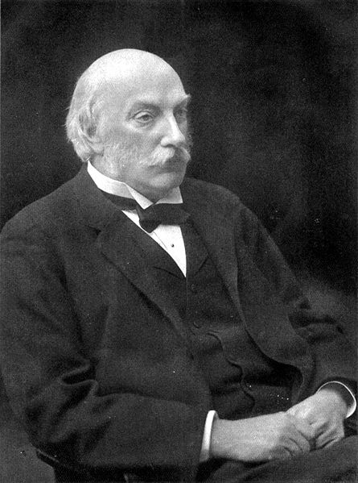
“Scientists must often experience a feeling not far removed from alarm, when we contemplate the flood of new knowledge which each year brings with it. ….new journals continually appear. Every year the additions to the common stock of knowledge become more bulky, and one is compelled to ask, Where is this to end?”
– Lord Rayleigh (1874)

Slide 10
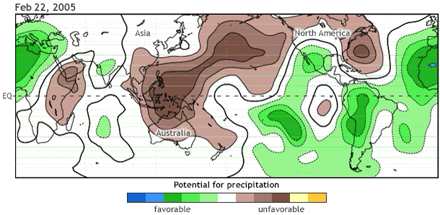
What is the Madden-Julian Oscillation (MJO)?
60°N
60°S
NOAA Climate.gov
MJO is dominant source of intra-seasonal variability in the tropics
MJO makes a global circuit every 30-60 days
MJO affects weather in the tropics and midlatitudes

Slide 11
Tropical cyclones
Tornadoes
Extreme rainfall
Flood
Fires
Cold surges
Heat waves
Storm track
Westerly wind burst
Equatorial waves
Monsoons (active/break periods)
Drought
ITCZ
ENSO, NAO, AO, AAO
Indian Ocean Dipole
Indonesian Throughflow
Wyrtki Jet
Seychelle-Chagos Thermocline Ridge (SCTR)
Antarctic circumpolar circulation
Weather
MJO
Climate
(courtesy Chidong Zhang)
Ozone, CO, Aerosol, Ocean chlorophyll
Earth’s angular momentum, Length of the day
Electromagnetic field (Schumann resonance)

Slide 12
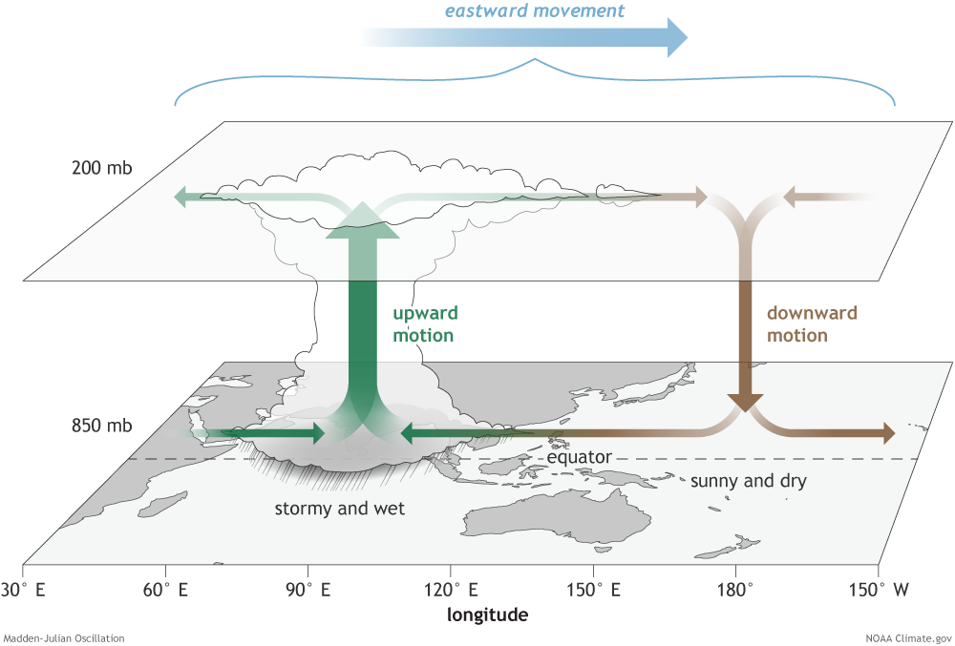
What is the structure of the MJO over the Eastern Hemisphere?
Convection amplifies over the Indian Ocean
…then moves east-ward at about 5 m s⁻¹

Slide 13
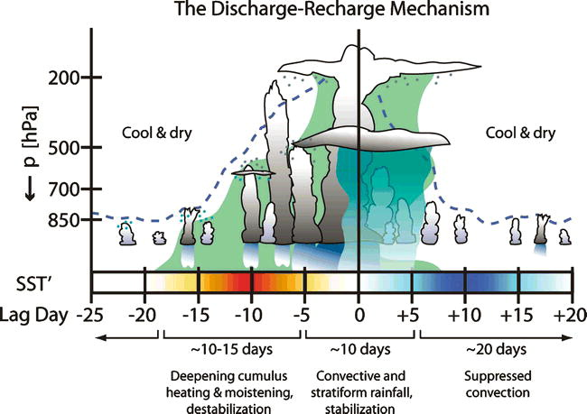
The MJO is an ocean-atmosphere coupled phenomenon
Benedict and Randall (2007)

Slide 14
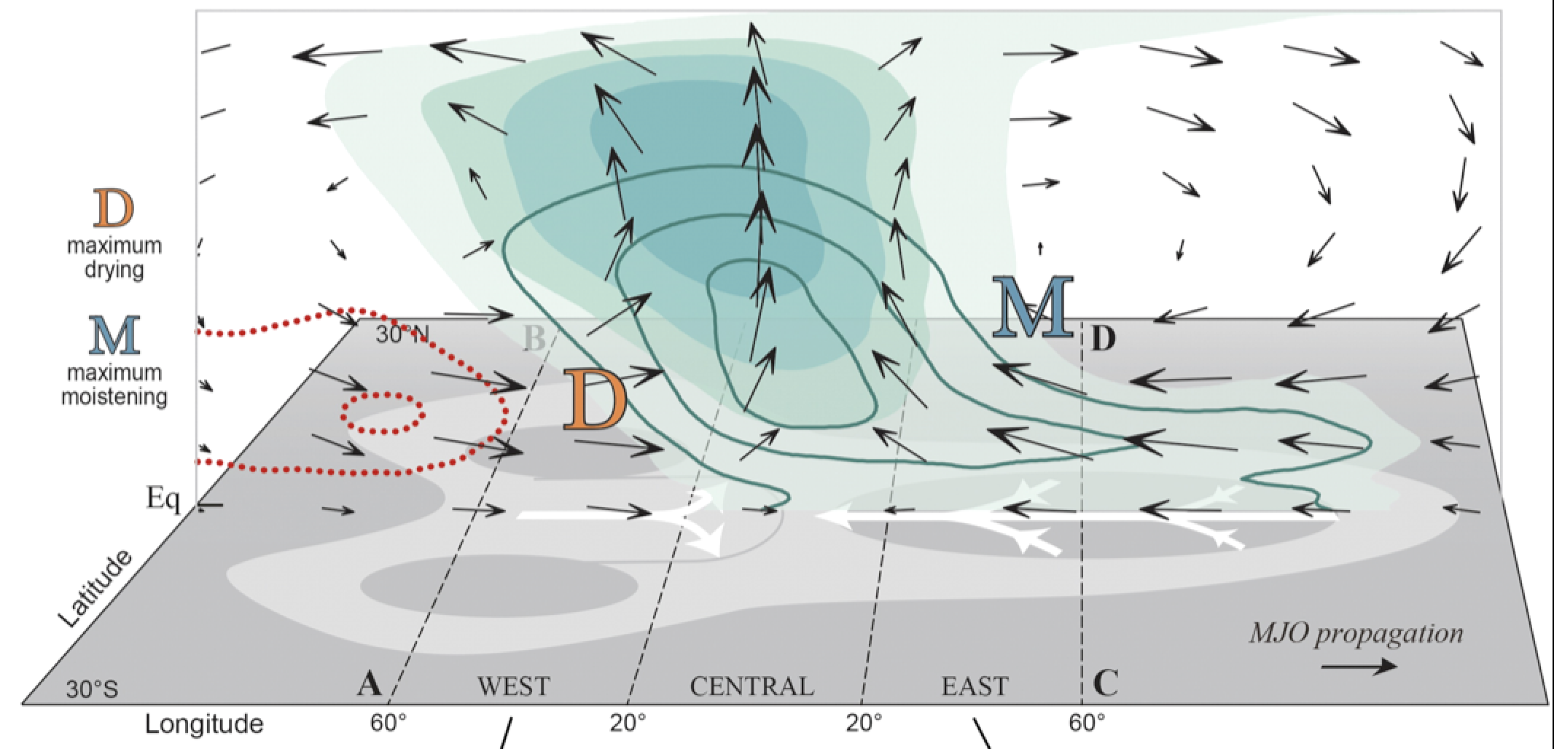
MJO Remains an Enigma
(Adames and Wallace 2015)
Theories:
WISHE (Wind-Induced Surface Heat Exchange)
Wave-CISK (Conditional Instability of the Second Kind)
Moisture mode or dispersive moisture wave
Multiscale interactions (convective to planetary scale)
Stratiform instability
Radiative-convective instability
Instability involving air-sea coupling

Slide 15
TOGA COARE
(Tropical Ocean Global Atmosphere Coupled Ocean-Atmosphere Response Experiment: 1992-93)
Scientific Objectives
No mention of the MJO!
The principal processes responsible for the coupling of the ocean and the atmosphere in the western Pacific warm-pool system;
the principal atmospheric processes that organize convection in the warm-pool region;
the oceanic response to combined buoyancy and wind-stress forcing in the western Pacific warm-pool region; and
the multiple-scale interactions that extend the oceanic and atmospheric influence of the western Pacific warm-pool system to other regions and vice versa.
Webster and Lukas 1992

Slide 16
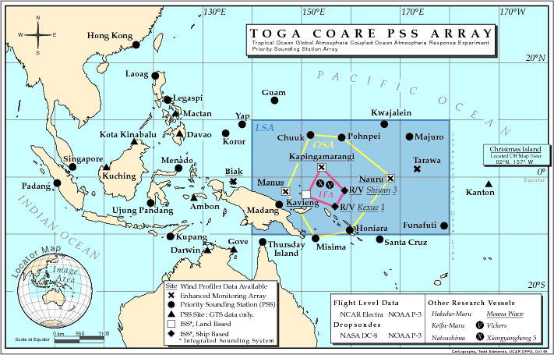
Sounding and Ship Network for TOGA COARE
NOVEMBER 1992 – FEBRUARY 1993
2/day
4/day
Deployment of six moorings by R/V Wecoma

Slide 17
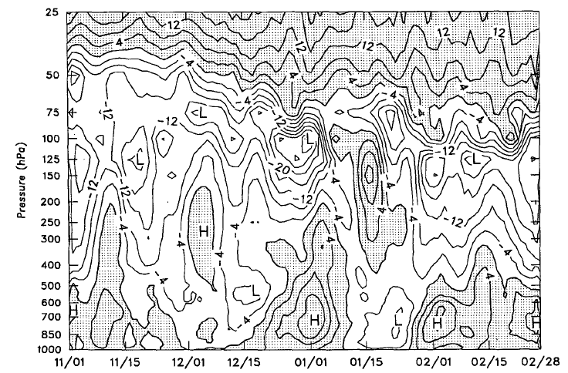
Zonal wind: TOGA COARE (1992-93)
Lin and Johnson (1996)
COARE IFA
u (m s⁻¹)
(Lin and Johnson 1996)
Prominent MJOs, WWBs
COARE observations: spurred interest in the MJO

Slide 18
DYNAMO
MADDEN-JULIAN OSCILLATION TERMNOLOGY INTRODUCED
1997-98 EL NIÑO
TOGA COARE

Slide 19
Zonal wind: TOGA COARE
COARE IFA
(Lin and Johnson 1996)
Prominent MJOs
Light wind period

Slide 20
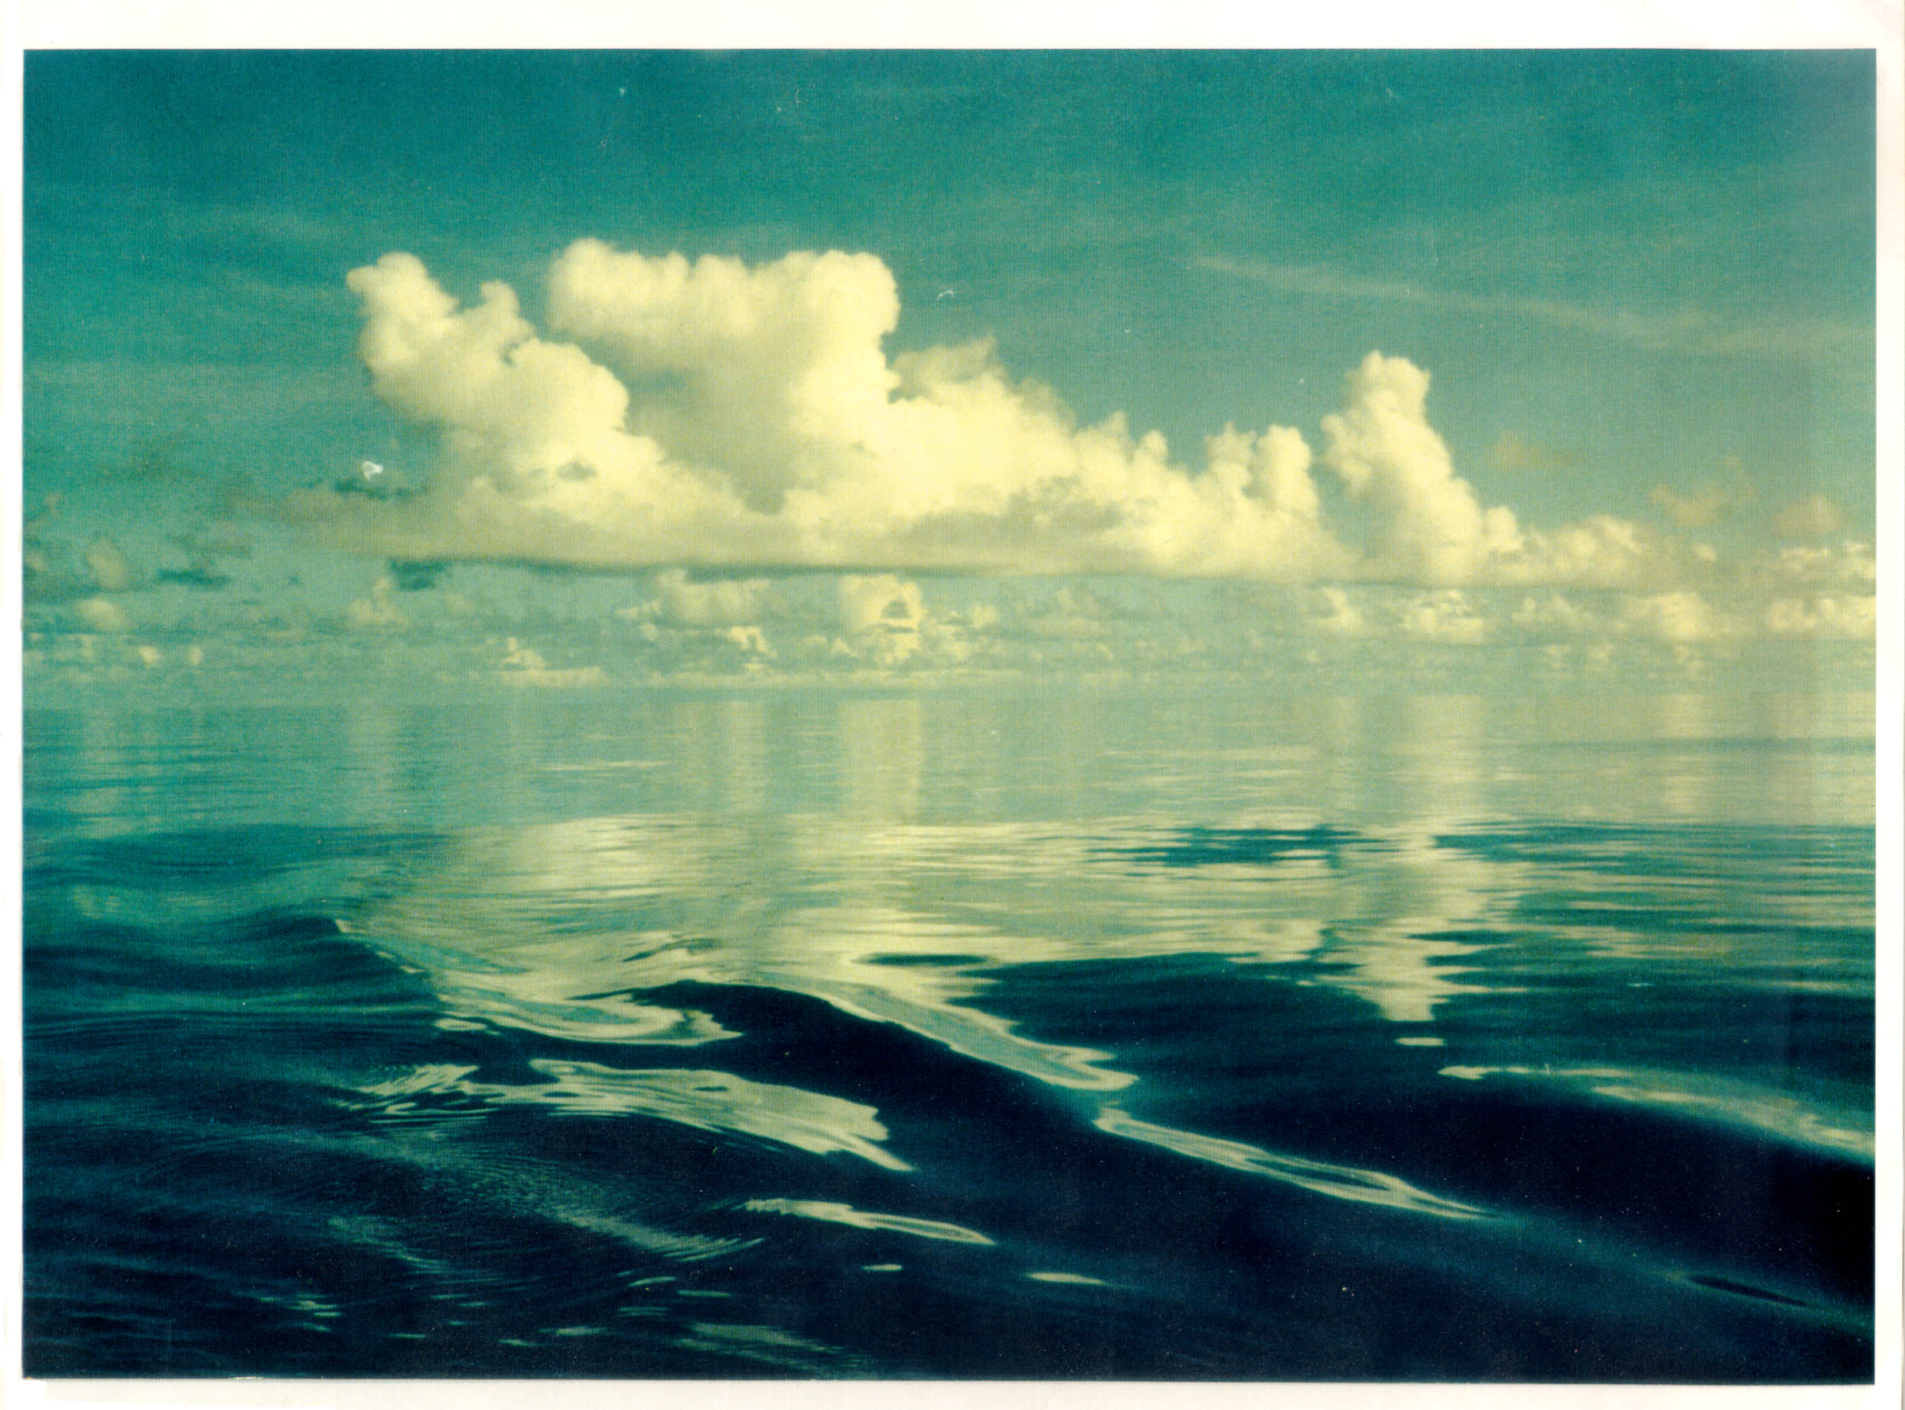
TOGA COARE
Early December 1992
Xiangyanghong #5
Photo by Xin Lin

Slide 21
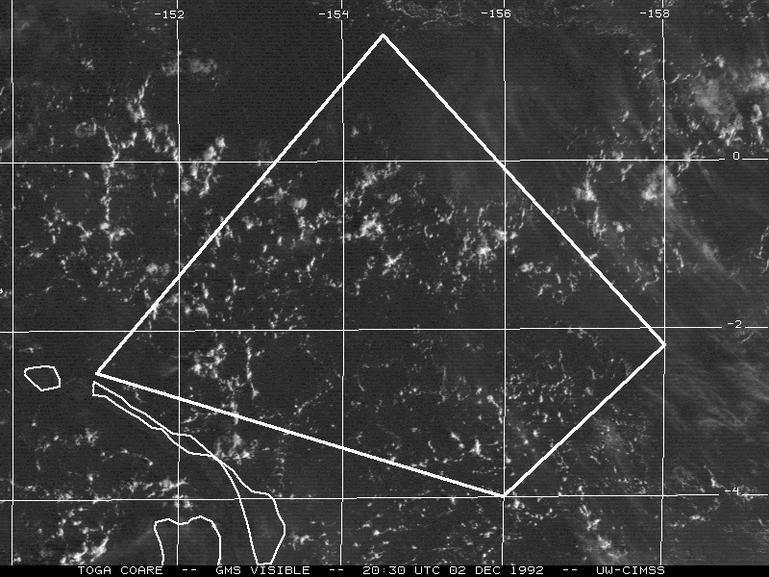
Mesoscale circulations (open cells)
152°E
154°E
156°E
2°N
2°N
Open cells
~ 30 km scale
TOGA COARE
EQ
EQ
2°S
2°S
Mesoscale circulations associated with development of isolated cumulus and showers
3 December 1992 – Light-wind day
(Satellite loop courtesy Chris Velden, CIMMS)
(Johnson et al. 2001)

Slide 22
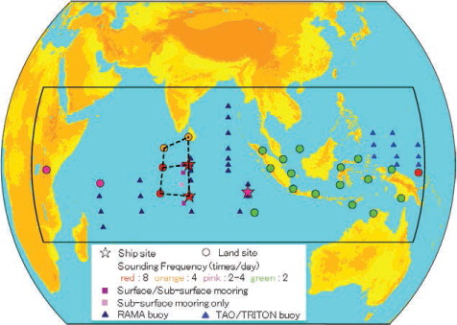

Dynamics of the MJO (DYNAMO)
(October 2011 – March 2012)
Joint field campaign with CINDY (Japan)
Scientific Objectives
Moistening processes during initiation stage of MJO over Indian Ocean
Role of convective cloud populations in MJO initiation
Role of air-sea interaction in the Indian Ocean in MJO initiation
Addu Atoll (Yoneyama et al. 2013)

Slide 23
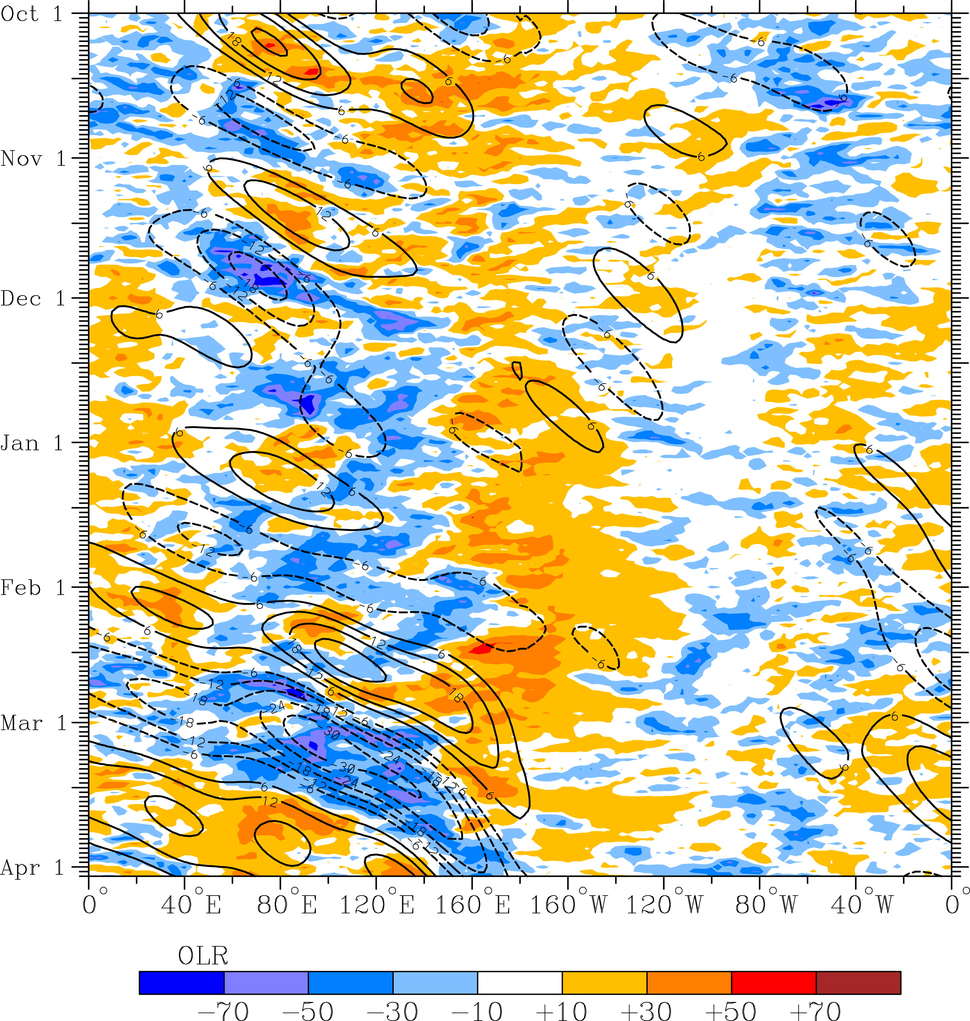
OLR anomalies and MJO-filtered OLR (10N to 10S) for DYNAMO period
OCTOBER MJO
NOVEMBER MJO
DYNAMO SOUNDING ARRAY
Time ➔
Kiladis et al. (2014)
East Asia

Slide 24
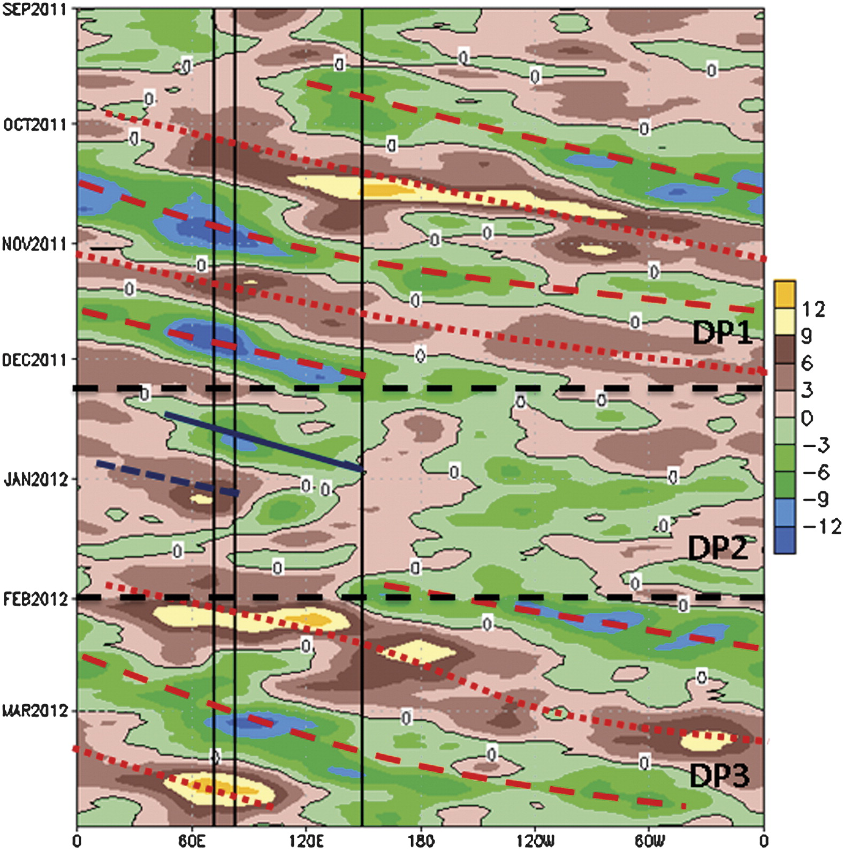
200-hPa Velocity Potential Anomalies
(10N-10S)
Gottschalck et al. (2013, MWR) and Powell and Houze (2015) link Oct and Nov events to global circuits in 200-hPa velocity potential anomalies
Time ➔
DIVERGENCE
DIVERGENCE
OCT MJO
Manus
NOV MJO
DYNAMO Arrays
(Gottschalck et al. 2013)

Slide 25
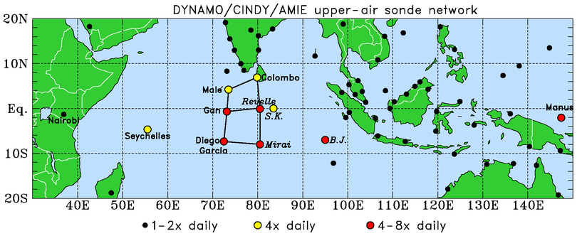
DYNAMO (Dynamics of the MJO); October 2011 – March 2012
.
N Array
(Addu Atoll)
S Array
Northern Array: October-early December, 4 & 8/day soundings
Southern Array: October-November, 8/day soundings

Slide 26
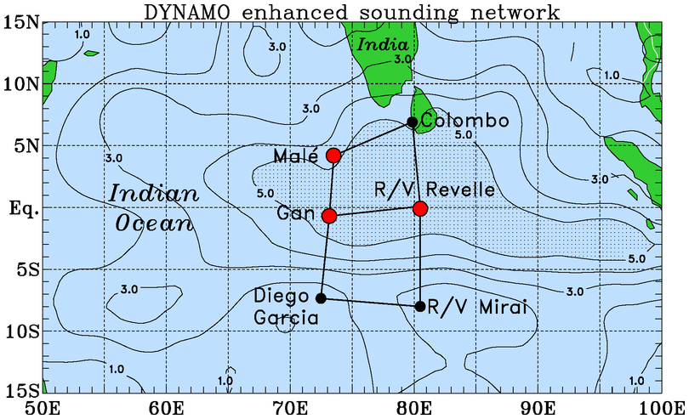
DYNAMO/CINDY/AMIE Sounding Domain
Amplitude of MJO signal (20-day low-pass filtered 450-hPa $−ω;$hPa h⁻¹)
(Johnson and Ciesielski 2017, JAS)

Slide 27
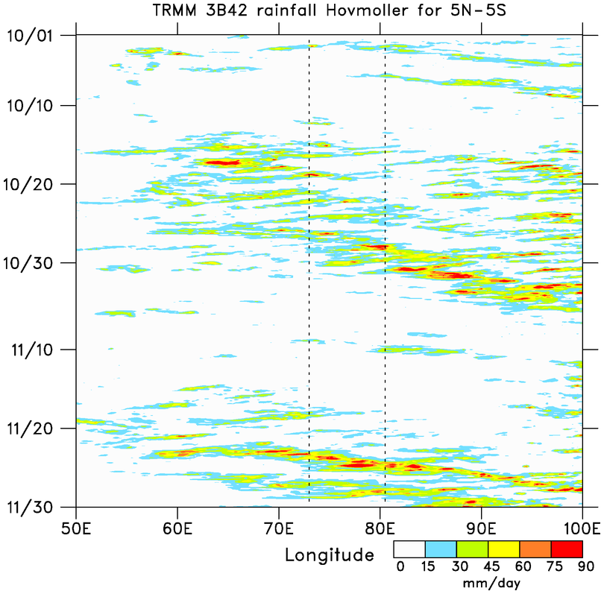
■ Two prominent MJO events: October and November
MJO 1
Sumatra diurnal cycle
2-day disturbances
WESTWARD
■ MJOs consist of westward- and eastward-moving disturbances
SUMATRA
Time
EASTWARD
■ Two-day disturbances over DYNAMO arrays during October MJO
MJO 2
WESTWARD
DYNAMO ARRAY
EASTWARD
Tip of Africa

Slide 28
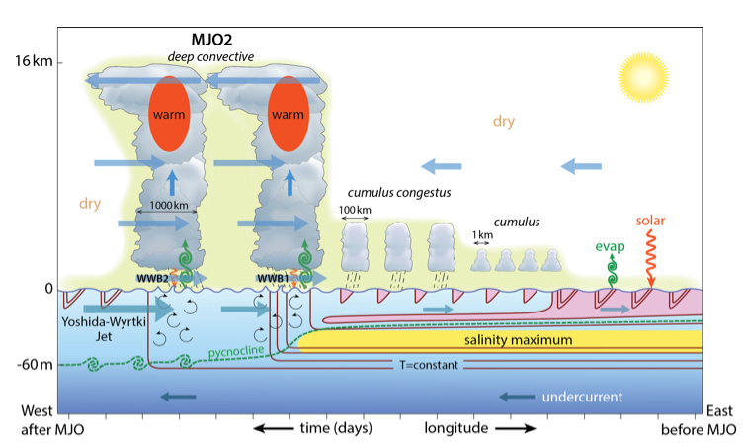
Moum et al. (2014, BAMS)

Slide 29
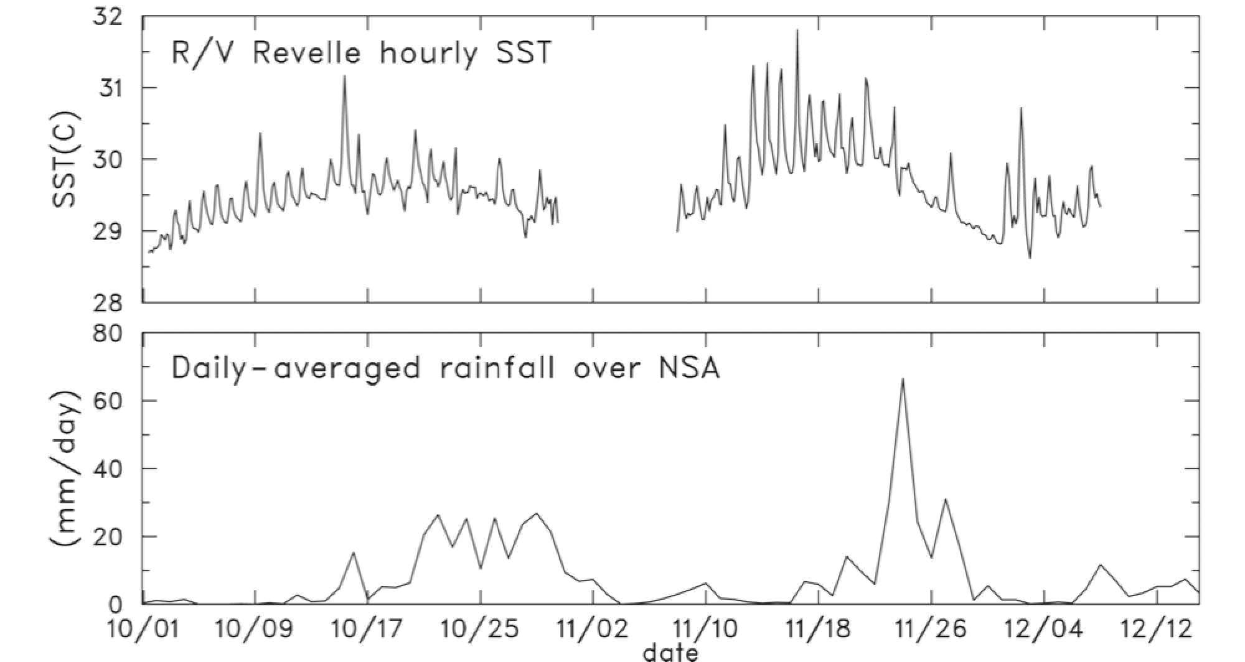
(Johnson and Ciesielski 2013)
Increasing SST, prominent diurnal cycle leading up to MJO active phases
Diurnal cycle amplifies intraseasonal SST variability (Li et al. 2013)
MJO 2
MJO 1

Slide 30
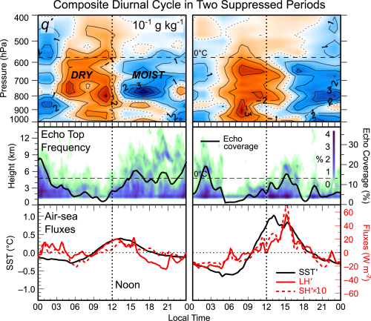
SST, surface fluxes peak in afternoon
Late afternoon (and nocturnal) peaks in radar echoes
Corresponding moistening of low to mid-troposphere
06-11 Oct
13-16 Nov
(Ruppert and Johnson 2016, JAMES)

Slide 31
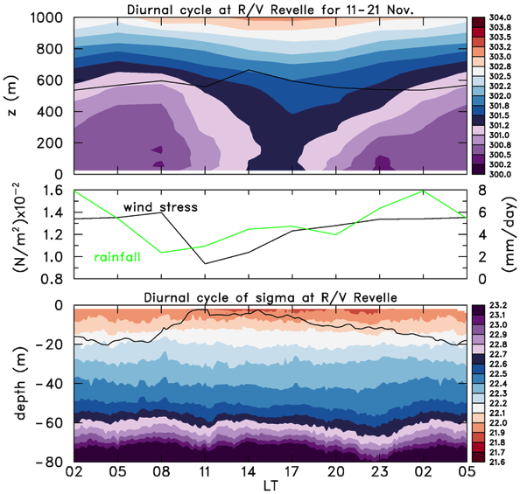
Composite for DYNAMO November Suppressed Period (11-21 Nov)
Potential temperature (K)
Mixed layer top
Opposite diurnal variability of ML in ocean & atmosphere: deepest ML in atmosphere at midday (Johnson and Ciesielski 2017), in ocean at night (Moulin et al. 2018)
Greatest wind stress at night due to rain-induced cold pools & gustiness
Secondary afternoon maximum in rainfall
NOON
Potential density (kg m⁻³)
Mixed layer base
NOON
Data: Jim Moum

Slide 32
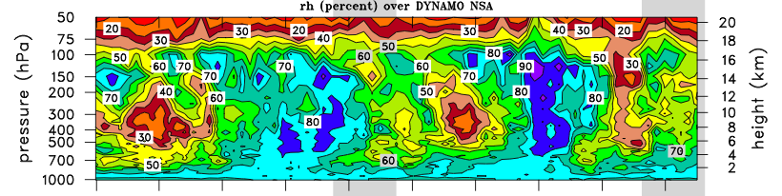
RELATIVE HUMIDITY
Lower-tropospheric moistening leading up to deep convection
Does the diurnal cycle of shallow cumulus accelerate the moistening?

Slide 33
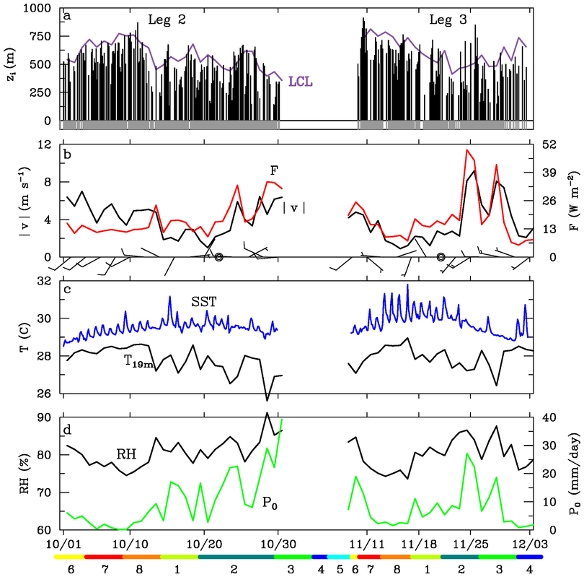
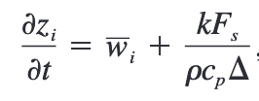
R/V Revelle
ML depths, LCL
?
ML deepens during SST warming phases
Buoyancy flux F nearly constant during early Oct: weakening L-S subsidence promoted ML growth
ML grows above LCL, promoting cloud growth
SST diurnal cycle during ocean warming phases
Surface buoyancy flux, wind speed
data courtesy Edson, Fairall, de Szoeke

Slide 34

Model Framework
Numerical simulations
(Ruppert 2016, JAMES; Ruppert and Johnson 2016)
CM1 (“Cloud Model 1”; Bryan and Fritsch 2002)
Physics:
  Morrison 2-moment
  Deardorff TKE
  Goddard LW and SW radiation
  CM1 surface flux
Model domain:
  150 x 50 km
  200-m spacing in x,y (periodic)
  50- (350-) m z-spacing in lowest 2 km (above 15 km), with a top at 22 km

Slide 35
Model Framework
Base state: composite sounding from a DYNAMO suppressed phase
  Dry aloft
  Weak zonal shear (u-wind only in base state)
Prescribed SST diurnal cycle (13-15 Nov Revelle mean; 2°C range)
Repeating diurnal radiation cycles for 17 days

Slide 36
External Forcing
Constant advective moisture source
Interactive “large-scale” subsidence using weak temperature gradient (WTG) theory (Sobel et al. 2001)
  Diabatic heating and adiabatic vertical motion offset one another
Spectral, relaxed WTG scheme of Herman and Raymond (2014)

Slide 37
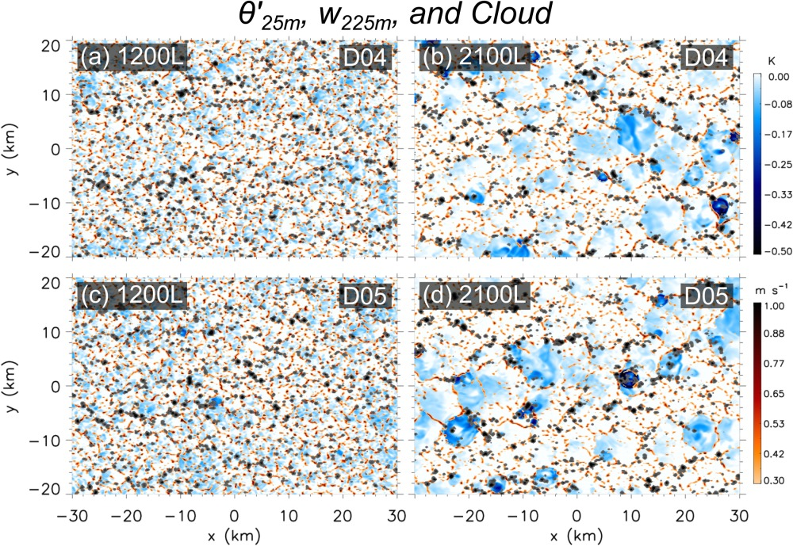

Slide 38
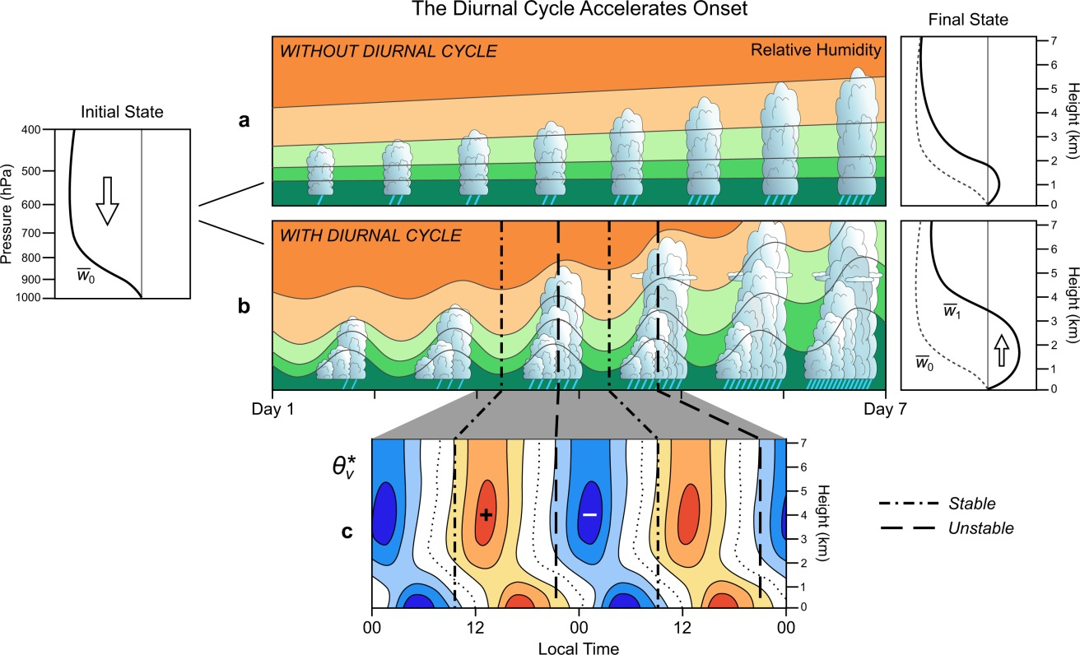
Results
Destabilization in late afternoon due to time lag between surface-flux-driven BL heating and shortwave heating above the BL
(Ruppert 2016, JAMES)

Slide 39
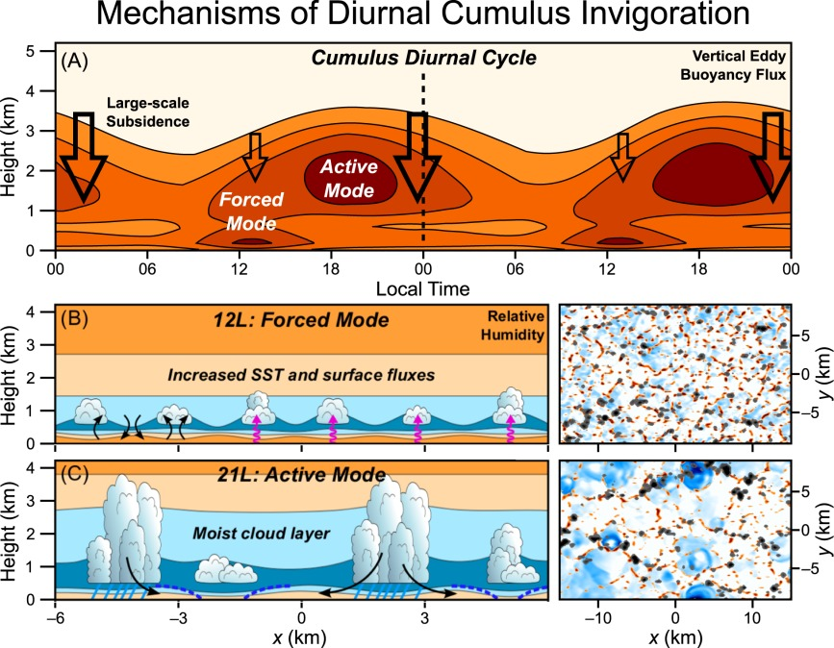
“Forced BL” clouds associated with afternoon SST/surface flux peaks (Esbensen 1978, Stull 1985)
Deeper, “active” clouds later afternoon/evening, aided by cold pools
MJO moistening phase is accelerated by diurnal cycle
(Ruppert and Johnson 2016, JAMES)
Notes:
Conceptualized forcing mechanisms of the cumulus diurnal cycle—both the “forced” and “active” modes—over the tropical warm pool. (a) Time‐height series of vertical eddy buoyancy flux (cf. Figure 13a; smoothed to emphasize robust features), with large‐scale subsidence indicated by the open arrows. (b and c, left) Schematized cloud scenes in the x‐z plane at (b) 12L and (c) 21L, including relative humidity (shaded; warmer colors indicate drier air), surface fluxes (magenta arrows), eddy circulation (black arrows), cold pools (blue‐dashed lines), and rainfall (light‐blue lines). (b and c, right) Corresponding maps in the x‐y plane of negative
at 25 m (blue), upward motion at 225 m (red), and cloud (gray‐black) (directly from model output; cf. Figure 6).
IF THIS IMAGE HAS BEEN PROVIDED BY OR IS OWNED BY A THIRD PARTY, AS INDICATED IN THE CAPTION LINE, THEN FURTHER PERMISSION MAY BE NEEDED BEFORE ANY FURTHER USE. PLEASE CONTACT WILEY'S PERMISSIONS DEPARTMENT ON PERMISSIONS@WILEY.COM OR USE THE RIGHTSLINK SERVICE BY CLICKING ON THE 'REQUEST PERMISSIONS' LINK ACCOMPANYING THIS ARTICLE. WILEY OR AUTHOR OWNED IMAGES MAY BE USED FOR NON-COMMERCIAL PURPOSES, SUBJECT TO PROPER CITATION OF THE ARTICLE, AUTHOR, AND PUBLISHER.

Slide 40
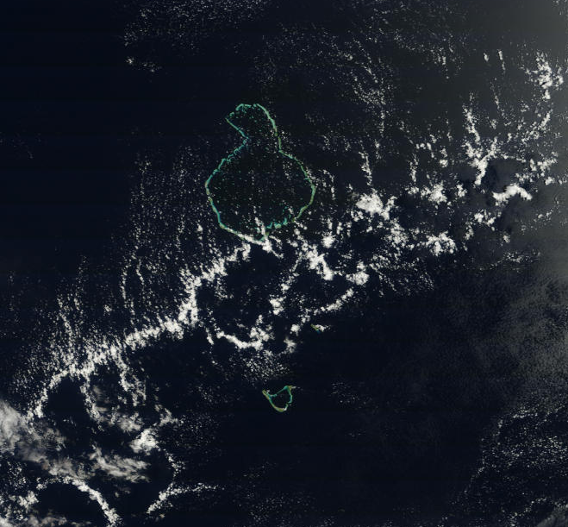
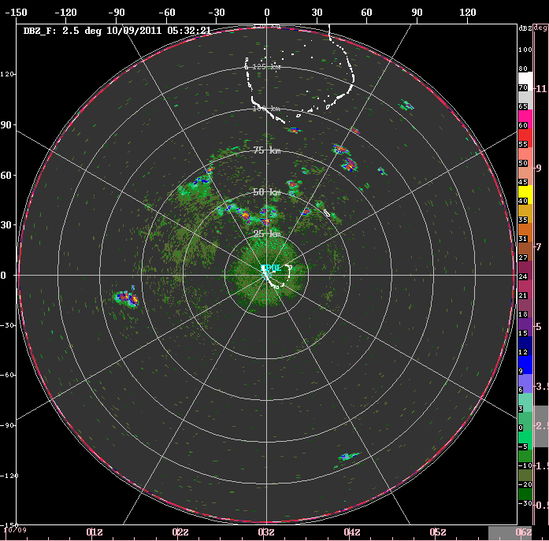
TERRA/MODIS
9 October 2011
1132 LT
50 km
OPEN CELLS
S-PolKa on Addu Atoll (Gan Island)

Slide 41

CONCLUSIONS
MJO: interest grew after 1982-83 El Niño $⟹$TOGA TAO array$⟹$TOGA COARE observations
TOGA COARE hinted that diurnal cycle may assist moistening, but only 6-hrly atmospheric soundings were taken
Prominent SST diurnal cycle during MJO build-up phases; afternoon maxima in surface fluxes, cumulus development
Corresponding afternoon maximum in lower-tropospheric moistening by congestus clouds
Modeling study suggests diurnal cycle accelerates MJO moistening process
Mesoscale circulations (open cells) further assist moistening process

Slide 42
END

Slide 44
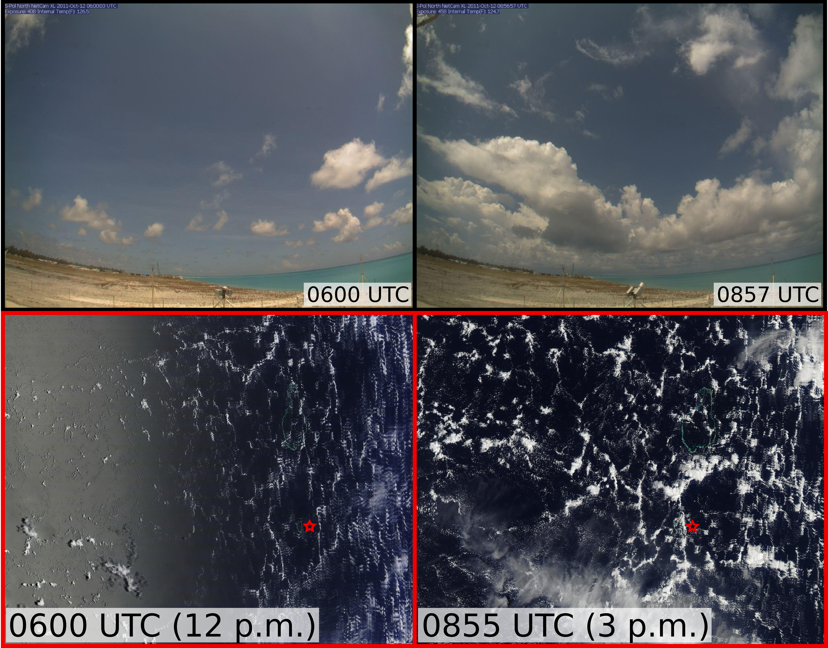
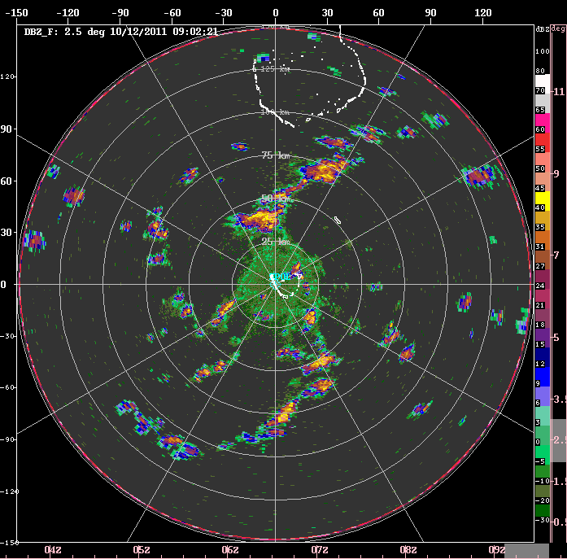
12 October 2011
Gan S-Pol Cam (north)
(James Ruppert)
MODIS/Terra
MODIS/Aqua
Gan Island
Notes:
Increased cloud depth and coverage by midafternoon
Most are non-raining, suggesting that the moisture remains in the troposphere
Rayleigh-Benard convection (open cells) is evident (during most days), consistent with the driving force of heating from below in light-wind conditions
(Radar) Convection is more vigorous along cell walls, suggesting the aid of low-level convergence by this organization

Slide 45
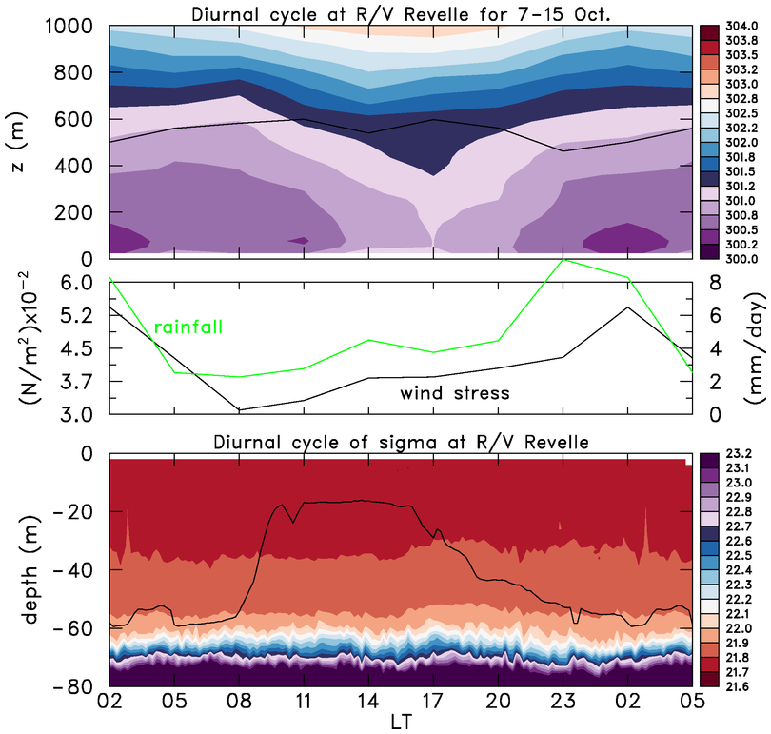
Composite for October Suppressed Period (7-15 Oct)
Deepest ocean ML at night, when rain and wind stress are greatest
Largest wind stress likely associated with rain-induced cool pools, gustiness
Deepest atm ML in afternoon, related to diurnal warm layers (not shown)
Diurnal variation in ocean ML depth during this period is particularly large
(note change in scale)

Slide 46
Rayleigh-Bénard Open Cell Convection
~ 30 km
Mesoscale circulations during suppressed periods lead to localized areas of enhanced boundary layer moistening, deeper cloud growth than would otherwise occur
Amplified by diurnal cycle

Slide 47
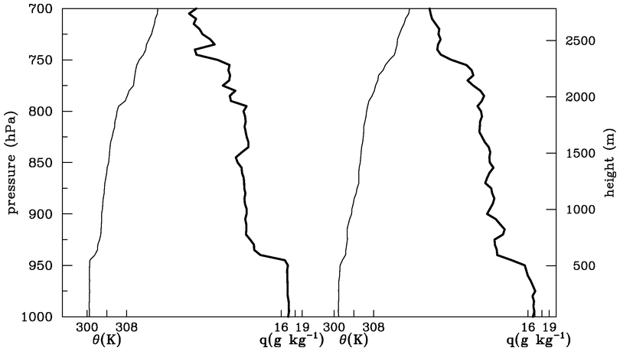
4 October Soundings at R/V Revelle
07 L
13 L
“trade-like” stable layer
q
θ
q
θ
07 L
13 L
Trade-wind-like cumulus frequently observed

Slide 48
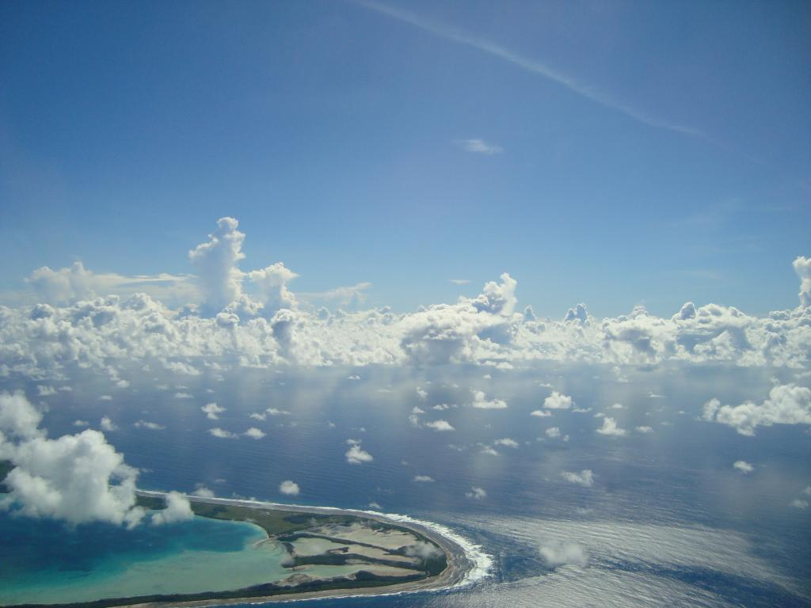
Two types of shallow cumulus
“Subinversion” cumulus (Esbensen 1978) or “forced cumulus” (Stull 1985): inactive clouds that are a reflection of overshooting PBL eddies
“Inversion-penetrating” cumulus (Esbensen 1978) or “active” cumulus (Stull 1985): experience considerable buoyancy and growth due to latent heat release
Walter Hannah
Diego Garcia from P-3

Slide 49
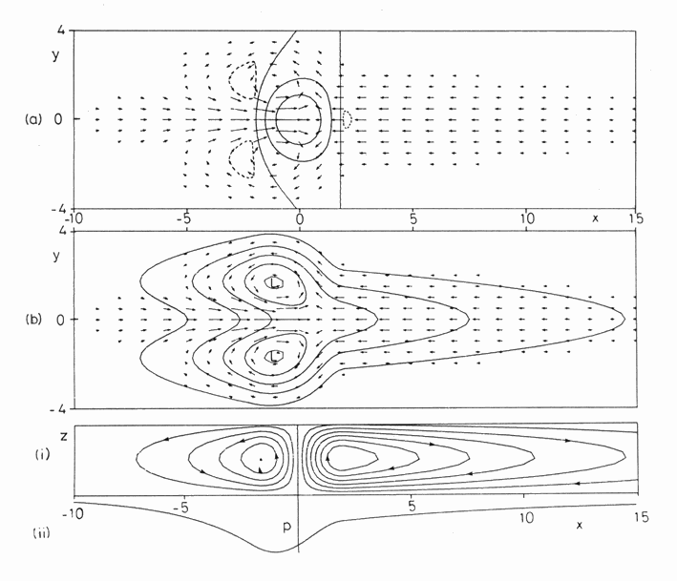
Heat Source
Move westward & poleward
At times form tropical cyclones
Rossby gyres
Kelvin wave
Gill, A., 1980: Some simple solutions for heat induced tropical circulation. Quart. J. Royal Meteorol. Soc., 106, 447-462.

Slide 50
■ Two prominent MJO events: October and November
Sumatra diurnal cycle
2-day disturbances
WESTWARD
■ MJOs consist of westward- and eastward-moving disturbances
SUMATRA
Time
EASTWARD
■ Two-day disturbances over DYNAMO arrays during October MJO
WESTWARD
DYNAMO ARRAY
EASTWARD
Tip of Africa

Slide 51
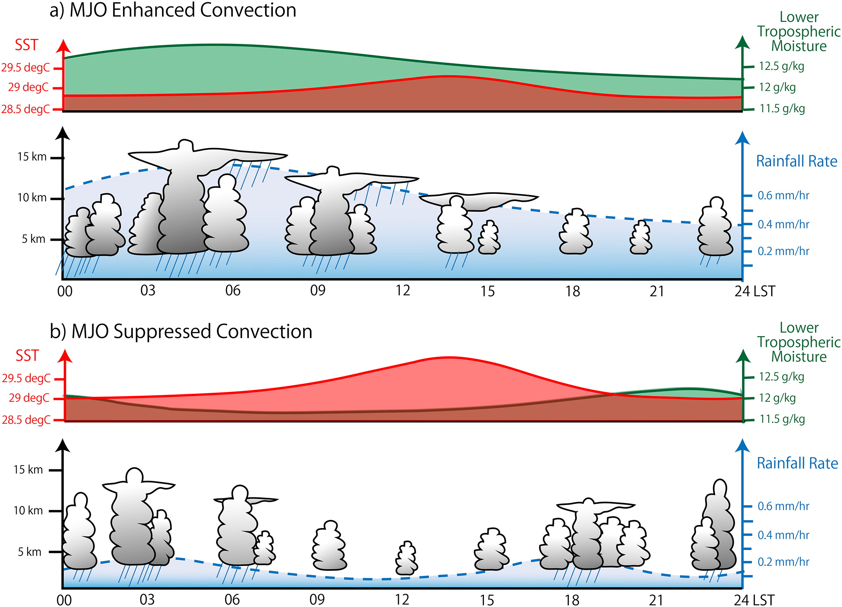
Based on S-Pol radar, soundings, Revelle data
Sakaeda et al. (2018, JAS)

Slide 52
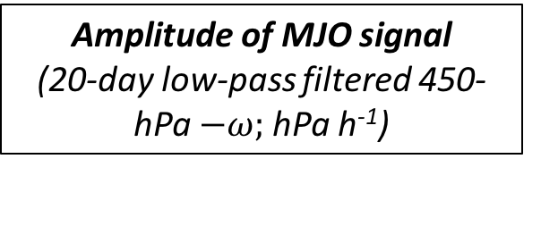
DYNAMO/CINDY/AMIE Sounding Domain
Boundary layer properties investigated at 5 sites
Amplitude of MJO signal (20-day low-pass filtered 450-hPa $−ω;$hPa h⁻¹)
(Johnson and Ciesielski 2017, JAS)

Slide 53
4 October Soundings at R/V Revelle
14 L
Procedure for determining mixed layers: soundings
Each sounding evaluated subjectively (5-hPa resolution)
Mixed layers: θ and q have approximately well-mixed structure over same depth, capped by distinct increase in stability, drying above; entrainment zone evident in majority of cases
Results at Diego Garcia and Revelle compared to 915-MHz wind profiler signal-to-noise data
08 L
q
θ
q
θ
hPa
m
θ
q
θ
q
ENTRAINMENT ZONE
07 L
13 L

Slide 55
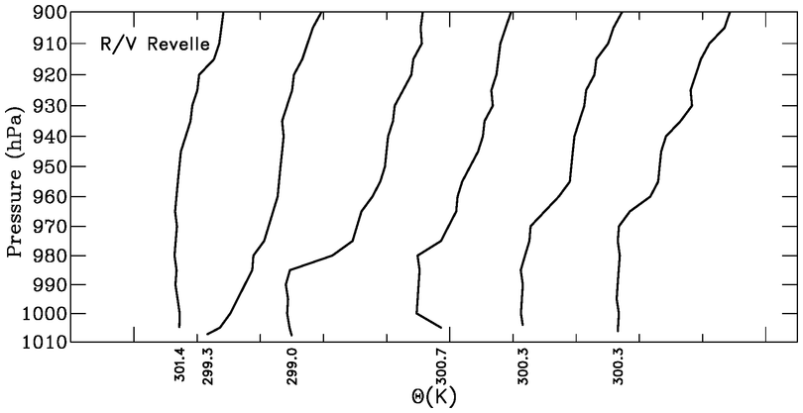
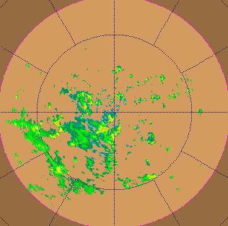
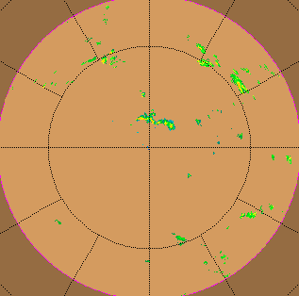
Recovering Boundary Layer Wake at R/V Revelle
22 November 2011
θ
04 LT
07 10 13 16 19
9-12 h
TOGA radar on Revelle
Comparable to wake recovery periods found in TOGA COARE (Young, Perugini, Fairall 1995)
0729 LT 22 Nov
1859 LT 22 Nov

Slide 56



Mixed Layers at Mal$\acute{e}$, Gan, and Revelle
Shallower MLs during rainy periods, less so at Gan
Oct/Nov MJO modulation of ML depth greatest at Mal$\acute{e}$ and Revelle
Greatest ML depths at Gan during dry, suppressed period in Jan and Feb
MJO1
MJO2

Slide 57



Slide 58

Mixed layer at Revelle during November undisturbed period
Diurnal Cycle at Revelle, 11-21 November
Afternoon SST peak leads to increased F, reduction in z_{LCL} – z_{i} , more BL thermals can reach condensation levels, afternoon cloud cover and rainfall maximum
Nocturnal rainfall peak still present, typical of open ocean

Slide 59




Cloud types
cumulus
congestus
cumulonimbus or deep convection
stratiform precipitation

Slide 60

Heating
⬥ Inferences regarding “dominant” cloud populations:
  Cumulus
  Congestus
  Deep convection
  Stratiform
Drying
Johnson et al. 2015
Rainfall
RMM Index

Slide 61
⬥ Inferred cloud populations:
  Cumulus
  Congestus
  Deep convection
  Stratiform
⬥ Similar evolution for both MJOs, but shorter periods for each stage for MJO2
Cumulus
Congestus
Cumulus
Deep
Congestus
Stratiform
Deep
Stratiform
⬥ Possible stepwise evolution of convection? [Kikuchi and Takayabu (2004), Katsumata et al. (2009), Virts and Wallace (2010), Del Genio et al. (2012)]

Slide 62

(Johnson and Ciesielski 2001)

Slide 63

Double-ITCZ pattern; similar average rain rates over both arrays…
Mean: 7.8 mm day⁻¹
…but evolution of rainfall differs between the two…
Mean: 8.0 mm day⁻¹

Slide 64

N
More prominent MJO signal
N ARRAY
S ARRAY
More persistent convection in southern array
Southern “ITCZ” convection shifts to equator during MJO active phase
S
Time

Slide 65


