Slide 1



MJO Dynamics Deduced from CINDY/DYNAMO/AMIE Sounding Data
Richard H. Johnson
Colorado State University
Contributors:
Paul Ciesielski, Thomas Birner, Erin Dagg, Zhe Feng, Caitlin Fine, Masaki Katsumata, James Ruppert
Acknowledgments: NSF Grant AGS-1360237 and DOE Grant DE-SC0008582
Symposium on Progress of the MJO Research Through the Field Campaigns, 23-25 July 2014, Sapporo, JAPAN

Slide 2
Outline
Overview of sounding arrays
Heat and moisture budgets
Diurnal cycle during “suppressed” periods
Atmospheric mixed layer
Column-integrated radiative heating rates
Effects of Sumatra on weather, tropical cyclogenesis over Indian Ocean

Slide 3
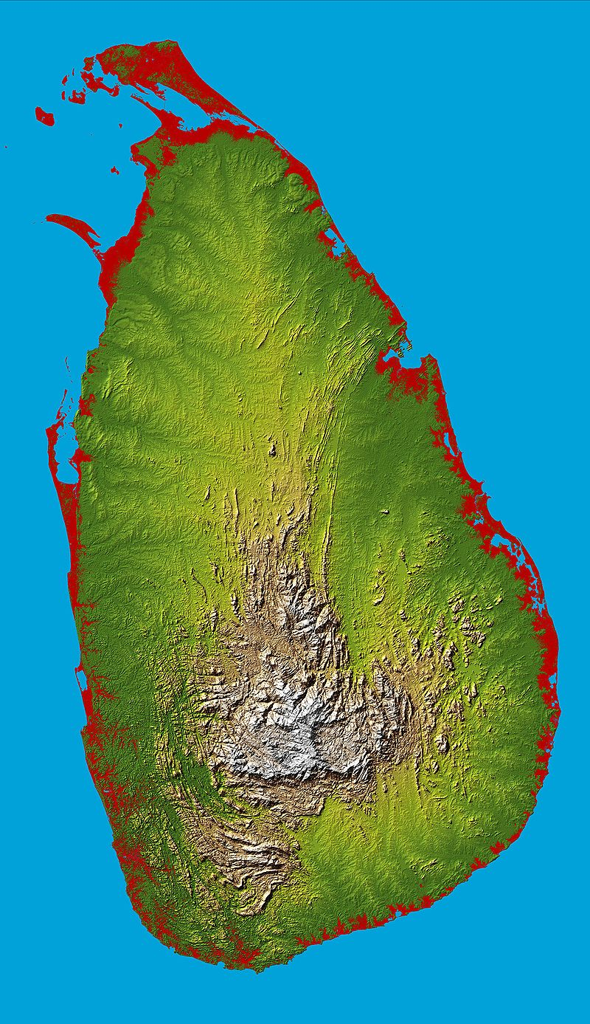
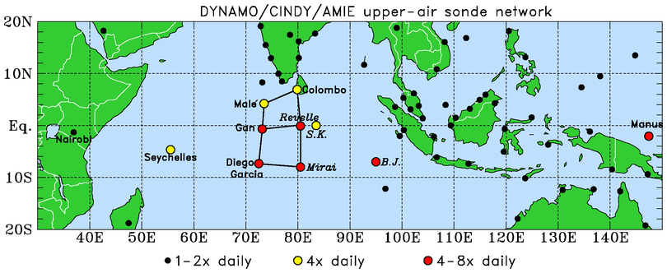
CINDY/DYNAMO/AMIE Sounding Network
.
NSA
SSA
*
Colombo
*2.5 km
Corrections applied to humidity data: Vaisala RS92 daytime dry biases much smaller than TOGA COARE – ~2% in lower troposphere, ~5-6% in upper troposphere
Procedure developed using ECMWF OA data to mitigate Sri Lanka island blocking/diurnal cycle effects on Colombo soundings

Slide 4
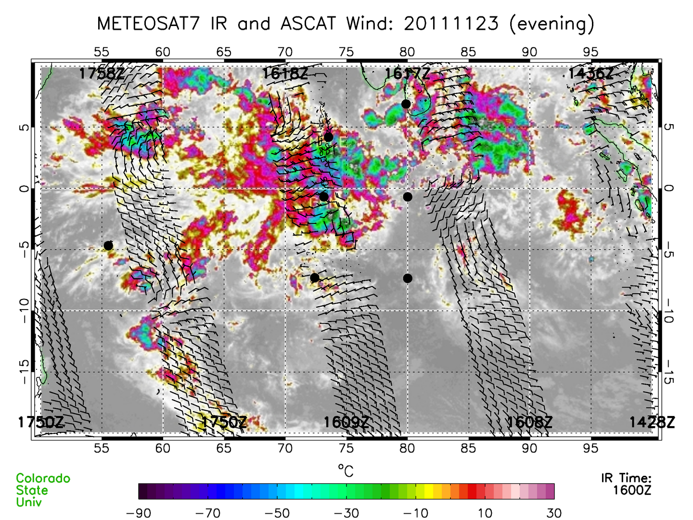
2006 MISMO
COARE IFA
Each array is ~1/2 the size of the TOGA COARE IFA, but small in com-parison to overall MJO convective envelope

Slide 5
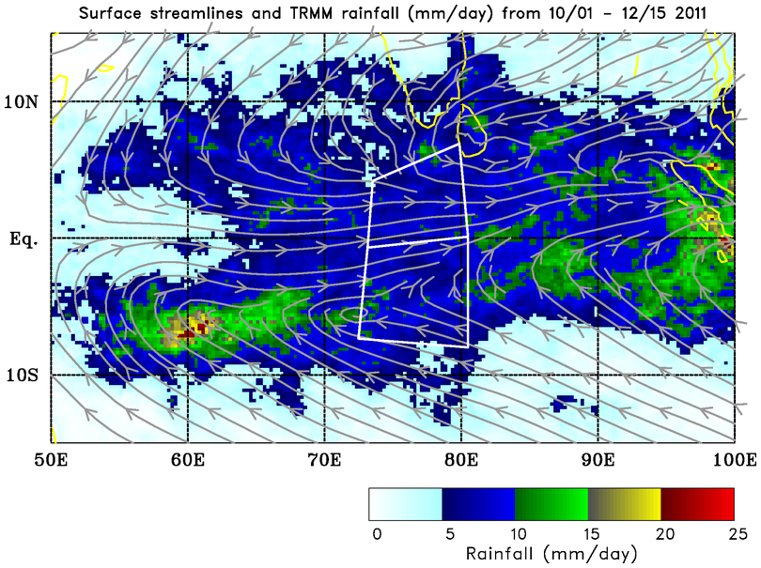
Double-ITCZ pattern; similar average rain rates over both arrays…
Mean: 7.8 mm day⁻¹
…but evolution of rainfall differs between the two…
Mean: 8.0 mm day⁻¹

Slide 6
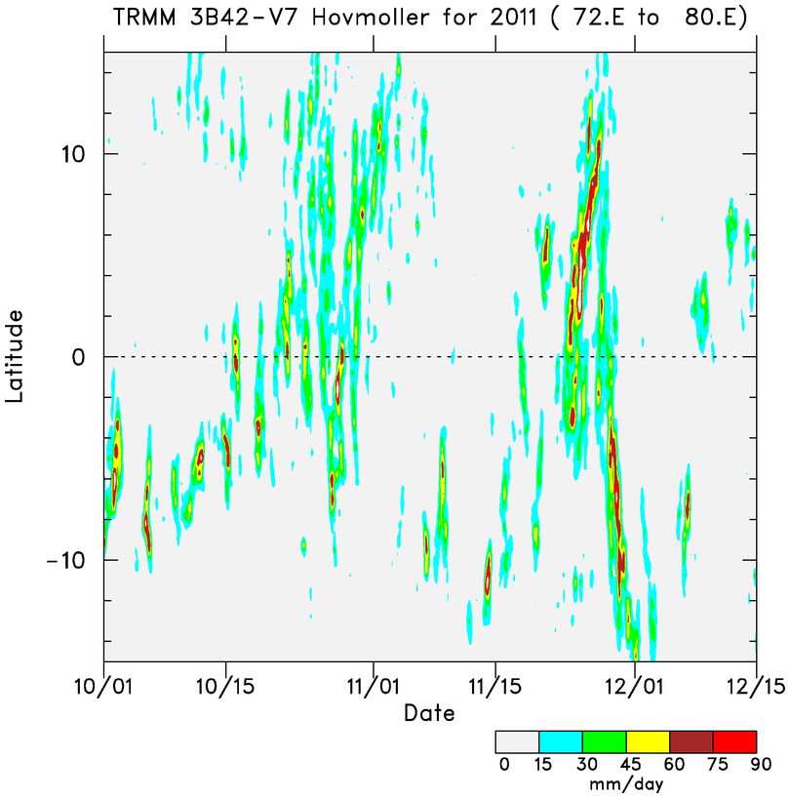
N
More prominent MJO signal
N ARRAY
MJO 1
MJO 2
S ARRAY
More persistent convection in southern array
“ITCZ” convection shifts to equator during MJO active phase
S
Time

Slide 7
October/November MJO activity over Northern Array associated with seasonal cycle of precipitation
MJO 1
MJO 2
MJO 3

Slide 8
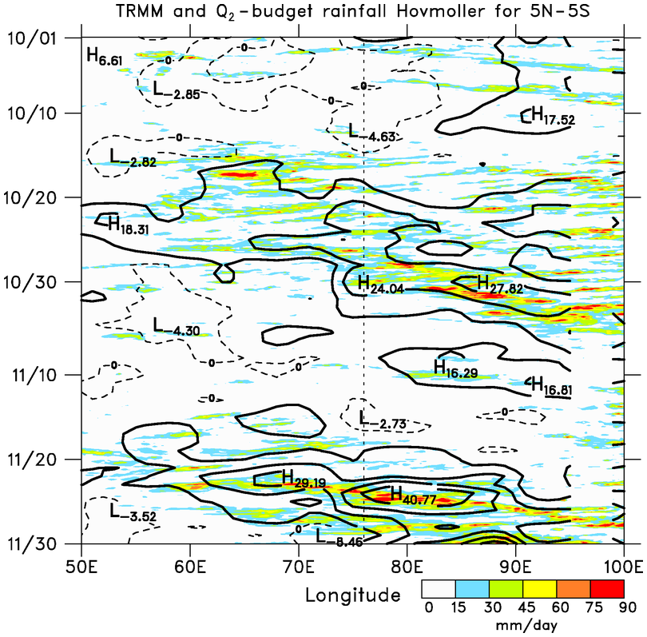
■ Two prominent MJO events: October and November
■ MJOs consist of westward- and eastward-moving disturbances
Time
MJO 1
DYNAMO ARRAY
SUMATRA
■ Q₂ budget captures precipitation envelopes
MJO 2
(Results based on ECMWF OA outside sounding arrays)

Slide 9
Northern Sounding Array
(NSA)
u
MJO1 preceded by low-level westerlies descent of easterlies; MJO2 by low-level easterlies; WWBs then follow
Low-to mid-level moisture build-up several weeks prior to active phases
Prominent UT/LS Kelvin/gravity wave signals
2-day disturbances with MJO1, 4-5 day period with MJO2
RH
T’
PRECIPITATION
MJO2
MJO1
(Johnson and Ciesielski 2013)

Slide 10
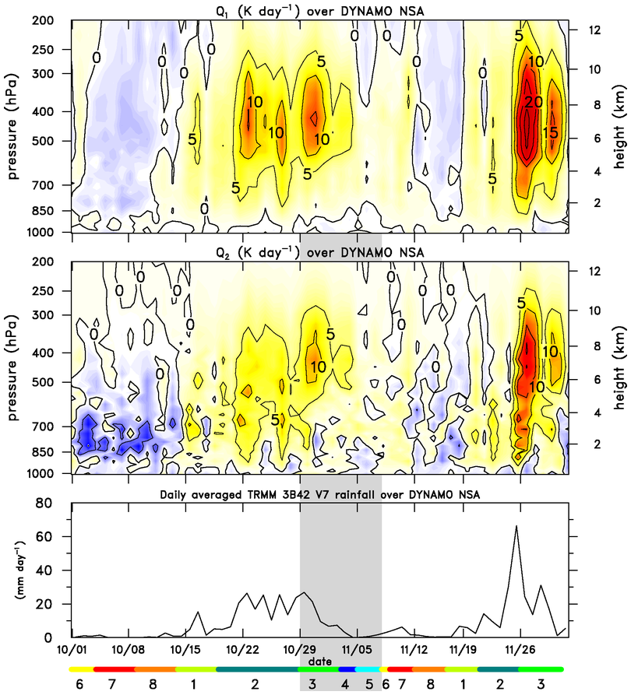
⬥ Preliminary inferences regarding cloud populations:
  Cumulus
  Congestus
  Deep convection
  Stratiform
Q₁
Q₂
Rainfall

Slide 11
⬥ Inferred cloud populations:
  Cumulus
  Congestus
  Deep convection
  Stratiform
⬥ Similar evolution for both MJOs, but shorter periods for each stage for MJO2
Cumulus
Congestus
Cumulus
Deep
Congestus
Stratiform
Deep
Stratiform
⬥ Possible stepwise evolution of convection: Kikuchi and Takayabu (2004), Katsumata et al. (2009), Virts and Wallace (2010), Del Genio et al. (2012)

Slide 12
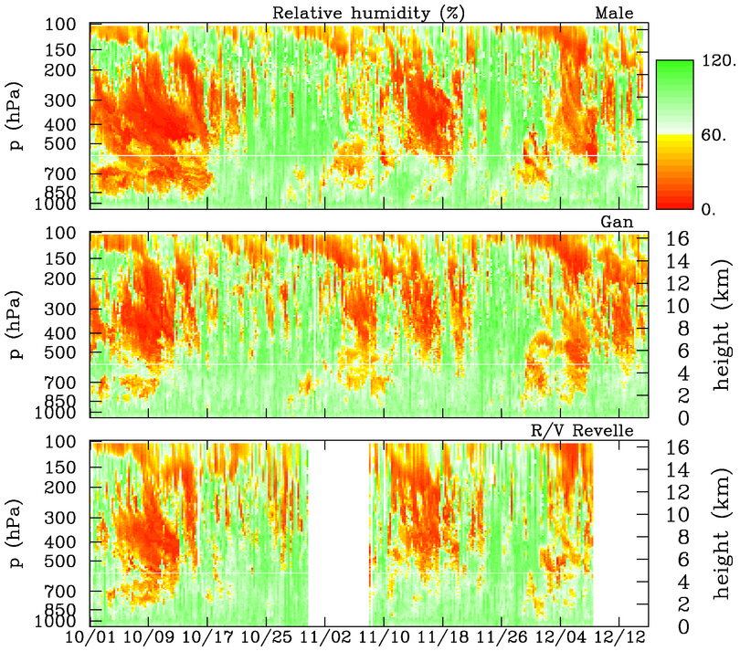
‘
Malé
deep
deep
DRY
0°C
mid
mid
mid
shallow
shallow
shallow
Gan
DRY
deep
deep
mid
mid
mid
shallow
shallow
shallow
Revelle
DRY
deep
deep
mid
mid
shallow
shallow

Slide 13
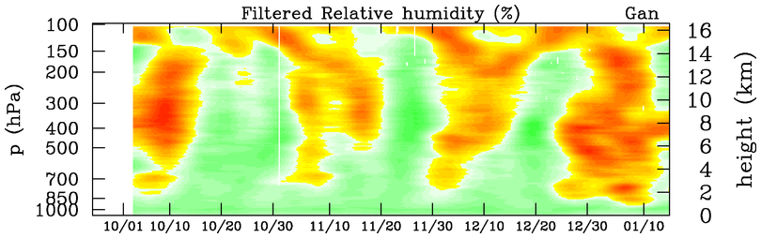
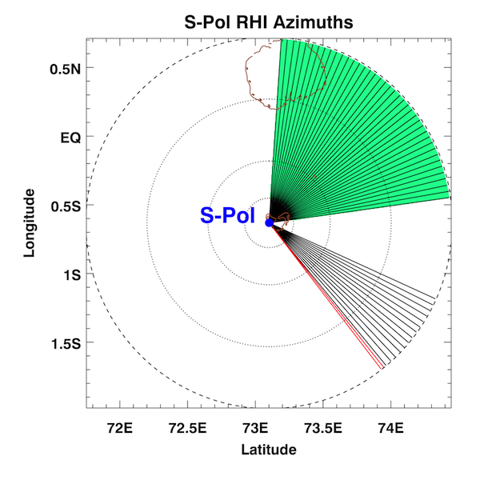
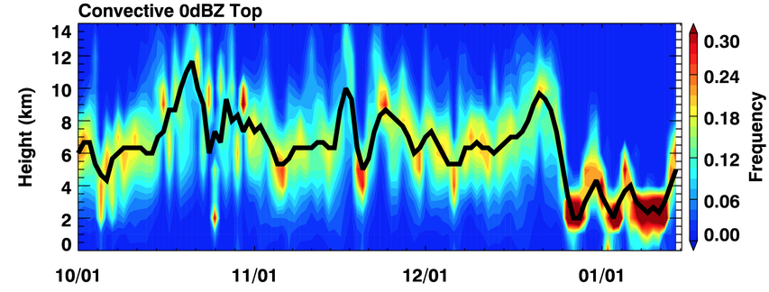
10-day low-pass
Oct/Nov/Dec: similar moistening during Cg periods
DRY
DRY
MOIST
S-PolKa RHI
Deep
Deep
Deep
Cg
Cg
Cg
Cu
Cu
0°C
Cu
1 October 2011 – 15 January 2012

Slide 14

Good agreement between Q₂ budget rainfall and satellite estimates

Slide 15
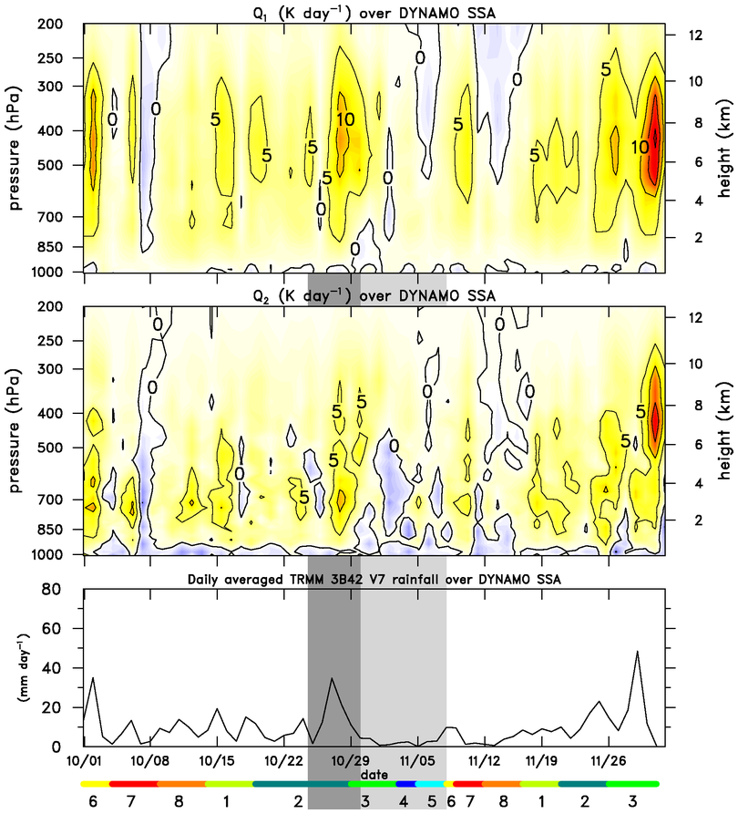
Q₁
⬥ Southern sounding array markedly different; more persistent convection
Q₂
⬥ MJO signal still present, but weaker
Rainfall

Slide 16
⬥ Mean profiles of Q₁ and Q₂ for NSA and SSA differ
NSA
⬥ NSA more stratiform; SSA more convective – supported by TRMM measurements (SF = 55% for NSA, 50% for SSA)
⬥ Consistent with findings by Lin et al. (2004) that MJO has greater stratiform rain fraction than tropical mean
SSA

Slide 17
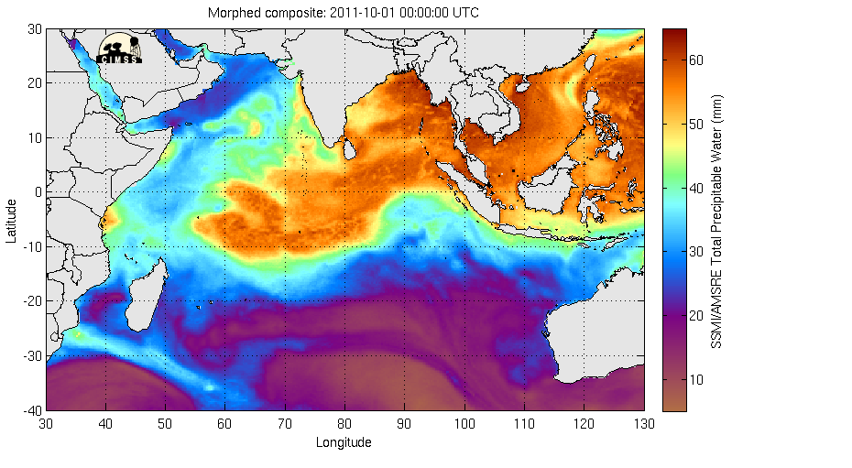
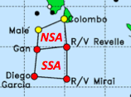
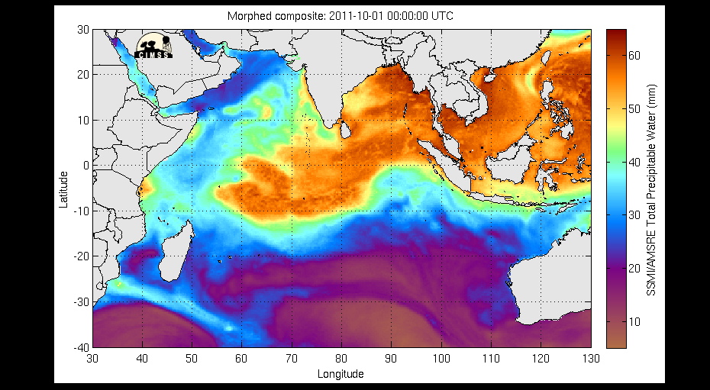
SSMI/AMSR-E Total Precipitable Water (mm) – October 1-15

Slide 18
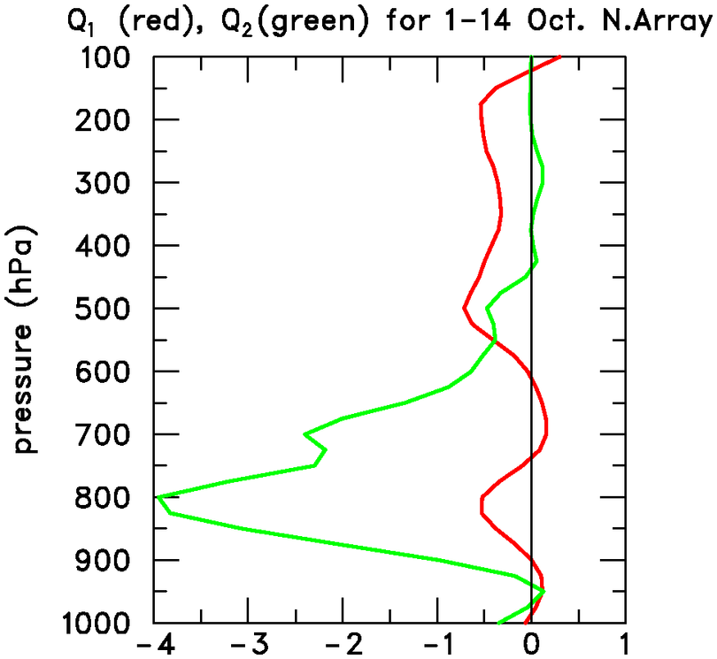
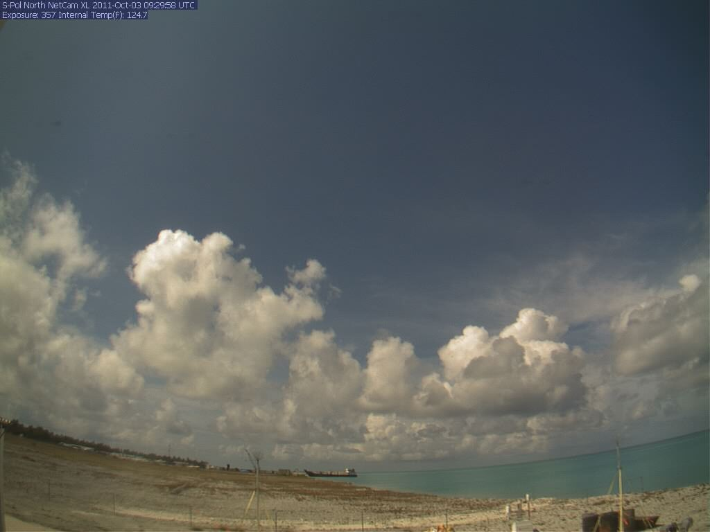
October 3, S-Polka
Moistening by shallow, nonprecipitating cumulus, offsetting drying by horizontal advection and subsidence; resembles trades
Q₂ (“apparent moisture sink”)
Q₁ (“apparent heat source”)
(K day⁻¹)

Slide 19
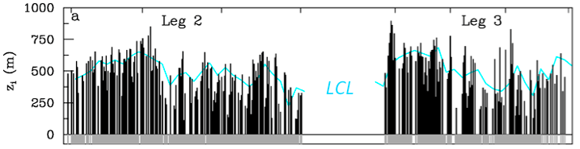
Atmospheric Mixed Layer Depth, SST, Rainfall
R/V Revelle
ATMOSPHERIC MIXED LAYER DEPTH, LCL
SST diurnal cycle during warming phase
Shallow diurnal warm layers, as in TOGA COARE (Soloviev and Lukas 1997)
?
SST-warming phases:
Deepest mixed layers
ML depth increases with time, extends above LCL
MJO1
MJO2
Notes:
Large diurnal cycle in SST before MJO heavy rainfall, particularly during Nov when sfc wind was weaker.

Slide 20
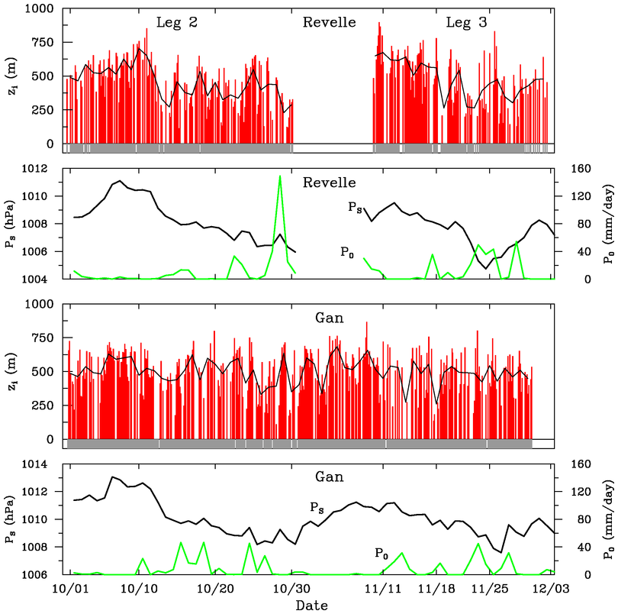
Mixed layers at Revelle and Gan Island
Modulation of ML by MJO at Gan less distinct than at Revelle
Shallow ML’s during rainy periods
Results at Gan may not be representative of open ocean
SFC PRESSURE
RAIN
SFC PRESSURE
RAIN

Slide 21
Peak moistening by shallow cu/congestus occurs in afternoon
NOON
3-hourly
data
(Ruppert and Johnson 2014, submitted)
SST
Surface Sensible Heat Flux
10-min
data

Slide 22
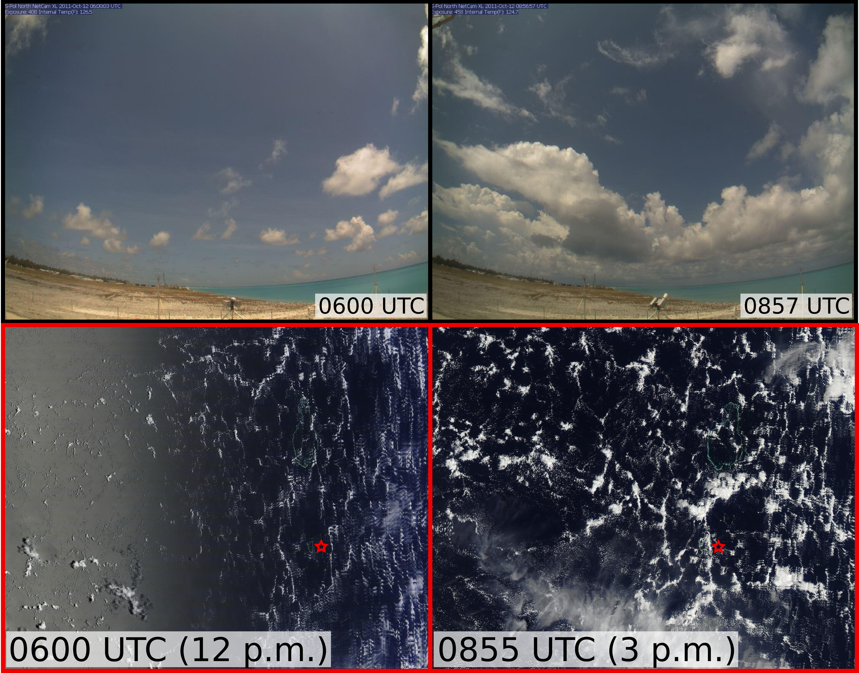
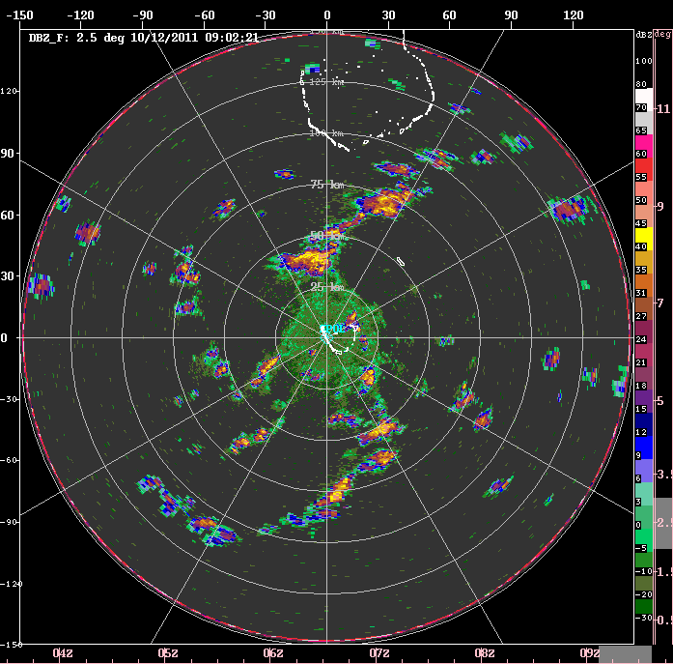
12 October 2011
Gan S-Pol Cam (north)
(James Ruppert)
MODIS/Terra
MODIS/Aqua
Gan Island
Notes:
Increased cloud depth and coverage by midafternoon
Most are non-raining, suggesting that the moisture remains in the troposphere
Rayleigh-Benard convection (open cells) is evident (during most days), consistent with the driving force of heating from below in light-wind conditions
(Radar) Convection is more vigorous along cell walls, suggesting the aid of low-level convergence by this organization

Slide 23
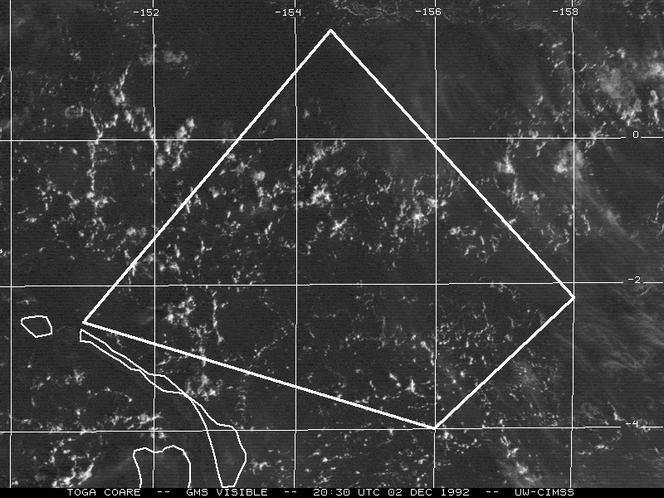
Mesoscale circulations (open cells)
152°E
154°E
156°E
2°N
2°N
Open cells
~ 30 km scale
TOGA COARE
EQ
EQ
2°S
2°S
Mesoscale circulations promote isolated cumulus and showers
3 December 1992 – Light-wind day
(Johnson et al. 2001)

Slide 24
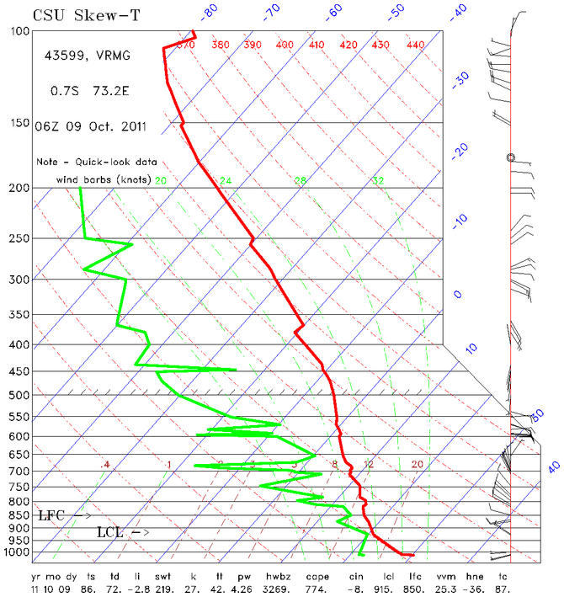
• Dry mid-troposphere inhibits deep convection
• Models have a difficult time re: convective sensitivity to midlevel moisture (Derbyshire et al. 2004; Del Genio et al. 2012)
GAN ISLAND
(11 L)
10 km

Slide 25
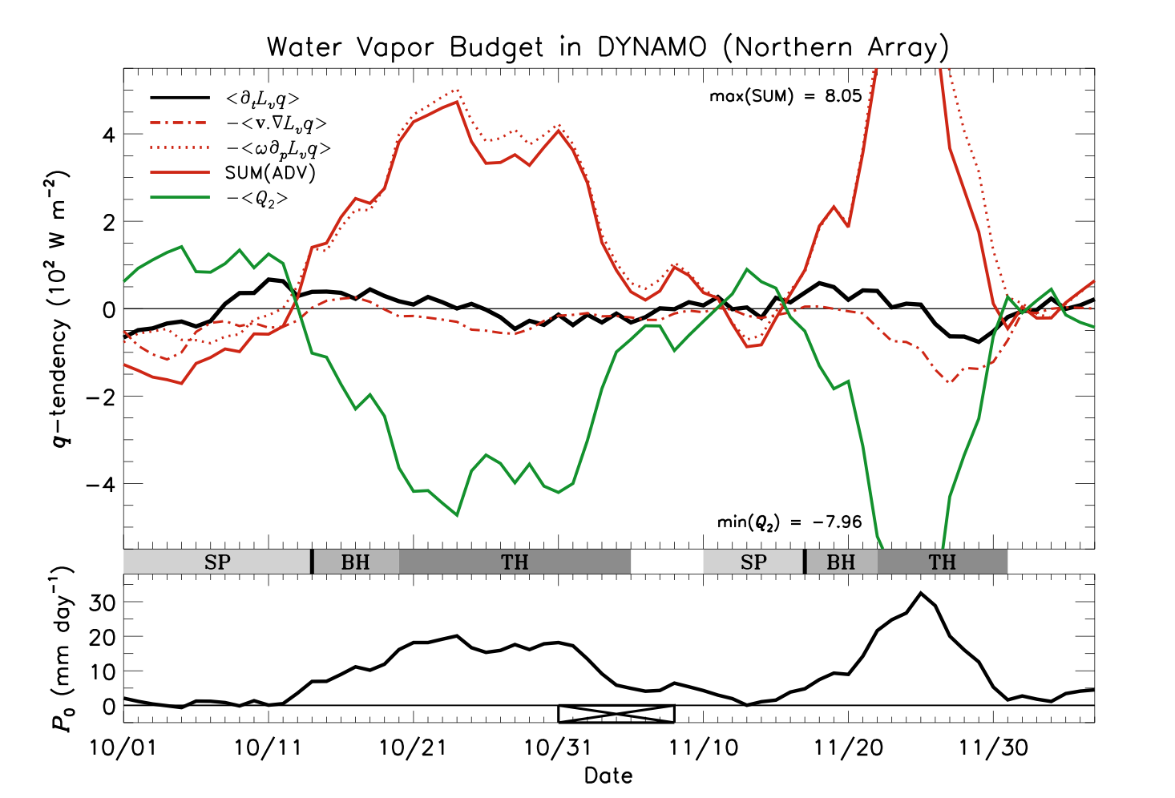
Vert
Shallow cumulus periods
q-tendency
Horiz
TOTAL ADVECTION
<−Q₂>
Rainfall rate
(Ruppert and Johnson 2014, submitted)

Slide 26
<Q_{R}> is significantly modulated by the MJO (~ 1 K day⁻¹)
<Q_{R}> determined as a residual
BUDGETS (−0.59 K day⁻¹)
(−0.63 K day⁻¹)
(CERES)

Slide 27
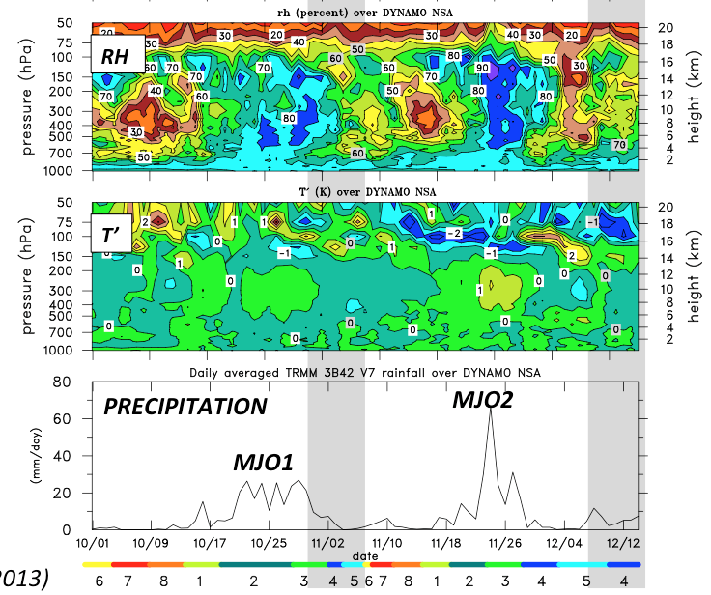
Tilted structure of T, RH in upper troposphere consistent with Kiladis et al. (2001), who found gravity wave excited in lower stratosphere in response to MJO convective envelope
(CERES)

Slide 28
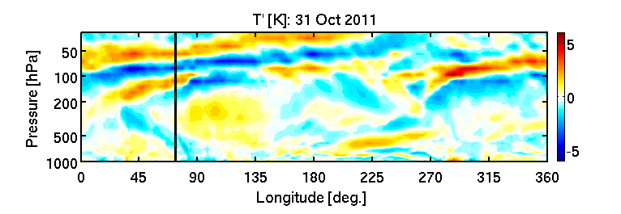
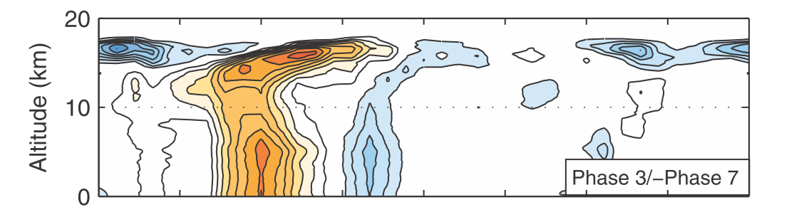
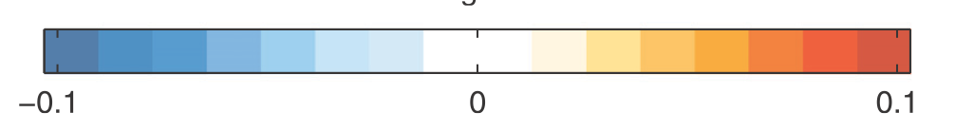
ERAi
cool
warm
(Virts and Wallace 2010)
CALIPSO cloud index

Slide 29
CINDY/DYNAMO/AMIE: 1 October 2011 – 31 March 2012
.
BORNEO
SUMATRA
Downstream effects of Sumatra on flow over Indian Ocean

Slide 30
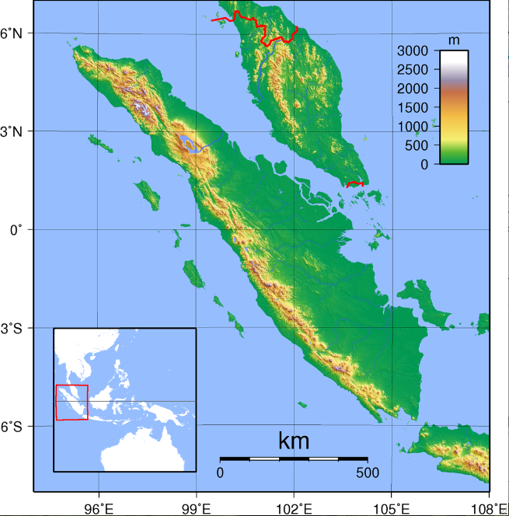
Max elevation = 3.8 km
Malaysia
* Diurnal cycle, westward propagation of convection (e.g., Mori et al. 2004; Sakurai et al. 2005; Ichikawa and Yasunari 2006)
* Inness and Slingo (2006) showed that Sumatra can block Kelvin wave signal, and hence propagation of the MJO across the maritime continent
Sumatra

Slide 31
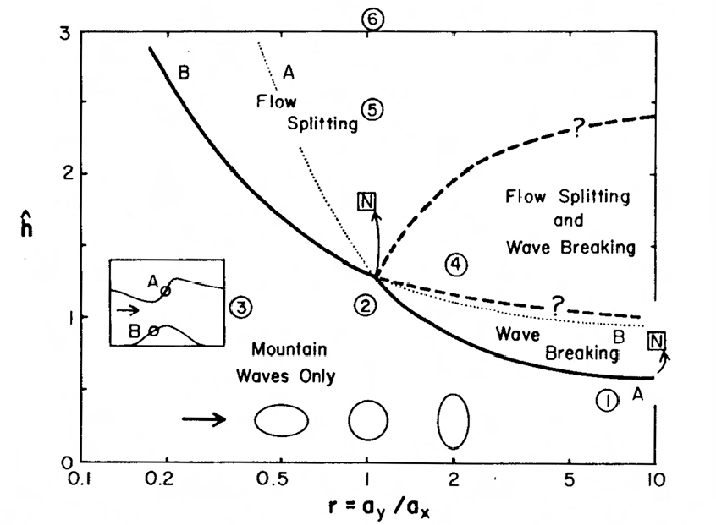

Wake vortices expected to the lee of N and S ends of Sumatra
Smith (1989)
*

Slide 32
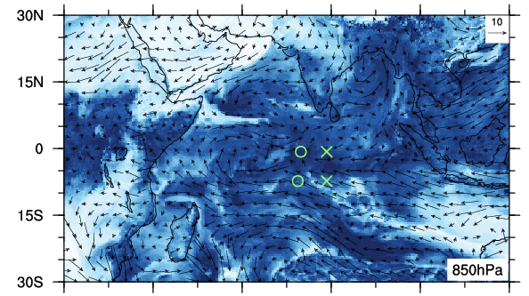

ECMWF 850 hPa Analysis, 18 October 1200 UTC
Wind (m s⁻¹), Relative Humidity (%)
“wake vortex”
×
○
DYNAMO sounding arrays
Sumatra
RH (%)

Slide 33
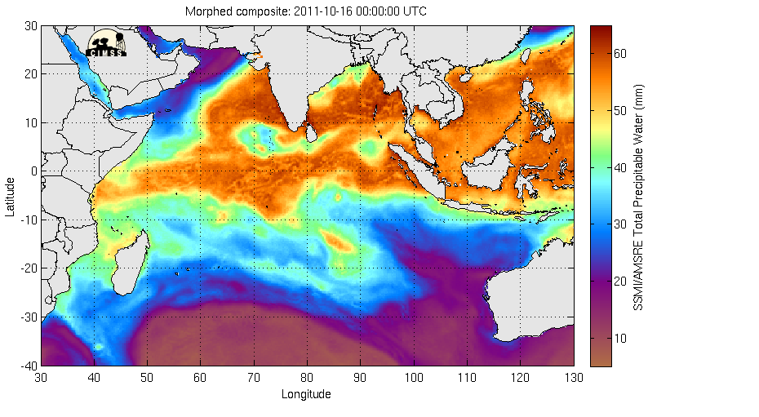
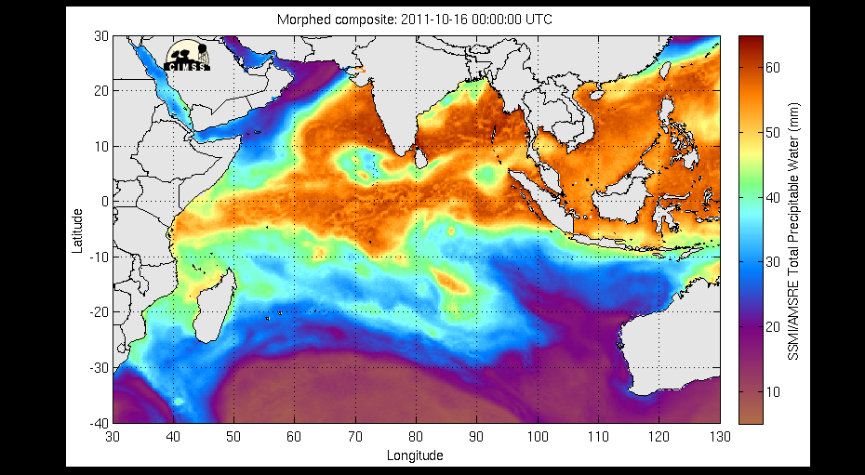
CIMMS TPW (16-20 October 2011)

Slide 35
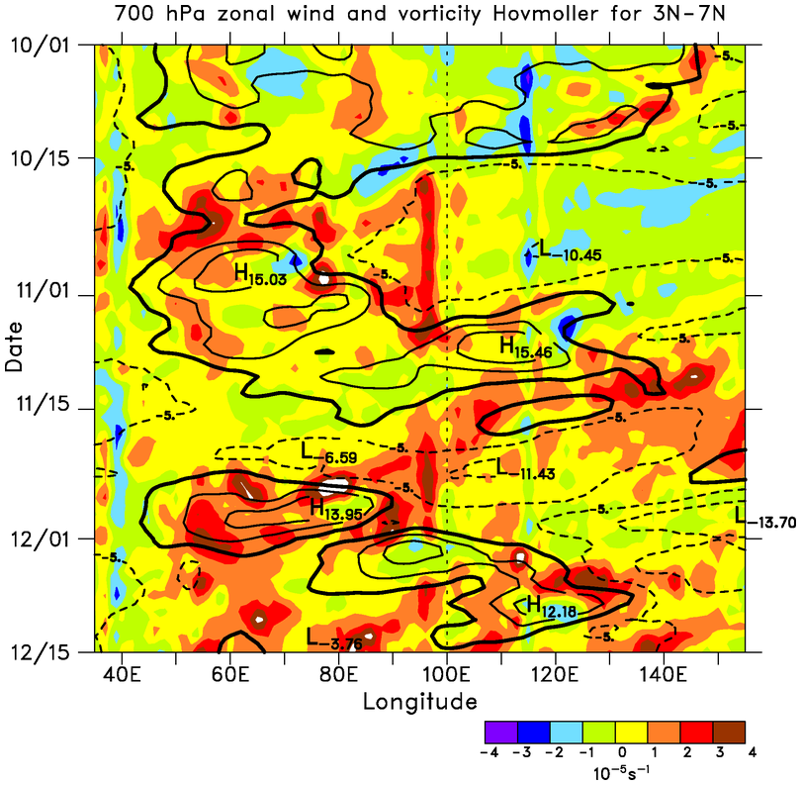
700-hPa u, ζ
Positive vorticity maxima downstream of Sumatra with easterly flow
Vorticity anomalies progress westward at 4-5 m s⁻¹
Time
SUMATRA
ECMWF OA 0.25°

Slide 36
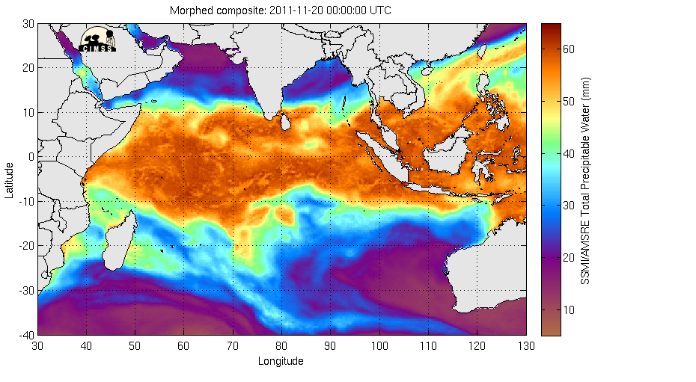
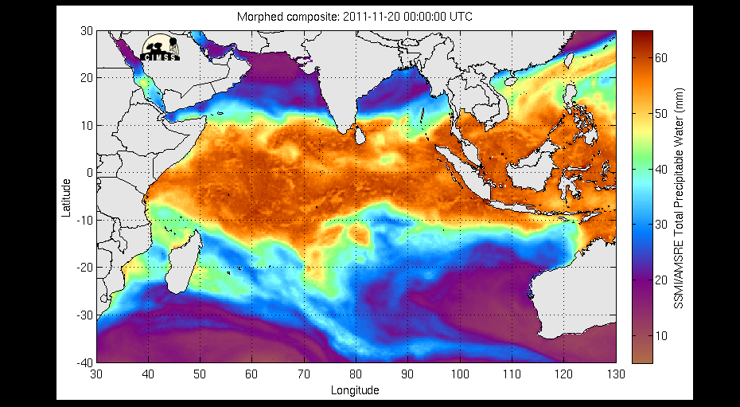
CIMMS TPW (20-24 November 2011)

Slide 37
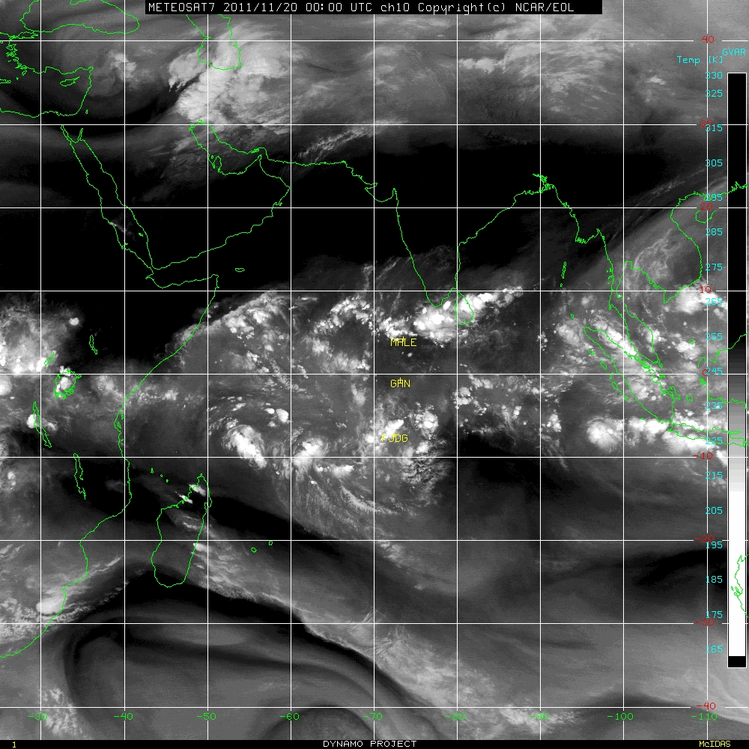

METEOSAT Water Vapor (20-27 November 2011)
Tropical Storm 05A

Slide 38
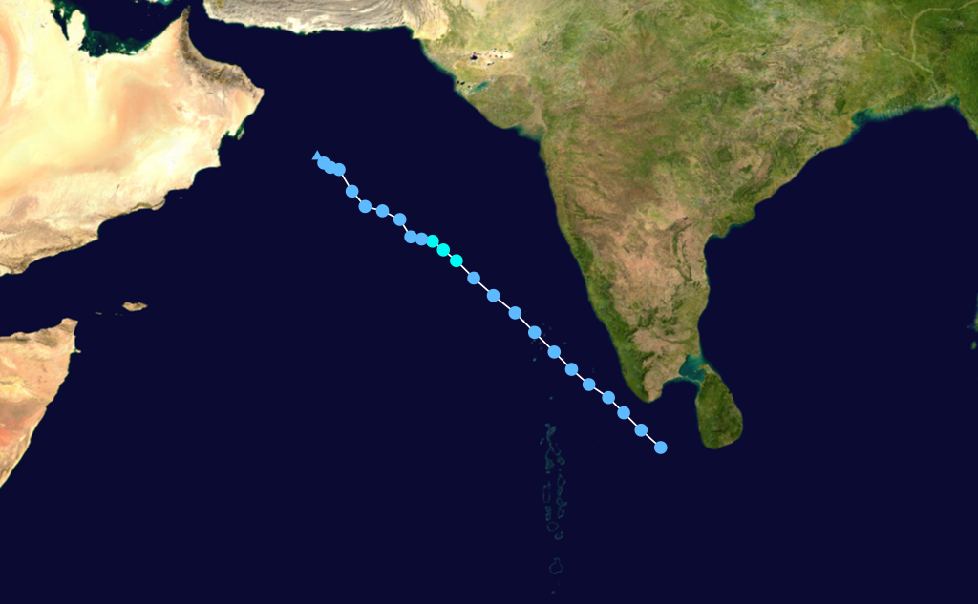
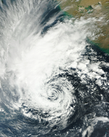
Tropical Storm 05A
(26 Nov - 1 Dec 2011)
29 Nov
Sri Lanka: Storm and Floods – 27 Nov 2011
19 killed, 43 fishermen missing

Slide 39
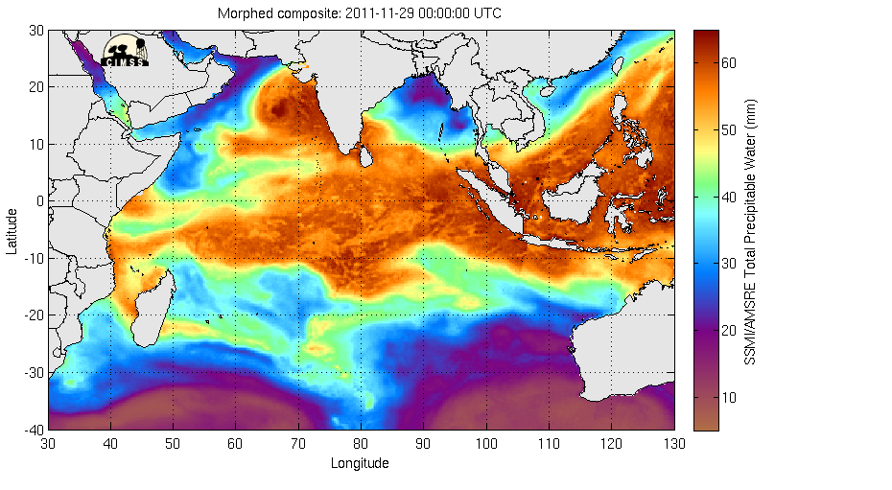
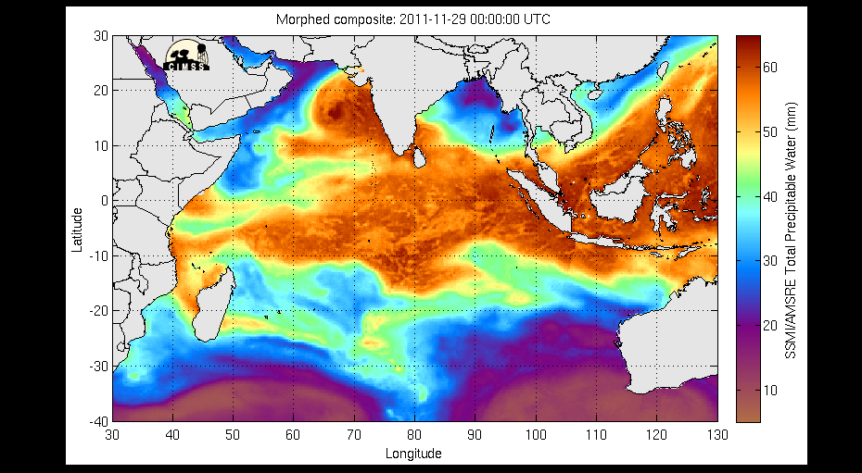
CIMMS TPW (29 Nov – 6 Dec 2011)
Tropical Storm Alenga

Slide 40
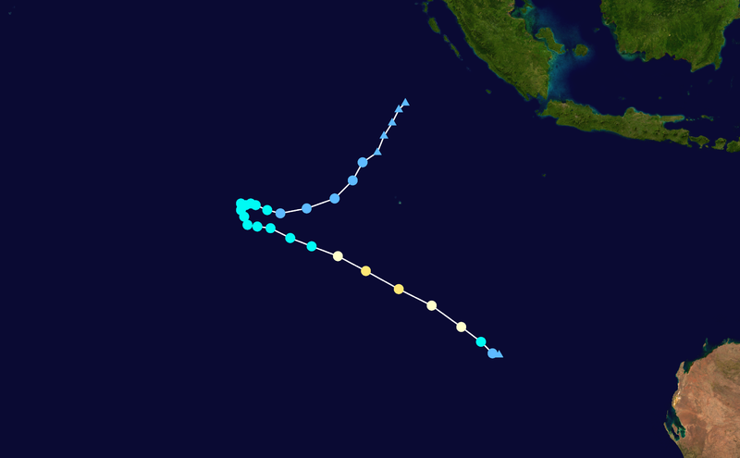
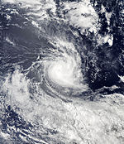
Borneo
Sumatra
Severe Tropical Storm Alenga
(5-7 December 2011)
Australia

Slide 41
Flow fields for |u| > 5 m s⁻¹ between 3 and 7°N at 100°E

Slide 42
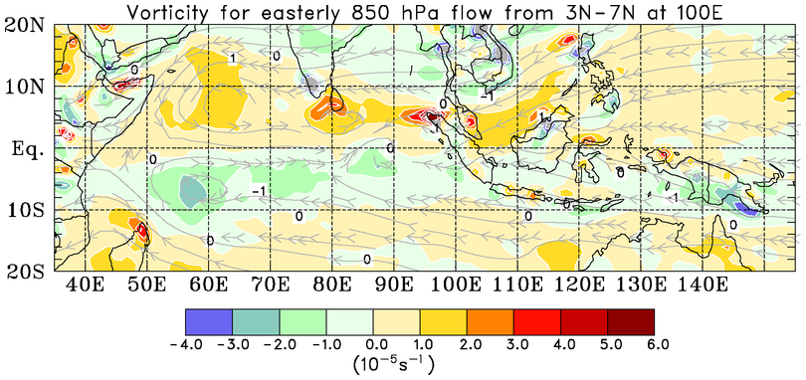
Positive vorticity anomalies to the lee of topographic features for easterly flow

Slide 43
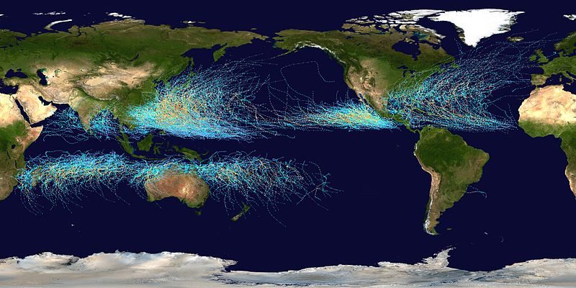
Tropical Cyclone Tracks 1985-2005

Slide 44
Summary
Sounding data QC completed; procedure applied to mitigate island effects on Colombo soundings
Rainfall, radiative heating rates from budgets in good agreement with satellite estimates
Inferred cloud transitions: shallow cu, congestus, deep convection, stratiform; shorter durations for November MJO; possible stepwise progression
Moistening process during suppressed phase strongly modulated by diurnal cycle
Island of Sumatra impacts MJO convection; possible role in tropical cyclogenesis over N & S Indian Ocean

Slide 46
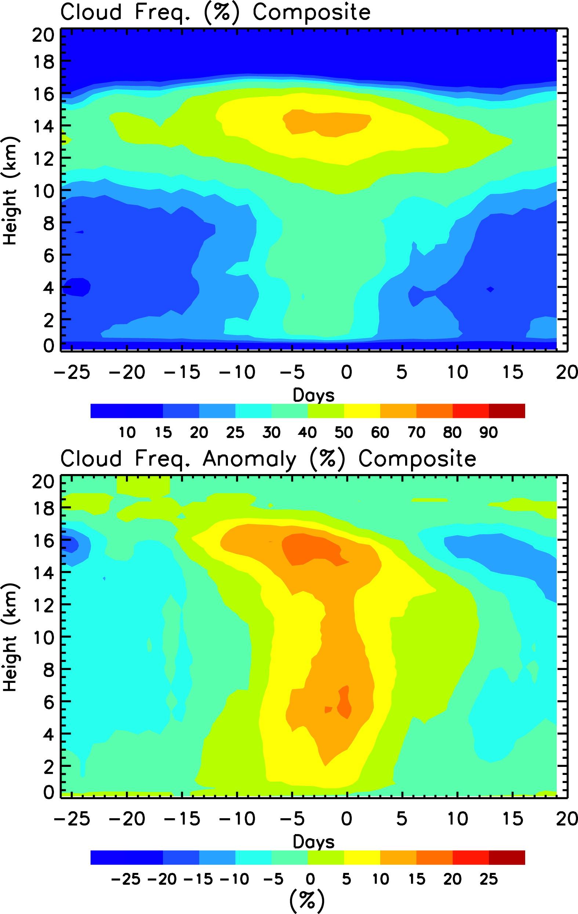
Del Genio et al.(2012)
⬥ CALIPSO ten MJO composite
⬥ Found shallow-to-congestus-deep transition
Cirrus top
Congestus
Cu

Slide 47
“Stepwise” Evolution of Clouds/Moisture During MJO Build-up Phase
W
E
1992-93 TOGA COARE: Kikuchi and Takayabu (2004)
2006 MISMO: Katsumata et al. (2009)
CALIPSO/CloudSat data: Virts and Wallace (2010); Del Genio et al. (2012)

Slide 48
‘
Malé
deep
deep
DRY
0°C
mid
mid
mid
shallow
shallow
shallow
Gan
DRY
deep
deep
mid
mid
mid
shallow
shallow
shallow
Revelle
DRY
deep
deep
mid
mid
shallow
shallow

Slide 49
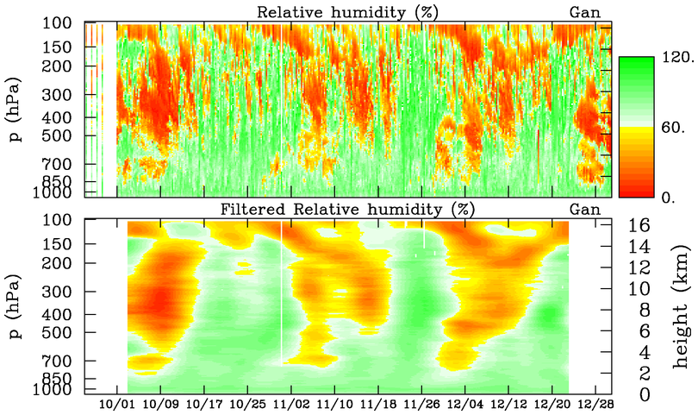
Unfiltered RH vs. 10-day Low-Pass Filtered RH
DRY
DRY
DRY
MOIST

Slide 50
DRY
DRY
MOIST
S-PolKa RHI
Deep
Deep
Deep
Cg
Cg
Cg
Cu
Cu
0°C
Cu
Figure courtesy Zhe Feng (PNNL)

Slide 51
Wake vortices expected to the lee of N and S ends of Sumatra
Smith (1989)
*

Slide 52
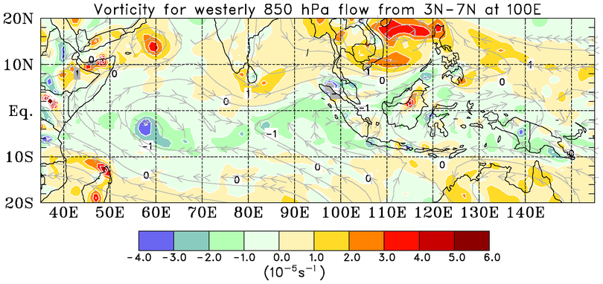
Negative vorticity anomalies to the lee of topographic features for westerly flow

Slide 53
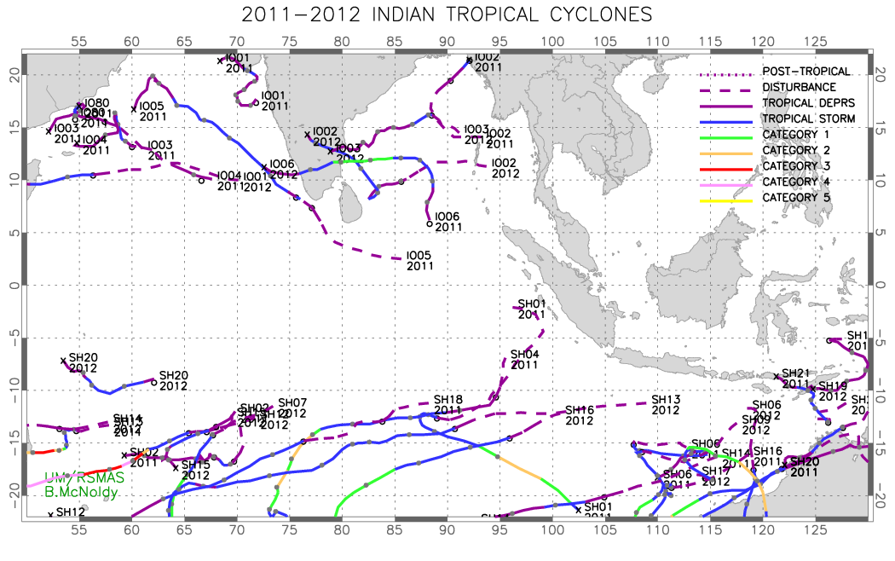

Slide 54
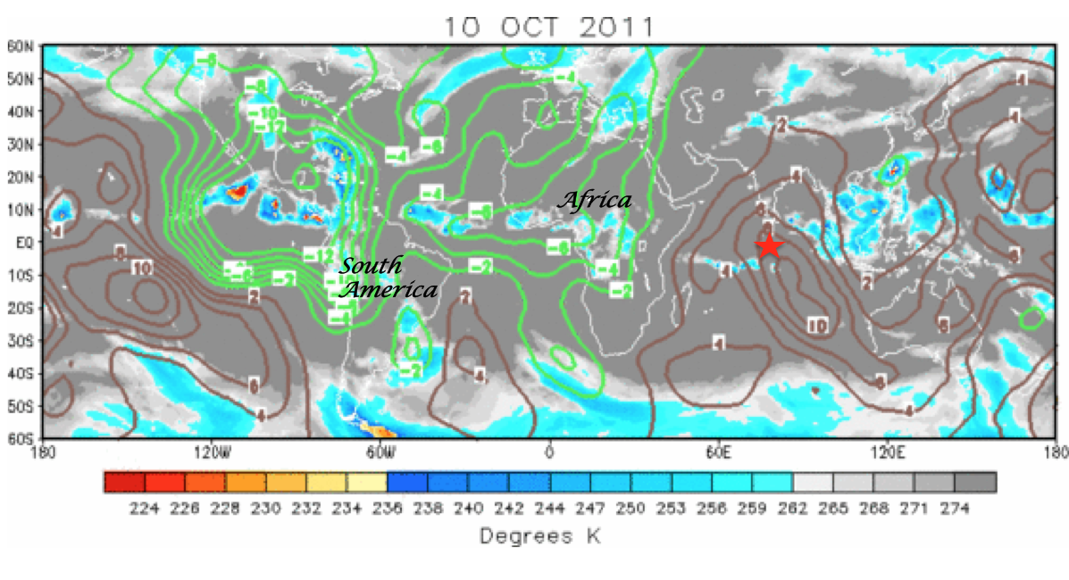
200 hPa Velocity Potential and IR Brightness Temperature
Africa
South America

Slide 55

200 hPa Velocity Potential and IR Brightness Temperature
Africa
South America

Slide 56

(Webster 1994)

Slide 57

Kuettner, J. P., 1989: Easterly flow over the cross-equatorial island of Sumatra and its role in the formation of tropical cyclone pairs over the Indian Ocean. Wetter und Leben, 41, 47-55.
1976-77 Tropical Cyclone Tracks
SUMATRA

Slide 58
DRY
SST diurnal cycle during warming phase
Shallow diurnal warm layers, as in TOGA COARE (Soloviev and Lukas 1997)
(Johnson and Ciesielski 2013)

Slide 59


SSMI/AMSR-E Total Precipitable Water (mm) – October 15-31

Slide 60


Budget results support idea of important role of horizontal moisture advection by easterlies in developing phase of MJO (Maloney 2009)
Zonal advection, meridional advection, and convective moistening all appear to play moistening roles over NSA for October MJO; zonal advection and convective moistening for November MJO
Notes:
Microwave-integrated Retrieval System

Slide 61
Ratio of anomaly of <Q_{R}> to <Q_{conv}>:
  MJO1 – 18%
  MJO2 – 11%
For MJO1, ratio approaches proposed threshold of ~20% (Lee et al. 2001) for radiative-convective instability (Yu et al. 1998; Raymond 2001)

Slide 62

850mb, 0Z 22NOV2011

Slide 63

850mb, 0Z 23NOV2011

Slide 64

850mb, 0Z 24NOV2011

Slide 65

850mb, 0Z 25NOV2011

Slide 66

ERA Interim 7-20 day bandpass T anomalies

Slide 67

DYNAMO Sounding Array
DYNAMO Workshop
Miami March 2011
Area: (824 km)²
Proposed Extension of the Sounding Network
October - November
Colombo
•
•
Hulhule, Malé
•
•
US (33 days)
US (36)
US (23)
Frequency
Malé: 4/day Oct-Nov
Colombo: 4/day Oct-Nov, 2/day Dec?
Gan
Single array
Following the Miami workshop, eleventh-hour efforts were made to establish sounding sites at Malé and Colombo.
Colombo – Masaki Katsumata/Kunio Yoneyama, support from WMO
Malé – CSU sounding system, support from NSF, Taiwan, JAMSTEC
Diego
Garcia
JPN (59)*
IND (??)
* Excludes port call

Slide 68



Theoretical Wind Field
with TOGA/COARE-like heating
(Schubert and Masarik 2006)
2006 MISMO
(Katsumata et al. 2011)
Rectangular array does better job of capturing all wave modes

Slide 69
ERA Interim 7-20 day bandpass-filtered T anomalies
Gan
Manus
K

Slide 70


Comparison of TOGA COARE and CINDY/DYNAMO/AMIE Sounding Array Areas

Slide 71
Comparison of TOGA COARE and CINDY/DYNAMO/AMIE Sounding Array Areas
Northern/southern DYNAMO/CINDY/AMIE arrays each about twice the size of the TOGA COARE IFA

