Slide 1
Heavy Rainfall in the South China Sea Area:
Four Decades of Field Campaigns
Richard H. Johnson
Colorado State University
Fourth International Workshop on Monsoon Heavy Rainfall (MHR-4), Shenzhen, China 16-18 April 2019

Slide 2
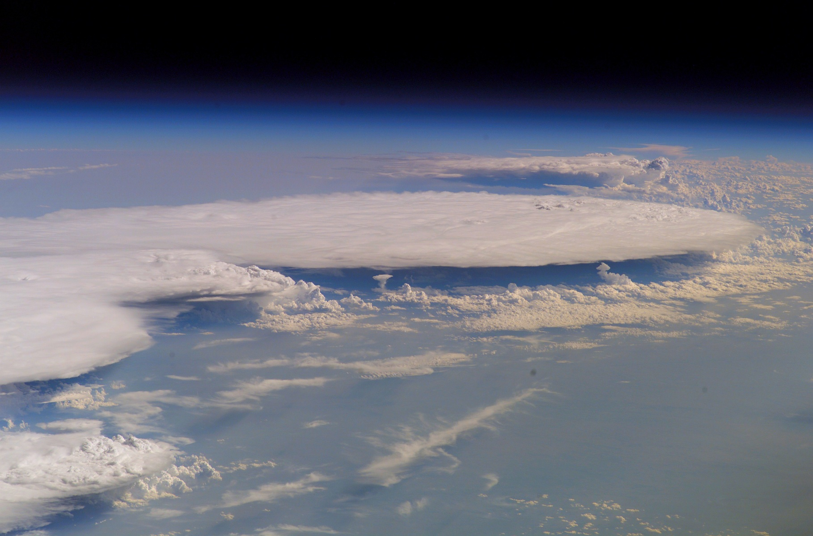
Field Campaigns in South China Sea Area Investigating Extreme Rainfall
-TiMREX/SoWMEX (2008)
-SCMREX (2013-2018)
-WMONEX (1978)
-SCSMEX (1998)
-PISTON II/CAMP2Ex
-TAMEX (1987)
-PISTON (2018)
-PRECIP2020
1980
1990
2000
2010
2020

Slide 3
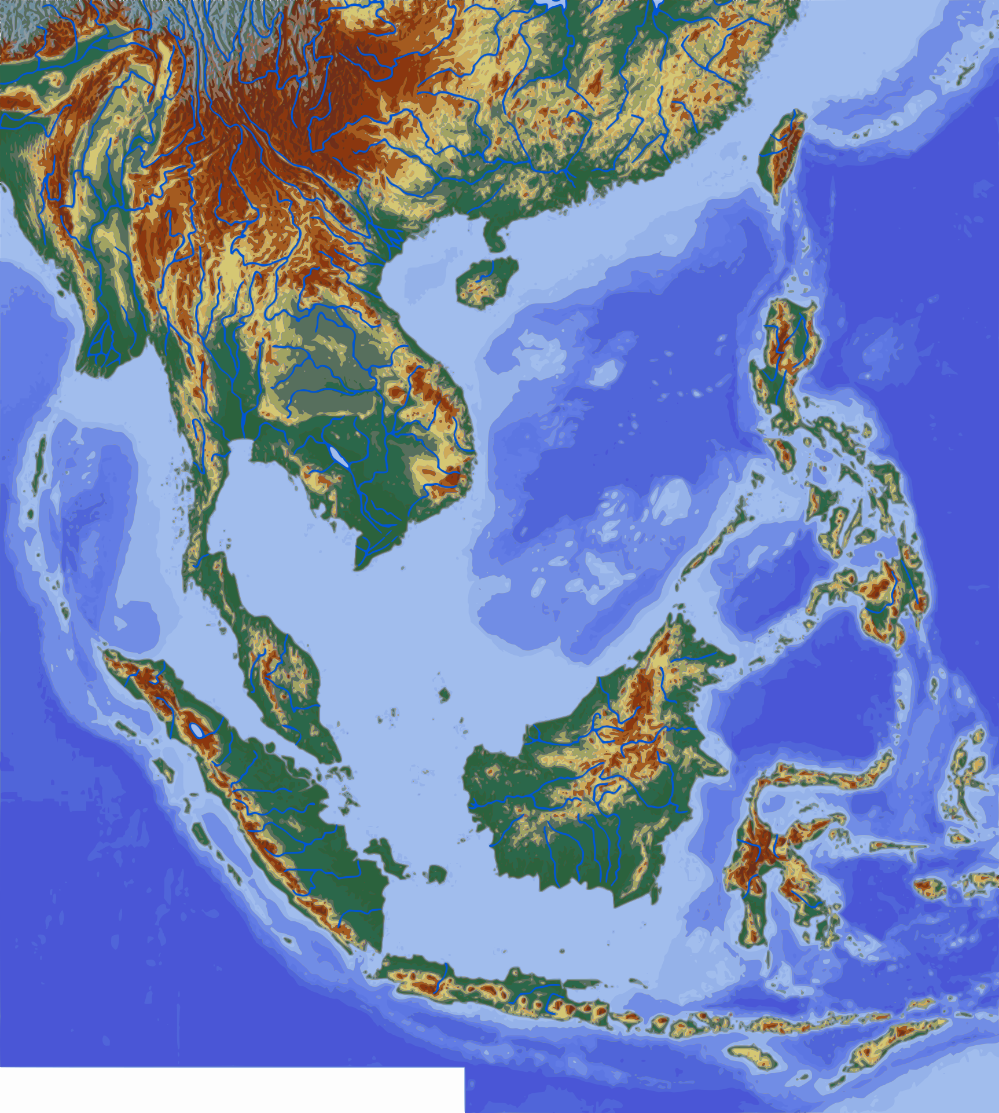
SCS area field campaigns…
TAMEX
SCMREX
1987
2013-2018
SoWMEX/TiMREX
2008
PISTON
SCSMEX
2018
1998
WMONEX
1978
PISTON
2018

Slide 4
Field Campaigns in East Asia/SCS Area Investigating Extreme Rainfall
-WMONEX (1978)
1980
1990
2000
2010
2020

Slide 5

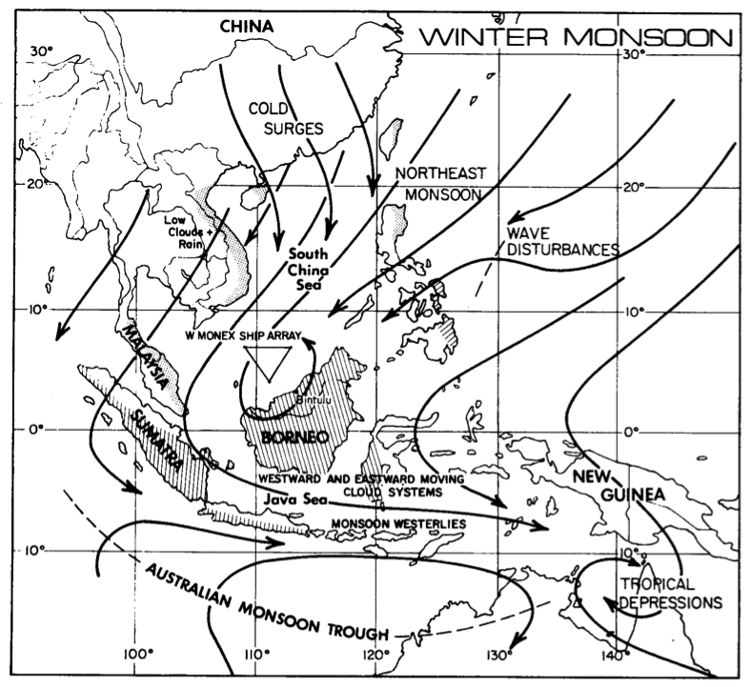
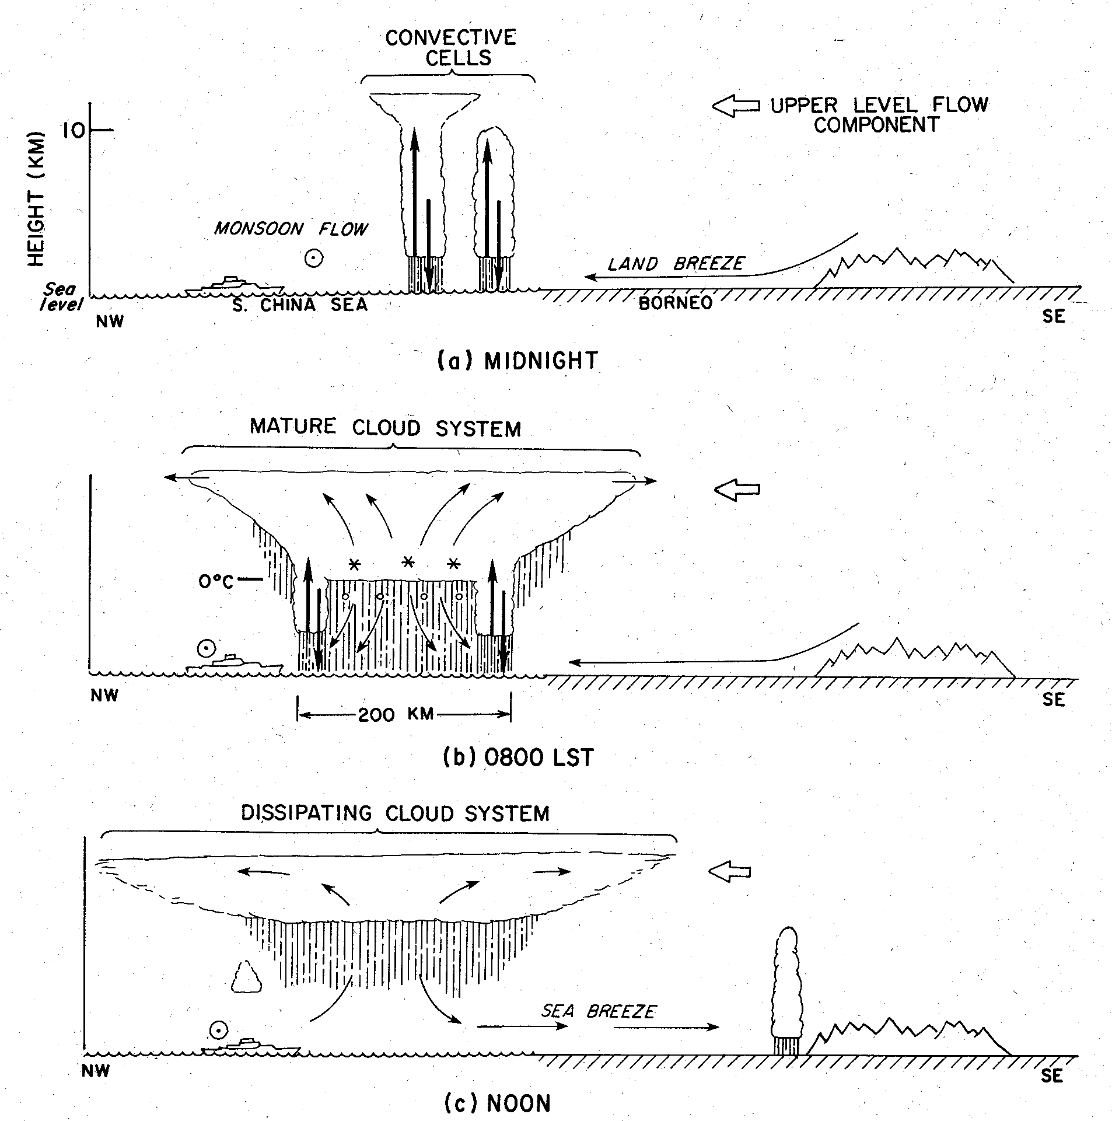
Winter MONEX
December 1978
Cold surges, Hadley/Walker circulations, interhemispheric exchanges, near-equatorial depressions, heat sources/sinks
Diurnal Cycle of Convection
Ops Center
Kuala Lumpur
MIT radar
Houze et al. (1981)
P-3
Participating countries: Malaysia, Indonesia, Thailand, Philippines, Hong Kong, Japan, Singapore, Australia, People’s Republic of China, U.S.S.R., U.S.A
Repeatable diurnal cycle of convection developing off north coast of Borneo at night, moving offshore, and growing into expansive MCS, then decaying anvil
(Johnson and Houze 1987)
Peter Webster
Ship soundings
Notes:
Scientific objectives were mostly related to cold surges, interhemispheric exchanges, and near-equatorial depression in southern SCS. Nevertheless, a major finding had to do with near-equatorial convection and its diurnal cycle.

Slide 6
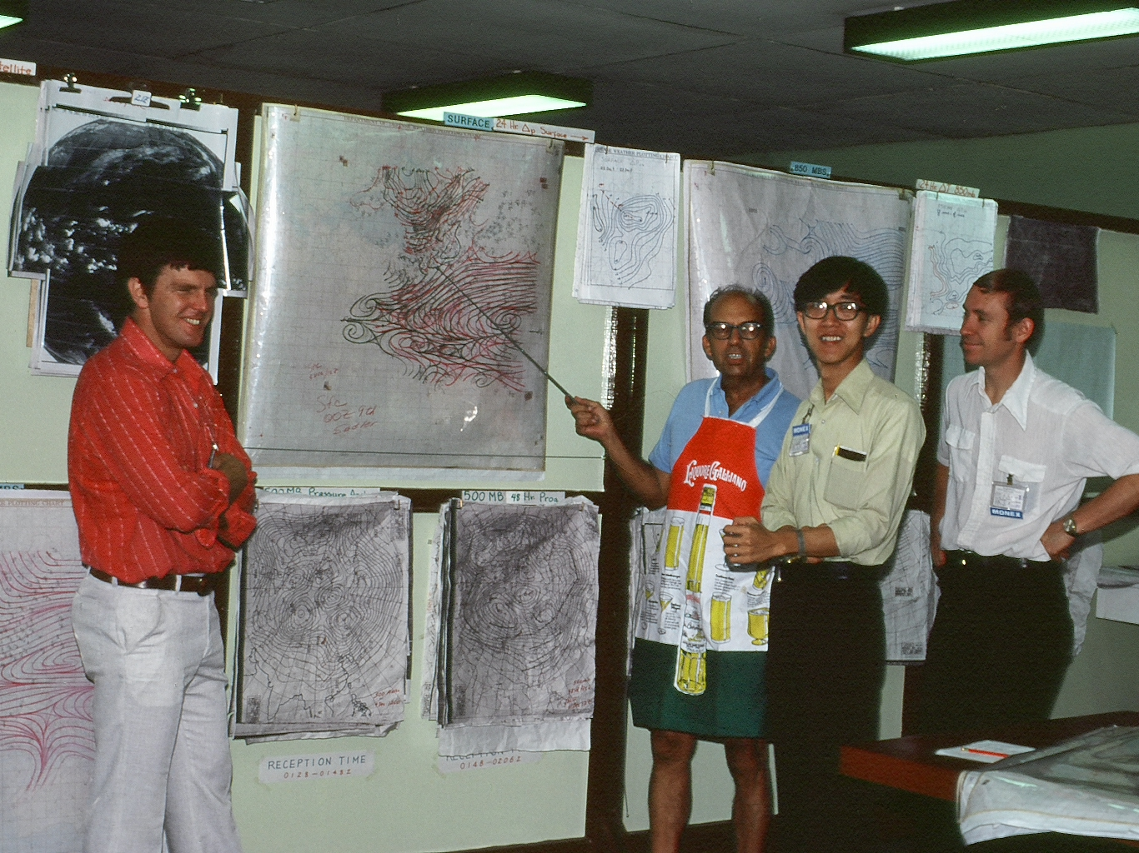
WMONEX Operations Center, Kuala Lumpur, December 1978
Webster
Chang
Sadler
Johnson
Houze

Slide 7
Winter MONEX
December 1978
Cold surge: initial pulse – internal gravity wave moving at ~40 m/s over SCS, followed by surge “front” moving at 11 m/s (Chang et al. 1983)
Surges can lead to or strengthen Borneo vortex, enhance rainfall over Borneo, Indonesia, Malaysia (Chang and Lau 1980; Lim and Chang 1981; Lau et al. 1983; Chang et al. 2005)
(Johnson and Houze 1987)
Peter Webster
Notes:
Scientific objectives were mostly related to cold surges, interhemispheric exchanges, and near-equatorial depression in southern SCS. Nevertheless, a major finding had to do with near-equatorial convection and its diurnal cycle.

Slide 8
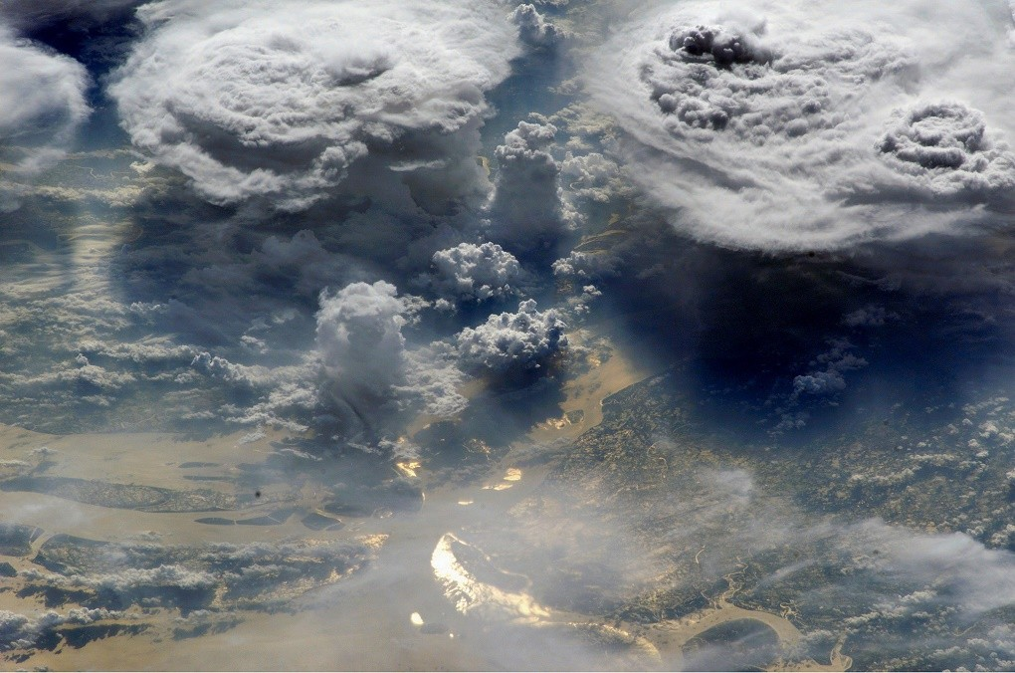
Heavy rainfall along coastal Viet Nam, eastern Philippines, eastern Malaysia, Borneo; Borneo vortex is common feature
(Johnson and Houze 1987)

Slide 9
Field Campaigns in East Asia/SCS Investigating Extreme Rainfall
-WMONEX
-TAMEX
1980
1990
2000
2010
2020

Slide 10
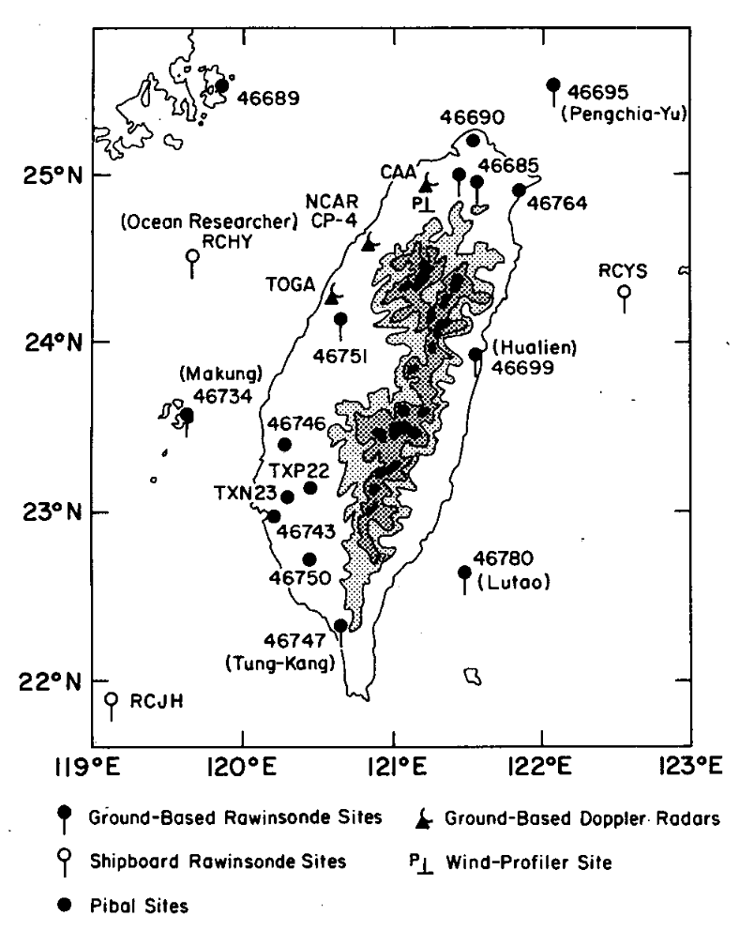
The Taiwan Area Mesoscale Experiment (TAMEX, May-June 1987)
Taiwan-USA
Study of heavy rainfall
  Meiyu front
  Mesoscale convective systems
  Orographic effects
  Local circulations
00Z 28 May 1981
Chi and Chen (1988)
(Trier et al. 1997)
Doppler radars, soundings, surface stations, NOAA P-3 aircraft

Slide 11
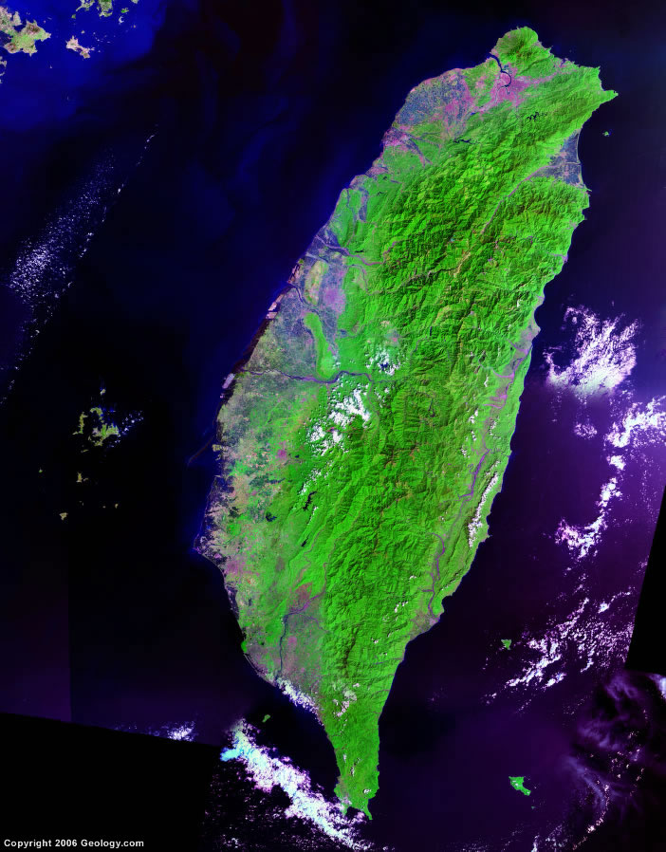

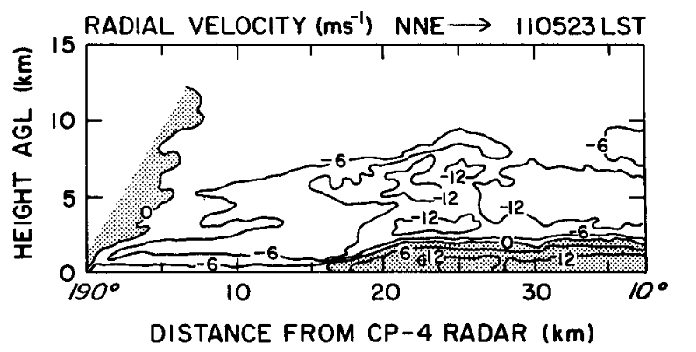
TAMEX Radar observations along “Meiyu” front (Trier et al. 1990; Lin et al. 1990, 1992; Wang et al. 1990; Chen and Chou 1993; Chen and Li 1995; Li et al. 1997; others)
“Meiyu front”
CP-4
(Trier et al. 1997)
Shallow front

Slide 12
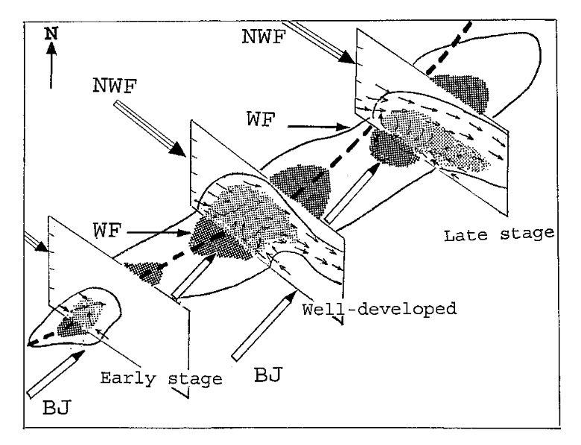
TAMEX Radar observations of convection along “Meiyu” front (Trier et al. 1990; Lin et al. 1990, 1992; Wang et al. 1990; Chen and Chou 1993; Chen and Li 1995; Li et al. 1997; others)
Back-building convection along Mei-Yu front
(Li, Chen and Lee 1997)

Slide 13
Field Campaigns in East Asia/SCS Investigating Extreme Rainfall
-WMONEX
-SCSMEX
-TAMEX
1980
1990
2000
2010
2020

Slide 14
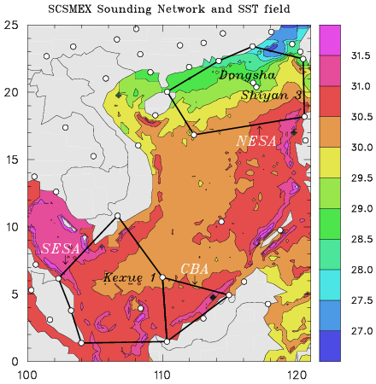
South China Sea Monsoon Experiment (SCSMEX) – May-June 1998
Study of key processes associated with onset and evolution of SE Asia summer monsoon
People’s Republic of China, Taiwan, U.S.A., Australia, Hong Kong, Philippines
(SCSMEX review: Lau et al. 2000, BAMS)

Slide 15
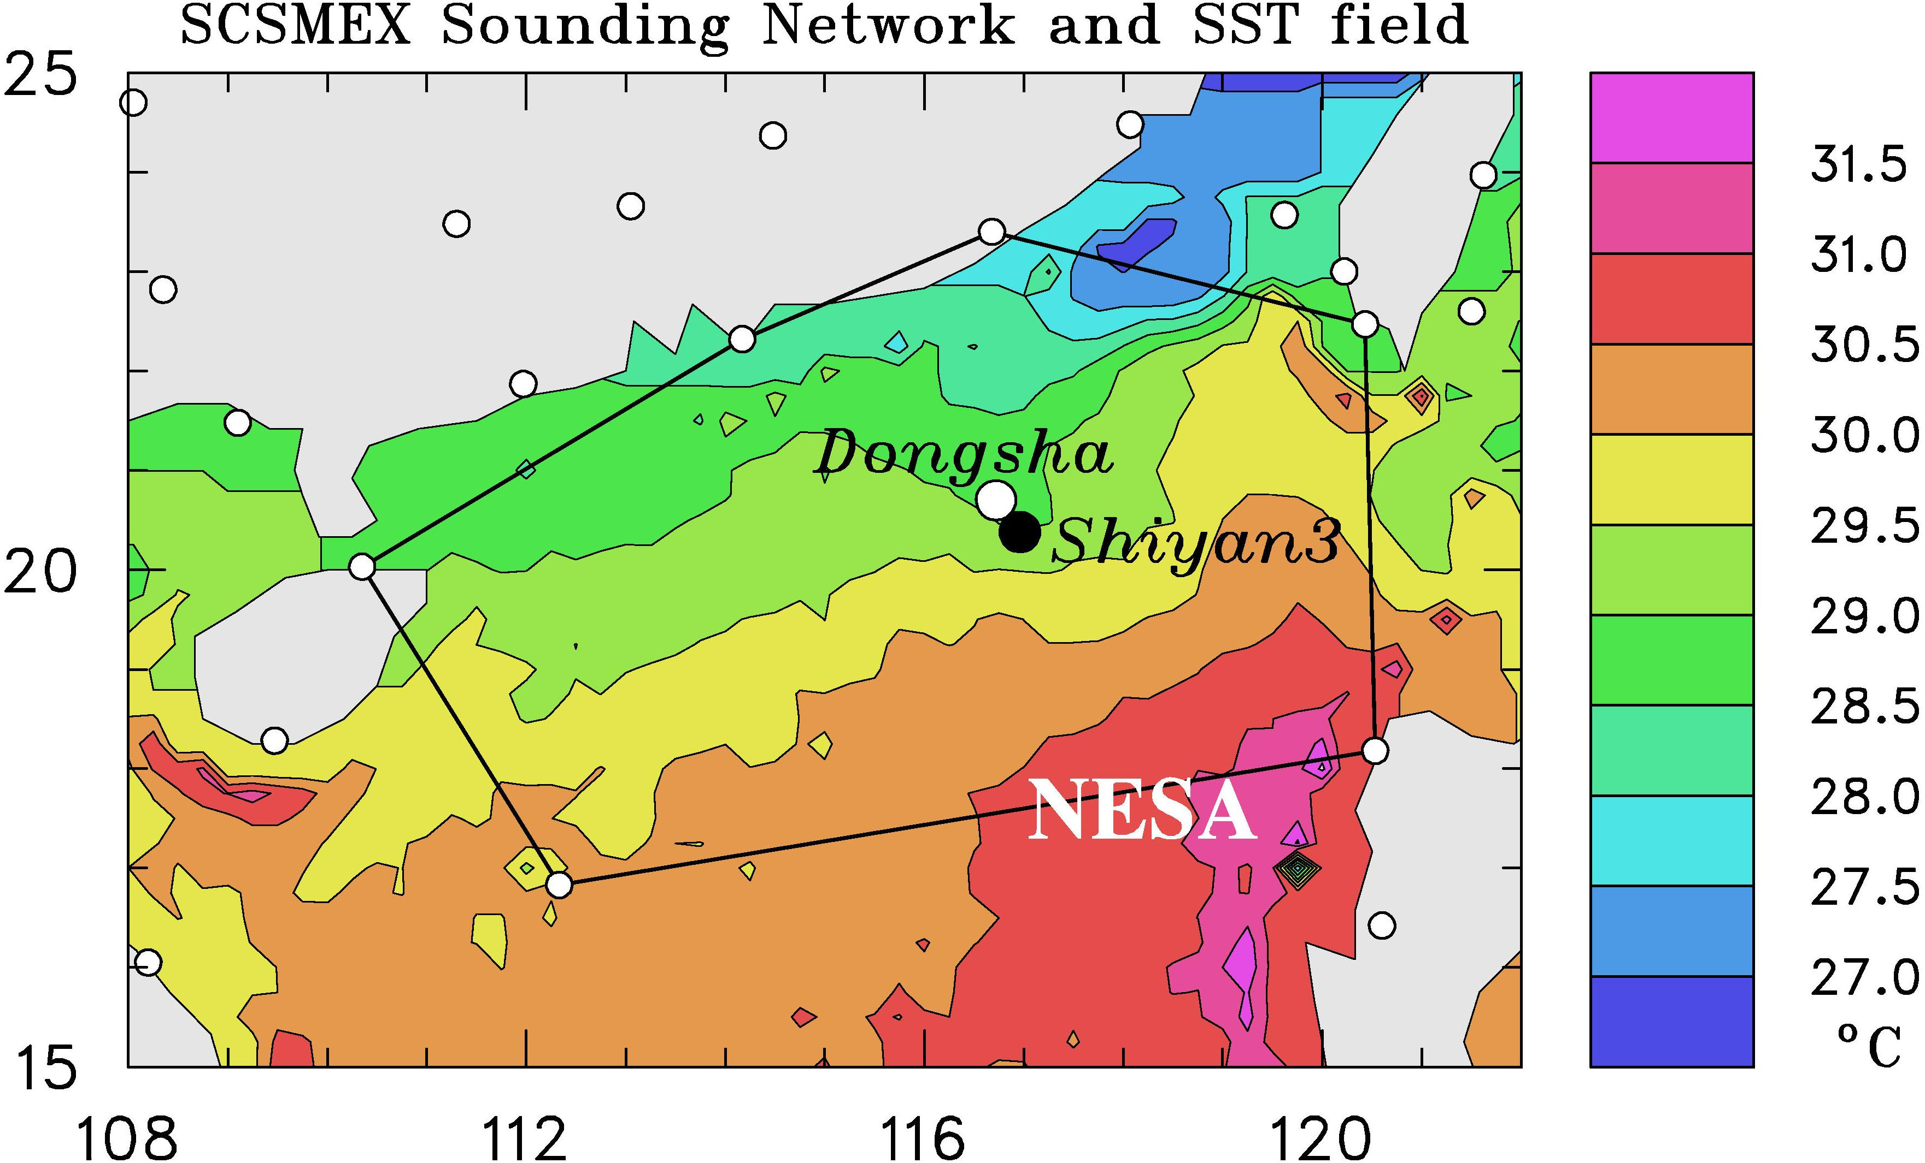
South China Sea Monsoon Experiment (SCSMEX) – May-June 1998
(May-June 1998)
BMRC C-POL RADAR
TOGA RADAR

Slide 16
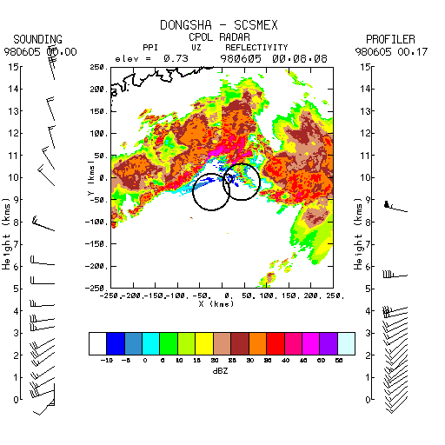
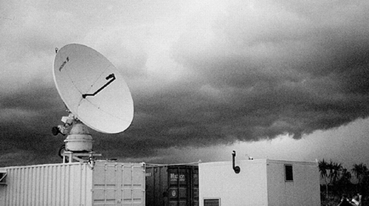
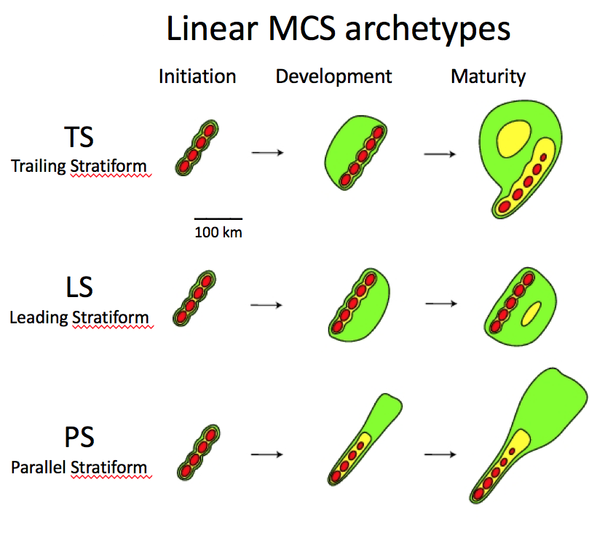
SCSMEX 6-hour Radar Animation
5 June 1998
Leading Line/Trailing
Stratiform
●
Hong Kong
BMRC C-POL Radar
BMRC C-POL RADAR
(Parker and Johnson 2000)
(Johnson, Aves, Ciesielski, Keenan 2005)

Slide 17
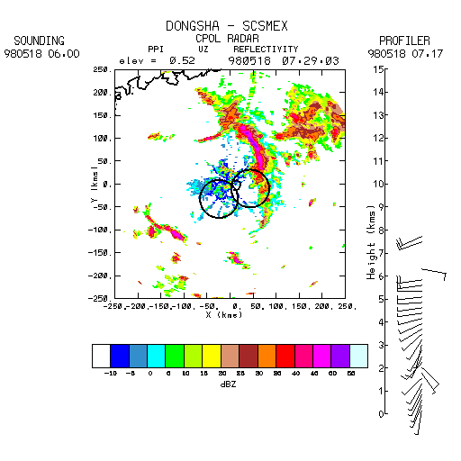
SCSMEX 4-hour Radar Animation
18 May 1998
Leading
Stratiform
●
Hong Kong
(Parker and Johnson 2000)

Slide 18
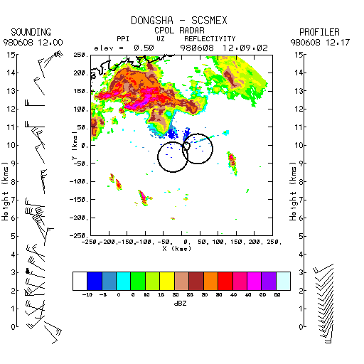
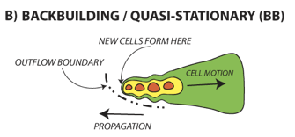
SCSMEX 6-hour Radar Animation
8 June 1998
Parallel
Stratiform,
Back-building
●
Hong Kong
Heavy rainfall
(Schumacher and Johnson 2005)
(Parker and Johnson 2000)

Slide 19
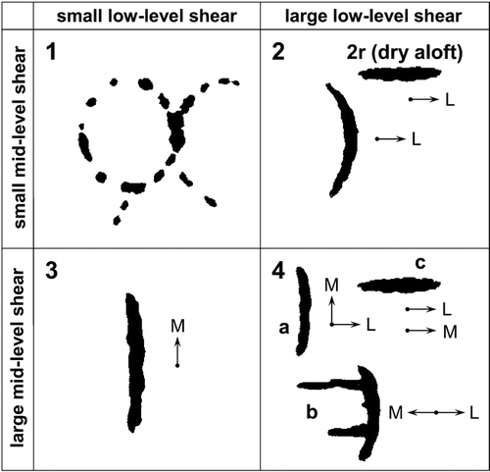
Organizational modes as a function of shear
(LeMone, Zipser, Trier 1998)
TOGA COARE
(6)
Weak low- & mid-level shear
Strong low-level shear, weak midlevel shear
Updated based on SCSMEX radar observations (Johnson, Aves, Ciesielski, Keenan 2005)
New SCSMEX modes
(3)
(2)
Weak low-level shear, strong midlevel shear
Strong low- & mid-level shear
(3)
Slow movement, training echoes, potential for heavy rain
(4)
(5)
(1)

Slide 20
Field Campaigns in East Asia/SCS Investigating Extreme Rainfall
-TiMREX/SoWMEX
-WMONEX
-SCSMEX
-TAMEX
1980
1990
2000
2010
2020

Slide 21

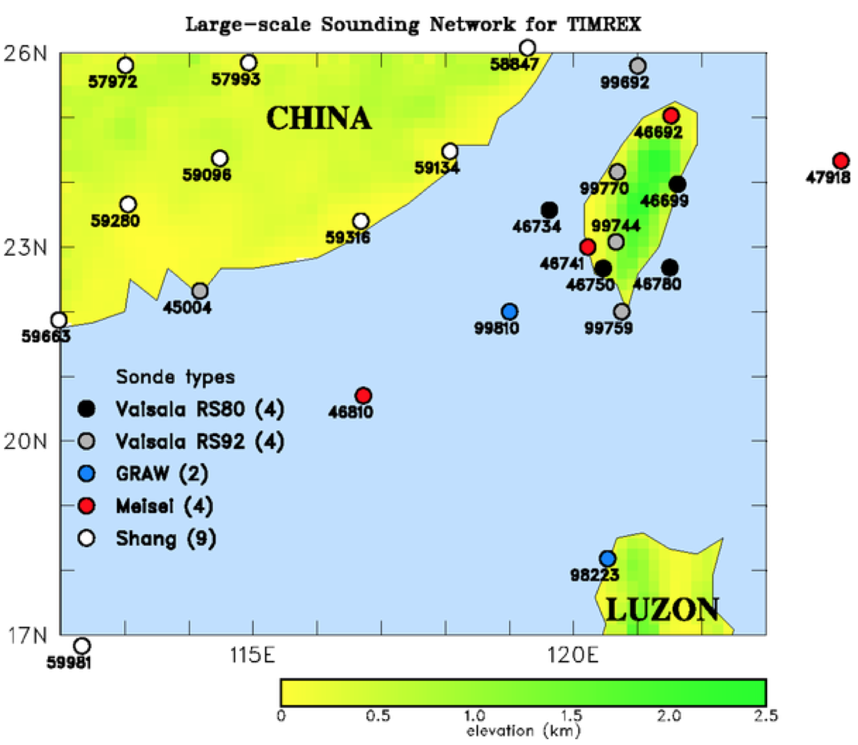
15 May – 30 June 2008
Scientific Objectives
Terrain effect on the flow and MCSs
MCS dynamics, microphysics, and predictability
Mesoscale data assimilation/ QPF
Convective initiation/diurnal cycle/boundary layer processes
Dropsonde missions
NCAR S-Pol
Participants
Field phase: US-Taiwan
Post-field phase activities/ workshops: Korea, Japan, Viet Nam, PRC

Slide 22

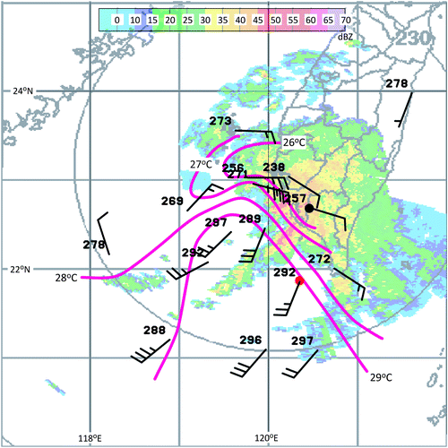
990 hPa wind, T_{v} at 06Z on 5 June 2008
Observations of shallow fronts
(Davis et al. 2012)
Despite shallowness and weak T gradient, impact on convection is significant
T contrast reinforced by cool downdrafts over land
Analogous to coastal fronts at higher latitudes
(Davis et al. 2012)

Slide 23
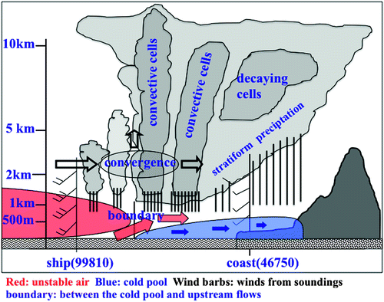
Extreme rainfall 14-16 June 2008
(Xu et al. 2012)
Convective cell triggering by low-level jet impinging on shallow cold pool
Cold pool reinforced by continuous precipitation
Cold pool trapped by terrain
Virtual extension of island barrier to the southwest
(Xu et al. 2012)

Slide 24
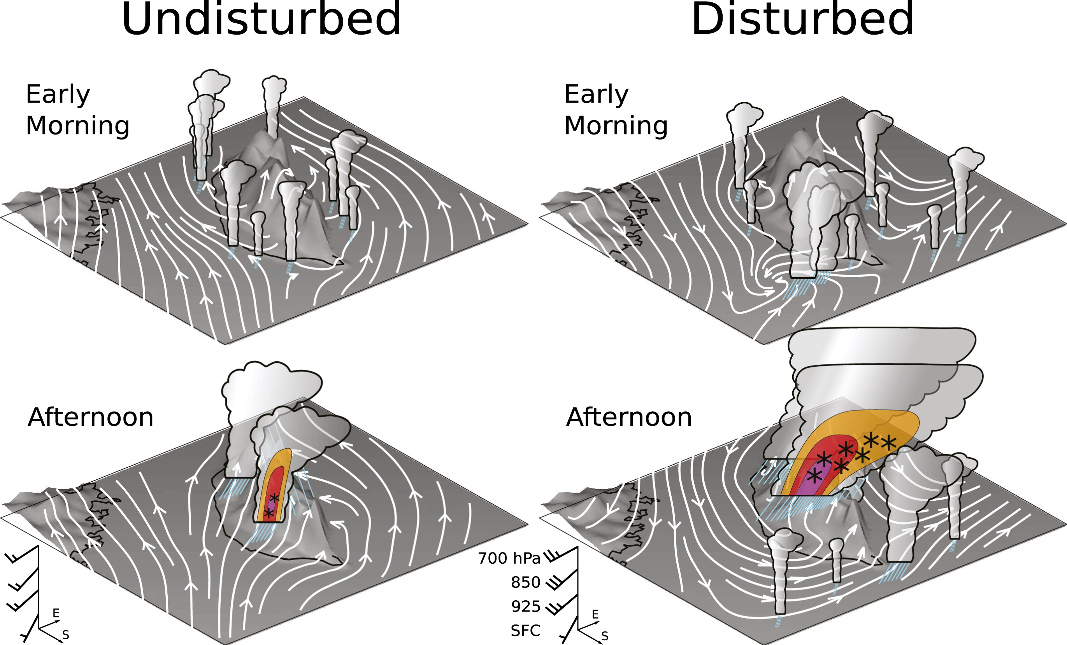
Diurnal Cycle of Convection during TiMREX
(Ruppert et al. 2013)
Morning rainfall offshore, after-noon maxima on coastal plain
Dominant rainfall on at higher elevations over CMR in afternoon

Slide 25
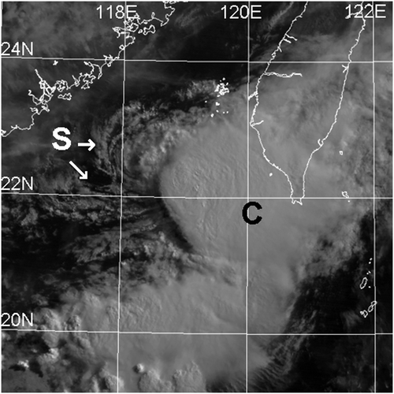

Mesoscale Convective Vortex (MCV) during TiMREX
4-5 June 2008 Heavy Rainfall
TiMREX/SoWMEX
(Lai, Davis, and Jou 2011, MWR)
MCV center
Heavy rain over southern Taiwan downshear of vortex center, aided by moist southwesterly flow
* > 250 mm
Sfc to 700 hPa shear
MOIST
2257 UTC 4 Jun 2008

Slide 26
Field Campaigns in East Asia/SCS Investigating Extreme Rainfall
-TiMREX/SoWMEX
-WMONEX
-SCSMEX
-SCMREX
-TAMEX
1980
1990
2000
2010
2020

Slide 27
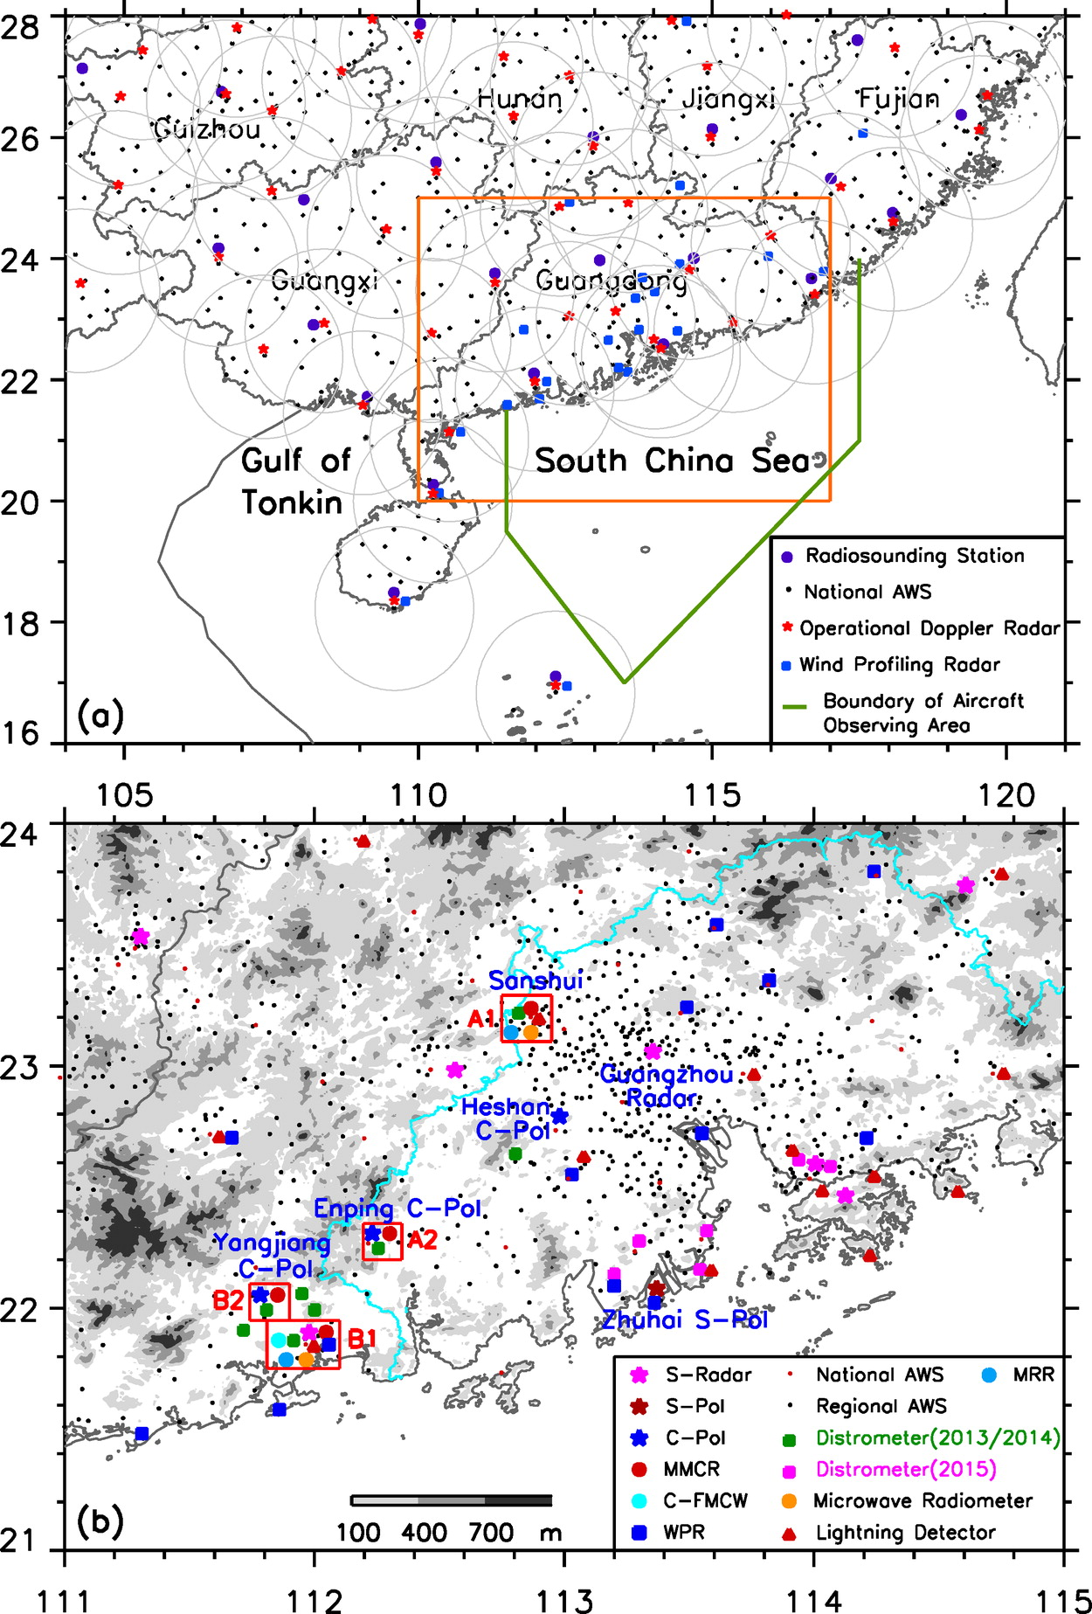
South China Monsoon Rainfall Experiment (SCMREX, 2013-18)
A program for improving heavy rainfall forecasts over southern China during the presummer rainy season
Luo et al. (2016, BAMS)
Collaborators: PRC, USA, UK, Taiwan

Slide 28
Field Campaigns in East Asia/SCS Area Investigating Extreme Rainfall
-TiMREX/SoWMEX
-WMONEX
-SCSMEX
-SCMREX
-TAMEX
-PISTON
1980
1990
2000
2010
2020

Slide 29
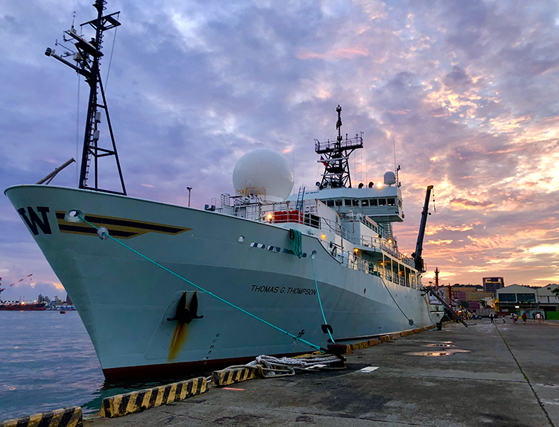
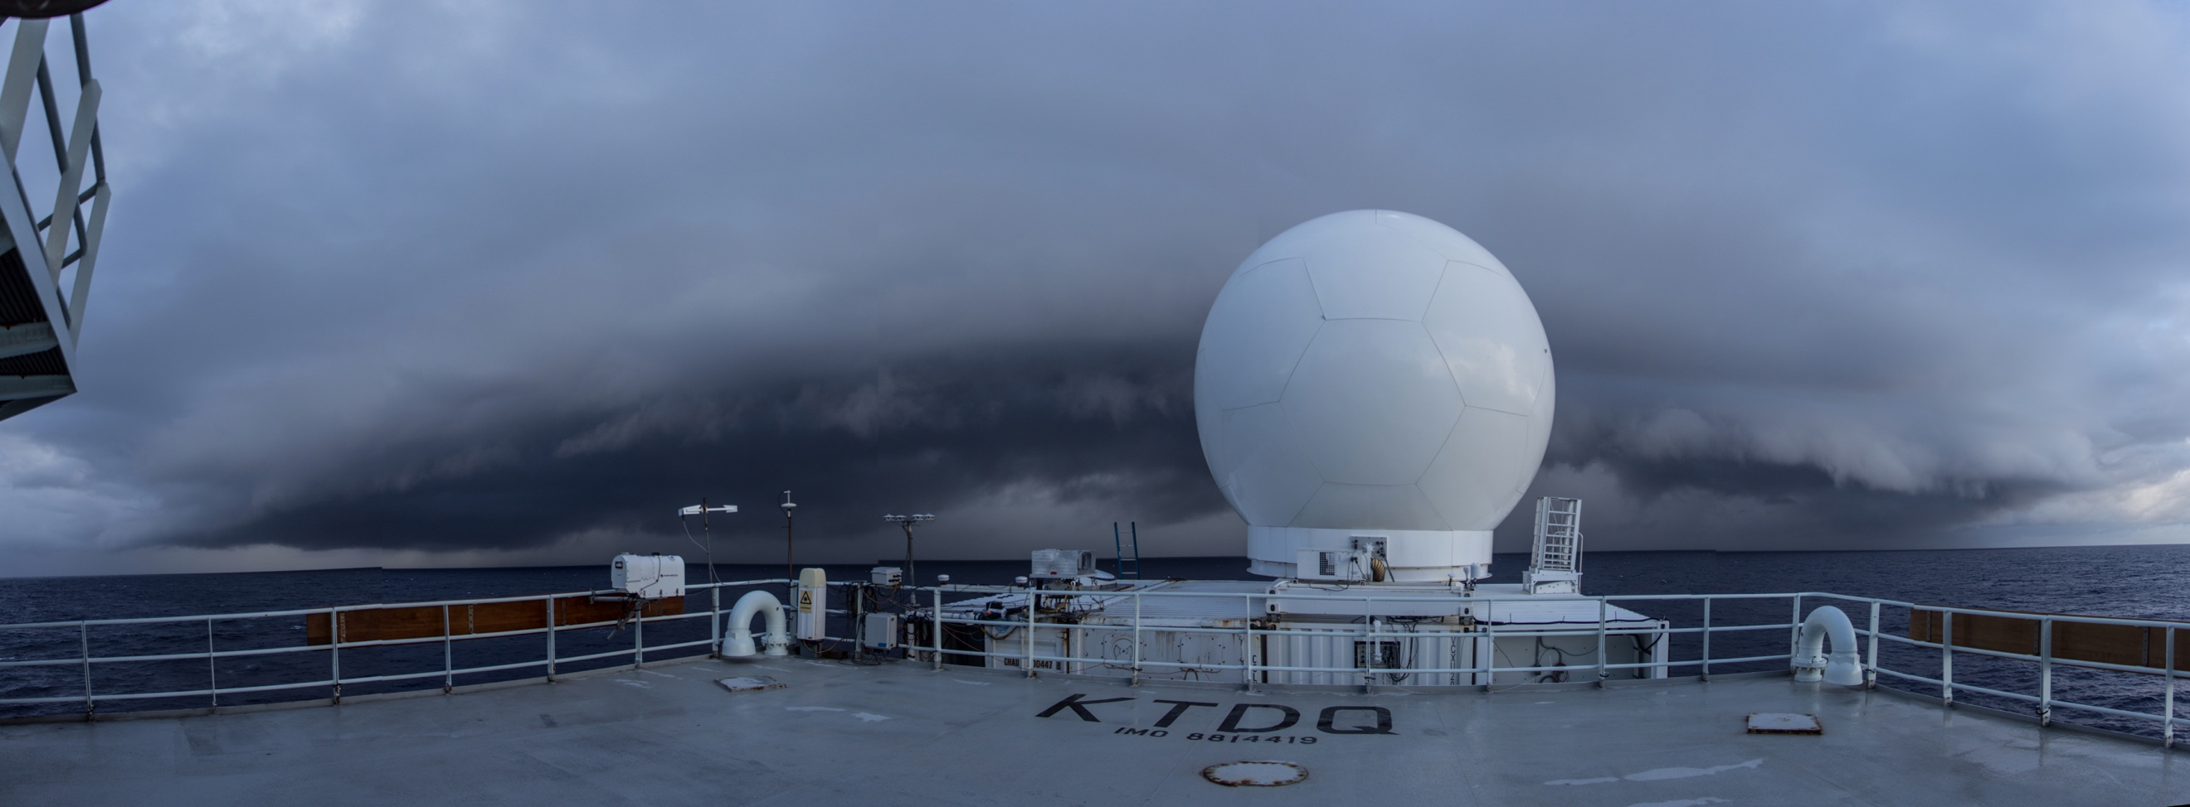
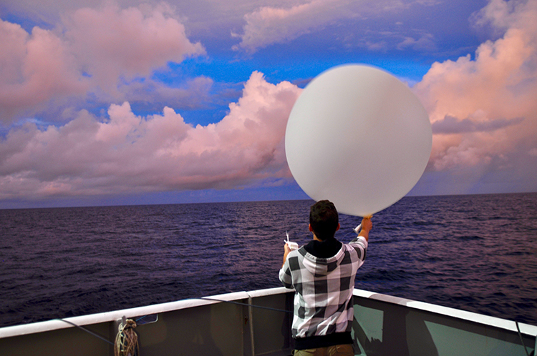
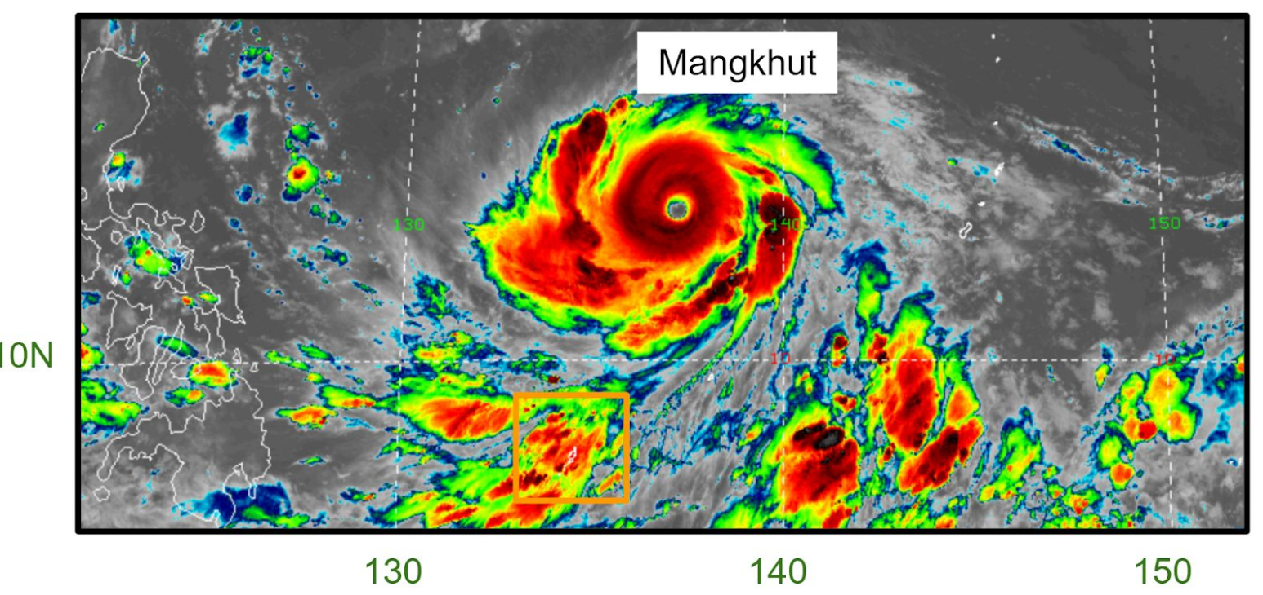
Propagation of Intra-Seasonal Tropical OscillatioNs (PISTON) (Aug-Oct 2018)
Soundings
SEA-POL radar
R/V Thompson
Science highlights
  Tropical cyclone “tails”
  Upper-ocean response to TC passage
Participating countries: US, Taiwan (SCSTIMEX), Philippines, Japan

Slide 30
Field Campaigns in East Asia/SCS Area Investigating Extreme Rainfall
-TiMREX/SoWMEX
-PISTON II/CAMP2Ex
-WMONEX
-SCSMEX
-SCMREX
-TAMEX
-PISTON
1980
1990
2000
2010
2020

Slide 31
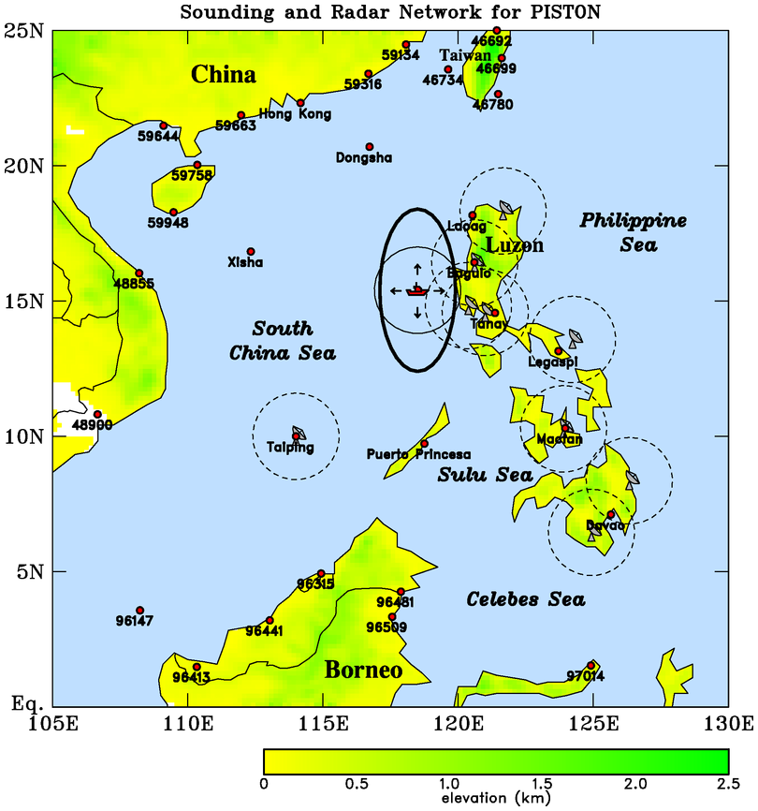
Propagation of Intra-seasonal Tropical Oscillations (PISTON II)
August-September 2019
PISTON II Science Objectives
R/V Thompson
How does the BSISO influence the atmosphere (convection, diurnal cycle) and upper ocean over SCS
How does convection/diurnal cycle/upper ocean feed back to influence the BSISO

Slide 32

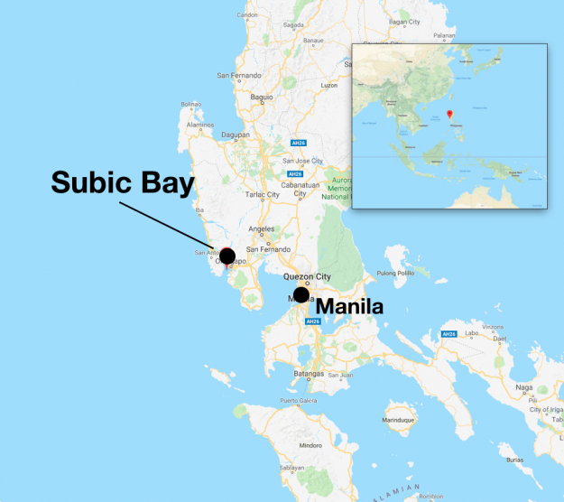
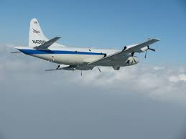
The Cloud, Aerosol and Monsoon Processes Philippines Experiment (CAMP²Ex)
(mid July-August 2019)
An investigation of the coupling between clouds and aerosols
Aerosol and cloud microphysics
Cloud and Aerosol Radiation
Aerosol and cloud meteorology
NASA P-3

Slide 33
Field Campaigns in East Asia/SCS Area Investigating Extreme Rainfall
-TiMREX/SoWMEX
-PISTON II/CAMP2Ex
-WMONEX
-SCSMEX
-SCMREX
-TAMEX
-PISTON
-PRECIP
1980
1990
2000
2010
2020

Slide 34
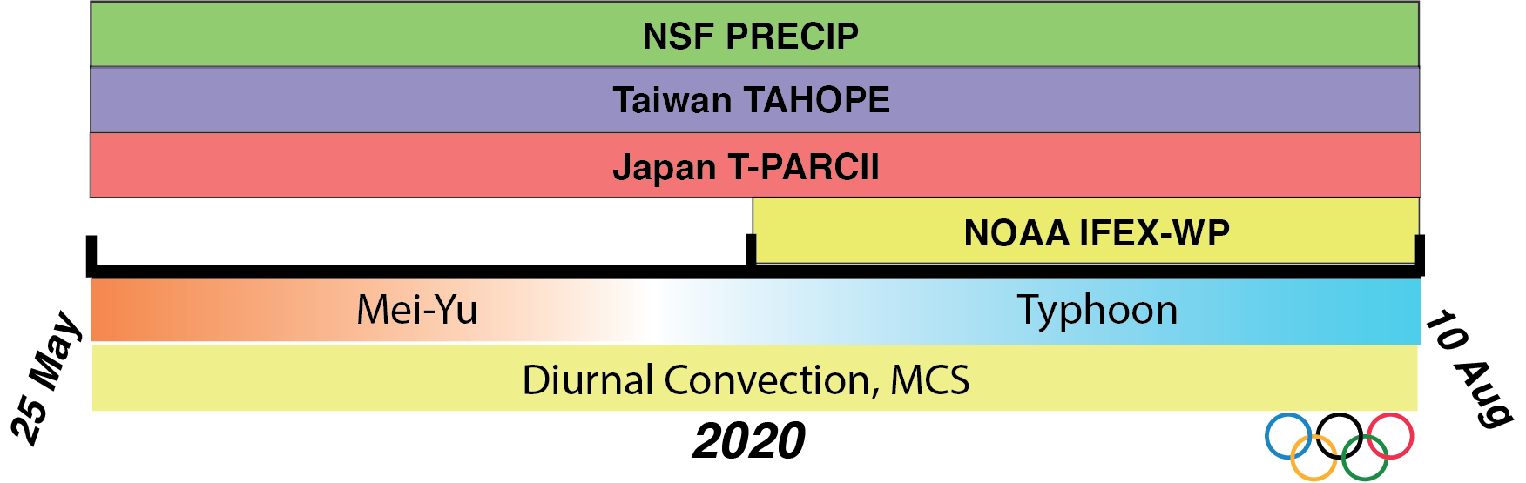

Prediction of Rainfall Extremes
Campaign In the Pacific (PRECIP) 2020
(Courtesy Michael Bell)
Lead PIs: Michael M. Bell
and Kristen L. Rasmussen
PRECIP has been proposed for 25 May – 10 August 2020 to observe Meiyu front, MCSs, diurnal convection, and typhoons near Taiwan
Part of an international effort to study extreme rainfall
  Taiwan TAHOPE (Taiwan-Area Heavy rain Observation and Prediction)
  Japan T-PARCII (Tropical cyclones-Pacific Asian Research Campaign for Improvement of Intensity estimations/forecasts)
  NOAA IFEX-WP (Intensity Forecast Experiment –Western Pacific)

Slide 35
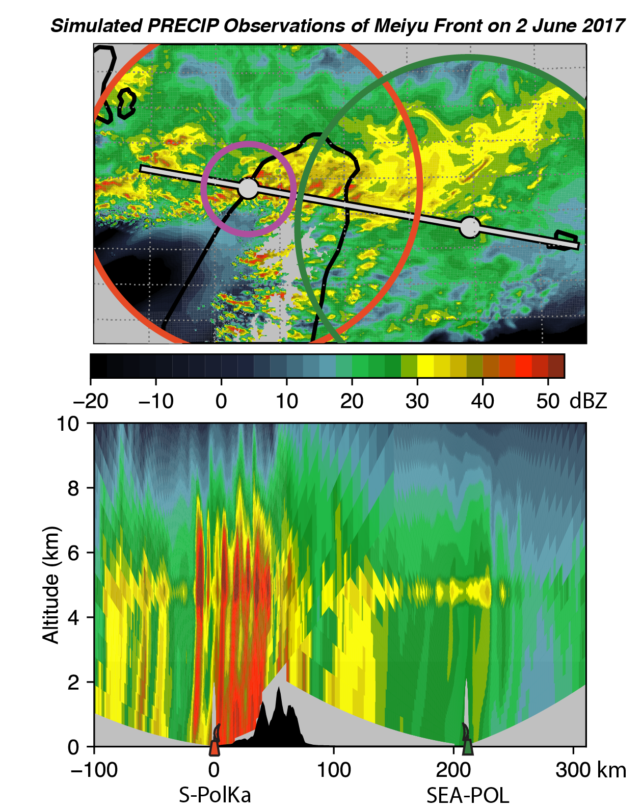
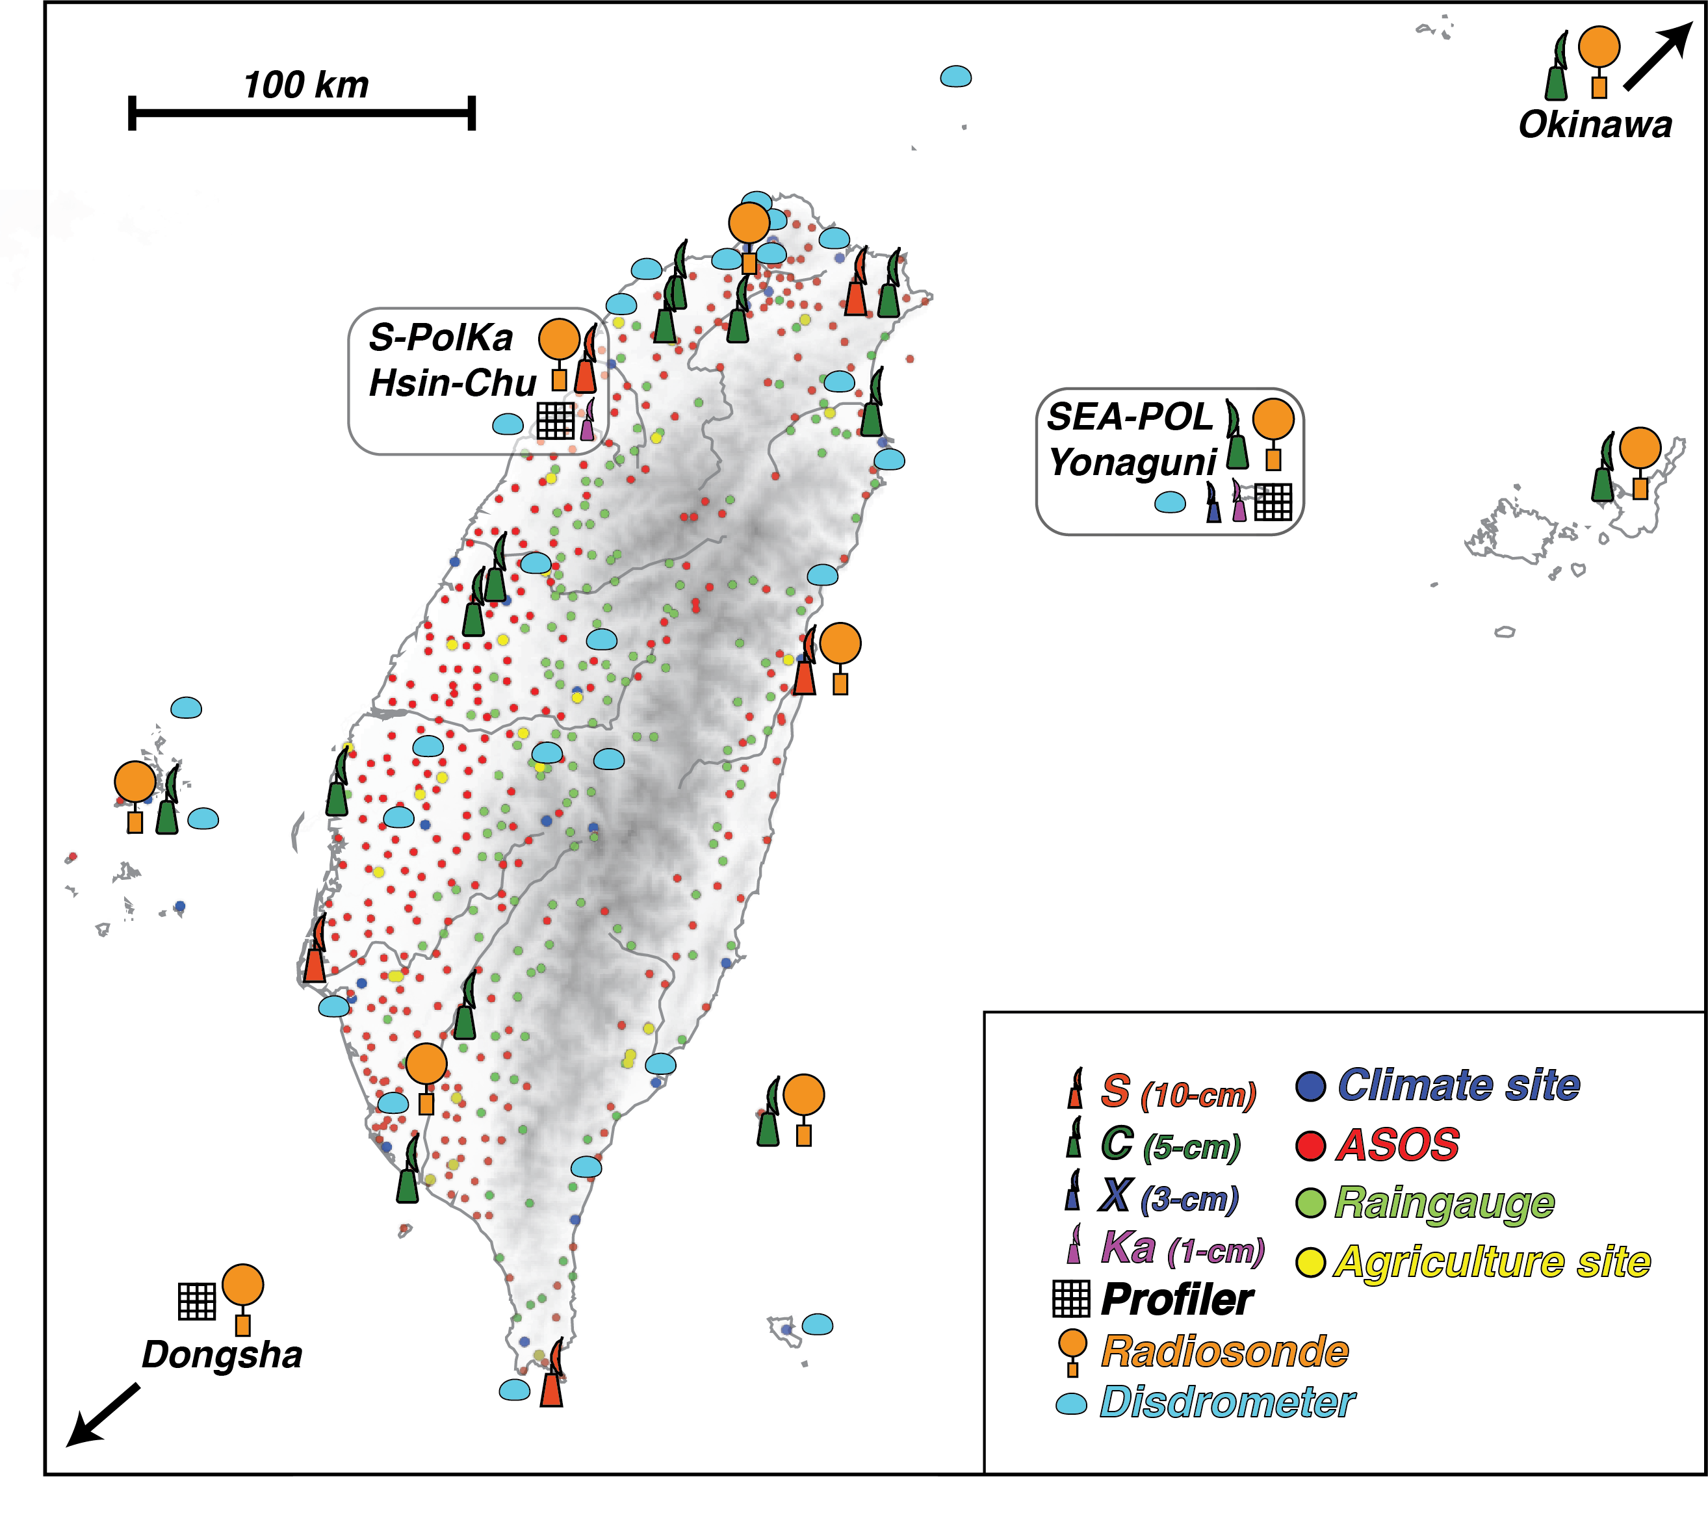
(Courtesy Michael Bell)
+ NOAA P-3 request

Slide 36
Summary
Forty years of international field campaigns over SCS: investigations of mechanisms contributing to heavy rainfall
Observing systems: increasing sophistication and density, yielding new insights into a wide range of phenomena
Extreme rainfall mechanisms, new understanding: Meiyu front, MCS organization, orographic effects, MCVs, cold pools, diurnal cycle, SST effects
Campaign results: have contributed to improvements in modeling, physical parameterizations, prediction

Slide 37
General Scientific Findings
Moist, unstable conditions and weak CIN over northern SCS during onset of summer monsoon: convection is readily initiated by Meiyu front, cold pools, orography, flow blocking, SST gradients
Extreme rainfall is often a result of a complex interplay among above processes
MCS organization leading to extreme rainfall: many aspects similar to that observed elsewhere in the tropics and in the midlatitudes
Scientific planning for campaigns: unexpected findings are the norm

Slide 38
END

