Slide 1
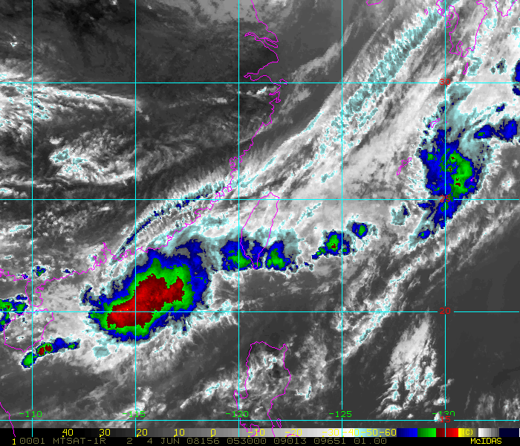
Convection over the Northern South China Sea during the Onset of the East Asian Summer Monsoon
Richard H. Johnson
Colorado State University
Acknowledgments: Paul Ciesielski, Mike Toy, Andy Newman, Tom Keenan, Steve Aves
Symposium on Ocean and Atmosphere Research in the South China Sea Taipei, 19-20 January 2016
4 June 2008

Slide 2
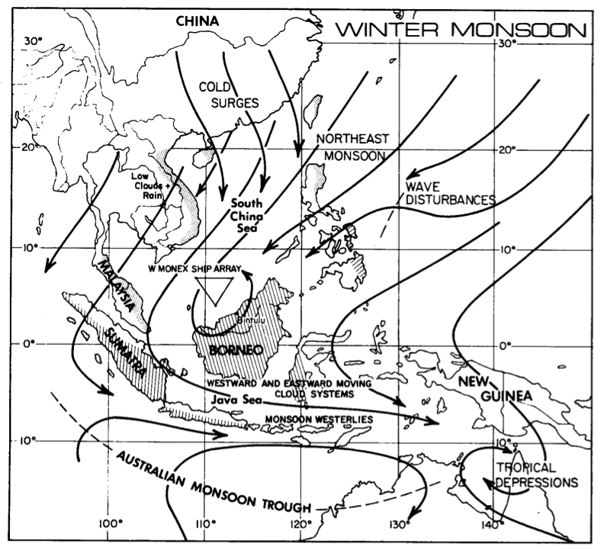
Cool water develops along China coastline during winter monsoon
COOL
COOL
(Johnson and Houze 1987)

Slide 3
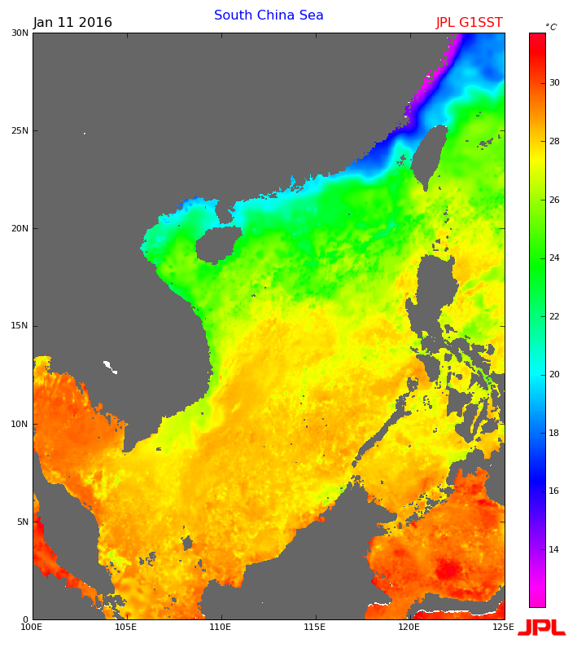
11 January 2016

Slide 4
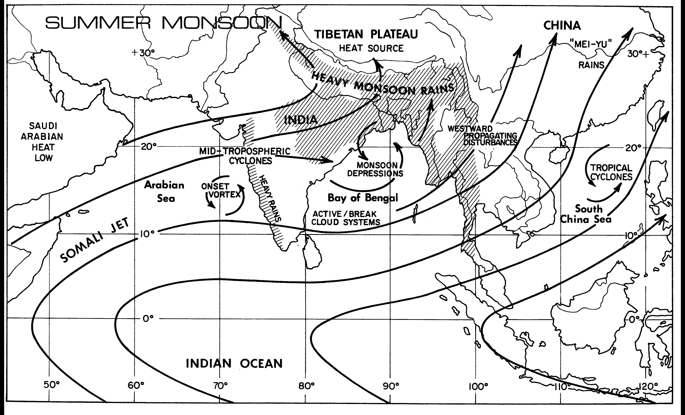
JUNE-JULY
Summer monsoon onset over northern SCS in mid-May: Northeasterlies switch to southwesterlies; warm air flow over cool water
(Johnson and Houze 1987)

Slide 5
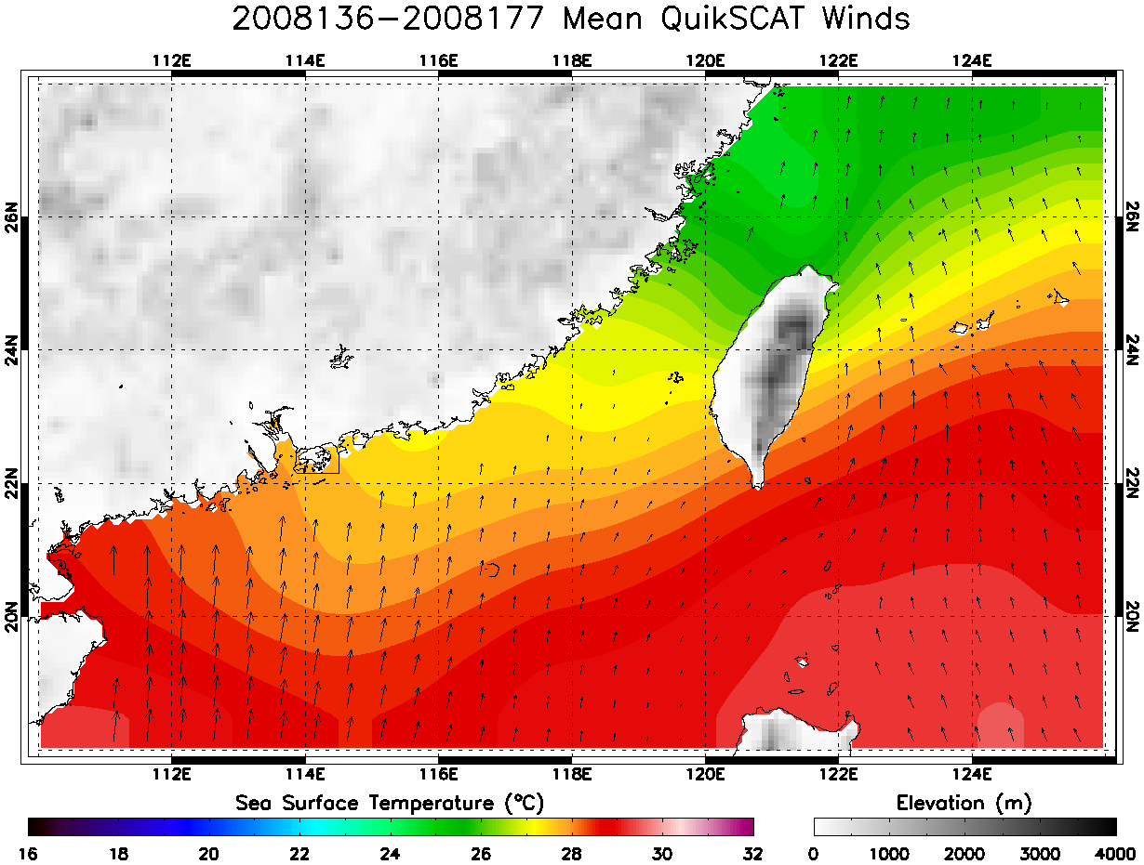
MAY-JUNE 2008
SOP-mean QuikSCAT winds: warm air flowing over cool water

Slide 6
Flow Across Meandering SST Front
Stable conditions prevent vertical mixing of higher momentum from aloft
Adapted from Chelton and Xie (2010)

Slide 7
MAY-JUNE 2008
SOP-mean QuikSCAT winds: warm air flowing over cool water

Slide 8
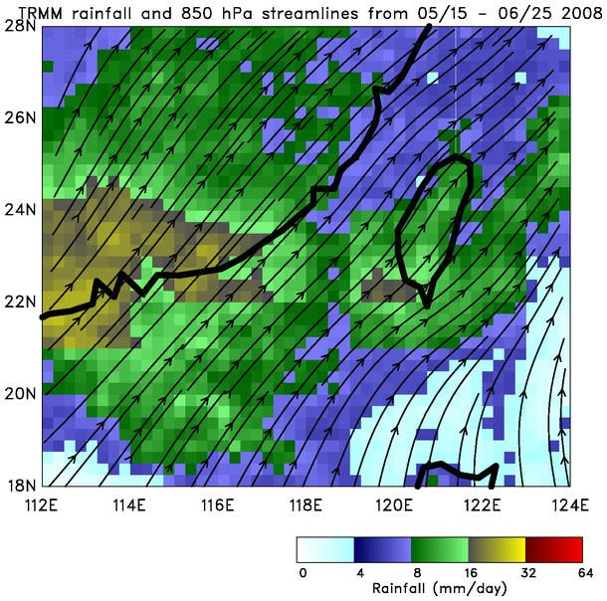

Slide 9
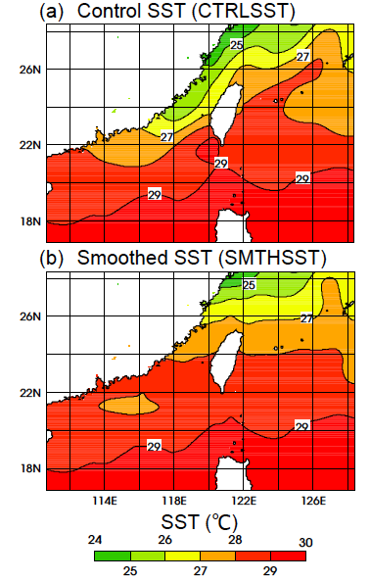
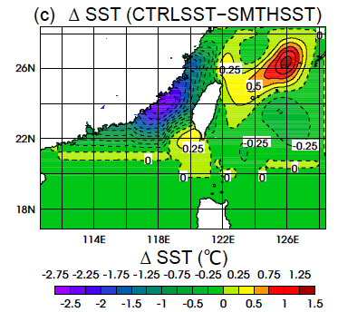
Control and Smoothed SST WRF-ARW Runs
SMTHSST adjusted to match GFS SST values at boundaries
SST gradient in SMTHSST not unlike some years (later)
13-18 JUNE
2008
(Toy and Johnson 2014, JAS)

Slide 10
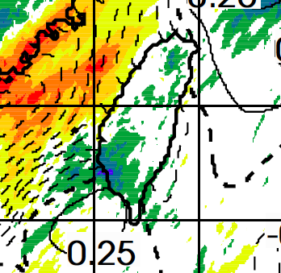
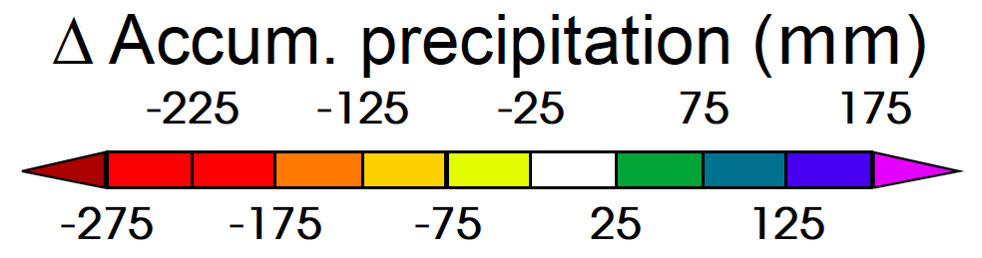
Rainfall Enhancement Due to SST Gradient
⬥ Difference in rainfall between smoothed and 2008 observed SST gradient around Taiwan
⬥ Parts of southwest Taiwan receive ~30% (125 mm) more rainfall over five-day period (13-18 June)
* Taipei
* Hualien
* Tainan
* Kaohsiung
Toy and Johnson (2014, JAS)

Slide 11
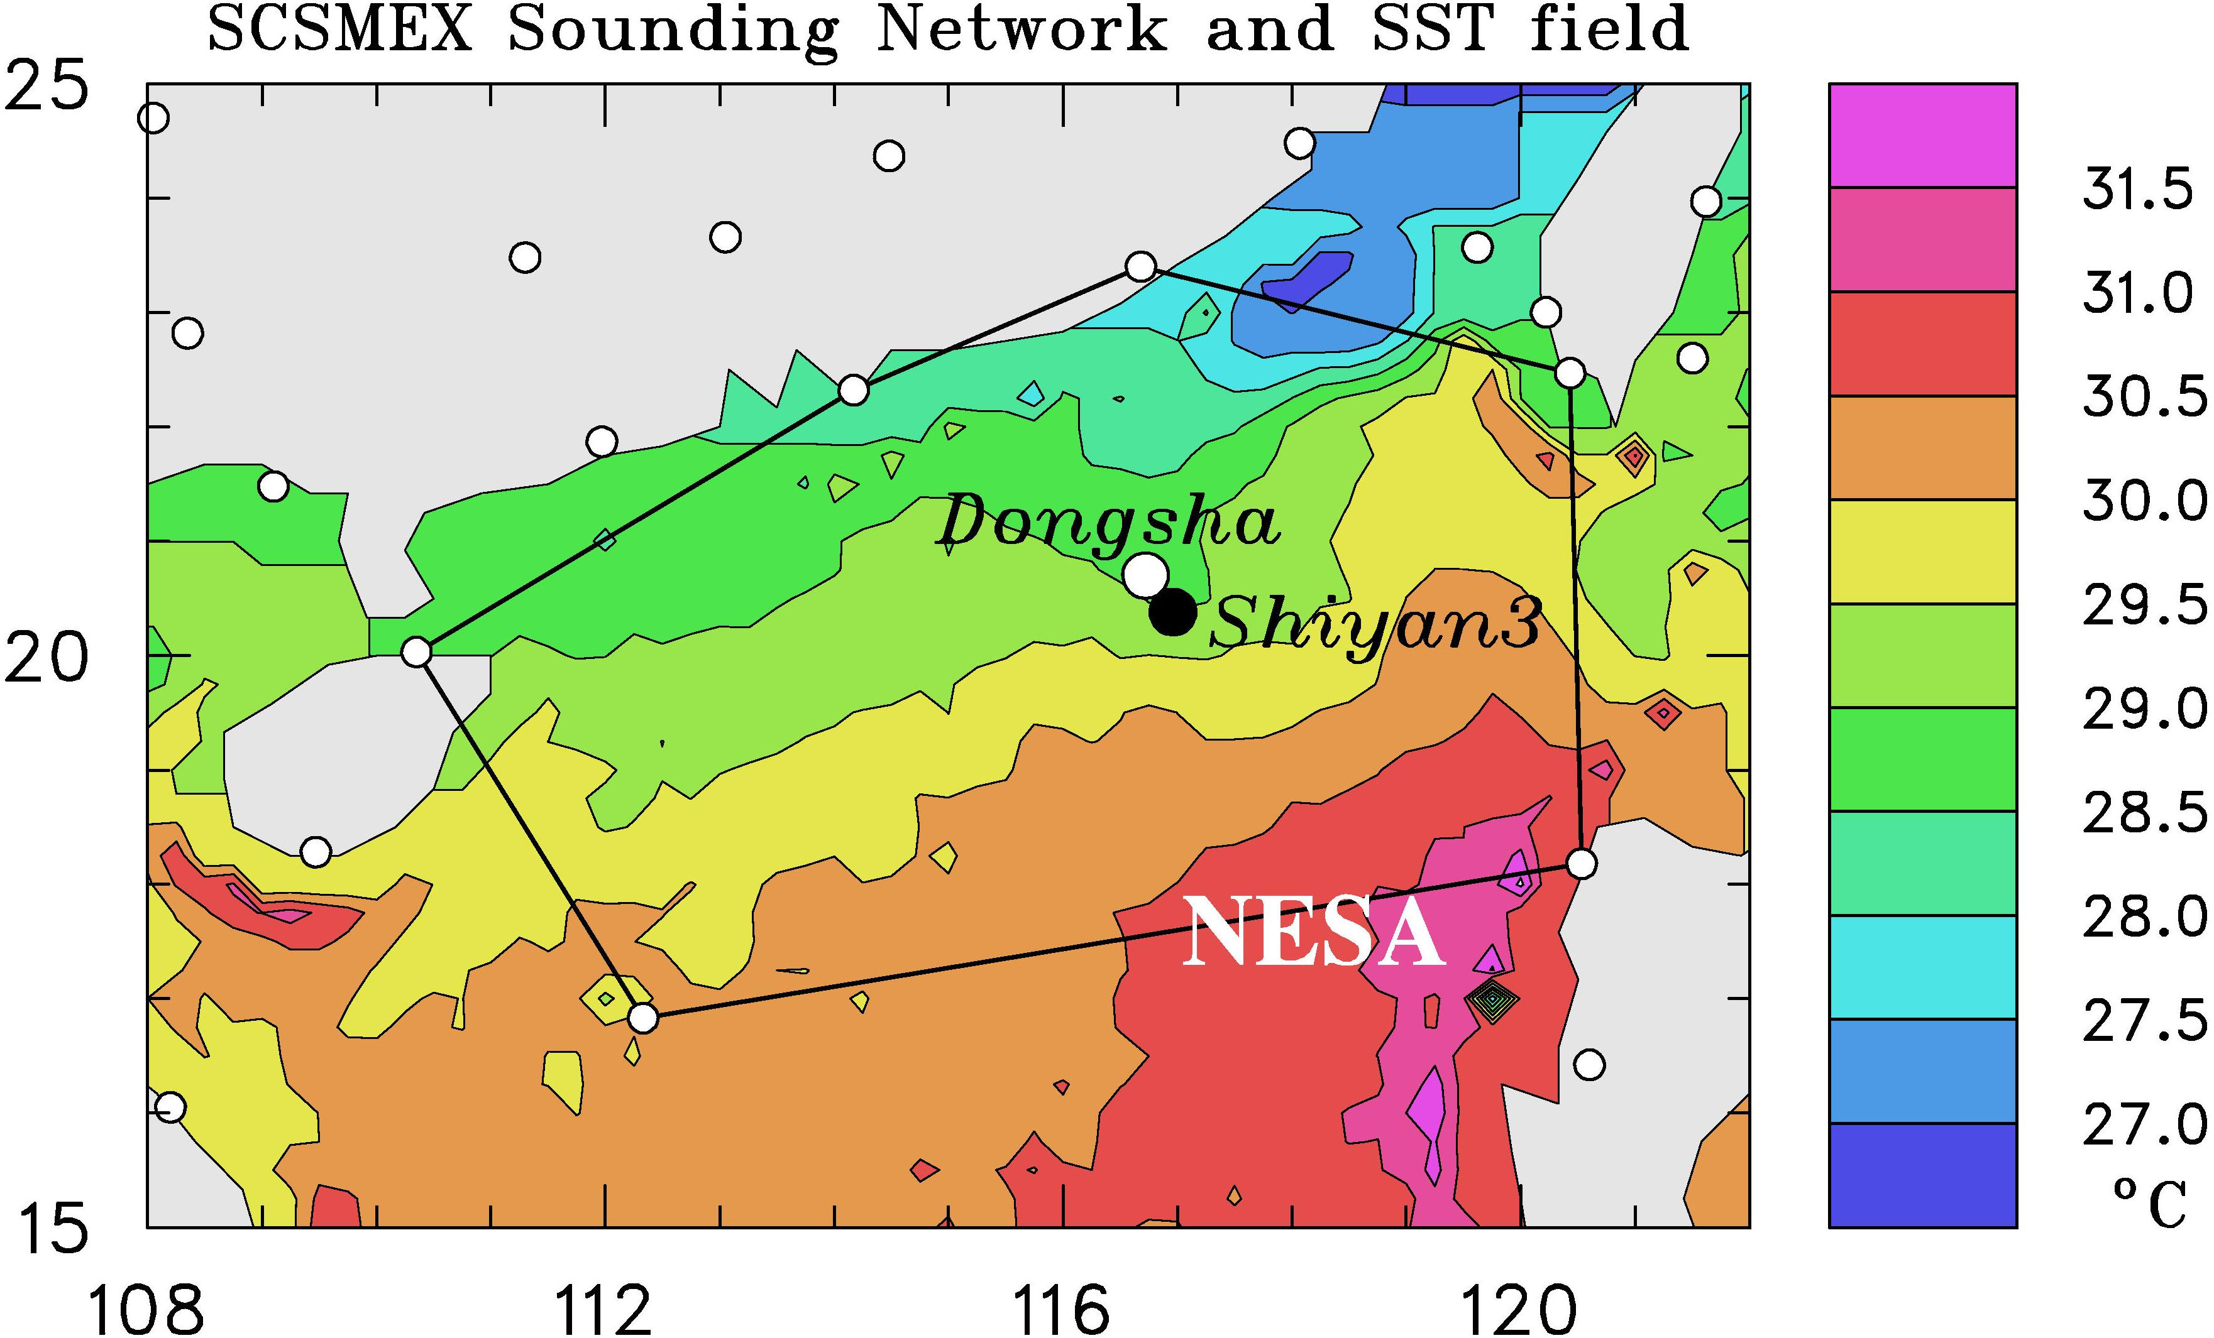
South China Sea Monsoon Experiment (SCSMEX) – May-June 1998
(May-June 1998)
Study of key processes associated with onset and evolution of SE Asia summer monsoon
BMRC C-POL RADAR

Slide 12
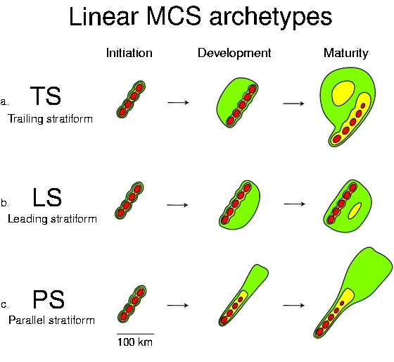
Mesoscale Convective System (MCS) Organization
(based on 88 linear, warm-sector MCSs, May 1996,97)
(58%)
6-8 h
(19%)
4-6 h
(19%)
4-6 h
(Parker and Johnson 2000)

Slide 13
South China Sea Monsoon Experiment (SCSMEX) – May-June 1998
(May-June 1998)
Study of key processes associated with onset and evolution of SE Asia summer monsoon
BMRC C-POL RADAR

Slide 14
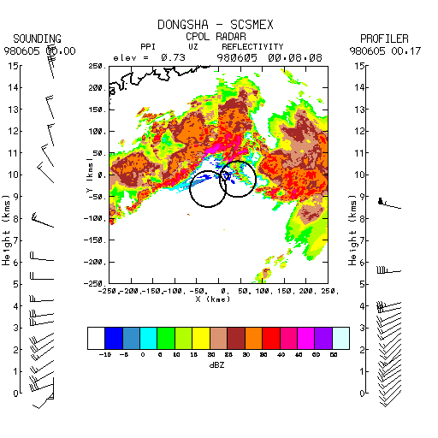
SCSMEX 6-hour Radar Animation
5 June 1998
TS
●
Hong Kong
BMRC C-POL RADAR

Slide 15
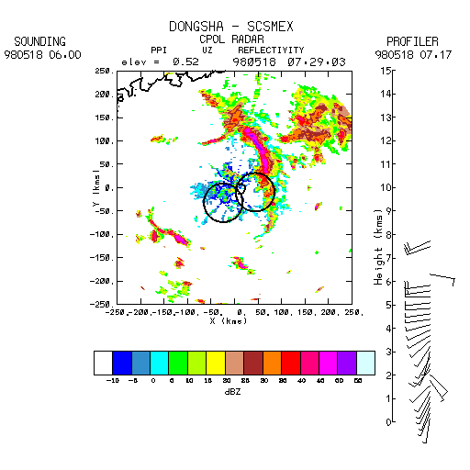
SCSMEX 4-hour Radar Animation
18 May 1998
LS
●
Hong Kong

Slide 16
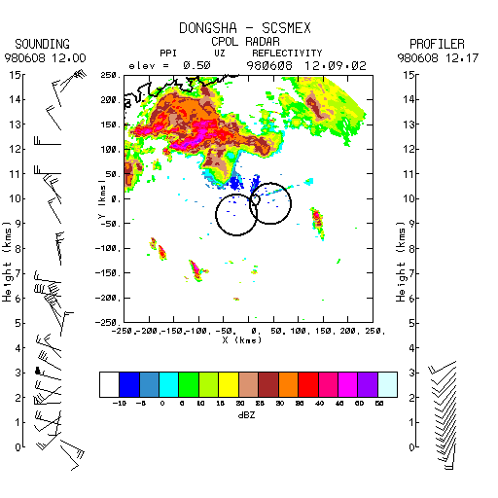
SCSMEX 6-hour Radar Animation
8 June 1998
PS
●
Hong Kong

Slide 17
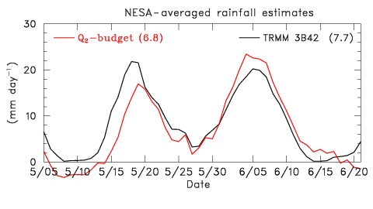
STUDY PERIOD
May-June 1998

Slide 18
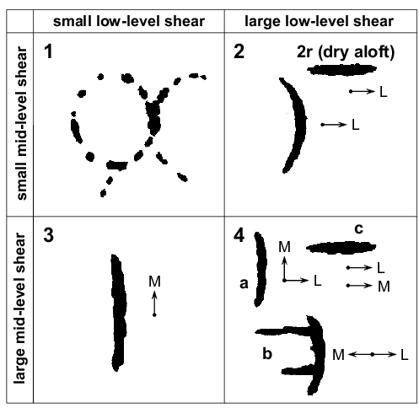
SCSMEX Modes of Organization as a Function of the Low and Midlevel Wind Shears
Low-level shear layer: 1000-800 hPa
Mid-level shear layer: 800-400 hPa
(>4 m s⁻¹)
CONVECTION ON OUTFLOW BOUNDARIES
SHEAR-// BAND
SHEAR-⊥ BAND
SHEAR-// BAND
SHEAR-// BAND
Classification based on LeMone et al. (1998)
(>5 m s⁻¹)
SHEAR-⊥ BANDS
(Johnson et al. 2005, MWR)

Slide 19
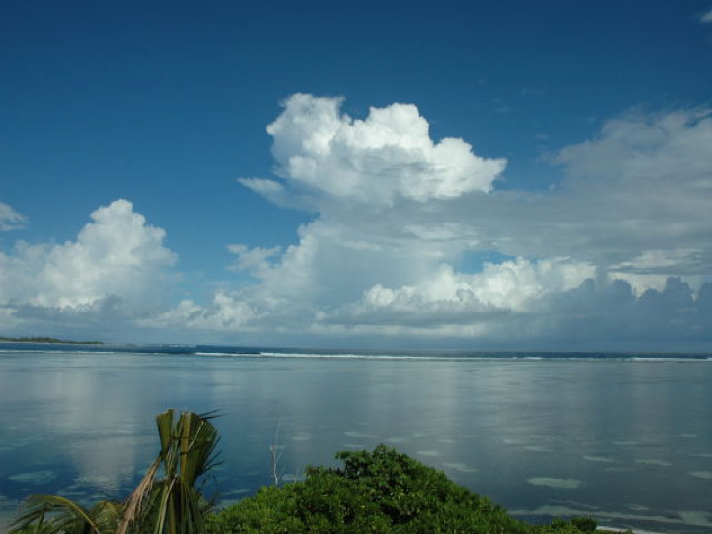
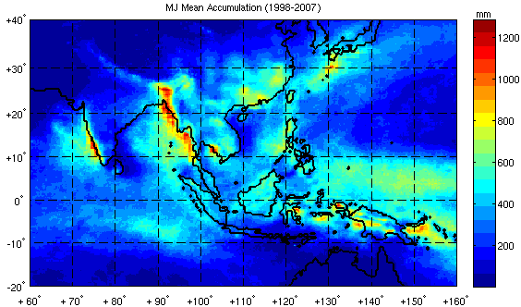
Ten-year (1998-2007) May-June Mean Rainfall
(Johnson 2011)
Heavy rainfall in coastal regions
TRMM 3B42

Slide 20
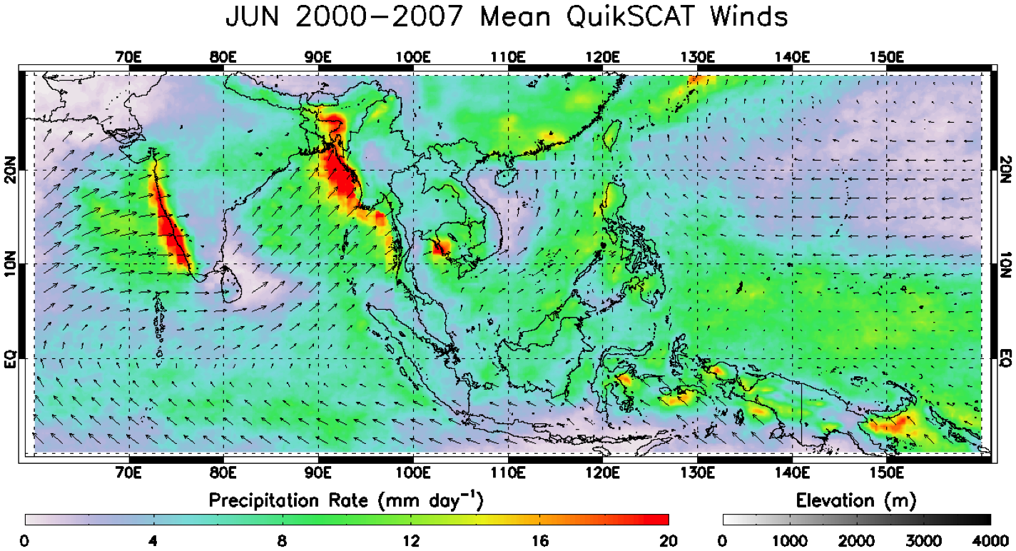
Heaviest rainfall occurs along shore – Western Ghats and Myanmar: suggests topography and diurnal cycle likely important (sea/land, mountain/valley breezes)

Slide 21
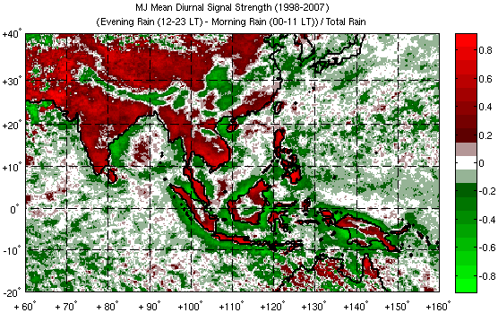
Normalized Amplitude, Mean Diurnal Cycle of May-June Rainfall (1998-2007)
(Johnson 2011)
Morning maxima: base of Himalayas, lee of Tibetan Plateau, interior Borneo
Afternoon/evening rainfall maxima over enclosed ocean basins
Morning rainfall maxima along coastlines

Slide 22
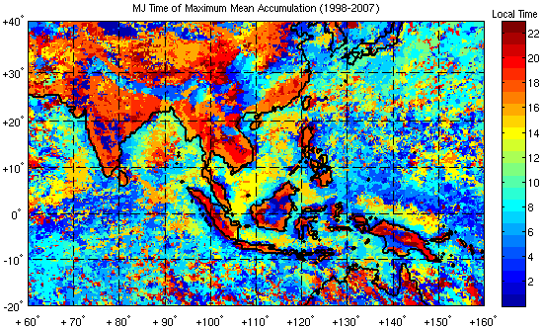
Time of Maximum May-June Rainfall (1998-2007)
Diurnally migrating or propagating convective features
~15 m s⁻¹
~10-15 m s⁻¹
~10 m s⁻¹
~13 m s⁻¹
~10-15 m s⁻¹
Morning rainfall maxima

Slide 23
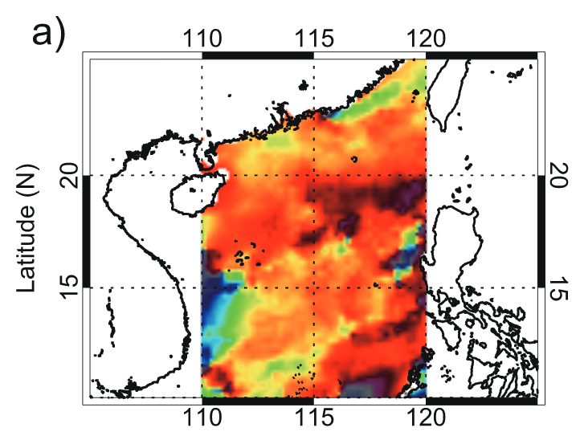
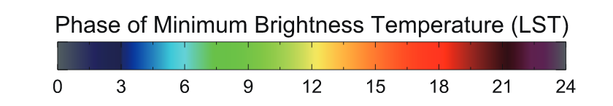
May-June 1998
(Aves and Johnson 2008)
Morning precipitation, moves southward

Slide 24
Evening
LLJ
Sea breeze
S
South China Sea
N
Some convection may move inland in the early morning and dissipate (Chan and Ng 1993)
LLJ
Land breeze or other effects?
S
South China Sea
N
Morning
(Johnson 2006)

Slide 25
Summary
SST pattern at summer monsoon onset leads to low-level convergence, precipitation over northern SCS; affects Mei-yu rainfall over Taiwan
Three organizational modes of MCSs observed during 1998 SCSMEX: TS, LS, and PS
Organization of convective systems determined by low and midlevel wind shear
Prominent diurnal cycle of convection over northern SCS during summer monsoon onset characterized by southward propagation of MCSs from mainland China

Slide 26
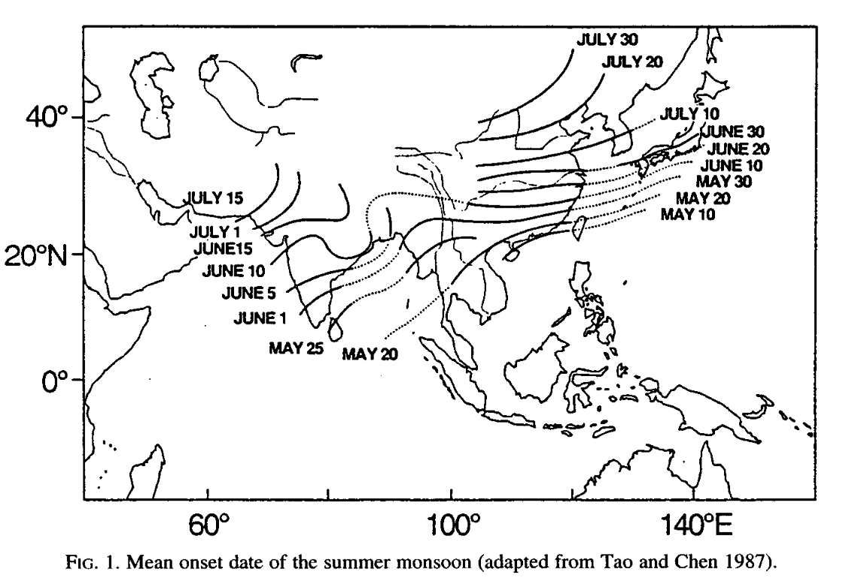

Summer Monsoon Onset Dates (Tao and Chen 1987)

Slide 27
Diurnal Oscillations of 850-hPa Wind (May-June 1998)
V
6
08
02
Hong Kong
08
LLJ: Inertial Oscillation
14
4
02
14
20
Dongsha Island
20
2
|v|₈₅₀ at 0200 L at Hong Kong
2
4
6
U (m s⁻¹)

