Slide 1
The East Asian Monsoon: Four Decades of Field Campaigns
Richard H. Johnson
Colorado State University
Collaborators: Steve Aves, James Bresch, C.-P. Chang, Paul Ciesielski, Ding Yihui, Caitlin Fine, Bob Houze, Ben Jou, Adam Kankiewicz, Tom Keenan, James Kossin, Don Kreite, Hung-Chi Kuo, Bill Lau, Yali Luo, David Priegnitz, Angela Rowe, James Ruppert, Kathy Straub, Richard Taft, Mike Toy, Stan Trier, Chung-Chieh Wang, George Young, Hungjui Yu, Jeff Zimmerman, Ed Zipser
Severe Weather and TAHOPE Planning Workshop, 14-16 October 2019, Taipei, TAIWAN

Slide 2
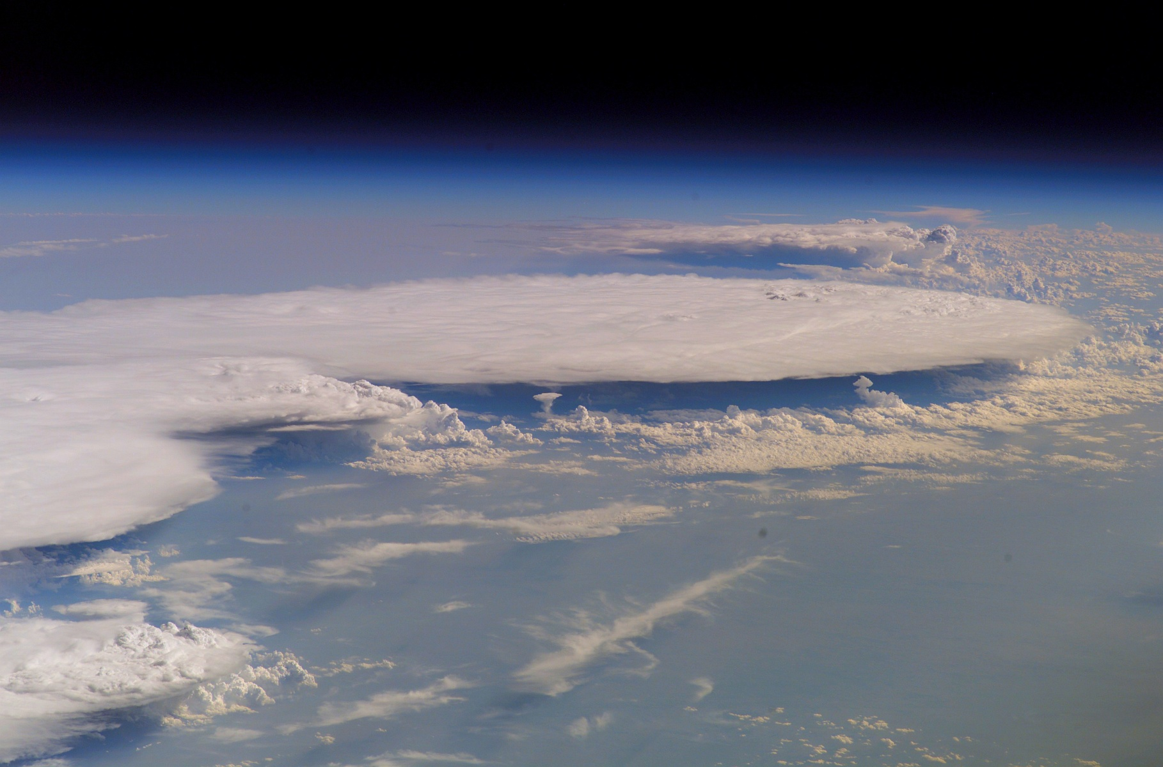
Field Campaigns in South China Sea Area Investigating Monsoon Weather and Climate
-TiMREX/SoWMEX (2008)
-SCMREX (2013-2018)
-WMONEX (1978)
-SCSMEX (1998)
-PISTON II/CAMP²EX
-PRECIP/TAHOPE/ T-PARCII
-TAMEX (1987)
-PISTON (2018)
1980
1990
2000
2010
2020

Slide 3
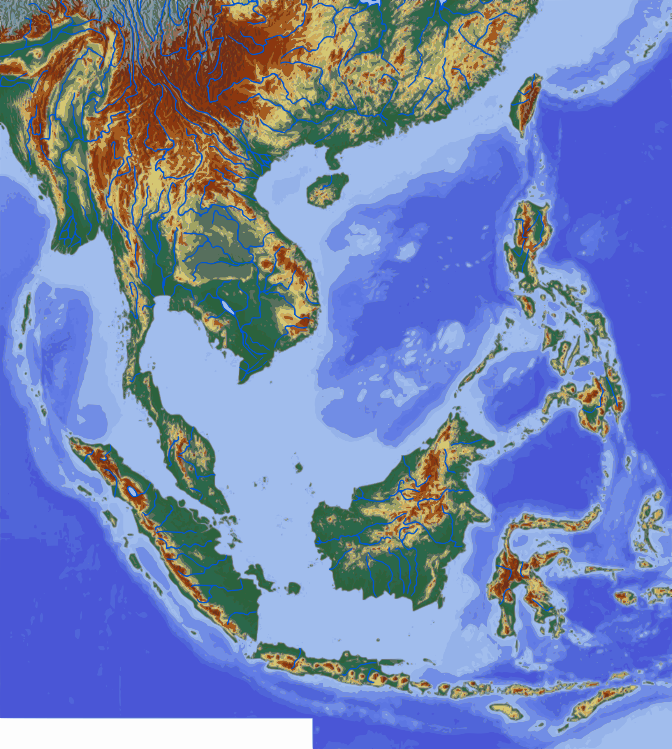
SCS area past field campaigns…
TAMEX
SCMREX
1987
2013-2018
SoWMEX/TiMREX
2008
PISTON II/ CAMP²EX
PISTON
SCSMEX
2018
2019
1998
PISTON
2018
WMONEX
1978

Slide 4
Field Campaigns in SCS Area Investigating Monsoon Weather and Climate
-WMONEX (1978)
1980
1990
2000
2010
2020

Slide 5

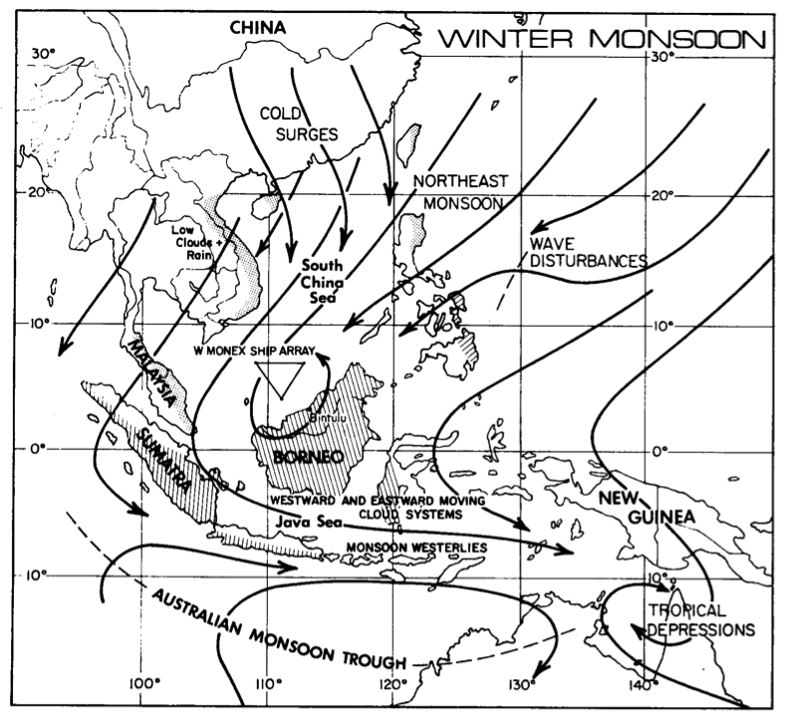
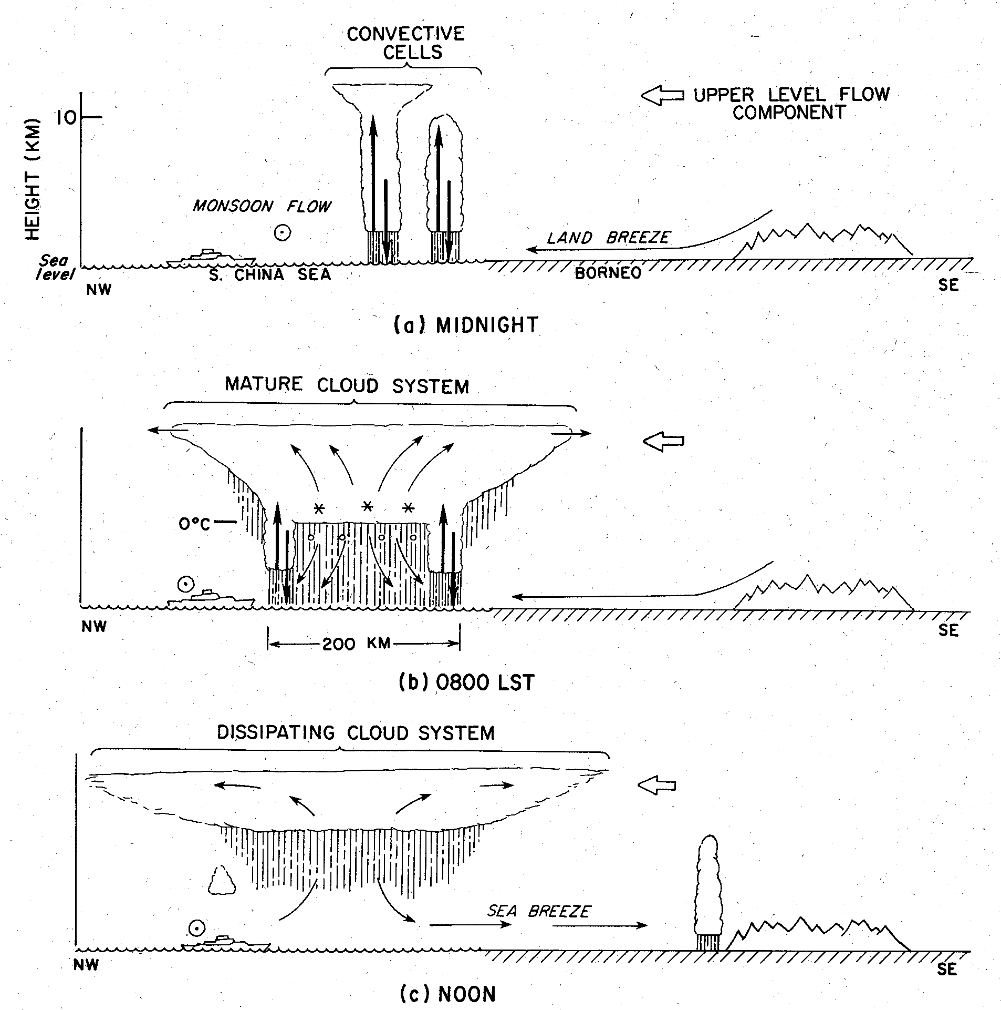
Winter MONEX
December 1978
Cold surges, Hadley/Walker circulations, interhemispheric exchanges, near-equatorial depressions, heat sources/sinks
Diurnal Cycle of Convection
Ops Center
Kuala Lumpur
MIDNIGHT
MIT radar
Houze et al. (1981)
NOAA P-3, Electra
Participating countries: Malaysia, Indonesia, Thailand, Philippines, Hong Kong, Japan, Singapore, Australia, People’s Republic of China, U.S.S.R., U.S.A.
8am
Repeatable diurnal cycle of convection developing off north coast of Borneo at night, moving offshore, and growing into expansive MCS, then decaying anvil
(Johnson and Houze 1987)
Peter Webster
NOON
Ship soundings
Notes:
Scientific objectives were mostly related to cold surges, interhemispheric exchanges, and near-equatorial depression in southern SCS. Nevertheless, a major finding had to do with near-equatorial convection and its diurnal cycle.

Slide 6
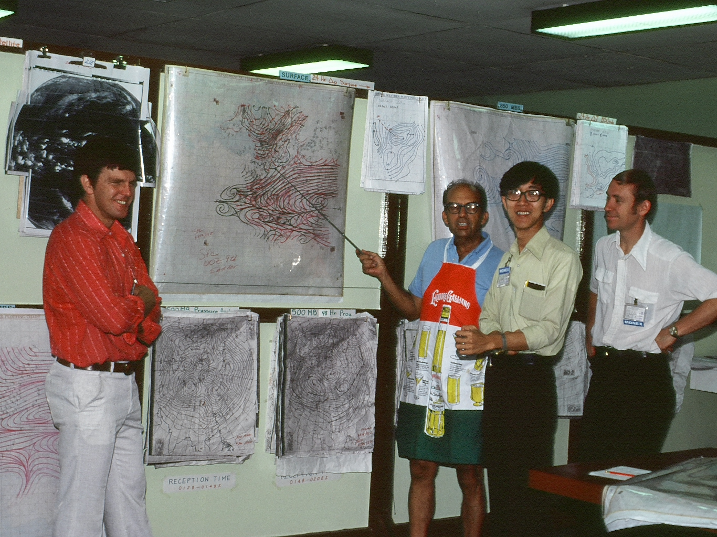
WMONEX Operations Center, Kuala Lumpur, December 1978
Webster
Chang
Sadler
Johnson
Houze

Slide 7
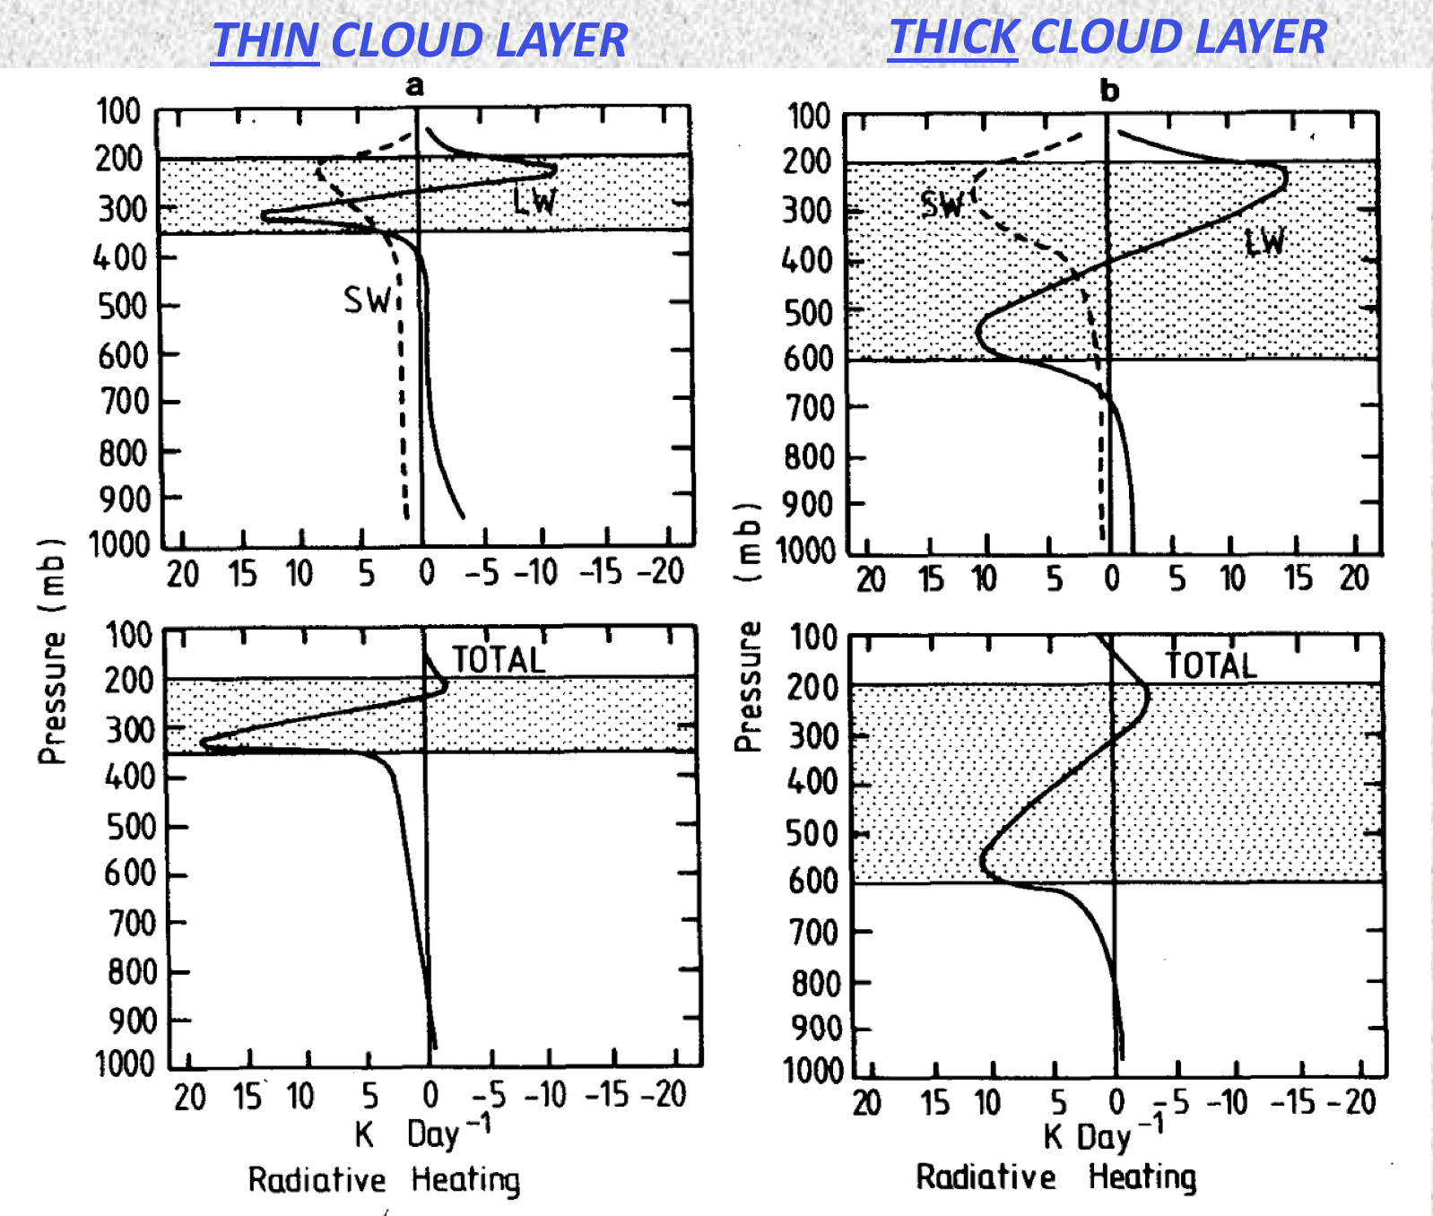
Winter MONEX
December 1978
Cold surges, Hadley/Walker circulations, interhemispheric exchanges, near-equatorial depressions, heat sources/sinks
Ops Center
Kuala Lumpur
Webster and Stephens (1980)
Participating countries: Malaysia, Indonesia, Thailand, Philippines, Hong Kong, Japan, Saudi Arabia, Singapore, Australia, People’s Republic of China, U.S.S.R., U.S.A
-
-
-
-
(Johnson and Houze 1987)
Radiative effects of thin and thick anvil clouds cannot be neglected in relation to latent heating effects
Peter Webster
Radiative Effects of Mesoscale Anvil Clouds
Notes:
Scientific objectives were mostly related to cold surges, interhemispheric exchanges, and near-equatorial depression in southern SCS. Nevertheless, a major finding had to do with near-equatorial convection and its diurnal cycle.

Slide 8
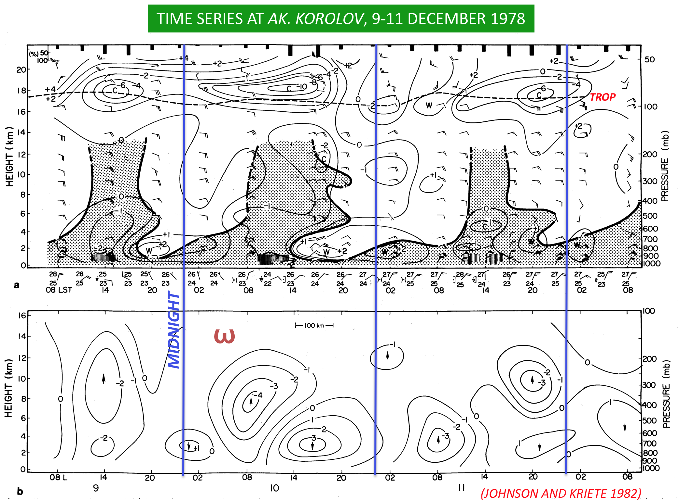
Winter MONEX
December 1978
Cold surges, Hadley/Walker circulations, interhemispheric exchanges, near-equatorial depressions, heat sources/sinks
Cool anomalies
Ops Center
Kuala Lumpur
Warm anomalies
RH>80%
Participating countries: Malaysia, Indonesia, Thailand, Philippines, Hong Kong, Japan, Saudi Arabia, Singapore, Australia, People’s Republic of China, U.S.S.R., U.S.A
(Johnson and Kriete 1982)
(Johnson and Houze 1987)
Properties of MCSs similar to those observed earlier in the tropics (e.g., Line Islands, GATE)
Peter Webster
UP
DOWN
Structure of Borneo MCSs Based on Soviet Soundings
Notes:
Scientific objectives were mostly related to cold surges, interhemispheric exchanges, and near-equatorial depression in southern SCS. Nevertheless, a major finding had to do with near-equatorial convection and its diurnal cycle.

Slide 9
Winter MONEX
December 1978
Cold surge: initial pulse – internal gravity wave moving at ~40 m/s over SCS, followed by surge “front” moving at 11 m/s (Chang et al. 1983)
Surges can lead to or strengthen Borneo vortex, enhance rainfall over Borneo, Indonesia, Malaysia (Chang and Lau 1980; Lim and Chang 1981; Lau et al. 1983; Chang et al. 2005)
(Johnson and Houze 1987)
Peter Webster
Notes:
Scientific objectives were mostly related to cold surges, interhemispheric exchanges, and near-equatorial depression in southern SCS. Nevertheless, a major finding had to do with near-equatorial convection and its diurnal cycle.

Slide 10
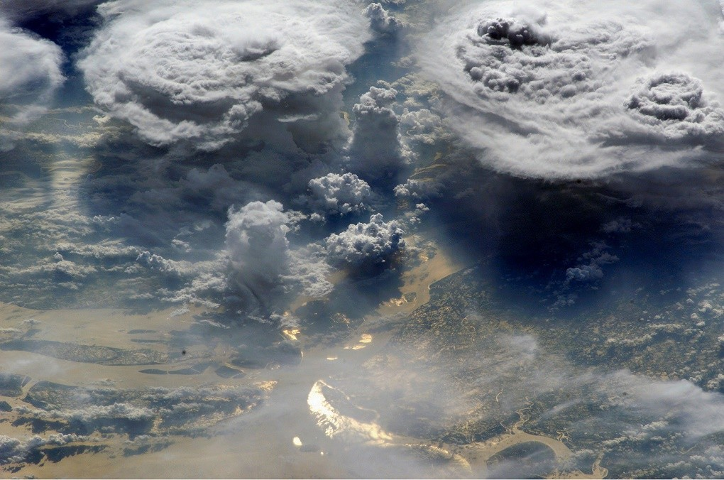
Heavy rainfall along coastal Viet Nam, eastern Philippines, eastern Malaysia, Borneo; Borneo vortex is common feature
(Johnson and Houze 1987)

Slide 11
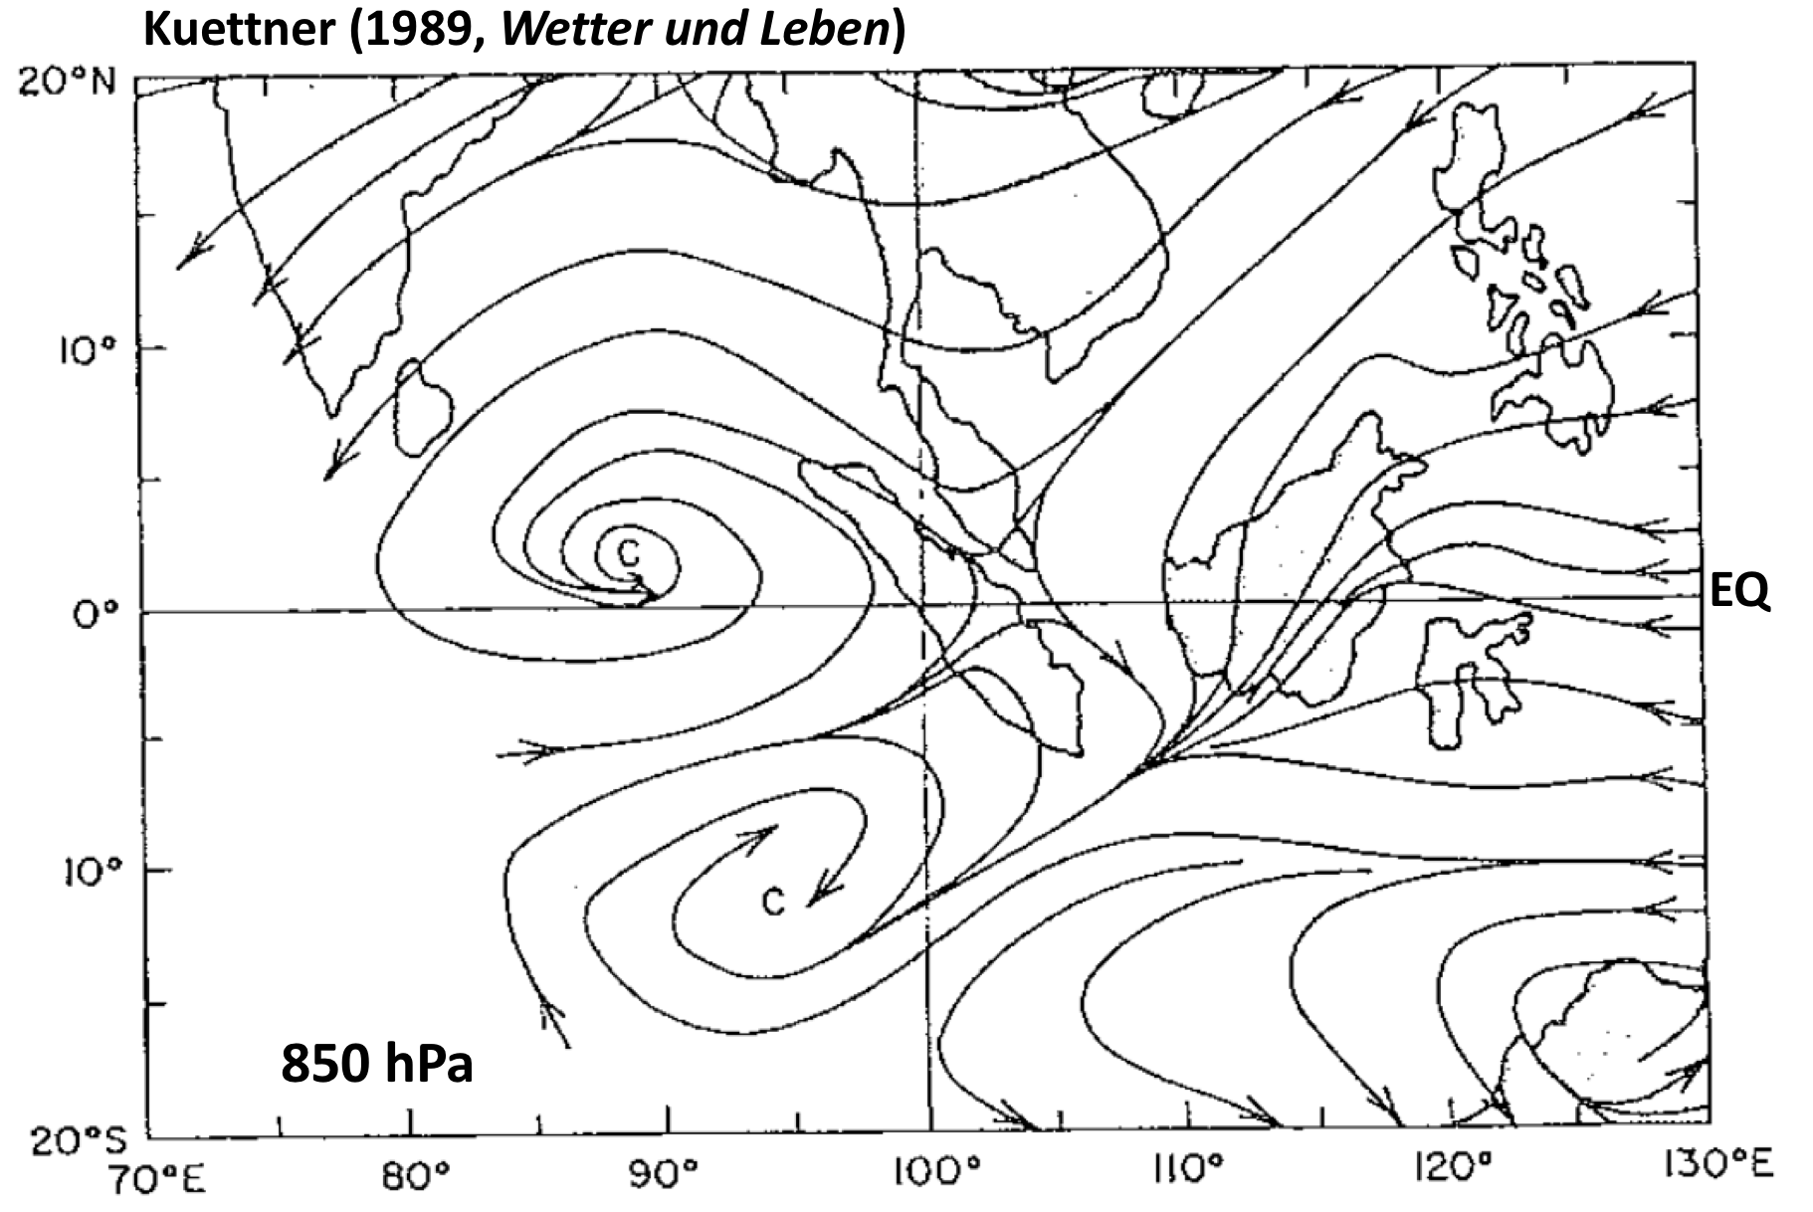
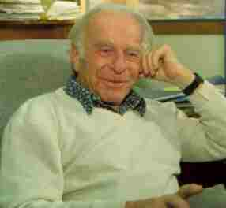
Winter MONEX
December 1978
[Kuettner and Soules 1967]
Ops Center
Kuala Lumpur
Participating countries: Malaysia, Indonesia, Thailand, Philippines, Hong Kong, Japan, Saudi Arabia, Singapore, Australia, People’s Republic of China, U.S.S.R., U.S.A
(Johnson and Houze 1987)
Project Director
Peter Webster
20 Dec 1978
P-3 Mission to Investigate “Sumatra Double Vortex”
Joach Kuettner
Notes:
Scientific objectives were mostly related to cold surges, interhemispheric exchanges, and near-equatorial depression in southern SCS. Nevertheless, a major finding had to do with near-equatorial convection and its diurnal cycle.

Slide 12
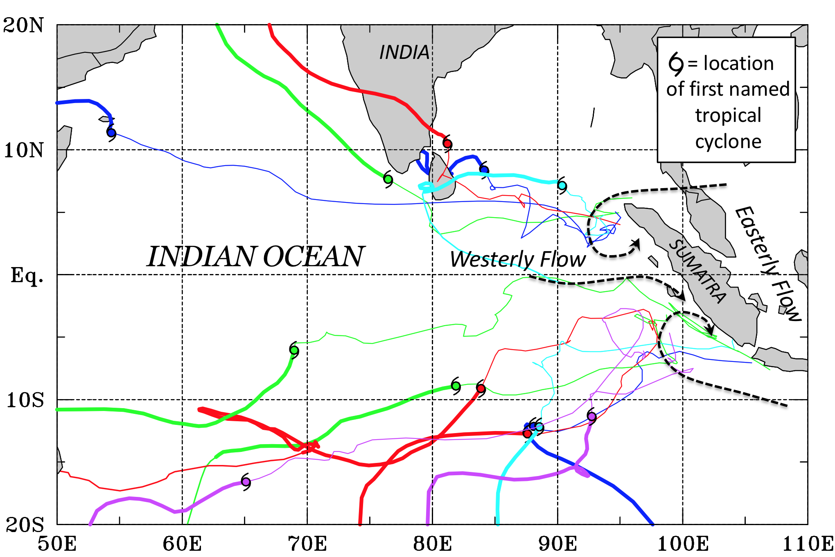
Winter MONEX
December 1978
Cold surges, Hadley/Walker circulations, interhemispheric exchanges, near-equatorial depressions, heat sources/sinks
Fine et al. (2016, MWR)
Ops Center
Kuala Lumpur
25% of TCs in 2.5 years can be traced back to Sumatra vortices!
Participating countries: Malaysia, Indonesia, Thailand, Philippines, Hong Kong, Japan, Saudi Arabia, Singapore, Australia, People’s Republic of China, U.S.S.R., U.S.A
DYNAMO, YOTC
More recent numerical simulations by Chung-Chieh Wang et al. (2019) have shown that many of the IO TCs can be traced back even farther to Western Pacific/SCS remnant TCs or the Borneo vortex, whose circulations become amplified by Sumatra topographic effects
(Johnson and Houze 1987)
Peter Webster
Kuettner’s Ideas Later investigated using DYNAMO, YOTC data
Notes:
Scientific objectives were mostly related to cold surges, interhemispheric exchanges, and near-equatorial depression in southern SCS. Nevertheless, a major finding had to do with near-equatorial convection and its diurnal cycle.

Slide 13
Field Campaigns in SCS Investigating Monsoon Weather and Climate
-WMONEX
-TAMEX
1980
1990
2000
2010
2020

Slide 14
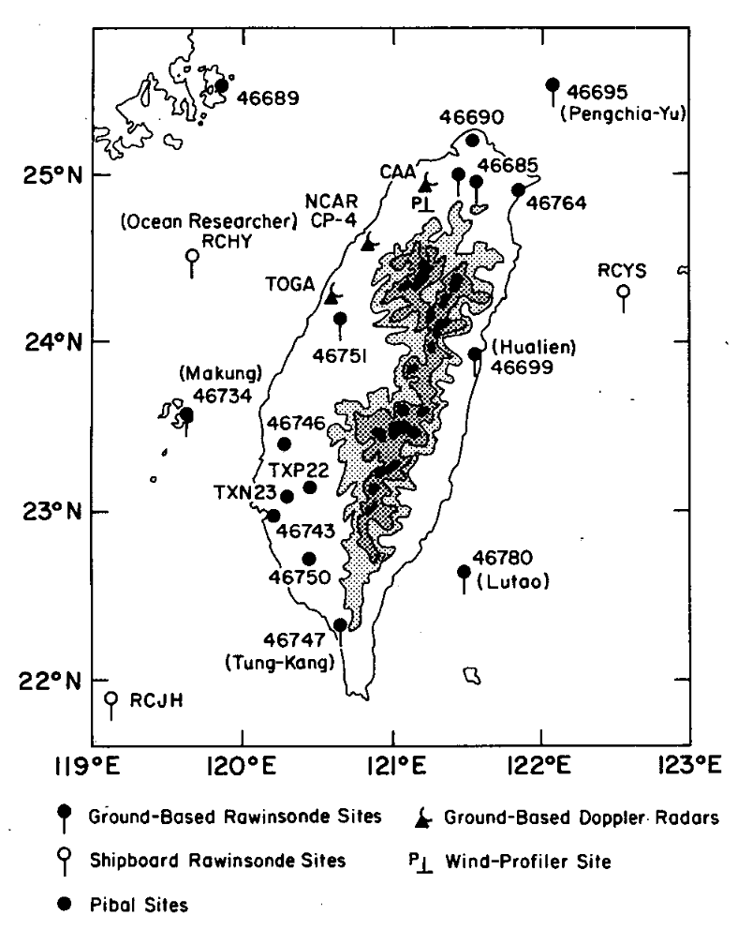
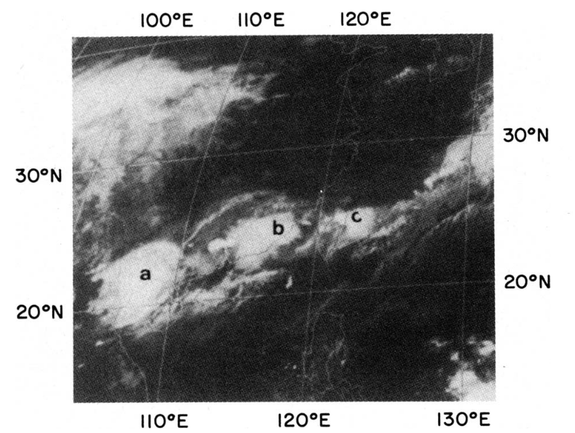
The Taiwan Area Mesoscale Experiment (TAMEX, May-June 1987)
Major 1981 flood in northern Taiwan motivated TAMEX
Taiwan-USA
Study of heavy rainfall
  Meiyu front
  Mesoscale convective systems
  Orographic effects
  Local circulations
00Z 28 May 1981
Chi and Chen (1988)
(Trier et al. 1997)
Doppler radars, soundings, surface stations, NOAA P-3 aircraft

Slide 15
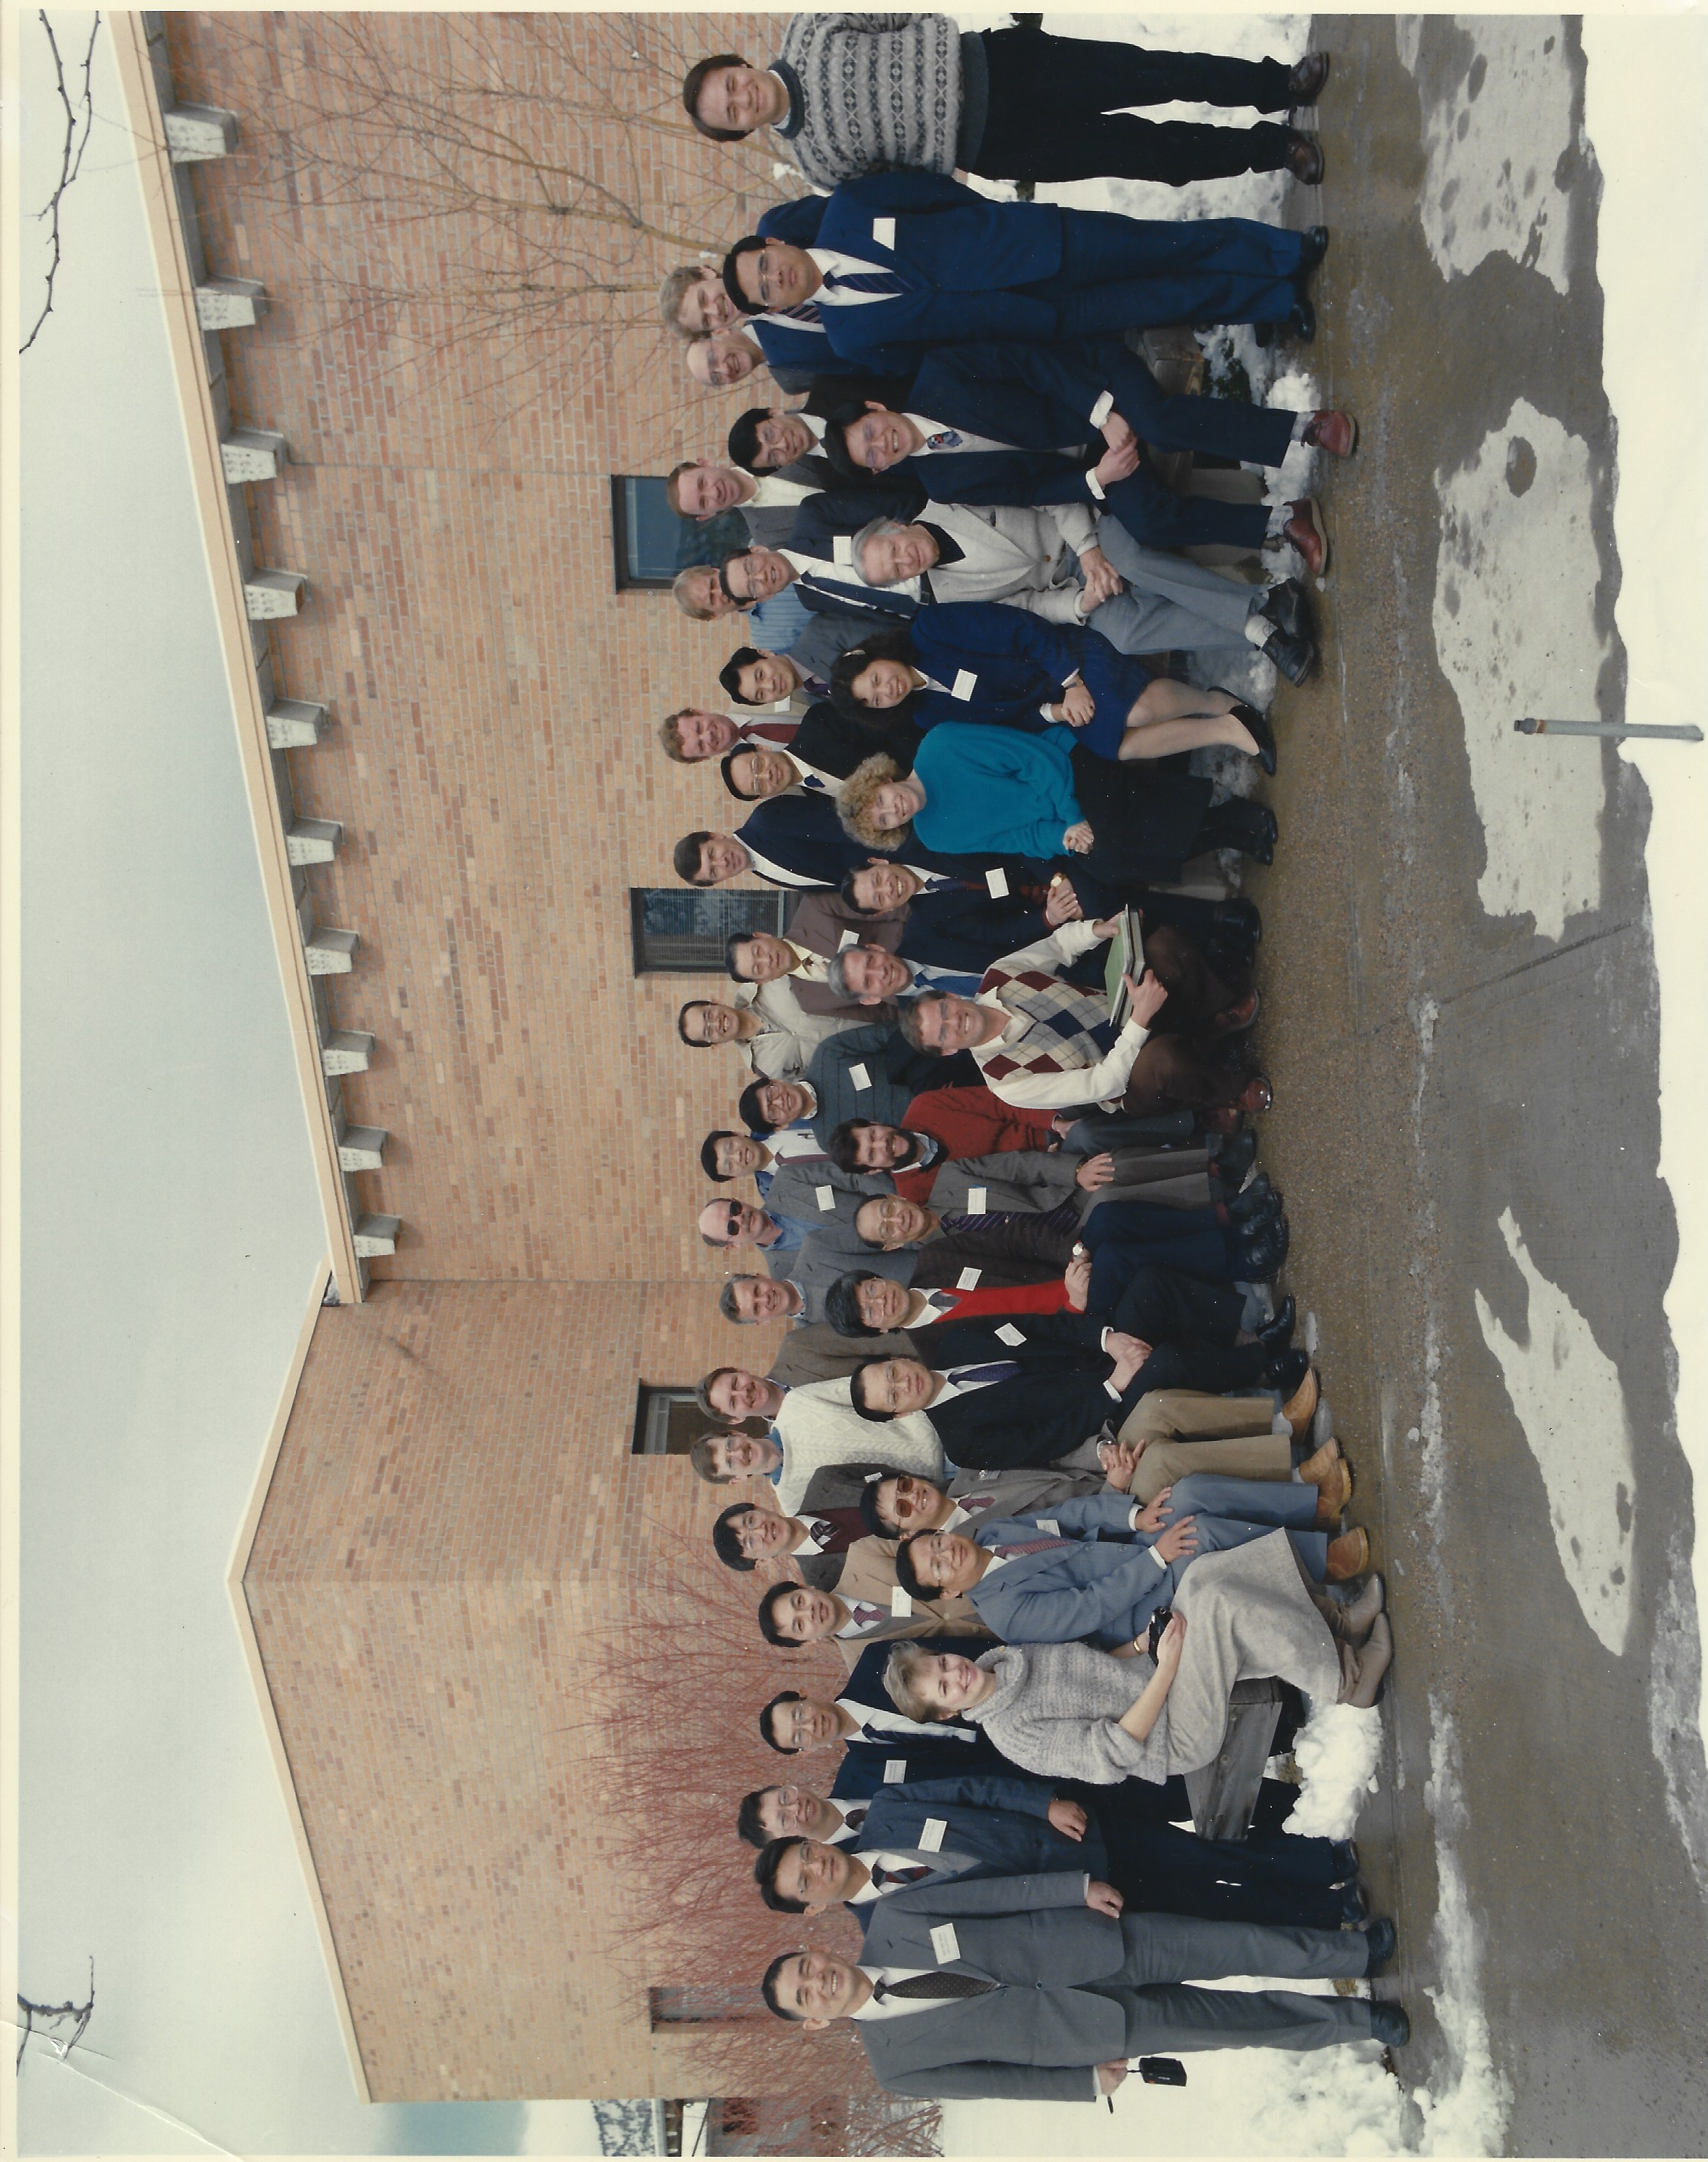
The Taiwan Area Mesoscale Experiment (TAMEX, May-June 1987)
Study of heavy rainfall associated with
  Meiyu front
  Mesoscale convective systems
  Orographic effects
  Local circulations
Taiwan-USA
TAMEX Planning Meeting, Boulder 1986

Slide 16
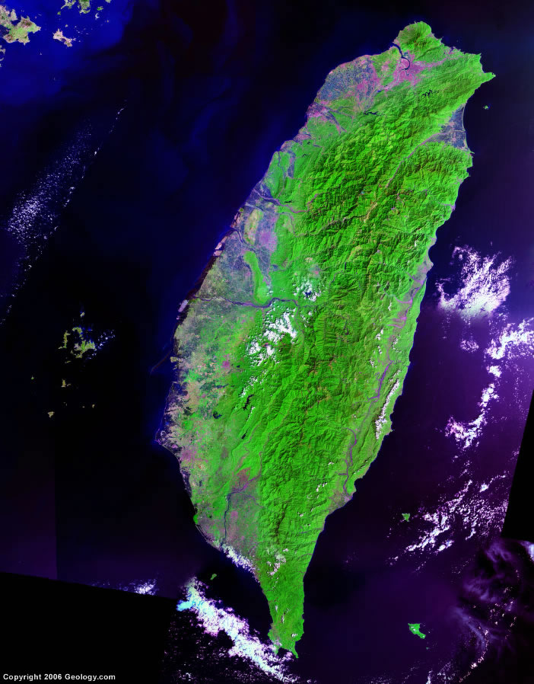

“Meiyu front”
TAMEX observations of convection (Chen et al. 1989; Trier et al. 1990; Ray et al. 1991; Lin et al. 1992; Chen and Chou 1993; Chen and Li 1995; Li et al. 1997; others)
Weather radars
“Meiyu front”: shallow (~1-2 km deep); T contrast ~5 C near N. Taiwan
Rainbands aligned along front, convection on warm side
Low-level jet in advance of front, assists convective development
Topography aids low-level convergence and convection
Back-building contributes to heavy rainfall

Slide 17
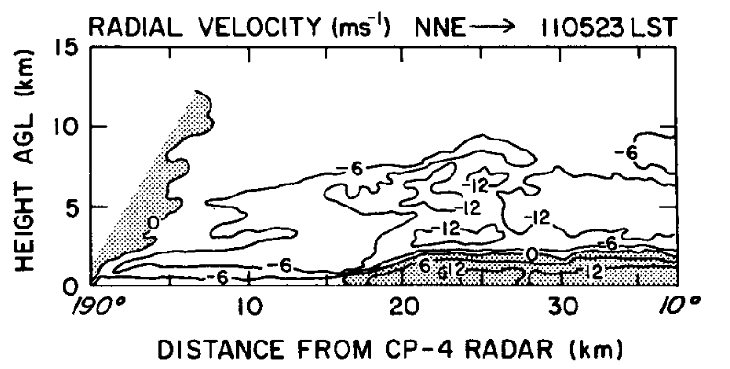
TAMEX Radar observations along “Meiyu” front (Trier et al. 1990; Lin et al. 1990, 1992; Wang et al. 1990; Chen and Chou 1993; Chen and Li 1995; Li et al. 1997; others)
CP-4
(Trier et al. 1997)
Shallow front

Slide 18
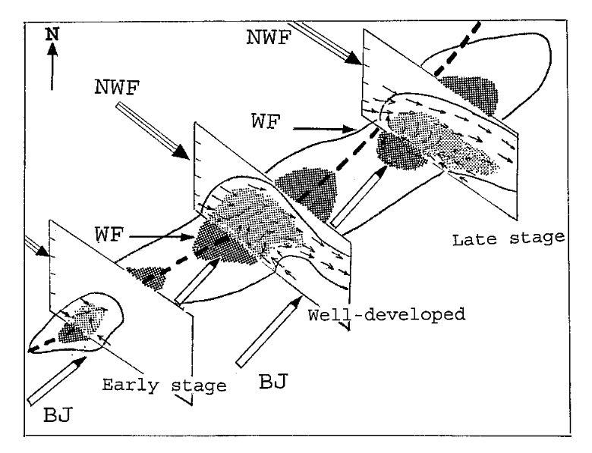
TAMEX Radar observations of convection along “Meiyu” front (Trier et al. 1990; Lin et al. 1990, 1992; Wang et al. 1990; Chen and Chou 1993; Chen and Li 1995; Li et al. 1997; others)
Back-building convection along Mei-Yu front
(Li, Chen and Lee 1997)

Slide 19

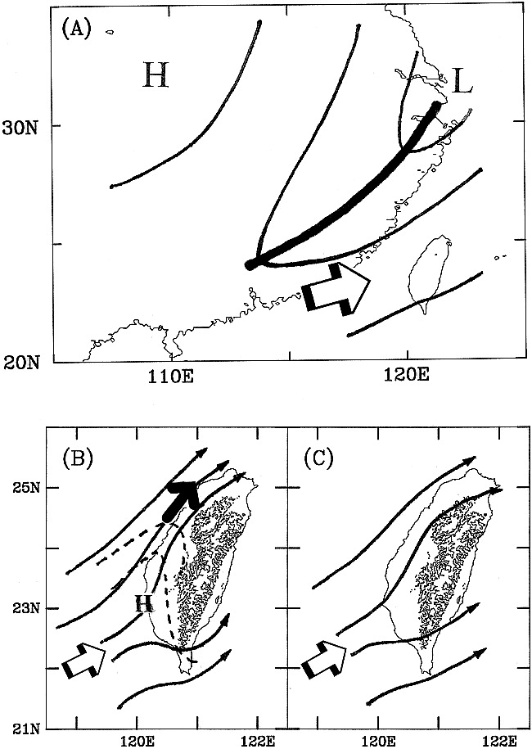

Barrier jets frequently associated with heavy rainfall; orographic effects (Chen et al. 1991; Akaeda et al. 1995; Chen and Chen 1995; Chen et al. 1994; Chen et al. 1997; Li and Chen 1998)
(Li and Chen 1998)

Slide 20
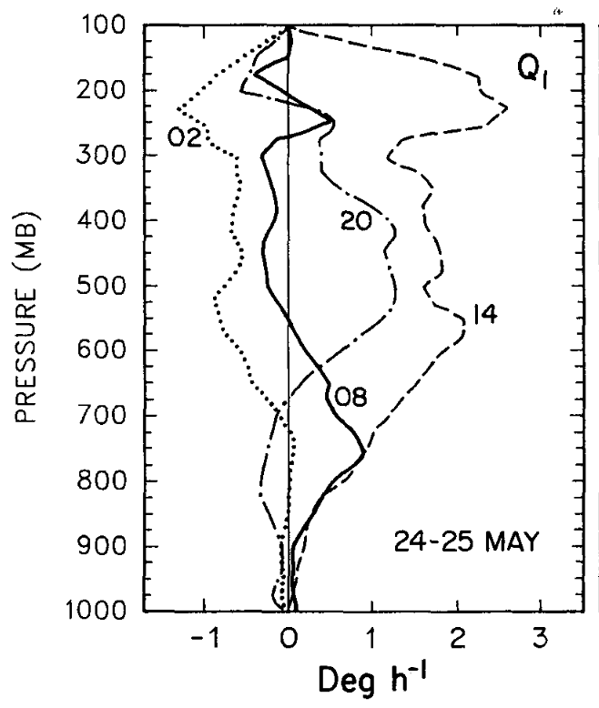
Diurnal cycle of convection over Taiwan (Johnson and Bresch 1991; Yeh and Chen 1998)
APPARENT HEAT SOURCE
Afternoon: deep convection
L
Afternoon sea breeze
Evening: stratiform precipitation
UNDISTURBED DAY
(Johnson and Bresch 1991)

Slide 21
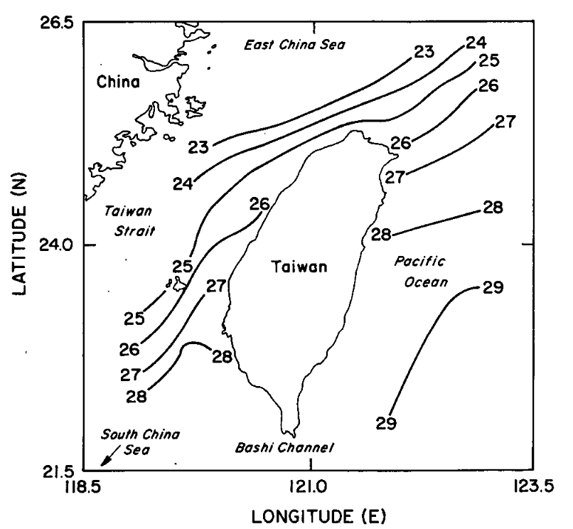
Air mass modification by strong SST gradient in northern SCS during Meiyu season (Trier et al. 1990)
Surface fluxes moderate the T gradient across front as it moves southward along west coast
COOL
WARM
Trier et al. (1990)

Slide 22
Field Campaigns in SCS Investigating Monsoon Weather and Climate
-WMONEX
-SCSMEX
-TAMEX
1980
1990
2000
2010
2020

Slide 23
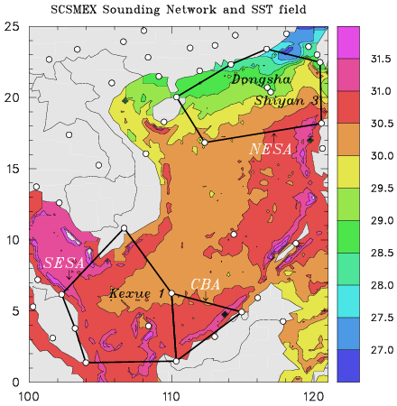
South China Sea Monsoon Experiment (SCSMEX) – May-June 1998
Study of key processes associated with onset and evolution of SE Asia summer monsoon
People’s Republic of China, Taiwan, U.S.A., Australia, Hong Kong, Philippines
(SCSMEX review: Lau et al. 2000, BAMS)

Slide 24
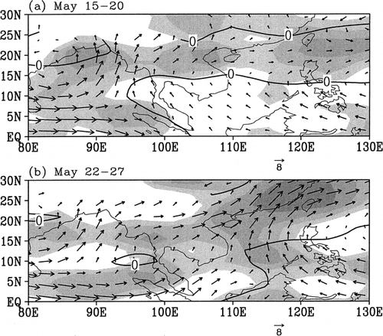
Evolution of Flow during SCS Monsoon Onset
850 hPa wind, OLR
Onset of monsoon first occurs over northern BOB
Then transitions to northern SCS
1998 SCSMEX
(Liu et al. 2002, MWR)
(Ding and Liu 2001; Liu et al. 2002)

Slide 25
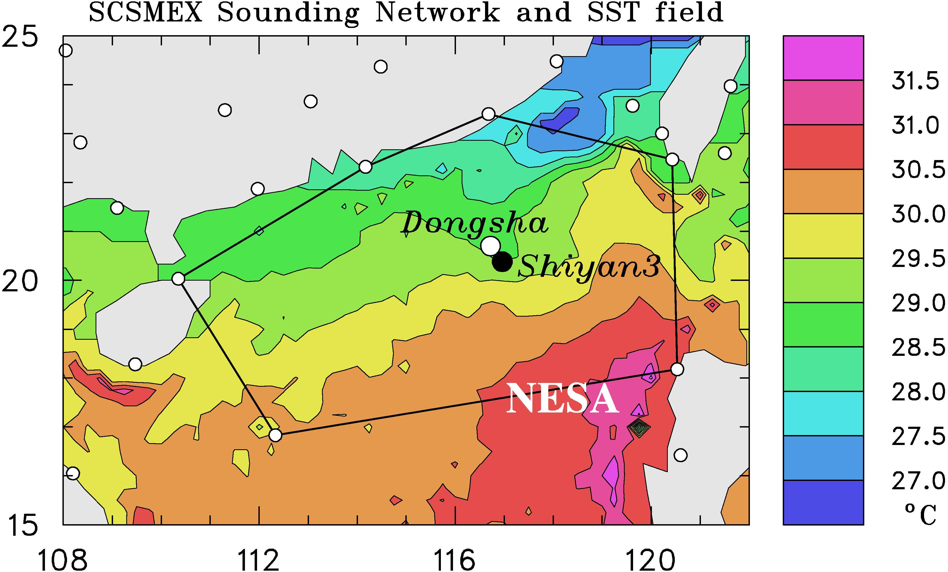
South China Sea Monsoon Experiment (SCSMEX) – May-June 1998
(May-June 1998)
BMRC C-POL RADAR
TOGA RADAR

Slide 26
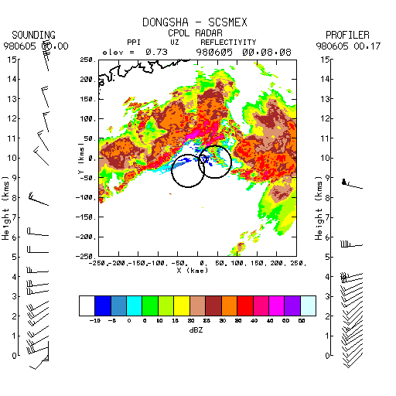
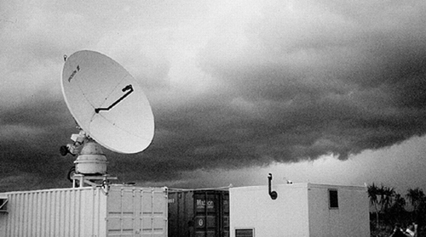
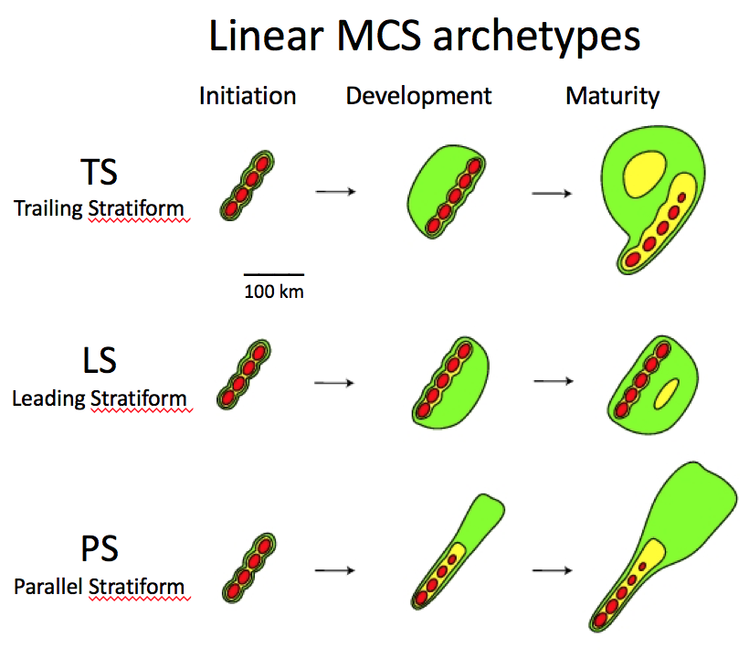
SCSMEX 6-hour Radar Animation
5 June 1998
Trailing
Stratiform
●
Hong Kong
BMRC C-POL Radar
BMRC C-POL RADAR
(Parker and Johnson 2000)
(Johnson, Aves, Ciesielski, Keenan 2005)

Slide 27
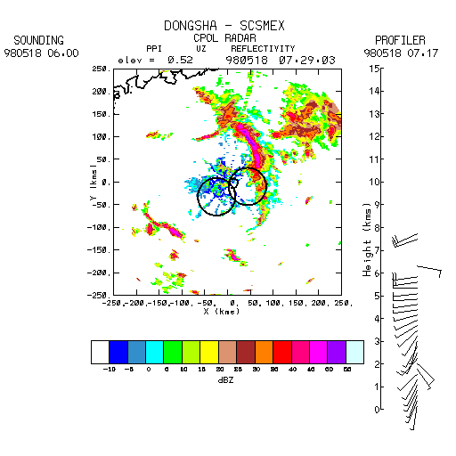
SCSMEX 4-hour Radar Animation
18 May 1998
Leading
Stratiform
●
Hong Kong
BMRC C-POL Radar
(Parker and Johnson 2000)

Slide 28
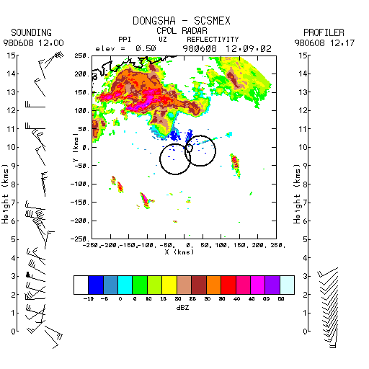
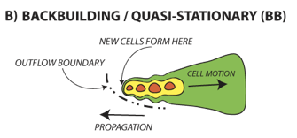
SCSMEX 6-hour Radar Animation
8 June 1998
Parallel
Stratiform,
Back-building
BMRC C-POL Radar
●
Hong Kong
Heavy rainfall
(Schumacher and Johnson 2005)
(Parker and Johnson 2000)

Slide 29
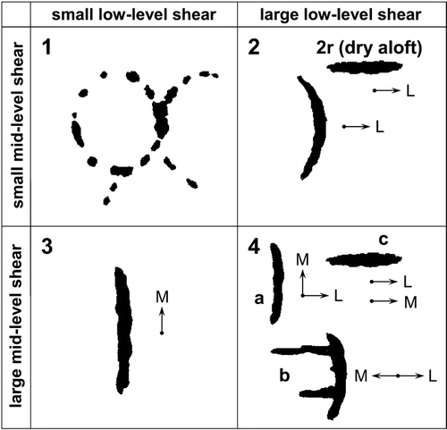
Organizational modes as a function of shear
(LeMone, Zipser, Trier 1998)
TOGA COARE
(6)
Weak low- & mid-level shear
Strong low-level shear, weak midlevel shear
Updated based on SCSMEX radar observations (Johnson, Aves, Ciesielski, Keenan 2005)
New SCSMEX modes
(3)
(2)
Weak low-level shear, strong midlevel shear
Strong low- & mid-level shear
(3)
Slow movement, training echoes, potential for heavy rain
(4)
(5)
(1)

Slide 30
Field Campaigns in East Asia/SCS Investigating Extreme Rainfall
-TiMREX/SoWMEX
-WMONEX
-SCSMEX
-TAMEX
1980
1990
2000
2010
2020

Slide 31

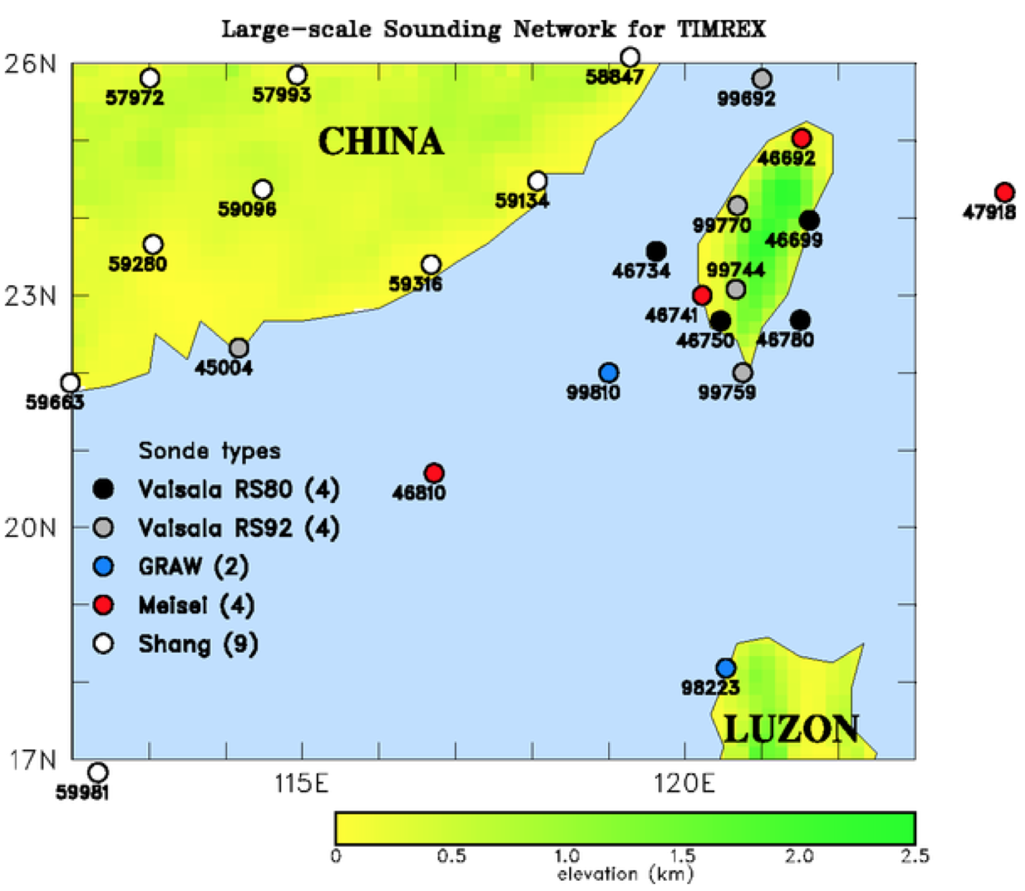
15 May – 30 June 2008
Scientific Objectives
Terrain effect on the flow and MCSs
MCS dynamics, microphysics, and predictability
Mesoscale data assimilation/ QPF
Convective initiation/diurnal cycle/boundary layer processes
Dropsonde missions
NCAR S-Pol
Participants
Field phase: US-Taiwan
Post-field phase activities/ workshops: Korea, Japan, Viet Nam, PRC

Slide 32

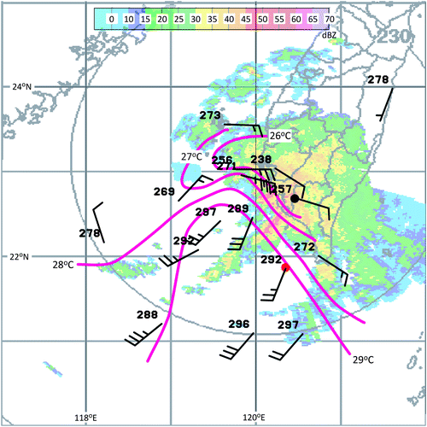
990 hPa wind, T_{v} at 06Z on 5 June 2008
Observations of shallow fronts
(Davis et al. 2012)
TAIWAN
Virtual temperature
Despite shallowness and weak T gradient, impact on convection is significant due to moist, unstable conditions
T contrast reinforced by cool downdrafts over land
Analogous to coastal fronts at higher latitudes
(Davis et al. 2012)

Slide 33
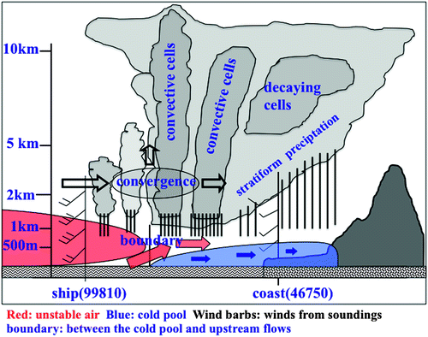
Extreme rainfall 14-16 June 2008
(Xu et al. 2012)
Convective cell triggering by low-level jet impinging on shallow cold pool
Cold pool reinforced by continuous precipitation
Cold pool trapped by terrain
Virtual extension of island barrier to the southwest
SW
NE
(Xu et al. 2012)

Slide 34
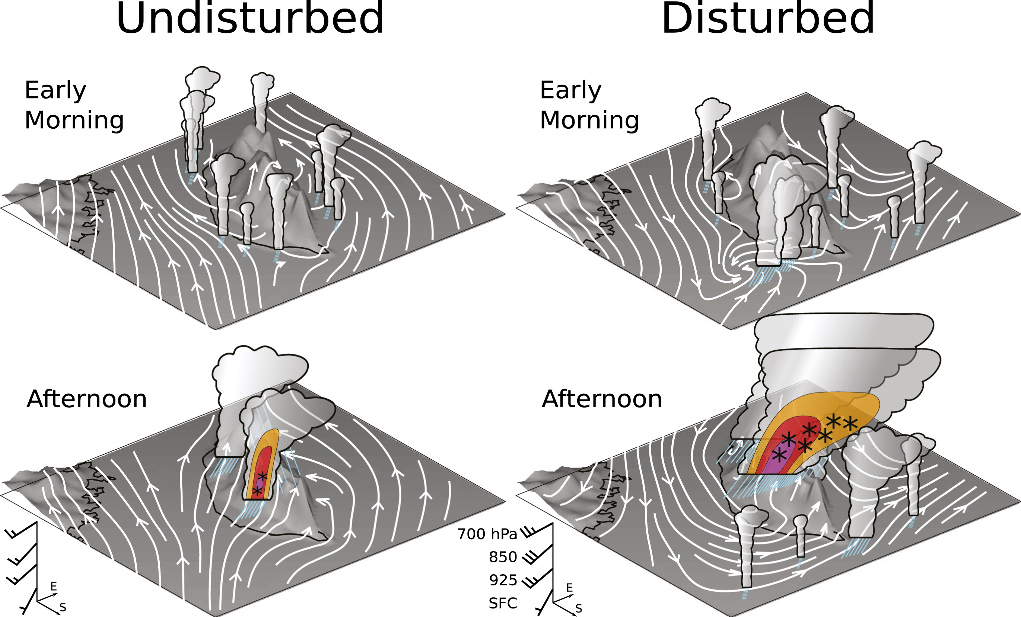
Diurnal Cycle of Convection during TiMREX
(Ruppert, Johnson & Rowe 2013)
Morning rainfall offshore, after-noon maxima on coastal plain
Dominant rainfall on at higher elevations over CMR in afternoon

Slide 35
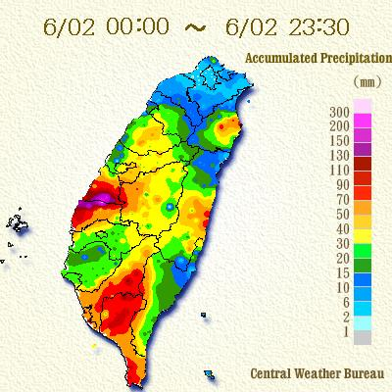

Heavy Rainfall South, Floods in Central Taiwan
SoWMEX/TiMREX
2 June 2008
> 300 mm

Slide 36
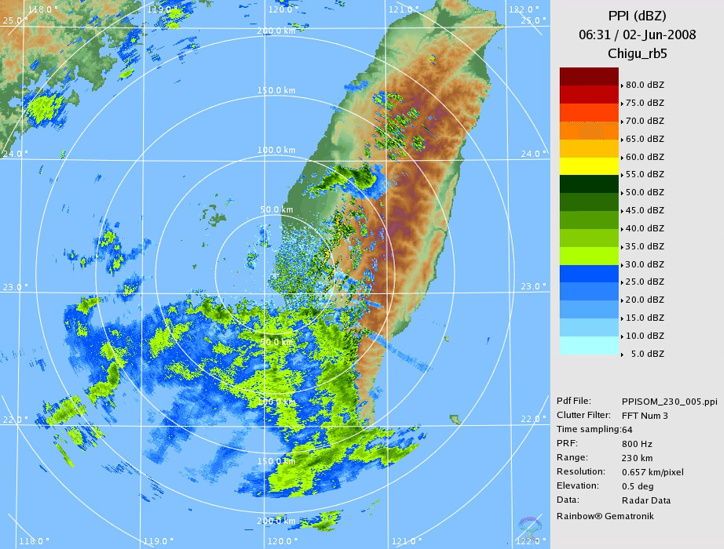
> 300 mm
Back-building, training echoes

Slide 37
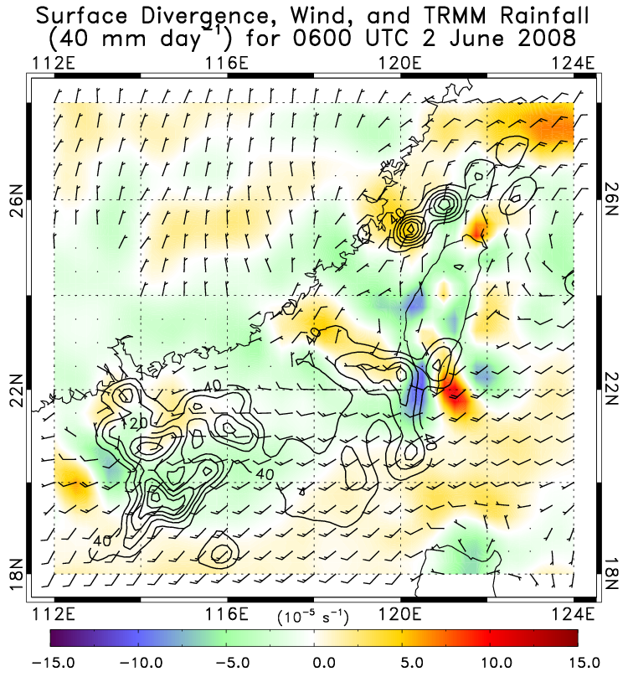
Meiyu front

Slide 38
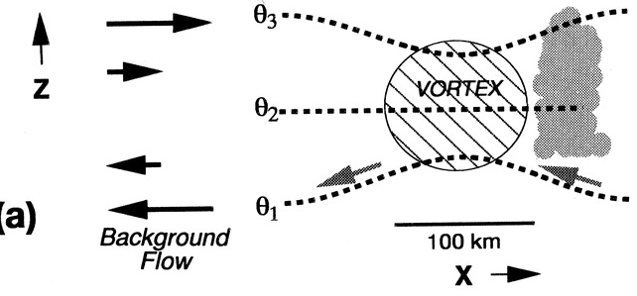
Dynamic Lifting on Downshear Side of Positive Potential Vorticity Anomaly
Shear vector
+P
Background PV-relative flow
Isentropic upglide
Heavy rain on downshear side
(figure from Trier, Davis, and Tuttle 2000, MWR)

Slide 39
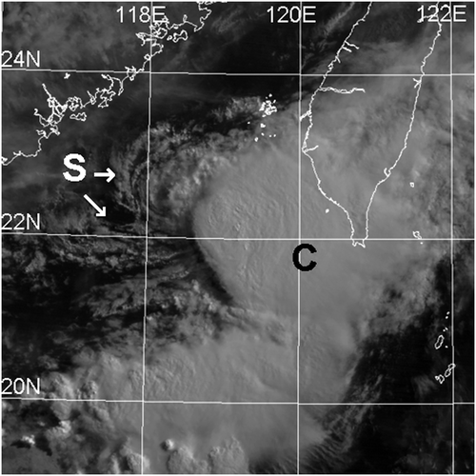

Mesoscale Convective Vortex (MCV) during TiMREX
4-5 June 2008 Heavy Rainfall
TiMREX/SoWMEX
(Lai, Davis, and Jou 2011, MWR)
MCV center
Heavy rain over southern Taiwan downshear of vortex center, aided by moist southwesterly flow
* > 250 mm
Sfc to 700 hPa shear
MOIST
2257 UTC 4 Jun 2008

Slide 40
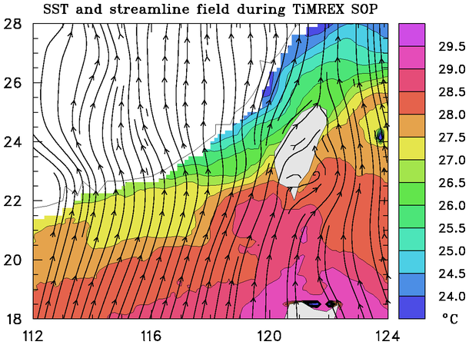
Surface flow and SST during TiMREX (15 May – 26 June)
(15 May-26 June)
Warm air flowing over cool water
Leads to weak surface fluxes, stable boundary layer, low-level convergence
SST-gradient-driven convergence enhanced rainfall along southwest coast of Taiwan by ~20% during 13-18 June (Toy and Johnson 2014)

Slide 41
Field Campaigns in East Asia/SCS Investigating Extreme Rainfall
-TiMREX/SoWMEX
-WMONEX
-SCSMEX
-SCMREX
-TAMEX
1980
1990
2000
2010
2020

Slide 42
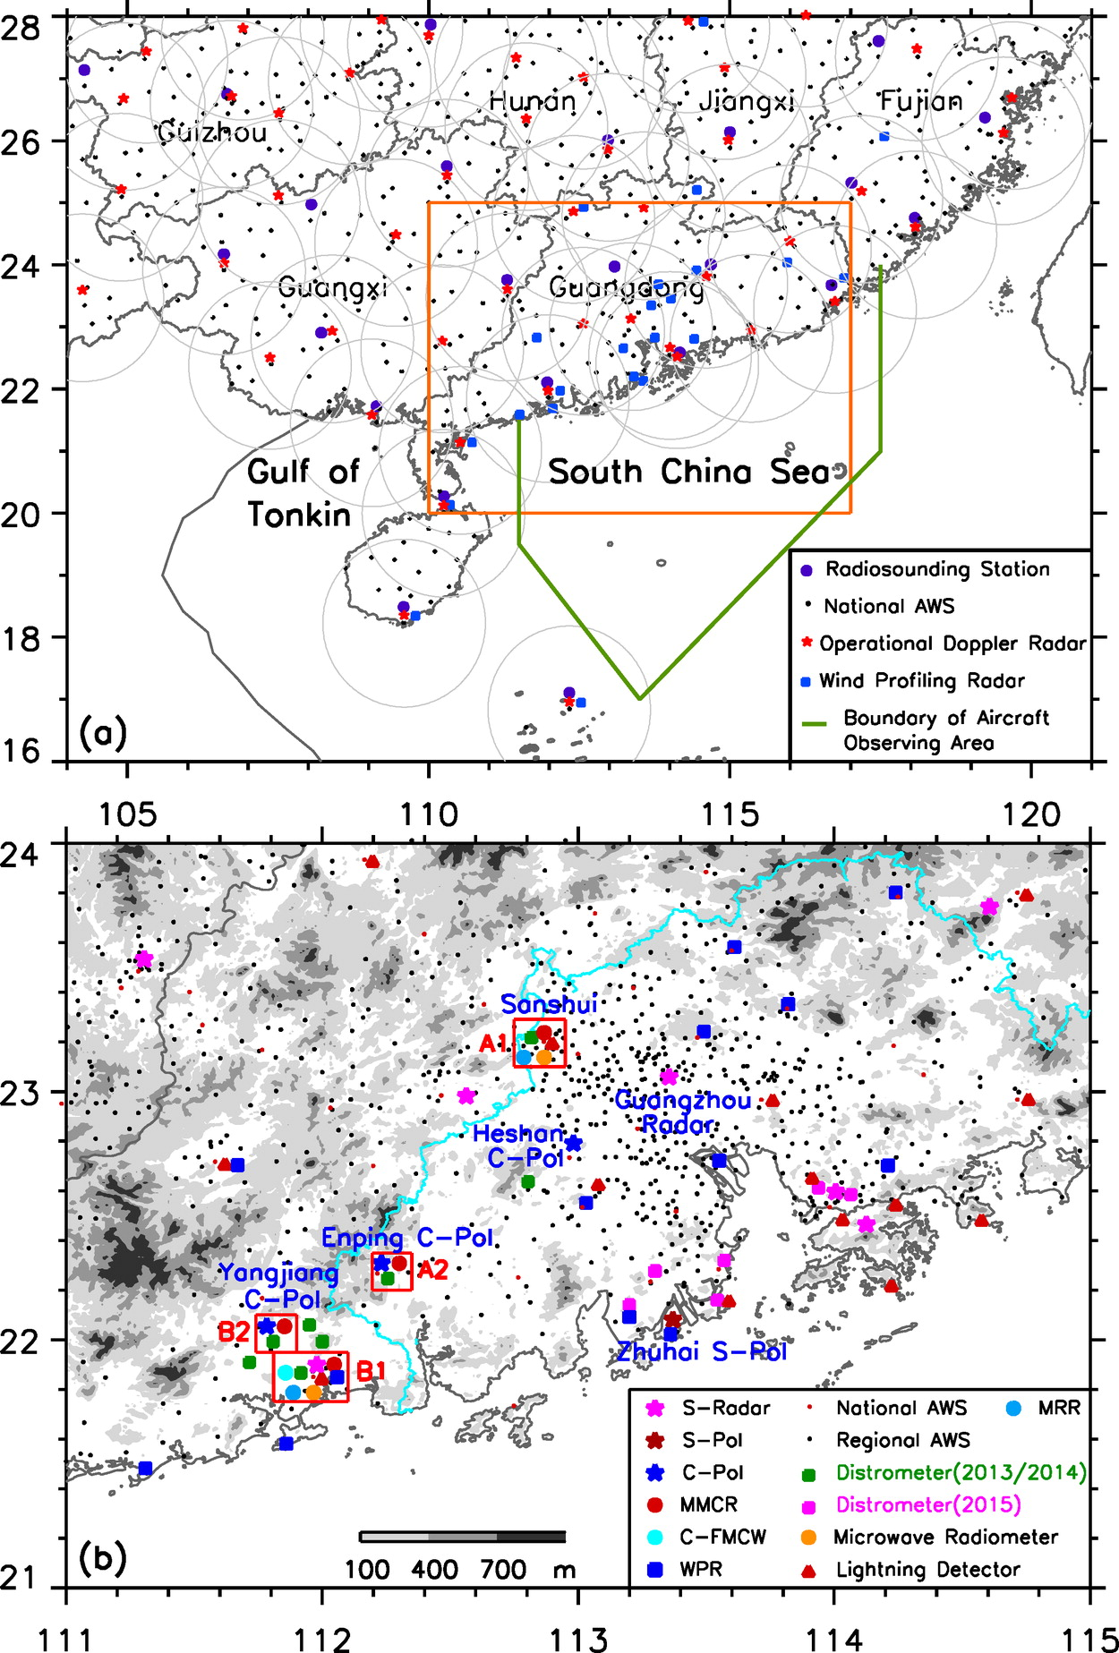
South China Monsoon Rainfall Experiment (SCMREX, 2013-18)
A program for improving heavy rainfall forecasts over southern China during the presummer rainy season
Luo et al. (2016, BAMS)
Collaborators: PRC, USA, UK, Taiwan

Slide 43
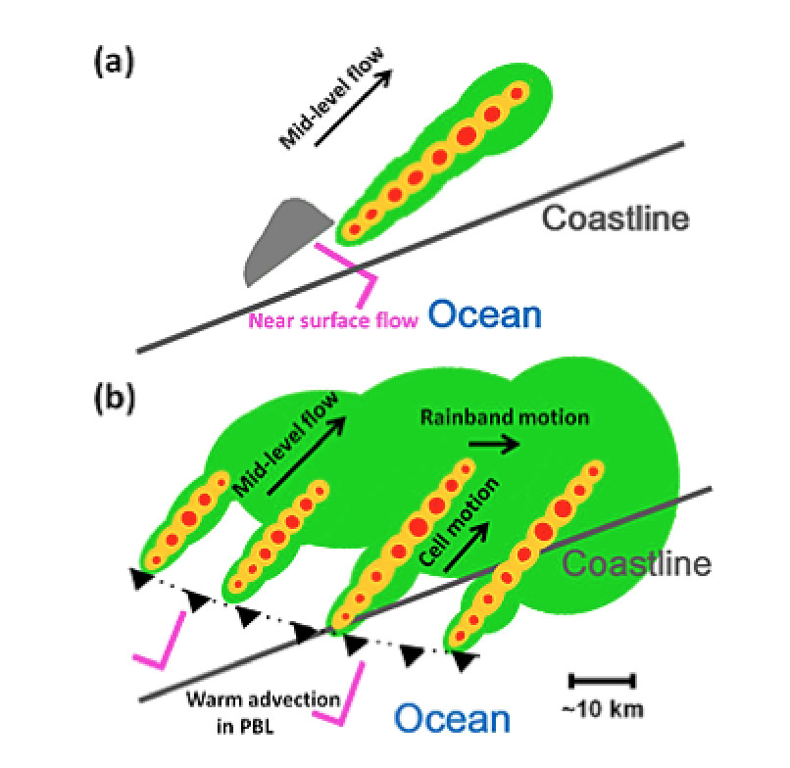
Conceptual Model of Extreme-Rain-Producing MCS during SCMREX
(Wang, Luo, & Jou 2014, JGR)
EARLY DEVELOPMENT STAGE
⬥ 10 May 2013
⬥ 451 mm, Yangjiang City
Two stages:
Development: orographic lifting, back-building and training cells
Mature: two scales of organization – training cells, eastward movement of rainbands
MATURE STAGE
Notes:
Schematic diagrams of the back building, echo training, and rainband training associated with the extreme rain‐producing MCS during its (a) early development and (b) mature stages. Shadings in red, orange, and green represent roughly the radar reflectivity values of 50, 35, 20 dBZ at 3 km above mean sea level, respectively. Gray symbol near the southwest edge of the linear‐shaped MCS in Figure a represent a mountain. See the text for more details.

Slide 44
Field Campaigns in East Asia/SCS Area Investigating Extreme Rainfall
-TiMREX/SoWMEX
-WMONEX
-SCSMEX
-SCMREX
-TAMEX
-PISTON
1980
1990
2000
2010
2020

Slide 45
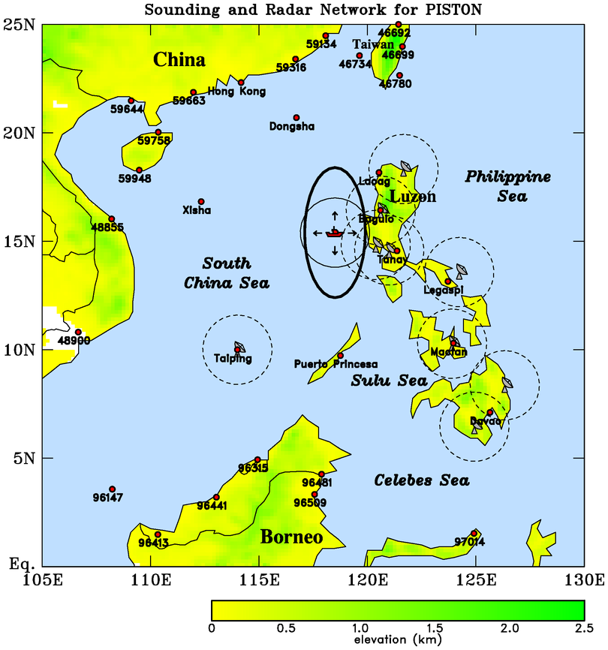
PISTON 2018
PISTON Science Objectives
How does the BSISO influence the atmosphere (convection, diurnal cycle) and upper ocean over SCS
How does convection/diurnal cycle/upper ocean feed back to influence the BSISO
R/V Thompson
Operations moved to Philippine Sea
ORIGINAL DESIGN

Slide 46
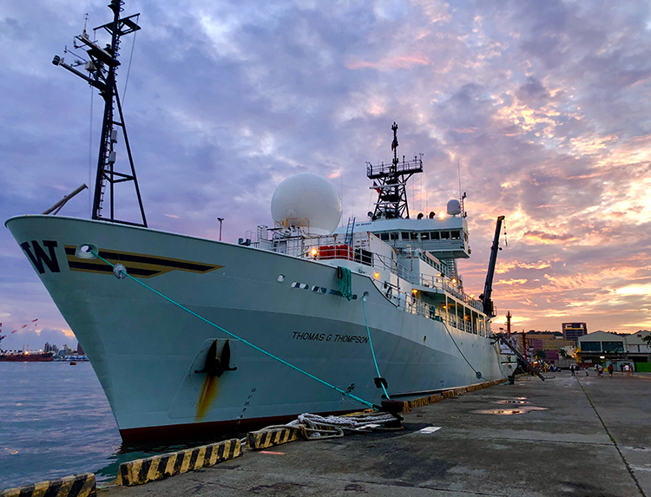
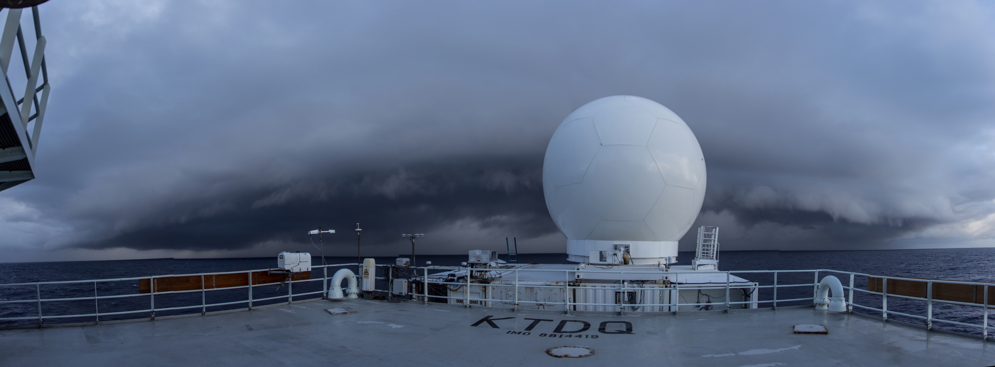
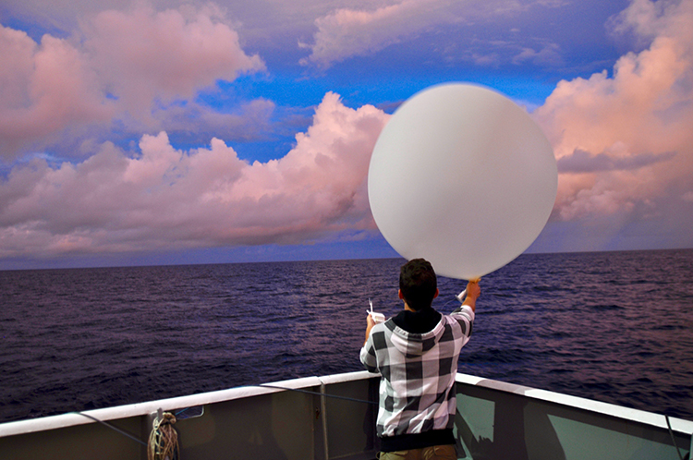
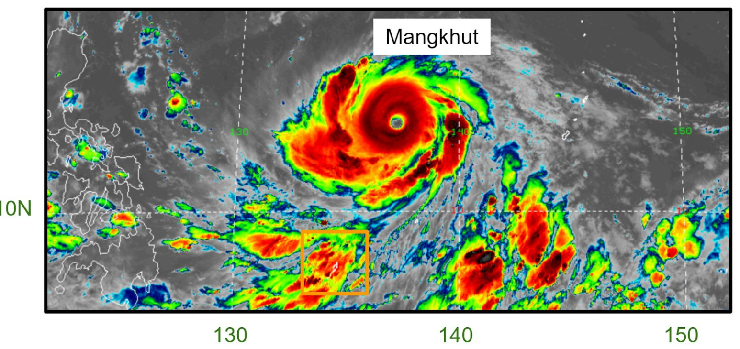
Propagation of Intra-Seasonal Tropical OscillatioNs (PISTON) (Aug-Oct 2018)
Soundings
SEA-POL radar
R/V Thompson
Science highlights
  Tropical cyclone “tails”
  Upper-ocean response to TC passage
Participating countries: US, Taiwan (SCSTIMEX), Philippines, Japan

Slide 47
Field Campaigns in East Asia/SCS Area Investigating Extreme Rainfall
-TiMREX/SoWMEX
-PISTON II/CAMP²EX
-WMONEX
-SCSMEX
-SCMREX
-TAMEX
-PISTON
1980
1990
2000
2010
2020

Slide 48
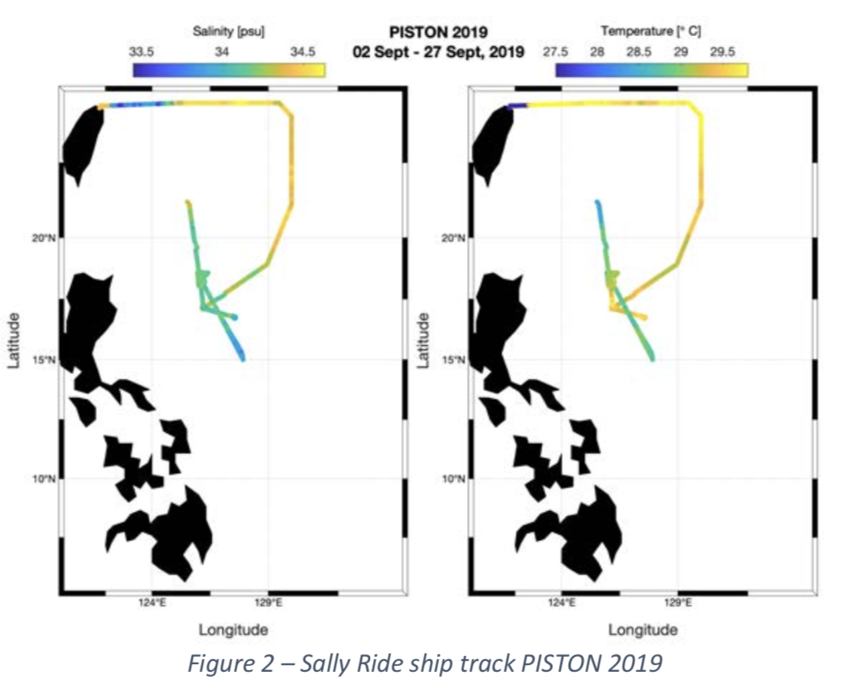
PISTON II September 2019
Operations again moved to Philippine Sea
PISTON II Science Objectives
How does the BSISO influence the atmosphere (convection, diurnal cycle) and upper ocean over SCS
How does convection/diurnal cycle/upper ocean feed back to influence the BSISO
SST
Salinity
R/V Thompson
ORIGINAL DESIGN
R/V Sally Ride
CAMP²EX NASA P-3
Air-sea interaction
Ocean processes – response to TC forcing, diurnal cycle
SST variability (P-3 missions)
Shallow cumulus, MCSs, cold pools
Aerosol and cloud microphysics (NASA mission)

Slide 49
Field Campaigns in East Asia/SCS Area Investigating Extreme Rainfall
-TiMREX/SoWMEX
-PISTON II/CAMP²EX
-PRECIP/TAHOPE/ T-PARCII
-WMONEX
-SCSMEX
-SCMREX
-TAMEX
-PISTON
1980
1990
2000
2010
2020

Slide 50
Summary
Forty years of international field campaigns over SCS: monsoon dynamics, investigations of mechanisms contributing to heavy rainfall
Observing systems: increasing sophistication and density, yielding new insights into a wide range of phenomena
Extreme rainfall mechanisms, new understanding: Meiyu front, MCS organization, orographic effects, MCVs, cold pools, diurnal cycle, SST effects
Campaign results: have contributed to improvements in modeling, physical parameterizations, prediction

Slide 51
Lessons
Science
Moist, unstable conditions and weak CIN over northern SCS during onset of summer monsoon: convection is readily initiated by Meiyu front, cold pools, orography, flow blocking, SST gradients
Extreme rainfall is often a result of a complex interplay among above processes (TCs not target in past)
MCS organization leading to extreme rainfall: many aspects similar to that observed elsewhere in the tropics and in the midlatitudes
Scientific results: unexpected findings are the norm

Slide 52
Lessons
Logistics
Field planning: be prepared to adjust for last-minute changes
Execution of field phase: doesn’t always go as planned
Weather: doesn’t always cooperate, be flexible
Observations, modeling, data assimilation: keep closely coupled during all phases
Collaborations: Maximize international partnerships
Encourage program managers to come to field
Students and young scientists: involve in field activities!

Slide 53
END

Slide 54

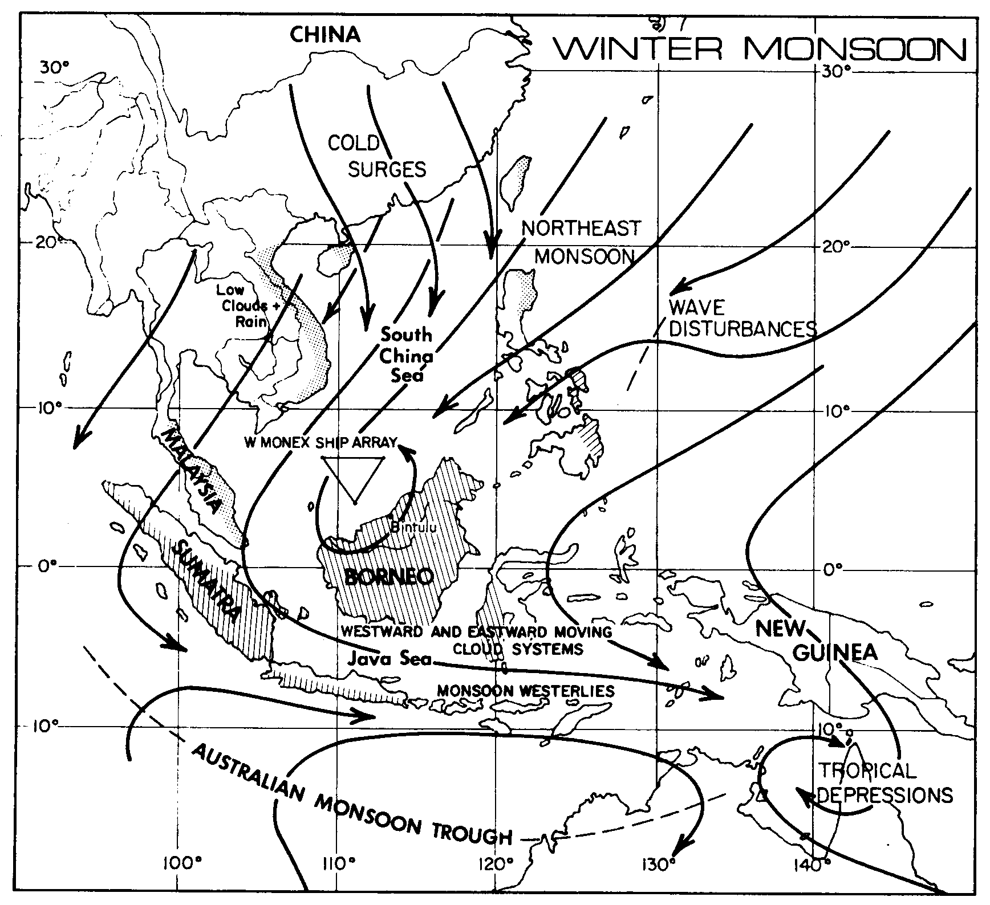
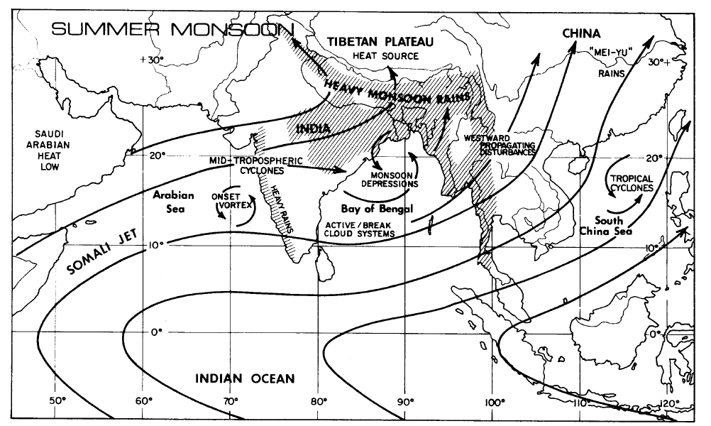
Winter/Summer MONEX (1978/79)
(part of FGGE – First GARP Global Experiment)
December 1978
Joach Kuettner
Summer 1979

Slide 55

SCSMEX sounding-derived fields used as a basis for TRMM/GPM latent heating algorithms (Tao et al., Shige et al.)
Divergence, omega, Q₁, Q₂
DIV
OMEGA
(Johnson and Ciesielski 2002)

Slide 56


Prediction of Rainfall Extremes
Campaign In the Pacific (PRECIP) 2020
(Courtesy Michael Bell)
Lead PIs: Michael M. Bell
and Kristen L. Rasmussen
PRECIP has been proposed for 25 May – 10 August 2020 to observe Meiyu front, MCSs, diurnal convection, and typhoons near Taiwan
Part of an international effort to study extreme rainfall
  Taiwan TAHOPE (Taiwan-Area Heavy rain Observation and Prediction)
  Japan T-PARCII (Tropical cyclones-Pacific Asian Research Campaign for Improvement of Intensity estimations/forecasts)
  NOAA IFEX-WP (Intensity Forecast Experiment –Western Pacific)

Slide 57


(Courtesy Michael Bell)

Slide 58



The Cloud, Aerosol and Monsoon Processes Philippines Experiment (CAMP²Ex)
(August-September 2019)
An investigation of the coupling between clouds and aerosols
Aerosol and cloud microphysics
Cloud and Aerosol Radiation
Aerosol and cloud meteorology
NASA P-3

Slide 59





Winter Monsoon Experiment (WMONEX)
December 1978
Joach Kuettner

Slide 60



(courtesy Yali Luo)
Understanding the microphysical drivers of model biases for SC heavy rainfall (Kalli Furtado, Met Office, UK)
(Furtado et al., 2018, JGR)
Reflectivity
Rain # concentration determines rainfall & low-level reflectivity biases
TOA biases are determined by:
      cloud fraction diagnosis (low clouds)
      assumption of ice crystal fallspeed (high clouds)
  1M could be tuned to produce comparable results of 2M
May 2016
Radar
Ice water content
2M
1M+mod. fallspeed
1M
2M
1M
1M+modified Nr
Notes:
A set of convection-permitting model-configurations of the Met Office Unified Model is evaluated against radar observations of the 20 May 2016 heavy-rainfall case, and against remotely sensed estimates of clouds, top-of-atmosphere radiation and surface precipitation (Furtado et al. 2018). In particular, the relative importance of the number of prognostic moments is assessed, in comparison to cloud-fraction diagnosis and the microphysical properties of hydrometeor particles. The sensitivity tests show differences in rainfall and the radiative properties of clouds, which are related to the distribution of condensed water between hydrometeor species. By “transplanting” individual parameterizations between the microphysics configurations, it is shown that only a small subset of the process-parameterizations is responsible for almost all the variations in model-performance with physics-configuration. This information is used to improve the performance of a single-moment scheme and to make judgments about the cost-to-benefit of higher-order microphysics schemes, for predicting organized convection.

Slide 61
Field Campaigns in East Asia/SCS Area
AMY
YMC
GARP
TOGA
GAME
MAHASRI
-TiMREX/SoWMEX (2008)
-SCMREX (2013-2018)
-WMONEX (1978)
-SCSMEX (1998)
-PISTON II/CAMP2Ex
-TAMEX (1987)
-PISTON (2018)
-PRECIP/TAHOPE
1980
1990
2000
2010
2020

Slide 62

Malaysia Flood
(Johnson and Chang 2007)

